Slide 1
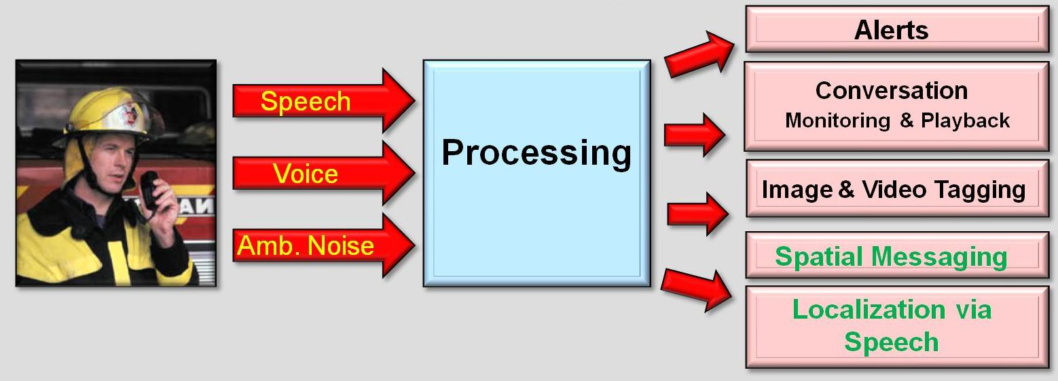
Using Acoustic Signal for Enhancing Situational Awareness in SAFIRE
Dmitri V. Kalashnikov
Notes:
My name is … I am a research scientist here at UCI working on the speech component of the SAFIRE project.

Slide 2
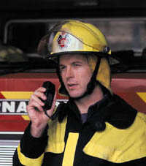
High-level Overview & Vision
Acoustic Capture
SA Applications
Acoustic Analysis
Alerts
Speech
Conversation
Monitoring & Playback
Processing
Voice
Image & Video Tagging
Amb. Noise
Spatial Messaging
Localization via Speech
Type of Acoustic Analysis
Human Speech: Who spoke to whom about what from where and when
Ambient Sounds: explosions, loud sounds, screaming, etc
Physiological Events: cough, gag, excited state of speaker, slurring, …
Other features: too loud, too quiet for too long, …
2

Slide 3
SA Apps
Alerts
Conversation
Monitoring & Playback
Image & Video Tagging
Purpose: alerts IC when certain events happen
Capture firefighter conversations
E.g., if a conversation mentions “victim” - an alert is raised
Purpose: allows IC to quickly locate & playback speech blocks that might contain critical info, by visualizing multiple firefighter conversations.
Purpose: allows firefighters to capture images of a crisis site and annotate them with important tags using speech interface. The images are then triaged to the IC for analysis.
Spatial Messaging
Localization via Speech
Purpose: allows firefighters to leave spatial messages via speech interface
“This room is clear”
Anyone walking in this room will get the msg.
Purpose: creates an additional firefighter localization capability
GPS does not work well indoor
E.g., “I’m near room 101 on the 4th floor”
Notes:
Sharad has briefly described the five speech related SA apps we have thought of.
Let me provide a few more details on them.
The purpose of the alert application is to…

Slide 4
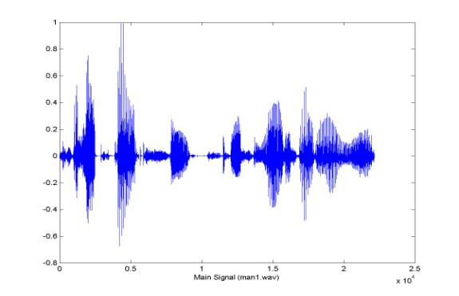
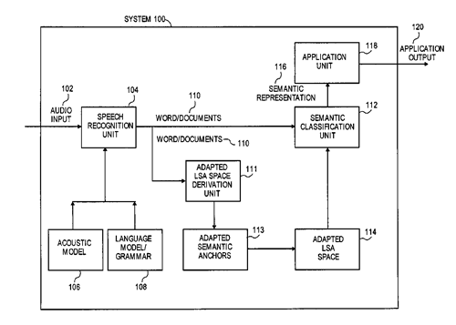
Core Challenge (for ongoing projects)
Recognition quality bottleneck
Poor recognition quality in noisy & realistic environments
Speech
Speech Recognizer
Output
This is a bed sun tan
“This is a bad sentence”
4

Slide 5

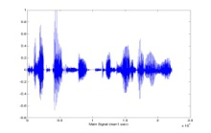
Different Goals of ASR & SA Applications
Recognition
Acoustic Tagging & Retrieval
DB
Query
This is a bed sun tan
Retrieval
Algo
Retrieve correctly
This is a bad sentence
Quality Metric :
Precision, recall, F-measure of
returned images
activated triggers
It can be possible to build a good retrieval system on uncertain data.
Low WER does not imply low retrieval & SA quality. Observe: Errors in words that are not in triggers do not matter
Quality Metric :
Word Error Rate (WER)
5

Slide 6
Research Techniques for Enhancing Quality
Semantics
Combining Recognizers
Retrieval
Idea: use past data to derive models of how content has been annotated in the past.
Use N-best lists
Correlation analysis
Probabilistic model based on Max Entropy
Speed optimization techniques
Idea: combining results of multiple recognizers can improve the recognition quality.
Analyze recognizers mutual behavior on past data
Build a probabilistic model for combining them
Idea:
(1) Use the fact that quality metrics are application dependent. (2) Develop algorithms for retrieval given uncertainty.
Use the given probabilistic representation
Derive methodology for optimal retrieval

Slide 7
Approach to Building SA Applications
Recognizers offer Alternatives - “N-best list”
Utterances
Fire | Emergency | Victims | Dispatch …
Hire 0.6 | A merchant sea 0.6 | Evict him 0.5 | This patch 0.8
Fryer 0.5 | Emerging sea 0.55 | With him 0.45 | Dispatch 0.7
Fire 0.4 | Emergency 0.5 | Victim 0.4 | His batch 0.6
… | … | … | …
N –Best lists coming from the speech recognizer
Probabilistic DB
High recall
Low precision
High precision
Low recall
Choose a representation that maximizes the performance of application
(e.g., maximizes precision and recall)
Key Issue: accurately estimate
P(W in utterance), for all W in Q
Notes:
Most recognizers give a ranked list of alternatives to every utterance. Shown above is one example of alternatives at the word level

Slide 8

Estimating P(W in Utterance): Learning
Convert confidence levels output by recognizer into probability
Fire | Emergency | Victims | Dispatch
Hire 0.6 | A merchant sea 0.6 | Evict him 0.5 | This patch 0.8
Fryer 0.5 | Emerging sea 0.55 | With him 0.45 | Dispatch 0.7
Fire 0.4 | Emergency 0.5 | Victim 0.4 | His batch 0.6
… | … | … | …
Word | Probability
Hire | 0.4
Fryer | 0.3
Fire | 0.2
… | …
Notes:
Most recognizers give a ranked list of alternatives to every utterance. Shown above is one example of alternatives at the word level

Slide 9
Estimating P(W): Combining Recognizers
Exploit multiple recognizers to estimate probability
Fire | Emergency | Victims | Dispatch
Hire 0.6 | A merchant sea 0.6 | Evict him 0.5 | This patch 0.8
Fryer 0.5 | Emerging sea 0.55 | With him 0.45 | Dispatch 0.7
Fire 0.4 | Emergency 0.5 | Victim 0.4 | His batch 0.6
… | …. | …. | ….
Fire | Emergency | Victims | Dispatch
Hire 0.5 | A merchant sea 0.6 | victory 0.5 | This patch 0.3
Flyer 0.1 | Emerging sea 0.45 | Victim 0.4 | Dispatch 0.7
Fire 0.8 | Emergency 0.6 | With him 0.45 | His batch 0.6
… | …. | …. | ….
…
…
Merging
Word | Probability
Hire | 0.3
Fryer | 0.2
Fire | 0.2
… | …
Notes:
Most recognizers give a ranked list of alternatives to every utterance. Shown above is one example of alternatives at the word level

Slide 10

Estimating P(W): Using Semantics
Exploit Semantics
Fire | Emergency | Victims | Dispatch
Hire 0.6 | A merchant sea 0.6 | Evict him 0.5 | This patch 0.8
Fryer 0.5 | Emerging sea 0.55 | With him 0.45 | Dispatch 0.7
Fire 0.4 | Emergency 0.5 | Victim 0.4 | His batch 0.6
… | …. | …. | ….
Fire | Emergency | Victims | Dispatch …
Hire 0.6 | A merchant sea 0.6 | Evict him 0.5 | This patch 0.8
Fryer 0.1↓ | Emerging sea 0.2 ↓ | With him 0.45 | Dispatch 0.7
Fire 0.8↑ | Emergency 0.8↑ | Victim 0.4 | His batch 0.6
… | …. | …. | ….
Word | Probability
Hire | 0.6
Fryer | 0.5
Fire | 0.5
… | ….
Word | Probability
Hire | 0.6
Fryer | 0.1↓
Fire | 0.8↑
… | ….
Notes:
Most recognizers give a ranked list of alternatives to every utterance. Shown above is one example of alternatives at the word level

Slide 11
One SA Application in More Detail
Acoustic Capture
SA Applications
Acoustic Analysis
Alerts
Speech
Conversation
Monitoring & Playback
Processing
Voice
Image & Video Tagging
Amb. Noise
Spatial Messaging
Localization via Speech
Type of Acoustic Analysis
Human Speech: Who spoke to whom about what from where and when
Ambient Sounds: explosions, loud sounds, screaming, etc
Physiological Events: cough, gag, excited state of speaker, slurring, …
Other features: too loud, too quiet for too long, …
11

Slide 12
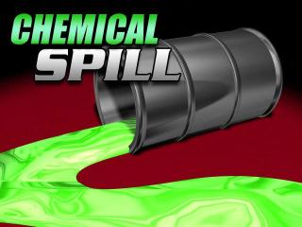
Purpose of Image Tagging
Chemical spill nitric acid
Take a picture of an incident
Speak tags
chemical | spill | nitric | acid
physical | still | citric | acid
lexical | spill | cyclic | placid
chemical | mill | nitric | AC
chemical | spill | nitric | acid
physical | still | citric | acid
lexical | spill | cyclic | placid
chemical | mill | nitric | AC
Apply speech recognizer, which will suggest alternatives for each utterance (N-best list)
Disambiguate among choices, by using a semantic model of how these words have been used in the past

Slide 13
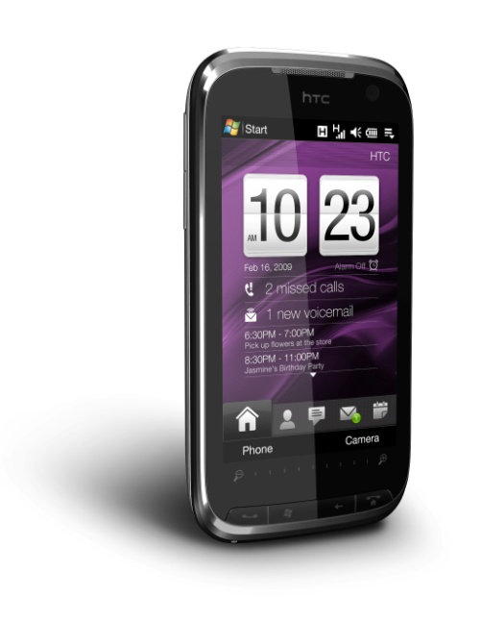
Tagging Images Using Speech
Challenge
Challenge: The correctness of tags depends on quality of speech recognizer!
Speech & Image
Speech Recognizer
Semantic Knowledge
N-best lists
USER Interface for image retrieval
Image & Tags
Image Database
Disambiguator

Slide 14
Overview of Solution
N-best lists
Results
(A sequence of tags)
Enumerating Possible Sequences
Smart (greedy) enumerator
of possible tag sequences
Detecting NULLs
(I.e., ground truth tag not present in N-best list)
Computing Score for Each Sequence
Co-occurrence based score
Probabilistic score
Using Max Entropy & Lidstone’s Estimation
Choosing Sequence
(with the highest score)

Slide 15
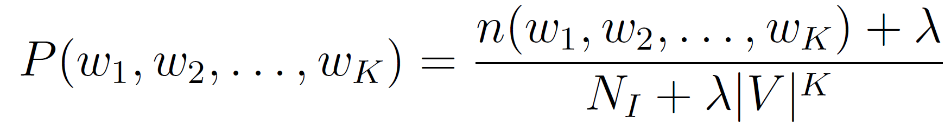
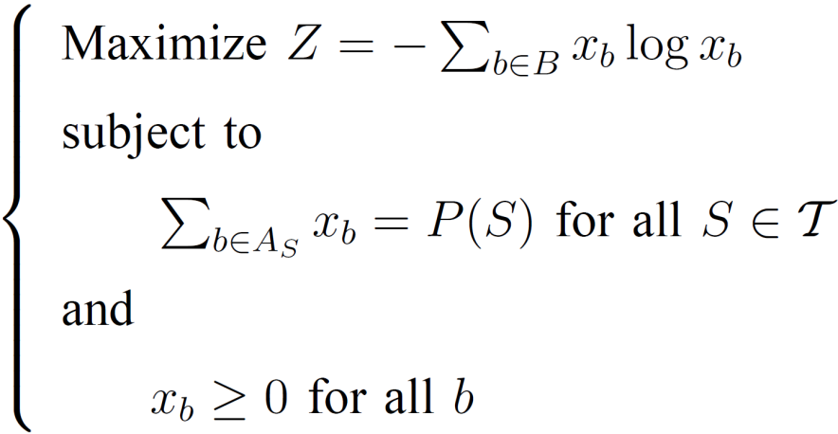
Probabilistic Score (Max Entropy)
Lidstone’s Estimation
“Good” estimates of P for short w₁,w₂,…,w_{K} sequences
P (w_{i}) ← Marginals
P (w_{i,} w_{j}) ← Pairwise joints
for many/most
P (w_{i,} w_{j,} w_{k}) ← Triples
for very few
Maximum Entropy (ME)
Estimates joint P()
From known smaller joint P()
“No assumptions”/uniformity
For unknown P()
Optimization problem
Computationally expensive

Slide 16

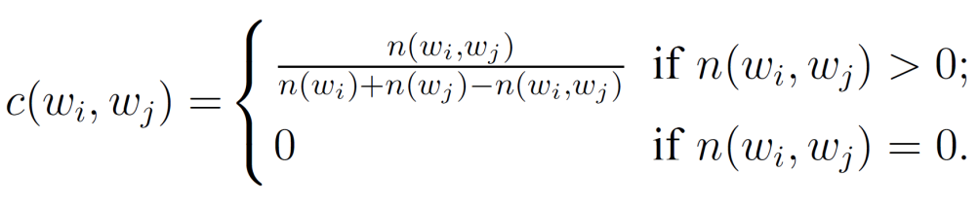
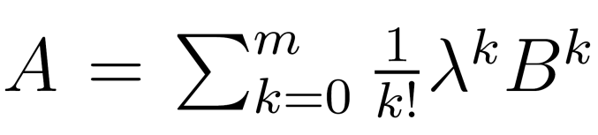
Correlation Score
Direct Correlation
Indirect Correlation
Base Correlation Matrix
B, where B_{ij} = c (w_{i}, w_{j})
Indirect Correlation Matrices
B₂ = B²
B_{k} = B^{k}
General Correlations Matrix
Considers correlations of various sizes
Image 1 | Hazard, victim
Image 2 | Hazard, acid
Image 3 | Victim, ambulance
Image 4 | Ambulance, acid
… | …
Correlation Graph
Jaccard Similarity

Slide 17
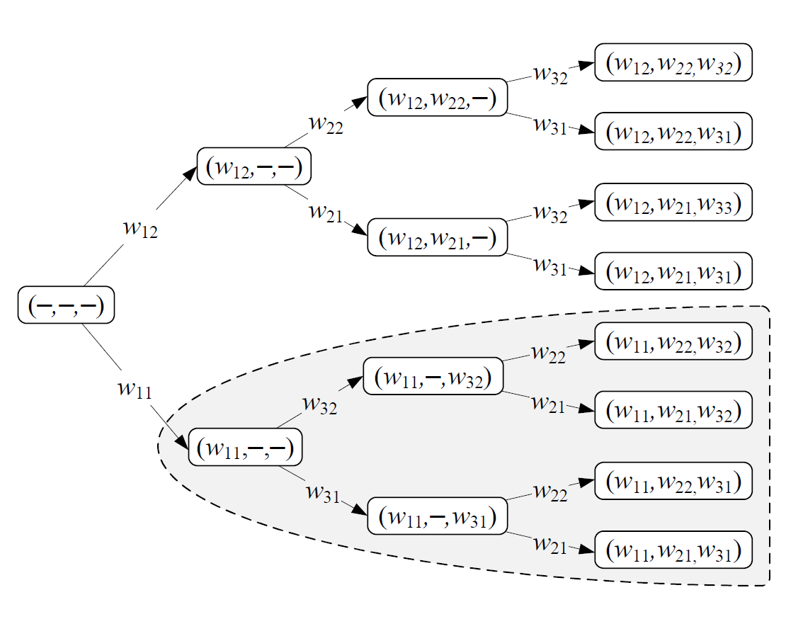
Branch and Bound Method
Motivation
Computing ME is expensive
Enumerating N^{K} sequences
Exponential
How to scale?
Branch and Bound Method!
Two logical parts
Searching part
How to go to the most promising “direction” to search
Bounding part
How to bound the search space, prune away unnecessary searches
Complete Search Tree
Only necessary part of it will be build/considered

Slide 18
Experiments
Dataset: 60,000 annotated images from Flickr.
Split 80% train + 20% test
Experiment 1:
Use Dragon recognizer to generate N-best lists for 120 images from test data
Different noise levels were created by introducing white Gaussian noise through a speaker
Figure shows a significant quality improvement by using the semantics-based approach.
Notes:
Precision – number of correct tags/total tags ; recall number of current tags/number of tags
3 correct 2 incorrect 2 nulls – precision is 3 /5 recall is 3/7

Slide 19
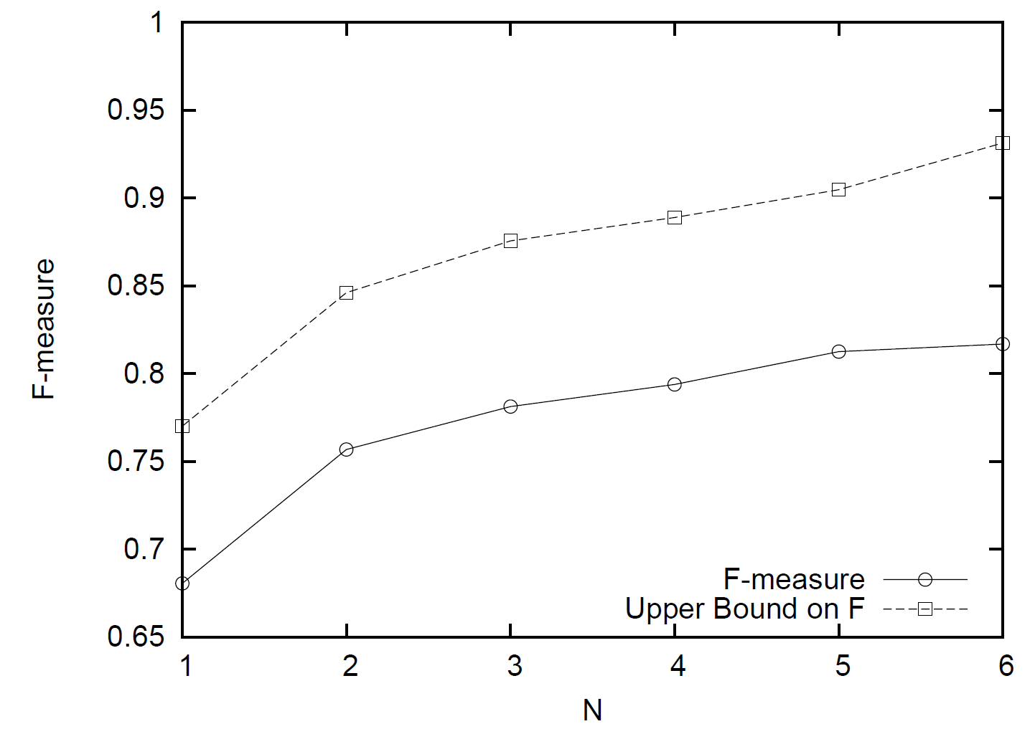
Experiment 2
Experiment 2
Quality of annotation vs. size of N-best lists
Tradeoff
With increasing N (size of list): greater chance that ground truth is present in the list.
However, more options to disambiguate among (more uncertainty)

Slide 20
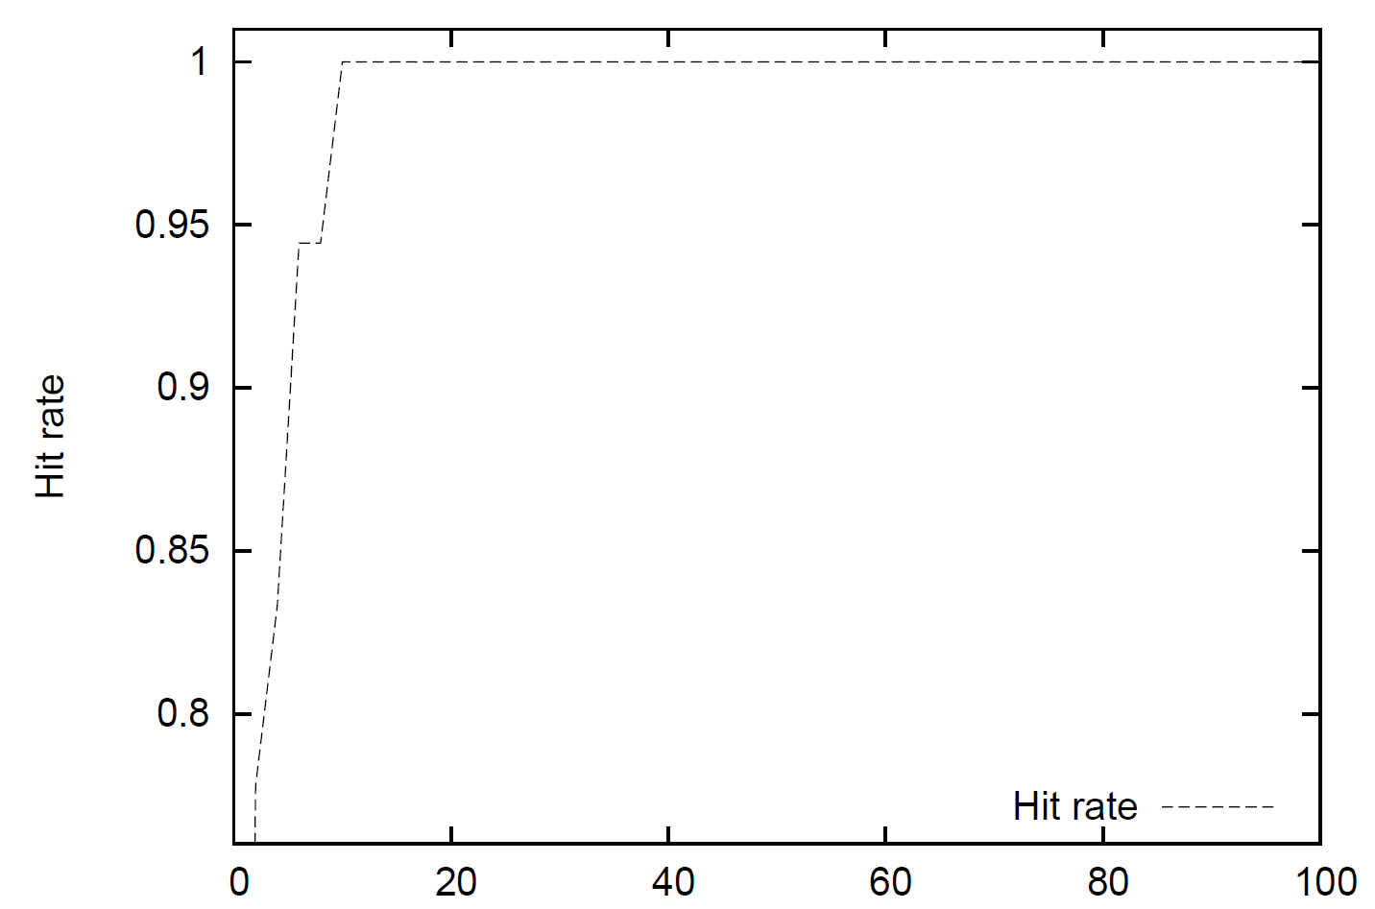
Experiment 3: Correlation of ME & CM scores
(Strong correlation) Figure shows the frequency
of how often the top-1 sequence according to ME score
is contained in among top M sequences according to CM score

Slide 21
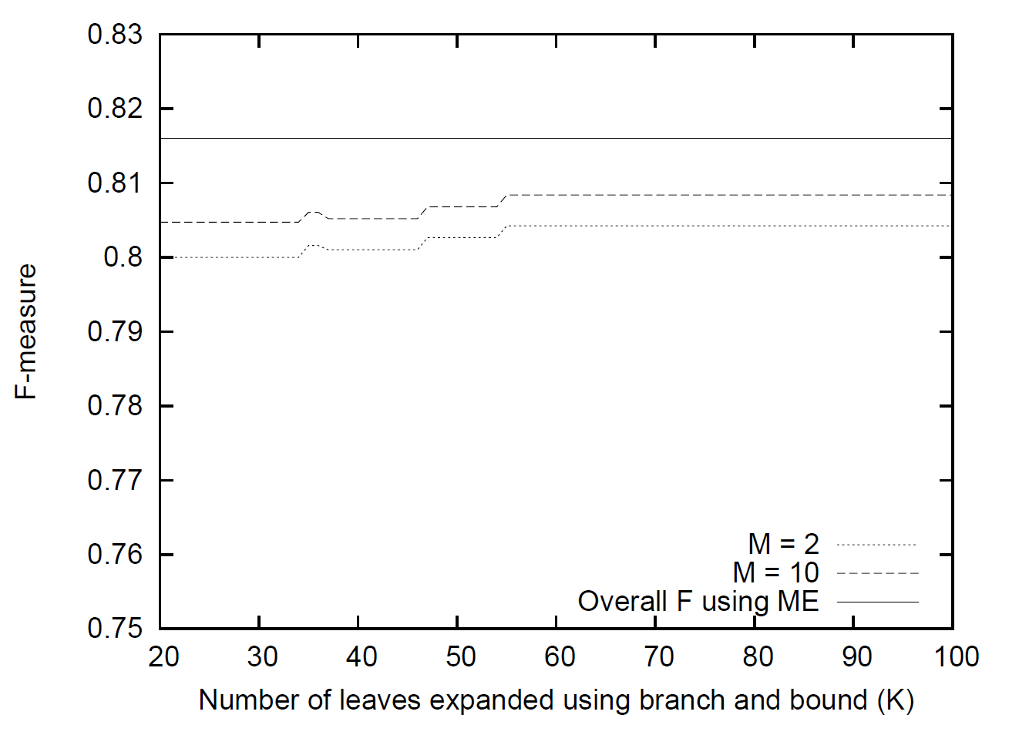
Experiment 4: Quality of BB Algorithm

Slide 22
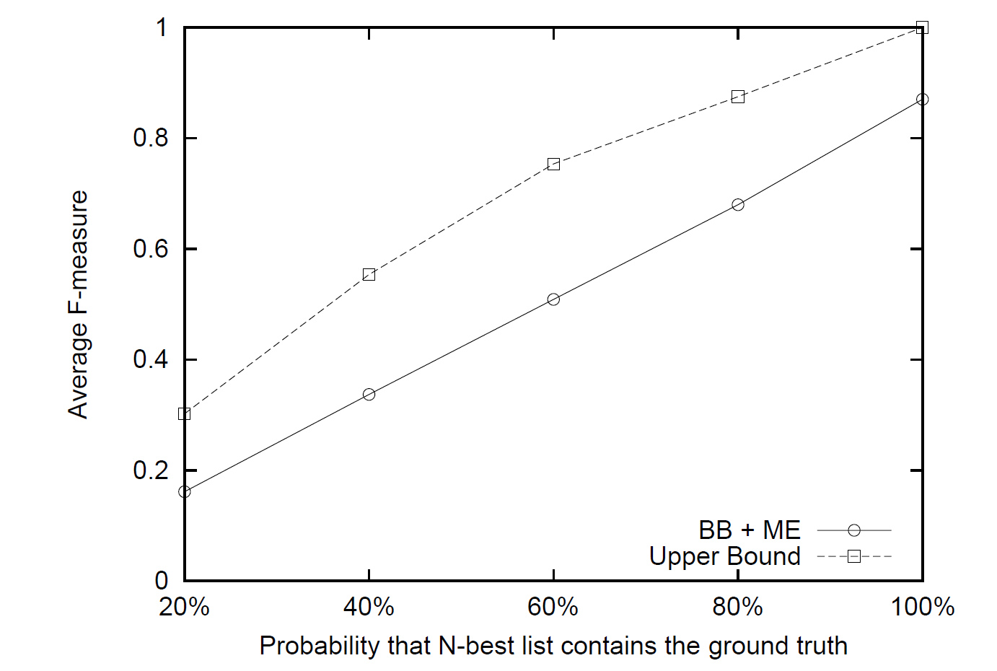
Experiment 5: Quality on a Larger Dataset

Slide 23
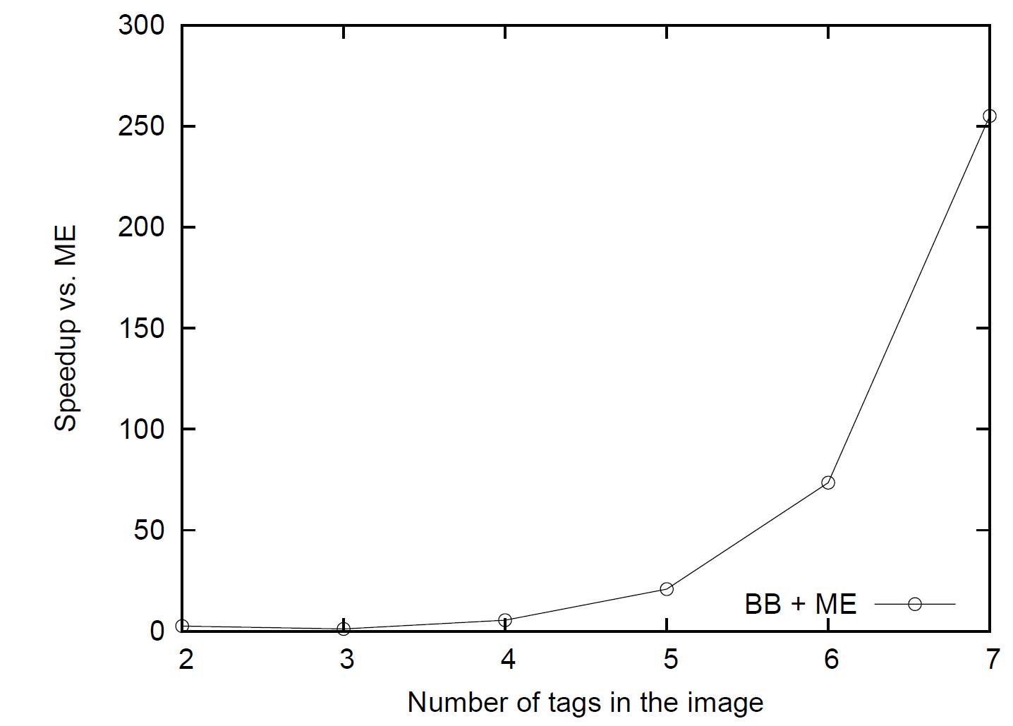
Experiment 6: Speedup of BB Algorithm

Slide 24
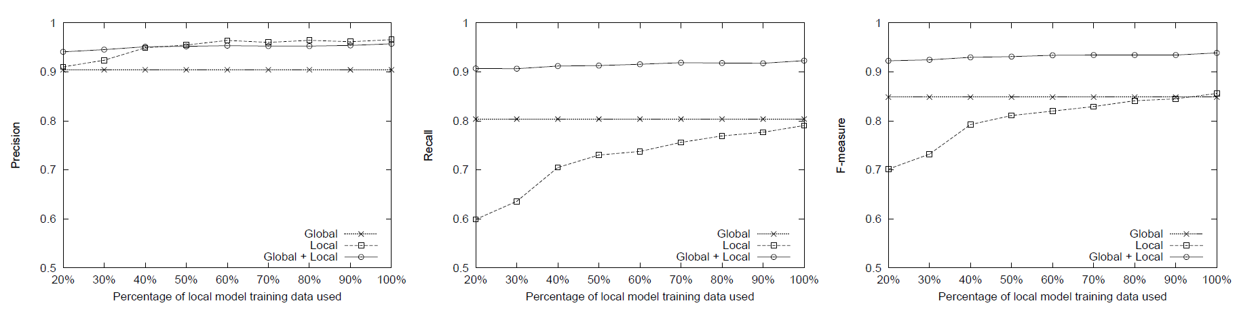
Experiment 7: Multi-model Case

Slide 25
Progress
SA Application | Status
Alerts | A prototype is implemented and integrated into SAFIRE/FICB. Research: Several novel retrieval algorithms have been designed and being evaluated. Algorithm of combining classifiers are being investigated.
Conversation Monitoring & Playback | A prototype is implemented. Integration into SAFIRE is ongoing.
Image & Video Tagging | Prototype system is implemented. Research: two new image tagging methods have been designed, optimization techniques have been investigated as well.
Spatial Messaging | Future work.
Localization via Speech | Future work. We have extensive experience on very related topics, possibly some of these ideas can be leveraged.

