Slide 1
ICS 6D Discrete Math for Computer Science Winter 2017

Slide 2
Course Instructors
Instructor: Prof. Sandy Irani
Teaching Assistants:
Siddharth Gupta
Dimitrios Kotzias
Zahra Montazeri
Readers
Elham Havvaei
Pedro Matias
Mehdi Rahimzadeh

Slide 3
Course Meeting Times
Lectures: MWF 2:00-2:50
SSLH 100
Discussion
Three different groups
MW 8AM, 6PM, 7PM, 8PM
Two hours per week
Lead by teaching assistants
No new material presented
Question and answer format
No discussion first week
Monday, January 16, MLK day: university holiday
First discussion meets Wednesday, January 18

Slide 4
Course Web Page
www.ics.uci.edu/~irani/w17-6D/6D
Office hours, contact info
Course administration
Schedule
Topics
Reading assignments
Homework/solutions
Test schedule

Slide 5
Text (zyBook)
Web-based, interactive text
Subscription for the quarter ($48)
zyBooks.com to sign up.
zyBook code: UCIICS6DWinter2017
Required for the course:
Data on activities is recorded and counts for a small portion of course credit.
You must have an account for this offering (Winter 2017)
You get credit if you eventually get the question correct.

Slide 6
Text (zyBook)
Two types of interactive activities:
Participation activities (labeled with “P”)
Due at the time the reading is due.
Shorter and easier.
Reinforce/teach concepts
Challenge activities (labeled with “C”)
Due at the time the homework is due.
More challenging
Test mastery
Will be explicitly listed in homework assignment

Slide 7
Text (zyBook)
Student activities automatically time-stamped
Your progress visible on your dashboard
Jan 11 and 13 is not for credit.
Jan 18 and 20 reading is due Monday January 23 at 2PM
After the first two weeks, the reading for each lecture is due by 2PM on the day of the lecture.

Slide 8
Text (zyBook)
Provide feedback:
Technical issues with your subscription:
support@zyBooks.com
Small bugs in the text
“Feedback” buttons in the text
support@zyBooks.com
Technical problems that prevent understanding material:
support@zyBooks.com
CC me: irani@ics.uci.edu
General ideas on how to improve the text
Come talk to me.

Slide 9
Schedule
Mon
Wed
Fri
Topic A
In lecture:
Reading and Participation Activities for Topic A are due.
Topic B
In lecture:
Reading and Participation Activities for Topic B are due.
Topic C
In lecture:
Reading and Participation Activities for Topic C are due.
Week x:
HW on topics ABC posted on Monday
Mon
Wed
Fri
Written homework
and Challenge Activites from zyBook on topics
ABC due by 1:45PM
Week x+1:

Slide 10
Homework
Homework consist of two parts:
Electronic: challenge activities in your zyBook
Written: exercises from the text
Both parts are due at 1:45PM
No late homework accepted
Lowest score dropped for final grade
Solutions will be made visible in text after due date.

Slide 11
Gradescope
You will hand in homework through a system called GradeScope (gradescope.com)
Everyone enrolled in the class has been added and has an account. (I will update the roster periodically.)
Please do not create an additional account with a non-UCI address.
You need to upload a pdf file with your written homework to Gradescope for grading.
You will get an email with your homework score and comments.
Scores also posted on EEE (HW and Tests)

Slide 12
Gradescope
The Course Reference (under “Homework”) has links that show how to scan in and upload your homework.
Use a scanner or scanning App (Genius Scan or Scannable) to create a pdf file with your homework
Do not just take a picture and upload the jpeg or embed the jpeg in a pdf file
The readers are not required to grade your homework if they can not read it. Ungraded homework will be given a 0.

Slide 13
Course Grades
Homework: 5% (total of 8 out of 9)
Reading: 5% (35 sections, drop lowest 5)
Class participation: 1.5% (19 lectures, drop 4)
4 Tests (all mandatory) 88% (22% each)
Completing Course Evaluation: .5%
(Anonymous)
NO FINAL EXAM

Slide 14
Course Grades
Homework: 5% (total of 8 out of 9)
Reading: 5% (35 sections, drop lowest 5)
Class participation: 1.5% (19 lectures, drop 4)
4 Tests (all mandatory) 88% (22% each)
Completing Course Evaluation: .5%
(Anonymous)
NO FINAL EXAM

Slide 15
Course Grades
Homework: 5% (total of 8 out of 9)
Reading: 5% (35 sections, drop lowest 5)
Class participation: 1.5% (19 lectures, drop 4)
4 Tests (all mandatory) 88% (22% each)
Completing Course Evaluation: .5%
(Anonymous)
NO FINAL EXAM

Slide 16
Class Participation
i>Clicker/REEF: Multiple-choice questions posed in lecture and you respond via an i>Clicker or mobile device
Cost: $15 for a REEF subscription or $56 for an i>Clicker device.
More Details Next week
Week 1: instructions
Week 2: trial runs
Week 3+: for course credit

Slide 17
4 Tests
Four tests, all on Fridays
Feb 3 (week 4)
Feb 17 (week 6)
March 3 (week 8)
March 17 (week 10)
Given during regular lecture time.
Material covered is posted on class web page for each test.
Test format is short answer.
Previous test available from my home page
No solutions provided

Slide 18
4 Tests
Four tests, all on Fridays
Feb 3 (week 4)
Sequences, recurrent relations, induction, recursion
HW 2 and 3 (Chapter 8 minus 8.7 and 8.8)
Feb 17 (week 6)
Number theory, cryptography
HW 4 and 5 (Chapter 9)
March 3 (week 8)
Combinatorics, Part I
HW 6 and 7 (Sections 10.1-10.7, 12.1)
March 17 (week 10)
Combinatorics, Part II
HW 8 and 9 (Sections 10.8-10.12, 11.1, 11.2)

Slide 19
4 Tests
All four tests are mandatory.
There are only two ways to miss a test and not get a 0:
Preapproved absence
Not a work commitment or family vacation
You must send me an email at least one week in advance – or as soon as you are aware of the problem.
Unforeseeable emergency – documented
e.g., medical
In either case, I will ask you to come see me in person so we can discuss your reason and a plan for your score
There will be no make up tests.

Slide 20
Questions on Grading?
After each test or HW score is posted the person who graded it will post a note on Piazza
Questions on grading should first go to the person who graded it
By email or by appointment
Come see me about unresolved grading questions.

Slide 21
Board notes
After each lecture, I will post the contents of the board generated from lecture
Purpose: reduce the amount of writing you need to do in class (not eliminate the need to take notes).
Posted board notes are NOT a complete record of what happened in class
You are responsible for whatever is said in lecture.
If you can not read anything written during lecture, please ask!

Slide 22
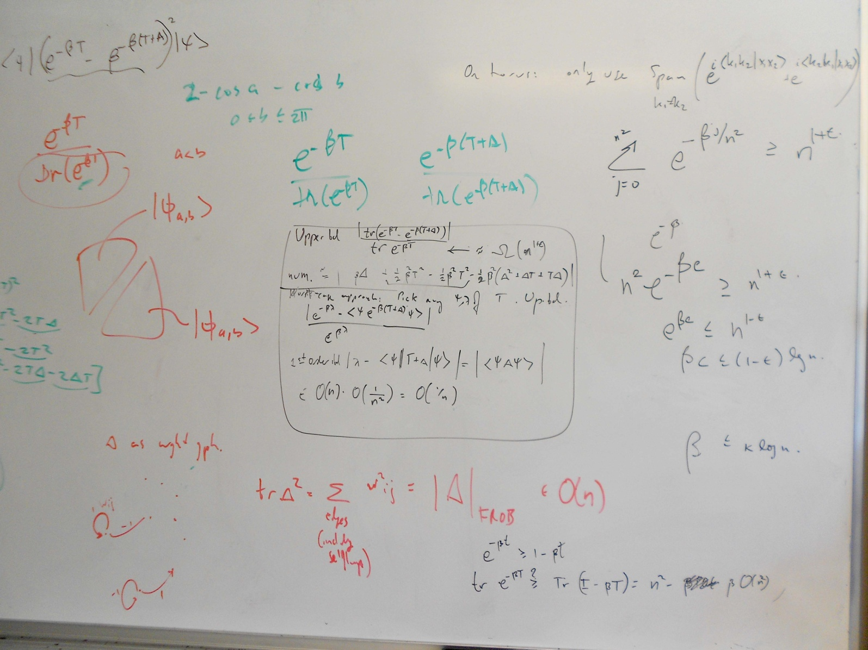
Board notes

Slide 23
Piazza
Online forum/”wiki”
All questions related to course content should be posted on Piazza (not asked by email).
Students can post anonymously
Collectively written/edited student solution
Instructor can mark “good question”/”good solution”
Instructors can add their own solution.
The TAs and I will each check Piazza at least once a day.

Slide 24
Piazza
Post general administrative questions on Piazza
e.g., What does quiz 1 cover?
Routine announcements will be posted on Piazza
Time sensitive announcements will generate an email to the class.
Check Piazza at least twice per week.

Slide 25
Piazza Questions
Questions/comments can be posted anonymously to Piazza, but they are only anonymous to other students.
Instructors see the identity of any individual who posts on Piazza
Before posting an administrative question to Piazza:
Check the course web page or Piazza announcements for an answer
Before posting a question to Piazza about course content:
Check the text for an explanation

Slide 26
Questions
The best way to get questions answered:
Discussion section
My office hours
TA office hours

Slide 27
Accounts for ICS 6D
EEE
zyBooks
Piazza
Gradescope
REEF

Slide 28
Office Hours
Highly under-utilized resource
If space is limited, priority given to students asking questions
OK to sit an listen to answers asked by other stidents if there is room.
Office hours are not “study hall”.

Slide 29
Academic Honesty
It’s important!
Read the school policy.
Write up your homework solutions on your own
Keep your eyes on your own test/quiz.

Slide 30
Class attendance
If you need to miss a class, ask a friend for notes.
If you do not understand an example or idea presented in class
Ask a question
Write down your question and bring it to discussion section.

Slide 31
Statistics from Spring Offering of ICS 6D
383 students enrolled and showed up for the final exam
Attendance taken during every lecture in weeks 3-10, except on test days
(19 lectures total)
“High attenders” (at least 75% attendance)
108 students (28% of the class)
“Low attenders” (less than 75% attendance)
275 students (72% of the class)

Slide 32
Statistics from Spring 2015 Offering of ICS 6D
High attenders (at least 75%) | Low attenders (less than 75%)
Median grade: B+ | Median grade: C+
7.5% received D+ or lower | 28.4% received D+ or lower
42.6% received an A+/A/A- | 21.1% received an A+/A/A-

Slide 33
Statistics from Spring Offering of ICS 6D

