Slide 1
9. Linking and Sharing
9.1 Single-Copy Sharing
  Why Share
  Requirements for Sharing
  Linking and Sharing
9.2 Sharing in Systems without Virtual Memory
9.3 Sharing in Paging Systems
  Sharing of Data
  Sharing of Code
9.3 Sharing in Segmented Systems
9.4 Principles of Distributed Shared Memory (DSM)
  The User's View of DSM
9.5 Implementations of DSM
  Implementing Unstructured DSM
  Implementing Structured DSM

Slide 2
Single-Copy Sharing
Focus: sharing a single copy of code or data in memory
Why share?
  Processes need to access common data
    Producer/consumer, task pools, file directories
  Better utilization of memory
    code, system tables, data bases

Slide 3
Requirements for Sharing
Requirement for sharing
  How to express what is shared
    A priori agreement (e.g., system components)
    Language construct (e.g., UNIX’s shmget/shmat)
  Shared code must be reentrant (also known as read-only or pure)
    Does not modify itself (read-only segments)
    Data (stack, heap) in separate private areas for each process

Slide 4
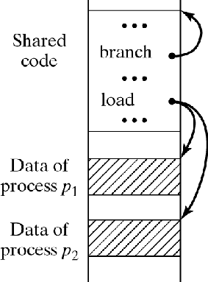
Linking and Sharing
Linking resolves external references
Sharing links the same copy of a module into two or more address spaces
Static linking/sharing:
  Resolve references
  before execution starts
Dynamic linking/sharing:
  While executing
Figure 9-1

Slide 5
Sharing without Virtual Memory
With one or no Relocation Register (RR)
  All memory of a process is contiguous
  Sharing user programs:
    Possible only with 2 user programs by partial overlap
    Too restrictive and difficult; generally not used
  Sharing system components:
    Components are assigned specific, agreed-upon starting positions
    Linker resolves references to those locations
    Can also use a block of transfer addresses,
    but this involves additional memory references.

Slide 6
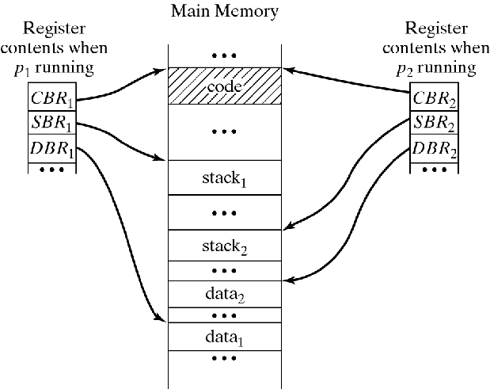
Sharing without Virtual Memory
With multiple RRs
  CBR = Code Base Register
  Point to shared
  copy of code
  SBR = Stack Base Register
  Point to private
  copy of stack
  DBR = Data Base Register
  Point to private
  copy of data
Figure 9-2

Slide 7
Sharing in Paging Systems
Data pages
Code pages
Generally, want to avoid requiring shared page to have the same page number in all processes that share it
  Code, data could be shared by many processes
  Could easily lead to conflicts

Slide 8
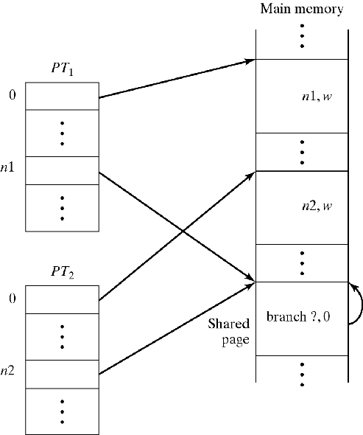
Sharing in Paging Systems
Sharing of data pages:
  Page table entries of different processes point to the same page
  If shared pages contain only data and no addresses, linker can
    Assign arbitrary page numbers to the shared pages
    Adjust page tables to point to appropriate page frames
  So the shared page can have a different page number in different processes
Figure 9-3

Slide 9
Sharing in Paging Systems
Sharing of code pages
Key issues:
  Self-references: references to the shared code from within the shared code
  Linking the shared code into multiple address spaces

Slide 10
Sharing of Code Pages in Paging Systems
Self references:
  avoid page numbers in shared code by compiling branch addresses relative to CBR
  This works provided the shared code is self-contained (does not contain any external references )
Linking shared pages into multiple address spaces:
  Issues:
    Want to defer loading of code until we actually use it
    When process first accesses the code, it may have already been loaded by another process
  Done through dynamic linking using a transfer vector
Figure 9-3

Slide 11
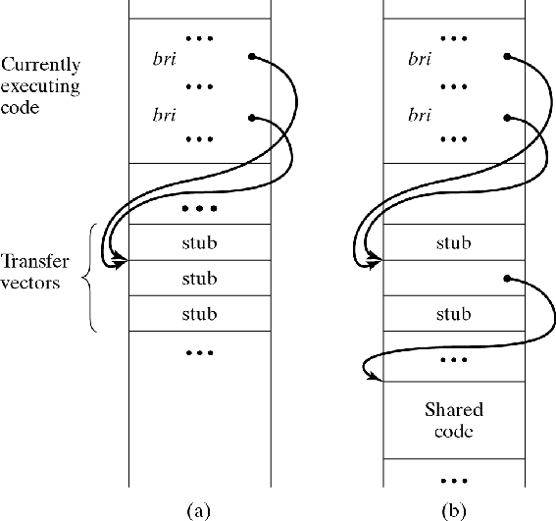
Dynamic Linking via Transfer Vector
Each Transfer Vector entry corresponds to a reference to shared code
Each entry initially contains a piece of code called a stub
Stub code does the following:
  Checks whether referenced shared code is loaded.
  If the shared code is not already loaded, the stub loads the code
  Stub code replaces itself by a direct reference to the shared code
Figure 9-4

Slide 12
Sharing in Segmented Systems
Much the same as with Paged Systems
Simpler and more elegant because segments represent logical program entities
ST entries of different processes point to the
same segment in physical memory (PM)
Data pages, containing only data and no addresses: same as with paged systems
Code pages:
  Assign same segment numbers in all STs, or
  Use base registers:
    Function call loads CBR
    Self-references have the form w(CBR)
    This works if shared segments are self-contained (i.e., it they do not contain any references to other segments).
    Full generality can be achieved using private linkage sections, introduced in Multics (1968).

Slide 13
Unrestricted Dynamic Linking/Sharing
Basic Principles (see Figure 9-5 on next page):
  Self-references resolved using CBR
  External references are indirect
  via a private linkage section
  External reference is (S,W), where S and W are symbolic names
  At runtime, on first use:
    Symbolic address (S,W) is resolved to (s,w), using trap mechanism)
    (s,w) is entered in linkage section of process
    Code is unchanged
  Subsequent references use (s,w) without involving OS
  Forces additional memory access for every external reference

Slide 14
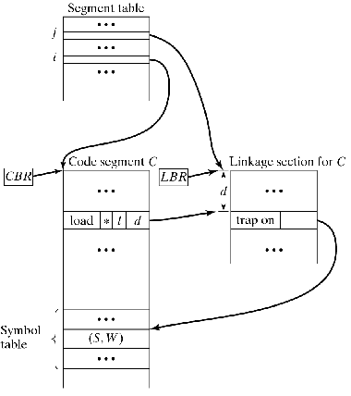
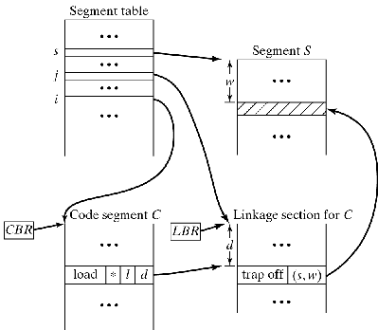
Dynamic Linking/Sharing
Before and After External Reference is Executed
Figure 9-5a: Before
Figure 9-5b: After

Slide 15
Distributed Shared Memory
Goal: Create illusion of single shared memory in a distributed system
The (ugly) reality is that physical memory is distributed.
References to remote memory trigger hidden transfers from remote memory to local memory
  Impractical/Impossible to do this one reference at a time.
How to implement transfers efficiently?
  Optimize the implementation.
  Most important with Unstructured DSM.
  Restrict the user. (Exploit what the user knows.)
  Basic to Structured DSM.

Slide 16
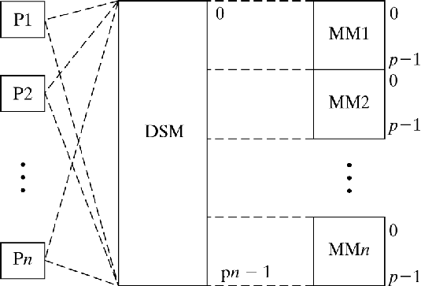
Unstructured DSM
Simulate single, fully shared, unstructured memory.
(Unlike paging, a CPU has no private space.)
Figure 9-6
  Advantage: Fully transparent to user
  Disadvantage: Efficiency. Every instruction fetch or operand read/write could be to remote memory

Slide 17
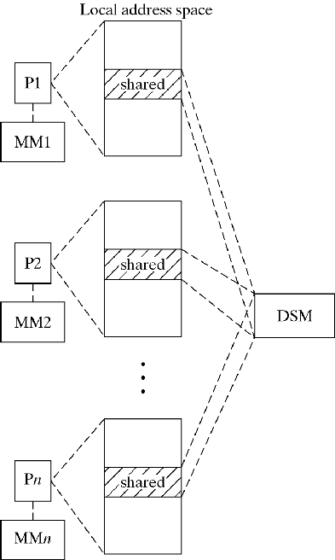
Structured DSM
Each CPU has both private and shared space.
Add restrictions on use of shared variables:
  Access only within (explicitly declared) Critical Sections
  Modifications only need to be propagated at beginning/end of critical sections.
Variant: Use objects instead of shared variables: object-based DSM
Figure 9-7

Slide 18
Implementing Unstructured DSM
Key Issues:
  Granularity of Transfers
  Replication of Data
  Memory Consistency: Strict vs Sequential
  Tracking Data: Where is it stored now?

Slide 19
Implementing Unstructured DSM
Granularity of Transfers
  Transfer too little:
    Time wasted in latency
  Transfer too much:
    Time wasted in transfer
    False sharing:
      Two unrelated variables, each accessed by a different process, are on the same page/set of pages being transferred between physical memories
      Can result in pages being transferred back and forth, similar to thrashing

Slide 20
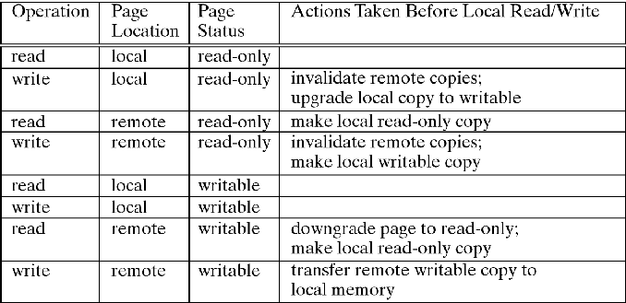
Implementing Unstructured DSM
Replication of Data: Move or Copy?
  Copying saves time on later references.
  Copying causes (cache or real) consistency confusion.
    Reads work fine.
    Writes require others to update or invalidate.
Figure 9-9

Slide 21
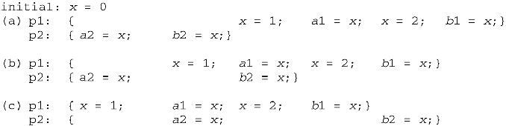
Implementing Unstructured DSM
Strict Consistency: Reading a variable x returns the value written to x by the most recently executed write operation.
Sequential Consistency: Sequence of values of x read by different processes corresponds to some sequential interleaved execution of those processes.
Figure 9-11
Reads of x in p1 will always produce (1,2)
Reads of x in p2 can produce (0,0), (0,1), (0,2), (1,1), (1,2), or (2,2)

Slide 22
Implementing Unstructured DSM
Tracking Data: Where is it stored now?
Approaches:
  Have owner track it by maintaining copy set (list).
  Only owner is allowed to write.
  Ownership can change when a write request is received.
  Now we need to find the owner. ☺
    Use broadcast.
    Central Manager (→ Bottleneck). Replicated managers share responsibilities.
    Probable owner gets tracked down. Retrace data’s migration. Update links traversed to show current owner.
Bottom line on Unstructured DSM:
  Isn’t there a better way?

Slide 23
Implementing Structured DSM
Memory Consistency
  Unstructured DSM assume that all shared variables are consistent at all times. This is a major reason why the performance is so poor.
  Structured DSM introduces new, weaker models of memory consistency
    Weak consistency
    Release consistency
    Entry consistency

Slide 24
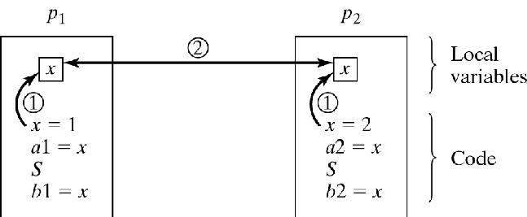
Implementing Structured DSM
Weak Memory Consistency
  Introduce synchronization variable S
  Processes access S when they are
  ready to adjust/reconcile their shared variables.
  The DSM is only guaranteed to be in a consistent state immediately following access to a synchronization variable
Figure 9-12

Slide 25
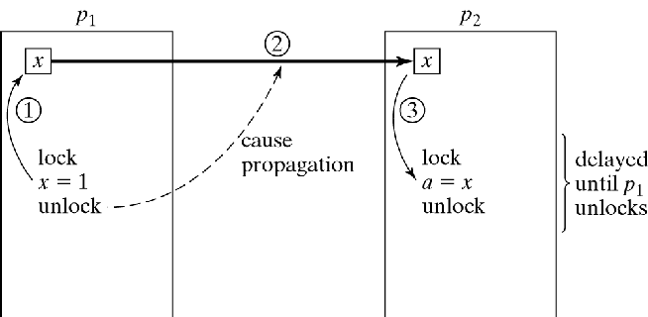
Implementing Structured DSM
Release Memory Consistency
  Export modified variables upon leaving CS
Figure 9-13
– This is a waste if p2 never looks at x.

Slide 26
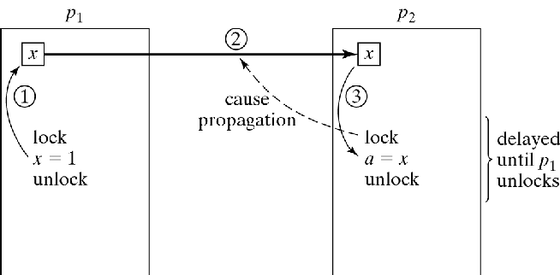
Implementing Structured DSM
Entry Memory Consistency
  Associate each shared variable with a lock variable
  Before entering CS, import only those variables associated with the current lock
Figure 9-14
  There is also a (confusingly named?) lazy release consistency model which imports all shared variables before entering CS

Slide 27
Object-Based DSM
An object’s functions/methods are part of it.
Can use remote method invocation
(like remote procedure calls, covered earlier)
instead of copying or moving an object into
local memory.
Can also move or copy an object to improve performance.
When objects are replicated, consistency issues again arise (as in unstructured DSM)
On write, we could
  Invalidate all other copies (as in unstructured DSM)
  Remotely invoke, on all copies, a method that does the same write

Slide 28
Memory Models on Multiprocessors
Processors share memory
Each processor may have its own cache
Memory models provide rules for deciding
  When processor X sees writes to memory by other processors
  When writes by processor X are visible to other processors
These questions are similar to some of the issues that arise in distributed shared memory
.

Slide 29
Java Memory Model
Similar issues arise in multithreaded code in Java
Each thread may have its own copy of shared variables
Threads may read from and write to their own copy of shared variables.
The Java Memory Model specifies
  When thread X must see writes to memory by other processors
  When writes by thread X must become visible to other processors
The issues in Java are different from those in other languages such as C/C++:
  Threads are an integral part of the Java language.
  Java compilers can rearrange thread code as part of optimization
  To achieve correctness, certain conditions must be guaranteed.

Slide 30
Java Memory Model (continued)
Full details in JSR 133 (2004).
A happened-before relation is defined on memory references, locks, unlocks, and other thread operation.
If one action happened-before the other according to this definition, then the Java Virtual Machine guarantees that the results of the first action are visible to the second action
Example:
  If x=1 happened-before y=x and no other assignment to x intervenes, then y must be set to 1.
  But if it is not true that x=1 happened-before y=x, then y will not necessarily be set to 1.
Note that this is a separate issue from mutual exclusion, although the two are related.

Slide 31
Java Memory Model (continued)
Some rules defining the happened before relation (not a complete list):
  An action in a thread happened-before an action in that thread that comes later in the thread’s sequential order.
  An unlock on an object happened-before every subsequent lock on that same object.
  A write to a volatile field happened-before every subsequent read of that same volatile field.
  A call to start() on a thread happened-before any actions within the thread.
  All actions within a thread happened-before any other thread returns from a join() on that thread.
  A write by a thread to a blocking queue happened-before any subsequent read from that blocking queue.
There are other rules. The compiler is free to reorder operations as long as the happened-before operation is respected.

Slide 32
History
Originally developed by Steve Franklin
Modified by Michael Dillencourt, Summer, 2007
Modified by Michael Dillencourt, Spring, 2009
Modified by Michael Dillencourt, Winter 2011 (added material on Java memory model)

