Slide 1
INF 123
SW Arch, dist sys & interop
Lecture 8
Prof. Crista Lopes

Slide 2
Objectives
Understanding of Remote Procedure Call
Understanding of Web Services
Understanding of mechanisms supporting Web Services

Slide 3
Recap: RESTful Design Guidelines
Embrace hypermedia
  Name your resources/features with URIs
  Design your namespace carefully
Hide mechanisms
  Bad: http://example.com/cgi-bin/users.pl?name=John
  Good: http://example.com/users/John
Serve POST, GET, PUT, DELETE on those resources
  Roughly, Create, Retrieve, Update, Delete (CRUD) life-cycle
Don’t hold on to state
  Serve and forget (functional programming-y)
Consider serving multiple representations
  HTML, XML

Slide 4
Lecture 8
Distributed services
Web Services
Remote Procedure Calls
  Historical context
  Interface Definition Languages
  Mechanism
RPC on the Web – XMLRRPC
SOAP
WSDL

Slide 5

So far: Anatomy of Web Apps
Client invokes
an HTTP operation,
may send data
2. Server accesses
persistent data
Client
(Browser)
DB
Web Server
Presentation
Business
Data
4. Server sends back
status and representation
3. Response from DB
“3-tier architecture”

Slide 6
More: Anatomy of Web Apps
Web Server
Client
(Browser)
Web Server
Web Server
…
Presentation
Business
Client
Web Server
“Web Services”

Slide 7
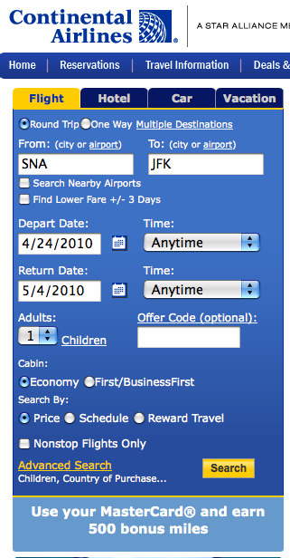
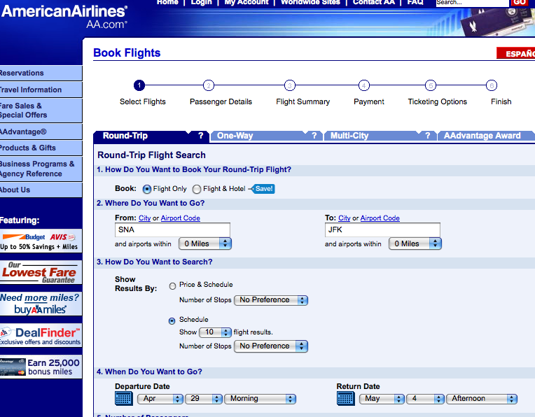
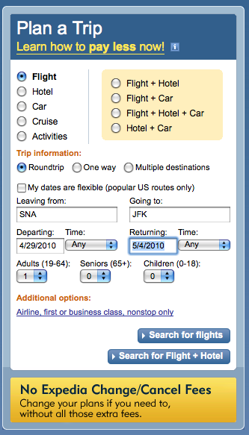
Canonical Example
…

Slide 8
More: Anatomy of Web Apps
Web Server
?
Client
(Browser)
HTTP
Web Server
Web Server
…
Presentation
Business
Client
Web Server
Web Services

Slide 9
Web Services isa Distributed System
“Collection of interacting components hosted on different computers that are connected through a computer network”
Component1
Component n
Network OS
Component1
Component n
…
Network OS
Network
Hardware
Component1
Component n
Network OS
Hardware
Host 3
Hardware
Host 2
Host 1

Slide 10
Back to the 70s
Remember, TCP/IP was *it*
Several special-purpose protocols on top
  telnet, SMTP, FTP, etc.
Question: Can we define a general purpose protocol that can make servers of any kind understand each other?
Answer: Let’s make them ‘speak’ procedure calls!

Slide 11
Remote Procedure Calls (RPC)
Local Procedure Calls
Remote Procedure Calls
host
host 1
program
program
caller
caller
r = foo(a, b)
r = foo(a, b)
host 2
callee
program
define foo(a, b)
…
end
callee
define foo(a, b)
…
end

Slide 12
Remote Procedure Calls (RPC)
Local Procedure Calls
Remote Procedure Calls
host
host 1
program
program
caller
caller
r = foo(a, b)
r = foo(a, b)
Stub
host 2
callee
program
Skeleton
define foo(a, b)
…
end
callee
define foo(a, b)
…
end

Slide 13
RPC
Procedure Call Program
(in PL)
Procedure Interface Definition
(in IDL)
Procedure Definition Program
(in PL)
generates
Stub
(in PL)
Skeleton
(in PL)
Network OS
Network OS

Slide 14
Example: Sun RPC (mid-80s)
Interface Definition
/*
* date.x - Specification of remote date and time service.
*/
/*
* Define 2 procedures:
* bin_date_1() returns the binary time and date (no arguments).
* str_date_1() takes a binary time and returns a human-readable string.
*/
program DATE_PROG {
version DATE_VERS {
long BIN_DATE(void) = 1; /* procedure number = 1 */
string STR_DATE(long) = 2; /* procedure number = 2 */
} = 1; /* version number = 1 */
} = 0x31234567; /* program number = 0x31234567 */

Slide 15
Example: Sun RPC (mid-80s)
Procedure Call Program
/* * rdate.c - client program for
remote date service. */
#include<stdio.h>
#include<rpc/rpc.h>
/* standard RPC include file */
#include"date.h”
/* this file is generated by rpcgen */
main(argc, argv)intargc;
char*argv[];
{
CLIENT*cl; /* RPC handle */
char*server;
long*lresult;
/* return value from bin_date_1() */
char**sresult;
/* return value from str_date_1() */
if (argc != 2)
{
fprintf(stderr, "usage: %s hostname\n",
argv[0]);
exit(1);
}
server = argv[1];
/* * Create the client "handle." */
if ((cl = clnt_create(server,
DATE_PROG, DATE_VERS, "udp"))
== NULL)
{/* * Couldn't establish connection with server. */
clnt_pcreateerror(server);
exit(2);
}
/* * First call the remote procedure "bin_date". */
if ((lresult = bin_date_1(NULL, cl)) == NULL)
{
clnt_perror(cl, server);
exit(3);
}
printf("time on host %s = %ld\n", server, *lresult);
/* * Now call the remote procedure "str_date". */
if ((sresult = str_date_1(lresult, cl)) == NULL)
{
clnt_perror(cl, server);
exit(4);
}
printf("time on host %s = %s", server, *sresult);
clnt_destroy(cl);
/* done with the handle */
exit(0);
}

Slide 16
Example: Sun RPC (mid-80s)
Stub
/*
* Please do not edit this file.
* It was generated using rpcgen.
*/
#include "date.h"
/* Default timeout can be changed using clnt_control() */
static struct timeval TIMEOUT = { 25, 0 };
long *
bin_date_1(argp, clnt)
void *argp;
CLIENT *clnt;
{
static long clnt_res;
memset((char *)&clnt_res, 0, sizeof (clnt_res));
if (clnt_call(clnt, BIN_DATE,
(xdrproc_t) xdr_void, (caddr_t) argp,
(xdrproc_t) xdr_long, (caddr_t) &clnt_res,
TIMEOUT) != RPC_SUCCESS) {
return (NULL);
}
return (&clnt_res);
}
char **
str_date_1(argp, clnt)
long *argp;
CLIENT *clnt;
{
static char *clnt_res;
memset((char *)&clnt_res, 0, sizeof (clnt_res));
if (clnt_call(clnt, STR_DATE,
(xdrproc_t) xdr_long, (caddr_t) argp,
(xdrproc_t) xdr_wrapstring, (caddr_t) &clnt_res,
TIMEOUT) != RPC_SUCCESS) {
return (NULL);
}
return (&clnt_res);
}

Slide 17
Example: Sun RPC (mid-80s)
Skeleton
/*
* Please do not edit this file.
* It was generated using rpcgen.
*/
#include "date.h"
#include <stdio.h>
#include <stdlib.h> /* getenv, exit */
#include <signal.h>
#include <sys/types.h>
#include <memory.h>
#include <stropts.h>
#include <netconfig.h>
#include <sys/resource.h> /* rlimit */
#include <syslog.h>
#ifdef DEBUG
#define RPC_SVC_FG
#endif
#define _RPCSVC_CLOSEDOWN 120
static int _rpcpmstart; /* Started by a port monitor ? */
/* States a server can be in wrt request */
#define _IDLE 0
#define _SERVED 1
static int _rpcsvcstate = _IDLE; /* Set when a request is serviced */
static int _rpcsvccount = 0; /* Number of requests being serviced */
…
static void
date_prog_1(rqstp, transp)
struct svc_req *rqstp;
register SVCXPRT *transp;
{
union {
long str_date_1_arg;
} argument;
char *result;
bool_t (*xdr_argument)(), (*xdr_result)();
char *(*local)();
_rpcsvccount++;
switch (rqstp->rq_proc) {
case NULLPROC:
(void) svc_sendreply(transp, xdr_void,
(char *)NULL);
_rpcsvccount--;
_rpcsvcstate = _SERVED;
return;
case BIN_DATE:
xdr_argument = xdr_void;
xdr_result = xdr_long;
local = (char *(*)()) bin_date_1;
break;
case STR_DATE:
xdr_argument = xdr_long;
xdr_result = xdr_wrapstring;
local = (char *(*)()) str_date_1;
break;
default:
svcerr_noproc(transp);
_rpcsvccount--;
_rpcsvcstate = _SERVED;
return;
}

Slide 18
Example: Sun RPC (mid-80s)
Skeleton (cont)
(void) memset((char *)&argument, 0, sizeof (argument));
if (!svc_getargs(transp, xdr_argument, &argument)) {
svcerr_decode(transp);
_rpcsvccount--;
_rpcsvcstate = _SERVED;
return;
}
result = (*local)(&argument, rqstp);
if (result != NULL && !svc_sendreply(transp, xdr_result, result)) {
svcerr_systemerr(transp);
}
if (!svc_freeargs(transp, xdr_argument, &argument)) {
_msgout("unable to free arguments");
exit(1);
}
_rpcsvccount--;
_rpcsvcstate = _SERVED;
return;
}

Slide 19
Example: Sun RPC (mid-80s)
Procedure Definition Program
/* * dateproc.c - remote procedures;
called by server stub. */
#include<rpc/rpc.h>
/* standard RPC include file */
#include"date.h”
/* this file is generated by rpcgen */
/* * Return the binary date and time. */
long *bin_date_1() {
static long timeval;
/* must be static */
long time();
/* Unix function */
timeval = time((long *) 0);
return(&timeval);
}
(continuation…)
/* * Convert a binary time and return
a human readable string. */
char **str_date_1(bintime)
long*bintime; {
static char* ptr;
/* must be static */
char*ctime();
/* Unix function */
ptr = ctime(bintime);
/* convert to local time */
return(&ptr);
}

Slide 20
RPC on the Web
Web Server
Client
(Browser)
HTTP
Web Server
Web Server
RPC
…
Presentation
Business
Client
Web Server
Web Services

Slide 21
RPC on the Web
XML RPC
  Remote Procedure Calls over HTTP
    POST exclusively!
  1998, grew popular, many language bindings
  http://www.xmlrpc.com/

Slide 22
XML RPC - Requests
POST /RPC2 HTTP/1.1
User-Agent: Frontier/5.1.2 (WinNT)
Host: betty.userland.com
Content-Type: text/xml
Content-length: 181
<?xml version="1.0"?>
<methodCall>
<methodName>examples.getStateName</methodName>
<params>
<param>
<value><int>41</int></value>
</param>
</params>
</methodCall>

Slide 23
XML RPC – Responses (success)
HTTP/1.1 200 OK
Connection: close
Content-Length: 158
Content-Type: text/xml
Date: Fri, 17 Jul 1998 19:55:08 GMT
Server: UserLand Frontier/5.1.2-WinNT
<?xml version="1.0"?>
<methodResponse>
<params>
<param>
<value><string>South Dakota</string></value>
</param>
</params>
</methodResponse>

Slide 24
XML RPC – Responses (fault)
HTTP/1.1 200 OK
Connection: close
Content-Length: 426
Content-Type: text/xml Date: Fri, 17 Jul 1998 19:55:02 GMT
Server: UserLand Frontier/5.1.2-WinNT
<?xml version="1.0"?>
<methodResponse>
<fault>
<value>
<struct>
<member>
<name>faultCode</name>
<value><int>4</int></value>
</member>
<member>
<name>faultString</name>
<value><string>Too many parameters.</string></value>
</member>
</struct>
</value>
</fault>
</methodResponse>

Slide 25
Try it
http://www.xmlrpc.com/directory/1568/services
  e.g. http://www.syndic8.com/services.php
Many of these services are gone
  some now provide REST APIs
  (e.g. http://help.freshmeat.net/faqs/api-7/data-api-intro )

Slide 26
XML RPC Analysis
Uses HTTP, but the style is different from REST
“Story” centered around calling methods
  Original story of the 70s
  Different implementation
Server
of
Functions
Server
of
Resources
Client
Client
call functions
vs.
access resources
Server
of
Functions
Server
of
Resources
RPC Style
REST Style

Slide 27
Next stop: SOAP
“Simple Object Access Protocol”
Inspired by RPC and its object-oriented counterpart, RMI – distributed objects
Inspired by HTTP and the Web
  Proxies
One level above XML RPC
  Adds processing and extensibility models to the “story”
  Style for exchanging arbitrary XML data
Protocol bindings may very, but usually HTTP (POST)
  Others: SMTP (email)
Promoted as the right style for Web Services

Slide 28
SOAP Processing Model
A SOAP app is made of communicating nodes
  Sender
  Receiver
  Message Path
  Initial Sender (Originator)
  Intermediary
  Ultimate Receiver
SOAP messages may target nodes in specific roles
(SOAP’s version of Web caches)

Slide 29
SOAP Extensibility Model
The basic SOAP can be extended
  Features
  Message Exchange Patterns
  Modules

Slide 30
SOAP Message
<env:Envelope xmlns:env="http://www.w3.org/2003/05/soap-envelope">
<env:Header>
<h:control xmlns:h="http://herong.com/header">
<h:sender>Herong</h:sender>
</h:control>
</env:Header>
<env:Body>
<b:greeting xmlns:b="http://herong.com/body">
<b:msg>Hello there!</b:msg>
</b:greeting>
</env:Body>
</env:Envelope>

Slide 31
SOAP Message over Email
From: me@my.com
To: you@your.com
Subject: Greeting
<env:Envelope xmlns:env="http://www.w3.org/2003/05/soap-envelope">
<env:Header>
<h:control xmlns:h="http://herong.com/header">
<h:sender>Herong</h:sender>
</h:control>
</env:Header>
<env:Body>
<b:greeting xmlns:b="http://herong.com/body">
<b:msg>Hello there!</b:msg>
</b:greeting>
</env:Body>
</env:Envelope>

Slide 32
SOAP Message over HTTP
POST /SOAPListener HTTP/1.1
Host: your.com
Content-Type: application/soap+xml; charset=utf-8
Content-Length: nnn
<env:Envelope xmlns:env="http://www.w3.org/2003/05/soap-envelope">
<env:Header>
<h:control xmlns:h="http://herong.com/header">
<h:sender>Herong</h:sender>
</h:control>
</env:Header>
<env:Body>
<b:greeting xmlns:b="http://herong.com/body">
<b:msg>Hello there!</b:msg>
</b:greeting>
</env:Body>
</env:Envelope>

Slide 33
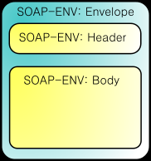
SOAP Messages
<env:Envelope xmlns:env="http://www.w3.org/2003/05/soap-envelope">
<env:Header>
...
</env:Header>
<env:Body>
...
</env:Body>
</env:Envelope>

Slide 34
More elaborate example
<?xml version="1.0"?>
<env:Envelope xmlns:env="http://www.w3.org/2003/05/soap-envelope">
<env:Header>
<m:reservation xmlns:m="http://travel.example.org/reservation"
env:role="http://www.w3.org/2003/05/soap-envelope/role/next"
env:mustUnderstand="true">
<m:reference>uuid:093a2da1-q345-73pqff98fe8j7d</m:reference>
<m:dateAndTime>2001-11-29T13:20:00.000-05:00</m:dateAndTime>
</m:reservation>
<n:passenger xmlns:n="http://mycompany.example.com/employees"
env:role="http://www.w3.org/2003/05/soap-envelope/role/next"
env:mustUnderstand="true">
<n:name>Herong Yang</n:name>
</n:passenger>
</env:Header>
(continues next page)

Slide 35
More elaborate example
(cont.)
<env:Body>
<p:itinerary xmlns:p="http://travelcompany.example.org/reservation/travel">
<p:departure>
<p:departing>New York</p:departing>
<p:arriving>Los Angeles</p:arriving>
<p:departureDate>2001-12-14</p:departureDate>
<p:departureTime>late afternoon</p:departureTime>
<p:seatPreference>aisle</p:seatPreference>
</p:departure>
<p:return>
<p:departing>Los Angeles</p:departing>
<p:arriving>New York</p:arriving>
<p:departureDate>2001-12-20</p:departureDate>
<p:departureTime>mid-morning</p:departureTime>
<p:seatPreference/>
</p:return>
</p:itinerary>
<q:lodging xmlns:q="http://travelcompany.example.org/reservation/hotels">
<q:preference>none</q:preference>
</q:lodging>
</env:Body>
</env:Envelope>

Slide 36
Status of SOAP
Used with WSDL
Not wide acceptance

Slide 37
WSDL – Problem being targeted
“Web Services Description Language”
How to tell the world what services my server provides

Slide 38
WSDL
provides a model and an XML format for describing Web services. WSDL 2.0 enables one to separate the description of the abstract functionality offered by a service from concrete details of a service description such as “how” and “where” that functionality is offered.
2.0 quite different from 1.1
  1.1 was bounced back from W3C (too much SOAP!)
  2.0 supports description of RESTful Web Services

Slide 39
WSDL content
The service’s URL
The communication mechanisms it understands
What operations it can perform
The structure of its messages

Slide 40
WSDL Example
http://www.ibm.com/developerworks/webservices/library/ws-restwsdl/

Slide 41
Recap of this lecture
Lots and Lots of Buzz words for your CV!
Understanding of Remote Procedure Call
Understanding of Web Services
Understanding of mechanisms supporting Web Services

