Slide 1
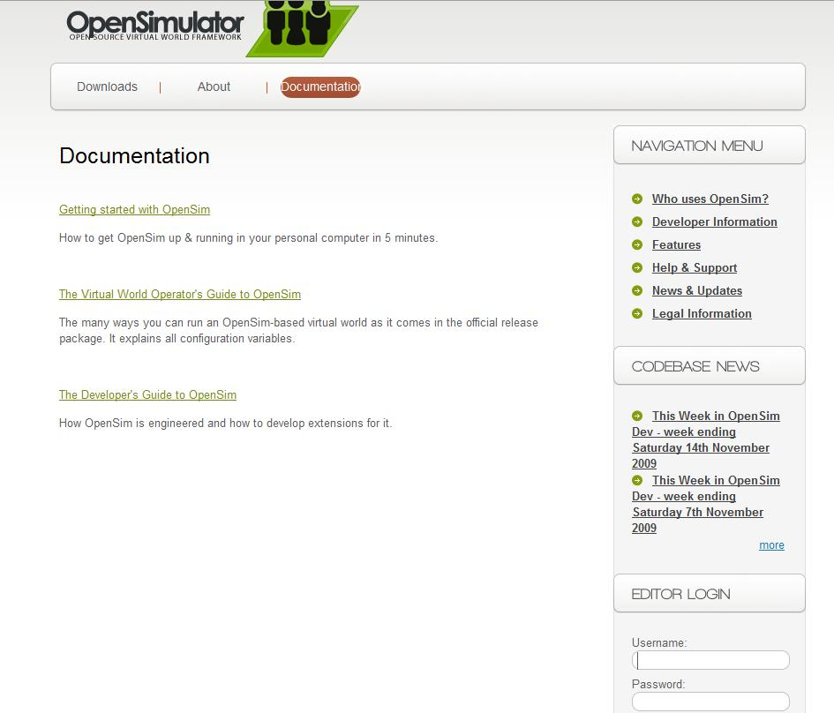
inf123
inf3210

Slide 2
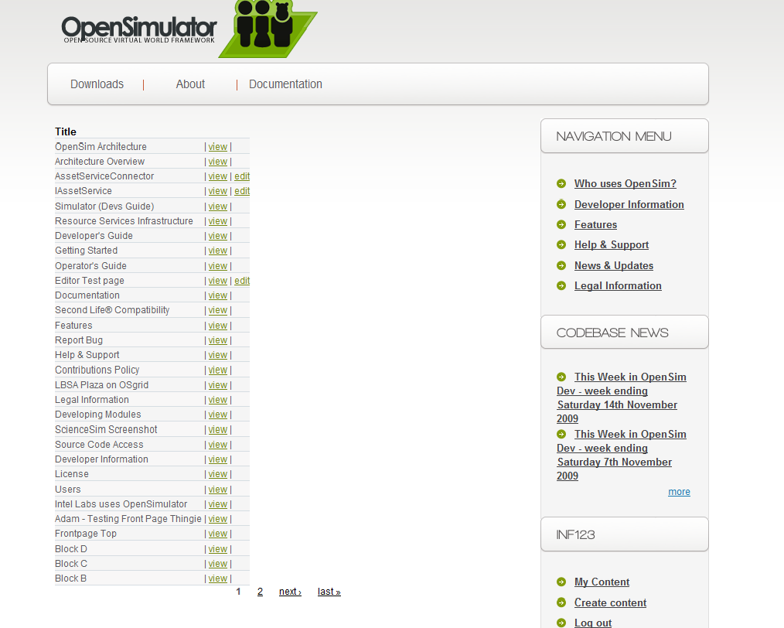
Create your page here

Slide 3
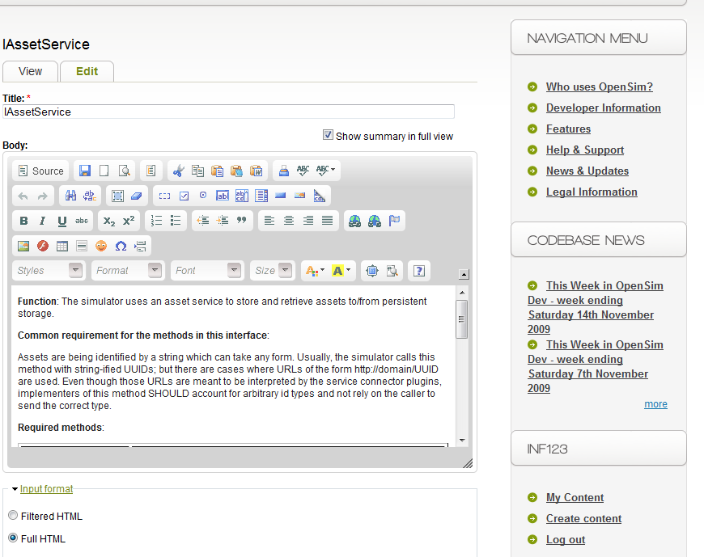
Make sure the input format is Full HTML!

Slide 4
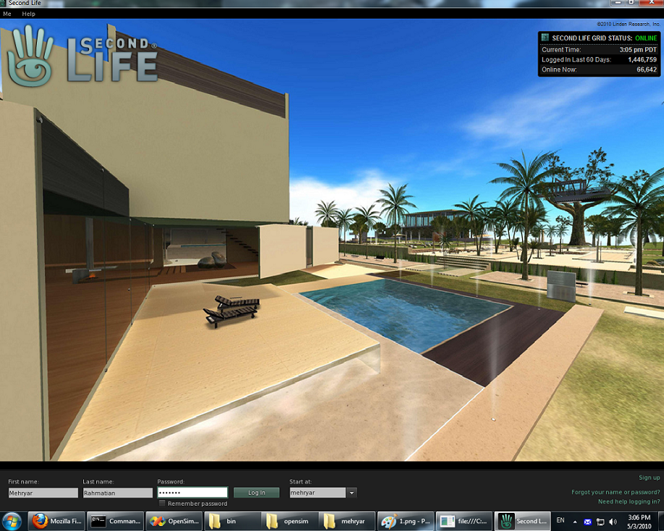
Enter your region name here!

Slide 5
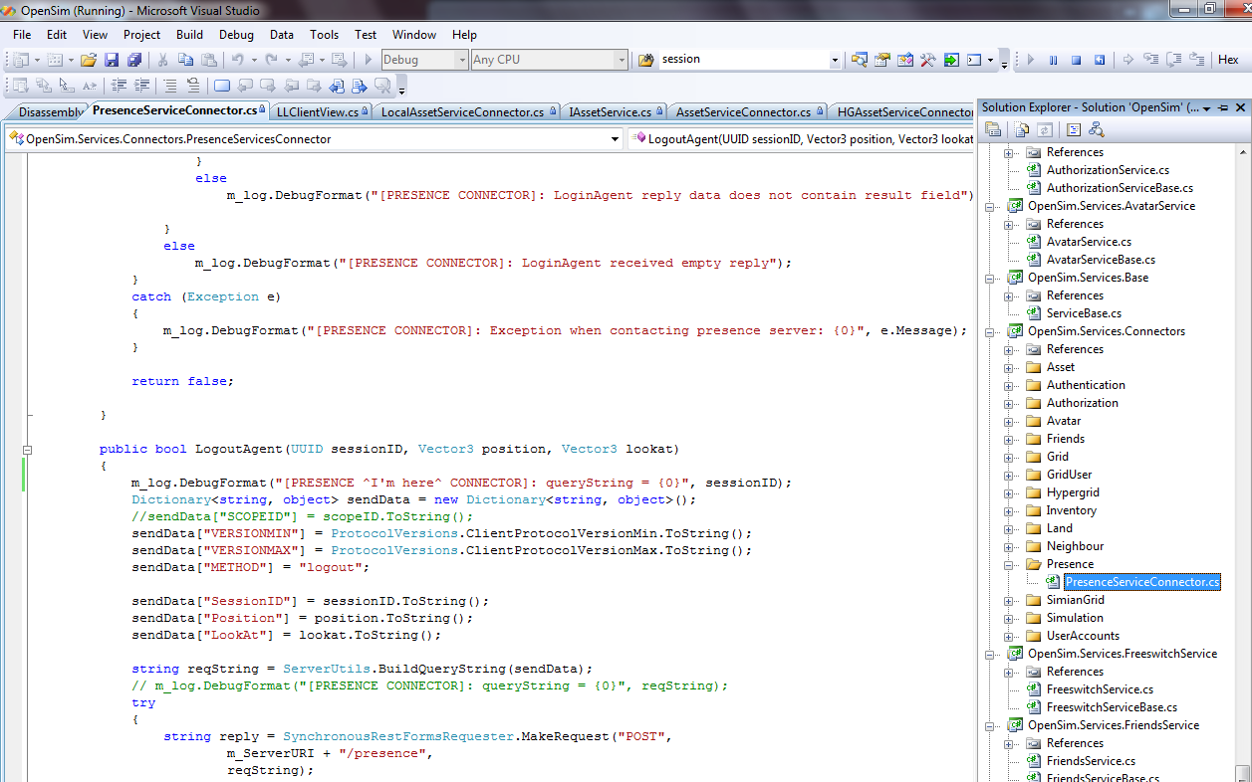
An arbitrary debug message

Slide 6
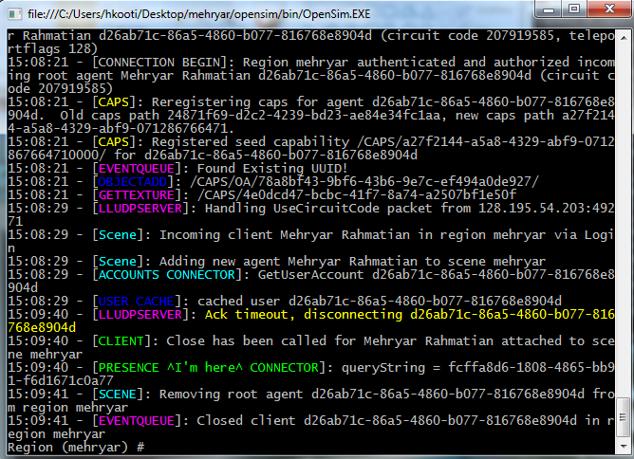
My debug message shows up in the command prompt as well as bin/OpenSim.log

