Slide 1
Learned Index Structures
CS 263
Michael T. Goodrich
University of California, Irvine
Some slides adapted from content by Paolo Ferragina, Fabrizio Lillo, Giorgio Vinciguerra,
Carola Wenk

Slide 2
A classical search problem in computer science
Given a set of 𝑛 sorted input keys (e.g. integers)
Implement membership and predecessor queries
Range queries in databases, conjunctive queries in search engines, IP lookup in routers…
𝑚𝑒𝑚𝑏𝑒𝑟 36
= True
2 | 11 | 13 | 15 | 18 | 23 | 24 | 29 | 31 | 34 | 36 | 44 | 47 | 48 | 55 | 59 | 60 | 71 | 73 | 74 | 76 | 88 | 95
1
𝑛
𝑝𝑟𝑒𝑑𝑒𝑐𝑒𝑠𝑠𝑜𝑟 50 = 48

Slide 3
Classical Index Structures
𝑘𝑒𝑦
O(log n) time search
search tree
𝑝𝑜𝑠𝑖𝑡𝑖𝑜𝑛
2 | 11 | 13 | 15 | 18 | 23 | 24 | 29 | 31 | 34 | 36 | 44 | 47 | 48 | 55 | 59 | 60 | 71 | 73 | 74 | 76 | 88 | 95
1
𝑛

Slide 4
Input data as pairs (𝑘𝑒𝑦, 𝑝𝑜𝑠𝑖𝑡𝑖𝑜𝑛)
positions
keys
2 | 11 | 13 | 15 | 18 | 23 | 24 | 29 | 31 | 34 | 36 | 44 | 47 | 48 | 55 | 59 | 60 | 71 | 73 | 74 | 76 | 88 | 95
1
𝑛

Slide 5

Input data as pairs (𝑘𝑒𝑦, 𝑝𝑜𝑠𝑖𝑡𝑖𝑜𝑛)
4
3
2
1
positions
2
11 13 15
keys
2 | 11 | 13 | 15 | 18 | 23 | 24 | 29 | 31 | 34 | 36 | 44 | 47 | 48 | 55 | 59 | 60 | 71 | 73 | 74 | 76 | 88 | 95
1 2 3 4
𝑛

Slide 6
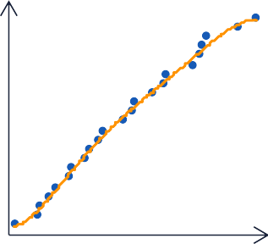

Learned index structures
𝑘𝑒𝑦
Black-box trained on a dataset of pairs (key, pos)
𝒟 = { 2,1 , 11,2 , … , (95, 𝑛)}
Machine Learning model
of the keys and their position
in a sorted array
positions
keys
𝑝𝑜𝑠𝑖𝑡𝑖𝑜𝑛 (approximate)
2 | 11 | 13 | 15 | 18 | 23 | 24 | 29 | 31 | 34 | 36 | 44 | 47 | 48 | 55 | 59 | 60 | 71 | 73 | 74 | 76 | 88 | 95
1
𝑛
Binary search in
𝑝𝑜𝑠𝑖𝑡𝑖𝑜𝑛 −Δ, 𝑝𝑜𝑠𝑖𝑡𝑖𝑜𝑛 + Δ
e.g. Δ is of the order of 100–1000

Slide 7
PGM-index
[Ferragina and Vinciguerra, PVLDB 2020]
Fix a max error Δ, e.g. so that keys in [𝑝𝑜𝑠 − Δ, 𝑝𝑜𝑠 + Δ] fit in a cache-line
Find the smallest Piecewise Linear Δ-Approximation (PLA), e.g., with λ pieces
Store triples (𝑓𝑖𝑟𝑠𝑡 𝑘𝑒𝑦, 𝑠𝑙𝑜𝑝𝑒, 𝑖𝑛𝑡𝑒𝑟𝑐𝑒𝑝𝑡) for each segment
search tree
positions
We can do search
in O(log Δ + log λ) time
8
24
keys
1 | 3 | 8 | 11 | 12 | 19 | 22 | 23 | 24 | 28 | 29 | 33 | 38 | 47 | 48 | 53 | 55 | 56 | 57
8
https://pgm.di.unipi.it
8
Binary search in
𝑝𝑜𝑠𝑖𝑡𝑖𝑜𝑛 −Δ, 𝑝𝑜𝑠𝑖𝑡𝑖𝑜𝑛 + Δ

Slide 8
New Idea: Exponential Search to Find the Balance Point for Δ and λ
Suppose we have an O(n) – time algorithm for finding the minimum piecewise-linear approximation (PLA) for a given value of Δ.
We can then do an exponential search to find the balance point for log Δ and log λ.
Start with Δ = 2, and keep squaring until log Δ and log λ cross.
positions
positions
positions
keys
keys
keys

Slide 9
Piecewise Linear Approximation
Given a sorted set of keys and an error term Δ, we need to find a piecewise linear approximation for this set of keys with the minimum number of line segments in O(n) time that has error Δ.
positions
keys

Slide 10
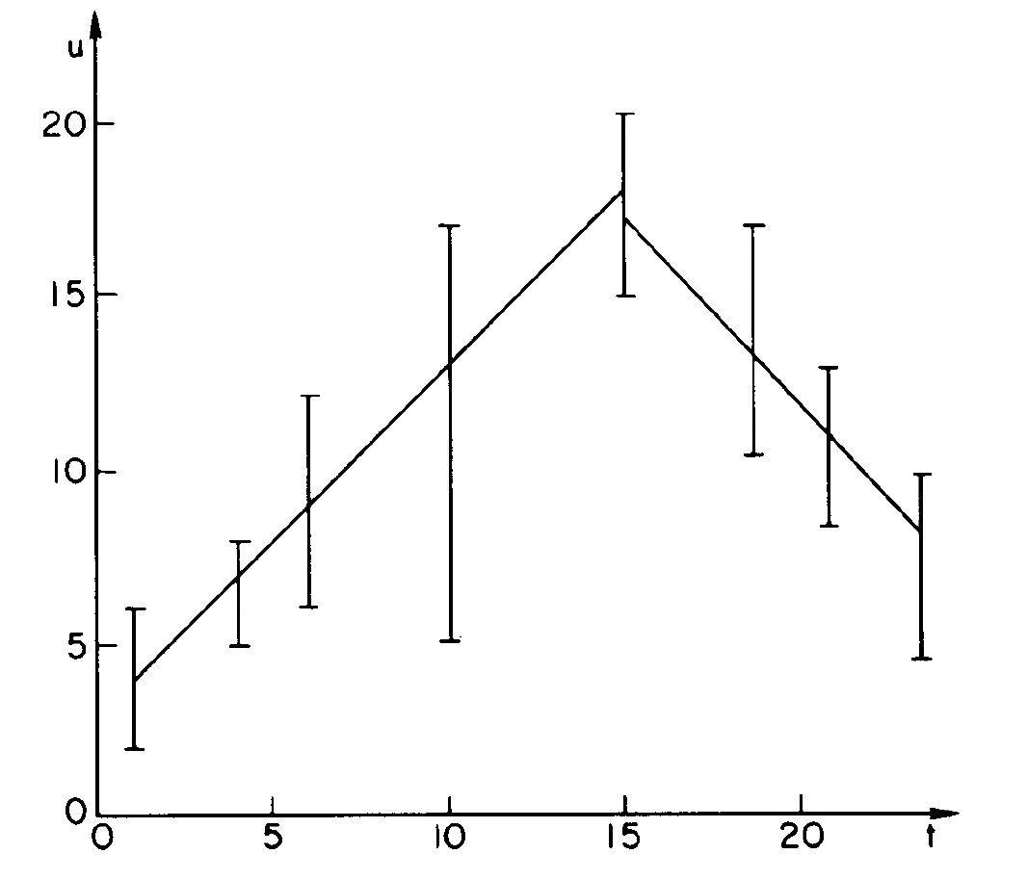
PLA Algorithm
We use a classic algorithm due to O’Rourke.
Model the input as key-rank (k,r) points.
Expand each (k,r) as a vertical segment from (k,r-Δ) to (k,r+Δ).
We want a piecewise linear approximation that intersects each vertical line segment.

Slide 11
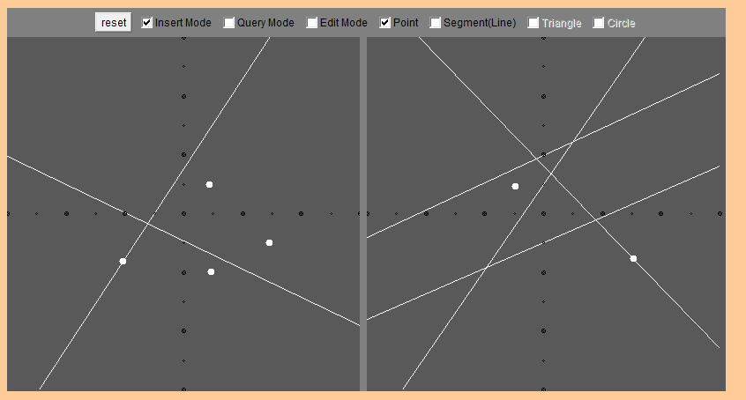
Point-Line Duality
Let $P=\left\{p_{1},…, p_{n}\right\}⊆ℝ^{2}$ be a set of $n$ points. Now define a set $P^{∗}=\left\{p_{1}^{∗},…, p_{n}^{∗}\right\}$ of $n$ lines as follows:
Primal plane
Point: $p=(p_{x},p_{y})$
Line: $l:y=mx+b$
Dual plane
Line: $p^{∗}:y=p_{x}x −p_{y}$
Point: $l^{∗}=(m, −b)$
p*₁
l₂
l₁
p₃
p*₂
l*₁
p₁
p₄
l*₂
p₂
p*₃
p*₄

Slide 12
Properties
Primal plane
Point: $p=(p_{x},p_{y})$
Line: $l:y=mx+b$
Dual plane
Line: $p^{∗}:y=p_{x}x −p_{y}$
Point: $l^{∗}=(m, −b)$
Primal
Dual
p*₁
l₂
l₁
p₃
p*₂
l*₁
p₁
p₄
l*₂
p₂
p*₃
p*₄
${\left(p^{∗}\right)}^{∗}=p$
$p∈l ⇔l^{∗}∈p^{∗}$ incidence-preserving
$p$ lies above $l ⇔l^{∗}$ lies above $p^{∗}$
p₁ ∈l₂ ⇔ l*₂ ∈p*₁
p₃ is above l₁ ⇔ l*₁ is above p*₃

Slide 13
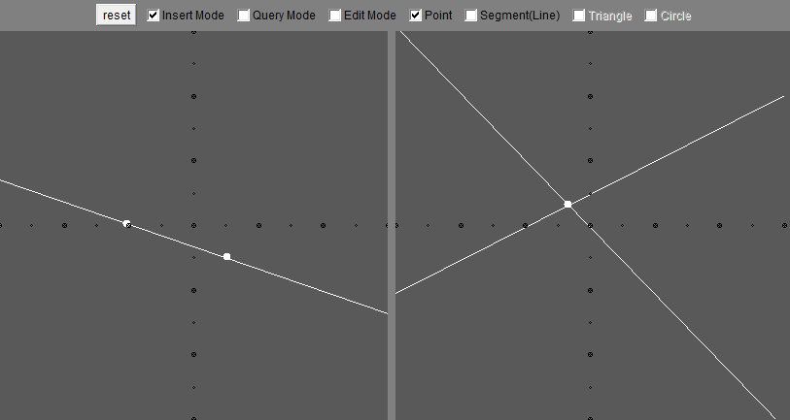
Properties
Primal plane
Point: $p=(p_{x},p_{y})$
Line: $l:y=mx+b$
Dual plane
Line: $p^{∗}:y=p_{x}x −p_{y}$
Point: $l^{∗}=(m, −b)$
Primal
Dual
p*₁
l₁
p₁
l*₁
p₂
p*₂
Points$p_{1}$ and $p_{2}$ lie on line $l_{1}$
Lines $p_{1}^{∗}$ and $p_{2}^{∗}$ contain point $l_{1}^{∗}$

Slide 14
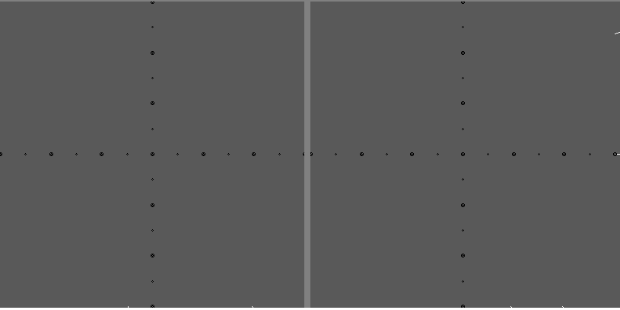
Point-Line Duality Puzzle
p₁
l*₂
l₁
l₂
p*₂
l*₁
p*₃
p₄
p*₄
p*₁
p₃
p₂
$$p_{1}$$
lies above
$$l_{1}$$
$$⇔$$
$$l_{1}^{∗}$$
lies above
$$p_{1}^{∗}$$
$$p_{2}$$
lies on
$$l_{1}$$
$$⇔$$
$$l_{1}^{∗}$$
lies on
$$p_{2}^{∗}$$
$$p_{2}$$
lies on
$$l_{2}$$
$$⇔$$
$$l_{2}^{∗}$$
lies on
$$p_{2}^{∗}$$
$$p_{3}$$
lies below
$$l_{1}$$
$$⇔$$
$$l_{1}^{∗}$$
lies below
$$p_{3}^{∗}$$
$$p_{4}$$
lies above
$$l_{2}$$
$$⇔$$
$$l_{2}^{∗}$$
lies above
$$p_{4}^{∗}$$

Slide 15
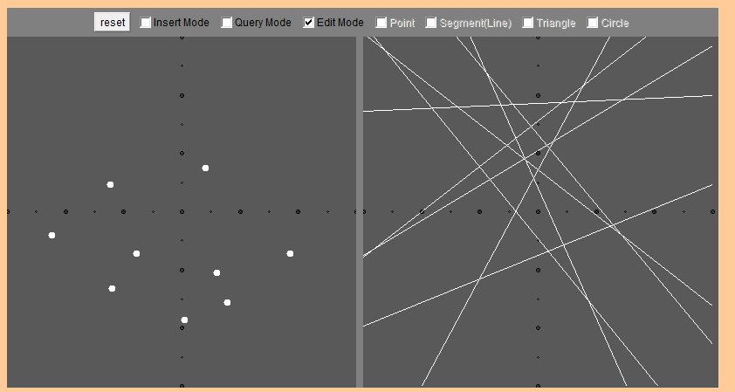
Lower Convex Hull ≅ Intersecting Halfspaces
Primal plane
Point: $p=(p_{x},p_{y})$
Line: $l:y=mx+b$
Dual plane
Line: $p^{∗}:y=p_{x}x −p_{y}$
Point: $l^{∗}=(m, −b)$
Primal
Dual
p*₂
p*₁
p*₃
p*₄
p₁
p₅
p₂
p₄
p₃
p*₅
lower convex hull
= halfplane intersection (of upper halfplanes)
LCH = p₁, p₂, p₃, p₄, p₅
UE = p*₁, p*₂, p*₃, p*₄, p*₅

Slide 16
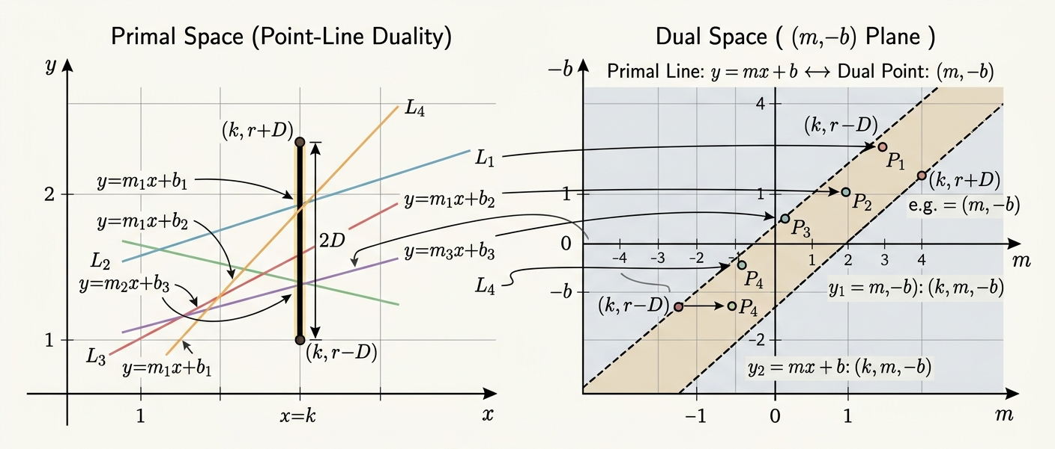
Using Point-Line Duality for PLA
Each vertical line segment defines constraints on each line that can intersect the segment (k,r-D) to (k,r+D). This defines a strip between two parallel lines in the dual space.
Image generated using Nano Banana Pro.

Slide 17
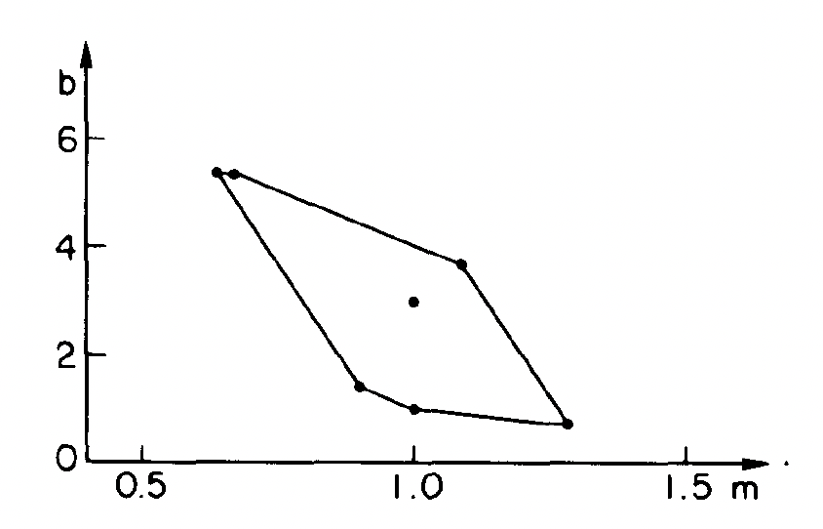
The Greedy Algorithm (High Level)
Consider the vertical segments one at a time, maintaining a representation in dual space of all the lines that can intersect all the segments considered so far.
Dual space region
The convex polygon in m-b dual space corresponding
to the first 5 data ranges of the left figure.
Every point inside the polygon represents a straight
line that fits the 5 data ranges. The single interior
corresponds to the straight line drawn in the figure.
Primal space ranges

Slide 18
The Greedy Step
Consider the vertical segments one at a time, maintaining a representation in dual space of all the lines that can intersect all the segments considered so far.
If a new set of constraints for a vertical segment causes the region to become empty, output a line approximating the segments considered so far and start over with the new segment.
constraints for the new segment
Why does this greedy
strategy give the
minimum number
of pieces?
Dual space region

Slide 19
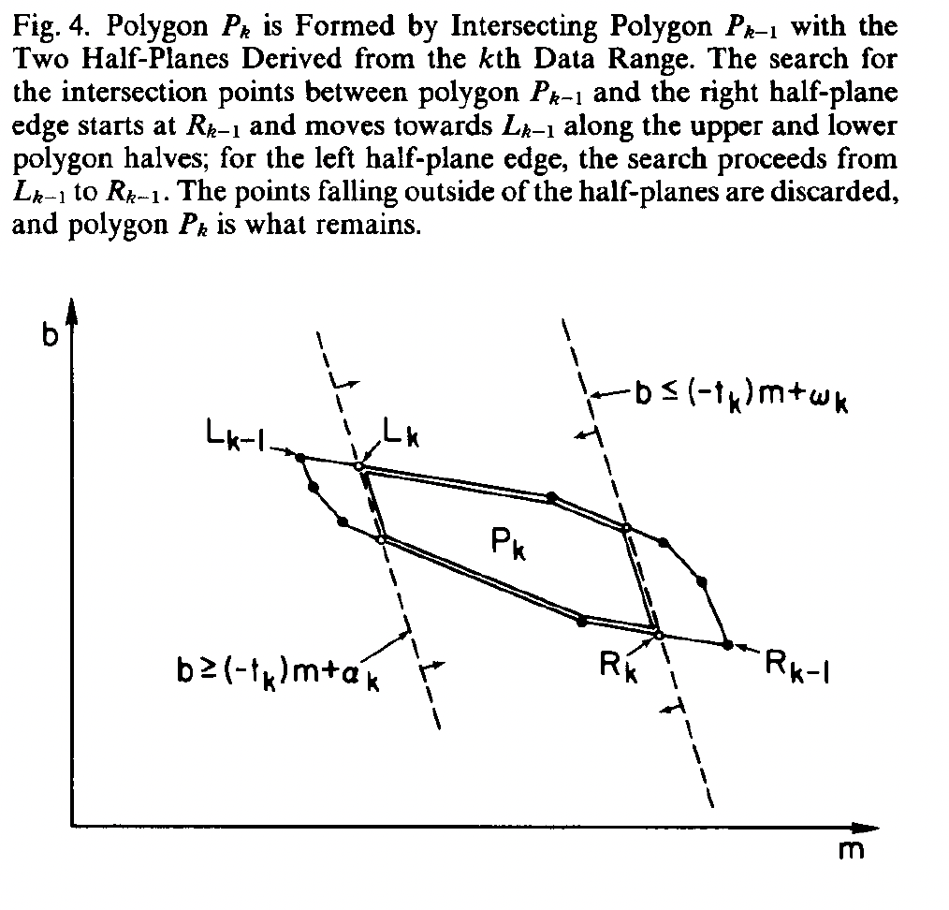
Maintaining the Constraint Polygon
We are maintaining a convex polygon of the common intersection of the strips, adding new strips one at a time.
We can do the update in amortized constant time, by maintaining L_{k} and R_{k}, the leftmost and rightmost points of the constraint polygon.

Slide 20
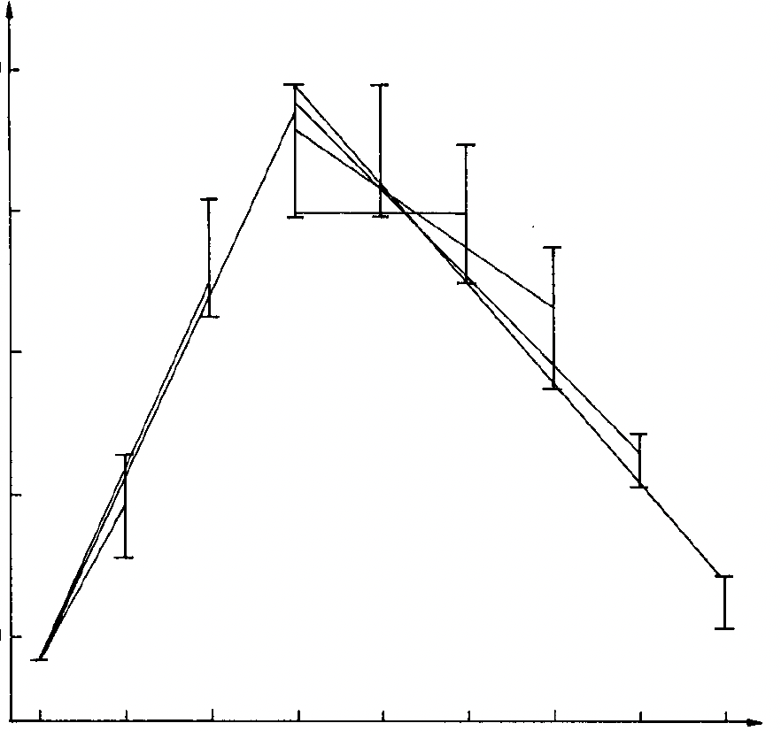
Primal Space View
This will construct a sequence of candidate lines, resulting in the minimum number of pieces in the piecewise linear approximation
O(n) time in total

Slide 21
Future Work
There are a lot of possible problems to work on in the future:
What if we allow gaps in the positional array?
What if we want to insert and/or delete keys from our data set?
What if we want to build a learned index structure for external memory, where we need to minimize the number input/output operations?

