Slide 1
Parallel Algorithm Design
CS 263
Michael T. Goodrich
University of California, Irvine
Some slides adapted from content by Joseph Jaja, Wikipedia, Guy Blelloch

Slide 2
Fundamental Algorithms
Prefix sums: O(log n) time, linear work, EREW PRAM, binary fork-join
List ranking: O(log n) time, linear work, EREW PRAM, binary fork-join (randomized)
Sorting: O(log n) time, O(n log n) work, EREW PRAM, binary fork-join
Maximum/minimum finding: O(log log n) time, linear work, CRCW PRAM

Slide 3
Binary tree
A
C
B
Let T be a binary tree stored in a PRAM
Each node i has fields parent[i], left[i] and right[i], which point to node i’s parent, left child and right child respectively
Let’s assume that each node is identified by a non-negative integer
Also we associate not one but 3 processes with each node; we call these node’s A,B and C processors

Slide 4
Computing depth of each node in an n node tree takes O(n) time on a serial RAM
A simple parallel algorithm to compute depths propagates a “wave” downward from the root of the tree.
The wave reaches all nodes at the same depth simultaneously, and thus by incrementing a counter carried along with the wave, we can compute the depth of each node.
This parallel algorithm works well on a complete binary tree, since it runs in time proportional to the tree’s height.
But the height of the tree could be as large as n-1

Slide 5
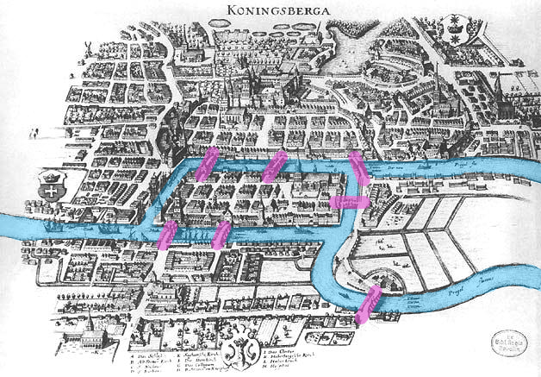
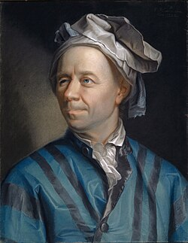
The Euler-tour technique
An Euler tour of a graph is a path that traverses each edge exactly once
A connected, directed graph has an Euler tour if and only if for all vertices v, the in-degree of v equals the out degree of v
A connected, undirected graph has an Euler tour if and only if all vertices, except possibly the start and finish, have even degree.
Leonhard Euler

Slide 6
Depth of nodes computation
First we form an Euler tour of the directed version of T.
The tour corresponds to walk of the tree with the following structure:
A node’s A processor points to the A processor of its left child, if it exist, and otherwise to its own B processor
A node’s B processor points to the A processor of its right child, if it exist, and otherwise to its own C processor
A node’s C processor points to the B processor of its parent, if it is a left child and to the C processor of its parent if it is a right child. The root’s C processor points to NIL.

Slide 7
The Euler Tour
Configuration
A
C
A
C
B
B
A
C
A
C
B
B
A
C
A
C
A
C
B
B
B
A
C
A
C
A
C
B
B
B

Slide 8
First step
The head of the linked list formed by the Euler tour is the root’s A processor, and the tail is the root’s C processor.
Given the pointers composing the original tree, an Euler tour can be constructed in O(1) time.
Once we have linked list representing the Euler tour of T, we place
a 1 in each A processor,
a 0 in each B processor and
a –1 in each C processor

Slide 9
An Euler Tour
Example
A
C
1
-1
B
0
1
-1
1
-1
0
0
1
-1
1
-1
1
-1
0
0
0
1
-1
1
-1
1
-1
0
0
0

Slide 10
Second step
We then perform list ranking and a parallel prefix computation using ordinary addition as the associative operation.
We claim that after performing the parallel prefix computation, the depth of each node resides in the node’s C processor.
Why?

Slide 11
Computing the levels in a tree
A
C
1
0
B
1
2
1
2
1
2
2
3
2
3
2
3
2
3
3
3
4
3
4
3
4
3
4
4
4

Slide 12
WHY?
The numbers are placed into the A,B and C processors in such a way that the net effect of visiting a subtree is to add 0 to the running sum
The A processor of each node i contributes 1 to running sum
The B processor of each node i contributes 0 because the depth of the node i’s left child equals the depth of the node i’s right child
The C processor contributes –1, so the entire visit to the subtree rooted at node i has no effect on the running sum.

Slide 13
Euler-tour Technique Analysis
The list representing Euler-tour can be computed in O(1) time.
It has 3n objects, and thus the parallel prefix computation takes only O(log n) time
Thus the total amount of time to compute all node depths is O(log n).
Work is O(n).
Because no concurrent memory accesses are needed, the algorithm is an EREW algorithm.
Can be used for lots of tree computations: pre-order, in-order, post-order, number-of-descendants, etc.

Slide 14
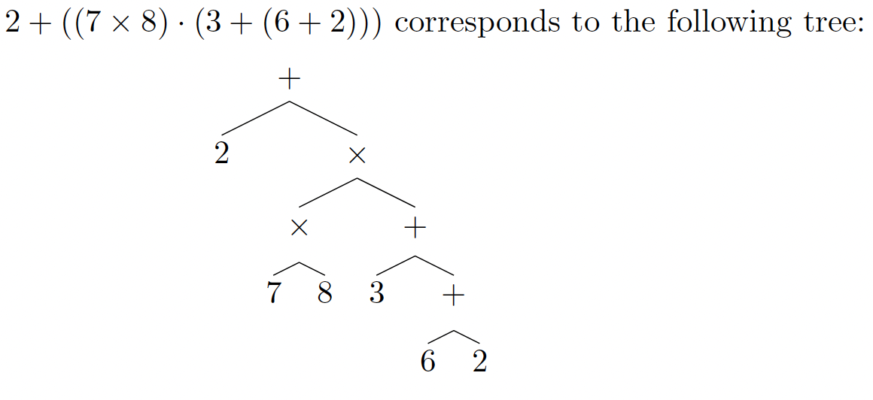
Arithmetic Expressions
Given a binary tree representing an arithmetic expression, involving addition and multiplication, compute the value associated with the root.

Slide 15
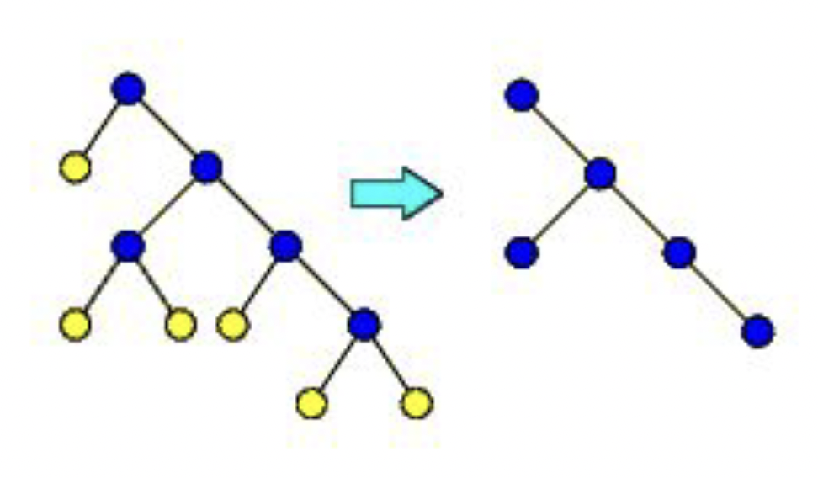
Rake
The rake operation removes all the leaves in a tree.

Slide 16
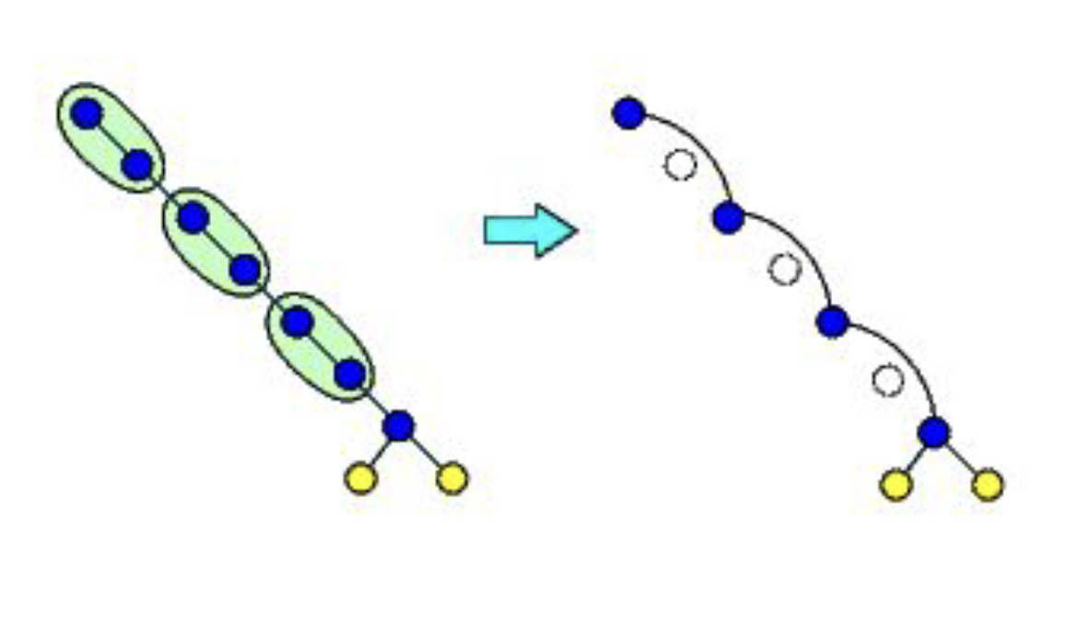
Compress
The compress operation compresses odd-depth nodes with their parents in chains of nodes with only one child.

Slide 17
Rake-and-Compress
Alternate rake and compress operations until there is only one node left.
There are O(log n) steps and linear work:
Every step removes the leaves and halves the depth of chains of nodes with only one child.

Slide 18
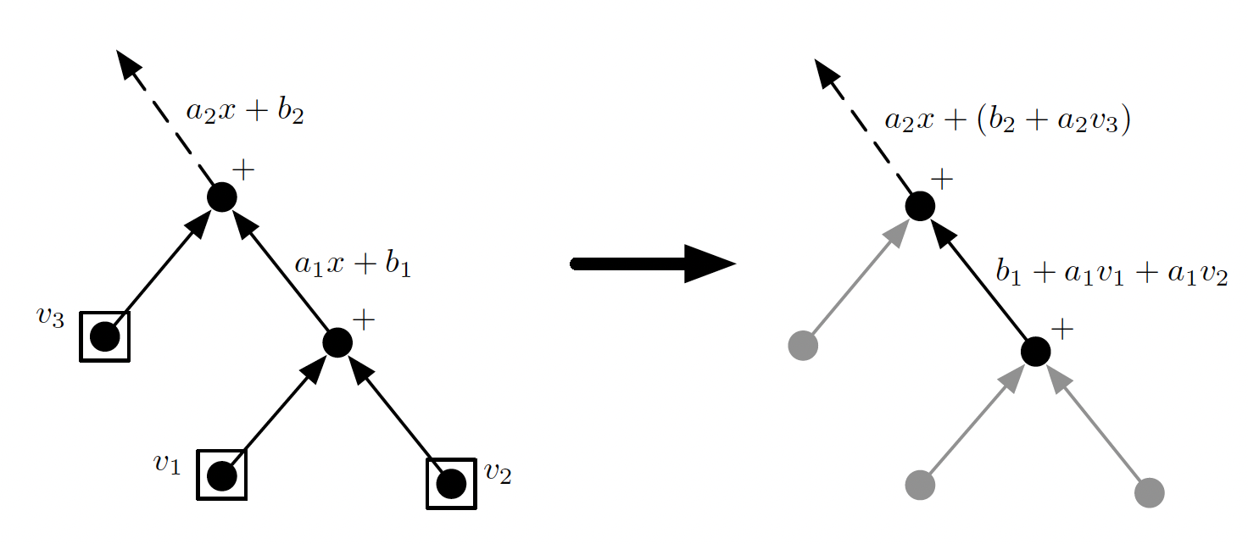
Use for Arithmetic Tree Operations
Represent the value of each edge as a linear expression, ax+b, which is initially just 1x+0 for each edge.

Slide 19
Update for Rake
Update the edge for the parent for each removed leaf.

Slide 20
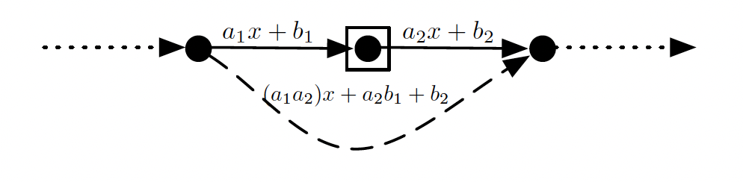
Update for Compress
Update the edge for the parent based on plugging in the child equation.
After O(log n) time and linear work in the EREW PRAM model we will have the root value, no matter how much the arithmetic tree is unbalanced.

Slide 21
Minimum Spanning Trees
2704
867
BOS
849
PVD
ORD
187
740
JFK
144
1846
621
802
184
1258
SFO
1391
BWI
337
1464
1090
LAX
1235
DFW
946
1121
MIA
2342

Slide 22
Minimum Spanning Tree
Spanning subgraph
Subgraph of a graph G containing all the vertices of G
Spanning tree
Spanning subgraph that is itself a (free) tree
Minimum spanning tree (MST)
Spanning tree of a weighted graph with minimum total edge weight
Applications
Communications networks
Transportation networks
ORD
10
1
PIT
DEN
6
7
9
3
DCA
4
STL
8
5
2
DFW
ATL

Slide 23
Cycle Property
f
8
Cycle Property:
Let T be a minimum spanning tree of a weighted graph G
Let e be an edge of G that is not in T and C let be the cycle formed by e with T
For every edge f of C, weight(f) ≤ weight(e)
Proof:
By contradiction
If weight(f) > weight(e) we can get a spanning tree of smaller weight by replacing e with f
4
C
9
2
6
3
e
8
7
7
Replacing f with e yields a better spanning tree
f
8
4
C
9
2
6
3
e
8
7
7

Slide 24
Partition Property
U
V
f
7
Partition Property:
Consider a partition of the vertices of G into subsets U and V
Let e be an edge of minimum weight across the partition
There is a minimum spanning tree of G containing edge e
Proof:
Let T be an MST of G
If T does not contain e, consider the cycle C formed by e with T and let f be an edge of C across the partition
By the cycle property, weight(f) ≤ weight(e)
Thus, weight(f) = weight(e)
We obtain another MST by replacing f with e
4
9
2
5
8
8
e
3
7
Replacing f with e yields another MST
U
V
f
7
4
9
2
5
8
8
e
3
7

Slide 25
Baruvka’s Algorithm
Baruvka’s algorithm grows many “clouds” of vertices at once.
Each iteration of the while-loop halves the number of connected compontents in T.
The sequential running time is O(m log n).
Implement this in parallel: O(log n) time O(m) work for each iteration of the while-loop
O(log² n) time and O(m log n) work.
Algorithm BaruvkaMST(G)
T ← V {just the vertices of G}
while T has fewer than n-1 edges do
for each connected component C in T do
Let edge e be the smallest-weight edge from C to another component in T.
if e is not already in T then
Add edge e to T
return T

Slide 26
Baruvka Example

Slide 27
After 1 iteration:

Slide 28
After 2 iterations:
2704
867
BOS
849
187
PVD
ORD
740
144
1846
JFK
621
184
1258
802
SFO
BWI
1391
1464
337
1090
DFW
946
LAX
1235
1121
MIA
2342

