Slide 1
Techniques for Parallel Algorithm Design
CS 263
Michael T. Goodrich
University of California, Irvine
Some slides adapted from content by Joseph Jaja, Yun Gu, and Yihan Sun

Slide 2
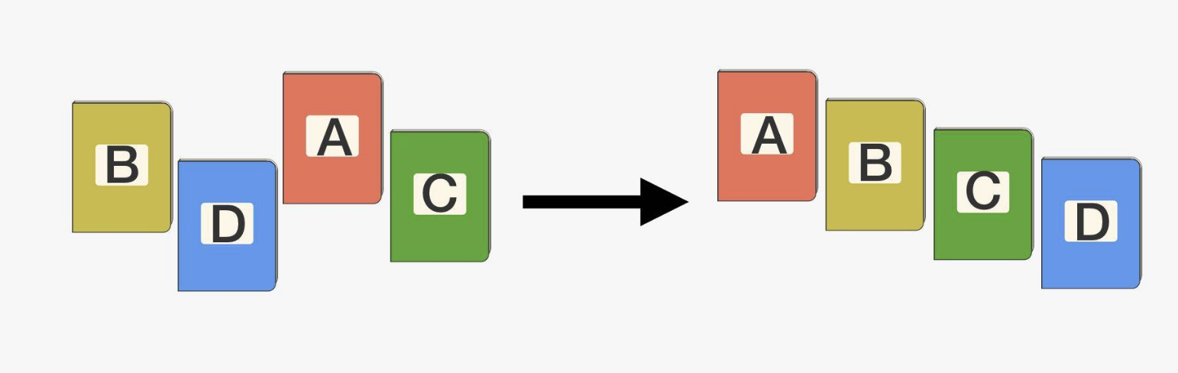

Parallel Sorting
Given an array of elements $A$ with size $n$, and a total order defined, create an array $B$ of the same elements in $A$, with:
$B\left[0\right]≤B\left[1\right]≤B\left[2\right]≤…≤B[n−1]$

Slide 3
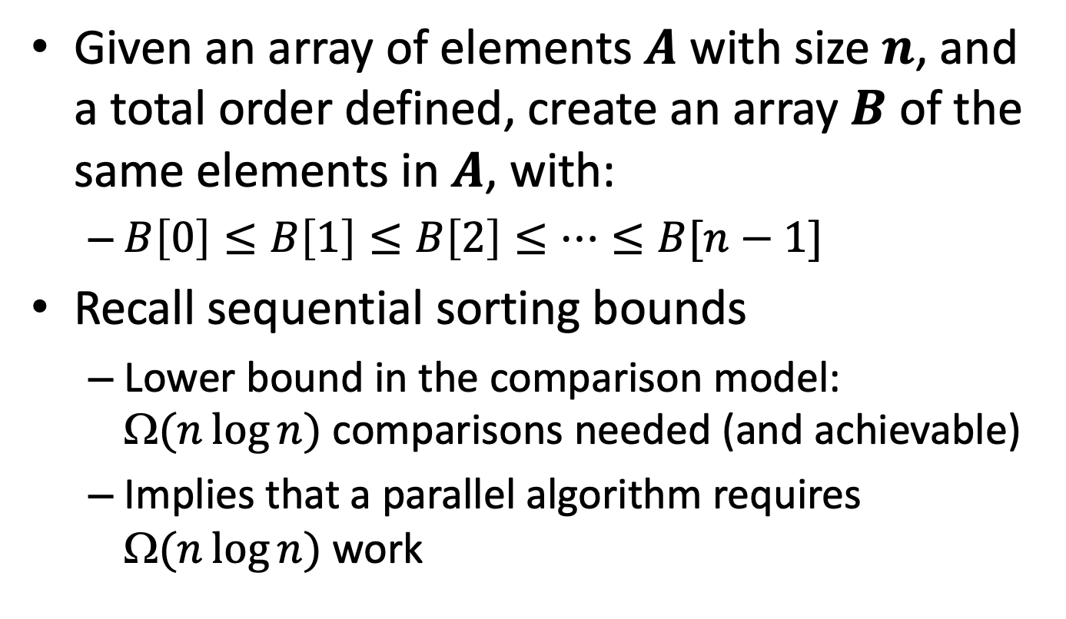
Sorting Algorithms
Given an array of elements $A$ with size $n$, and a total order defined, create an array $B$ of the same elements in $A$, with:
$B\left[0\right]≤B\left[1\right]≤B\left[2\right]≤…≤B[n−1]$
Recall sequential sorting bounds
Lower bound in the comparison model: Ω$(n\log{n})$ comparisons needed (and achievable)
Implies that a parallel algorithm requires Ω$(n\log{n})$ work

Slide 4
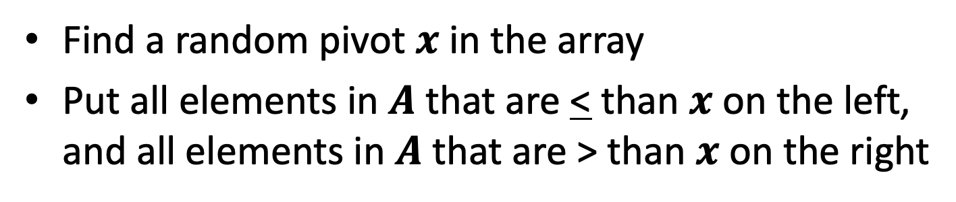
Recall Randomized Quicksort
Find a random pivot $x$ in the array
Put all elements in $A$ that are < than $x$ on the left, and all elements in $A$ that are > than $x$ on the right
3
2
9
4
6
1
5
8
7
0
6
3
4
2
1
5
0
6
8
9
7
Runs in O(n log n) time whp
2
8
1
0
2
4
3
5
7
6
8
9
1
4
7
8
0
1
3
2
4
5
6
7
8
9
3
4
0
1
2
3
4
5
6
7
8
9

Slide 5
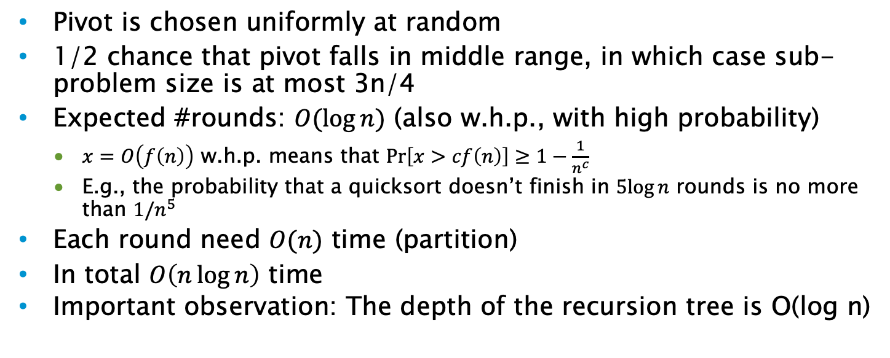
Quicksort cost analysis
Keys in order
n/4 keys
n/2 keys
n/4 keys
Pivot is chosen uniformly at random
1/2 chance that pivot falls in middle range, in which case sub-problem size is at most 3n/4
Expected #rounds: $O(\log{n})$ (also w.h.p., with high probability)
$x=O\left(f\left(n\right)\right)$ w.h.p. means that $Pr\left[x>cf\left(n\right)\right]≥1−\frac{1}{n^{c}}$
E.g., the probability that a quicksort doesn’t finish in $5log⁡n$ rounds is no more than $1/n^{5}$
Each round need $O(n)$ time (partition)
In total $O\left(n\log{n}\right)$ time
Important observation: The depth of the recursion tree is O(log n)

Slide 6
Sequential quicksort
Parallel quicksort
Use a pivot and partition the array into two parts
Sort each of them recursively
Use a pivot and partition the array into two parts
Sort each of them recursively, in parallel

Slide 7
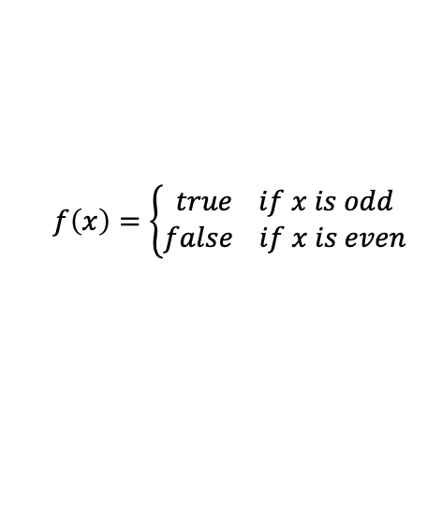
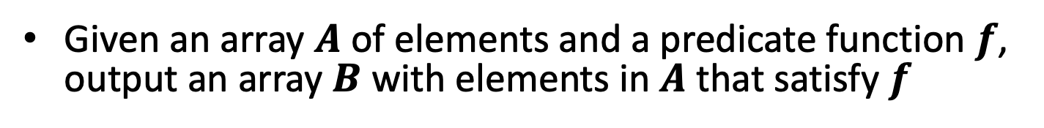


Parallel filtering / packing
Given an array $A$ of elements and a predicate function $f$, output an array $B$ with elements in $A$ that satisfy $f$
$$f\left(x\right)=\left\{\begin{aligned}true if x is odd \\ false if x is even\end{aligned}\right.$$
$$A=$$
4 | 2 | 9 | 3 | 6 | 5 | 7 | 11 | 10 | 8
$$B=$$
9 | 3 | 5 | 7 | 11
We can use parallel prefix to solve this in O(log n) span and O(n) work.

Slide 8
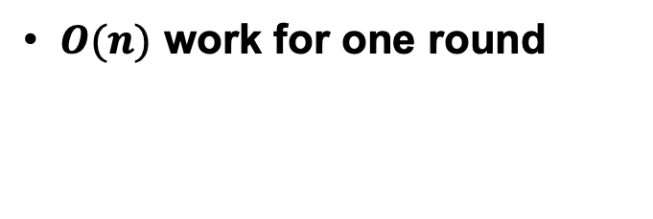
Using prefix-sum filter for partition
How to move elements around? The filter algorithm!
using 6 as a pivot
filter(A, flag, n) {
ps = scan(flag);
parallel_for(i=1 to n) {
if (ps[i]!=ps[i-1])
B[ps[i]] = A[i];
}
}
A
6
2
9
4
1
3
5
8
7
0
flag
0
1
0
1
1
1
1
0
0
1
A
X
2
X
4
1
3
5
X
X
0
flag
0
1
0
1
1
1
1
0
0
1
$O(n)$ work for one round
Prefix sum of flag
0
1
1
2
3
4
5
5
5
6
pack
2
4
1
3
5
0

Slide 9
Using filter to partition
To get all elements smaller than the pivot and all elements larger than the pivot
We can run two separate filters
Two rounds of I/O and global data movement
Parallel partition
After doing the first scan, we know the result of the second scan!

Slide 10
Using filter for partition
using 6 as a pivot
A
6
2
9
4
1
3
5
8
7
0
flag
0
1
0
1
1
1
1
0
0
1
scan1
0
1
1
2
3
4
5
5
5
6
scan1[]: the prefix sum of 1s
scan2[]: the prefix sum of 0s
=> scan1[i] + scan2[i] = i
=> scan2[i] = i - scan1[i]
pack
2
4
1
3
5
0
6
9
8
7
scan2
1
1
2
2
2
2
2
3
4
4

Slide 11
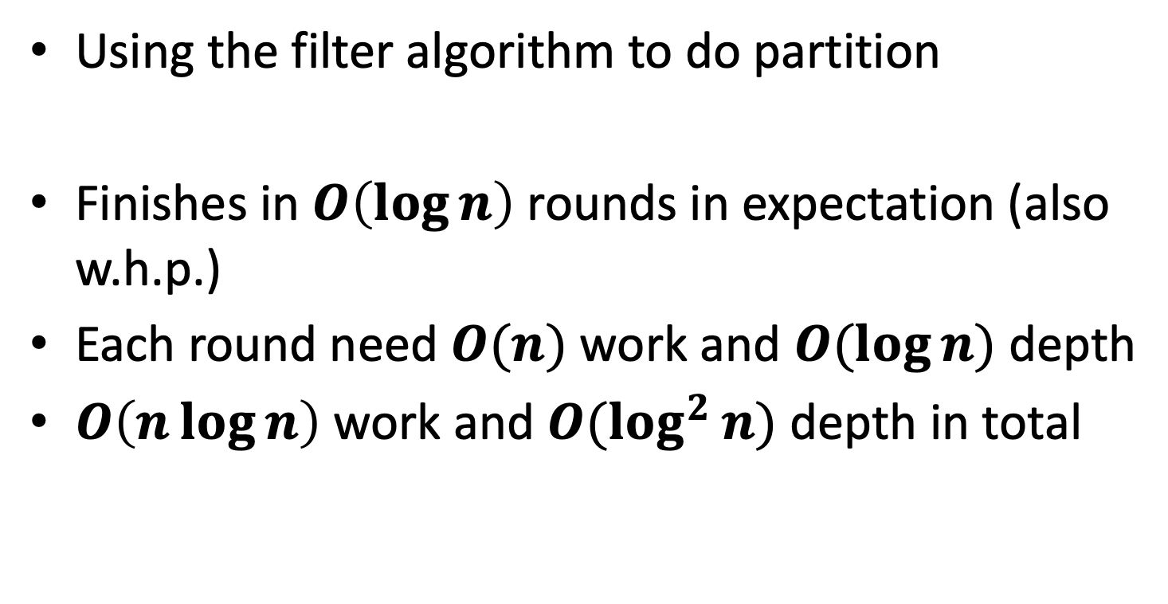
Parallel quicksort
Using the filter algorithm to do partition
Finishes in $O\left(\log{n}\right)$ rounds in expectation (also w.h.p.)
Each round need $O(n)$ work and $O(\log{n})$ depth
$O\left(n\log{n}\right)$ work and $O(\log^{2}{n})$ depth in total

Slide 12
Sequential mergesort
Parallel mergesort
Split the array evenly in two
Sort each of them recursively
Merge them back
Split the problem size evenly in two
Sort each of them recursively, in parallel
Merge them back

Slide 13
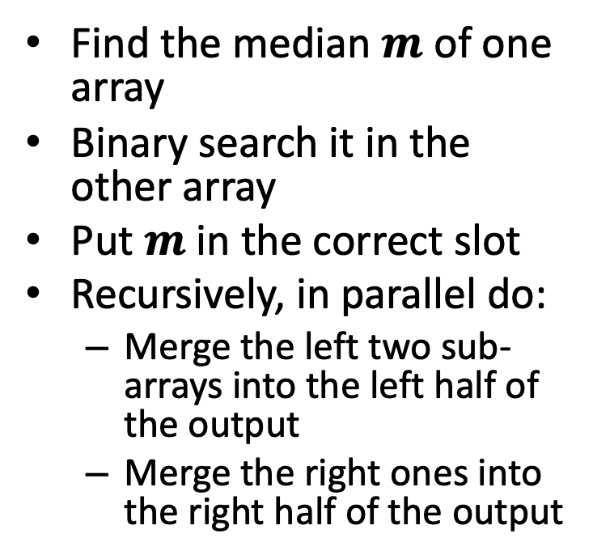
A parallel merge algorithm: First attempt
2
3
4
6
9
Binary search
0
1
5
7
8
Find the median $m$ of one array
Binary search it in the other array
Put $m$ in the correct slot
Recursively, in parallel do:
Merge the left two sub-arrays into the left half of the output
Merge the right ones into the right half of the output
Subproblem 1:
Merge 2,3 with 0,1
Subproblem 2:
Merge 6,9 with 5,7,8
2
3
6
9
0
1
5
7
8
0
1
2
3
4
5
6
7
8
9

Slide 14
A parallel merge algorithm
2
3
4
6
9
Binary search
0
1
5
7
8
//merge array A of length n1 and array B of length n2 into array C.
Merge(A’, n1, B’, n2, C) {
if (A’ is empty or B’ is empty) base_case;
m = n1/2;
m2 = binary_search(B’, A’[m]);
C[m+m2+1] = A’[m];
in parallel:
merge(A’, m, B’, m2, C);
merge(A’+m+1, n1-m-1, B’+m2+1, n2-m2-1, C+m+m2);
return C;
}
Subproblem 1:
Merge 2,3 with 0,1
Subproblem 2:
Merge 6,9 with 5,7,8
2
3
6
9
0
1
5
7
8
0
1
2
3
4
5
6
7
8
9

Slide 15

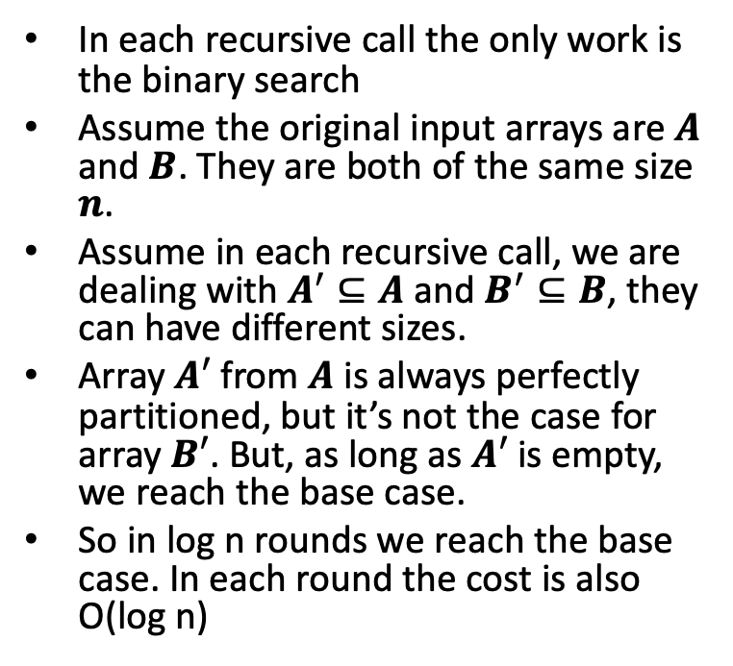
A parallel merge algorithm
2
3
4
6
9
Binary search
0
1
5
7
8
In each recursive call the only work is the binary search
Assume the original input arrays are $A$ and $B$. They are both of the same size $n$.
Assume in each recursive call, we are dealing with $A^{′}⊆A$ and $B^{′}⊆B$, they can have different sizes.
Array $A′$ from $A$ is always perfectly partitioned, but it’s not the case for array $B′$. But, as long as $A′$ is empty, we reach the base case.
So in log n rounds we reach the base case. In each round the cost is also O(log n)
Subproblem 1:
Merge 2,3 with 0,1
Subproblem 2:
Merge 6,9 with 5,7,8
2
3
6
9
0
1
5
7
8
0
1
2
3
4
5
6
7
8
9
$D\left(N\right)=O(\log^{2}{N})$

Slide 16
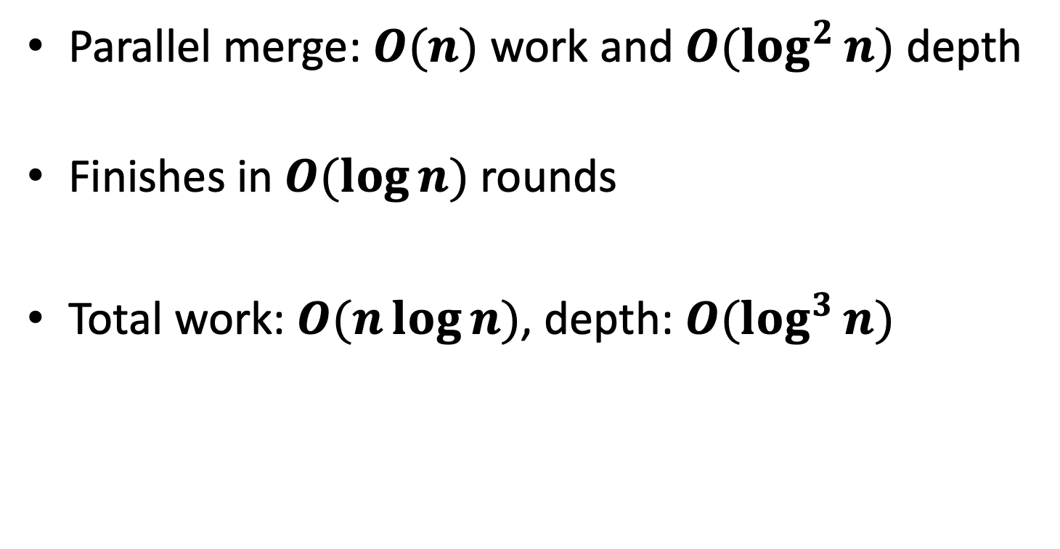
Parallel merge sort
Parallel merge: $O(n)$ work and $O(\log^{2}{n})$ depth
Finishes in $O(\log{n})$ rounds
Total work: $O(n\log{n})$, depth: $O(\log^{3}{n})$

Slide 17
A parallel merge algorithm: Second attempt
For each element in each array, binary search for it in the other array
Put the element in the correct slot
O(log n) time, but O(n log n) work
2
3
4
6
9
Binary search
0
1
5
7
8
0
1
2
3
4
5
6
7
8
9

Slide 18
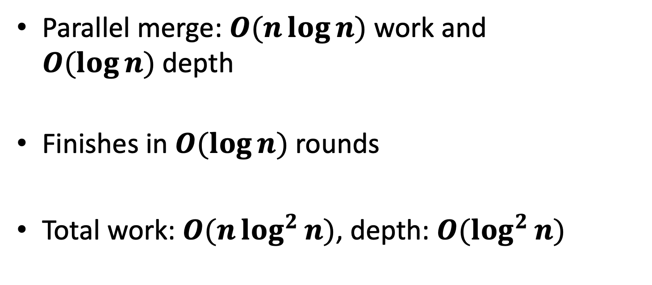
Parallel merge sort: Second Attempt
Parallel merge: $O(n\log{n})$ work and $O(\log{n})$depth
Finishes in $O(\log{n})$ rounds
Total work: $O(n\log^{2}{n})$, depth: $O(\log^{2}{n})$

Slide 19
A parallel merge algorithm: Third attempt (for CREW PRAM)
For each element in each array, do a fast search to compute its rank in merged array
Put the element in the correct slot
2
3
4
6
9
Fast search
0
1
5
7
8
0
1
2
3
4
5
6
7
8
9

Slide 20
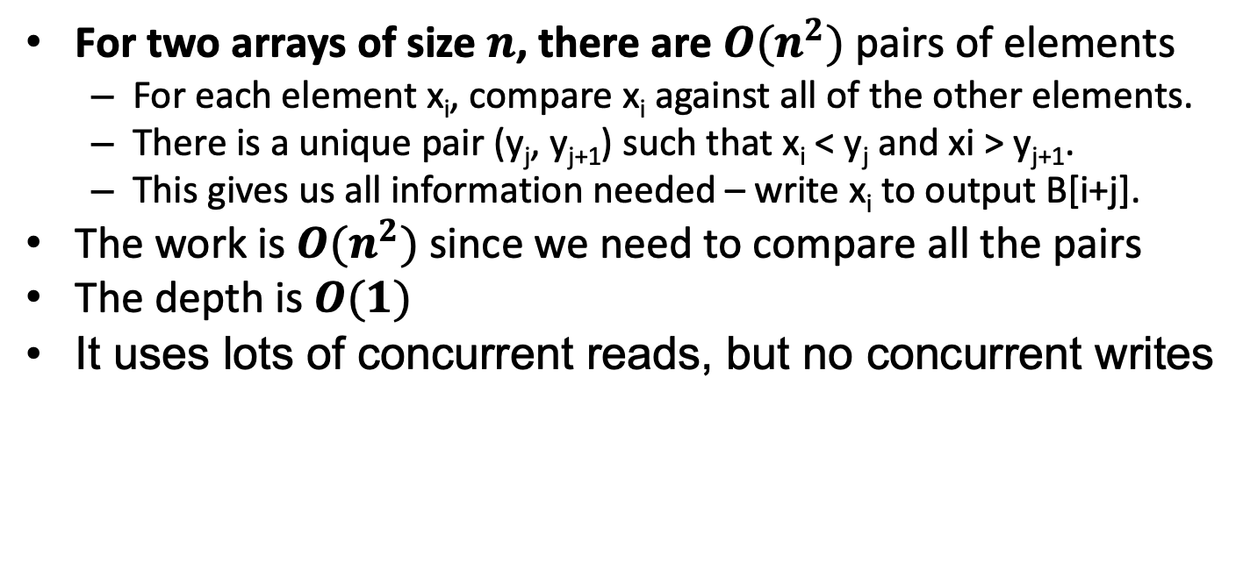
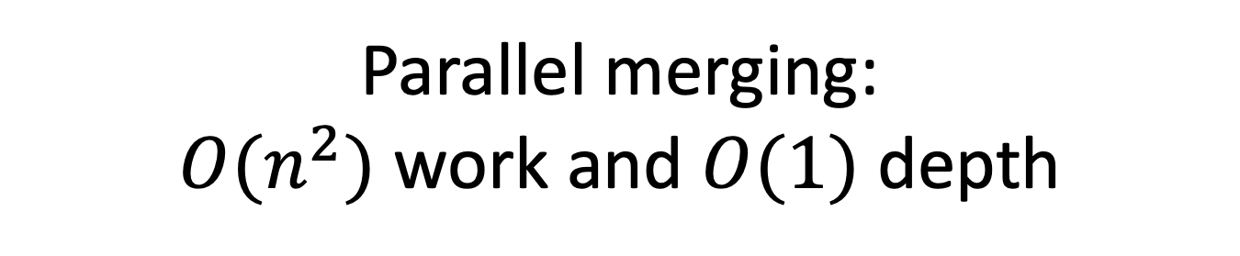
Parallel merging: $O(n^{2})$ work and $O(1)$ depth
For two arrays of size $n$, there are $O(n^{2})$ pairs of elements
For each element x_{i}, compare x_{i} against all of the other elements.
There is a unique pair (y_{j}, y_{j+1}) such that x_{i} < y_{j} and xi > y_{j+1}.
This gives us all information needed – write x_{i} to output B[i+j].
The work is $O(n^{2})$ since we need to compare all the pairs
The depth is $O(1)$
It uses lots of concurrent reads, but no concurrent writes

Slide 21
Valiant’s Merge Algorithm
Use this fast merging technique along with square-root-way divide-and-conquer.
Choose n^{1/2} evenly spaced elements from array A and n^{1/2} evenly spaced elements from array B.
Merge these two sampled lists in O(1) time using the constant-time merge method.
Recursively merge the O(n^{1/2}) pairs of overlapping subproblems of size O(n^{1/2}) each.

Slide 22
CREW PRAM Merging Algorithm
Time: T(n) = T(n^{1/2}) + 1, which implies T(n) is O(loglog n).
Work: W(n) = n^{1/2} W(n^{1/2}) + n, which means W(n) is O(n loglog n).
We can get the work down to O(n) by stopping when the problem size is O(loglog n) and doing the merges sequentially.

Slide 23
Parallel Mergesort
Use the fast merge algorithm as a part of a binary parallel mergesort.
O(log n) levels of recursion, which take O(log log n) time each.
Total work: O(n log n).

Slide 24
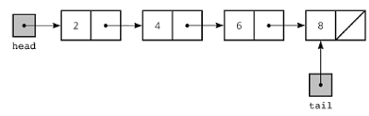
Linked Lists
Linked lists are simple and important data structures
Sometimes we want to know the rank of each node (e.g., the distance to the head/tail)

Slide 25
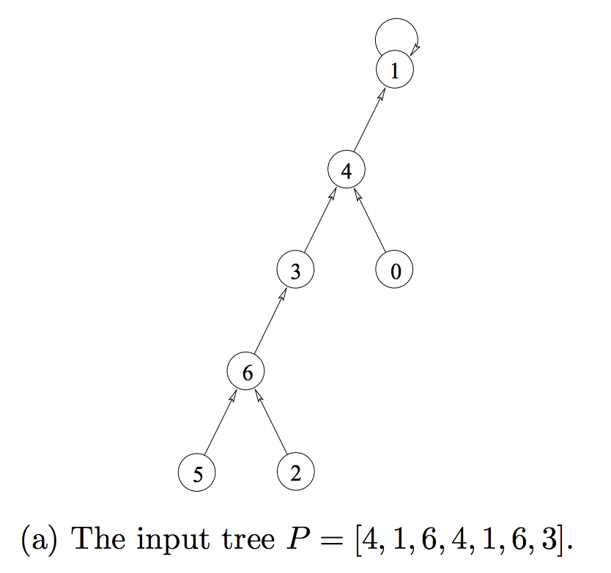
List Ranking
Input array P, P[i]=j means that the i-th element’s parent is the j-th element
In practice the input can be a linked list with next/parent pointers
Follow the pointers until reaching the root
Source: “Parallel Algorithms” by Guy E. Blelloch and Bruce M. Maggs

Slide 26
Work-Efficient List Ranking
Idea: reduce the problem size by a constant factor per round, and apply the algorithm recursively
ListRanking(list P)
If list has two or fewer nodes, then return //base case
Every node flips a fair coin
For each vertex u (except the last vertex), if u flipped Tails and P[u] flipped Heads then u will be paired with P[u]
rank(u) = rank(u)+rank(P[u])
P[u] = P[P[u]]
Recursively call ListRanking on smaller list
Insert contracted nodes v back into list with rank(v) = rank(v) + rank(P[v])
Remove an element if:
It is head
Its previous element is a tail
1
1
1
1
1
0
T
H
H
T
H
T
2
1
2
0
Source: MIT 6.886 by Julian Shun

Slide 27
Work-Efficient List Ranking
1
1
1
1
1
0
T
H
H
T
H
T
Contract + packing
2
1
2
0
Apply recursively
5
3
2
0
Expand
5
4
3
2
1
0
Source: MIT 6.886 by Julian Shun

Slide 28

Work-Depth Analysis
Remove an element if:
It is head
Its previous element is a tail
Number of pairs per round is reduced by (n-1)/4 in expectation
For all nodes u except for the last node, probability of u flipping Head and its previous element flipping Tails is 1/4
=> A node gets removed with probability 1/4
Each round takes linear work and O(log n) depth
Expected work: W(n) ≤ W(3n/4) + O(n)
Expected depth: D(n) ≤ D(3n/4) + O(log n)
W = O(n)
D = O(log² n)
$D=O(\log{n})$ in arbitrary-forking
Source: MIT 6.886 by Julian Shun

Slide 29
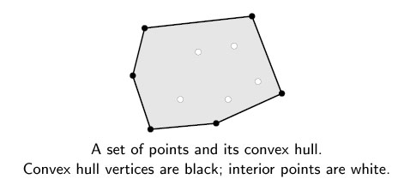
Convex Hull
Given a set of points in a plane P , convex hull is the largest convex polygon whose vertices are all in P.
Notes:
It has many applications in computer graphics – to find an approximate location of an object as a very simple descriptor of its shape.
GIS – In case of a natural disaster emergency planners may easily calculate the emergency response times using GIS.
Visual pattern recognition – detecting car plates

Slide 30
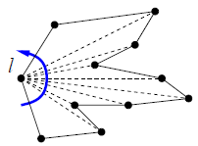
Serial Algorithms
Brute force
Divide and Conquer
Graham Scan
Select the left most point as pivot
Sort the rest of the points by polar angles with respect to the pivot
March around this points and build the hull
Add edges when left turn and backtrack when right

Slide 31
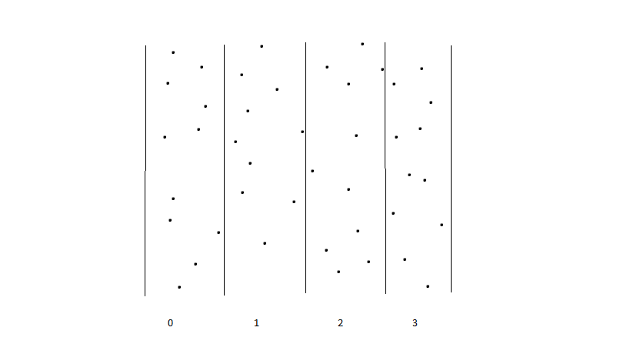
Parallel Algorithm
Divide and Conquer
Divide the plane containing the points among the processors
Sequentially find the local convex hull
Merge the convex hull from neighboring processors

Slide 32
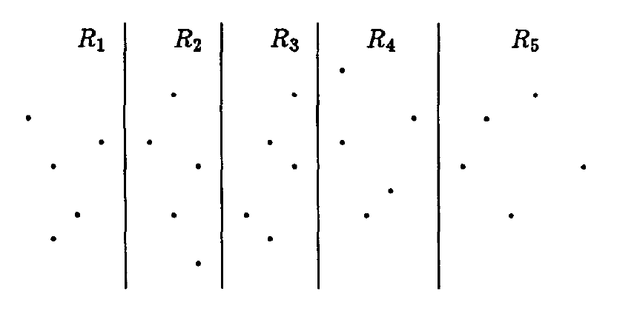
Convex Hulls and Divide-and-Conquer
Divide into n^{1/2} groups of size n^{1/2} each.
Recursively solve each problem
Merge the subproblems
T(n)=T(n^{1/2}) + O(log n)
T(n)=O(log n)

Slide 33
