Slide 1
Parallel Algorithms
CS 263
Michael T. Goodrich
University of California, Irvine
Some slides adapted from content by Joseph Jaja, Yun Gu, and Yihan Sun

Slide 2

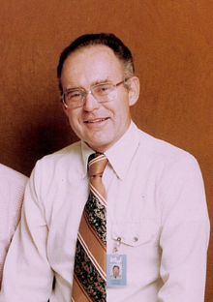
Moore’s Law
Moore’s “law” is the observation that the number of transistors in an integrated circuit doubles about every two years.
Gordon Moore
(Intel co-founder)

Slide 3



Technology Scaling – Clock Speed Kept Pace Until 2004
1,000,000
100,000
Normalized
10,000
transistor count
1,000
Clock speed (MHz)
100
10
1
0
1970
1975
1980
1985
1990
1995
2000
2005
2010
2015
Year
Stanford’s CPU DB [DKM12]

Slide 4



Advances in Hardware
Apple computers with similar prices from 1977 to 2004
Apple II
Power Macintosh G4
Power Macintosh G5
Launched: Clock rate: Data path: Memory: Cost:
1977
1 MHz
8 bits
48 KB
$1,395
Launched: Clock rate: Data path: Memory: Cost:
2000
400 MHz
32 bits
64 MB
$1,599
Launched: Clock rate: Data path: Memory: Cost:
2004
1.8 GHz
64 bits
256 MB
$1,499

Slide 5
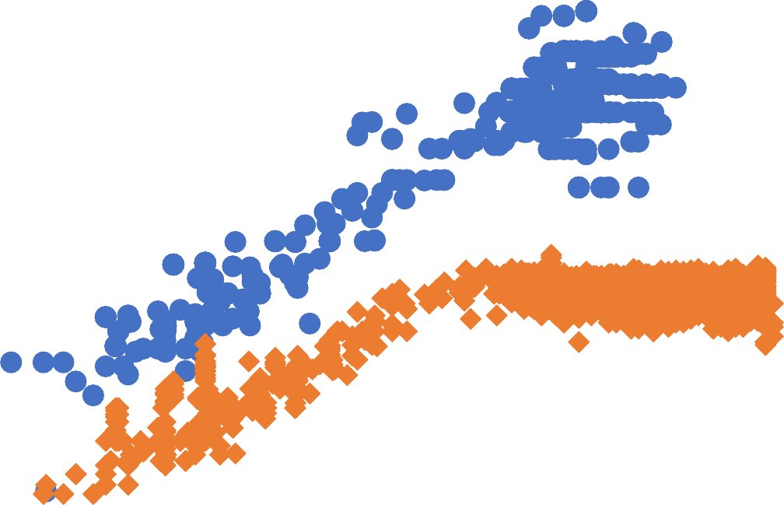


Technology Scaling After 2004 – Clock Speed Hit a Wall
1,000,000
100,000
Normalized
10,000
transistor count
1,000
Clock speed (MHz)
100
10
1
0
1970
1975
1980
1985
1990
1995
2000
2005
2010
2015
Year
Stanford’s CPU DB [DKM12]

Slide 6
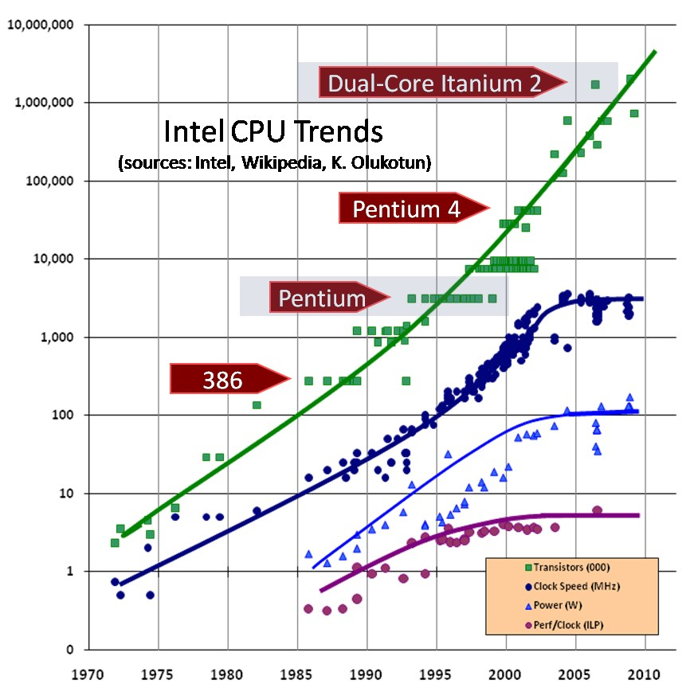

Moore’s Law Misquote
Not clock speed
Grace Hopper gave out “nanoseconds” to prove this point.
Her prediction: Computers are going to have to utilize parallel processing.

Slide 7
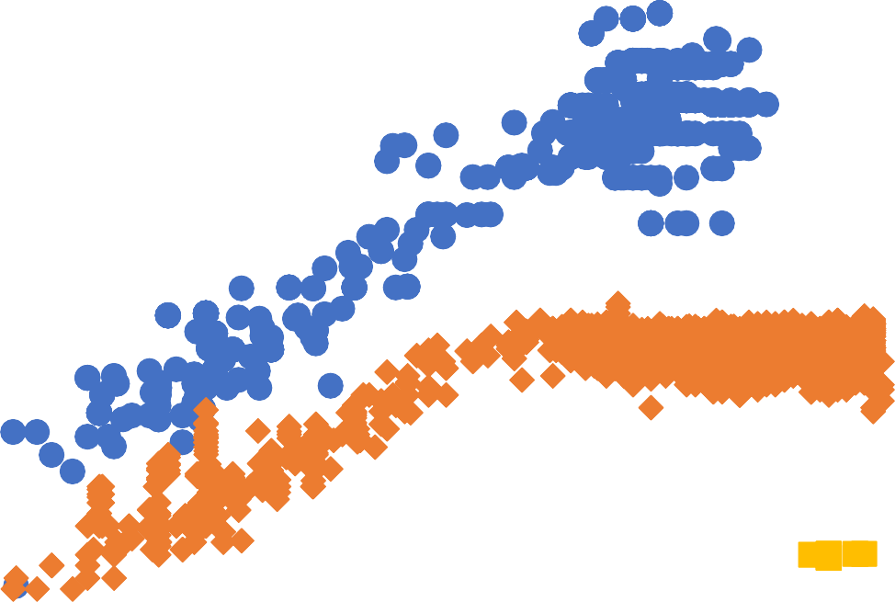

Technology Scaling:
Multicore CPUs
1,000,000
100,000
Normalized
10,000
transistor count
1,000
Clock speed (MHz)
100
10
Processor cores
1
0
2010 2015
1970
1975
1980
1985
1990
1995
Year
2000
2005
Stanford’s CPU DB [DKM12]

Slide 8
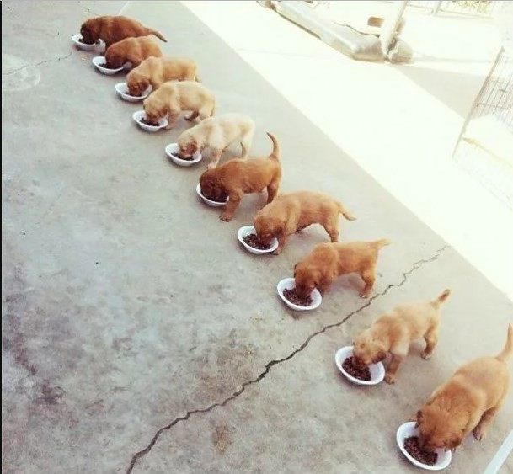
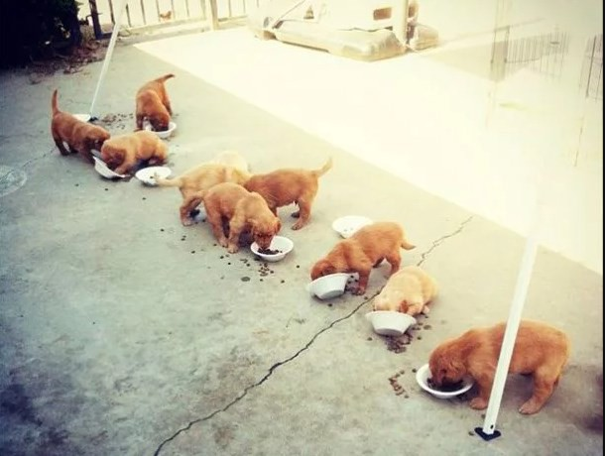
Parallel Computing: Theory and Practice
Theory
Practice
(Pictures from 9gag.com)

Slide 9
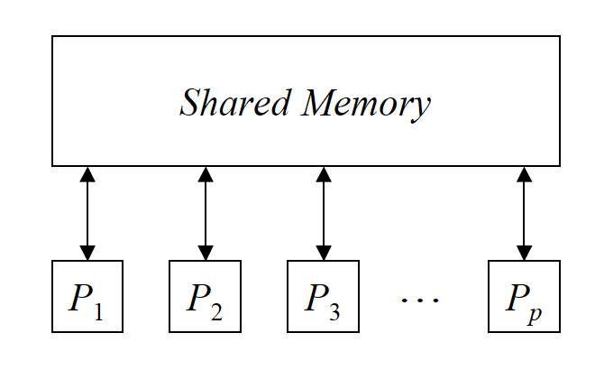
The PRAM Model
Parallel Random Access Machine (PRAM)
Extension of RAM: each processor is a RAM
Processors operate synchronously
Memory space is shared among all processors

Slide 10
PRAM Variations
A PRAM step (“clock cycle”) consists of three phases
  Read: each processor may read a value from shared memory
  Compute: each processor performs operations on local data
  Write: each processor may write a value to shared memory
Model is refined for concurrent read/write capability
  Exclusive Read Exclusive Write (EREW)
  Concurrent Read Exclusive Write (CREW)
  Concurrent Read Concurrent Write (CRCW)
CRCW PRAM is further refined as follows:
  Common CRCW: all processors must write the same value
  Arbitrary CRCW: one of the processors succeeds in writing
  Priority CRCW: processor with highest priority succeeds in
  writing

Slide 11
Work and Span for a PRAM Algorithm
The work, W, done in a T-step PRAM algorithm:
  Let P_{i} be the number of active processors in step i
  Then work W = sum of P_{i} values, for i=1,2,…,T.
The span for a PRAM algorithm is its number of parallel steps.
Span corresponds to parallel time.
Work is the total number of computations done.

Slide 12
Brent’s Meta-theorem for PRAMs
A T-step PRAM algorithm with work W can be implemented with P processors in time O(T+W/P).
This ignores the problem of how to assign tasks to the P processors.
  But sometimes this processor allocation is easy

Slide 13
Example Computations
OR of n bits
  O(1) time in CRCW PRAM (all versions)
  O(log n) time in CREW/EREW PRAM
Broadcast a value to all processors
  O(1) time in CREW/CRCW PRAM
  O(log n) time in EREW PRAM

Slide 14
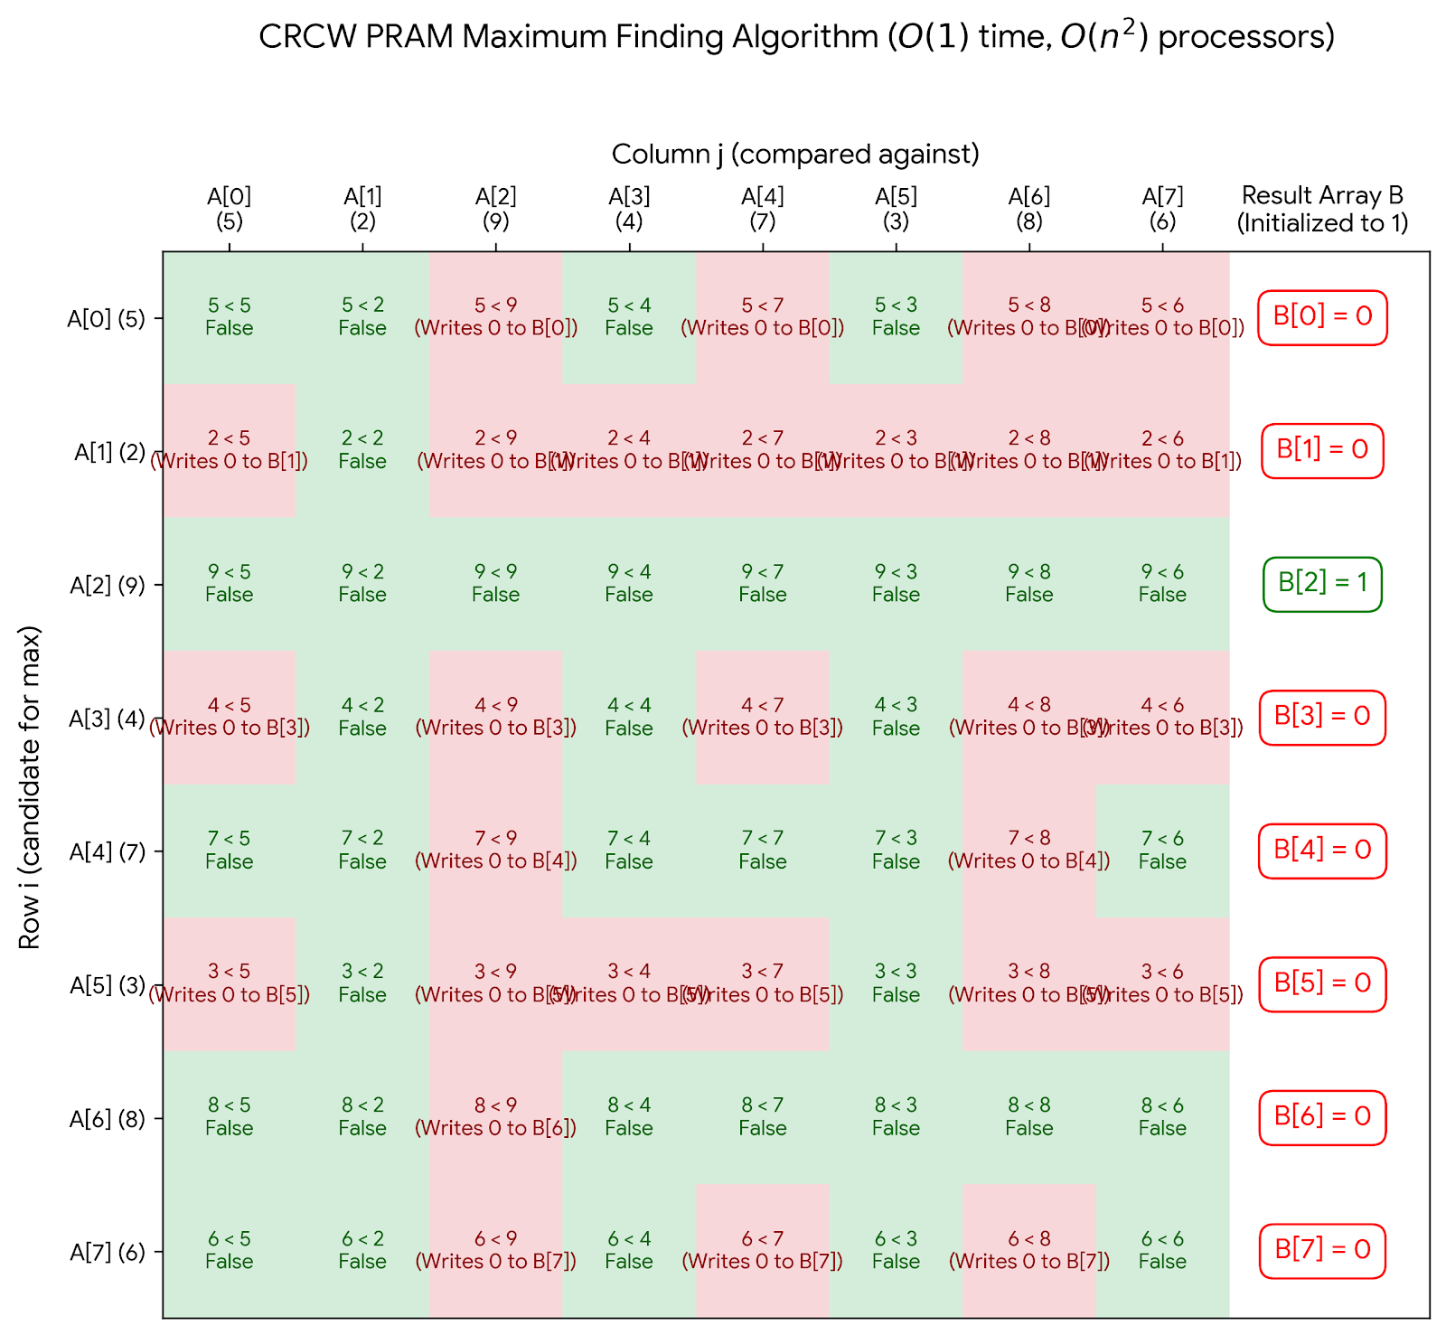
CRCW PRAM Maximum Finding
Image generated using Nano Banana Pro

Slide 15
CRCW PRAM Maximum Finding
Use divide-and-conquer but divide into O(n^{1/2}) groups of size O(n^{1/2}) each, recursively find the maximum in each group.
Use the constant-time maximum-finding algorithm on the results.
Time: T(n) = T(n^{1/2}) + 1, which implies T(n) is O(loglog n).
Work: W(n) = n^{1/2} W(n^{1/2}) + n, which means W(n) is O(n loglog n).

Slide 16
The Reduce Operation - Summing n numbers
Compute the sum (reduce) of all values in an array
reduce(A, n) {
if (n == 1) return A[0];
parallel_do:
L = reduce(A, n/2);
R = reduce(A + n/2, n-n/2);
return L+R;
}
1
+
2
3
+
4
5
+
6
7
+
8
+
+
+
16

Slide 17
Two algorithms to implement a reduce
Top-down
Bottom-up
reduce(A, n) {
if (n == 1) return A[0];
parallel_do:
L = reduce(A, n/2);
R = reduce(A + n/2, n-n/2);
return L+R;
}
reduce(A, n) {
if (n == 1) return A[0]; if (n is odd) n=n+1; parallel_for i=0 to n/2
B[i]=A[2i]+A[2i+1];
return reduce(B, n/2); }
Divide-and-conquer: Dealing with the left and right halves recursively, in parallel
Decrease and conquer:
Shrink the original size into a half, in parallel
1
+
2
3
+
4
5
+
6
7
+
8
+
+
+
Both run in O(log n) time using n processors on an EREW PRAM.

Slide 18
Alternative Model: Binary fork-join
All computation start from a thread
A thread can:
  Do normal operations as in RAM model (arithmetic operations, memory access)
  Fork: create one new thread to run in parallel (1->2); can be nested and/or repeated
  Join: synchronize with previous forked threads
Top-down
Top-down using fork-join
reduce(A, n) {
if (n == 1) return A[0];
In parallel:
L = reduce(A, n/2);
R = reduce(A + n/2, n-n/2);
return L+R;
}
reduce(A, n) {
if (n == 1) return A[0];
Fork:
L = reduce(A, n/2);
R = reduce(A + n/2, n-n/2);
Join
return L+R;
}

Slide 19
More on Binary fork-join Model
All computation start from a thread
A thread can:
  Do normal operations as in RAM model (arithmetic operations, memory access)
  Fork: create one new thread to run in parallel (1->2), can be done in a nested manner
Join: synchronize with previous forked thread
Here since it’s forking out n/2 threads, it’s generally more expensive than just forking out one thread – requires O(log n) steps of binary fork operations
Bottom-up
reduce(A, n) {
if (n == 1) return A[0]; if (n is odd) n=n+1; parallel_for i=1 to n/2
B[i]=A[2i]+A[2i+1];
return reduce(B, n/2); }
reduce(A, n) {
if (n == 1) return A[0];
if (n is odd) n=n+1;
Fork n/2 threads for i=1 to n/2
B[i]=A[2i]+A[2i+1];
Join
return reduce(B, n/2); }

Slide 20














Viewing a Binary fork-join Algorithm as a DAG
Fork
For all computations, we can draw a DAG (directed acyclic graph)
  A->B means that B can be performed only when A has been finished
Join
It shows the dependency of operations in the algorithm

Slide 21








Binary Fork-Join Work and Span
For all computations, imagine a DAG
  A->B means that B can be performed only
when A has been finished
Unit cost per operation, including fork and join
Work: the total number of operations
Span (depth): the longest length of sequential dependency chain (the “critical path”)

Slide 22





Computational DAG
Call reduce(A, 1 to 4)
reduce(A, n) {
if (n == 1) return A[0];
Fork:
L = reduce(A, n/2);
R = reduce(A + n/2, n-n/2);
Join
return L+R; }
(n==1)? No!
fork
Call L=reduce(A, 1 to 2) Call R=reduce(A, 3 to 4)
(n==1)? No!
(n==1)? No!
fork
fork
Call L=reduce(A, 1 to 1) |  |  | Call R=reduce(A, 2 to 2) |  |  | Call L=reduce(A, 3 to 3) |  |  | Call R=reduce(A, 4 to 4)
(n==1)? Yes! return 1 |  |  | (n==1)? Yes! return 2 |  |  | (n==1)? Yes! return 3 |  |  | (n==1)? Yes! return 4
join
join
return 3+4 = 7
1
+
3
2
3
+
7
4
return 1+2 = 3
join
+
10
return 3+7 = 10

Slide 23
Work
reduce(A, n) {
if (n == 1) return A[0];
parallel_do:
L = reduce(A, n/2);
R = reduce(A + n/2, n-n/2);
return L+R;
}
1
+
3
2
3
+
7
4
5
+
11
6
7
+
15
8
What is the work?
+
10
+
26
O(log n)
O(n)
O(n log n)
+
36
Work: The total number of operations in the algorithm
  Sequential running time when the algorithm runs on one processor
  Work-efficiency: the work is (asymptotically) no more than the best (optimal)
sequential algorithm
  Goal: make the parallel algorithm efficient when a small number of processor are available

Slide 24
Span
reduce(A, n) {
if (n == 1) return A[0];
parallel_do:
L = reduce(A, n/2);
R = reduce(A + n/2, n-n/2);
return L+R;
}
1
+
3
2
3
+
7
4
5
+
11
6
7
+
15
8
What is the span?
+
10
+
26
O(log n)
O(log² n)
O(n)
O(n log n)
+
36
Span (depth): The longest dependency chain
Total time required if there are infinite number of processors
Low span: Logarithmic is ideal, or at least it should be asymptotically lower than
work (sequential time complexity)
Goal: make the parallel algorithm faster and faster when more and more processors are available - scalability

Slide 25
Work for the other reduce algorithm
Reduce(1,2,3,4,5,6,7,8)
reduce(A, n) {
if (n == 1) return A[0];
if (n is odd) n=n+1;
Fork n/2 threads for i=1 to n/2 B[i]=A[2i]+A[2i+1];
Join
return reduce(B, n/2); }
1+2=3
3+4=7
5+6=11
7+8=15
reduce(3,7,11,15)
3+7=10
11+15=26
What is the work?
O(log n)
O(n)
O(n log n)
reduce(10,26)
10+26=36
reduce(36)
return 36

Slide 26
Span for the other reduce algorithm
Reduce(1,2,3,4,5,6,7,8)
reduce(A, n) {
if (n == 1) return A[0];
if (n is odd) n=n+1;
Fork n/2 threads for i=1 to n/2 B[i]=A[2i]+A[2i+1];
Join
return reduce(B, n/2); }
1+2=3
3+4=7
5+6=11
7+8=15
reduce(3,7,11,15)
3+7=10
11+15=26
What is the span?
O(log n)
O(log² n)
O(n)
O(n log n)
reduce(10,26)
10+26=36
reduce(36)
return 36

Slide 27
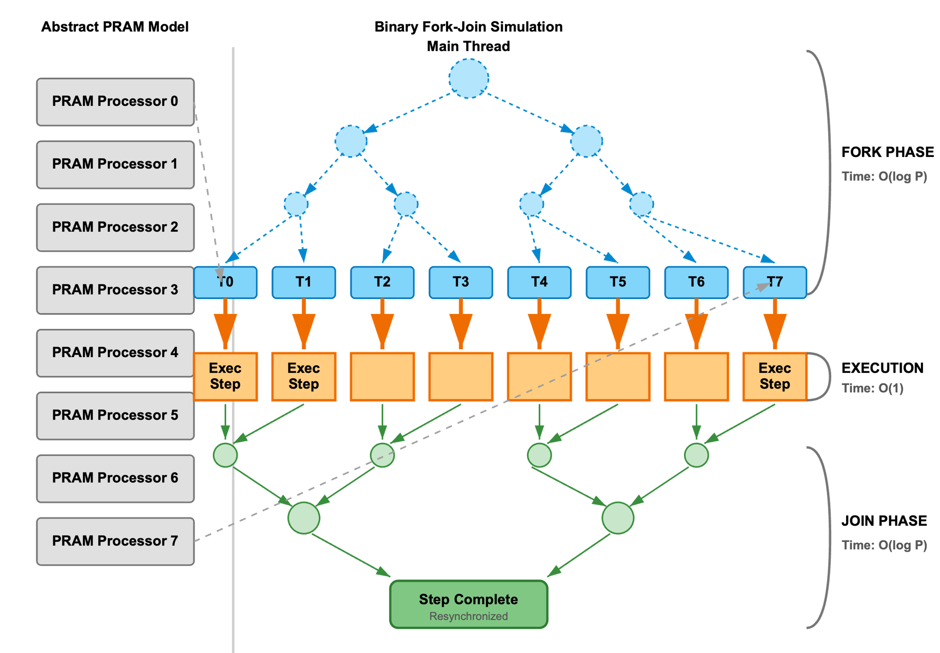
Simulating a PRAM in the Fork-Join Model
Perform O(log P) forks and joins for each step to the P active processors.
Work is the same as for the PRAM algorithm.
Image generated using Nano Banana Pro.

Slide 28
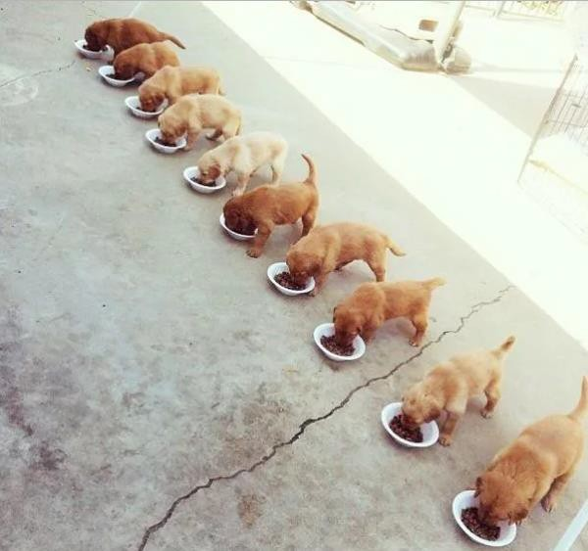
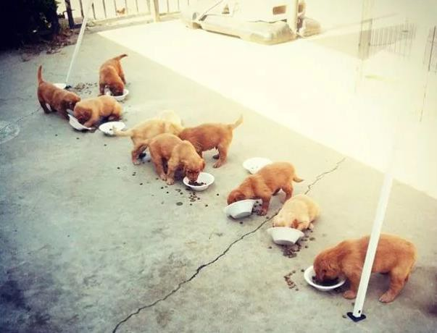
Why is parallelism hard in practice?
Concurrency!
Theory
Practice
(Pictures from 9gag.com)

Slide 29

Concurrency!
Things can be executed at the same time or “almost” same time
Scheduling is unknown
Processors are asynchronous
  delays from cache misses, processor pipelines, branch prediction, hyper-threading, changing clock speeds, interrupts, …
Relative ordering for operations is unknown
Race conditions (e.g., between multiple reads and writes)
Image from https://www.nytimes.com/2022/02/18/sports/olympics/speedskating-mass-start-joey-mantia.html

Slide 30

















Which tasks are “parallel”?
Two threads are “logically parallel” if
they CAN run in parallel
A
B
Are they parallel?
  A and B?
  A and C?
  A and D?
  B and C?
  C and D?
C
D
As long as X is not an ancestor of Y on the DAG, X and Y can be parallel

Slide 31
Race Conditions
Race occurs when two logically parallel instructions access the same memory location and at least one of the instructions performs a write.
int bal = 5;
void deposit(x) { bal = bal + x;
}
balance = 5 P1: deposit(3)
P2: deposit(4)

Slide 32
Race Example 1
Race occurs when two logically parallel instructions access the same memory location and at least one of the instructions performs a write.
bal = 5
int bal = 5;
void deposit(x) { bal = bal + x;
}
r0 = bal
1
4
r1 = bal
r0 += 3
2
5
r1 += 4
balance = 5
P1: deposit(3)
bal = r0
3
6
bal = r1
P2: deposit(4)
bal = ?

Slide 33
Race Example 2
Race occurs when two logically parallel instructions access the same memory location and at least one of the instructions performs a write.
bal = 5
int bal = 5;
void deposit(x) { bal = bal + x;
}
r0 = bal
1
3
r1 = bal
r0 += 3
2
4
r1 += 4
balance = 5
P1: deposit(3)
bal = r0
3
6
bal = r1
P2: deposit(4)
bal = ?

Slide 34
Types of Race Conditions
Suppose that instruction A and instruction B both access a location x, and suppose that A ∥ B (A is parallel to B).
A | B | Race Type
Read | Read | No race
Read | Write | Read race
Write | Read | Read race
Write | Write | Write race
33

Slide 35
“Atomic” operations
“Atomic operations” are operations that cannot be interfered by
other operations
Race occurs when two logically parallel instructions access the same memory location and at least one of the instructions performs a write.
int bal;
void deposit(x) {
bal = bal + x;
}
bal = 0
r0 = bal
1
4
r1 = bal
balance = 5 P1: deposit(3)
P2: deposit(4)
r0 += 3
2
5
r1 += 4
The process of “deposit” should happen
atomically!
No other operations (from other threads) can interrupt in the middle!
bal = r0
3
6
bal = r1
bal = ?
35

Slide 36
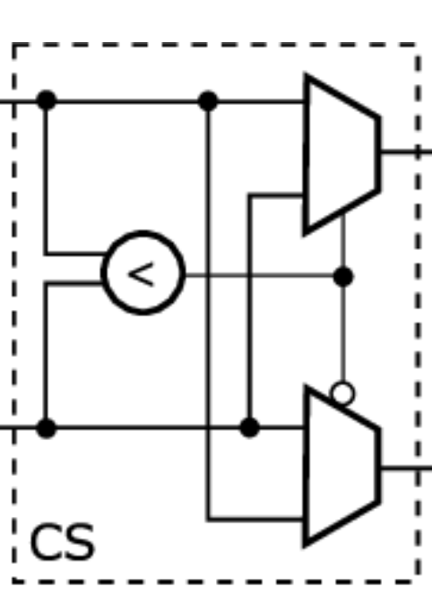
An Atomic Operation: compare_and_swap
Compare-and-swap (CAS)
  bool CAS(p, v_{old} , v_{new}): compare the value stored in the pointer
p with value v_{𝑜𝑙𝑑} , if they are equal, change p’s value to v_{new} and return true. Otherwise do nothing and return false.
Supported by Intel and AMD machines
Other operations can be simulated using compare-and-swap
Can assume unit-cost
Allows us to simulate some CRCW operations

Slide 37

Guarantee correctness
When we have concurrency, it’s easy to get things wrong…
Correctness is the first consideration (more important than performance!)!
You must show your parallel algorithm is correct, either using PRAM synchronization, fork-join synchronization, or correctly using atomic operations.

Slide 38
Prefix sum
In = 1
Out = 1
2 3 4 5 6 7 8
3 6 10 15 21 28 36
The most widely-used building block in parallel
algorithm design
scan (A[1..n]) {
B[0] = A[0];
for i = 1 to n
B[i] = B[i-1] + A[i];
return B[1..n];
}

Slide 39
Prefix Sum Parallel Algorithm
1 2 3
4
5
6
7
8
reduce(A, n) {
if (n == 1) return A[0]; if (n is odd) n=n+1; parallel_for i=1 to n/2
B[i]=A[2i]+A[2i+1];
return reduce(B, n/2); }
+
3
+
7
+
11
+
15
+
10
+
26
+
36
A
1 | 2 | 3 | 4 | 5 | 6 | 7 | 8
Shrink the problem size into ^{𝑛} ,
2
possibly in parallel
Prefix sum of A
1
3
6
10
15
21
28
36
𝑛 2
Solve the same problem on
Convert the result of the subproblem to the final answer, possibly in parallel.
Prefix sum of B
B
3 | 10 | 21 | 36
3 | 7 | 11 | 15

Slide 40
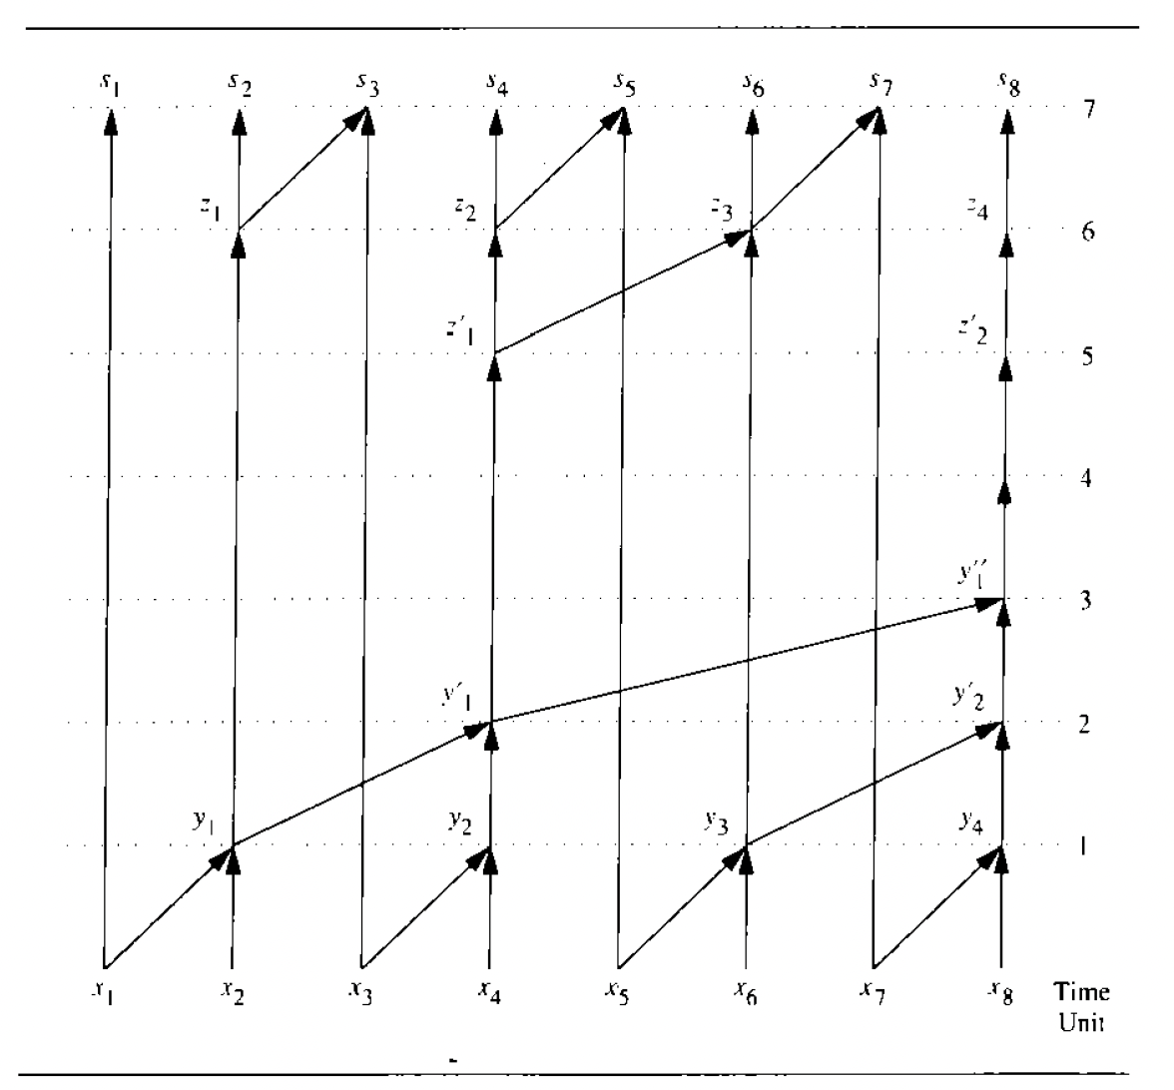
Implementations of the prefix sum algorithm
EREW PRAM prefix sum algorithm:
  𝑂(𝑛) work, 𝑂(log 𝑛) span
  E.g., can be done in O(log n) time using O(n/log n) processors.
Binary fork-join algorithm:
  𝑂(𝑛) work, 𝑂(log 𝑛) span
  Slightly more complicated, e.g., can be done by two divide-and-conquer methods, one going bottom-up and the other going top-down.

Slide 41
Application: Array Compaction
Suppose you have an array of data and you want to filter out certain elements (e.g., keep only the positive numbers) and pack the remaining elements into a dense, gapless array.
The Problem: In a parallel environment, if multiple processors try to write their surviving elements to a new array simultaneously, they will overwrite each other unless they know exactly where to write.
The Prefix Sum Solution:
  Create a temporary array of 1s and 0s: assign 1 to elements you want to keep, and 0 to elements you want to discard.
  Run a parallel prefix sum (using addition) on this 1/0 array.
  The result of the prefix sum gives each surviving element its exact, unique target index in the new, compacted array.

Slide 42
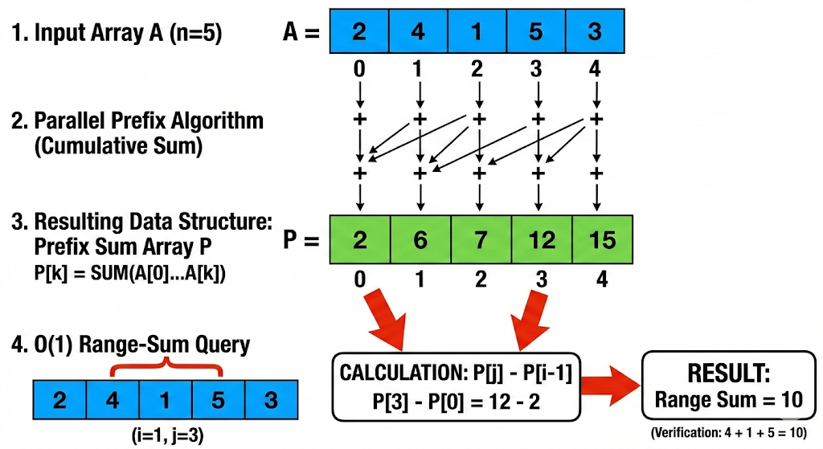
Application: Range-Sum Queries
Image generated using Nano Banana Pro

Slide 43
Extension: Any Associative Operation
Running Maximums, Minimums, or Logic
  The prefix algorithm doesn't just work with addition. It works with any associative operator.
Running Max: If you have an array of daily stock prices and you want to find the highest price seen up to that point for every single day in history, you run a prefix sum but replace the addition operator + with the max() function.
Note that this can’t be used for range-minimum or range-maximum queries, since min and max don’t have inverses.

