Slide 1
More Instance-Sensitive Algorithms
Michael T. Goodrich
University of California, Irvine
Some slides adapted from material from Jérémy Barbay, Christos Levcopoulos, Ola Petersson, and Wikipedia.

Slide 2
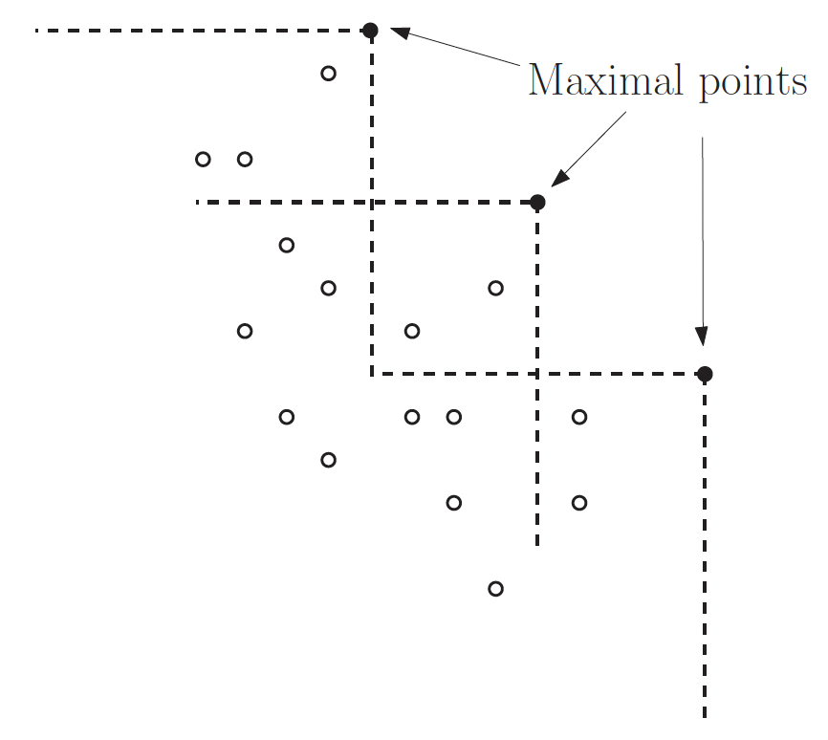
The Maximal Points Problem
Given a set of n points in the plane, determine the maximal points that are not dominated by any other points.
A point (x,y) is maximal if there is no other point with x-coordinate greater than x and y-coordinate greater than y.

Slide 3
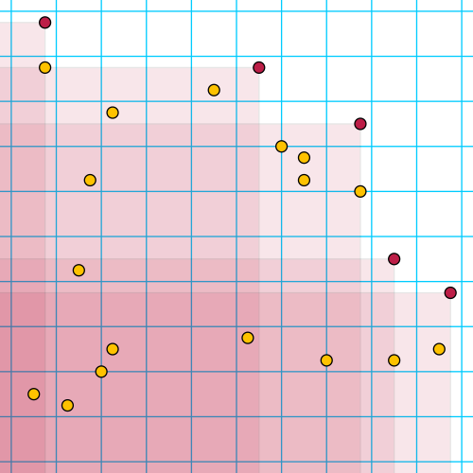
A Simple Plane-Sweep Algorithm
Sort the points by decreasing x-coordinates.
For each point in this order, test whether its y-coordinate is greater than the maximum y-coordinate of any previously processed point.
If it is, output the point as a maximal point, and remember its y-coordinate as the greatest seen so far.
This algorithms runs in O(n) time after sorting,
so its running time depends on the time to sort.

Slide 4
Combine-and-Conquer
Apply divide-and-conquer, but do the conquer step first.
MaximalPoints(S):
If |S| = 1 then return S.
Divide S into the left and right halves S_{L} and S_{R} by the median x-coordinate. (Can do this in O(n) time.)
Find the point q with the maximum y-coordinate in S_{R}.
Prune all points in S_{L} and S_{R} that are dominated by q.
Return the concatenation of MaximalPoints(S_{L}) and MaximalPoints(S_{R}).

Slide 5
Split Step
Divide at the median.

Slide 6
Conquer Step
Find the point on the right with maximum y-coordinate.

Slide 7
Prune Step
Prune away points dominated by the maximal point in S_{R}.

Slide 8
Divide Step
Recursively solve the remaining points in S_{L} and S_{R}.

Slide 9
A First Analysis
Each recursive call takes O(n) time plus the times for the recursive steps.
Each recursive call is guaranteed to find a maximal point.
These facts imply that the time is O(n log h), where h is the size of the output.
Why?

Slide 10
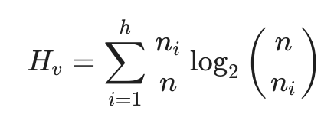
Vertical Entropy
Let n_{i} be the number of points dominated by the i-th maximal point but not the (i-1)-set maximal point.
Note that H_{v} is at most log₂ h.

Slide 11
An Entropy-Sensitive Analysis
The combine-and-conquer algorithm runs in O(nH_{v}) time.
Proof sketch:
If a maximal point dominates at least n_{i} input points, then it will be identified by the MaximalPoints algorithm after at most log₂(n/n_{i}) rounds.
For example, if n_{i} ≥ n/2, it will be identified immediately; if n_{i} ≥ n/4 it will be identified after at most two levels of recursion; and so on.
Thus, the n_{i} input points that it dominates contribute at most n_{i} comparisons to at most log₂(n/n_{i}) partition phases.

Slide 12

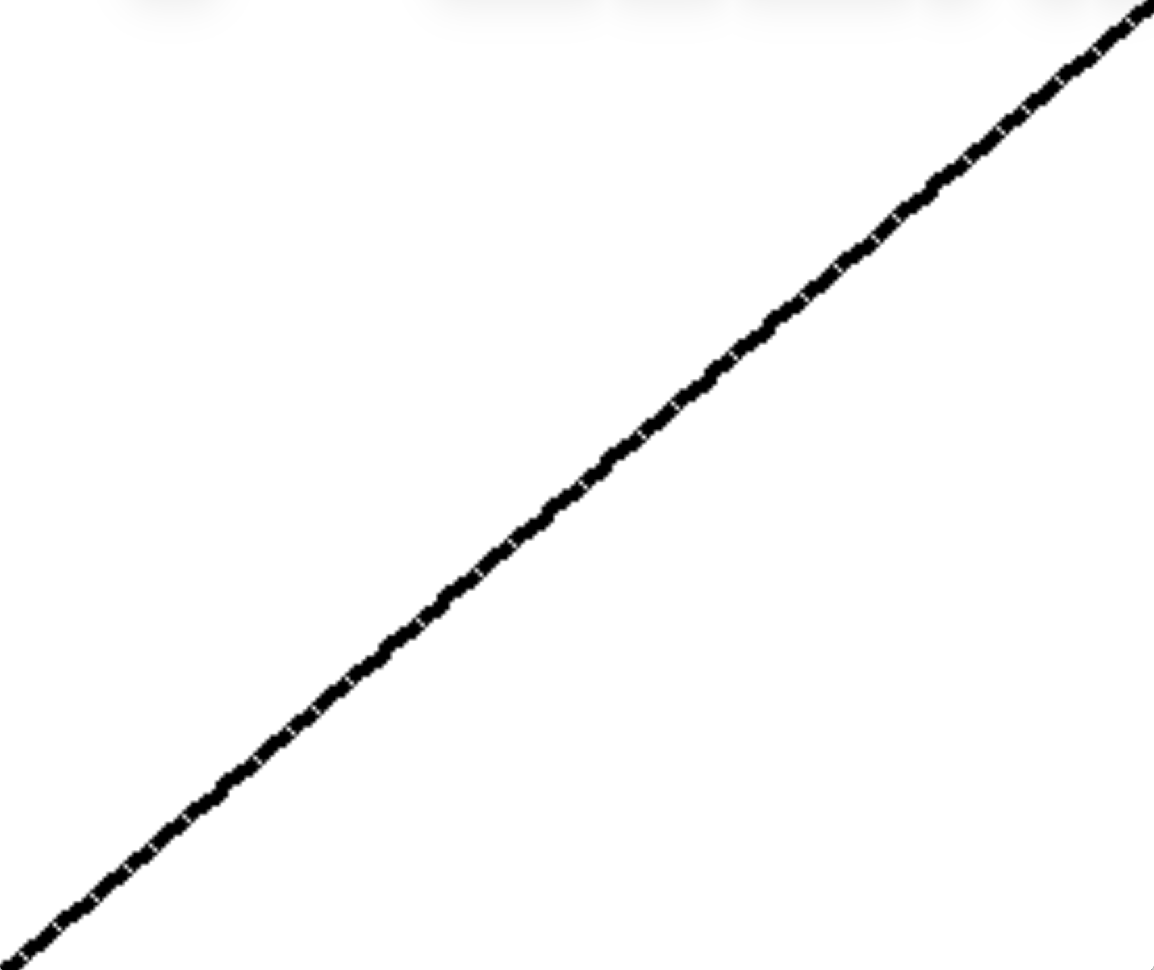
Revisiting the Sorting Problem
Given an array, X, of n elements, reorder the elements to be in nondecreasing order.

Slide 13
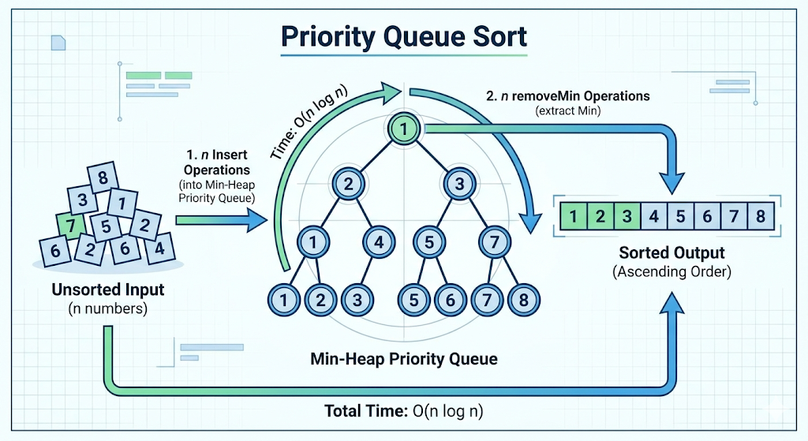
Recalling Priority Queue Sort (Heapsort)
Let Q be a priority queue, e.g., using a heap that supports insert and extractMin operations in O(log n) time:
Insert the elements into Q using n insert operations.
Perform n extractMin operations on Q to output the elements in sorted order.
Worst case:
O(n log n)
time
Best case:
O(n log n)
time
Image generated using Nano Banana Pro.

Slide 14
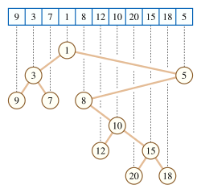
Cartesian Tree
A Cartesian tree is a binary tree derived from a sequence of numbers.
To construct the Cartesian tree, set its root to be the minimum number in the sequence, and recursively construct its left and right subtrees from the subsequences before and after this number.
Introduced by Jean Vuillemin
in 1980 for geometric data retrieval

Slide 15
Hybrid Nature of Cartesian Trees
A Cartesian tree elegantly combines the properties of two distinct data structures:
A Heap (specifically, a min-heap or max-heap).
A Binary Search Tree (in terms of its structural traversal).

Slide 16
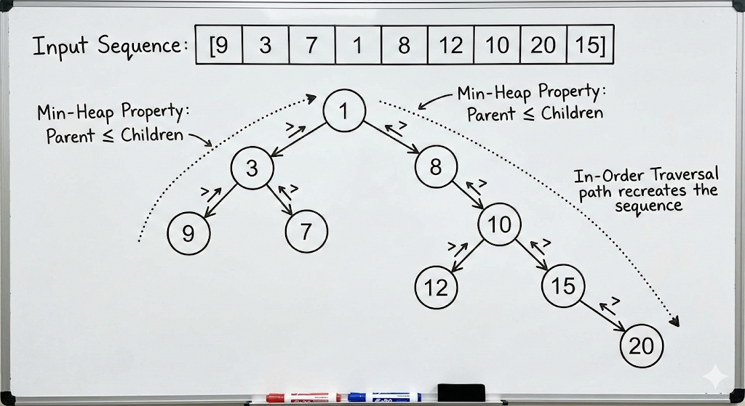


Two Properties for Cartesian Trees
Heap Property: The value of any node is strictly less than (or strictly greater than) the values of all its descendants. Result: The minimum (or maximum) value of the sequence is at the root.
In-Order Traversal Property: If you perform an in-order traversal (Left Child -> Node -> Right Child), you recreate the original sequence.
Image generated using Nano Banana Pro.

Slide 17
Algorithm for Constructing a Cartesian Tree
The recursive method can degrade to an algorithm running in O(n²) time, but we can build it in O(n) time using a stack:
Process the array left to right, maintaining a stack of nodes for the “right spine,” i.e., the nodes from the last inserted elements up to the root.
When inserting a new number, pop nodes off the stack as long as they are larger than the new number. The last node popped becomes the left child of the new number. The new number becomes the right child of the new top of the stack. Push the new number onto the stack.
Image generated using Nano Banana Pro.

Slide 18
Cartesian-Tree Priority Queue Sort
Construct a cartesian tree for the input sequence.
Initialize a priority queue, Q, initially containing only the tree root of the cartesian tree.
While Q is non-empty:
Find and remove the minimum value in Q
Add this value to the output sequence
Add the Cartesian tree children* of the removed value to Q
This algorithm is correct because of the heap property of the cartesian tree. [Levocopoulos & Petersson, 1989]
*We assume each element is stored along with a pointer to its node in the cartesian tree.

Slide 19
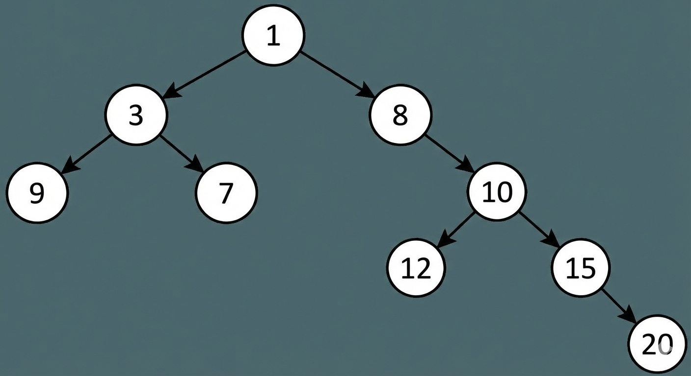
Step 1: Construct the Cartesian Tree
For the sequence [9, 3, 7, 1, 8, 12, 10, 15, 20], the smallest element 1 is the root and the tree is as follows:
Image generated using Nano Banana Pro.

Slide 20
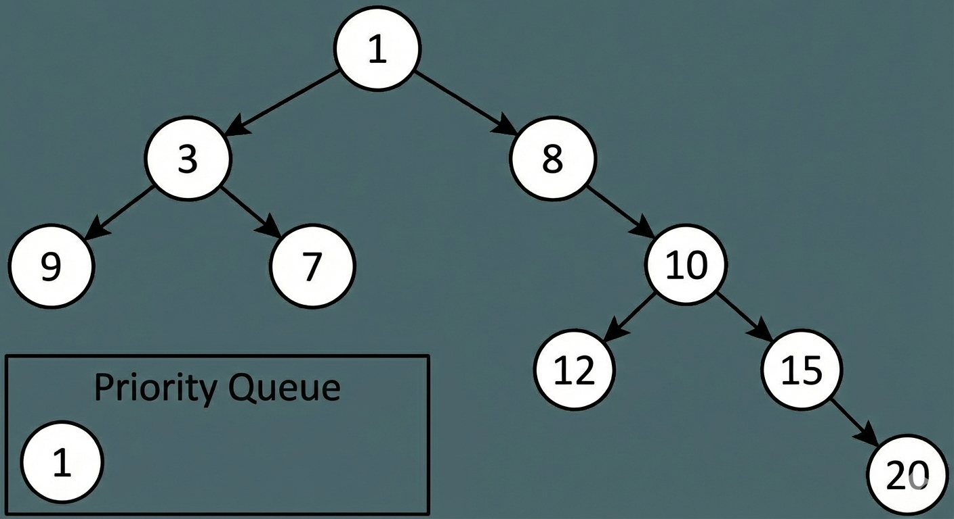
Step 2: Initialization
Initialize the priority queue, Q.
Image generated using Nano Banana Pro.

Slide 21
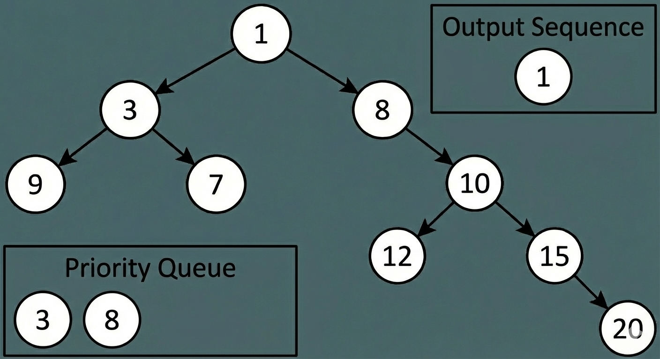
The Beginning of the Loop
We find and remove the minimum value (1) from Q. We add 1 to our output sequence. We add the children of 1 from the Cartesian tree, which are 3 and 8, to Q.
Image generated using Nano Banana Pro.

Slide 22
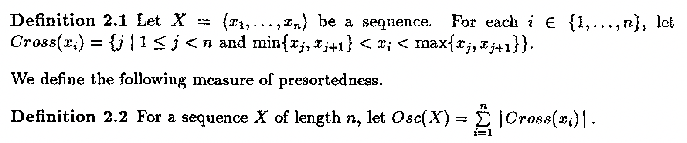
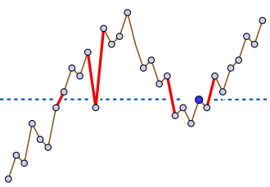
Analysis
The running time for Cartesian-tree Priority Queue sort is O(n log n) in the worst case, just like heapsort.
We can do a finer analysis by considering an oscillation measure, Osc(X), for the input sequence, X.
Pairs of consecutive sequence values (shown as the thick red edges) that bracket a sequence value (the darker blue point). The cost of including this value in the sorted order produced by the Levcopoulos–Petersson algorithm is proportional to the logarithm of this number of bracketing pairs.

Slide 23
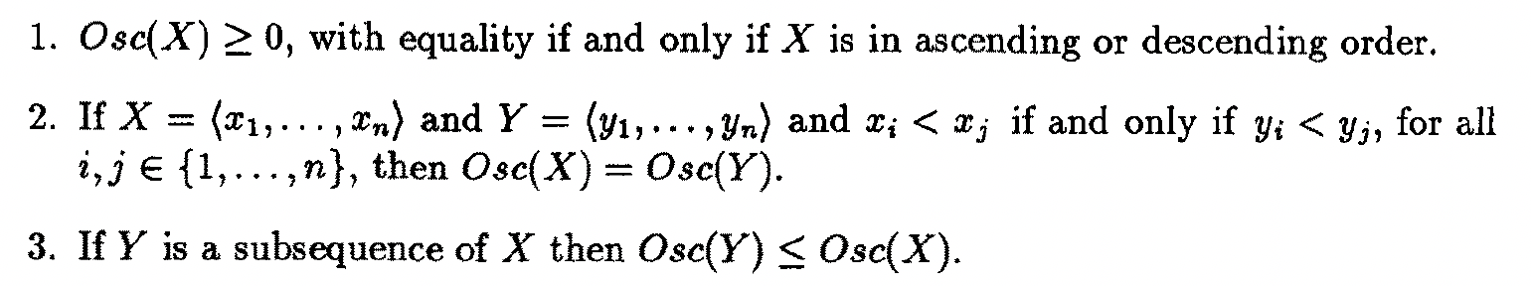
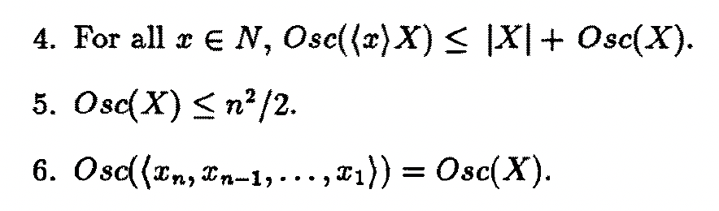
Properties of Osc(X)
This oscillation measure has the following properties:

Slide 24
ExtractMin Lemma
When an element x_{i} is removed from the priority queue, Q, there are O(|Cross(x_{i})|) elements in Q.
These elements have already been removed when we remove x_{i}.
x_{i}
For each red edge, there is at most one element currently in Q.

Slide 25
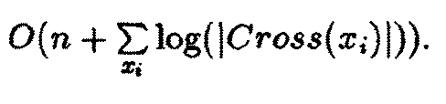
The Running Time Lemma
The running time for Cartesian-tree Priority Queue sort is
Proof:
By the ExtractMin Lemma, the size of the priority queue is O(|Cross(x_{i})|) when x_{i} is removed.
When x_{i} is removed, we add two more elements to Q.
Thus, processing each x_{i} takes O(log |Cross(x_{i})|) time.

Slide 26
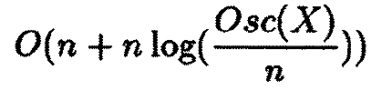
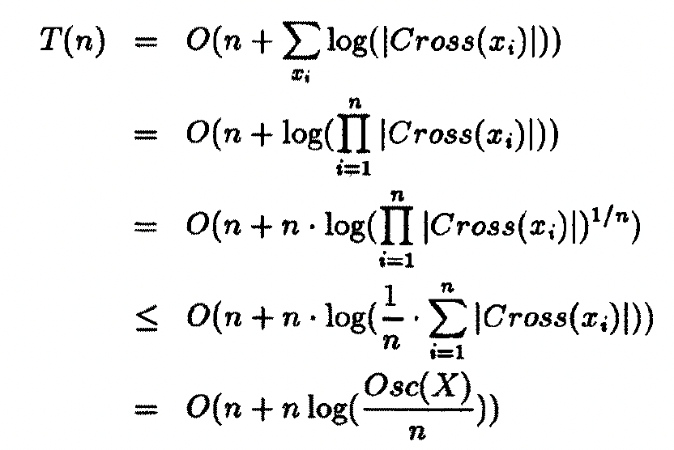
Total Running Time
The total running time for Cartesian-tree Priority Queue sort is
Proof:
because of the inequality for geometric and arithmetic averages.

