Slide 1
Entropy-Sensitive Sorting
Michael T. Goodrich
University of California, Irvine
Some slides adapted from material from Ian Munro, Sabastian Wild, and Wikipedia.

Slide 2
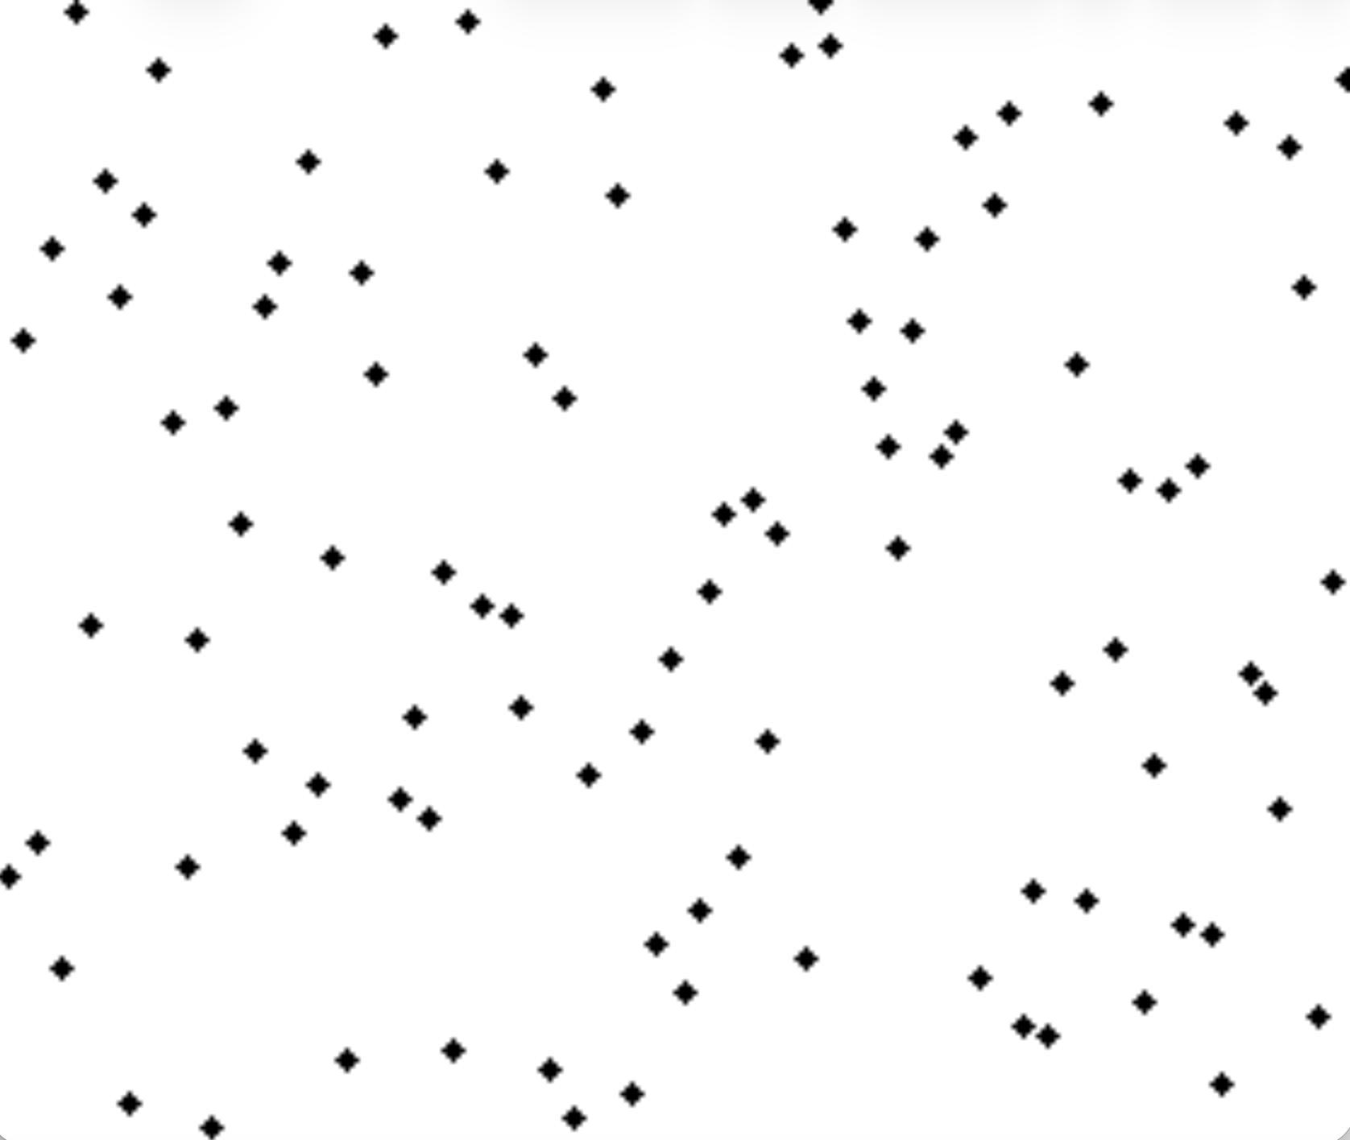
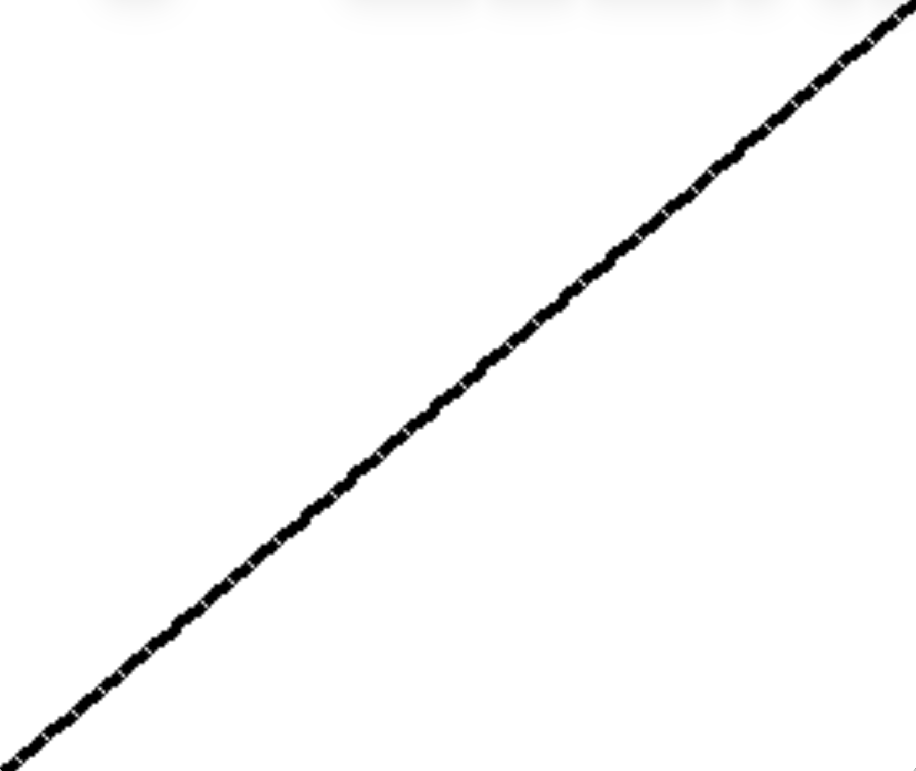
Recall the Sorting Problem
Given an array, A, of n elements, reorder the elements to be in nondecreasing order.

Slide 3
Worst-Case Running Time for Sorting
There are several comparison-based algorithms that sort in O(n log n) time in the worst case:
Heap-sort
Merge-sort
Quick-sort (runs in O(n log n) time with high probability)
Note: if we can assume that all keys are integers in the range from 0 to N (or even N^{c} for some constant, c), we can sort in O(n + N) time using radix-sort, but this is not a comparison-based algorithm.

Slide 4
Comparison-Based Sorting
Many sorting algorithms are comparison based.
They sort by making comparisons between pairs of objects
Examples: bubble-sort, selection-sort, insertion-sort, heap-sort, merge-sort, quick-sort, ...
Let us therefore derive a lower bound on the running time of any algorithm that uses comparisons to sort n elements, x₁, x₂, …, x_{n}.
Is x_{i} < x_{j}?
no
yes

Slide 5
Counting Comparisons
Let us just count comparisons then.
Each possible run of the algorithm corresponds to a root-to-leaf path in a decision tree

Slide 6
Decision Tree Height
The height of the decision tree is a lower bound on the running time
Every input permutation must lead to a separate leaf output
If not, some input …4…5… would have same output ordering as …5…4…, which would be wrong
Since there are n!=1⋅2 ⋅ … ⋅n leaves, the height is at least log (n!)

Slide 7


Sorting Lower Bound
Any comparison-based sorting algorithms takes at least log n! time (assuming all permutations are possible).
Stirling’s Approximation:
Therefore, any comparison-based sorting algorithm must run in Ω(n log n) time.
or

Slide 8
Skip-List Insertion Sort
Expected running time is O(n(1+ log (1+Inv(A)/n))).
Can beat the worst-case sorting lower bound in inputs with a smaller than worst-case number of inversions.
S₃ S₂ S₁ S₀
−∞
+∞
−∞
31
+∞
−∞
23
31
34
64
+∞
−∞
12
23
26
31
34
44
56
64
78
+∞

Slide 9
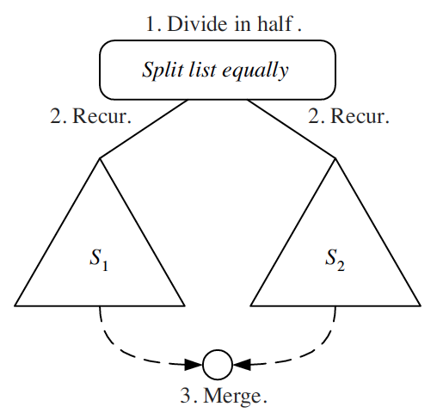
Review: Divide-and-Conquer
Divide-and conquer is a general algorithm design paradigm:
Divide: divide the input data S in two disjoint subsets S₁ and S₂
Recur: solve the subproblems associated with S₁ and S₂
Conquer: combine the solutions for S₁ and S₂ into a solution for S
The base case for the recursion are subproblems of size 0 or 1

Slide 10
The Merge-Sort Algorithm
Merge-sort on an input sequence S with n elements consists of three steps:
Divide: partition S into two sequences S₁ and S₂ of about n/2 elements each
Recur: recursively sort S₁ and S₂
Conquer: merge S₁ and S₂ into a unique sorted sequence
Algorithm mergeSort(S)
Input sequence S with n elements
Output sequence S sorted
according to C
if S.size() > 1
(S₁, S₂) ← partition(S, n/2)
mergeSort(S₁)
mergeSort(S₂)
S ← merge(S₁, S₂)

Slide 11
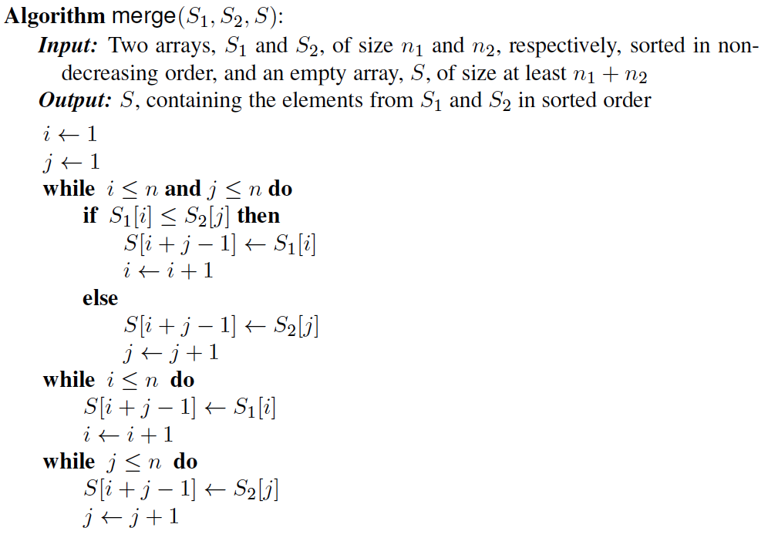
Merging Two Sorted Sequences
The conquer step of merge-sort consists of merging two sorted sequences A and B into a sorted sequence S containing the union of the elements of A and B
Merging two sorted sequences, each with n/2 elements and implemented by means of a doubly linked list, takes O(n) time

Slide 12
Merge-sort Tree
An execution of merge-sort is depicted by a binary tree
each node represents a recursive call of merge-sort and stores
the leaves are calls on subsequences of size 0 or 1
The sum of the cost across all calls on a single level is O(n).
There are O(log n) levels; hence, the total time is O(n log n).
7 2 ⏐ 9 4 → 2 4 7 9
7 ⏐ 2 → 2 7
9 ⏐ 4 → 4 9
7 → 7
2 → 2
9 → 9
4 → 4

Slide 13
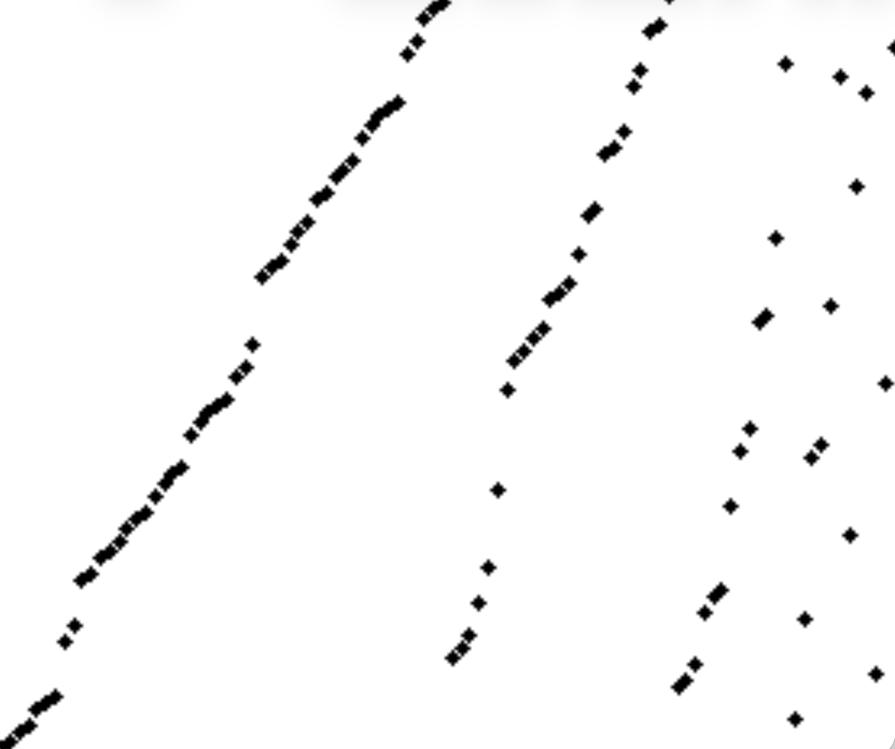
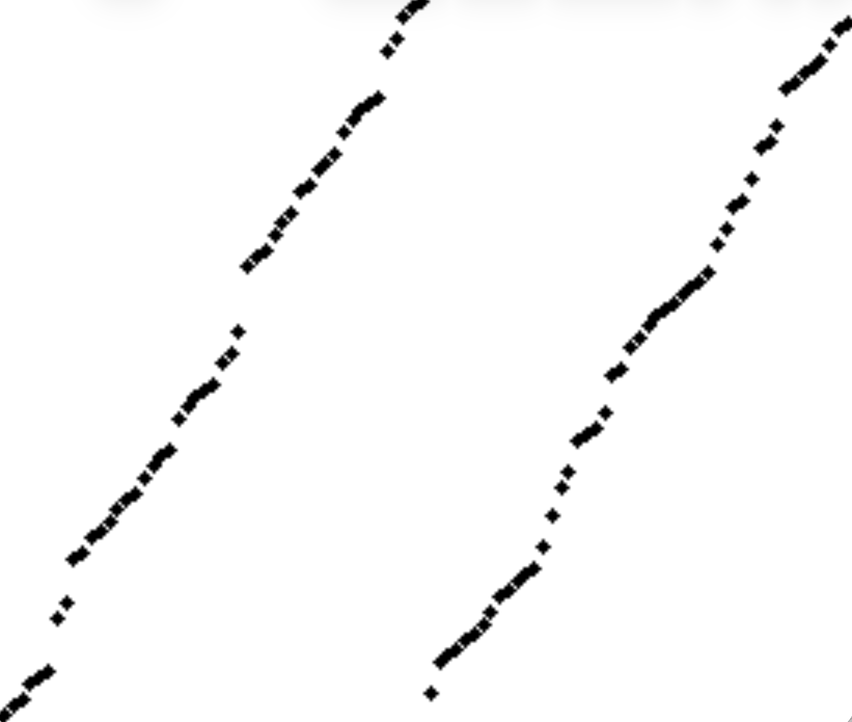
Pre-sortedness Based On Runs
A run is a sequence of non-decreasing contiguous cells in the input array.
6 runs: some long, some short
2 runs: both long

Slide 14
Natural Merge-Sort
The term “natural merge-sort” was coined by Don Knuth to refer to a merge-sort algorithm that starts with the maximal runs in an input array as the leaf-level inputs.
All the maximal runs can be found in O(n) time.
This natural merge-
sort algorithm
takes O(n log R)
time, where R is the
number of runs.
But it is not
sensitive to the
fact that some runs
are long and some
are short.

Slide 15
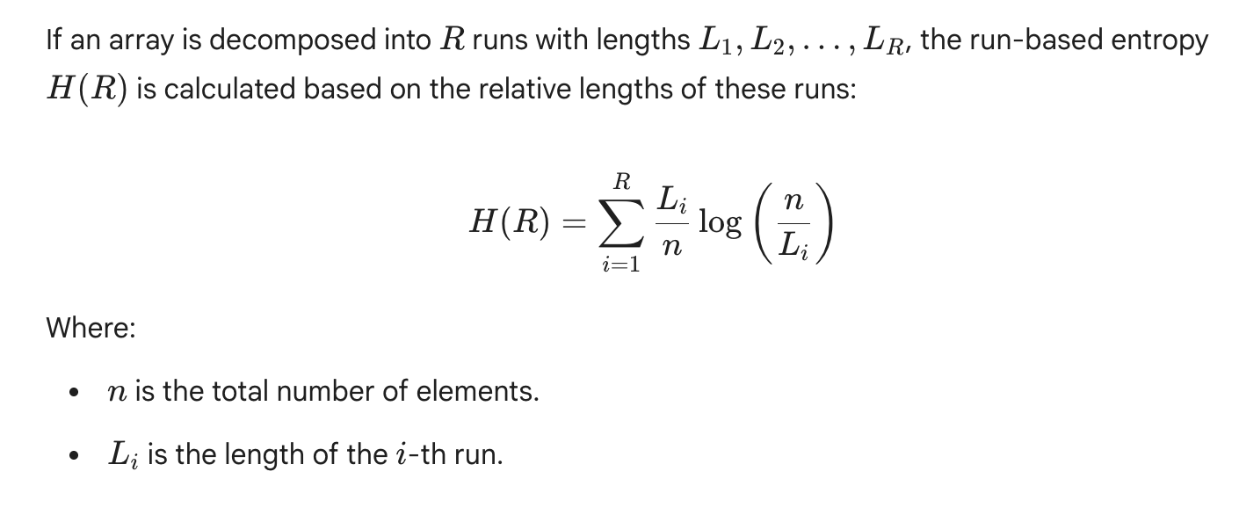
Run-Based Entropy

Slide 16
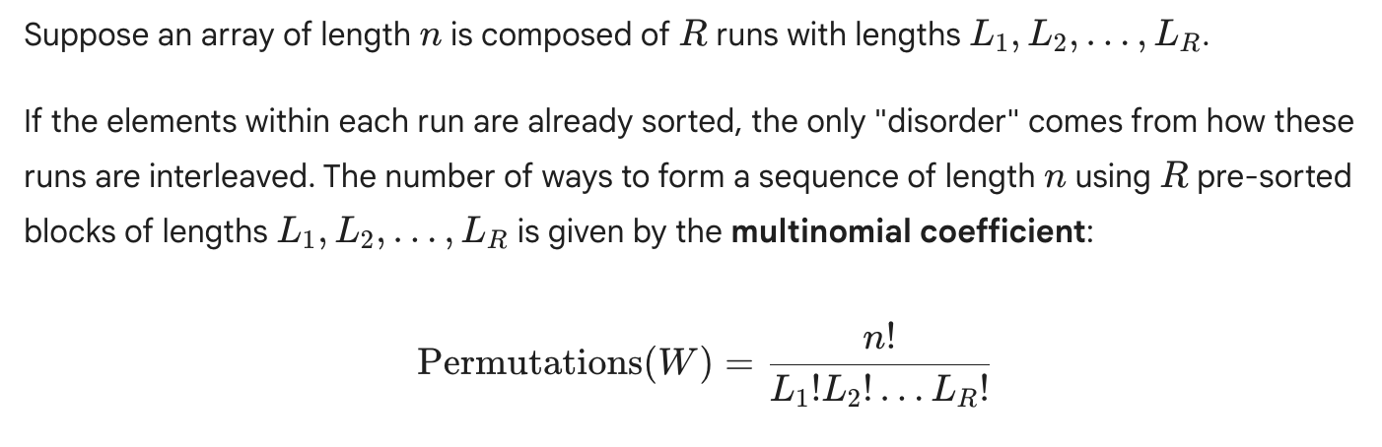
Entropy Sorting Lower Bound
Theorem: The running time for sorting a sequence of size n is Ω(n H(R)).
Proof uses the multinomial coefficient for the number of permutations in the set, W, of all possible inputs:

Slide 17
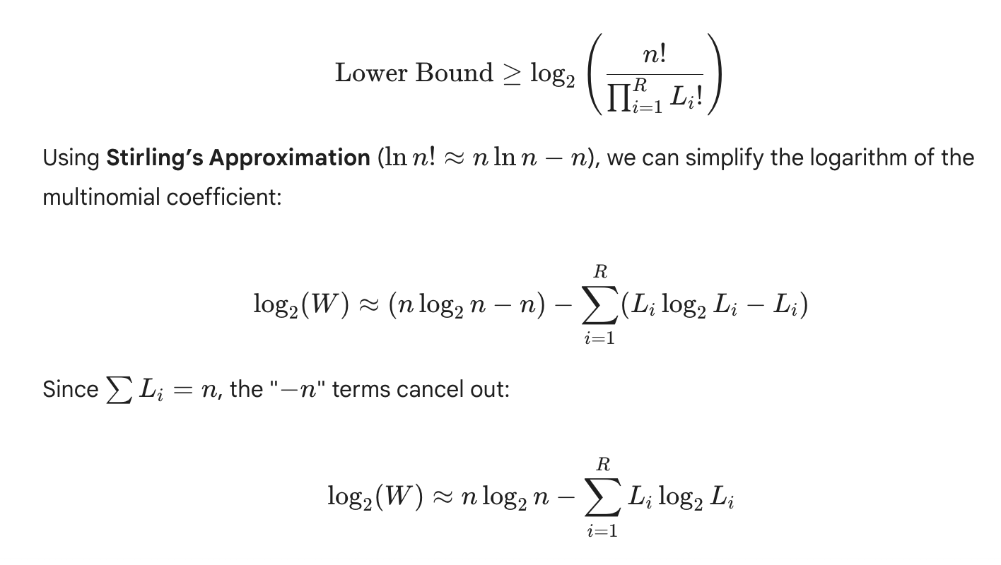
Proof of Entropy-Based Sorting Lower Bound

Slide 18
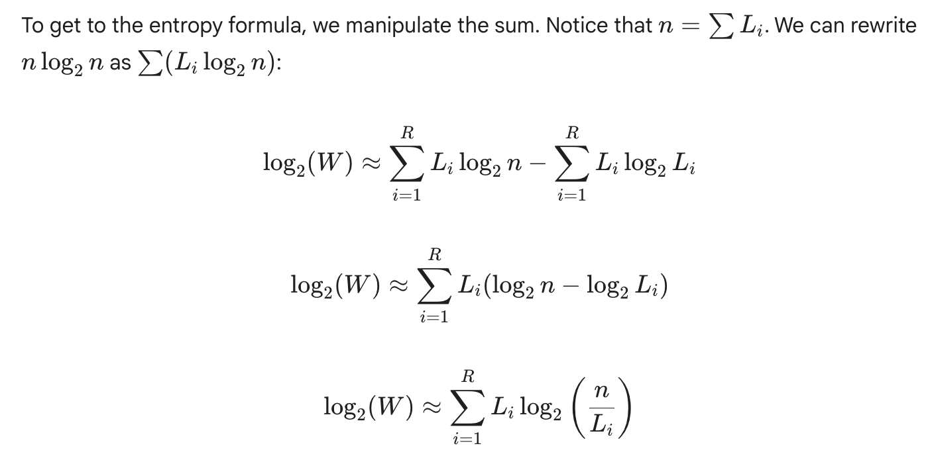
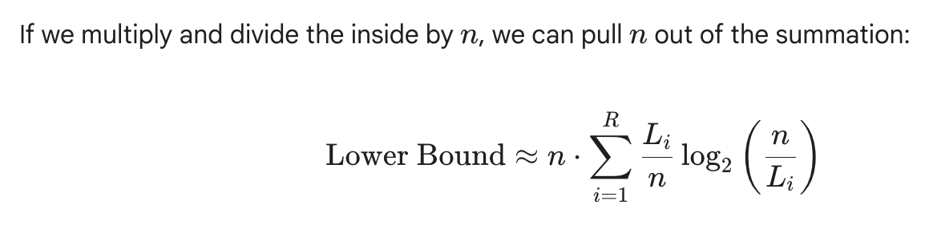

Completing the Proof
=

Slide 19
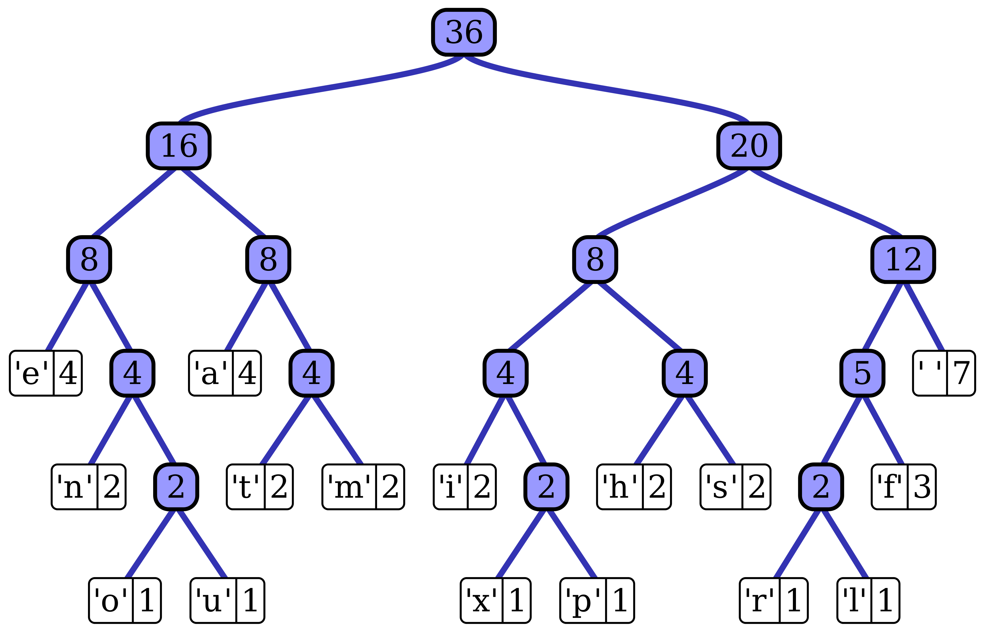
Building a Better Merge-sort Tree
Let’s try to design a better merge-sort algorithm by building a better merge-sort tree, which is sensitive to the run-based entropy.
Idea: Use a Huffman tree, where the “frequencies” or “probabilities” assigned to leaves are the run sizes.
Public domain image of a Huffman tree from Wikipedia.

Slide 20
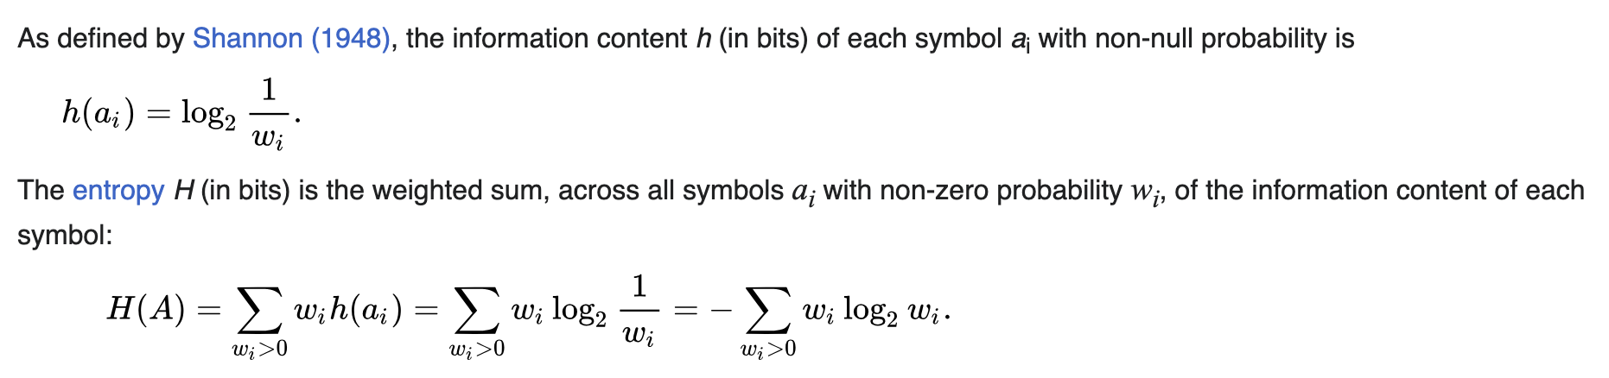
Huffman Tree Idea: Good News
Huffman tree method: Given a set of symbols and their probabilities, put each into a leaf subtree and repeatedly combine the two subtrees with smallest weights.
The sum of the depths of all the leaves matches the entropy bound.
For us, the “probability” for leaf i is L_{i} /n.
Public domain image of a Huffman tree from Wikipedia.

Slide 21
Huffman Tree Idea: Bad News
The textbook algorithm for building a Huffman tree takes O(n log n) time, where n is the number of leaves.
In our case, we have R leaves, so the time needed to build the Huffman tree is O(R log R), which is too large, e.g., if R is Ω(n).
Public domain image of a Huffman tree from Wikipedia.

Slide 22
Huffman Tree Idea: The Fix
Since run lengths are integers between 1 and n, we can sort the runs by their lengths in O(n) time by radix-sort. Then we can construct the Huffman tree in O(R) time.
If the symbols (i.e., runs) are sorted by probability (i.e., run lengths), there is a linear-time method to create a Huffman tree using two queues, the first one (Queue A) containing the initial weights (along with pointers to the associated leaves), and combined weights (along with pointers to the trees) being put in the back of the second queue (Queue B).
This assures that the lowest weight is always kept at the front of one of the two queues, and the second lowest weight is right after the lowest weight in the same queue or it is at the front of the other queue.

Slide 23
Huffman Tree Idea: The Fixed Algorithm
Start with as many leaves as there are symbols.
Enqueue all leaf nodes into Queue A (by probability in increasing order so that the least likely item is in the head of the queue).
While there is more than one node in the queues:
Dequeue the two nodes with the lowest weight by examining the fronts of both queues.
Create a new internal node, with the two just-removed nodes as children (either node can be either child) and the sum of their weights as the new weight.
Enqueue the new node into the rear of Queue B.
The remaining node is the root node; the tree has now been generated.

Slide 24
Huffman Tree Idea: Proof
The reason this algorithm works:
Queue A is sorted by definition (the input).
Queue B will naturally be sorted. Because we always pick the two smallest available values to create a new sum, each new sum added to Queue B will be equal to or greater than the previous sum added to Queue B.
Since we only ever look at the front of the queues and add to the back, every operation is O(1). We perform this R - 1 times, resulting in a total complexity of O(R).
Drawbacks: We need to explicitly build the merge tree, and the order of merges is likely different than the ordering of the runs (which is bad for cache misses and can cause the sorting method to not be stable).

Slide 25
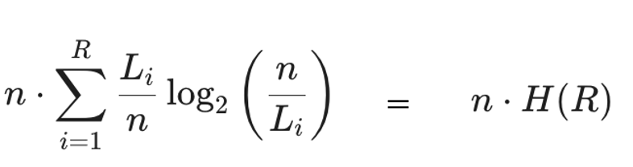
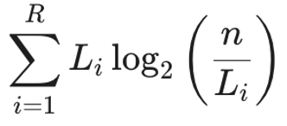
Weight-Balanced Binary Search Trees
Suppose we want to build a binary search trees on weighted elements, such that element i has weight w_{i} and the depth of each element is O(log W/w_{i}), where W is the sum of the weights.
Then taking w_{i} = L_{i}, the sum of the depths of all the leaf elements in each run is proportional to
Thus, using such a tree as a merge tree gives an entropy-sensitive sorting algorithm.
=

Slide 26
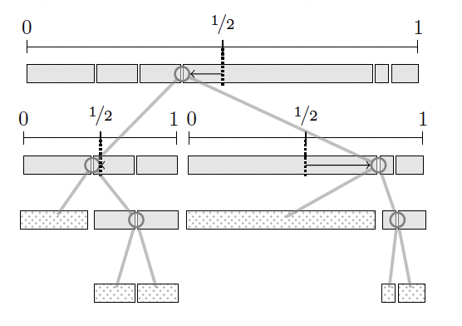
Method 1 for a Weighted BST
Normalize run lengths to sum to 1.
Choose the split closest to the midpoint of the subtree’s actual weights (1/2 after (re)normalizing)
Recursively split the left and right children (renormalizing based on the sum of the sizes of their respective sets of runs).

Slide 27
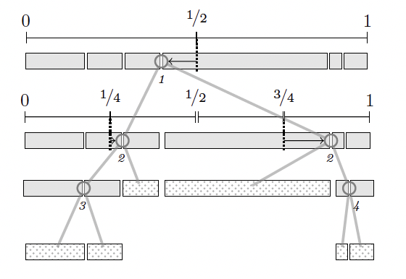
Method 2 for a Weighted BST
Normalize run lengths to sum to 1.
Choose the split closest to the midpoint of the subtree’s assigned subinterval.
Recursively split the left and right children (but don’t renormalize weights).

Slide 28
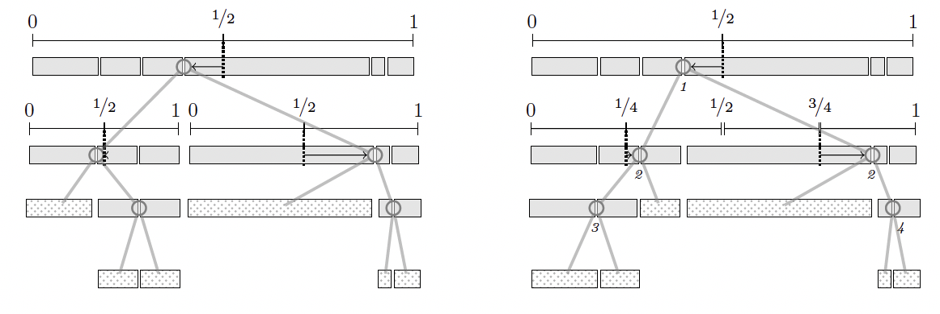
Method 1 and 2 Both Work
Both Method 1 and 2 build a binary search tree on weighted elements, such that element i has weight w_{i} and the depth of each element is O(log W/w_{i}), where W is the sum of the weights.

Slide 29
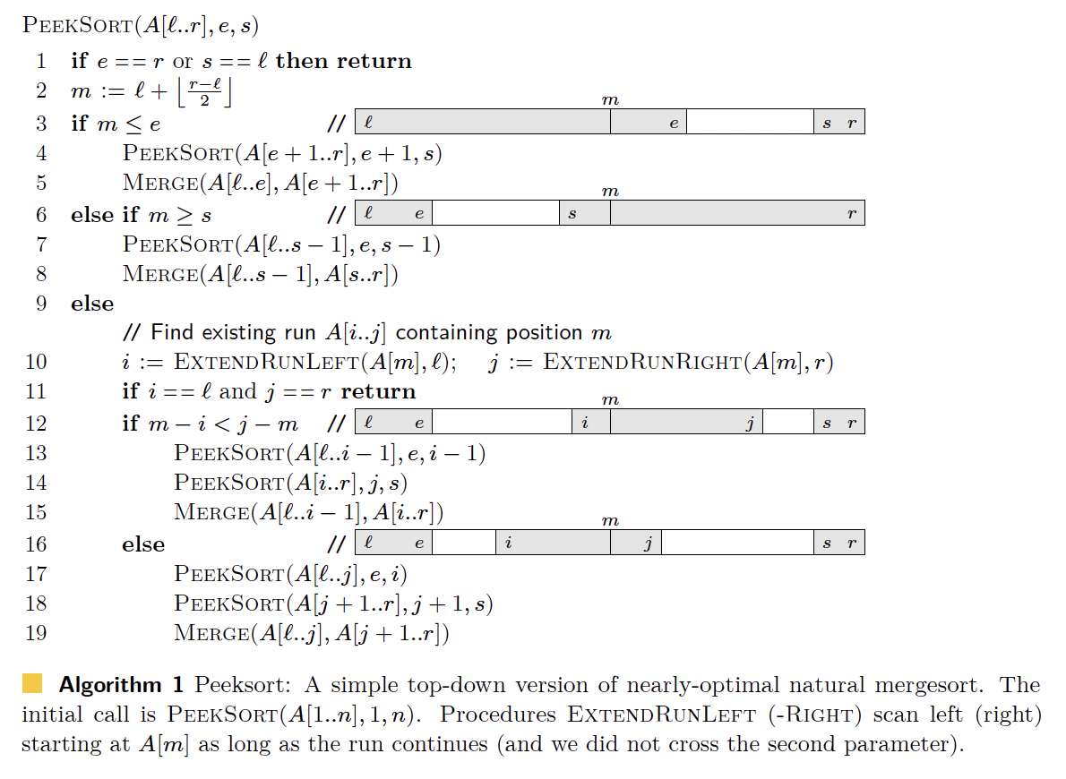
Method 1 Leads to Peeksort

Slide 30
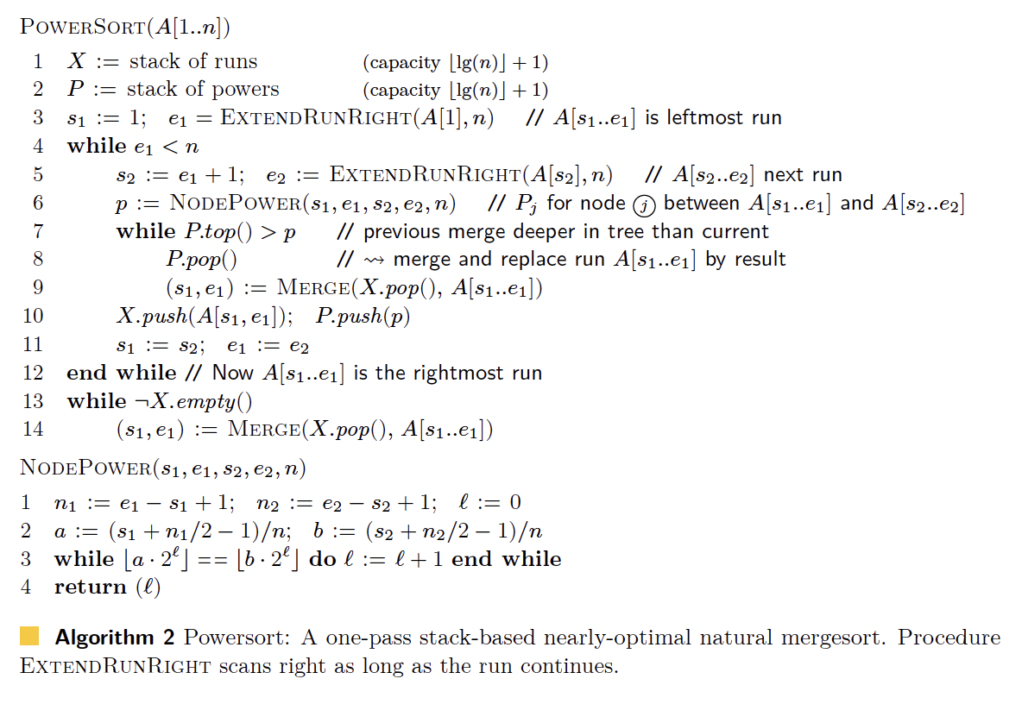
Method 2 Leads to Powersort

Slide 31
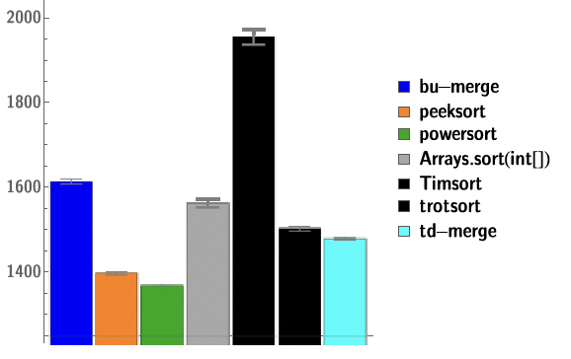
Both Are Good, Powersort is a Little Better
Both Peeksort and Powersort run in time O(n(1+H(R)), and both are fast in practice.
Powersort is now the reference sorting algorithm in the PyPy JIT Python complier, CPython, NumPy, and AssemblyScript.

