Slide 1
Combinatorial Group Testing
Michael T. Goodrich
University of California, Irvine

Slide 2
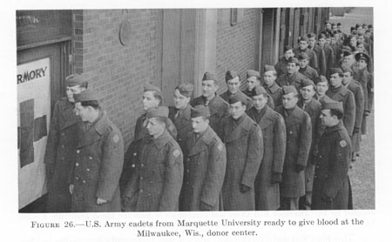
Group Testing
Input: n items, numbered 0,1, …, n-1, at most d of which are defective.
Output: the indices of the defective items.
Items can be grouped into subsets, each of which can be tested to see it contains a defective item or not.
Goal: minimize the total number of tests
Original problem: Testing blood samples.

Slide 3

Testing Schemes
Non-adaptive: All tests must be done in parallel.
Adaptive: Tests can be done sequentially.
Adaptive is easier, but the non-adaptive approach has wider applications.
In some applications, high probability of success is sufficient.
Others require 0% errors.
Semi-adaptive: Do tests in a sequence of rounds, where the tests in each round are done in parallel.

Slide 4
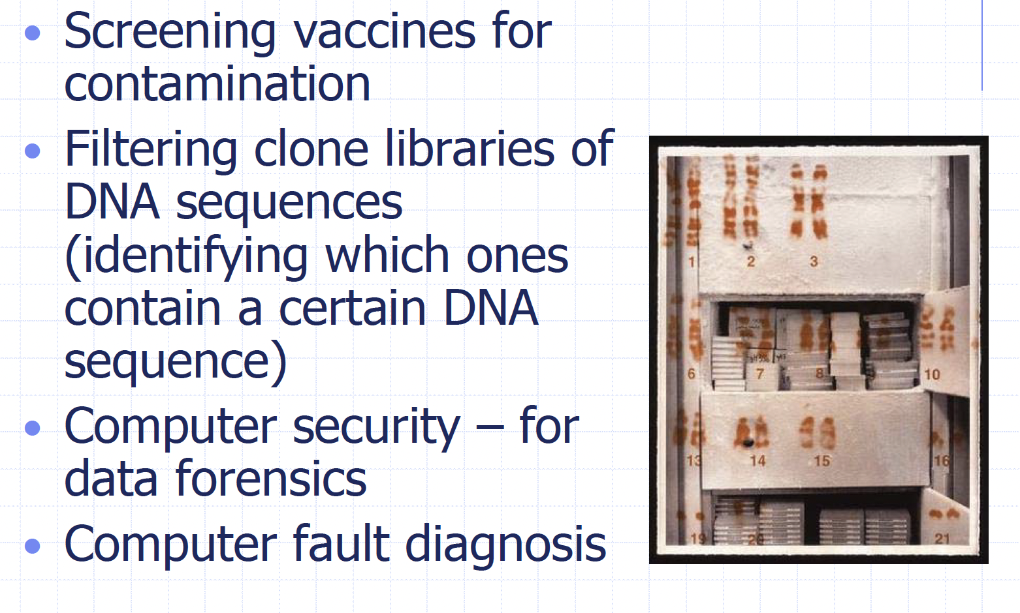
Applications

Slide 5
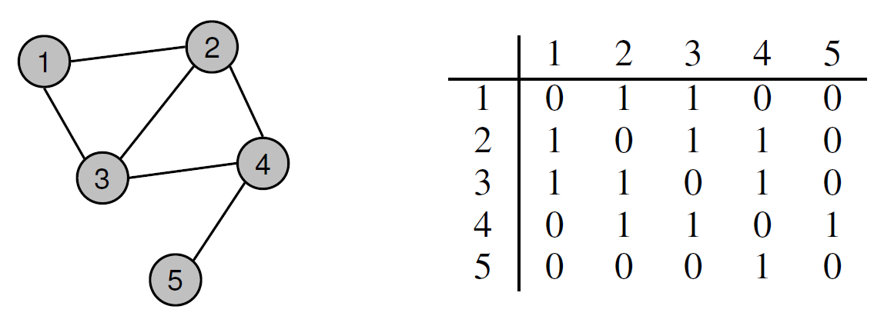
Application: Learning Attribute Vectors
Viewed abstractly, we are trying to learn a database X of g attribute vectors:

Slide 6

Facebook Application
Each member has a “vector” of friendships
For any member M, the system returns a bit for whether M has a friend in common with the attacker, even if M restricts this information to friends-of-friends
We can use non-adaptive scheme to learn friendship relationships in any sub-community in Facebook

Slide 7
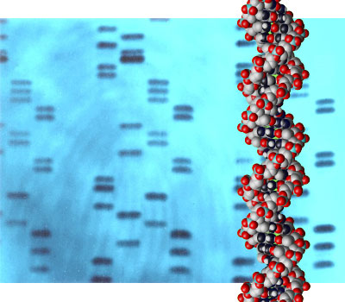
DNA Application
DNA sequences are stored in a database, D.
For any sequence Q, the database returns a score for how close Q is to each sequence in D
We form a binary vector w.r.t. places where mutations happen relative to a reference string R
We can use non-adaptive scheme to learn DNA strings in D.

Slide 8

Netflix Application
Movie ratings vectors are stored in a database, D.
For any vector V, the database returns a score for how close V is to each vector in the database
We can form a binary attribute vector for movies
We can use non-adaptive scheme to learn ratings vectors in D.

Slide 9
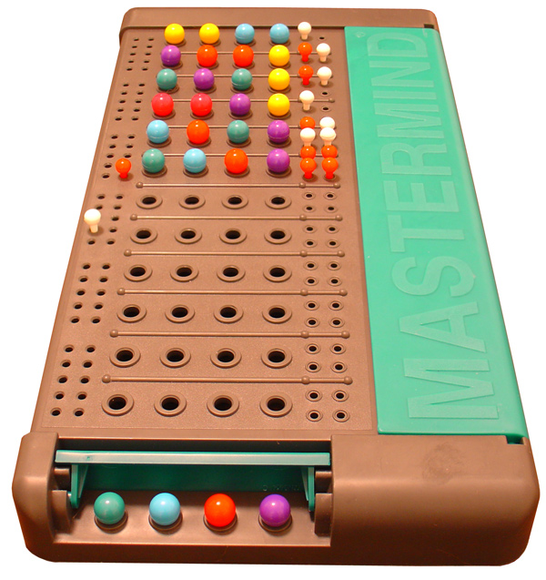
Mastermind
Mastermind is a two-player game
A codemaker: creates a vector X of length N using an alphabet of size K (called “colors”)
A codebreaker: guesses vectors Q₁, Q₂, …, of length N using same alphabet
Codemaker scores each guess:
Black score: number of characters in right place
White score: number of characters not in right place but with right color
Image by ZeroOne from http://commons.wikimedia.org/wiki/File:Mastermind.jpg, used under Creative Commons Attribution ShareAlike 2.0 License

Slide 10

Mastermind example
Turn number 1

Slide 11
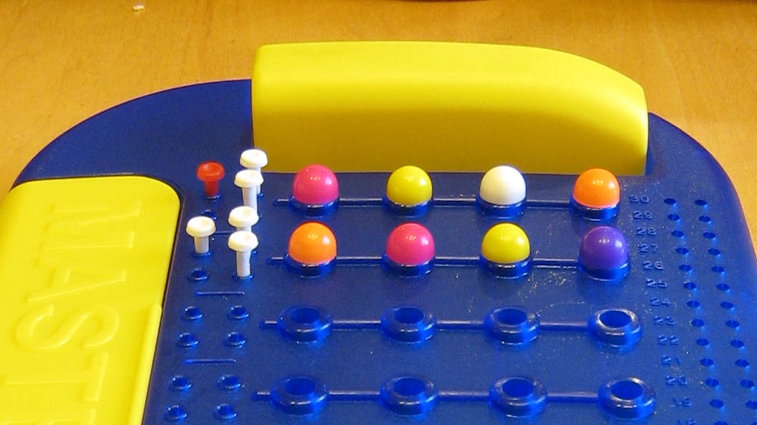
Mastermind example
Turn number 2

Slide 12
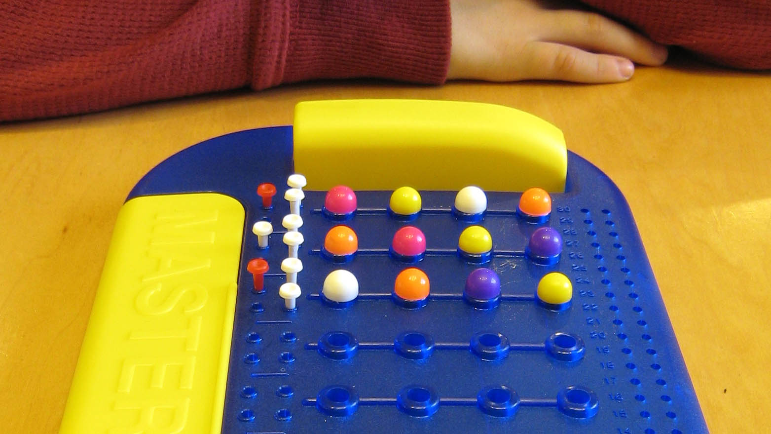
Mastermind example
Turn number 3

Slide 13
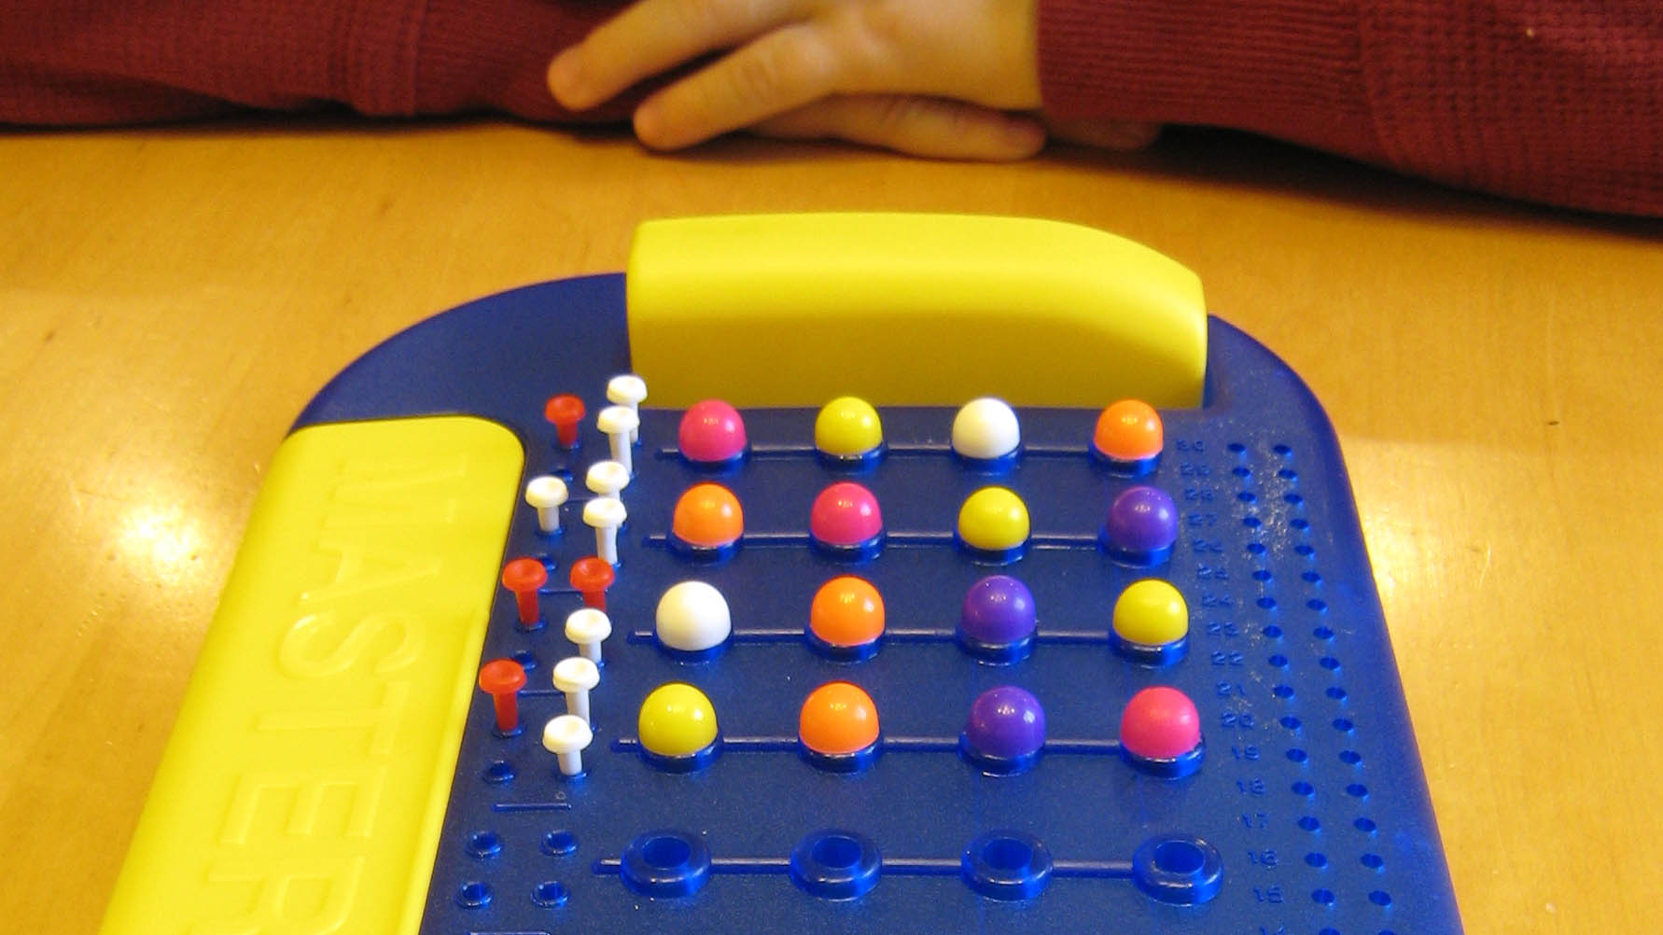
Mastermind example
Turn number 4

Slide 14
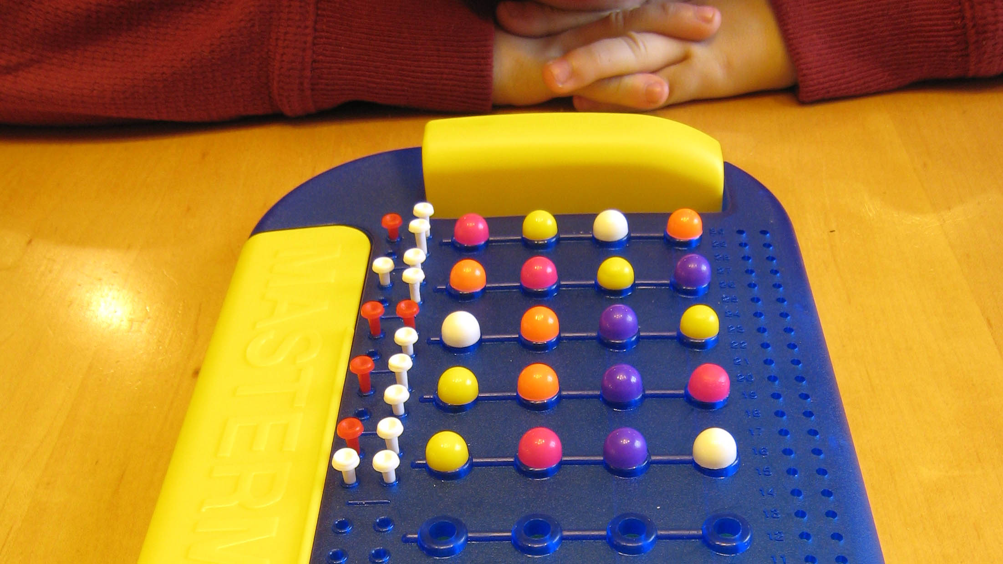
Mastermind example
Turn number 5

Slide 15
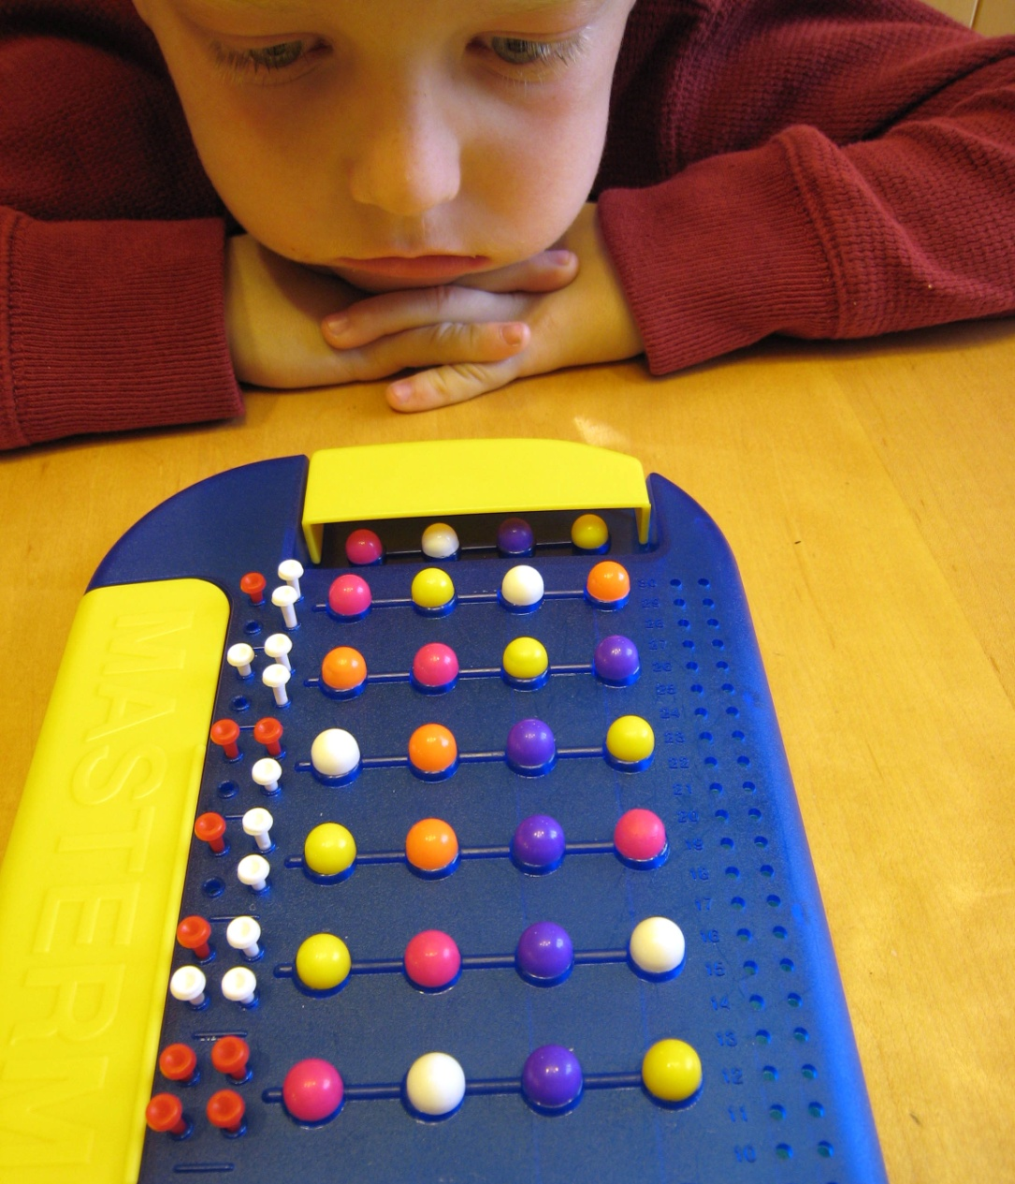
Mastermind example
Solved!

Slide 16

Restricted Mastermind
Goal: Try to guess the secret vector as quickly as possible, in terms of
N = length of vector
K = number of colors
Restriction: use only:
Black score: number of characters in right place
Non-adaptive guesses

Slide 17
Efficiency Measures
t(n,d) = number of tests to identify up to d defectives among n items.
t(n,d) must be Ω(min{n, d log (n/d)}).
A(n,t) = analysis time needed to determine which items are defective (after the tests are done).
time-optimal is A(n,t) is O(t).

Slide 18
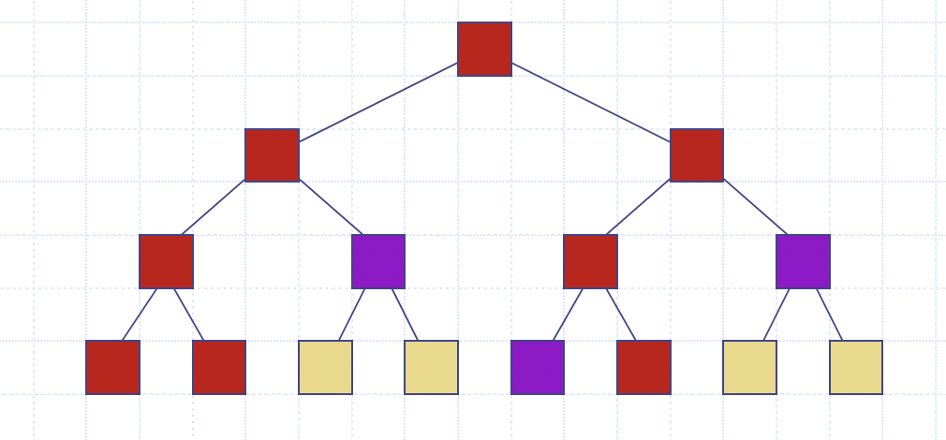
Simple Adaptive Algorithm
For the fully-adaptive case:
Place a complete binary tree “on top of” the items
Do a top-down search to defectives
This will use t(n,d) = O(d log (n/d)) tests.

Slide 19
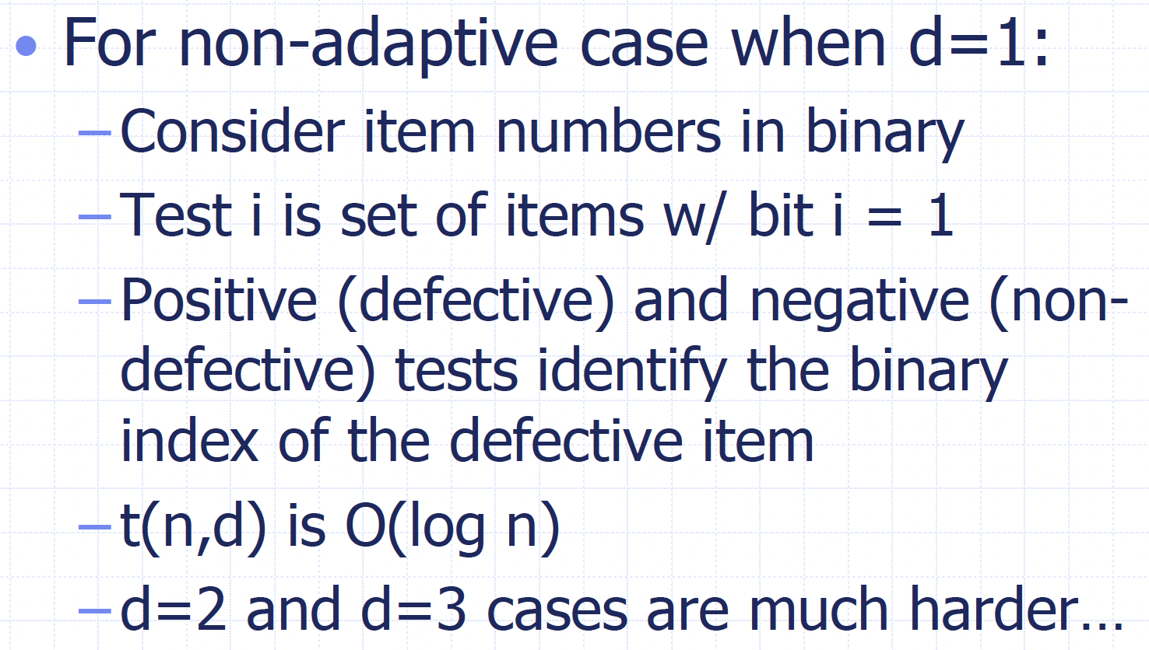
A Simple Nonadaptive Case

Slide 20
Matrix View of Nonadaptive Testing
A non-adaptive testing regimen can be viewed as a t x n binary matrix M:
M[i,j] = 1 if and only if
test i includes item j
M is d-disjunct if the Boolean sum of any d columns does not contain any other column.
An item is defective iff all its tests are positive
M is d-separable if the Boolean sums of each set of at most d columns are distinct (harder analysis algorithm)
n
t
M

Slide 21
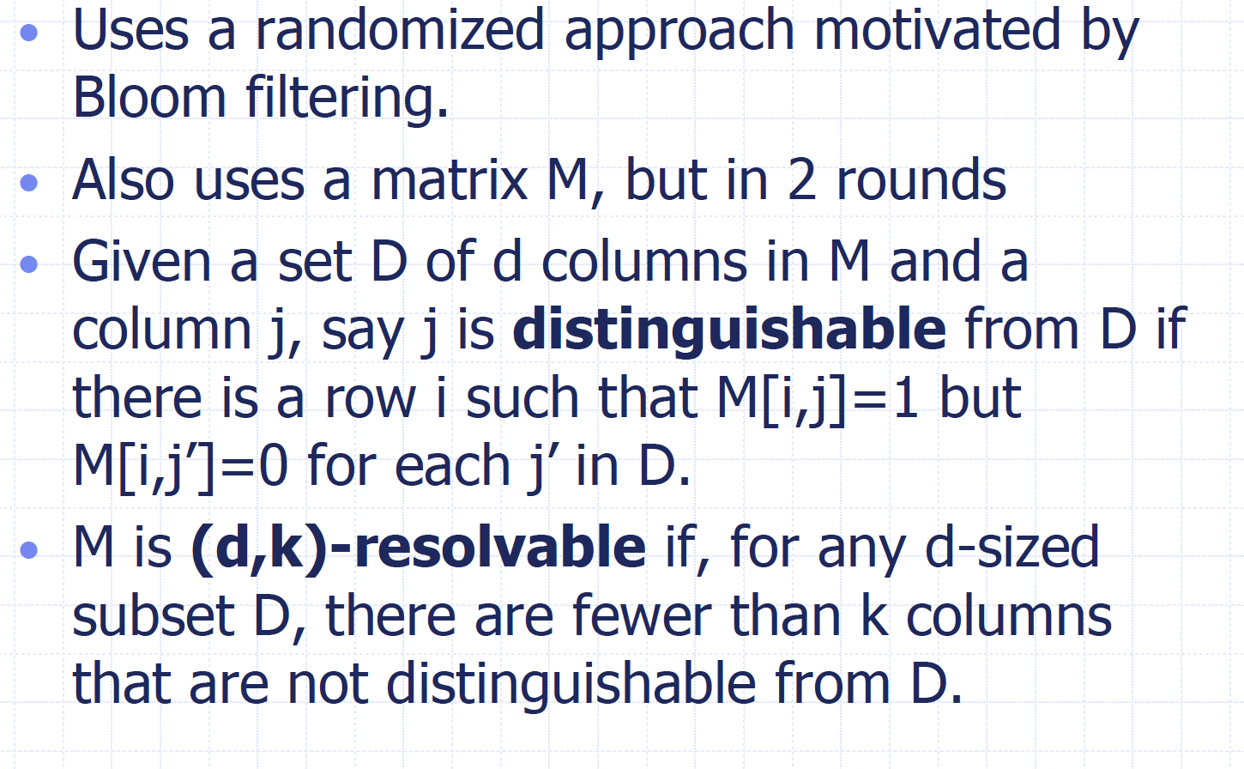
Rake-and-Winnow Algorithm

Slide 22
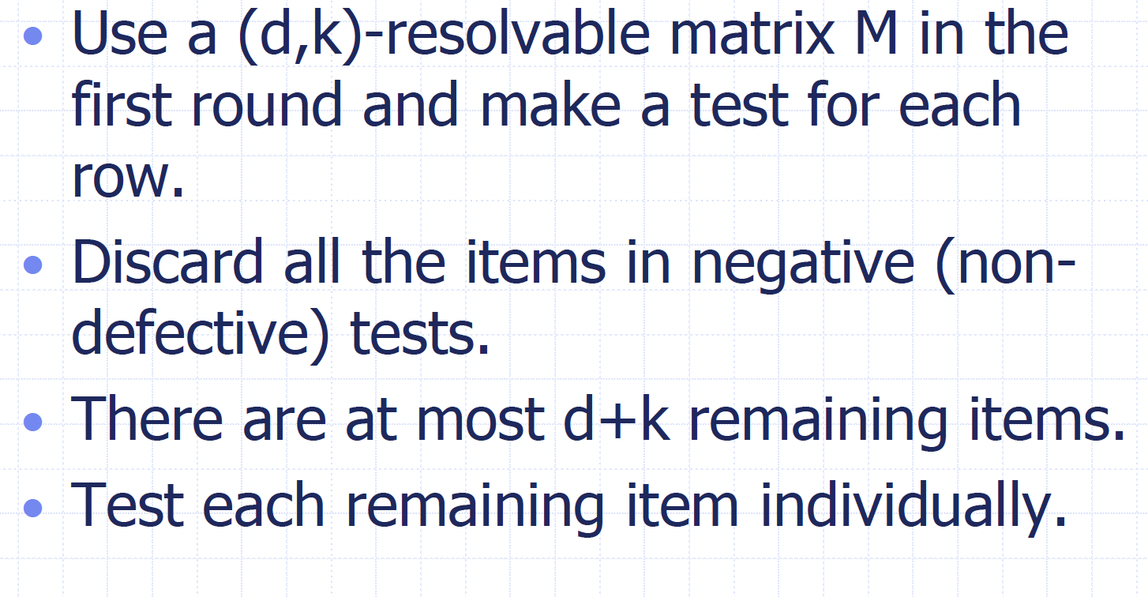
Two-Stage Algorithm

Slide 23
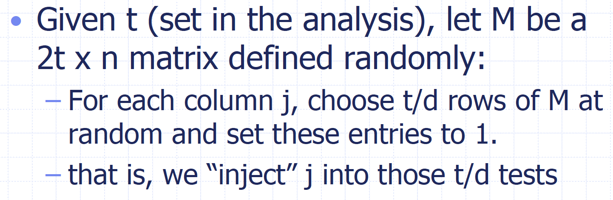
Constructing the Matrix

Slide 24
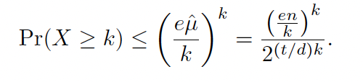
Analysis
Let D be a fixed set of d defectives samples. For each (column) item i in C−D, let X_{i} denote the indicator random variable that is 1 if i is falsely identified as a positive sample by M (that is, i is not included in the set of (negative) items distinguished from those in D), and is 0 otherwise.
X_{i}’s are independent and any Xi is 1 (a false positive) with probability at most 2^{−t/d}.
Therefore, the expected value of the sum, X, E[X], is at most μ = n/2^{t/d}. By a Chernoff bound,
Thus, whp, M is (d,d)-resolvable and we can find all the defectives with 2d tests in a second round.

Slide 25
Recall the Matrix View of Nonadaptive Testing
A non-adaptive testing regimen can be viewed as a t x n binary matrix M:
M[i,j] = 1 if and only if
test i includes item j
M is d-disjunct if the Boolean sum of any d columns does not contain any other column.
An item is defective iff all its tests are positive
n
t
M

Slide 26
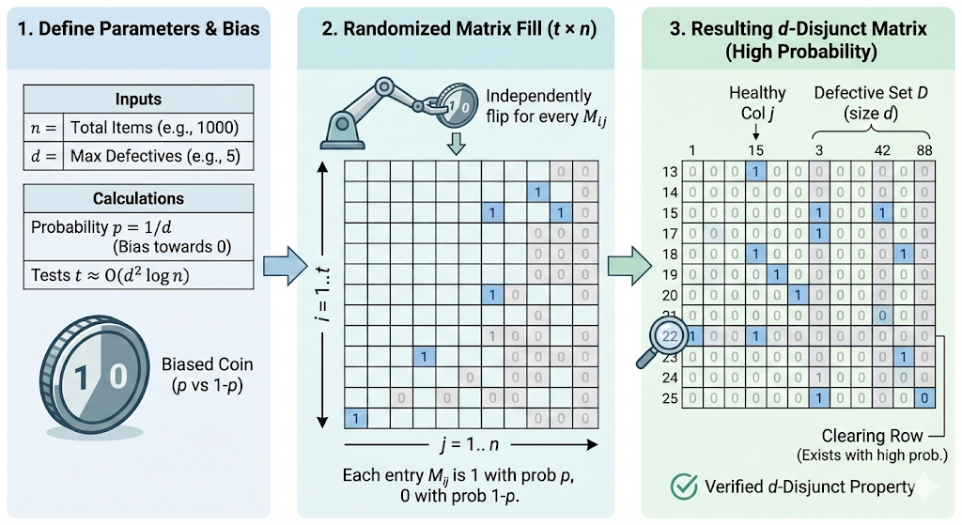
High-Probability Nonadaptive
With high probability, there exists a nonadaptive group test using O(d² log n) tests.
Image generated using Nano Banana Pro.

Slide 27
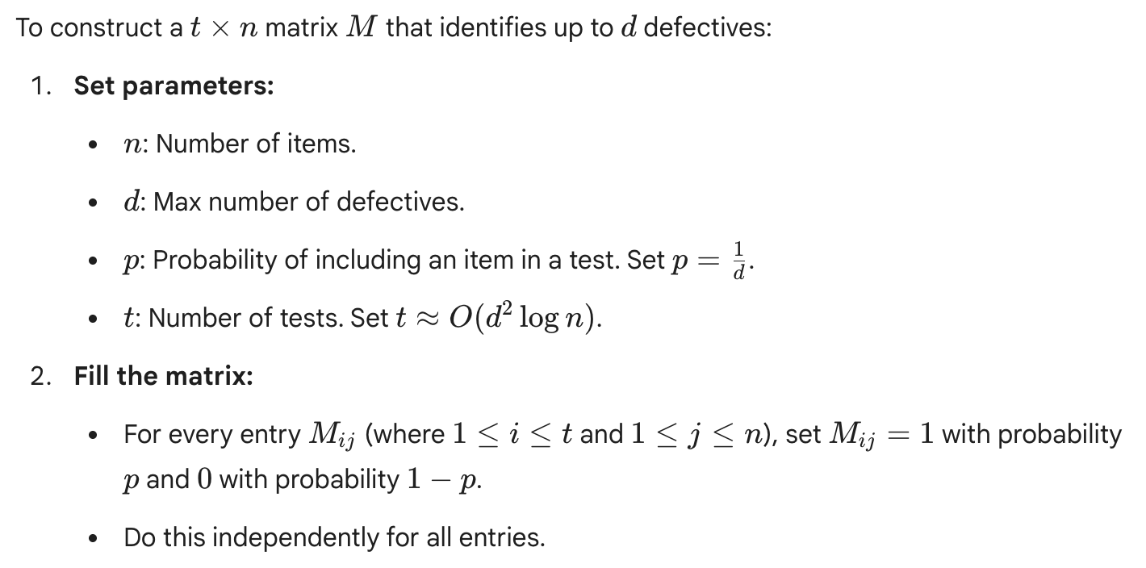
Constructing the Matrix

Slide 28
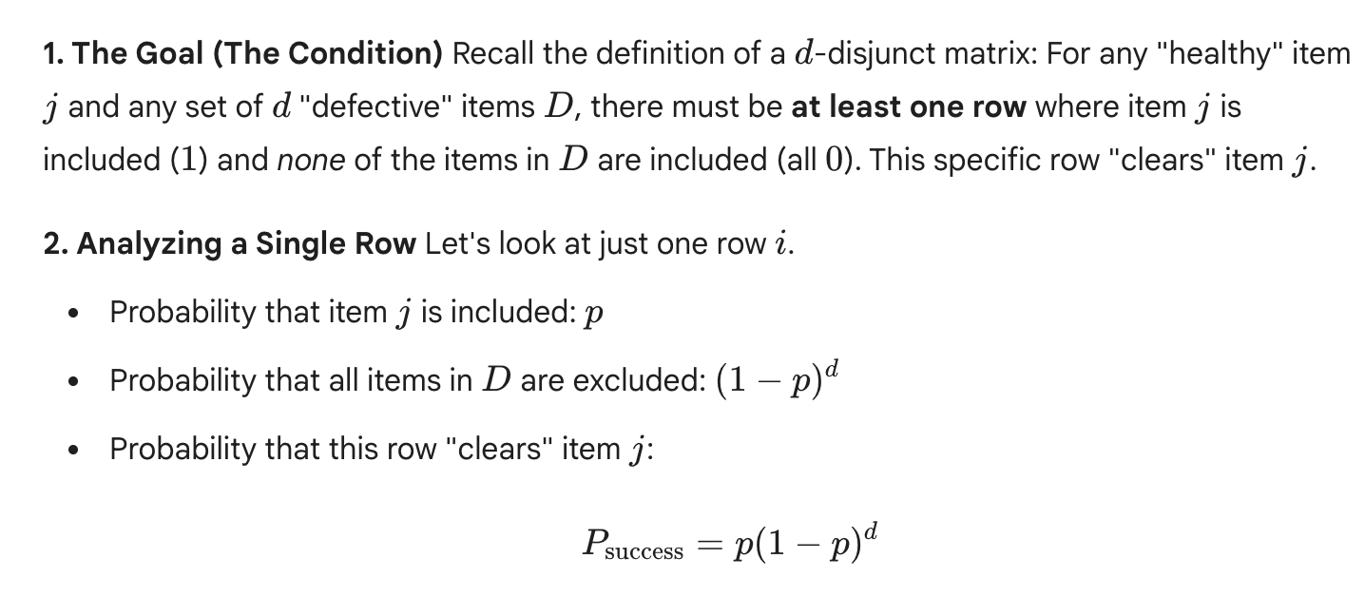
Analysis for Nonadaptive Algorithm

Slide 29
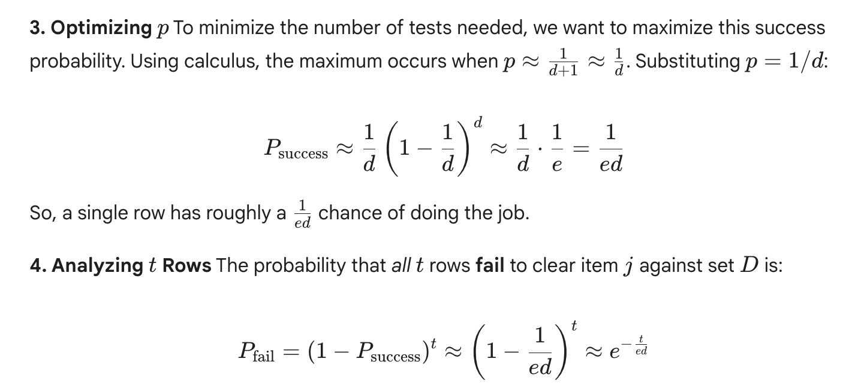
Analysis, Part 2

Slide 30
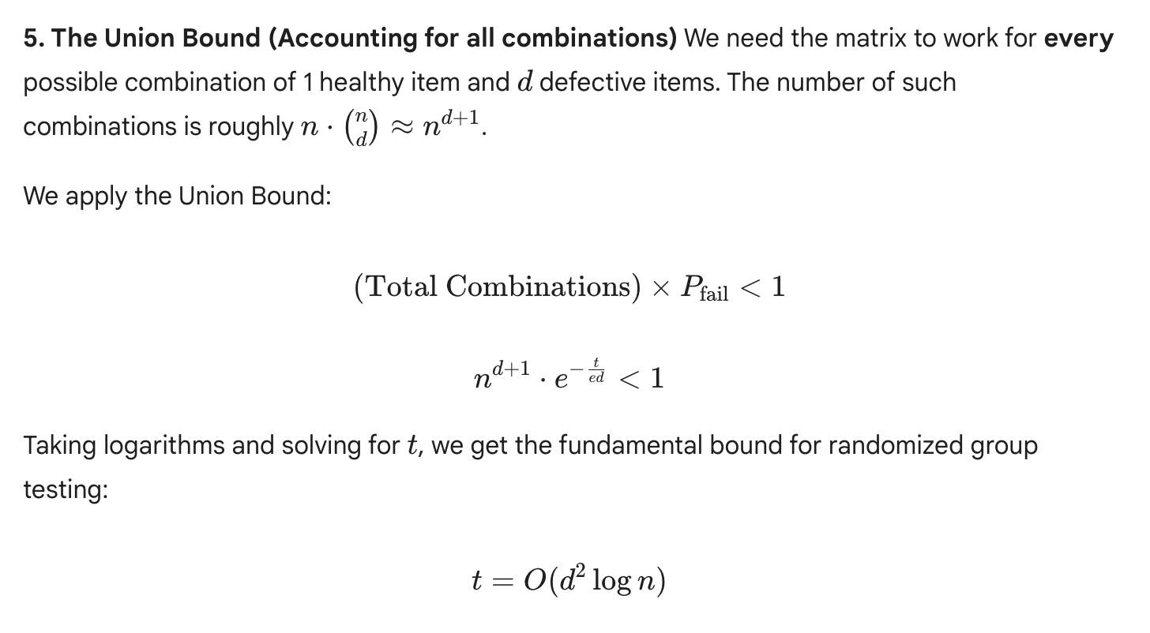
Analysis, Part 3
/n
/n

