Slide 1
Randomized Graph Algorithms
Michael T. Goodrich
University of California, Irvine

Slide 2
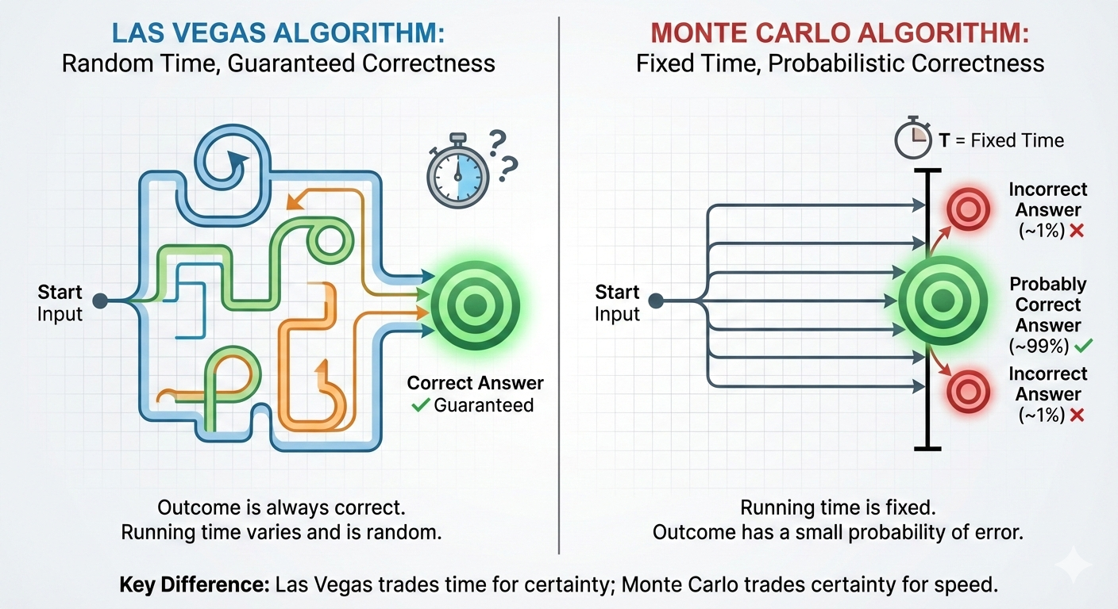
Las Vegas and Monte Carlo Algorithms
Image generated using Nano Banana Pro.

Slide 3
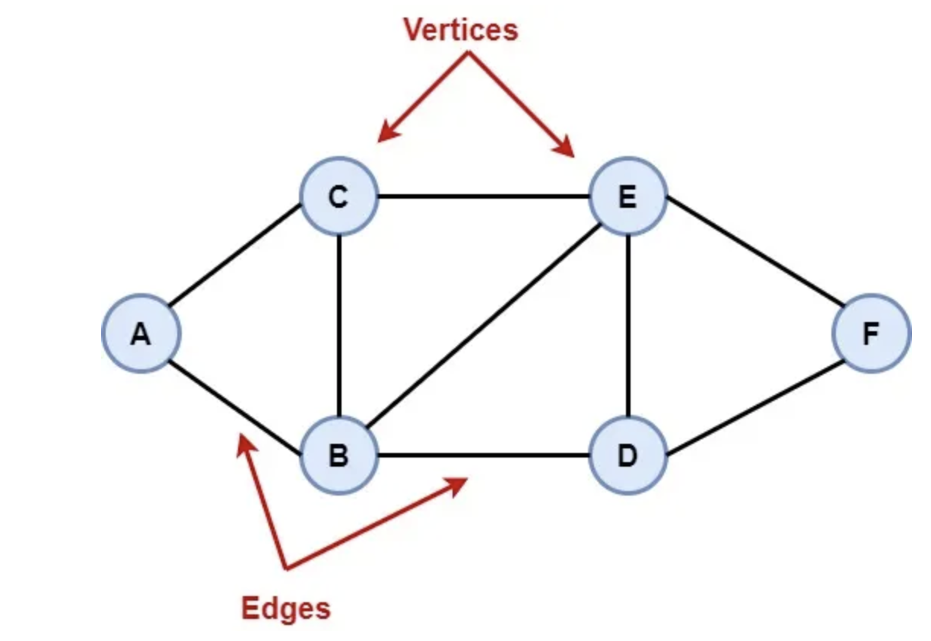
Graphs
A graph, G=(V,E) is defined by a set of vertices, V, and a set of edges, E, which is a subset of V x V.
The following graph is an undirected graph, in which the set of vertices is V = {A, B, C, D, E, F} and the set of edges is
E = {AB, AC, BC, BE, BD, CE, DE, DF, EF}.

Slide 4
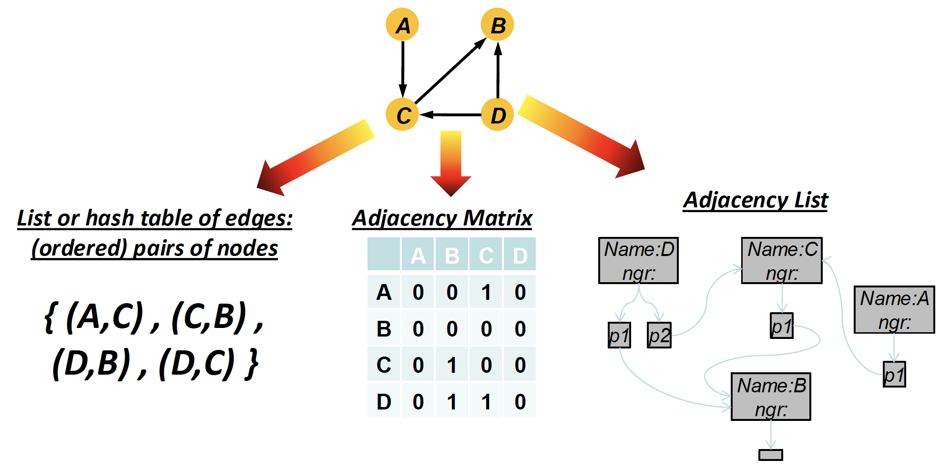
Traditional Graph Representations

Slide 5
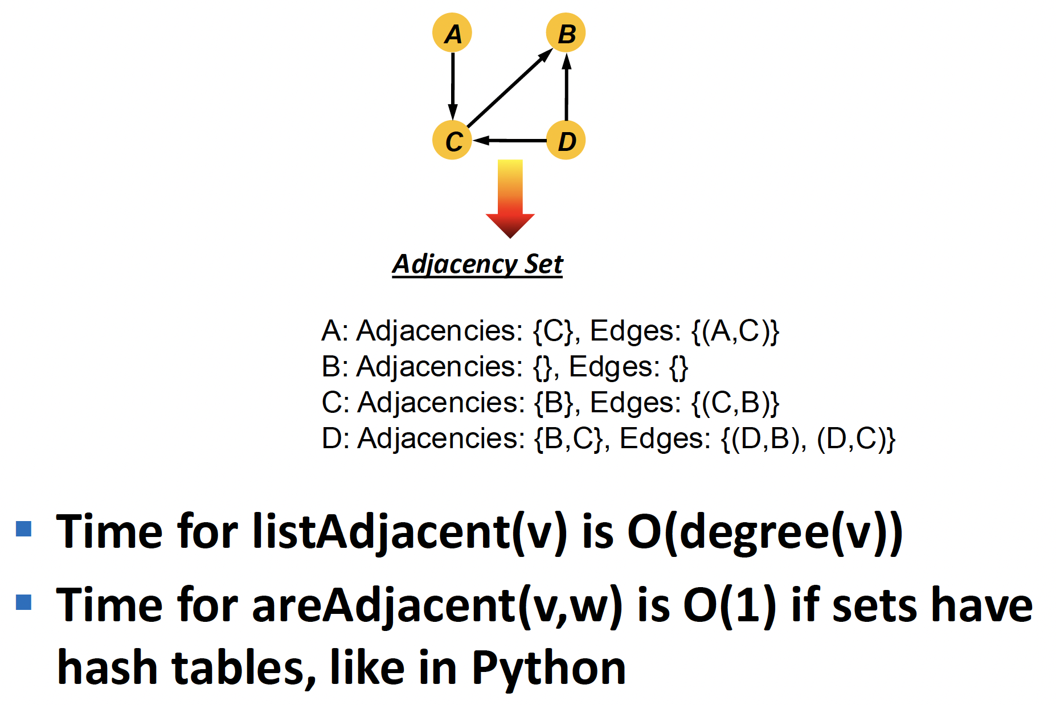
A Unified Graph Representation

Slide 6
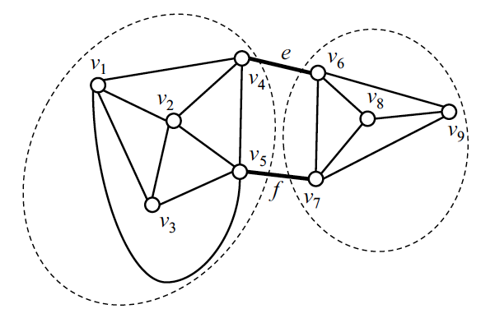
Definition of Minimum Cut
A cut, C, of a connected graph, G, is a subset of the edges of G whose removal disconnects G.
That is, after removing all the edges of C, we can partition the vertices of G into two subsets, A, and B such that there are no edges between a vertex in A and a vertex in B.
A minimum cut of G is a cut of smallest size among all cuts of G.

Slide 7
Applications
In several applications, it is important to determine the size of a smallest cut of a graph.
  For example, in a communications network, the failures of the edges of a cut prevents the communication between the nodes on the two sides of a cut.
  Thus, the size of a minimum cut and the number of such cuts give an idea of the vulnerability of the network to edge failures.
Small cuts are also important for the automatic classification of web content.
  Namely, consider a collection of web pages and model them as a graph, where vertices correspond to pages and edges to links between pages.
  The size of a minimum cut provides a measure of how much groups of pages have related content. Also, we can use minimum cuts to recursively partition the collection into clusters of related documents.

Slide 8
Flow Network
A flow network (or just network) N consists of
  A weighted digraph G with nonnegative integer edge weights, where the weight of an edge e is called the capacity c(e) of e
  Two distinguished vertices, s and t of G, called the source and sink, respectively, such that s has no incoming edges and t has no outgoing edges.
Example:
v
3
6
1
7
t
s
3
w
1
9
5
5
u
2
z

Slide 9
Flow
A flow f for a network N is is an assignment of an integer value f(e) to each edge e that satisfies the following properties:
  Capacity Rule: For each edge e, 0 ≤ f (e) ≤ c(e)
  Conservation Rule: For each vertex v ≠ s,t
  where E⁻(v) and E⁺(v) are the incoming and outgoing edges of v, resp.
The value of a flow f , denoted |f|, is the total flow from the source, which is the same as the total flow into the sink
Example:
v
1/3
2/6
1/1
3/7
t
s
3/3
w
1/1
2/9
4/5
3/5
u
2/2
z

Slide 10
Maximum Flow
A flow for a network N is said to be maximum if its value is the largest of all flows for N
The maximum flow problem consists of finding a maximum flow for a given network N
Applications
  Hydraulic systems
  Electrical circuits
  Traffic movements
  Freight transportation
v
1/3
2/6
1/1
3/7
t
s
3/3
w
1/1
2/9
4/5
3/5
u
2/2
z
Flow of value 8 = 2 + 3 + 3 = 1 + 3 + 4
v
3/3
4/6
1/1
3/7
t
s
3/3
w
1/1
2/9
4/5
3/5
u
2/2
z
Maximum flow of value 10 = 4 + 3 + 3 = 3 + 3 + 4

Slide 11
Cut
A cut of a network N with source s and sink t is a partition χ = (V_{s},V_{t}) of the vertices of N such that s ∈ V_{s} and t ∈ V_{t}
  Forward edge of cut χ: origin in V_{s} and destination in V_{t}
  Backward edge of cut χ: origin in V_{t} and destination in V_{s}
Flow f(χ) across a cut χ: total flow of forward edges minus total flow of backward edges
Capacity c(χ) of a cut χ: total capacity of forward edges
Example:
  c(χ) = 24
  f(χ) = 8
χ
v
3
6
1
7
t
s
3
w
1
9
5
5
u
2
z
χ
v
1/3
2/6
1/1
3/7
t
s
3/3
w
1/1
2/9
4/5
3/5
u
2/2
z

Slide 12
Flows and Cuts
Lemma:
The flow f(χ) across any cut χ is equal to the flow value |f|
Lemma:
The flow f(χ) across a cut χ is less than or equal to the capacity c(χ) of the cut
Theorem:
The value of any flow is less than or equal to the capacity of any cut, i.e., for any flow f and any cut χ, we have
|f| ≤ c(χ)
χ₁
χ₂
v
1/3
2/6
1/1
3/7
t
s
3/3
w
1/1
2/9
4/5
3/5
u
2/2
z
c(χ₁) = 12 = 6 + 3 + 1 + 2
c(χ₂) = 21 = 3 + 7 + 9 + 2
|f| = 8

Slide 13
Augmenting Path
Consider a flow f for a network N
Let e be an edge from u to v:
  Residual capacity of e from u to v: Δ_{f}(u, v) = c(e) − f (e)
  Residual capacity of e from v to u: Δ_{f}(v, u) = f (e)
Let π be a path from s to t
  The residual capacity Δ_{f}(π) of π is the smallest of the residual capacities of the edges of π in the direction from s to t
A path π from s to t is an augmenting path if Δ_{f}(π) > 0
π
v
1/3
2/6
1/1
2/7
t
s
3/3
w
0/1
2/9
4/5
2/5
u
2/2
z
Δ_{f}(s,u) = 3
Δ_{f}(u,w) = 1
Δ_{f}(w,v) = 1
Δ_{f}(v,t) = 2
Δ_{f}(π) = 1
|f| = 7

Slide 14
Flow Augmentation
π
Lemma:
Let π be an augmenting path for flow f in network N. There exists a flow f′ for N of value
| f′ | = |f | + Δ_{f}(π)
Proof:
We compute flow f′ by modifying the flow on the edges of π
  Forward edge:
  f′ (e) = f(e) + Δ_{f}(π)
  Backward edge:
  f′ (e) = f(e) − Δ_{f}(π)
v
1/3
2/6
1/1
2/7
t
s
3/3
w
0/1
2/9
4/5
2/5
u
z
| f | = 7
2/2
Δ_{f}(π) = 1
π
v
2/3
2/6
0/1
2/7
t
s
3/3
w
1/1
2/9
4/5
3/5
u
z
| f′ | = 8
2/2

Slide 15
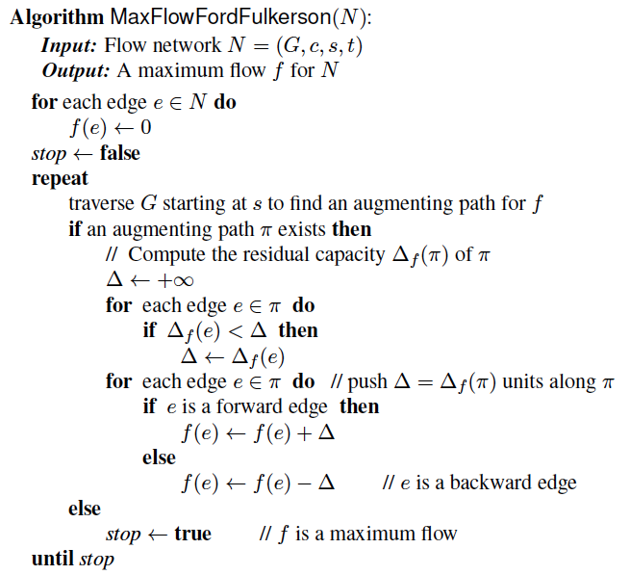
The Ford-Fulkerson Algorithm
Initially, f(e) = 0 for each edge e
Repeatedly
  Search for an augmenting path π
  Augment by Δ_{f}(π) the flow along the edges of π
A specialization of DFS (or BFS) searches for an augmenting path
  An edge e is traversed from u to v provided Δ_{f}(u, v) > 0

Slide 16
Max-Flow and Min-Cut
Termination of Ford-Fulkerson’s algorithm
  There is no augmenting path from s to t with respect to the current flow f
Define
  V_{s} set of vertices reachable from s by augmenting paths
  V_{t} set of remaining vertices
Cut χ = (V_{s},V_{t}) has capacity
c(χ) = |f|
  Forward edge: f(e) = c(e)
  Backward edge: f(e) = 0
Thus, flow f has maximum value and cut χ has minimum capacity
Theorem:
  The value of a maximum flow is equal to the capacity of a minimum cut
χ
v
3/3
4/6
1/1
4/7
t
s
3/3
w
1/1
1/9
3/5
3/5
u
z
2/2
c(χ) = | f | = 10

Slide 17
Example (1)
v
0/3
v
0/3
0/6
1/6
0/1
1/7
t
1/1
2/7
t
s
0/3
s
1/3
w
w
1/1
0/9
0/5
0/1
0/9
1/5
1/5
1/5
u
0/2
z
u
z
1/2
v
0/3
v
1/3
0/6
1/6
0/1
1/7
t
0/1
t
1/3
2/7
s
s
2/3
w
w
0/1
0/9
1/5
0/1
0/9
1/5
1/5
1/5
u
z
u
z
1/2
1/2

Slide 18
Example (2)
v
3/3
v
3/3
3/6
4/6
0/1
2/7
t
1/1
t
2/3
3/7
s
s
3/3
w
w
0/1
0/9
1/5
0/1
1/9
2/5
1/5
1/5
u
z
u
z
1/2
1/2
two steps
v
3/3
v
3/3
3/6
4/6
0/1
2/7
t
1/1
4/7
t
s
3/3
s
3/3
w
w
0/1
1/9
2/5
1/1
1/9
3/5
1/5
3/5
u
z
u
z
1/2
2/2

Slide 19
Analysis
In the worst case, Ford-Fulkerson’s algorithm performs |f*| flow augmentations, where f* is a maximum flow
Example
  The augmenting paths found alternate between π₁ and π₂
  The algorithm performs 100 augmentations
Finding an augmenting path and augmenting the flow takes O(n + m) time
The running time of Ford-Fulkerson’s algorithm is O(|f*|(n + m))
v
0/50
1/50
s
1/1
t
π₁
1/50
0/50
u
v
1/50
1/50
s
0/1
t
π₂
1/50
1/50
u

Slide 20
Min-Cut Relationship to Max Flow
The min-cut/max-flow theorem states that, given a pair of vertices, s and t, we can compute a minimum cut in polynomial time such that s is on one side of the cut and t is on the other.
In this case, however, we want the minimum cut over all possible cuts.
Nevertheless, we can compute such an overall minimum cut by O(n) calls to an (s,t)-min-cut-max-flow algorithm.
  How?
Here, we show how to design a simple, efficient Monte Carlo randomized algorithm that succeeds with high probability without using min-cut-max-flow.

Slide 21
Contracting Edges
The simple randomized algorithm algorithm repeatedly performs contraction operations on the graph.
Let G be a graph with n vertices, where we allow G to have parallel edges. We denote with (v,w) any edge with endpoints v and w.
The contraction of an edge e of G with endpoints u and v consists of the following steps that yield a new graph with n − 1 vertices, denoted G/e:
Remove edge e and any other edge between its endpoints, u and v.
Create a new vertex, w.
For every edge, f, incident on u, detach f from u and attach it to w. Formally speaking, let z be the other endpoint of f. Change the endpoints of f to be z and w.
For every edge, f, incident on v, detach f from v and attach it to w.

Slide 22
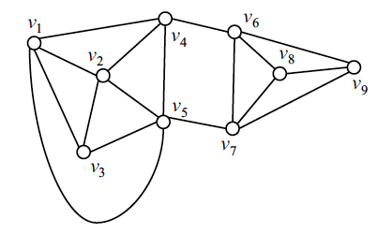
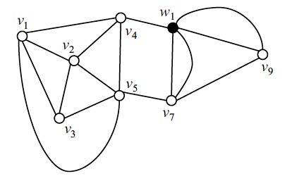
Contracting Edges, An Example
Contracting the edge (v₆,v₈)

Slide 23
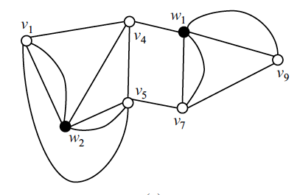
Contracting Edges, An Example
Contracting the edge (v₂,v₃)

Slide 24
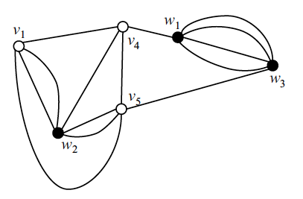
Contracting Edges, An Example
Contracting the edge (v₇,v₉)

Slide 25
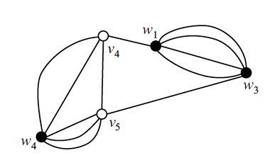
Contracting Edges, An Example
Contracting the edge (v₁,w₂)

Slide 26
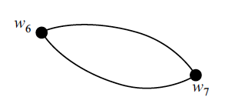
Contracting Edges, An Example
Contracting the edge (v₄,v₅), yielding w₅, contracting (w₄,w₅), yielding w₆, and contracting (w₁,w₃), yielding w₇.
This final graph has the same minimum cut as the original graph.

Slide 27
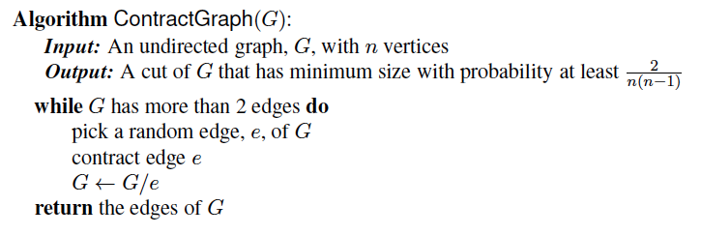
Karger’s Algorithm
A simple min-cut algorithm, which succeeds with high probability is to repeat the following procedure multiple times, keeping track of the smallest cut that it ever finds:

Slide 28

Analysis
Let G be a graph with n vertices and m edges, and let C be a given minimum cut of G. We will evaluate the probability that the algorithm returns the cut C.
Since G may have other minimum cuts, this probability is a lower bound on the success probability of the algorithm.
Let G_{i} be the graph obtained after i contractions performed by the algorithm and let m_{i} be the number of edges of G_{i}. Assume that G_{i−1} contains all the edges of C. The probability that G_{i} also contains all the edges of C is equal to 1 − k/m_{i-1} since we contract any given edge of C with probability 1/m_{i−1} and C has k edges.
Thus, the probability, P, that the algorithm returns cut C is

Slide 29

Analysis, part 2
Since k is the size of the minimum cut of each graph G_{i}, we have that each vertex of G_{i} has degree at least k.
Thus, we obtain the following lower bound on m_{i}, the number of edges of G_{i}:
We can then use these bounds to derive a lower bound for P.

Slide 30
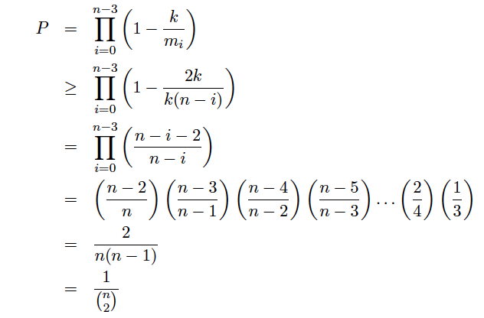
Analysis, part 3
The following bound implies that P is at least proportional to 1/n²:

Slide 31

Analysis, part 4
We can boost the probability by running the algorithm multiple times. In particular, if we run the
algorithm for t*n-choose-2 rounds, where t is a positive integer, we have that at least one round returns cut C with probability
By a well-known property of the mathematical constant e, the base of the natural logarithm, ln, we obtain P(t) > 1 – 1/e^{t} .
If we choose t = c ln n, where c is a constant, then the success probability is at least 1 – 1/n^{c} .

Slide 32
Running Time Analysis
A contraction operation can be executed in O(n) time, if the graph is represented using an adjacency list.
Thus, the running time of one round is O(n²).
We repeat the algorithm O(n² log n) times.
Thus, the total running time is O(n⁴ log n).
This can be improved to O(n² log³ n)…

Slide 33
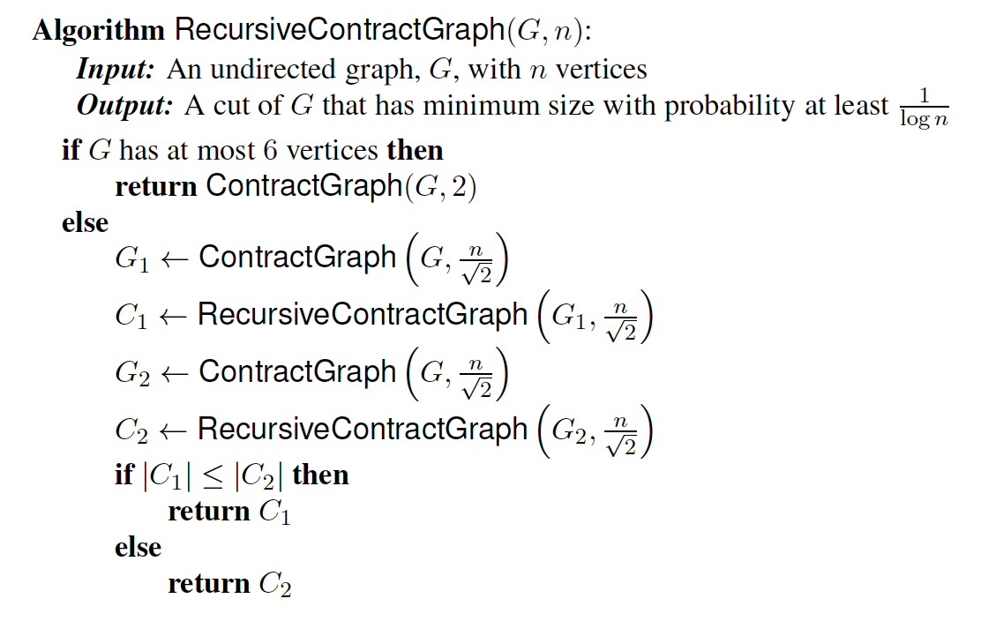
Improved Algorithm
ContractGraph(G, r) is a variation of ContractGraph(G) that performs n − r contractions and returns the resulting graph, which has r vertices

Slide 34
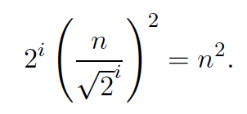
Time Analysis of Improved Algorithm
RecursiveContractGraph makes two recursive calls.
After each call, the size of the input graph is a constant fraction, 1/√2, of the size before the call.
Thus, the execution of the algorithm can be modeled by a binary recursion tree with depth 2 log n.
The number of contractions performed in a call, excluding those within its recursive calls, is proportional to the number of vertices of the graph.
Since each contraction takes linear time in the number of vertices, the work done within a call, excluding its recursive calls, is quadratic in the number of vertices.
Thus, the total work done at level i in the recursion tree is
(So total time is O(n² log n)

Slide 35
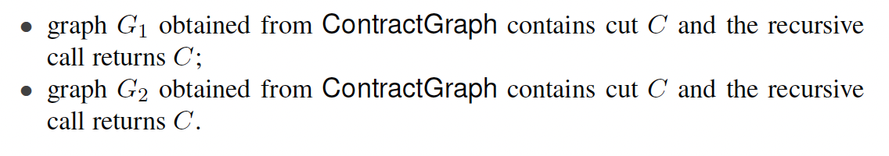
Probability Analysis
Referring to the recursion tree, we say that a node is safe if its associated graph contains cut C.
The recursive call at a safe node succeeds in returning C if one of the following events occurs:

Slide 36
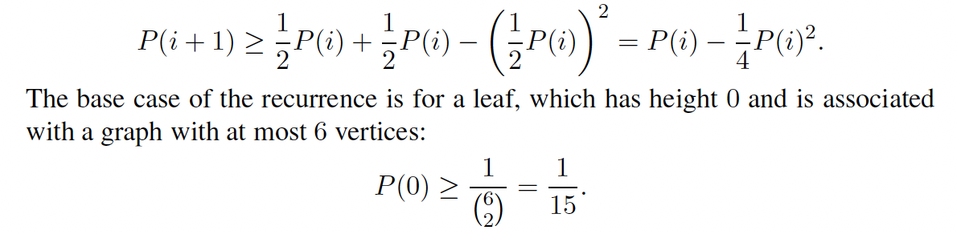
Probability Analysis, Part 2
Define P(i) as the probability that a safe node at height i of the recursion tree has a safe leaf in its subtree. Thus, P(2 log n) denotes the probability that algorithm RecursiveContractGraph succeeds in returning C.
Each of graphs G1 and G2 returned by ContractGraph contains C with probability 1/2. Thus,
This implies P(i) is c/log n, for come constant c; hence, to get high probability takes O(n²log³ n) time.

