Slide 1
Pattern Matching Algorithms
Michael T. Goodrich
University of California, Irvine
Some slides adapted from https://www.cs.bgu.ac.il/~dinitz/Course/SS-12/Boyer-Moore-algorithm-Vladimir.pptx

Slide 2
Strings
A string is a sequence of characters (indexed from 0)*
Examples of strings:
Python program
HTML document
DNA sequence
Digitized image
An alphabet Σ is the set of possible characters for a family of strings
Example of alphabets:
ASCII or Unicode
{0, 1}
{A, C, G, T}
Let P be a string of size m
A substring P[i : j] of P is the subsequence of P consisting of the characters with ranks between i and j
A prefix of P is a substring of the type P[0 : i]
A suffix of P is a substring of the type P[i : m − 1]
Given strings T (text) and P (pattern), the pattern matching problem consists of finding a substring of T equal to P
Applications:
Text editors
Search engines
Biological research
*Some people index starting from 1.

Slide 3
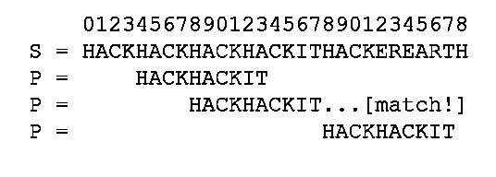
Application: fgrep
Recall that fgrep looks for an exact match of a text string in a file.
So we are interested in fast algorithms for the exact match problem:
Given a text string, T, of length n, and a pattern string, P, of length m, over an alphabet of size k, find the first (or all) places where a substring of T matches P.
Image from https://www.hackerearth.com/practice/notes/exact-string-matching-algorithms/

Slide 4

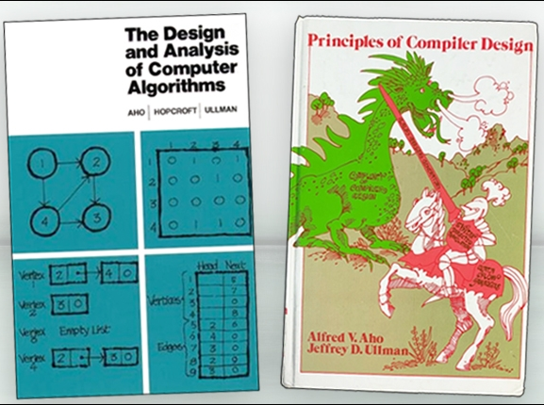
Alfred Aho
1975: Invented fgrep
…*
2020: received the Turing Award
* Also invented text processing techniques used in every modern source-code compiler and co-authored two influential textbooks.
Images from https://awards.acm.org/about/2020-turing

Slide 5
Brute-force Pattern Matching
Algorithm BruteForceMatch(T, P)
Input text T of size n and pattern P of size m
Output starting index of a substring of T equal to P or −1 if no such substring exists
for i ← 0 to n − m
{ test shift i of the pattern }
j ← 0
while j < m ∧ T[i + j] = P[j]
j ← j + 1
if j = m
return i {match at i}
else
break while loop {mismatch}
return -1 {no match anywhere}
The Brute-force (Naïve) pattern matching algorithm compares the pattern P with the text T for each possible shift of P relative to T, until either
a match is found, or
all placements of the pattern have been tried
Brute-force pattern matching runs in time O(nm)
Example of worst case:
T = aaa … ah
P = aaah
may occur in images and DNA sequences

Slide 6
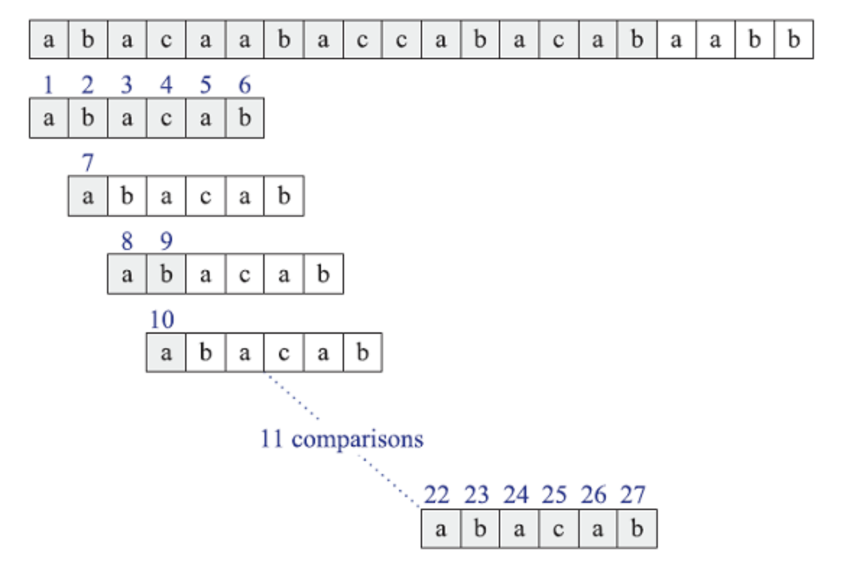
Brute-Force Matching Example
Trying every possible position for a match:

Slide 7
Expected-case Analysis for Brute-force
The worst-case running time for Brute-force algorithm O(mn), but it runs in expected linear time for random strings.
Suppose P and T are strings of m and n characters respectively chosen uniformly and independently at random from an alphabet of size k.
Let X_{i,j} be a random variable that is 1 if and only if P[i] is compared to T[j], and note that probability X_{i,j} is 1 is 1/k^{i} because this occurs when we have i character matches.
By the linearity of expectation, the expected number of comparisons for any T[j] is therefore
1/k + 1/k² + 1/k³ + … + 1/k^{m},
which is at most 2.
Thus, the expected number of comparisons is at most 2n.

Slide 8

Expected-case Analysis for Exact String Matching is Problematic
If a pattern string P and text string T are strings of characters chosen uniformly and independently at random from an alphabet of size k, then the probability that P appears anywhere in T is at most n/k^{m}.
For example, if n=1000, m=10, and k=50, then the probability of a match of P in T is about 1 in 10 trillion!
In this case, a fast (and very accurate) exact matching algorithm is:

Slide 9
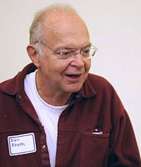
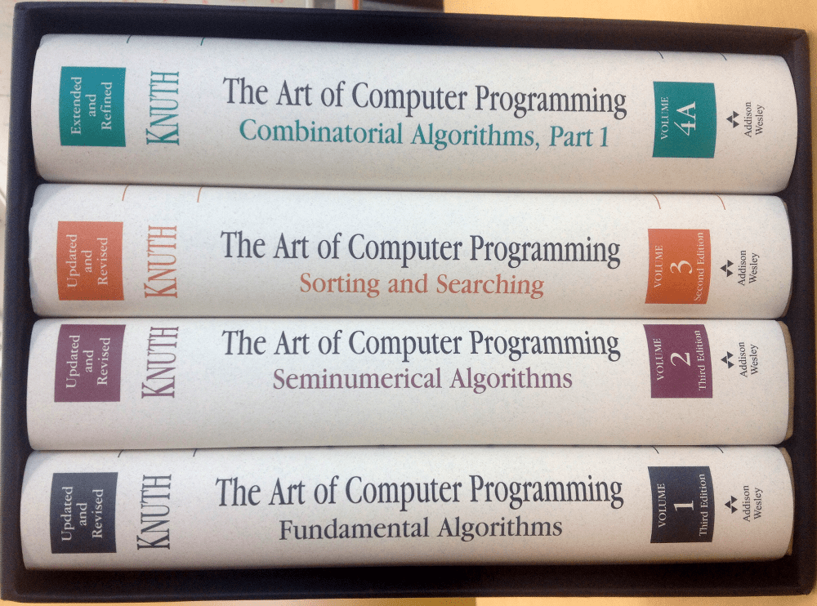
Donald Knuth
1973: Discovered the KMP algorithm (which was also published in a technical report by Morris and Pratt in 1970—all three published a joint paper describing the algorithm in 1977).
1974: Received the Turing Award.
He is also known for his book series, “The Art of Computer Programming,” which formalized and popularized algorithm analysis (e.g., the “big O”).
Image from https://en.wikipedia.org/wiki/Donald_Knuth

Slide 10
The KMP Algorithm
Consider the comparison of a pattern with a text as in the brute-force algorithm.
When a mismatch occurs, what is the most we can shift the pattern so as to avoid redundant comparisons?
Answer: the largest prefix of P[0..j] that is a suffix of P[1..j]
This approach is similar to the NFA-to-DFA approach, but is implemented more efficiently.
.
.
a
b
a
a
b
x
.
.
.
.
.
a
b
a
a
b
a
j
a
b
a
a
b
a
No need to
repeat these
comparisons
Resume
comparing
here

Slide 11
The KMP Failure Function
Knuth-Morris-Pratt’s algorithm preprocesses the pattern to find matches of prefixes of the pattern with the pattern itself
The failure function F(j) is defined as the length of the longest prefix of P[0..j] that is also a suffix of P[1..j]
Knuth-Morris-Pratt’s algorithm modifies the brute-force algorithm so that if a mismatch occurs at P[j] ≠ T[i] and j > 0, we set j ← F(j − 1)
j | 0 | 1 | 2 | 3 | 4 | 5
P[j] | a | b | a | a | b | a
F(j) | 0 | 0 | 1 | 1 | 2 | 3

Slide 12
The KMP Algorithm
The failure function can be represented by an array and can be computed in O(m) time
At each iteration of the while-loop, either
i increases by one, or
the shift amount i − j increases by at least one (observe that F(j − 1) < j)
Hence, there are no more than 2n iterations of the while-loop
Thus, KMP’s algorithm runs in optimal time O(m + n)
Algorithm KMPMatch(T, P)
F ← failureFunction(P)
i ← 0
j ← 0
while i < n
if T[i] = P[j]
if j = m − 1
return i − j { match }
else
i ← i + 1
j ← j + 1
else
if j > 0
j ← F[j − 1]
else
i ← i + 1
return −1 { no match }

Slide 13
Computing the Failure Function
The failure function can be represented by an array and can be computed in O(m) time
The construction is similar to the KMP algorithm itself
At each iteration of the while-loop, either
i increases by one, or
the shift amount i − j increases by at least one (observe that F(j − 1) < j)
Hence, there are no more than 2m iterations of the while-loop
Algorithm failureFunction(P)
F[0] ← 0
i ← 1
j ← 0
while i < m
if P[i] = P[j]
{we have matched j + 1 chars}
F[i] ← j + 1
i ← i + 1
j ← j + 1
else if j > 0 then
{use failure function to shift P}
j ← F[j − 1]
else
F[i] ← 0 { no match }
i ← i + 1

Slide 14
Example
j | 0 | 1 | 2 | 3 | 4 | 5
P[j] | a | b | a | c | a | b
F(j) | 0 | 0 | 1 | 0 | 1 | 2

Slide 15
Summary for KMP
Thus, the KMP algorithm runs in O(m+n) time for constant-size alphabets.

Slide 16
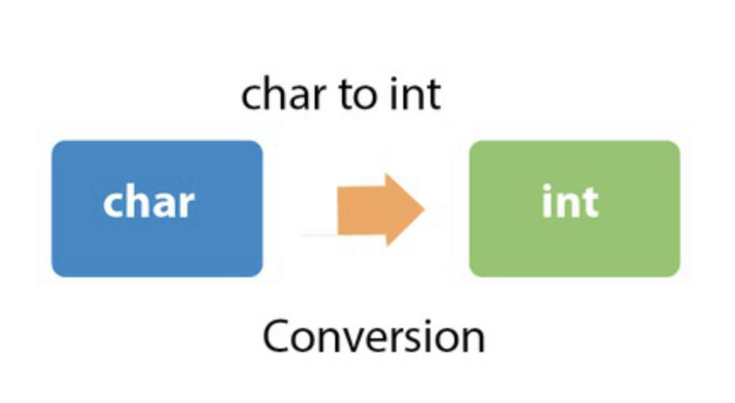
The Data Type Duality Principle
Rather than rely only on comparing characters, numerical matching algorithms take advantage of the fact that characters in a string can also be viewed as (binary) numbers.
This concept is often referred to as data type duality.
Image from https://www.javatpoint.com/java-char-to-int

Slide 17
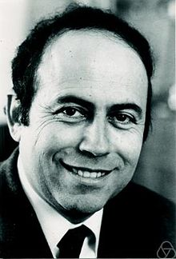
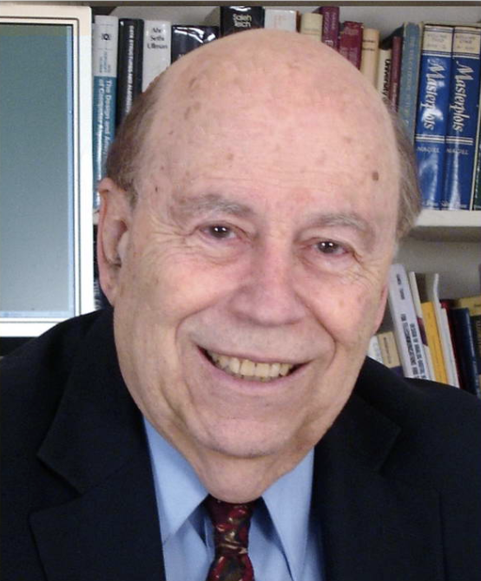
Michael Rabin
1959: He introduced the nondeterminism concept.
1976: He received the Turing Award
The “Nobel Prize” of Computer Science
Images from https://en.wikipedia.org/wiki/Michael_O._Rabin, https://en.wikipedia.org/wiki/Dana_Scott

Slide 18

Richard Karp
1985: Received the Turing Award.
1987: Developed the Rabin-Karp string searching algorithm with Michael Rabin.
He is also known for publishing a landmark paper proving 21 problems to be NP-complete.
He was also the PhD advisor to UCI Professor Sandy Irani.
Image from https://en.wikipedia.org/wiki/Richard_M._Karp

Slide 19
The Rabin-Karp Algorithm
The Rabin-Karp string searching algorithm calculates a hash value for the pattern, and for each M-character substring of text to be compared.
If the hash values are unequal, the algorithm will calculate the hash value for next M-character sequence.
If the hash values are equal, the algorithm will do a Brute Force comparison between the pattern and the M-character sequence at this location (in case of a hash value collision causing a false match).
In this way, there is only one comparison per text subsequence, and Brute Force is only needed when hash values match.
(Recall that we highlighted Michael Rabin in a previous lecture.)

Slide 20
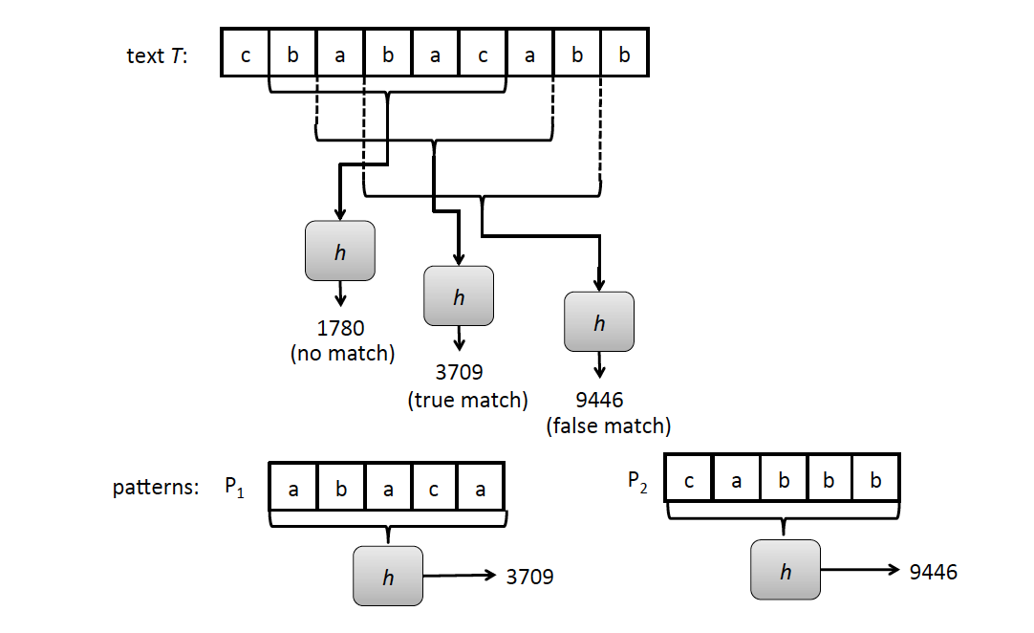

Rabin-Karp Example
Text T = cbabacabb
Pattern P = abaca

Slide 21
Rabin-Karp Algorithm (High Level)
text is n characters long, pattern is m characters long
hash_p=hash value of pattern
hash_t=hash value of first m letters in text
repeat
if (hash_p == hash_t)
do brute force comparison of pattern and selected section of text
hash_t = hash value of next section of text, one character over
until (end of text or brute force comparison == true)
Running time is O(nm) if we recompute hash_t for each substring of m characters in the text, which is no better than brute-force matching!

Slide 22

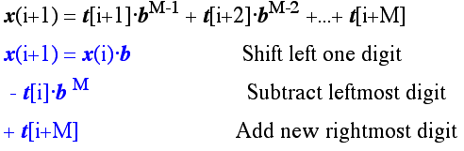
Rabin-Karp Rolling Hash Function
We can do better by using a rolling hash function, which allows us to compute each hash value from the previous hash value.
Consider an m-character sequence as an m-digit number in base b, where b is the number of letters in the alphabet. The text subsequence t[i : i+m-1] is mapped to the number
Given x(i) we can compute x(i+1) for the next substring t[i+1 : i+M] in constant time:

Slide 23
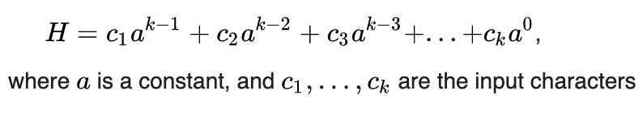
Polynomial Rolling Hash Function
The original Rabin-Karp algorithm used the a standard polynomial hash function:
This requires 2 multiplications and an addition and subtraction to compute each new hash value.
Multiplications are generally slower than comparing characters, and these multiplications are in the “inner loop” of the algorithm.
So it may be helpful to have a different hash function.

Slide 24
The Rabin-Karp Algorithm
Assumes a shiftHash(f, T, i) function for computing a shifted rolling hash value for position i in T given the hash value, f, for position i-1 in T.
Let H be the hash of the pattern, i.e., H = h(P)
for i ← 0 to n − m do
if i = 0 then // initial hash
f ← h(T[0 : m − 1])
else
f ← shiftHash(f, T, i)
if f == H then
// check P against T[i : i + m − 1]
j ← 0
while j < m and T[i + j] = Pk[j] do
j ← j + 1
if j = m then
return j as a match location

Slide 25
Analysis of the Rabin-Karp Algorithm
We are given a test of length n and a pattern of length m.
Use a hash function that is random enough so the probability of a false match is at most 1/m.
Then the expected running time to find a first match for the pattern (if it exists) is O(n+m).

Slide 26
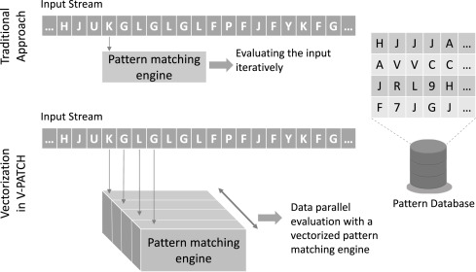
The Multi-Pattern Matching Problem
Given a text, T, of length n and a set of k patterns, P₁, …, P_{k}, each of length at most m, find the first (or each) occurrence of a given pattern in T.
Image from https://www.sciencedirect.com/science/article/abs/pii/S0743731519301984

Slide 27
Multi-Pattern Brute-Force Algorithm
We can run the brute-force algorithm k times.
This would run in O(nmk) time, which is very bad.
k Brute force algs.
Image from https://www.sciencedirect.com/science/article/abs/pii/S0743731519301984

Slide 28
Alternative: Build a Reg. Exp.
Given k patterns, P₁, P₂, …, P_{k}, each of size at most m, build a regular expression:
R = P₁ | P₂ | … | P_{k}
Then, use R to match for any pattern P_{i}.
If we simulate the NFA for R, then this takes O(nmk) time.
This is no better than brute-force!

Slide 29
KMP Algorithm for Multiple Patterns
We can run the KMP algorithm k times.
This would run in O((n+m)k) time, which is better than brute force but still not great.
k diff. KMP algs.
Image from https://www.sciencedirect.com/science/article/abs/pii/S0743731519301984

Slide 30
Recall the Rabin-Karp Algorithm
The Rabin-Karp string searching algorithm calculates a hash value for the pattern, and for each m-character substring of text to be compared.
If the hash values are unequal, the algorithm will calculate the hash value for next m-character sequence, using a rolling hash function
If the hash values are equal, the algorithm will do a Brute Force comparison between the pattern and the m-character sequence at this location (in case of a hash value collision causing a false match).
In this way, there is only one comparison per text subsequence, and Brute Force is only needed when hash values match.

Slide 31
Rabin-Karp for Multiple Patterns
Text T = cbabacabb
Pattern P₁ = abaca, P₂ = cabbb

Slide 32
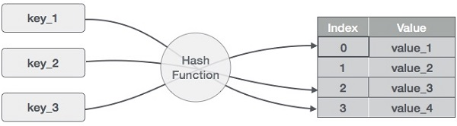
Hash Tables
The multi-pattern Rabin-Karp algorithm uses hashing in two ways:
It uses the hash function, h, for computing the rolling hash values of the pattern and text substrings.
It uses a hash table, H, for storing key-value pairs.
This provides expected O(1) time insertions and lookups (see any good reference on hash tables for this)
Image from https://www.tutorialspoint.com/data_structures_algorithms/hash_data_structure.htm

Slide 33
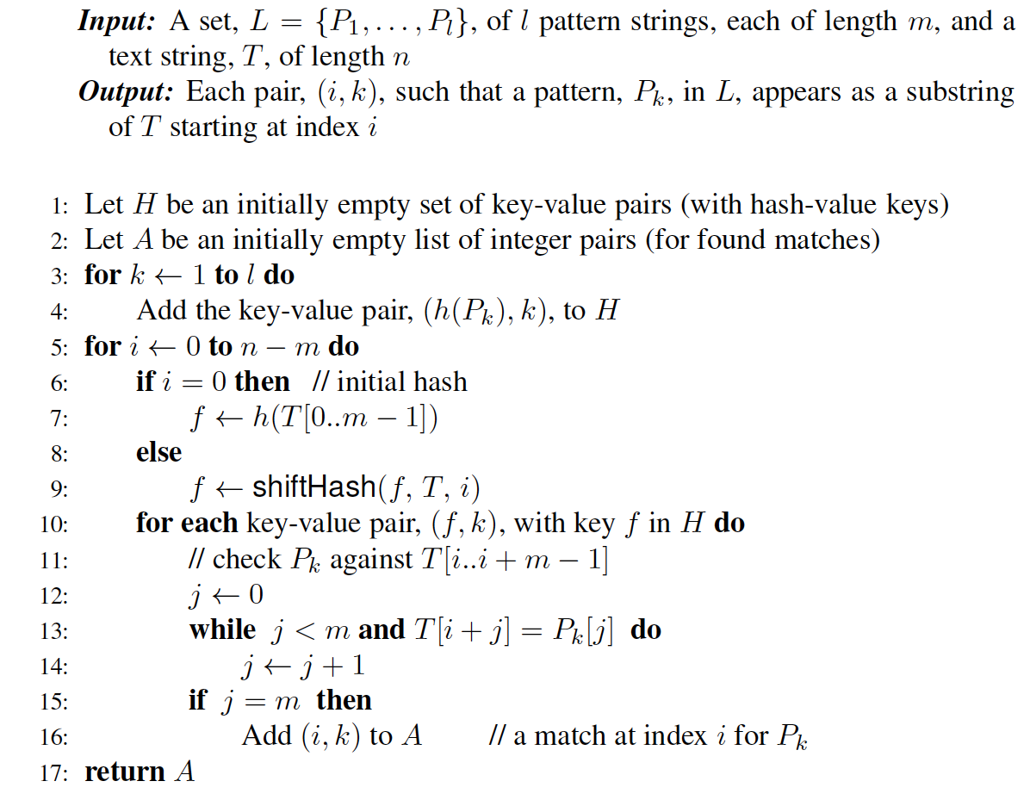
Rabin-Karp for Multiple Patterns
Assumes a shiftHash function for computing a shifted hash value.

Slide 34
Analysis of the Rabin-Karp Multi-Pattern Matching Algorithm
We are given a test of length n, and k patterns, each of length at most m.
Use a hash function, h, that is random enough so the probability of a false match is at most 1/m.
Use a hash table, H, that supports expected O(1) time insertions and lookups.
Building H takes O(km) time, including computing h(P_{i}) for each pattern, P_{i}.
Then the expected running time to find a first match for each pattern (if it exists) is O(n+km).

