Slide 1
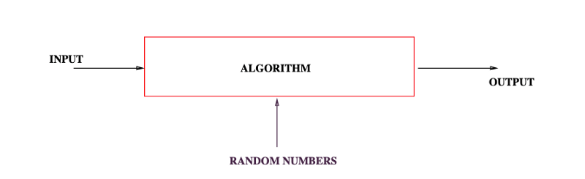
The Birthday Paradox and Coupon Collector Problem
Michael T. Goodrich
CS 263
Univ. of California, Irvine
Some slides adapted from Rutgers University

Slide 2
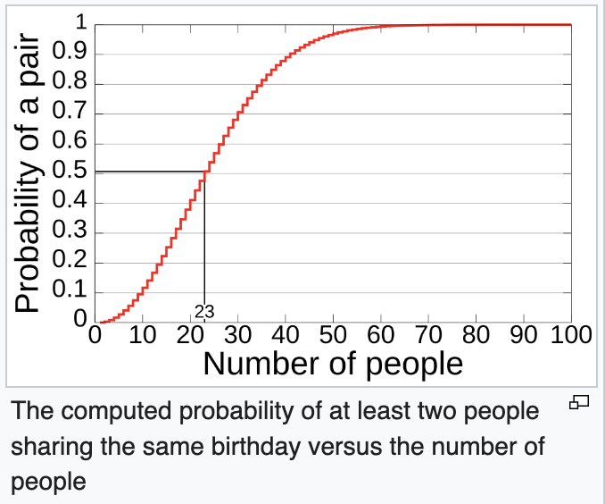
The Birthday Paradox
How many must be in a room before there is a 50% probability that two share the same birthday?
Answer: 23 individuals are required to reach a 50% probability of a shared birthday.
This seems wrong at first glance, but it is, in fact, true.

Slide 3
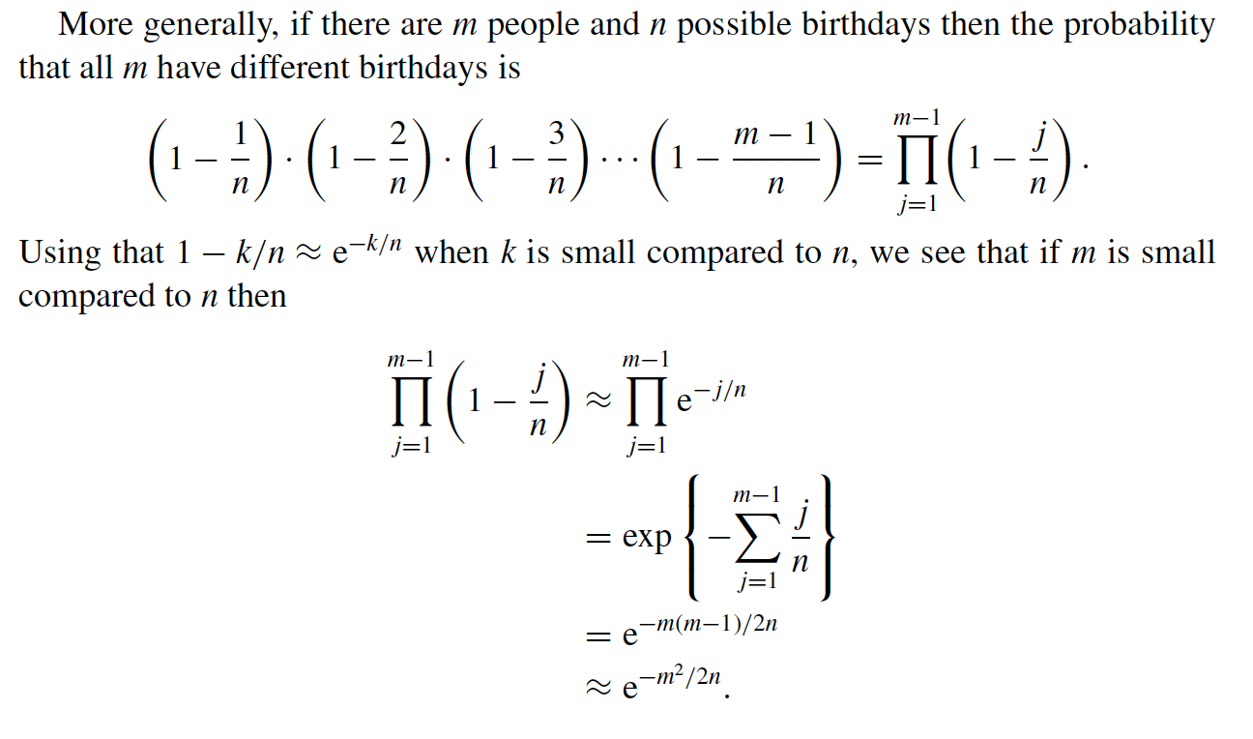
The Birthday Paradox

Slide 4
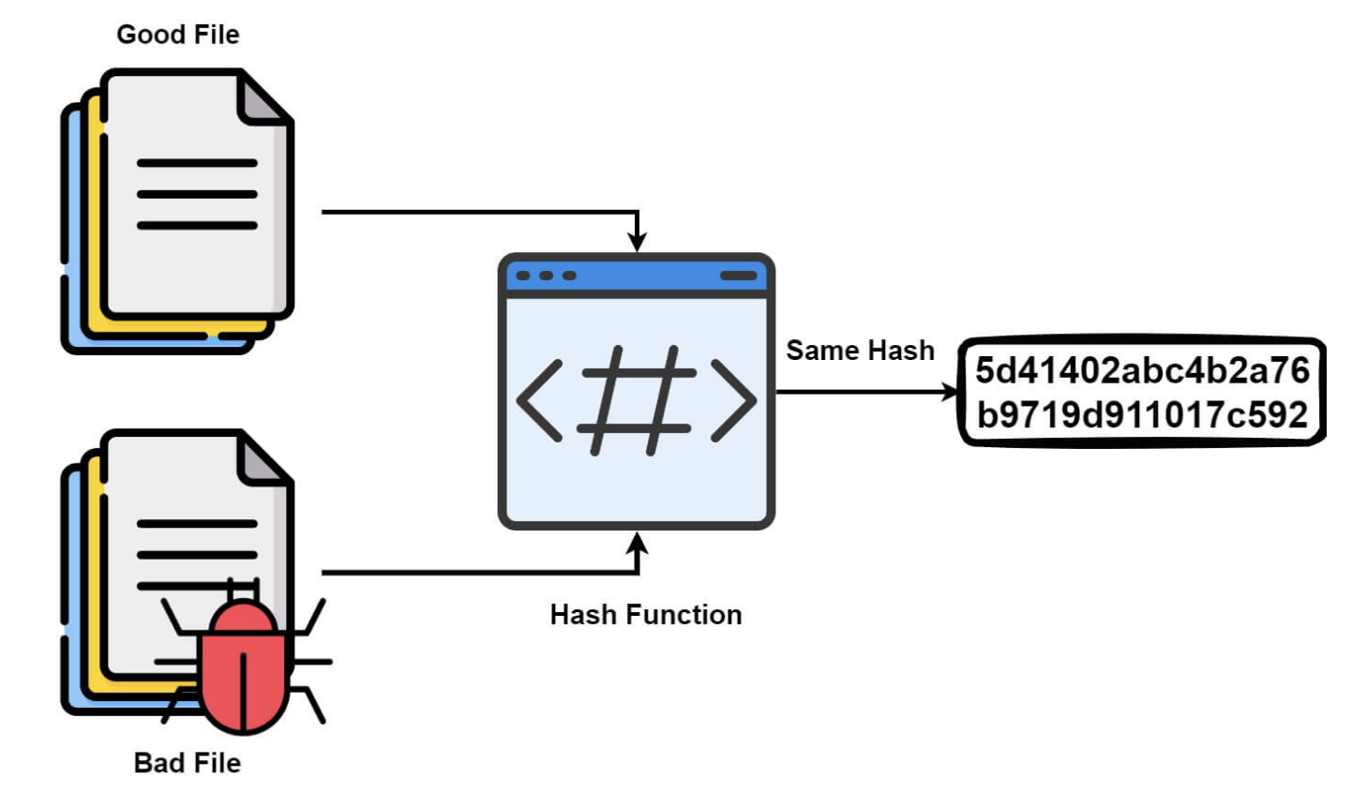
Application: Hash Collisions
A cryptographic hash collision is when two different inputs produce the exact same fixed-length hash output, creating a major security weakness because attackers can forge data or signatures by substituting malicious data for legitimate data with the same hash.
Image from https://library.mosse-institute.com/articles/2023/08/collision-birthday-attack.html

Slide 5

Birthday Attack
As shown above, the probability is roughly
In terms of bits, if the hash function uses k bits, then to get 50% probability you just need
m ~= (2^{k})^{1/2} = 2^{k/2} tries.
For example, if k=128, as in MD5, you only need roughly 2⁶⁴ tries to find a collision.
This is not considered secure by modern standards.

Slide 6
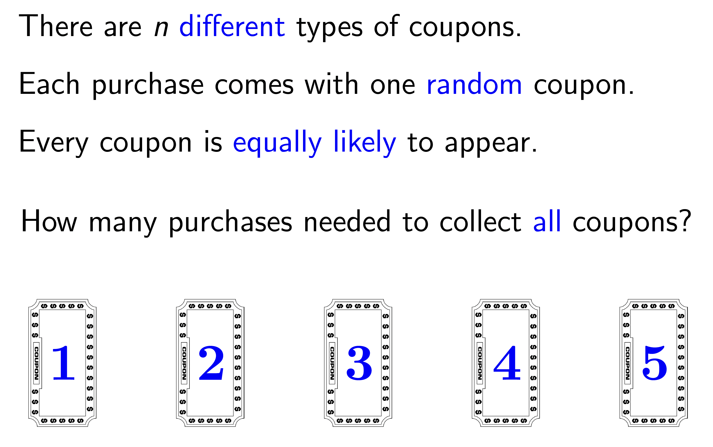
Coupon Collector Problem

Slide 7
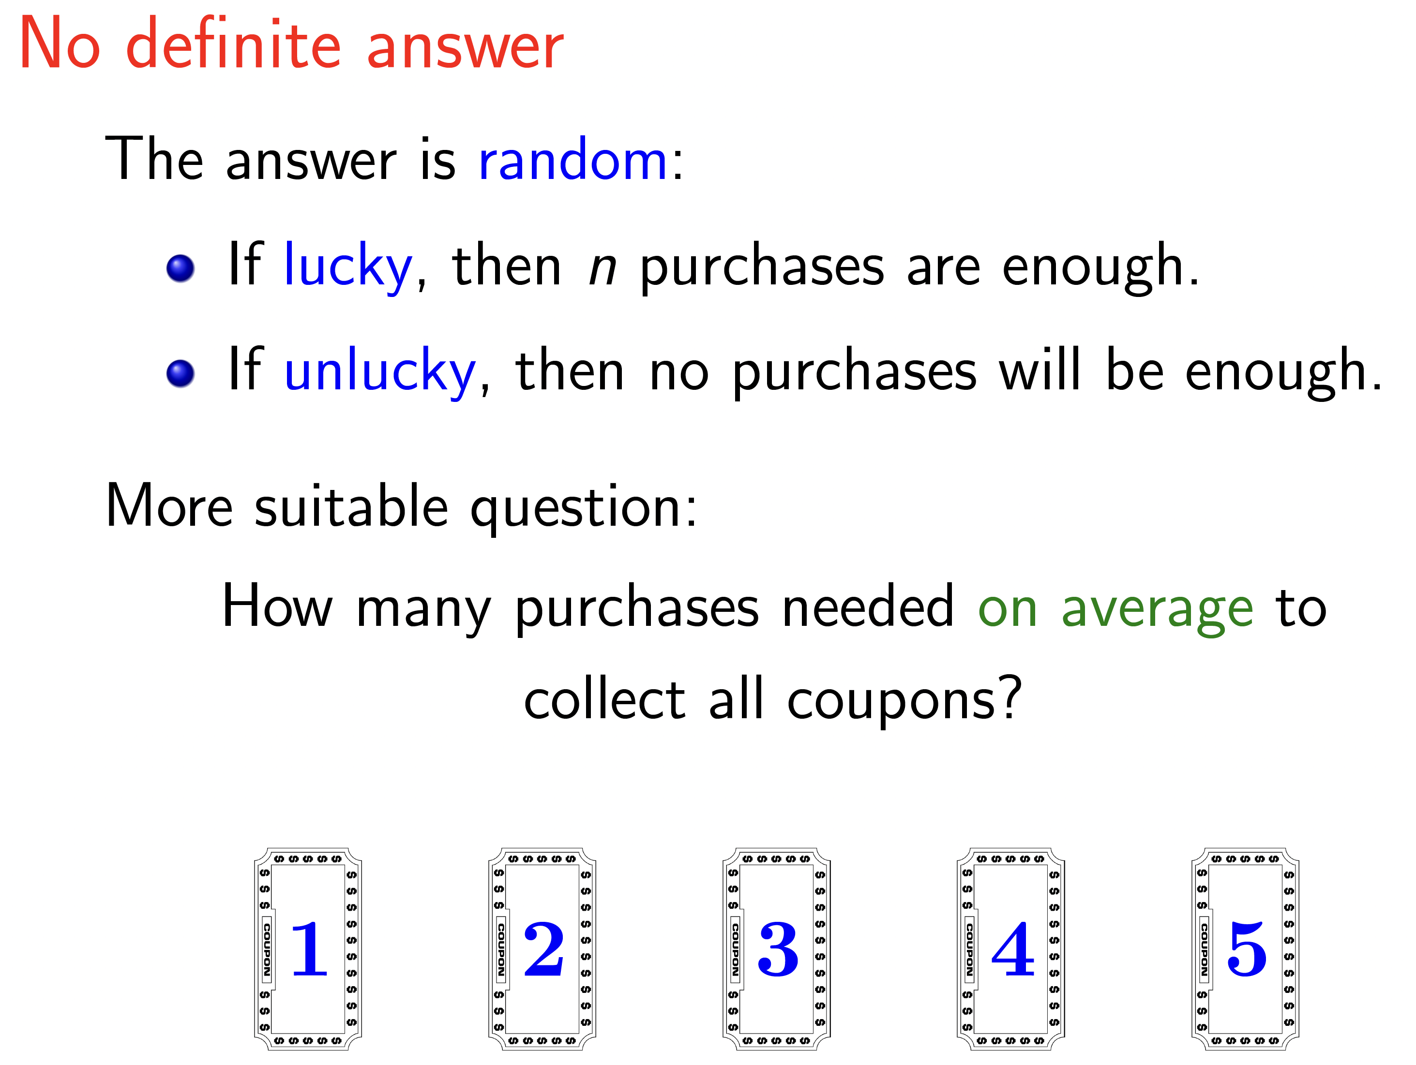

Slide 8


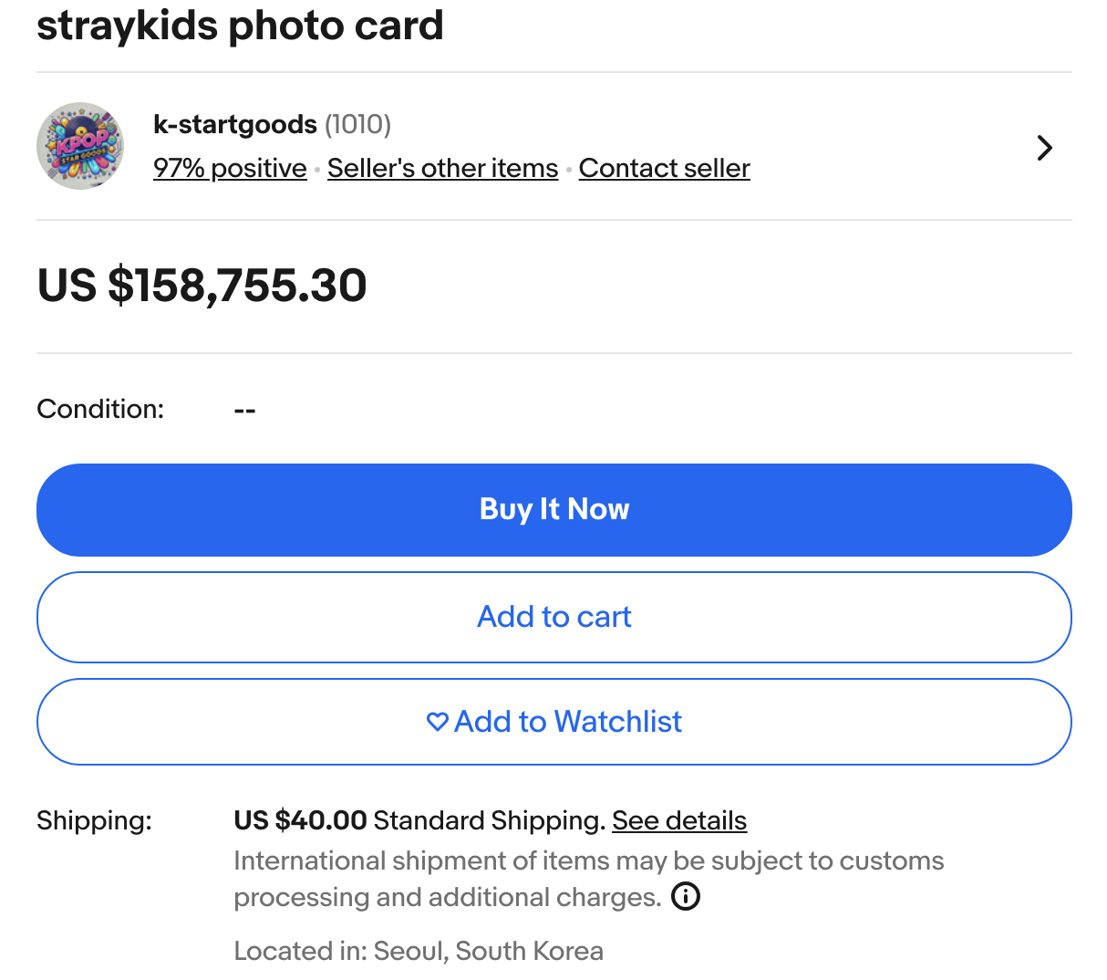
Example – K-Pop Photocards

Slide 9
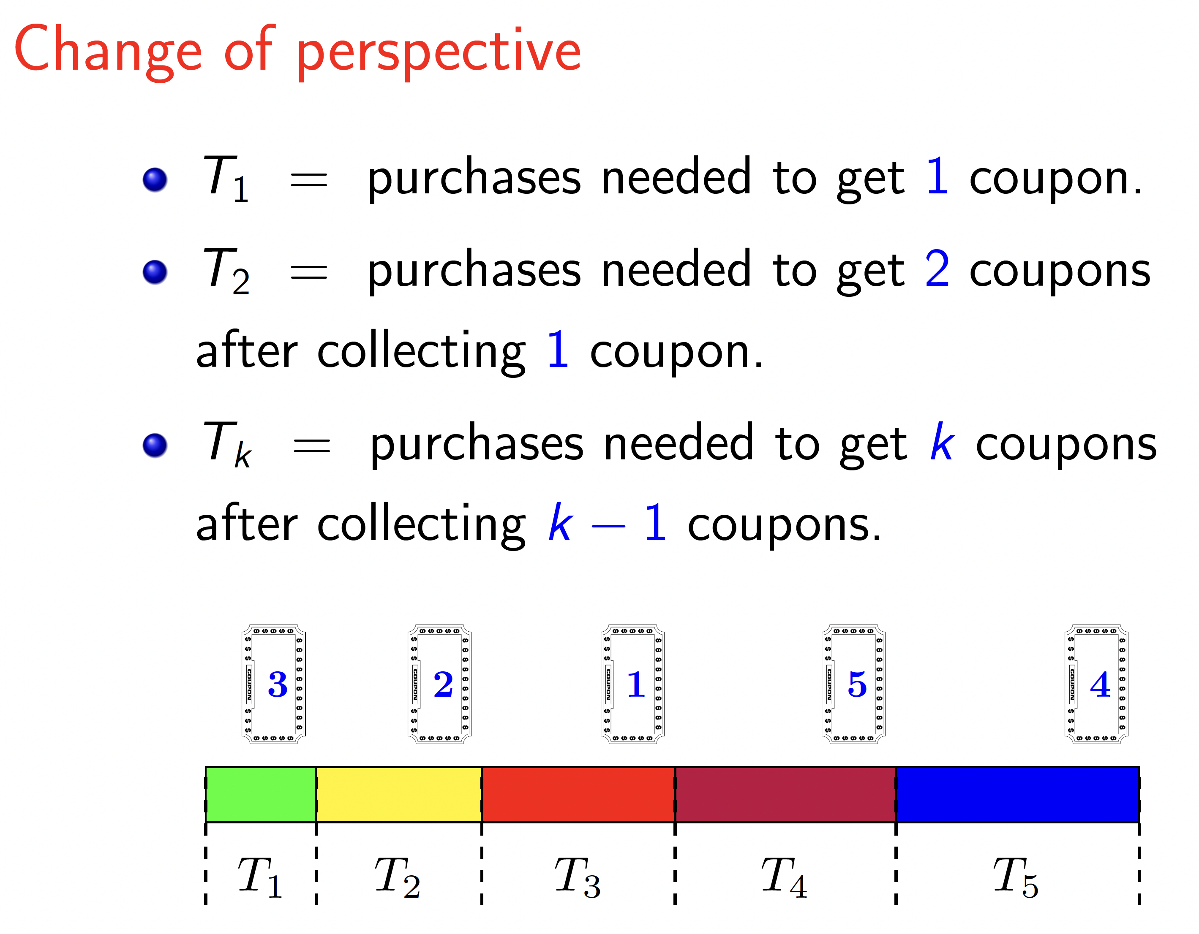

Slide 10
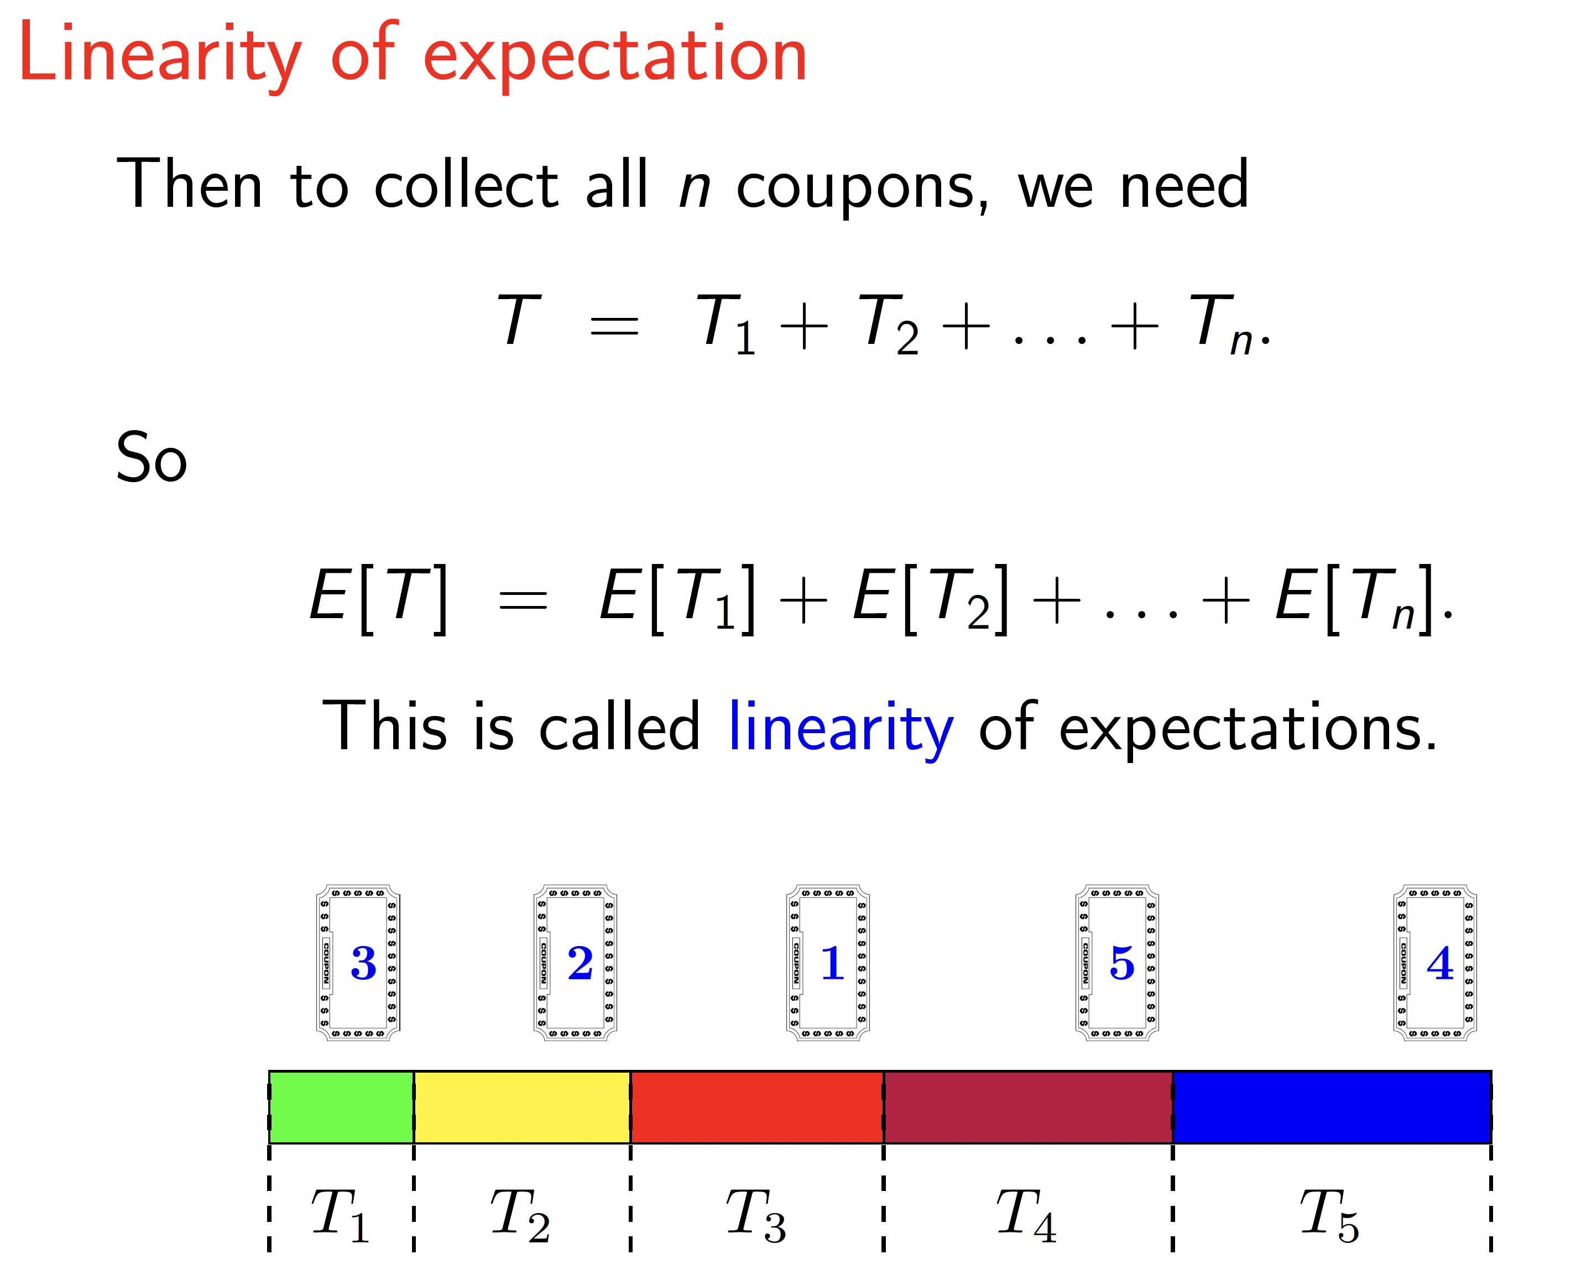

Slide 11
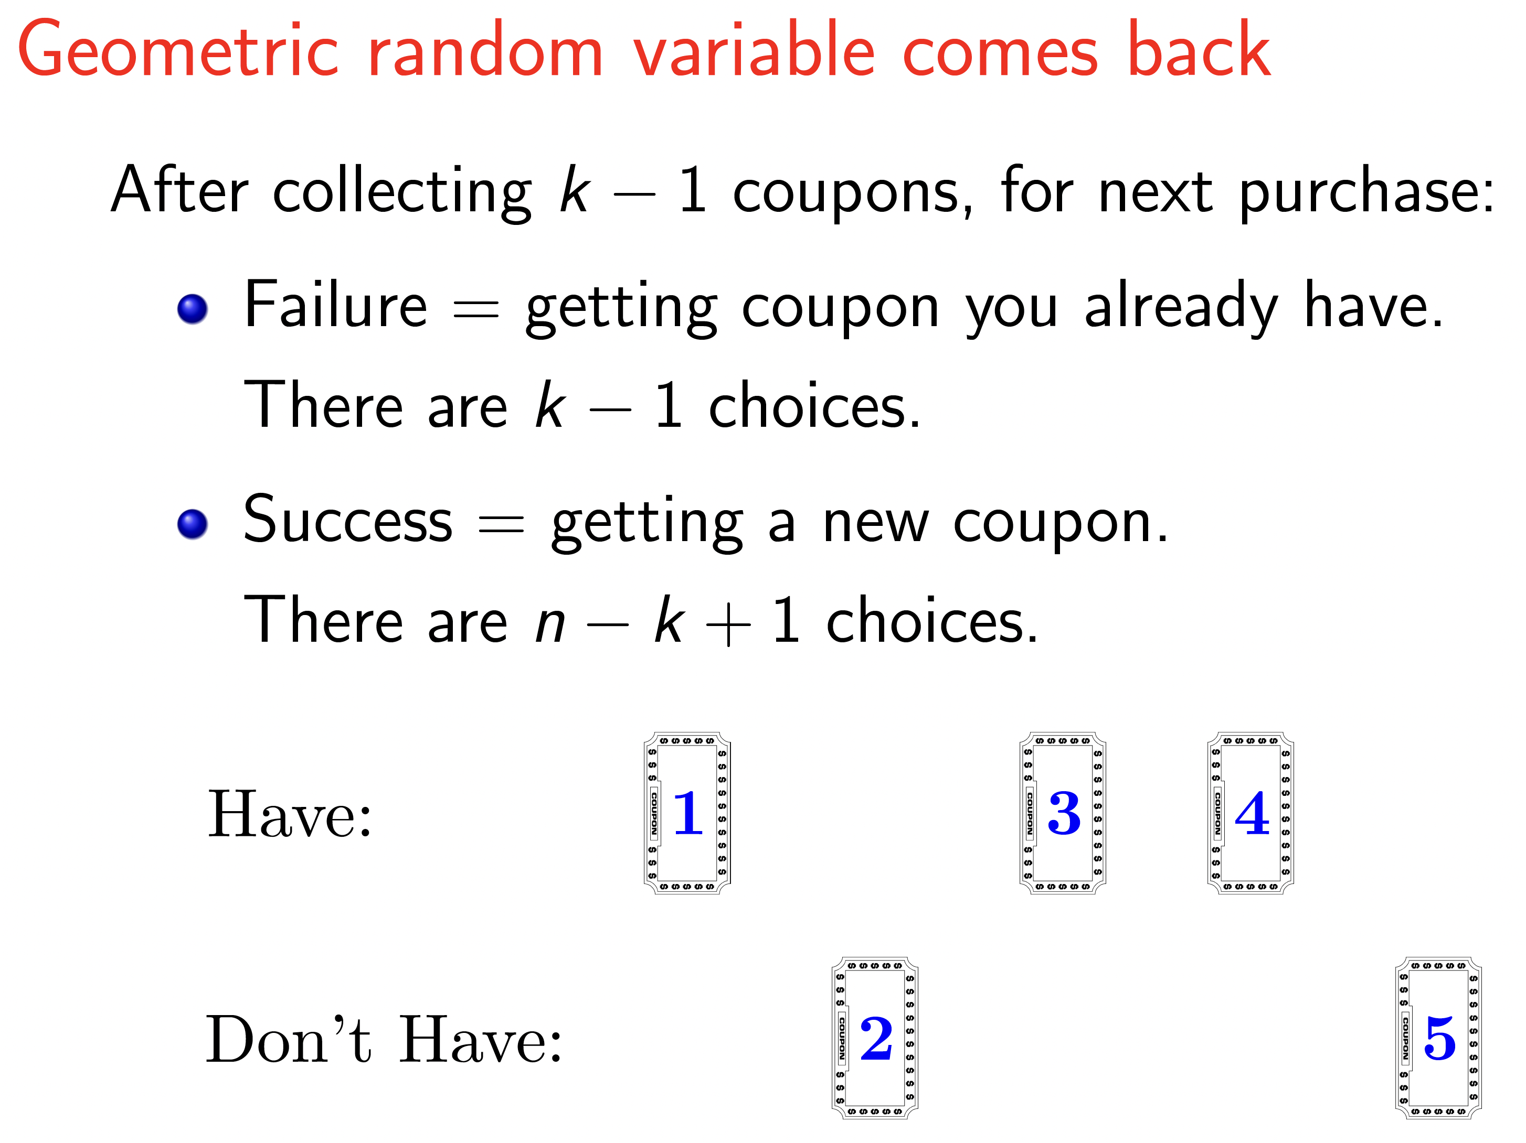

Slide 12
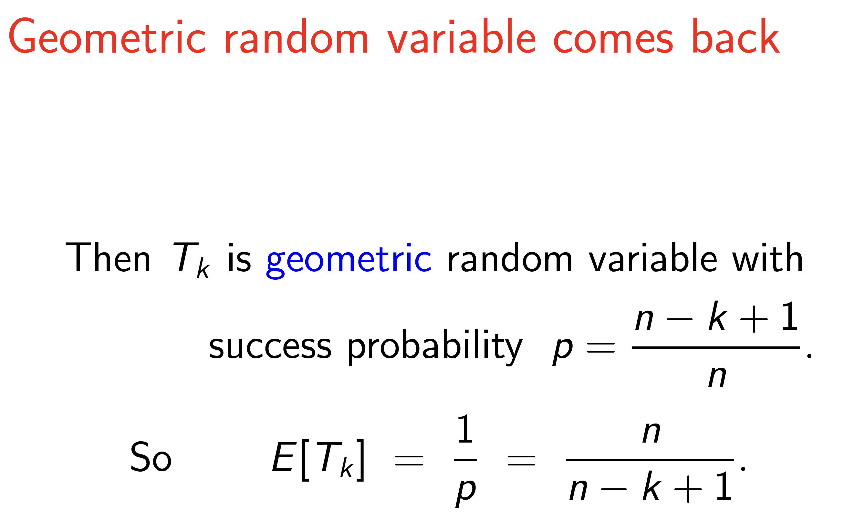

Slide 13
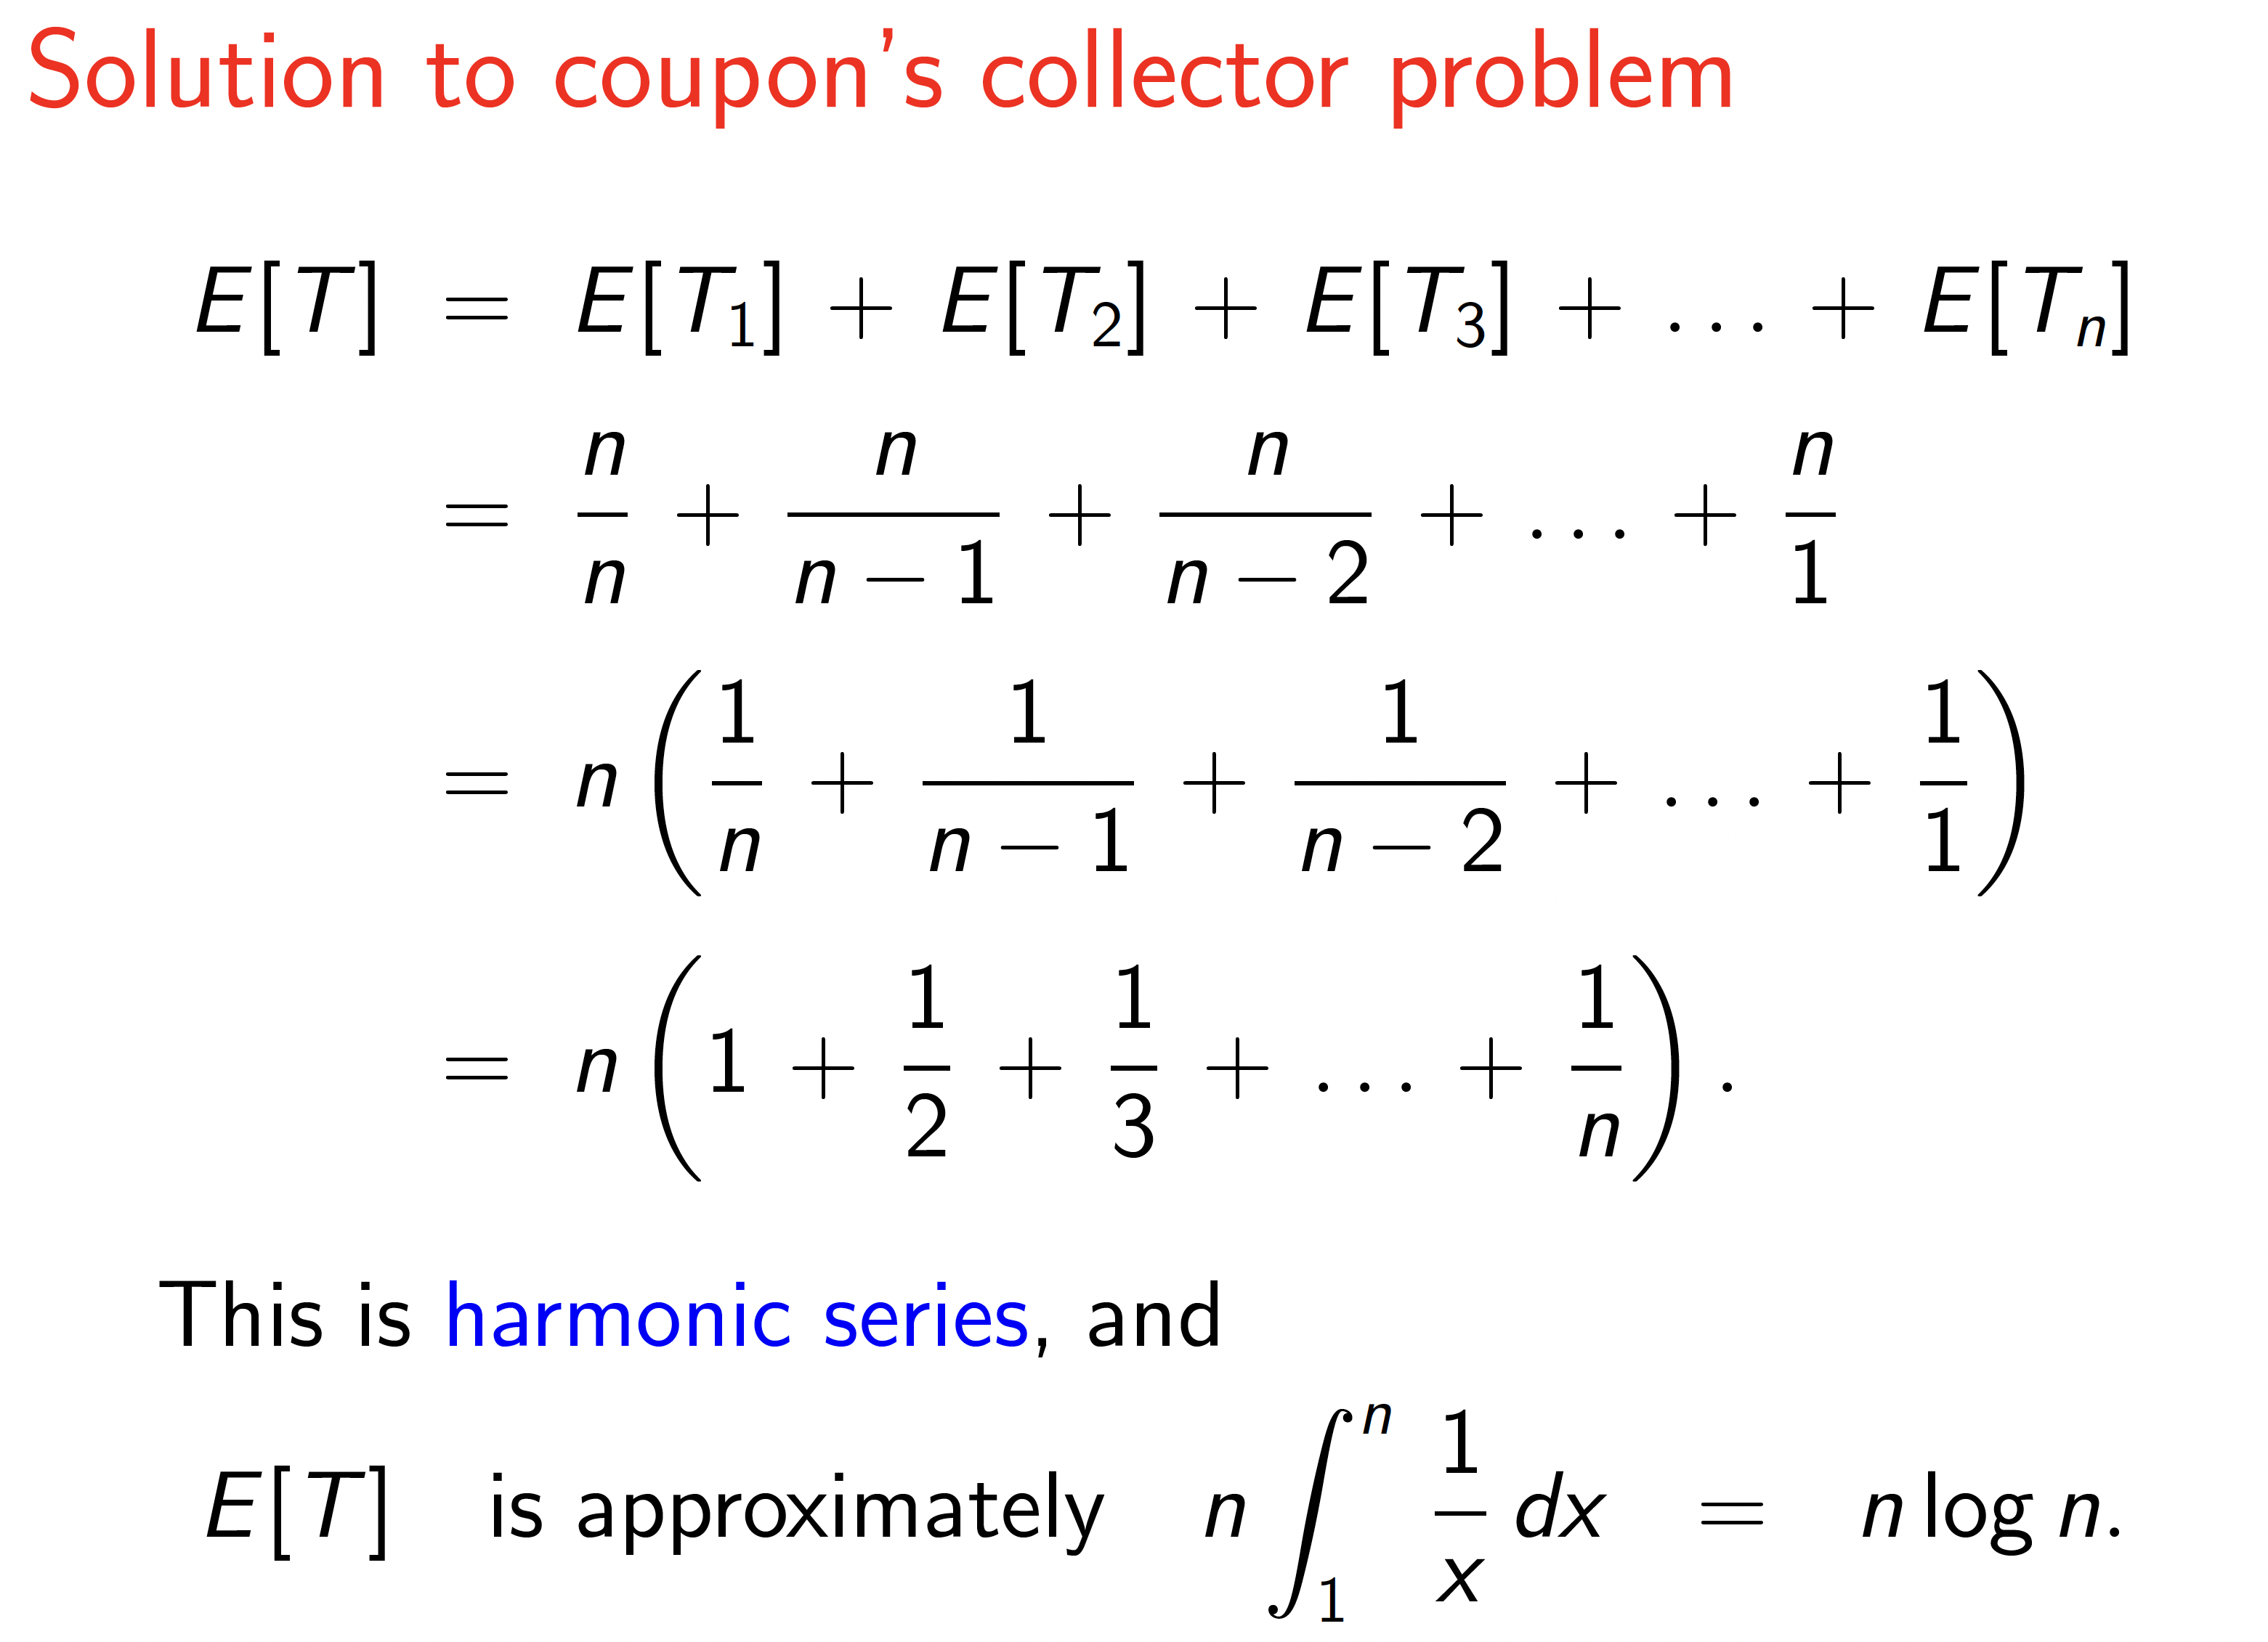

Slide 14
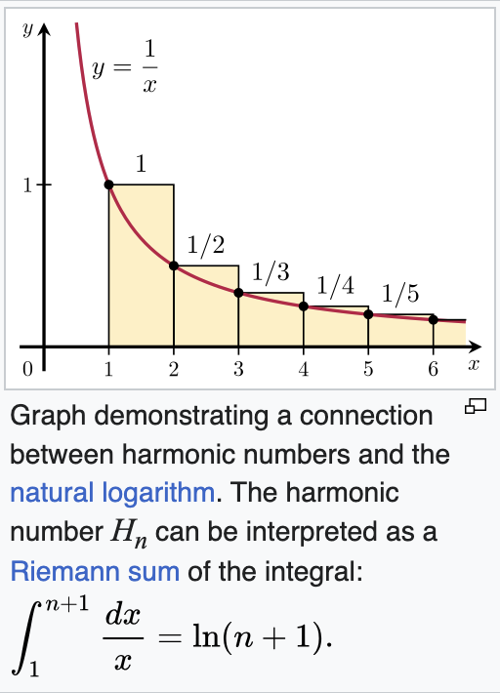
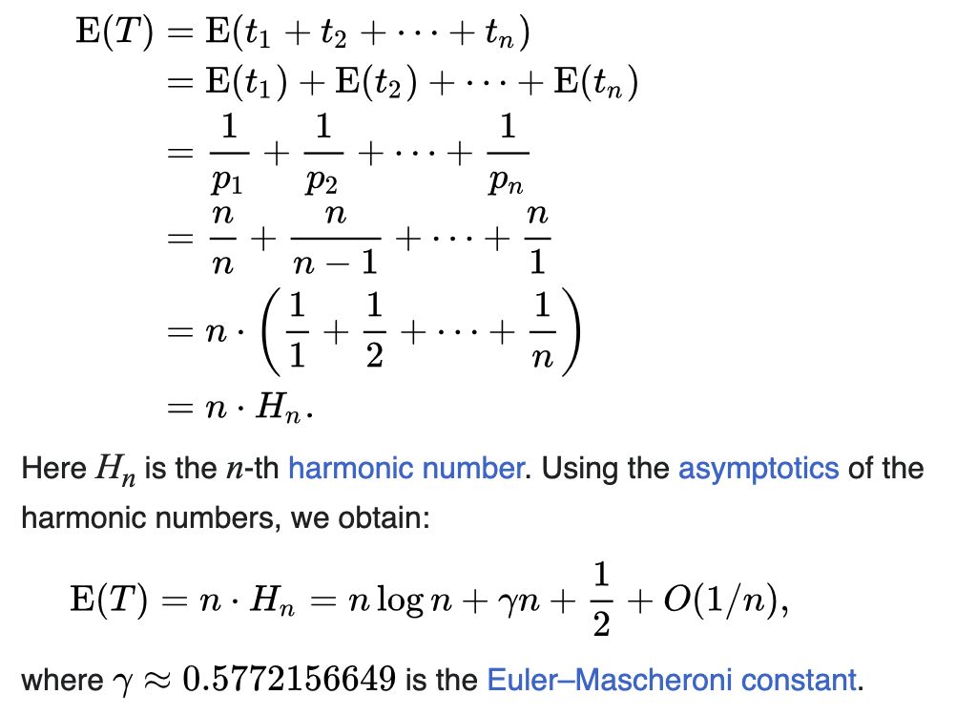
Precise Expected Time for Coupon Collecting
ln

Slide 15
High Probability Bound
To prove that the coupon collector problem requires O(n log n) time with high probability, to collect all n coupons we will actually calculate the probability that a specific number of trials is insufficient to collect all coupons.
The total time, T, can be viewed as a sum of n geometric random variables (which are not identically distributed), so we will apply a standard Chernoff bound here using an independent count technique, where we fix the number of trials and analyze the number of times each specific coupon appears.

Slide 16
Independent Count Technique
Let n be the number of distinct coupons.
We run the coupon collection for t trials, where:
t = c * n ln n,
where c is a constant we will choose later.
We want to prove that after t trials, the probability that we have not collected all n coupons is very small (i.e., bounded by 1/n).

Slide 17
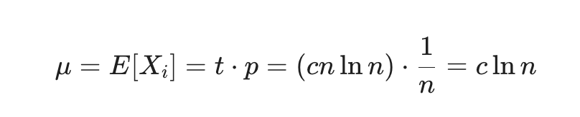
Defining the Random Variables
Let X_{i} be a random variable representing the number of times the i-th coupon is collected during these t trials. This is a sum of t independent 0-1 random variables, each of which is 1 with probability p = 1/n.
Then
We will actually compute the probability that we collect fewer than (c/2)ln n copies of the i-th coupon.

Slide 18
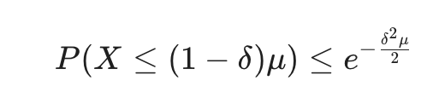
Applying a Chernoff Bound
Use a simplified Chernoff bound, with δ=1/2.
So, with μ=c*ln n, this probability is at most
e^{-(c/8)ln n} = n^{-c/8}
Taking c=16, we get a failure probability of 1/n².
Thus, by a union bound for all n coupons, we will collect at least (c/2)ln n copies of each coupon with probability at least 1-1/n.
i

Slide 19
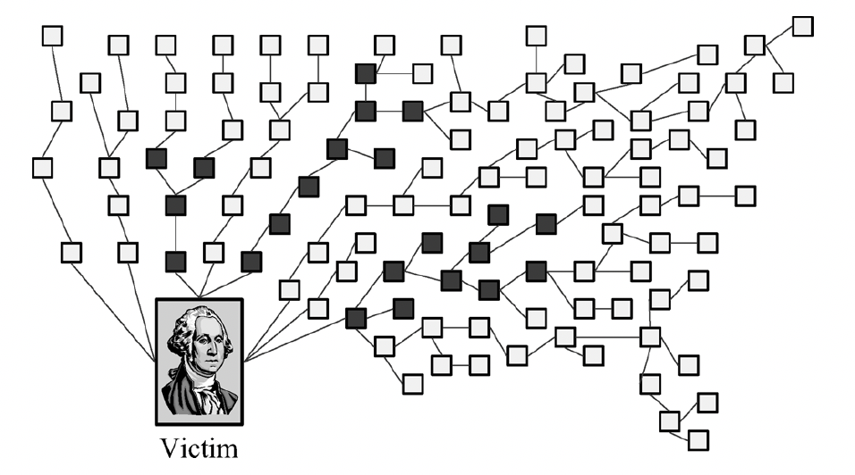
Application – IP Traceback
During a distributed denial-of-service (DDOS) attack, zombie hosts send a lot of message requests to a victim.
The goal in the traceback problem is to identify the leaves of the attack tree, that is, the routers upstream from the victim closest to attack by having routers mark packets with their ID with some probability p (e.g., p=1/20).

Slide 20
Application – IP Traceback
To save bits, each router breaks its ID into l pieces and randomly chooses which piece to use to mark a packet.
In order to traceback the attack nodes, the victim needs to collect at least one packet marked by each intermediate router.
The probability that a packet at distance d reaches the victim is p(1-p)^{d-1}.

Slide 21
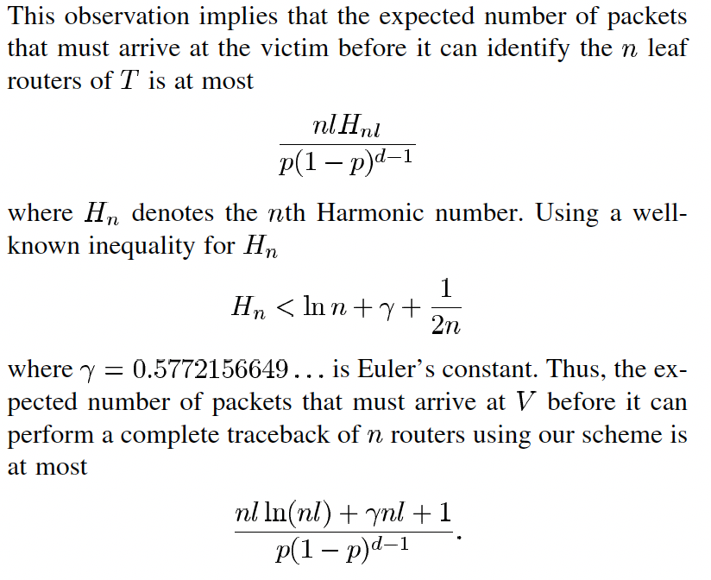
IP Traceback is Coupon Collecting

Slide 22
The Attacker’s Problem
From the attacker’s perspective, finding all the zombie computers, which are vulnerable to a given intrusion attack is also a coupon collection problem.
Note that in the coupon collection problem the goal is to collect all the coupons.
If we change the goal to that of collecting, e.g., 50% or 75% of the coupons, then this can be done in expected linear time.
Why?

Slide 23
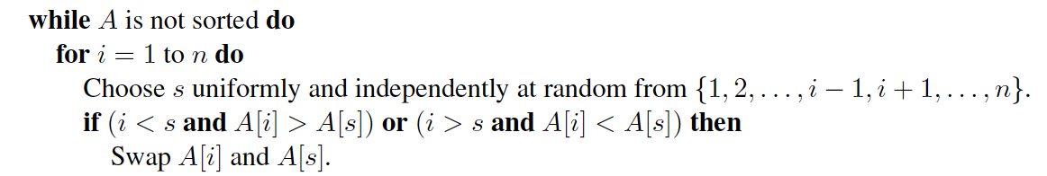
A Silly (But Instructive) Application
Spin-the-Bottle Sort:
What is a high-probability bound for its running time?

Slide 24
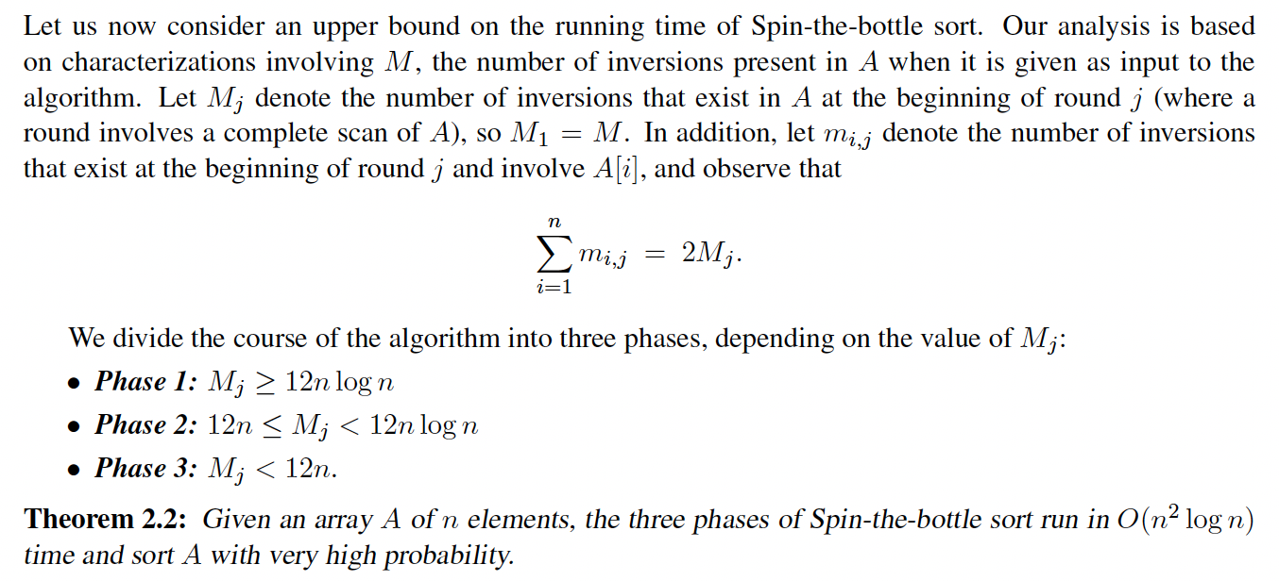
Running Time Analysis

Slide 25
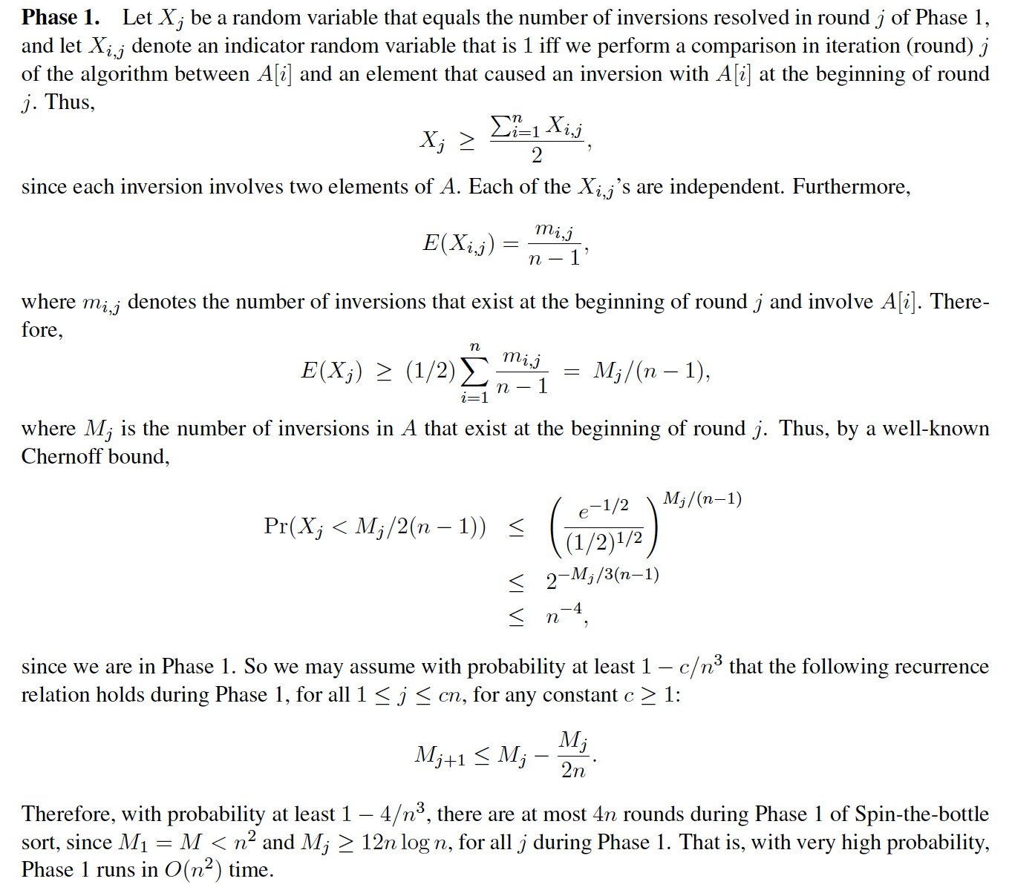

Slide 26
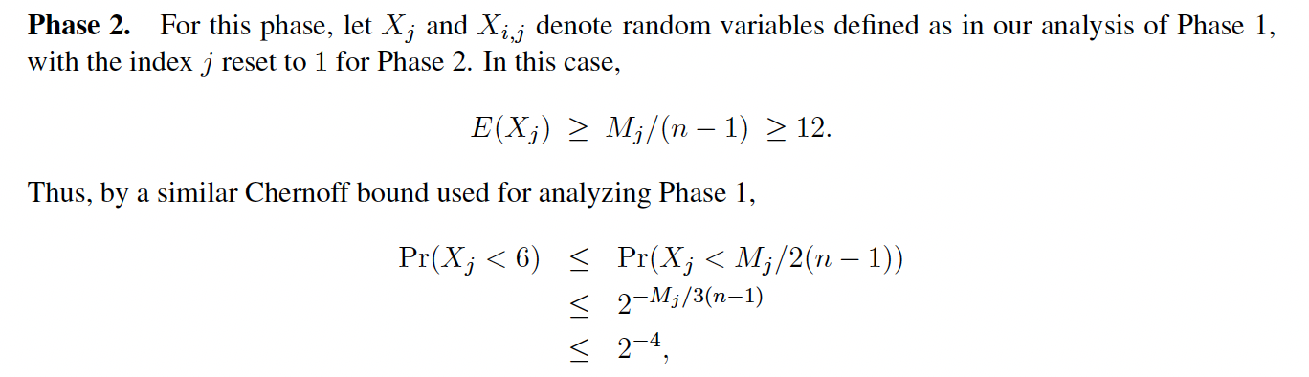
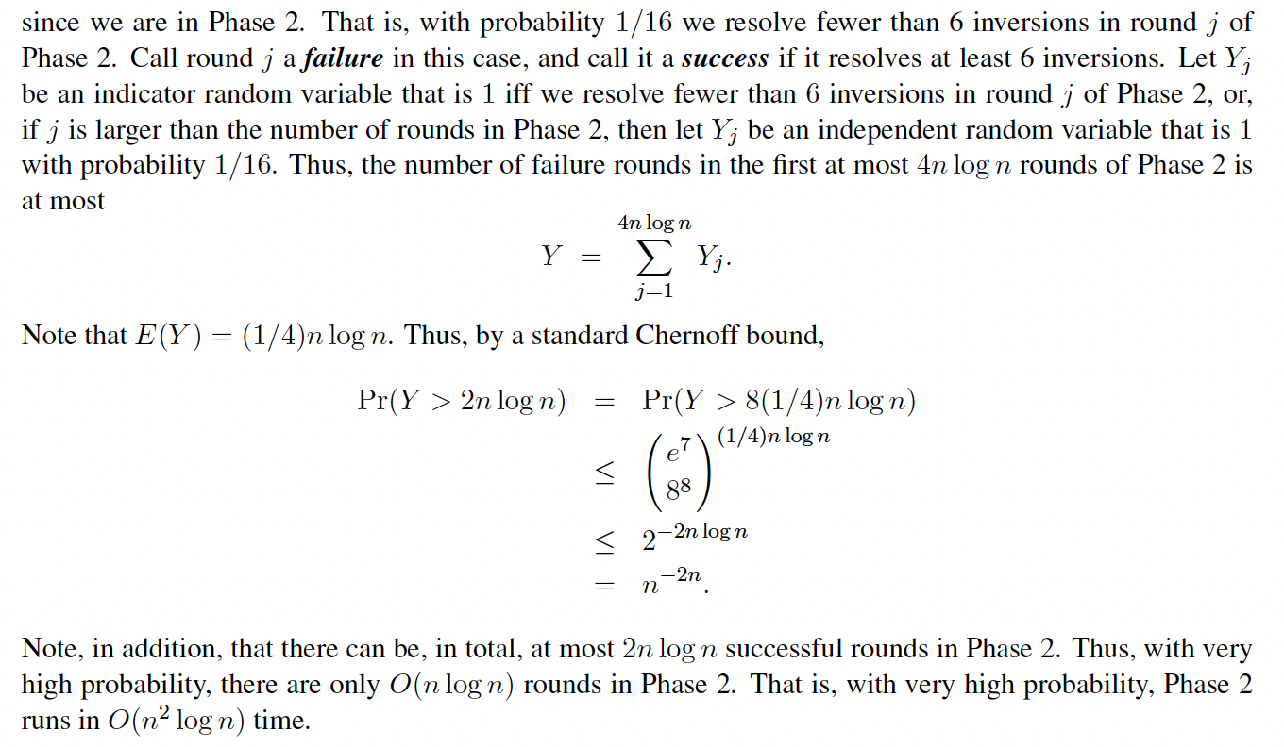

Slide 27
