Slide 1
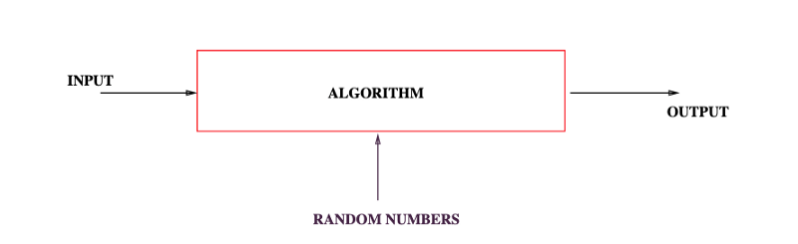
Concentration Bounds
Michael T. Goodrich
CS 263
Univ. of California, Irvine
Some slides adapted from Rutgers University and Mitzenmacher and Upfal.

Slide 2
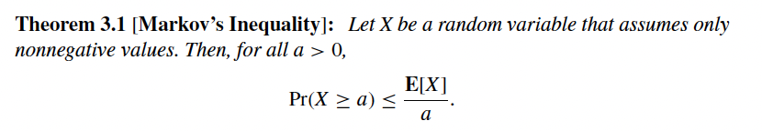
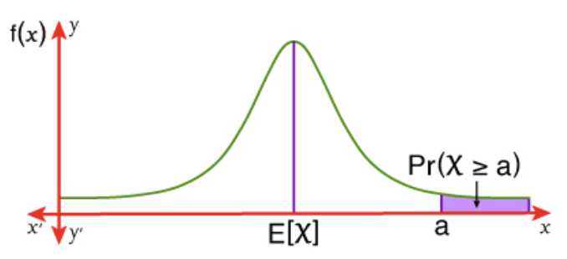
Markov’s Inequality
Image from https://mathmonks.com/inequalities/markov-and-chebyshevs-inequality

Slide 3
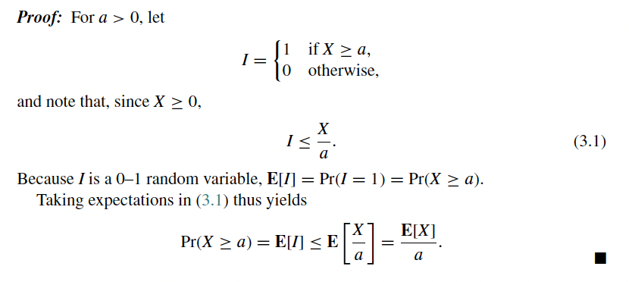
Markov’s Inequality

Slide 4
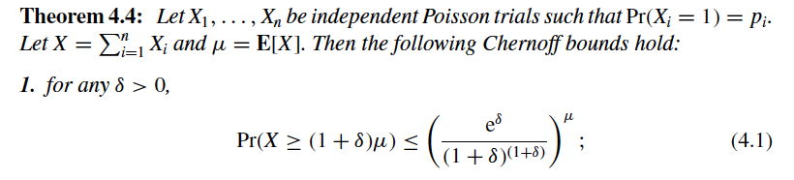
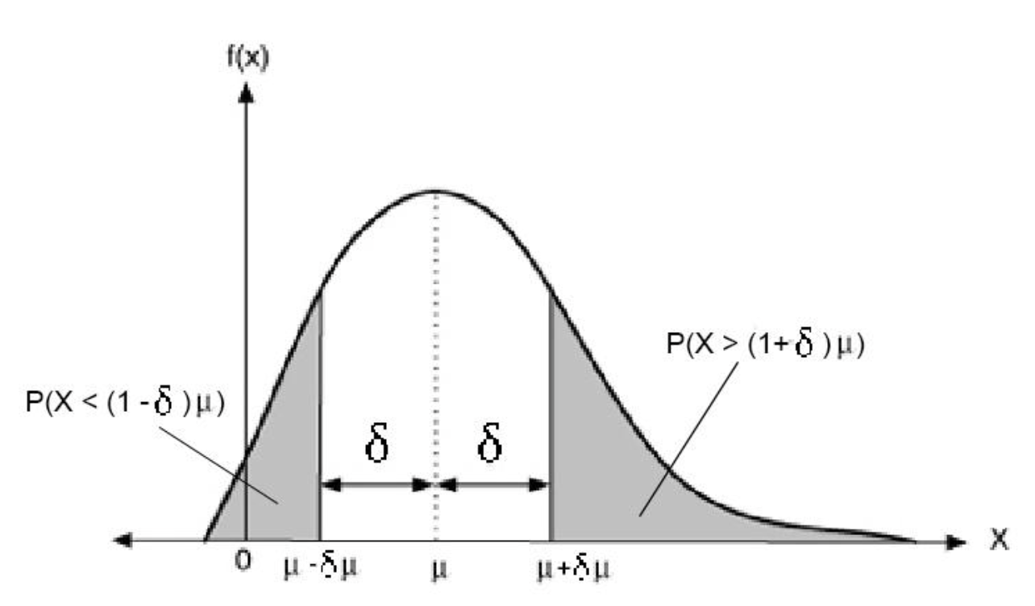
Chernoff Bound – Upper Tail
Image from https://zhuanlan.zhihu.com/p/441281881

Slide 5
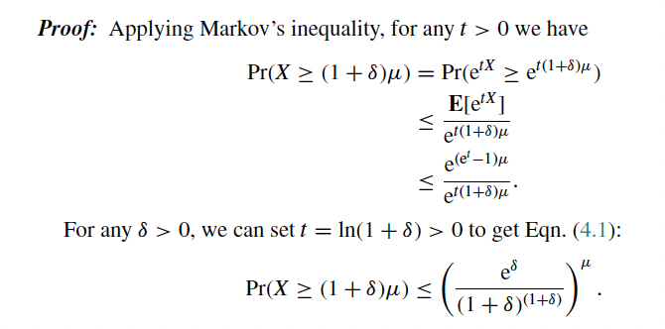
Chernoff Bound – Proof

Slide 6
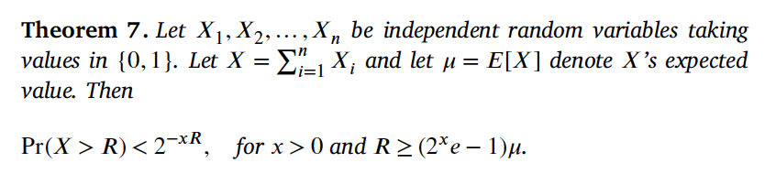
Chernoff Bound - Simplified
Proof: See Dillencourt-Goodrich-Mitzenmacher
Image from https://zhuanlan.zhihu.com/p/441281881

Slide 7

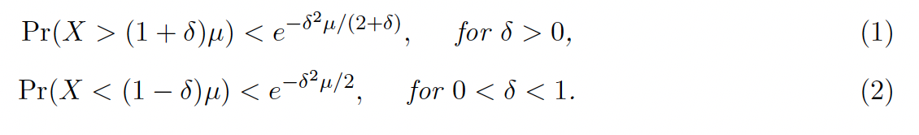
Chernoff Bound - Simplified
For example, for x=1: Pr(X>R)<2^{-R} for R>4.5μ

Slide 8
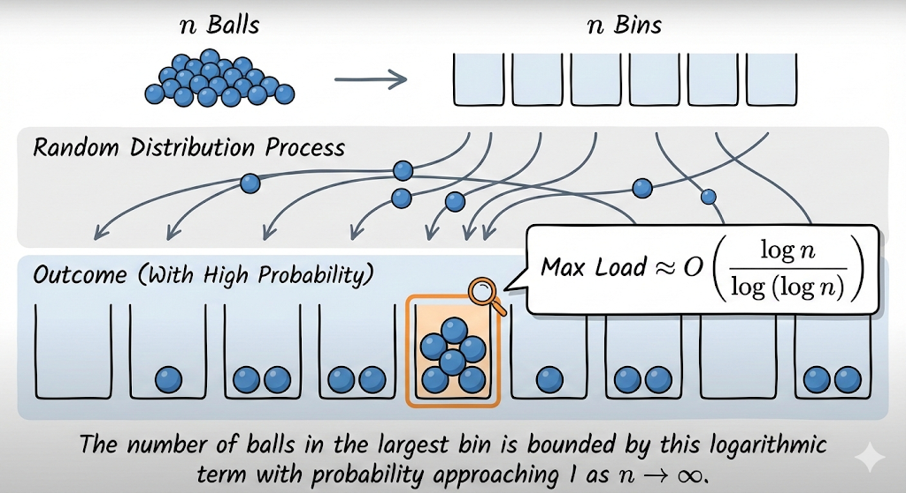
Balls in Bins
Image generated using Nano Banana Pro.

Slide 9
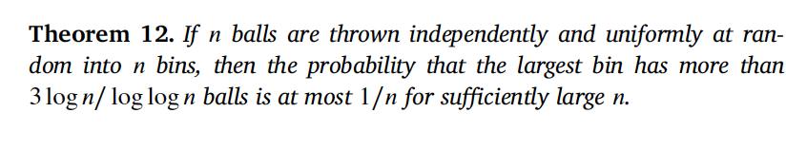
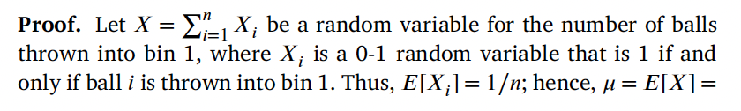
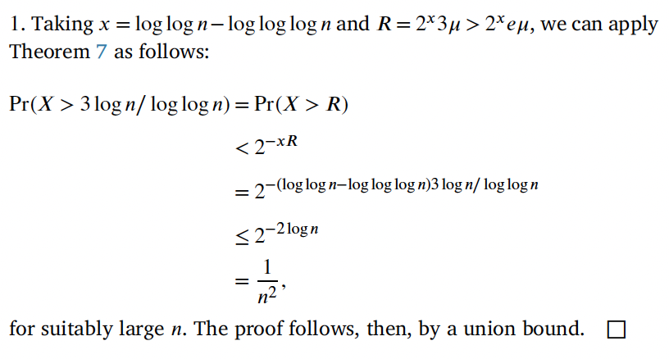
Maximum Bin Size

Slide 10
Application – Load Balancing
Suppose we have a set of n processors and a set of n jobs for them to perform, but no good way of assigning jobs to processors.
So we just assign jobs to processors at random.
Then, with high probability, no processor is assigned more than O(log n/loglog n) jobs.

Slide 11
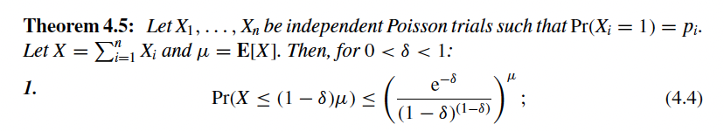
Chernoff Bounds – lower tail
Image from https://zhuanlan.zhihu.com/p/441281881

Slide 12
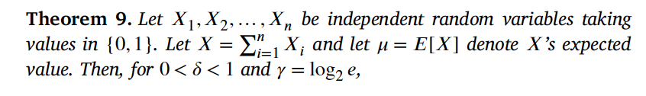
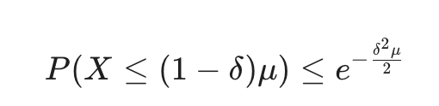
Chernoff Bounds - Simplified
Image from https://zhuanlan.zhihu.com/p/441281881

Slide 13
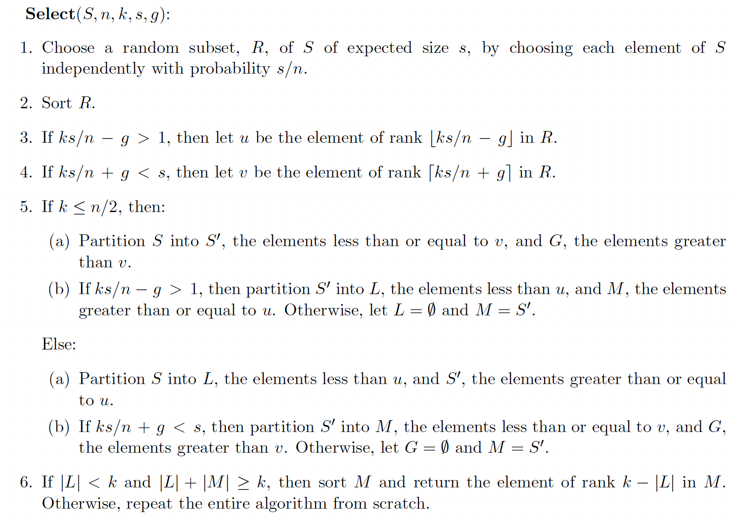
Floyd-Rivest selection

Slide 14
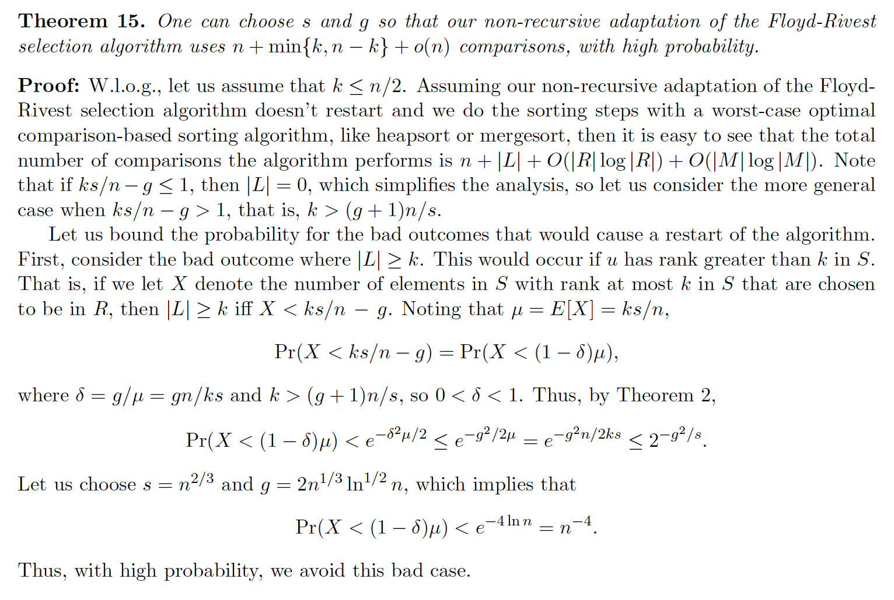
Floyd-Rivest selection, continued

Slide 15
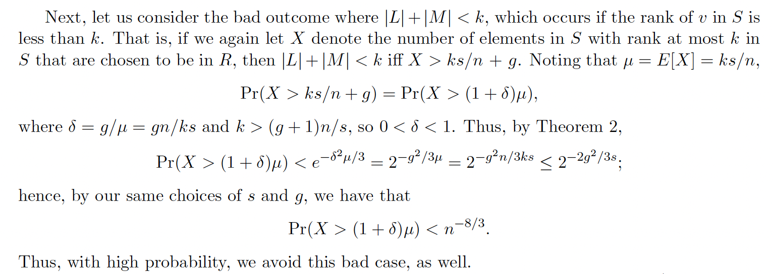
Floyd-Rivest selection, analysis

Slide 16
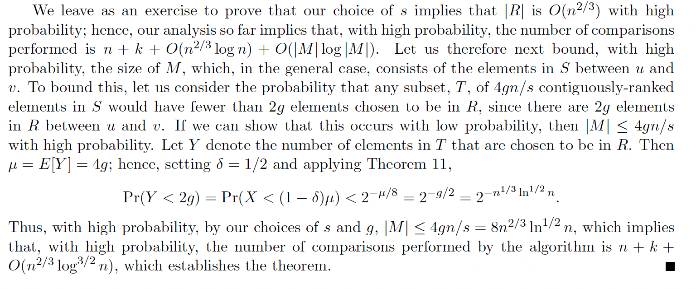
Floyd-Rivest selection, analysis

Slide 17
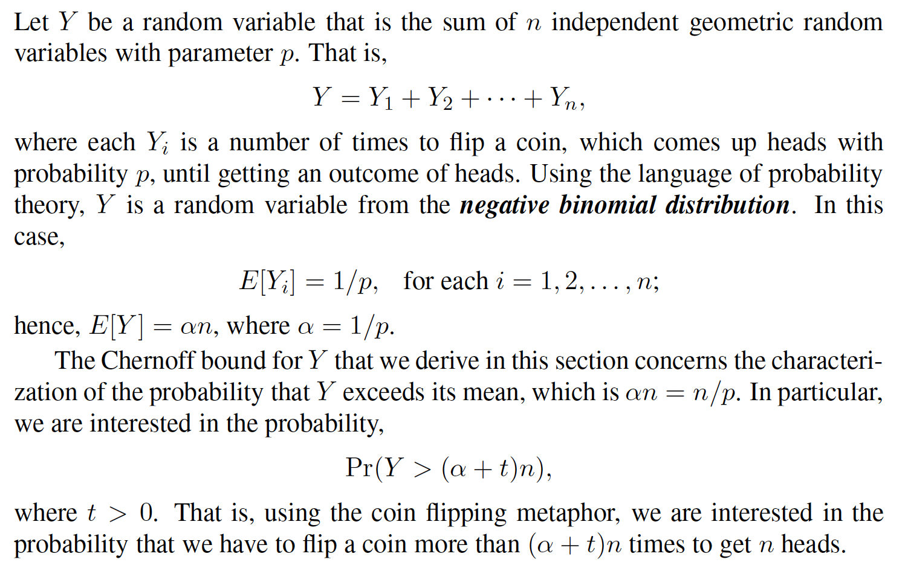
Sums of Geometric Random Variables

Slide 18
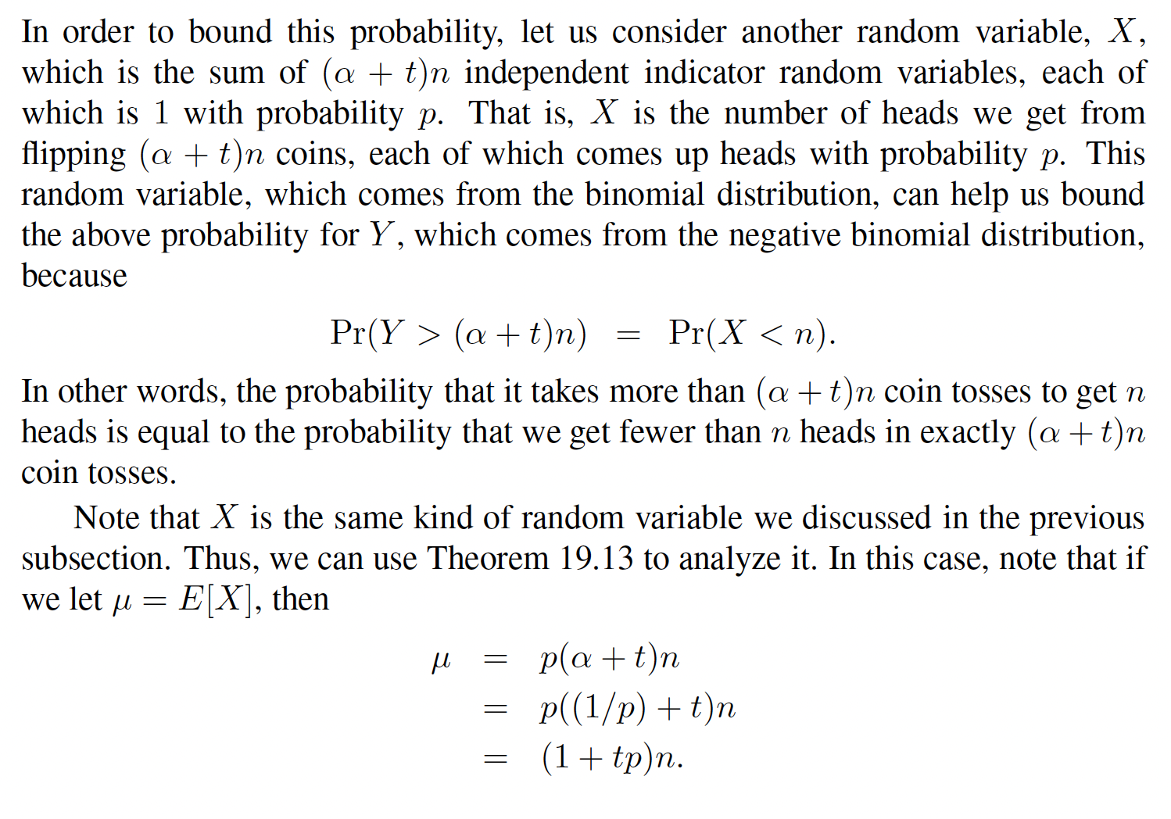
Sums of Geometric Random Variables

Slide 19
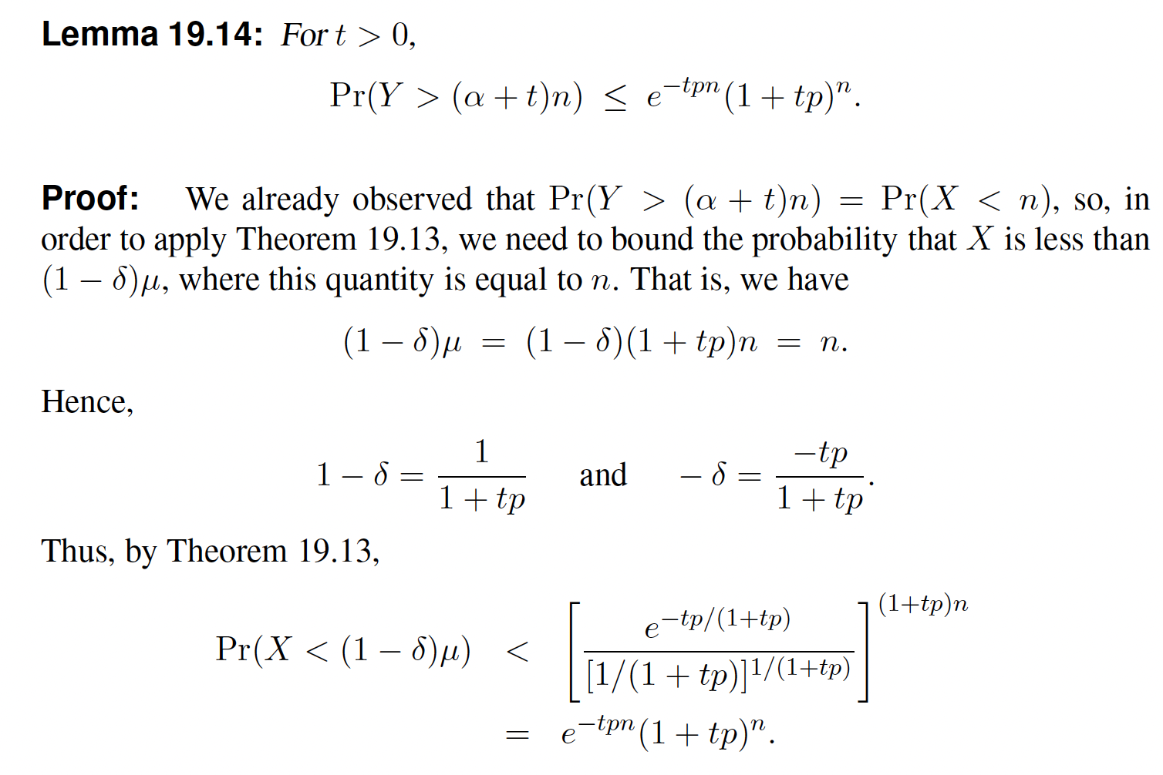
Sums of Geometric Random Variables

Slide 20
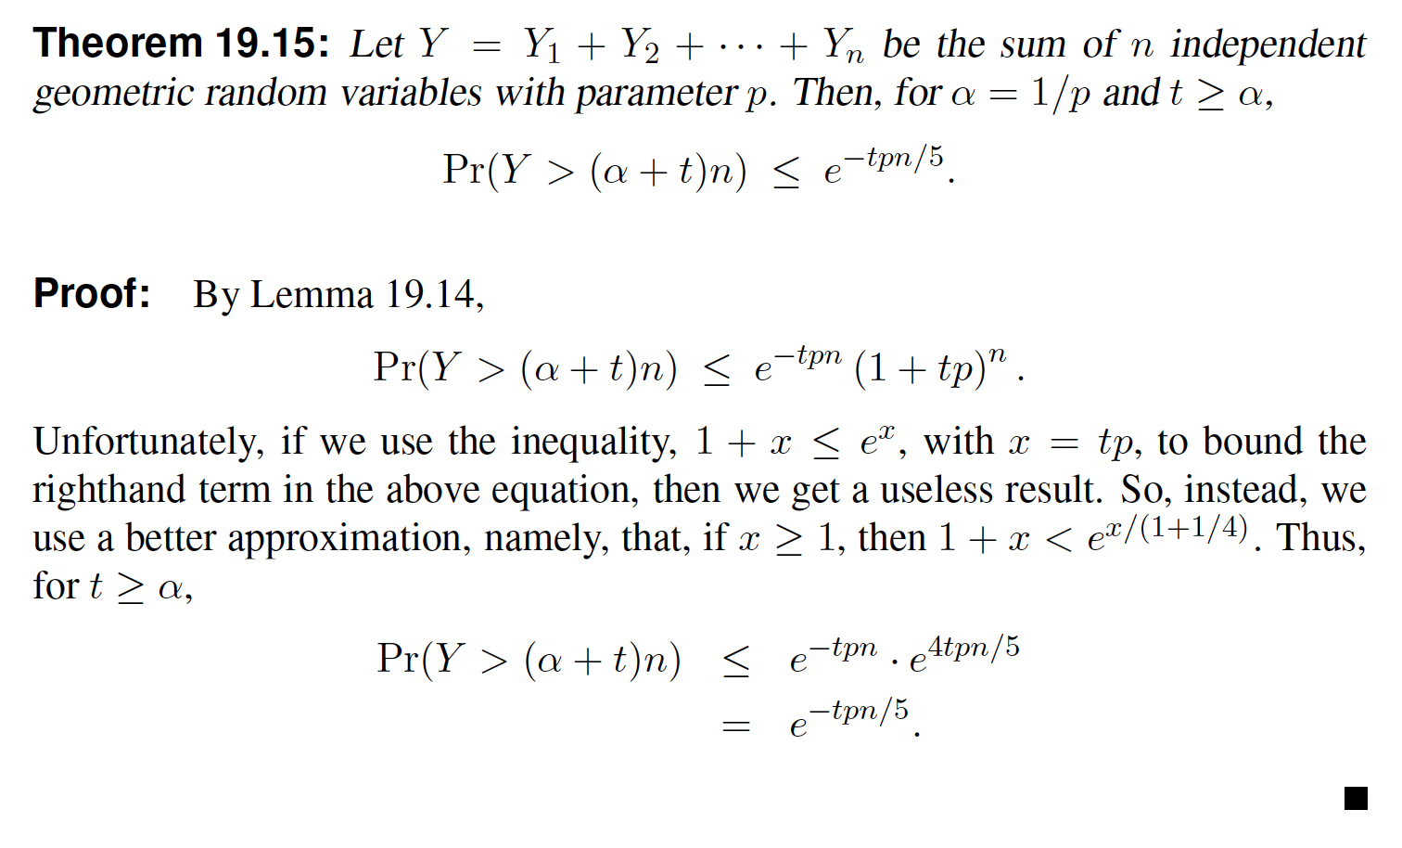
Sums of Geometric Random Variables

Slide 21
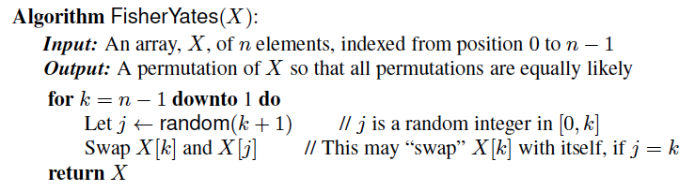
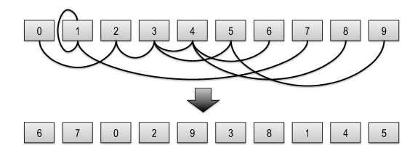
Fisher-Yates Random Shuffling

Slide 22

Analysis of Fisher-Yates
This algorithm runs in O(n) time, by spending O(1) time per element, swapping it with an element earlier in the array (or itself).
Notice that each element has an equal probability, of 1/n, of being chosen as the last element in the array X (including the element that starts out in that position).
Applying this analysis recursively, we see that the output permutation has probability
That is, each permutation is equally likely.

Slide 23
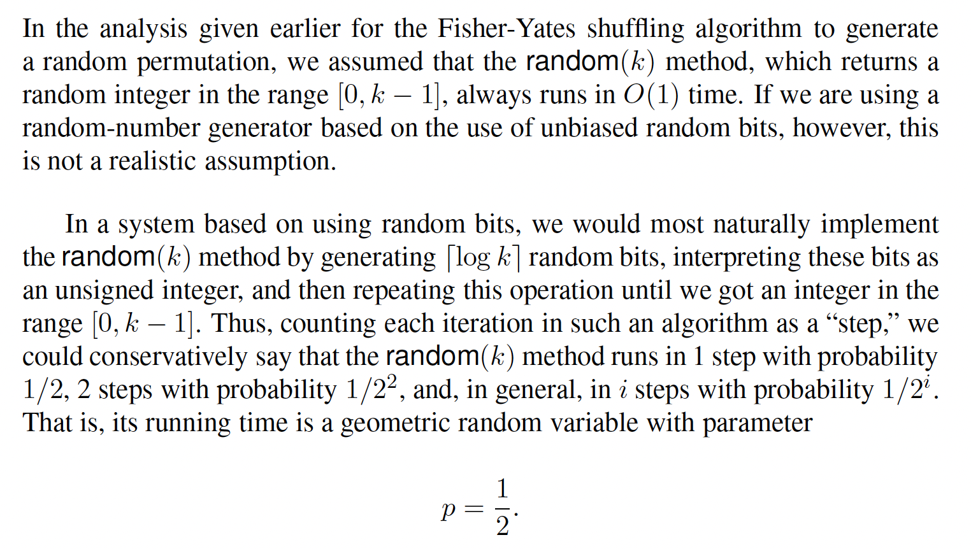
A More Careful Analysis

Slide 24
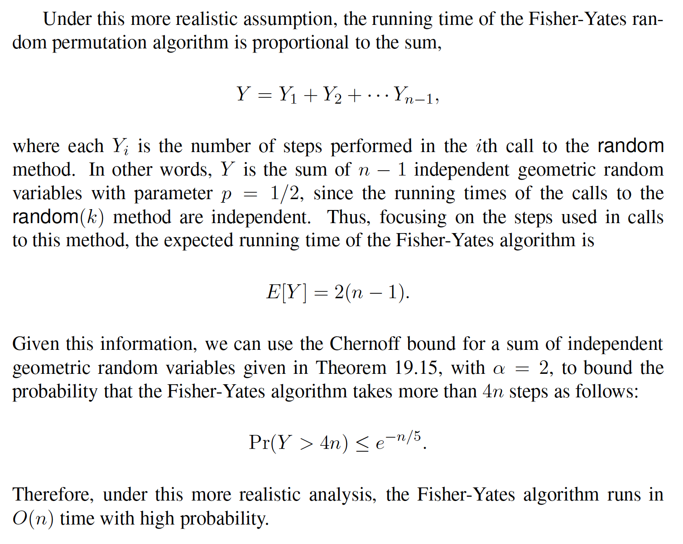
A More Careful Analysis

Slide 25
Revisiting Skip Lists
A skip list for a set S of distinct (key, element) items is a series of lists S₀, S₁ , … , S_{h} such that
Each list S_{i} contains the special keys +∞ and −∞
List S₀ contains the keys of S in non-decreasing order
Each list is a subsequence of the previous one, i.e., S₀ ⊇ S₁ ⊇ … ⊇ S_{h}
List S_{h} contains only the two special keys, plus and minus infinity
Each element is copied to the next higher level with probability 1/2.
S₃
−∞
+∞
S₂
−∞
31
+∞
S₁
−∞
23
31
34
64
+∞
S₀
−∞
12
23
26
31
34
44
56
64
78
+∞

Slide 26
Top-Down Search
We search for a key x in a a skip list as follows:
We start at the first position of the top list
At the current position p, we compare x with y ← key(after(p))
x = y: we return element(after(p))
x > y: we “scan forward”
x < y: we “drop down”
If we try to drop down past the bottom list, we return NO_SUCH_KEY
Example: search for 78
S₃
−∞
+∞
S₂
−∞
31
+∞
S₁
−∞
23
31
34
64
+∞
S₀
−∞
12
23
26
31
34
44
56
64
78
+∞

Slide 27
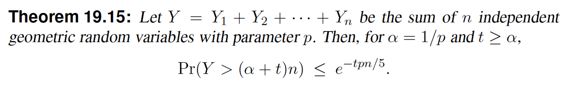
Refined Analysis of Skip Lists
There are at most 3*log n levels with probability 1-1/n².
Thus, whp, the expected time to do a search is bounded by the sum of 3*log n geometric random variables with probability 1/2, which has expected value 6*log n.
So α=2, n=6*log n, and take t=3.
Then search is O(log n) with high probability.

