Slide 1
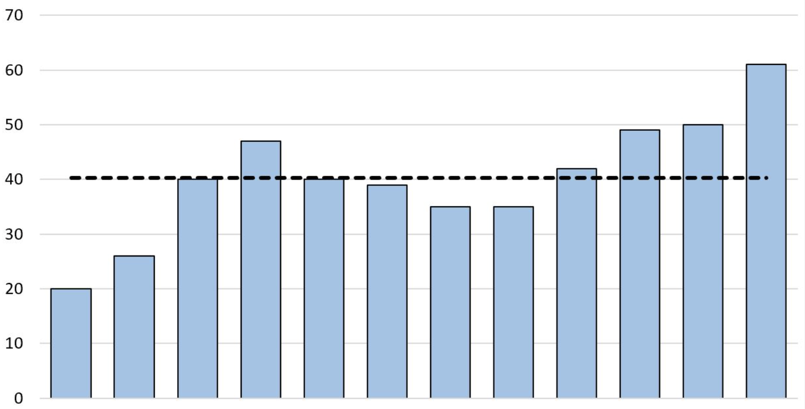
Amortized Analysis
Michael T. Goodrich
CS 263
Univ. of California, Irvine
Some slides adapted from Nanjing University, Basheer Qolomany, Michael Bender, Haodong Hu, and Jeff Erickson.

Slide 2
The Accounting Method Example: Binary Counter
Use length $n$ binary array $A$ to represent a number.
The number is 0 initially, and Inc op. adds 1 to this number.
Cost of Inc: number of bits it flipped.
Average cost of $k$ Inc operations?
Easy answer: $O\left(n\right)$
More careful analysis… (Amortized analysis…)
$$A\left[n−1\right]$$
$$A\left[0\right]$$
Inc(A):
i=0
while (i<n and A[i]==1)
A[i]=0
i=i+1
if (i<n)
A[i]=1
0
1
0
0
1
1
Inc()
0
1
0
1
0
0

Slide 3
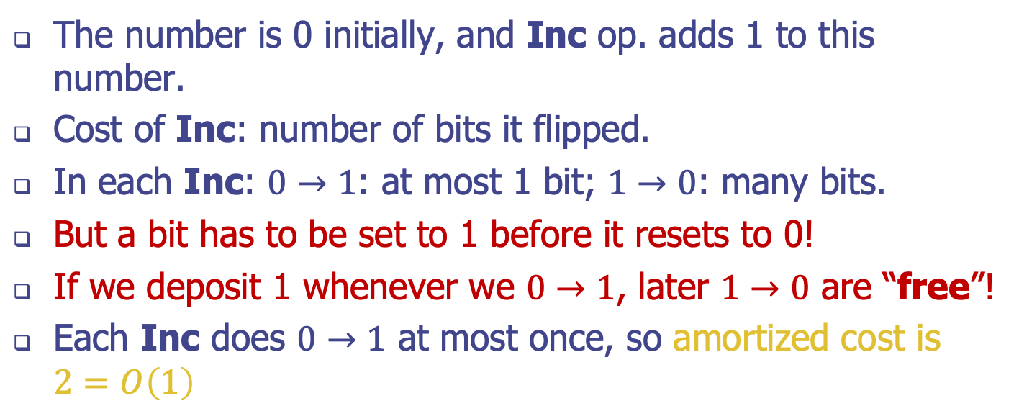
Example: Binary Counter
The number is 0 initially, and Inc op. adds 1 to this number.
Cost of Inc: number of bits it flipped.
In each Inc: $0→1$: at most 1 bit; $1→0$: many bits.
But a bit has to be set to 1 before it resets to 0!
If we deposit 1 whenever we $0→1$, later $1→0$ are “free”!
Each Inc does $0→1$ at most once, so amortized cost is $2=O\left(1\right)$
0
1
0
0
1
1
Inc(A):
i=0
while (i<n and A[i]==1)
A[i]=0
i=i+1
if (i<n)
A[i]=1
Inc()
0
1
0
1
0
0

Slide 4
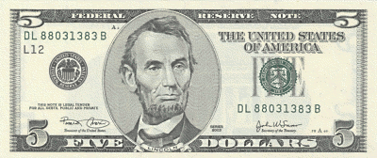
Actual Total Cost
Amortized Total Cost
0
0
0
0
0
0
$$1$$
$$×2$$
0
0
0
0
0
1
$$1+2=3$$
$$×4$$
0
0
0
0
1
0
$$3+1=4$$
$$×6$$
0
0
0
0
1
1
$$4+3=7$$
$$×8$$
0
0
0
1
0
0

Slide 5
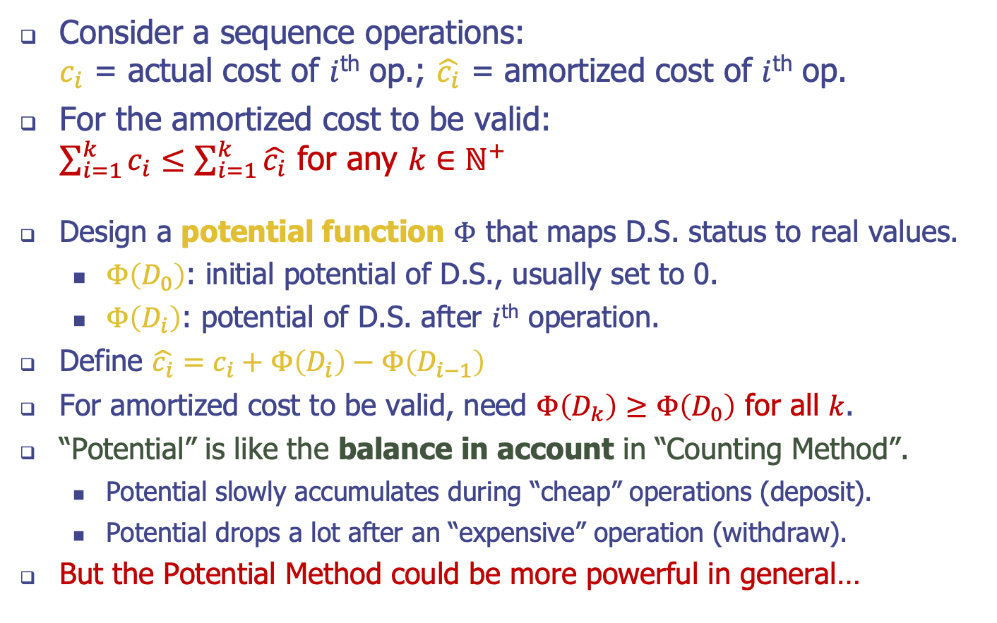
The Potential Method
Consider a sequence operations: $c_{i}$ = actual cost of $i$^{th} op.; $\hat{c_{i}}$ = amortized cost of $i$^{th} op.
For the amortized cost to be valid: $\sum_{i=1}^{k}{c_{i}}≤\sum_{i=1}^{k}{\hat{c_{i}}}$ for any $k∈ℕ^{+}$
Design a potential function $Φ$ that maps D.S. status to real values.
$Φ\left(D_{0}\right)$: initial potential of D.S., usually set to 0.
$Φ\left(D_{i}\right)$: potential of D.S. after $i$^{th} operation.
Define $\hat{c_{i}}=c_{i}+Φ\left(D_{i}\right)−Φ\left(D_{i−1}\right)$
For amortized cost to be valid, need $Φ\left(D_{k}\right)≥Φ\left(D_{0}\right)$ for all $k$.
“Potential” is like the balance in account in “Counting Method”.
Potential slowly accumulates during “cheap” operations (deposit).
Potential drops a lot after an “expensive” operation (withdraw).
But the Potential Method could be more powerful in general…

Slide 6
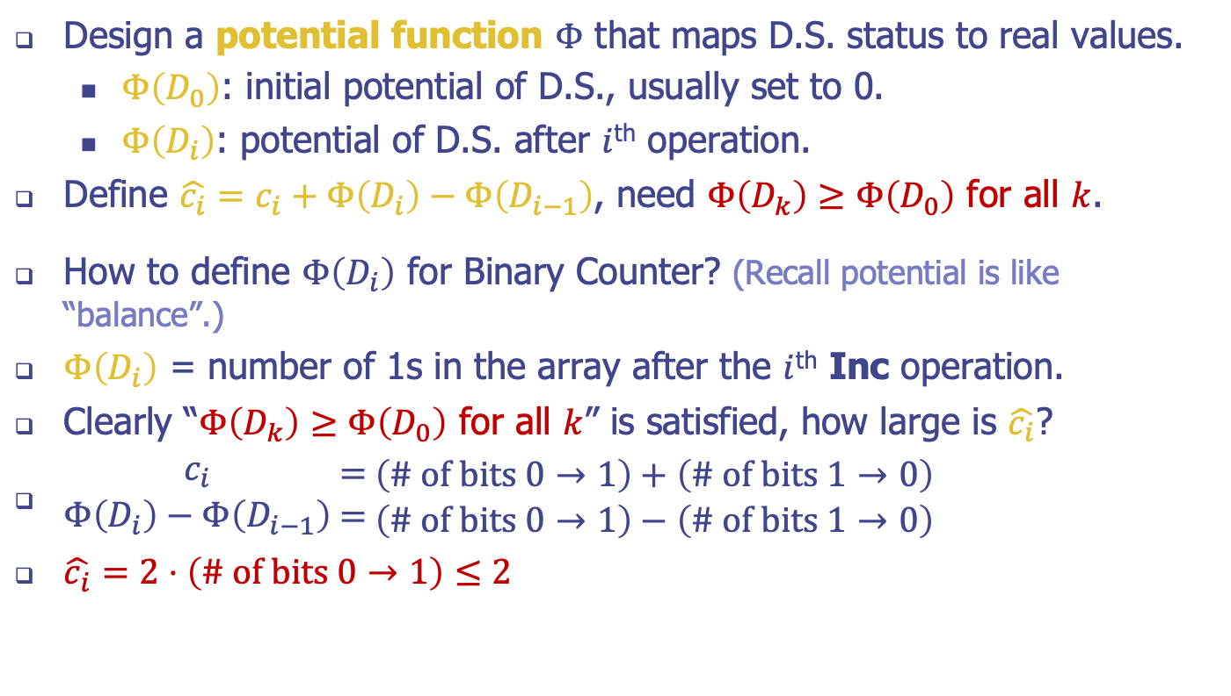
Example: Binary Counter
Design a potential function $Φ$ that maps D.S. status to real values.
$Φ\left(D_{0}\right)$: initial potential of D.S., usually set to 0.
$Φ\left(D_{i}\right)$: potential of D.S. after $i$^{th} operation.
Define $\hat{c_{i}}=c_{i}+Φ\left(D_{i}\right)−Φ\left(D_{i−1}\right)$, need $Φ\left(D_{k}\right)≥Φ\left(D_{0}\right)$ for all $k$.
How to define $Φ\left(D_{i}\right)$ for Binary Counter? (Recall potential is like “balance”.)
$Φ\left(D_{i}\right)$ = number of 1s in the array after the $i$^{th} Inc operation.
Clearly “$Φ\left(D_{k}\right)≥Φ\left(D_{0}\right)$ for all $k$” is satisfied, how large is $\hat{c_{i}}$?
$\begin{matrix}c_{i} \\ Φ\left(D_{i}\right)−Φ\left(D_{i−1}\right)\end{matrix}\begin{matrix} = \\ =\end{matrix}\begin{matrix}\left(\text{\# }\text{of} \text{bits} 0→1\right)+\left(\text{\#} \text{of} \text{bits} 1→0\right) \\ \left(\text{\# }\text{of} \text{bits} 0→1\right)−\left(\text{\# }\text{of} \text{bits} 1→0\right)\end{matrix}$
$\hat{c_{i}}=2⋅\left(\text{\# }\text{of} \text{bits} 0→1\right)≤2$
0
1
0
0
1
1
Inc()
0
1
0
1
0
0

Slide 7
Making Structures Dynamic
Two types of data structures for solving searching problems:
A static structure is built once and then searched many times; insertions and deletions of elements are not allowed.
dynamic structure: This structure is initially empty, and the three operations available on it are for inserting a new element, for deleting a current element, and for performing a search.

Slide 8
Static & Dynamic Structures
To describe the performance of the static structure A we give three functions of n :
P(n) = the preprocessing time required to build A,
Q(n) = the query time required to perform a search in A,
S(n) = the storage required to represent A.
We analyze the performance of the dynamic structure B by giving the functions
I(n) = the insertion time for B,
D(n) = the deletion time for B,
Q(n) = the query time required to perform a search in B,
S(n) = the storage required to represent B.

Slide 9
Decomposable search problems
The notion of decomposable search problems, and the idea of a static-to-dynamic transformation, goes back to Bentley and Saxe (1980).
A search problem is decomposable if, for any pair of disjoint data sets D and D′, the answer to a query over D ∪ D′ can be computed in constant time from the answers to queries over the individual sets; that is,
Q(x, D ∪ D′) = Q(x, D) ⋄ Q(x, D′),
for some commutative and associative binary function ⋄ that maps A x A → A and can be computed in O(1) time.

Slide 10
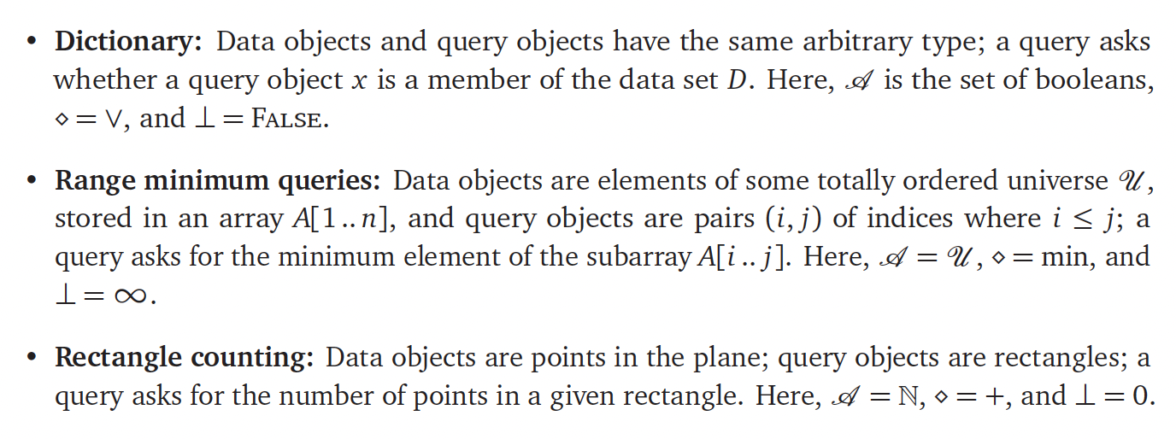
Examples

Slide 11
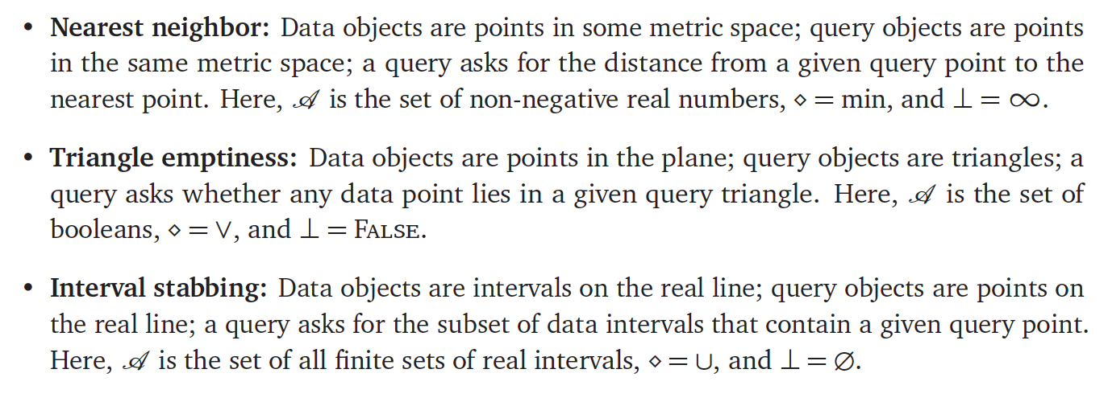
Examples, continued

Slide 12
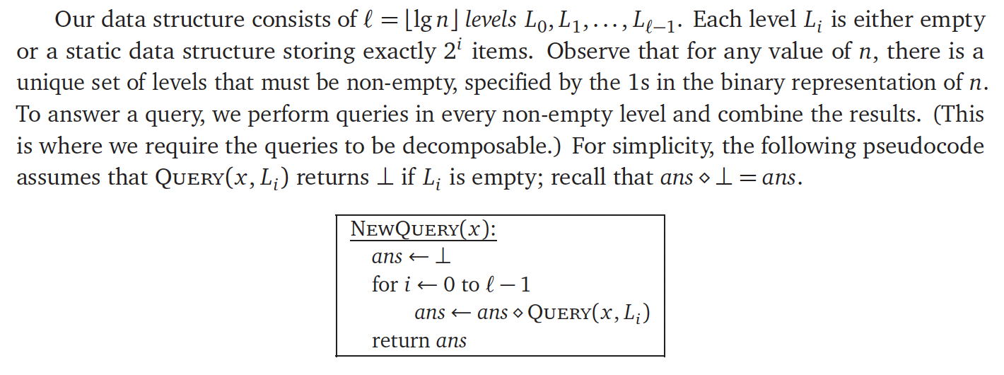
Insertions Only - Build & Query

Slide 13
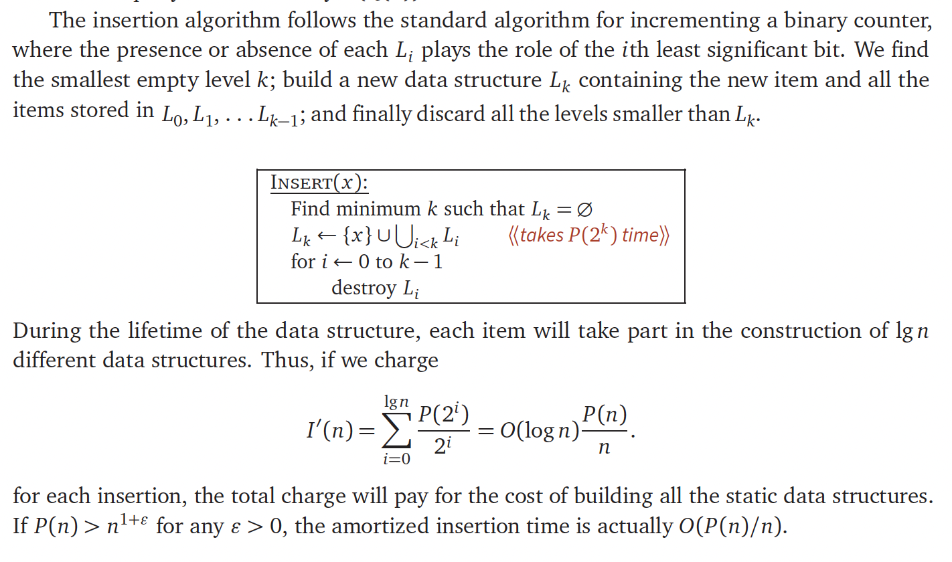
Insertions Only - Updates

Slide 14
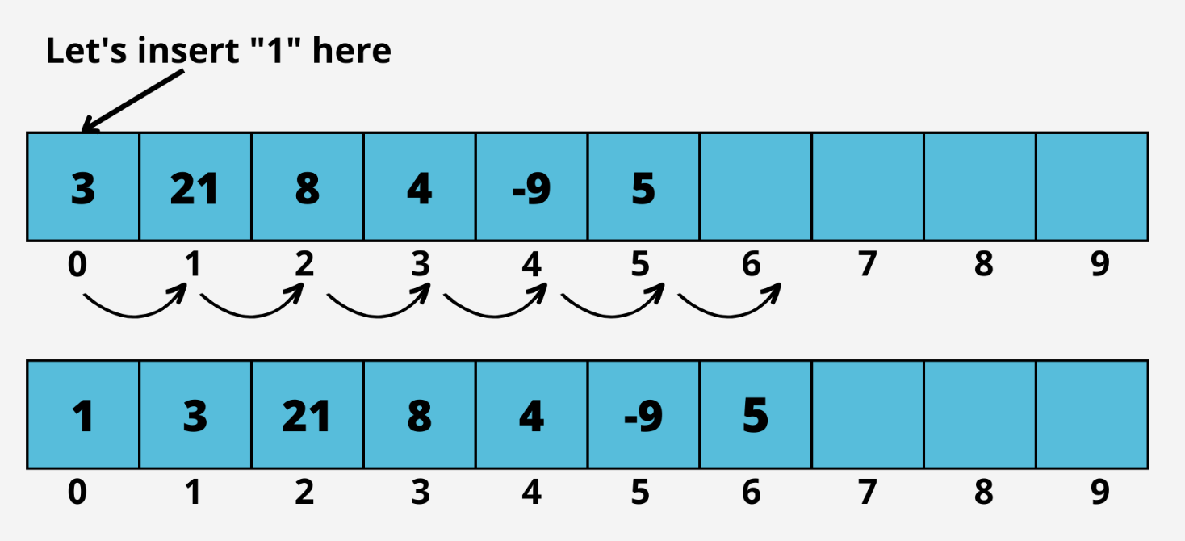
Array Order Maintenance
Problem: Maintain an array, A, of elements according to a specific order.
This is often a low-level data structure used by other structures.
Performance: insert & delete take O(n) time in the worst case (and average case).

Slide 15
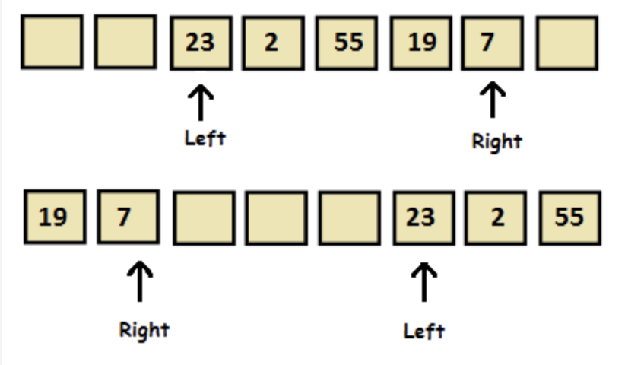
Array Order Maintenance
Best case is O(1) time: insert/delete at the end.
Another best case in O(1) time: insert/delete at the beginning or end.
How?

Slide 16
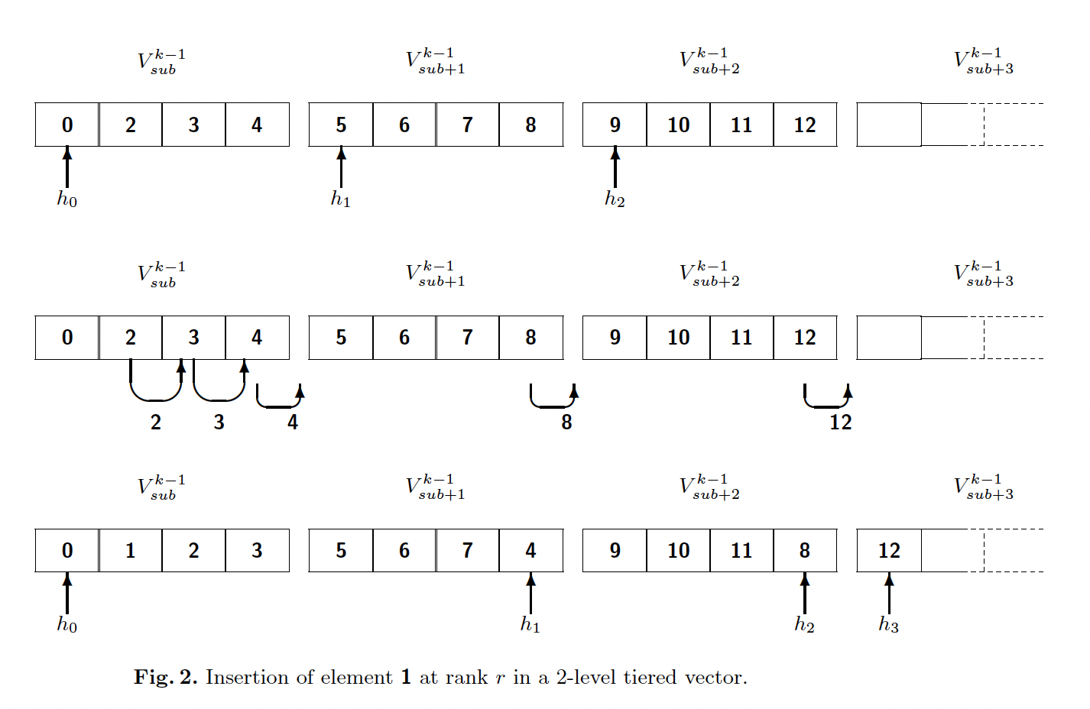
Tiered Vector
The worst-case performance for insert and delete can be improved to O(n^{ε}) for any constant ε>0.
E.g., for ε=1/2, we keep n^{1/2} subarrays of size exactly n^{1/2} each (so indexing still takes O(1) time).

Slide 17
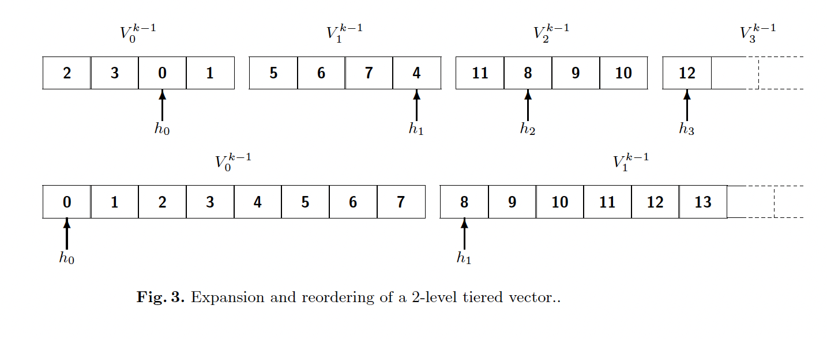
Tiered Vector Amortization
If we grow or shrink by more than a factor of 2, we rebuild the whole structure.
This gives amortized overhead of O(1) using an argument similar to that for growing a dynamic array.

Slide 18
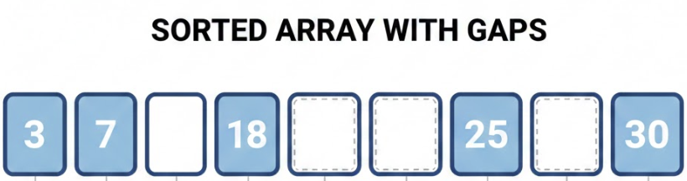
Packed-Memory Array
A packed-memory array (PMA) maintains a dynamic set of N elements in sorted order in a Θ(N)-sized array.
The idea is to intersperse Θ(N) empty spaces or gaps among the elements so that only a small number of elements need to be shifted around on an insert or delete.
The PMA maintains the density invariant that in any region of size S (for S greater than some small constant value), there are Θ(S) elements stored in it. To scan L elements after a given element x costs Θ(1+L/B) memory transfers, where B is the block size. Also, given the position of any element, we can find the next or previous one in O(1) time.

Slide 19
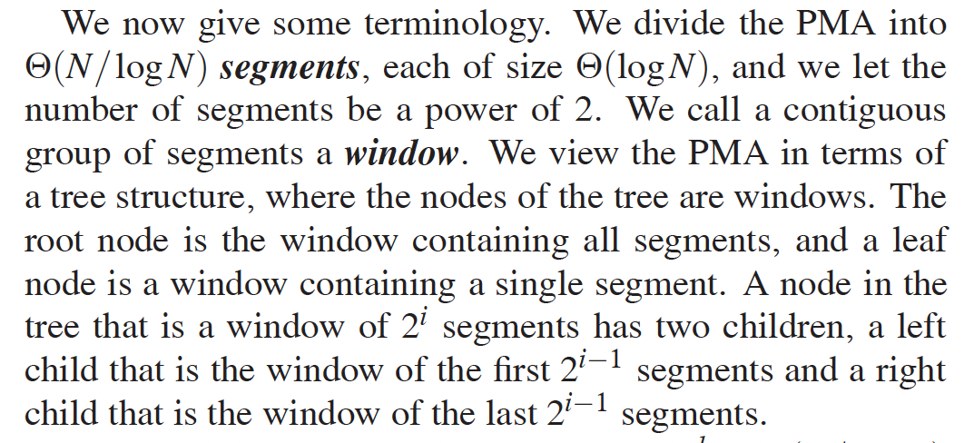
Segments and Windows

Slide 20
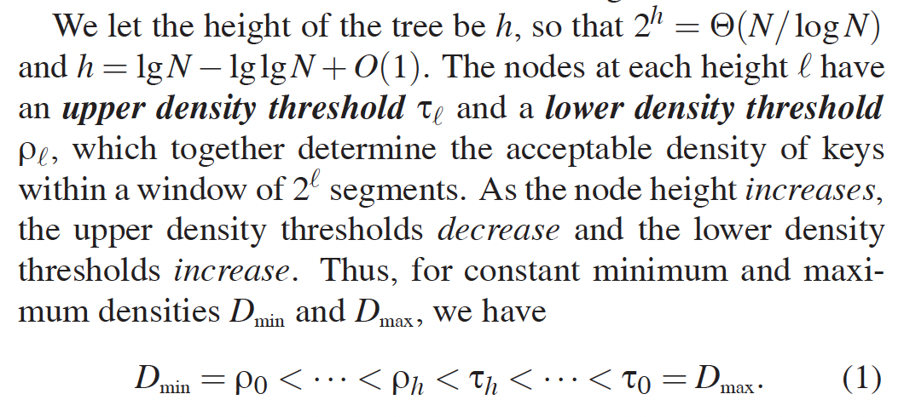
Density Thresholds

Slide 21
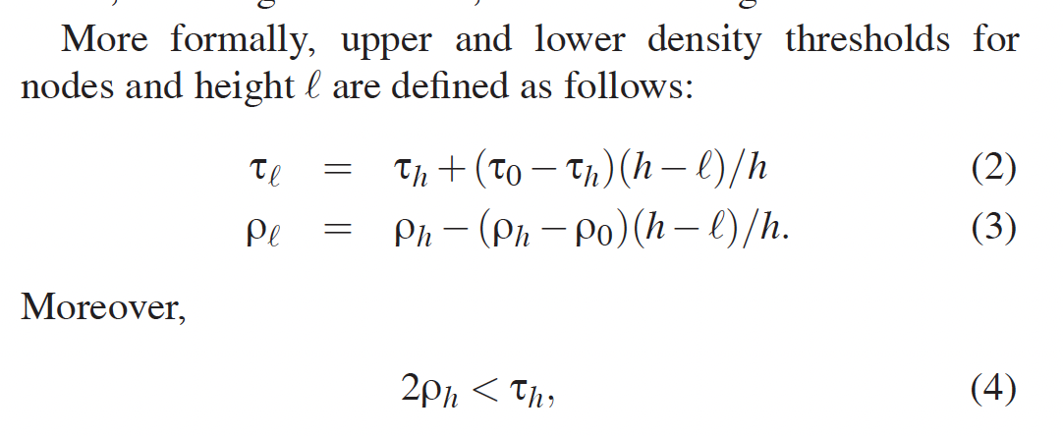
Density is distributed by height

Slide 22
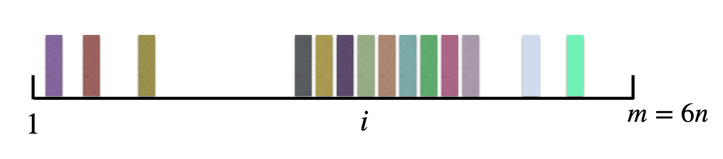
Insert in a PMA
If there is enough space in the leaf (segment) containing x, then we rearrange the elements evenly within the leaf to make room for y.
If the leaf is full, then we find the closest ancestor of the leaf whose density is within the permitted thresholds and rebalance.

Slide 23
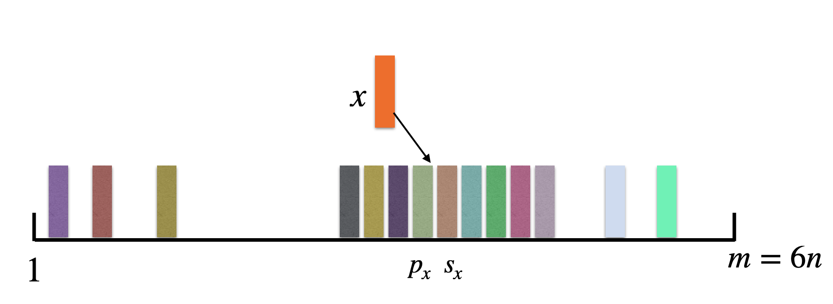
Insert in a PMA, Part 2
If there is enough space in the leaf (segment) containing x, then we rearrange the elements evenly within the leaf to make room for y.
If the leaf is full, then we find the closest ancestor of the leaf whose density is within the permitted thresholds and rebalance.

Slide 24
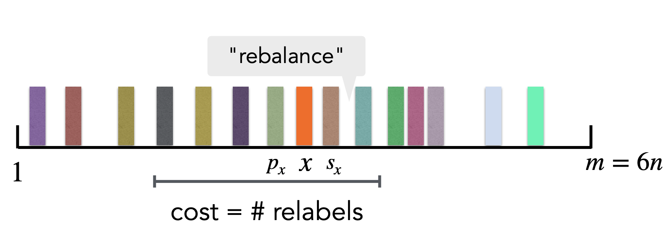
Insert in a PMA: Rebalance
If there is enough space in the leaf (segment) containing x, then we rearrange the elements evenly within the leaf to make room for y.
If the leaf is full, then we find the closest ancestor of the leaf whose density is within the permitted thresholds and rebalance.

Slide 25
Delete in a PMA
To delete an element x, we remove x from its segment. If the segment falls below its density threshold, then, as before, we find the smallest enclosing window whose density is within threshold and rebalance.
If the entire array is above the maximum density threshold (resp., below the minimum density threshold), then we recopy the keys into a PMA of twice (resp., half) the size.

Slide 26
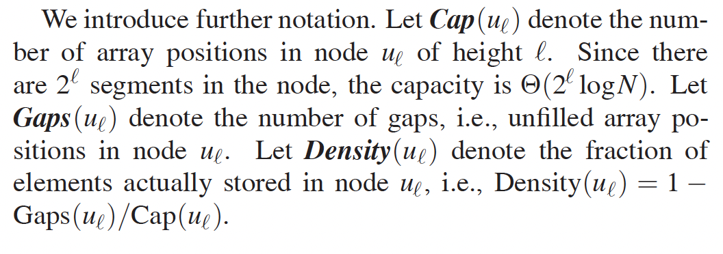
Some Notation

Slide 27
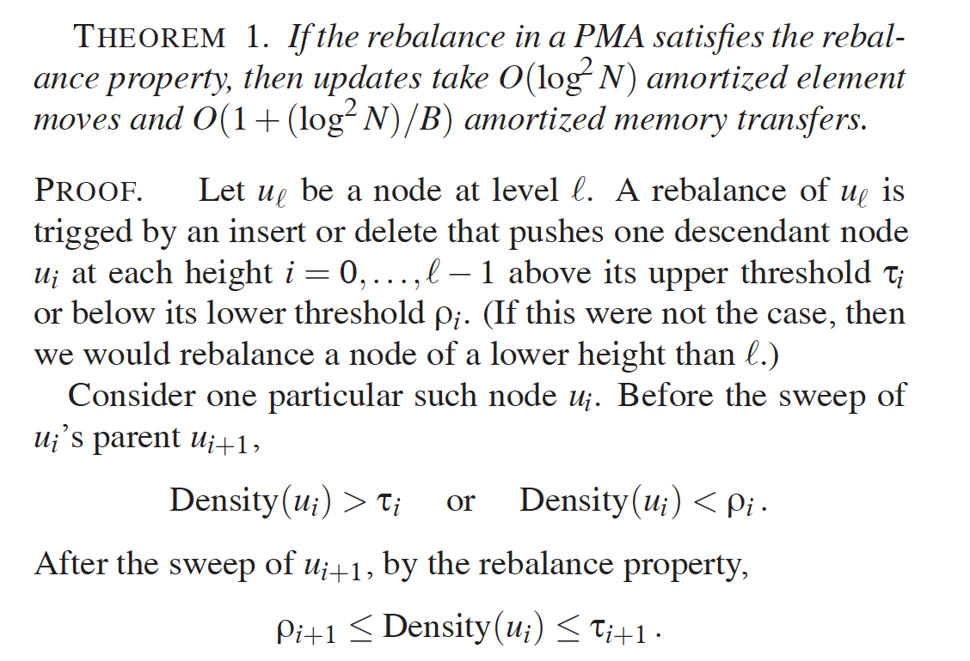
Amortized Analysis

Slide 28
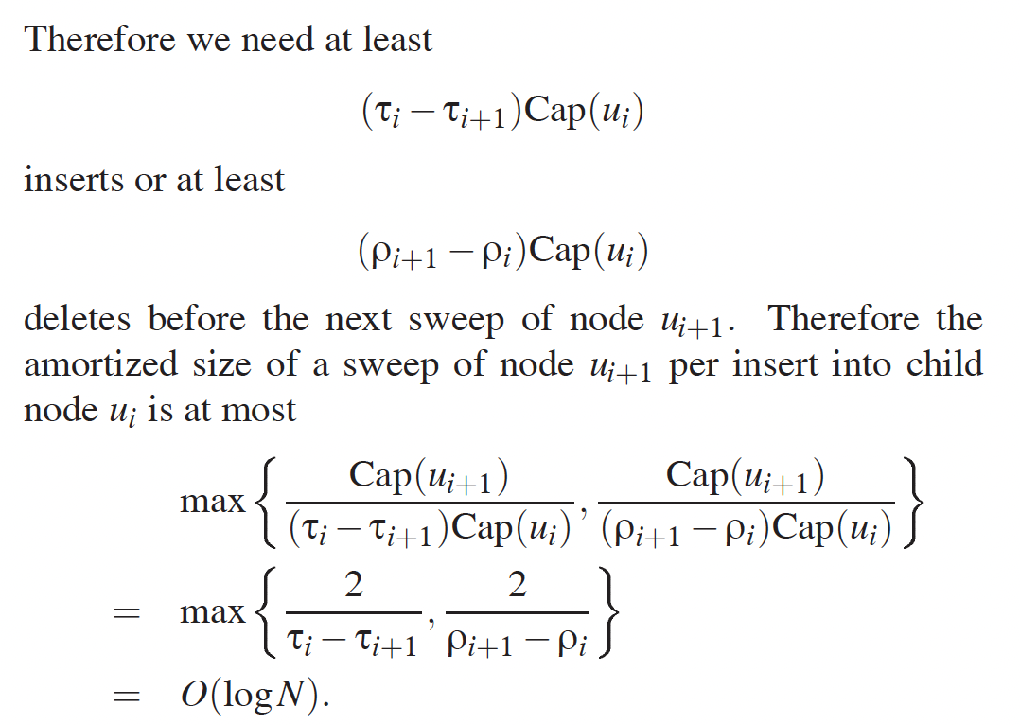
Amortized Analysis, part 2

Slide 29
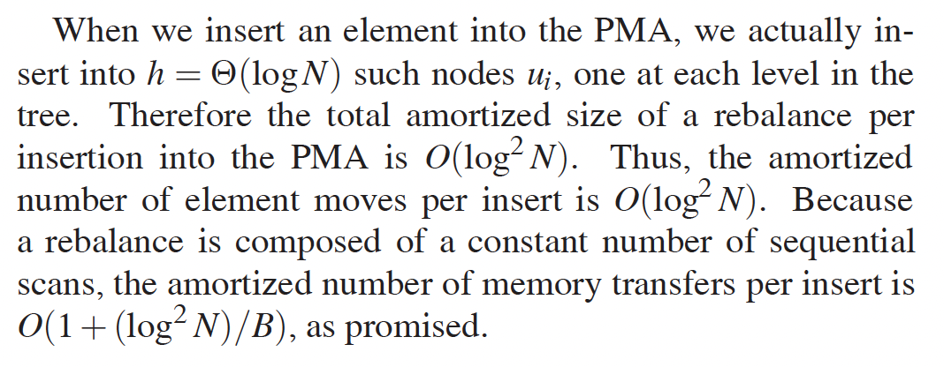
Amortized Analysis, conclusion

