Slide 1
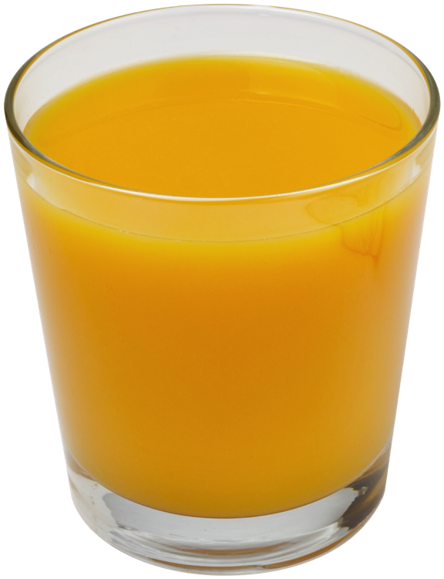
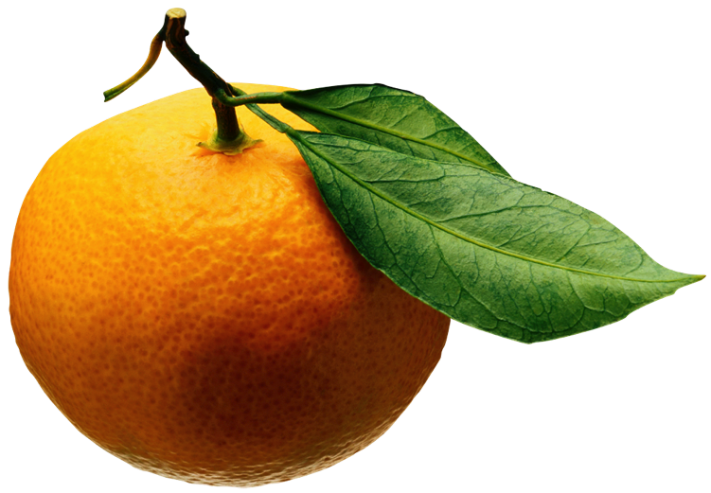

Beyond Worst-cast
Algorithm Analysis:
Introduction
Michael T. Goodrich
CS 263
Univ. of California, Irvine
Input
Algorithm
Output
Some slides adapted from Uriel Feige, Michael Mitzenmacher

Slide 2
Algorithms and Data Structures
An algorithm is a step-by-step procedure for performing some task in a finite amount of time.
  Typically, an algorithm takes input data and produces an output based upon it.
A data structure is a systematic way of organizing and accessing data.
Input
Algorithm
Output

Slide 3
Running Times
Most algorithms transform input objects into output objects.
The running time of an algorithm typically grows with the input size.
Traditionally, we focus on the worst case running time.
  Theoretical analysis
  Might not capture real-world performance

Slide 4
Experimental Studies
Write a program implementing the algorithm
Run the program with inputs of varying size and composition, noting the time needed:
  Plot the results
  Try to match a curve to the times
Is good for capturing average case analysis, but isn’t theoretical and doesn’t provide deep insights.

Slide 5

Limitations of Experiments
It is necessary to implement the algorithm, which may be difficult
Results may not be indicative of the running time on other inputs not included in the experiment.
In order to compare two algorithms, the same hardware and software environments must be used

Slide 6
Big-Oh Notation
Given functions f(n) and g(n), we say that f(n) is O(g(n)) if there are positive constants
c and n₀ such that
f(n) ≤ cg(n) for n ≥ n₀
Example: 2n + 10 is O(n)
  2n + 10 ≤ cn
  (c − 2) n ≥ 10
  n ≥ 10/(c − 2)
  Pick c = 3 and n₀ = 10

Slide 7
Relatives of Big-Oh
big-Omega
  f(n) is Ω(g(n)) if there is a constant c > 0
  and an integer constant n₀ ≥ 1 such that
  f(n) ≥ c g(n) for n ≥ n₀
big-Theta
  f(n) is Θ(g(n)) if there are constants c’ > 0 and c’’ > 0 and an integer constant n₀ ≥ 1 such that
  c’g(n) ≤ f(n) ≤ c’’g(n) for n ≥ n₀

Slide 8
Traditional Theoretical Analysis
Uses a high-level description of the algorithm instead of an implementation
Characterizes the worst-case running time only as a function of the input size, n
Takes into account all possible inputs, whereas some inputs might be rare or never occur in the real world

Slide 9
Worst case analysis
Performance guarantees that hold for every possible instance that might be encountered.
Benefits:
Guarantees are applicable across all application domains.
Many fundamental problems actually have algorithms with excellent worst-case guarantees (minimum spanning tree, fast Fourier transform).
Leads to clean theory, well understood proof techniques, successful classification of many computational problems of interest (theory of NP-completeness, fined grained complexity within P).

Slide 10
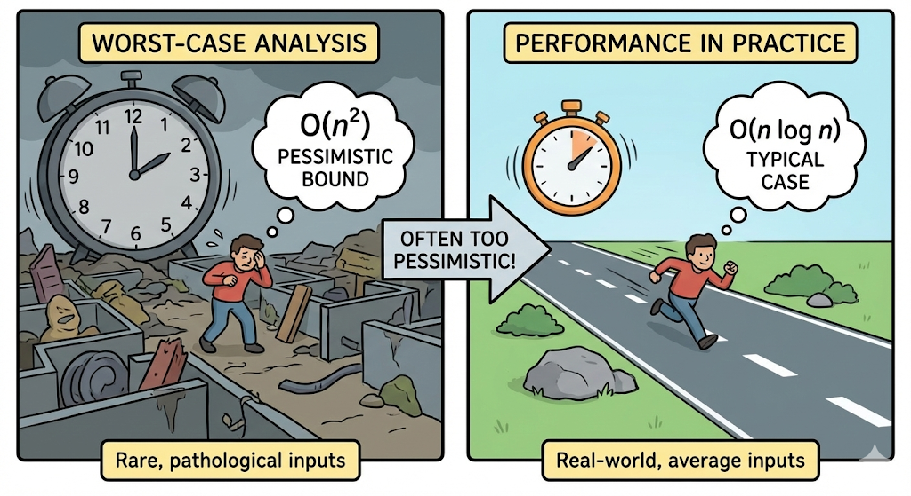
Deficiencies of worst-case analysis
Might be much too pessimistic compared to performance in practice.
Ranking algorithms by their worst case performance might turn out to be a misleading predictor for their typical performance in practice.
Decorative image generated using Nano Banana Pro

Slide 11
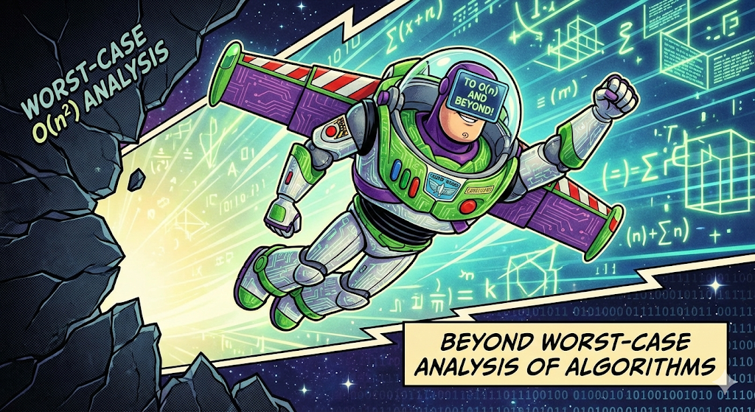
Beyond Worst-case Analysis
Decorative image generated using Nano Banana Pro

Slide 12
Beyond Worst-case Analysis
Amortized analysis
Randomized algorithms
Instance sensitivity
Fixed parameter tractability
Learning-augmented algorithm design

Slide 13

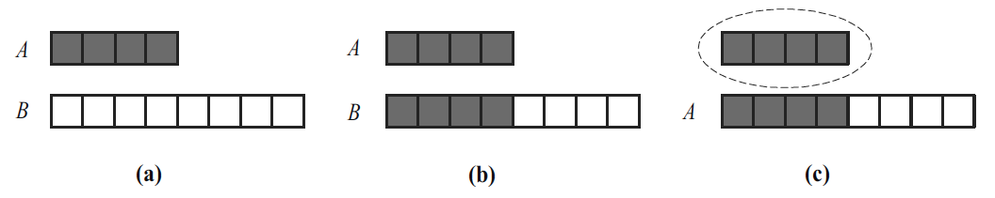
Amortized Analysis
The amortized running time of an operation within a series of operations is the worst-case running time of the series of operations divided by the number of operations.
Example: A growable array, S. When needing to grow:
  a. Allocate a new array B of larger capacity.
  b. Copy A[i] to B[i], for i = 0, . . . , n − 1, where n is size of A.
  c. Let A = B, that is, we use B as the array now supporting A.

Slide 14
Growable Array Description
Let add(e) be the operation that adds element e at the end of the array, A
When the array is full, we replace the array with a larger one
But how large should the new array be?
  Incremental strategy: increase the size by a constant c
  Doubling strategy: double the size
Algorithm A.add(e):
if n = A.length − 1 then
B ← new array of
size …
for i ← 0 to n−1 do
B[i] ← A[i]
A ← B
n ← n + 1
A[n−1] ← e

Slide 15
Comparing the Strategies
We compare the incremental strategy and the doubling strategy by analyzing the total time T(n) needed to perform a series of n add operations
We assume that we start with an empty list represented by a growable array of size 1
We call amortized time of an add operation the average time taken by an add operation over the series of operations, i.e., T(n)/n

Slide 16
Incremental Strategy Analysis
Over n add operations, we replace the array k = n/c times, where c is a constant
The total time T(n) of a series of n add operations is proportional to
n + c + 2c + 3c + 4c + … + kc =
n + c(1 + 2 + 3 + … + k) =
n + ck(k + 1)/2
Since c is a constant, T(n) is O(n + k²), i.e., O(n²)
Thus, the amortized time of an add operation is O(n)

Slide 17
Doubling Strategy Analysis
We replace the array k = log₂ n times
The total time T(n) of a series of n push operations is proportional to
n + 1 + 2 + 4 + 8 + …+ 2^{k} =
n + 2^{k + 1} − 1 =
3n − 1
T(n) is O(n)
The amortized time of an add operation is O(1)
geometric series
2
4
1
1
8

Slide 18
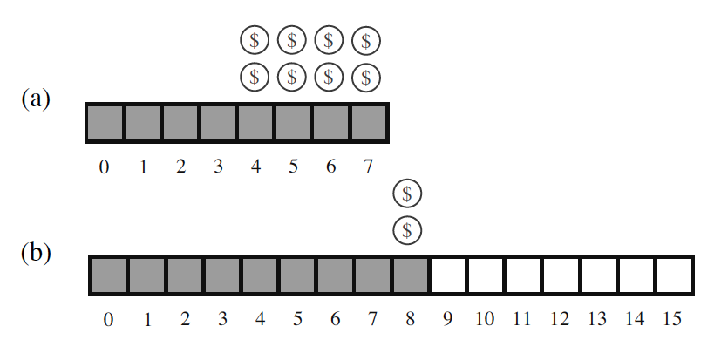
Accounting Method Proof for the Doubling Strategy
We view the computer as a coin-operated appliance that requires the payment of 1 cyber-dollar for a constant amount of computing time.
We shall charge each add operation 3 cyber-dollars, that is, it will have an amortized O(1) amortized running time.
  We over-charge each add operation not causing an overflow 2 cyber-dollars.
  Think of the 2 cyber-dollars profited in an insertion that does not grow the array as being “stored” at the element inserted.
  An overflow occurs when the array A has 2^{i} elements.
  Thus, doubling the size of the array will require 2^{i} cyber-dollars.
  These cyber-dollars are at the elements stored in cells 2^{i−1} through 2^{i}−1.

Slide 19
Union-Find Operations
A partition or union-find structure is a data structure supporting a collection of disjoint sets subject to the following operations:
makeSet(e): Create a singleton set containing the element e and return the position storing e in this set
union(A,B): Return the set A U B, naming the result “A” or “B”
find(e): Return the set containing the element e

Slide 20
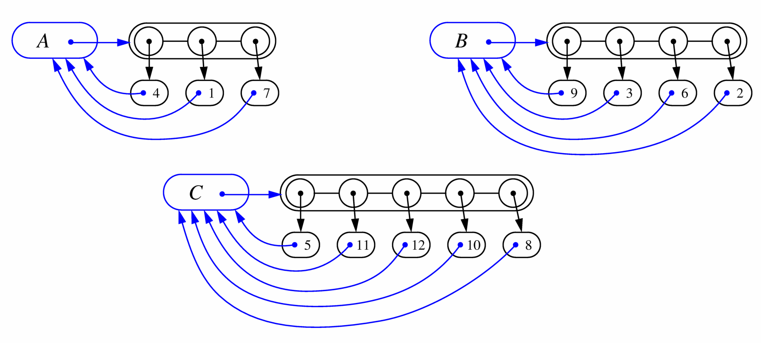
List-based Implementation
Each set is stored in a sequence represented with a linked-list
Each node should store an object containing the element and a reference to the set name

Slide 21
Amortized Analysis of List-based Representation
When doing a union, always move elements from the smaller set to the larger set
  Each time an element is moved it goes to a set of size at least double its old set
  Thus, an element can be moved at most O(log n) times (charge a cyber dollar for each move)
Total time needed to do n unions and m finds is O(n log n + m).

Slide 22
Tree-based Implementation
Each element is stored in a node, which contains a pointer to a node
A node v whose set pointer points back to v is also a set name, otherwise, the pointer is to a parent node.
Can be implemented so that each union and find takes amortized time O(α(n)), which is O(log* n).
See CS 261.
1
2
5
4
7
3
6
8
10
9
11
12

Slide 23
Randomized Algorithms
A randomized algorithm is an algorithm whose behavior depends, in part, on the outcomes of random choices or the values of random bits.
The main advantage of using randomization in algorithm design is that the results are often simple and efficient.
In addition, there are some problems that need randomization for them to work effectively, because we use randomization to avoid the worst-case behavior with high probability.

Slide 24
Traditional Quick-Sort
Quick-sort is a classic sorting algorithm based on the divide-and-conquer paradigm:
  Divide: pick the first element x (called pivot) and partition S into
    L elements less than x
    E elements equal x
    G elements greater than x
  Recur: sort L and G
  Conquer: concat L, E and G
x
x
L
G
E
x

Slide 25
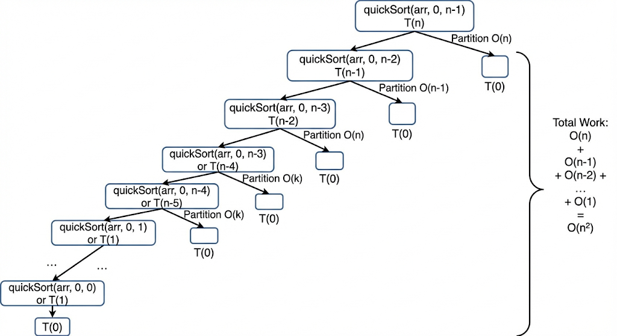
Traditional Quick-Sort
Worst-case running time is O(n²).
T(n) = T(n-1) + n
Example: The array is already sorted!
Illustration of a worst-case recursion tree for quick-sort generated using Nana Banana Pro

Slide 26
Visualizing the Worst-Case Time
The worst-case running time of traditional Quick-Sort is
O(1 + 2 + …+ n)
The sum of the first n integers is n(n + 1) / 2
  There is a simple visual proof of this fact
Thus, algorithm Quick-Sort runs in O(n²) time

Slide 27
Randomized Quick-Sort
Randomized Quick-sort is a randomized sorting algorithm based on the divide-and-conquer paradigm:
  Divide: pick a random element x (called pivot) and partition S into
    L elements less than x
    E elements equal x
    G elements greater than x
  Recur: sort L and G
  Conquer: concat L, E and G
x
x
L
G
E
x

Slide 28
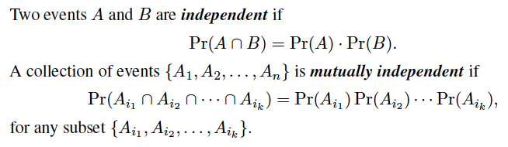
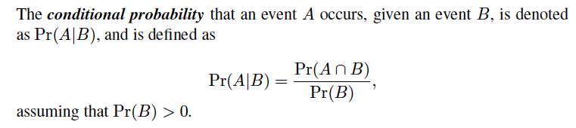
Independence and
Conditional Probability

Slide 29


Random Variables
A random variable is a function X that maps outcomes from some sample space S to real numbers.
An indicator random variable is a random variable that maps outcomes to the set {0, 1}.
The expected value of a discrete random variable X is defined as
where the sum is taken of the range of X.
Two random variables X and Y are independent if
for all real numbers x and y.
If two random variables X and Y are independent, then we have E(XY) = E(X)E(Y).

Slide 30
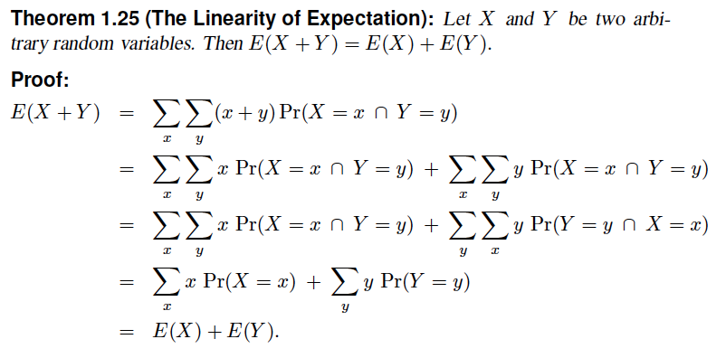
Linearity of Expectation

Slide 31
Expected Running Time
Consider a recursive call of quick-sort on a sequence of size s
  Good call: the sizes of L and G are each less than 3s/4
  Bad call: one of L and G has size greater than 3s/4
A call is good with probability 1/2
  1/2 of the possible pivots cause good calls:
7 2 9 4 3 7 6 1 9
7 2 9 4 3 7 6 1
2 4 3 1
7 9 7 1 → 1
1
7 2 9 4 3 7 6
Good call
Bad call
1 2 3 4 5 6 7 8 9 10 11 12 13 14 15 16
Bad pivots
Good pivots
Bad pivots

Slide 32
Expected Running Time, Part 2
Probabilistic Fact: The expected number of coin tosses required in order to get k heads is 2k
For a node of depth i, we expect
  i/2 ancestors are good calls
  The size of the input sequence for the current call is at most (3/4)^{i/2}n
Therefore, we have
  For a node of depth 2log_{4/3}n, the expected input size is one
  The expected height of the quick-sort tree is O(log n)
The amount or work done at the nodes of the same depth is O(n)
Thus, by the linearity of expectation, the expected running time of randomized quick-sort is O(n log n).

Slide 33
Instance Sensitivity
Instance optimality algorithm analysis focuses on properties of input instances and differs from traditional worst-case analysis, which focuses on the maximum cost an algorithm might incur over all possible inputs of a given size.
Instance optimality provides a finer-grained guarantee, ensuring that the algorithm performs well not just on average or in the worst case, but that it adapts to specific characteristics of individual inputs.
Achieving instance optimality leverages favorable properties of the input data.

Slide 34
Insertion sort
insertion sort: orders a list of values by repetitively inserting a particular value into a sorted subset of the list
more specifically:
  consider the first item to be a sorted sublist of length 1
  insert the second item into the sorted sublist, shifting the first item if needed
  insert the third item into the sorted sublist, shifting the other items as needed
  repeat until all values have been inserted into their proper positions

Slide 35
Insertion sort
Simple sorting algorithm.
  n-1 passes over the array
  At the end of pass i, the elements that occupied A[0]…A[i] originally are still in those spots and in sorted order.
2 | 15 | 8 | 1 | 17 | 10 | 12 | 5
0 | 1 | 2 | 3 | 4 | 5 | 6 | 7
after
pass 2
2 | 8 | 15 | 1 | 17 | 10 | 12 | 5
0 | 1 | 2 | 3 | 4 | 5 | 6 | 7
after
pass 3
1 | 2 | 8 | 15 | 17 | 10 | 12 | 5
0 | 1 | 2 | 3 | 4 | 5 | 6 | 7

Slide 36
Insertion sort code
public static void insertionSort(int[] a) {
for (int i = 1; i < a.length; i++) {
int temp = a[i];
// slide elements down to make room for a[i]
int j = i;
while (j > 0 && a[j - 1] > temp) {
a[j] = a[j - 1];
j--;
}
a[j] = temp;
}
}

Slide 37
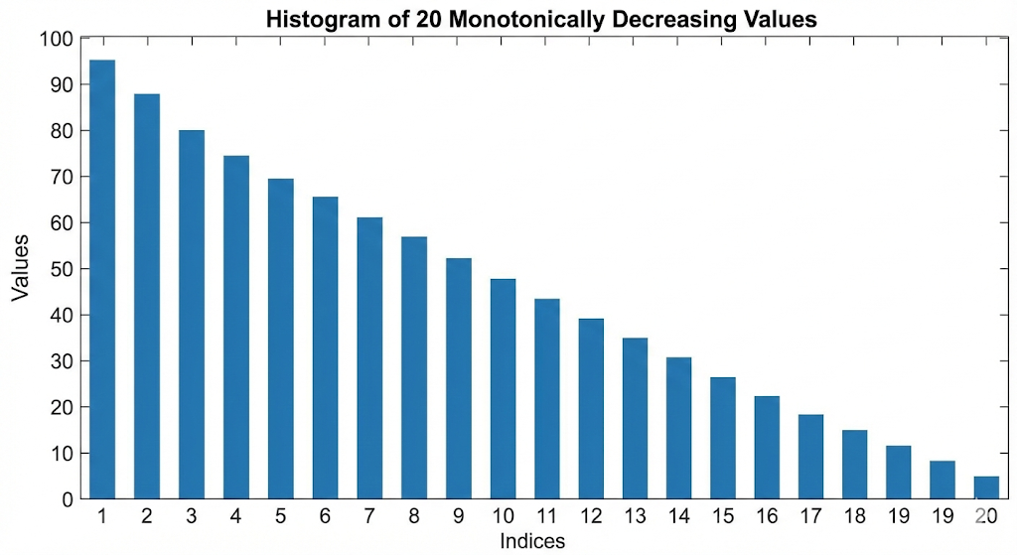
Worst-case Insertion-sort Analysis
The worst case for for each loop of insertion sort is when the insertion of the i-th item takes O(i) time.
This occurs for a list in reverse-sorted order.
Worst-case time, therefore, is O(n²).

Slide 38
Instance Analysis of Insertion-sort
An inversion in a permutation is the number of pairs that are out of order, that is, the number of pairs, (i,j), such that i<j but x_{i}>x_{j}.
Each step of insertion-sort fixes an inversion or stops the while-loop.
Thus, the running time of insertion-sort is O(n + Inv(X)), where Inv(X) is the number of inversions in the input, X.

Slide 39
Skip List
A skip list for a set S of distinct (key, element) items is a series of lists
S₀, S₁ , … , S_{h} such that
  Each list S_{i} contains the special keys +∞ and −∞
  List S₀ contains the keys of S in non-decreasing order
  Each list is a subsequence of the previous one, i.e.,
  S₀ ⊇ S₁ ⊇ … ⊇ S_{h}
  List S_{h} contains only the two special keys, plus and minus infinity
S₃
−∞
+∞
S₂
−∞
31
+∞
S₁
−∞
23
31
34
64
+∞
S₀
−∞
12
23
26
31
34
44
56
64
78
+∞

Slide 40
Possible Implementation
We can implement a skip list with quad-nodes
A quad-node stores:
  item
  link to the node before
  link to the node after
  link to the node below
Also, we define special keys PLUS_INF and MINUS_INF, and we modify the key comparator to handle them
quad-node
x

Slide 41
Top-Down Search
We search for a key x in a a skip list as follows:
  We start at the first position of the top list
  At the current position p, we compare x with y ← key(after(p))
  x = y: we return element(after(p))
  x > y: we “scan forward”
  x < y: we “drop down”
  If we try to drop down past the bottom list, we return NO_SUCH_KEY
Example: search for 78
S₃
−∞
+∞
S₂
−∞
31
+∞
S₁
−∞
23
31
34
64
+∞
S₀
−∞
12
23
26
31
34
44
56
64
78
+∞

Slide 42
Insertion
To insert an item (x, o) into a skip list, we use a randomized algorithm:
  We repeatedly toss a coin until we get tails, and we denote with i the number of times the coin came up heads
  If i ≥ h, we add to the skip list new lists S_{h+1}, … , S_{i +1}, each containing only the two special keys
  We search for x in the skip list and find the positions p₀, p₁ , …, p_{i} of the items with largest key less than x in each list S₀, S₁, … , S_{i}
  For j ← 0, …, i, we insert item (x, o) into list S_{j} after position p_{j}
Example: insert key 15, with i = 2
S₃
−∞
+∞
S₂
−∞
+∞
S₂
−∞
15
+∞
S₁
−∞
23
+∞
S₁
−∞
15
23
+∞
S₀
−∞
10
23
36
+∞
S₀
−∞
10
15
23
36
+∞

Slide 43
Deletion
To remove an item with key x from a skip list, we proceed as follows:
  We search for x in the skip list and find the positions p₀, p₁ , …, p_{i} of the items with key x, where position p_{j} is in list S_{j}
  We remove positions p₀, p₁ , …, p_{i} from the lists S₀, S₁, … , S_{i}
  We remove all but one list containing only the two special keys
Example: remove key 34
S₃
−∞
+∞
S₂
−∞
34
+∞
S₂
−∞
+∞
S₁
−∞
23
34
+∞
S₁
−∞
23
+∞
S₀
−∞
12
23
34
45
+∞
S₀
−∞
12
23
45
+∞

Slide 44
Space Usage
Consider a skip list with n items
  By Fact 1, we insert an item in list S_{i} with probability 1/2^{i}
  By Fact 2, the expected size of list S_{i} is n/2^{i}
The expected number of nodes used by the skip list is
The space used by a skip list depends on the random bits used by each invocation of the insertion algorithm
We use the following two basic probabilistic facts:
  Fact 1: The probability of getting i consecutive heads when flipping a coin is 1/2^{i}
  Fact 2: If each of n items is present in a set with probability p, the expected size of the set is np
Thus, the expected space usage of a skip list with n items is O(n)

Slide 45
Height
The running time of the search an insertion algorithms is affected by the height h of the skip list
We show that with high probability, a skip list with n items has height O(log n)
We use the following additional probabilistic fact:
  Fact 3: If each of n events has probability p, the probability that at least one event occurs is at most np
Consider a skip list with n items
  By Fact 1, we insert an item in list S_{i} with probability 1/2^{i}
  By Fact 3, the probability that list S_{i} has at least one item is at most n/2^{i}
By picking i = 3log n, we have that the probability that S_{3log n} has at least one item is
at most
n/2^{3log n} = n/n³ = 1/n²
Thus a skip list with n items has height at most 3log n with probability at least 1 − 1/n²

Slide 46
Search and Update Times
The search time in a skip list is proportional to
  the number of drop-down steps, plus
  the number of scan-forward steps
The drop-down steps are bounded by the height of the skip list and thus are O(log n) with high probability
To analyze the scan-forward steps, we use yet another probabilistic fact:
  Fact 4: The expected number of coin tosses required in order to get tails is 2
When we scan forward in a list, the destination key does not belong to a higher list
  A scan-forward step is associated with a former coin toss that gave tails
By Fact 4, in each list the expected number of scan-forward steps is 2
Thus, the expected number of scan-forward steps is O(log n)
We conclude that a search in a skip list takes O(log n) expected time
The analysis of insertion and deletion gives similar results

Slide 47
Up-Down Search
We search for a key x in a a skip list as follows:
  We start at the last bottom position of the top list
  We move left and up until we reach a level with previous key less than the search key
  Then we move down and left until we find the correct position
Example: search for 26
S₃
−∞
+∞
S₂
−∞
31
+∞
S₁
−∞
23
31
34
64
+∞
S₀
−∞
12
23
26
31
34
44
56
64
78
+∞

Slide 48
Skip-List Sort
Insert the elements x₁, x₂, …, into a skip-list, doing up-down search from the bottom-left part of the skip-list for each element x_{i}.
The expected time to insert x_{i} is O(log d_{i}(X)), where d_{i}(X) is the distance in the bottom level to the place where x_{i} belongs.
d_{i}(X) is bounded by I_{i}(X), where I_{i}(X) is the number of inversions with x_{i} as the right element.

Slide 49
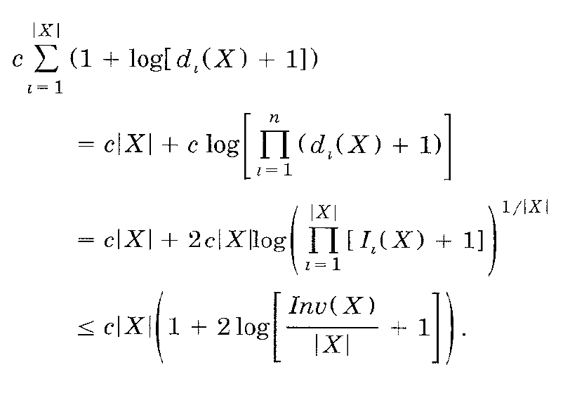
Analysis of Skip-List Sort
The analysis of the expected running time uses the fact that the geometric mean is always at most the arithmetic mean:
So running time is O(n(1+ log (1+Inv(X)/n))).

Slide 50

Fixed Parameter Tractability
When standard worst-case analysis is not sufficiently informative, identify parameters of interest and perform worst case analysis with respect to these parameters.
Decorative image generated using Nano Banana

Slide 51
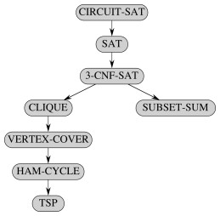
First, a review of NP-completeness…
Reductions for well-known NP-complete problems

Slide 52
Polynomial-Time
Decision Problems
To define a notion of “hardness,” we will focus on the following:
  Polynomial-time as the cut-off for efficiency
  Decision problems: output is 1 or 0 (“yes” or “no”)
    Examples:
    Does a text T contain a pattern P?
    Is the sequence, S, in sorted order?
    Is it possible to graduate with a Computer Science major from UCI in 3 years without any AP credits?

Slide 53
Problems and Languages
A language L is a set of strings defined over some alphabet Σ
Every decision algorithm A defines a language L
  L is the set consisting of every string x such that A outputs “yes” on input x.
  We say “A accepts x’’ in this case
    Example:
    If A determines whether or not a given graph G has an Euler tour, then the language L for A is all graphs with Euler tours.

Slide 54
The Complexity Class P
A complexity class is a collection of languages
P is the complexity class consisting of all languages that are accepted by polynomial-time algorithms
For each language L in P there is a polynomial-time decision algorithm A for L.
  If n=|x|, for x in L, then A runs in p(n) time on input x.
  The function p(n) is some polynomial

Slide 55
The Complexity Class NP
We say that an algorithm is non-deterministic if it uses the following operation:
  Choose(b): chooses a bit b
  Can be used to choose an entire string y (with |y| choices)
We say that a non-deterministic algorithm A accepts a string x if there exists some sequence of choose operations that causes A to output “yes” on input x.
NP is the complexity class consisting of all languages accepted by polynomial-time non-deterministic algorithms.

Slide 56
The Complexity Class NP Alternate Definition
We say that an algorithm B verifies the acceptance of a language L if and only if, for any x in L, there exists a certificate y such that B outputs “yes” on input (x,y).
NP is the complexity class consisting of all languages verified by polynomial-time algorithms.
We know: P is a subset of NP.
Major open question: P=NP?
Most researchers believe that P and NP are different.

Slide 57
NP-Completeness
A language M is polynomial-time reducible to a language L if an instance x for M can be transformed in polynomial time to an instance x’ for L such that x is in M if and only if x’ is in L.
  Denote this by M→L.
A problem (language) L is NP-hard if every problem in NP is polynomial-time reducible to L.
  Many optimization problems are NP-hard.
A problem (language) is NP-complete if it is in NP and it is NP-hard.

Slide 58
Some Thoughts about P and NP
NP
NP-complete
problems live here
P
Belief: P is a proper subset of NP.
Implication: the NP-complete problems are the hardest in NP.
  Why: Because if we could solve an NP-complete problem in polynomial time, we could solve every problem in NP in polynomial time.
That is, if an NP-complete problem is solvable in polynomial time, then P=NP.
Since so many people have attempted without success to find polynomial-time solutions to NP-complete problems, showing your problem is NP-complete is equivalent to showing that a lot of smart people have worked on your problem and found no polynomial-time algorithm.
If you prove or disprove the P=NP, you will win $1 million.
  See https://en.wikipedia.org/wiki/Millennium_Prize_Problems

Slide 59
Vertex Cover
A vertex cover of graph G=(V,E) is a subset W of V, such that, for every (a,b) in E, a is in W or b is in W.
OPT-VERTEX-COVER: Given an graph G, find a vertex cover of G with smallest size.
OPT-VERTEX-COVER is NP-hard.
Very unlikely to be solvable for all inputs in polynomial time…

Slide 60
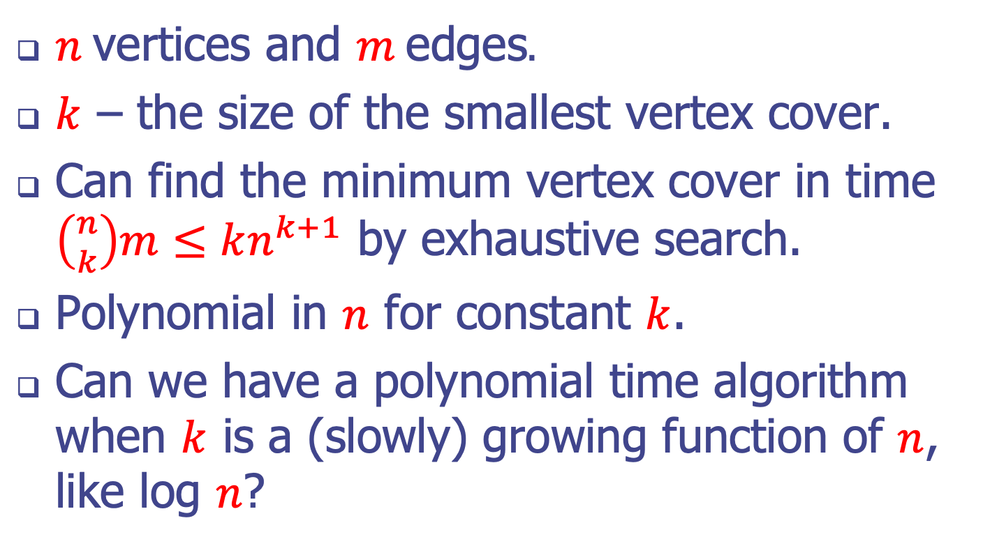
A parameter for vertex cover
$n$ vertices and $m$ edges.
$k$ – the size of the smallest vertex cover.
Can find the minimum vertex cover in time $\left({n \atop k}\right)m≤kn^{k+1}$ by exhaustive search.
Polynomial in $n$ for constant $k$.
Can we have a polynomial time algorithm when $k$ is a (slowly) growing function of $n$, like log $n$?

Slide 61
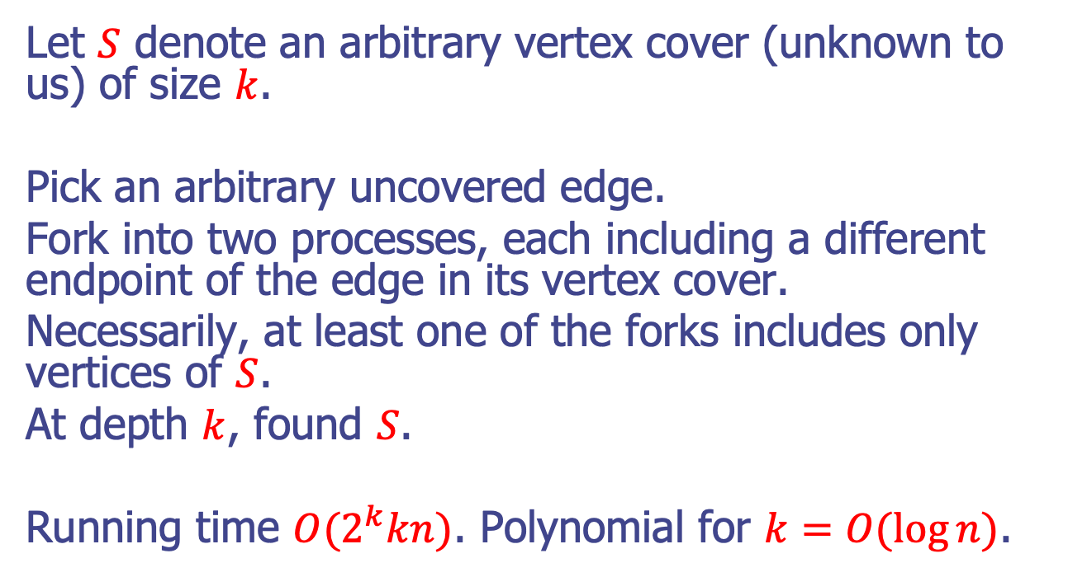
A better algorithm for vertex cover
Let $S$ denote an arbitrary vertex cover (unknown to us) of size $k$.
Pick an arbitrary uncovered edge.
Fork into two processes, each including a different endpoint of the edge in its vertex cover.
Necessarily, at least one of the forks includes only vertices of $S$.
At depth $k$, found $S$.
Running time ${O(2}^{k}kn)$. Polynomial for $k=O(\log{n)}$.

Slide 62
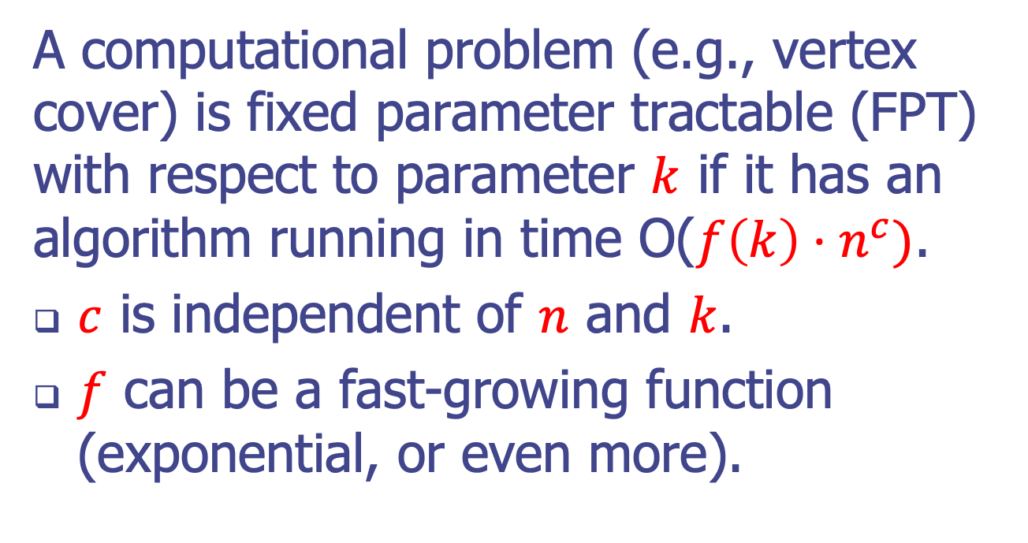
Fixed parameter tractability
A computational problem (e.g., vertex cover) is fixed parameter tractable (FPT) with respect to parameter $k$ if it has an algorithm running in time O($f\left(k\right)⋅n^{c})$.
$c$ is independent of $n$ and $k$.
$f$ can be a fast-growing function (exponential, or even more).

Slide 63
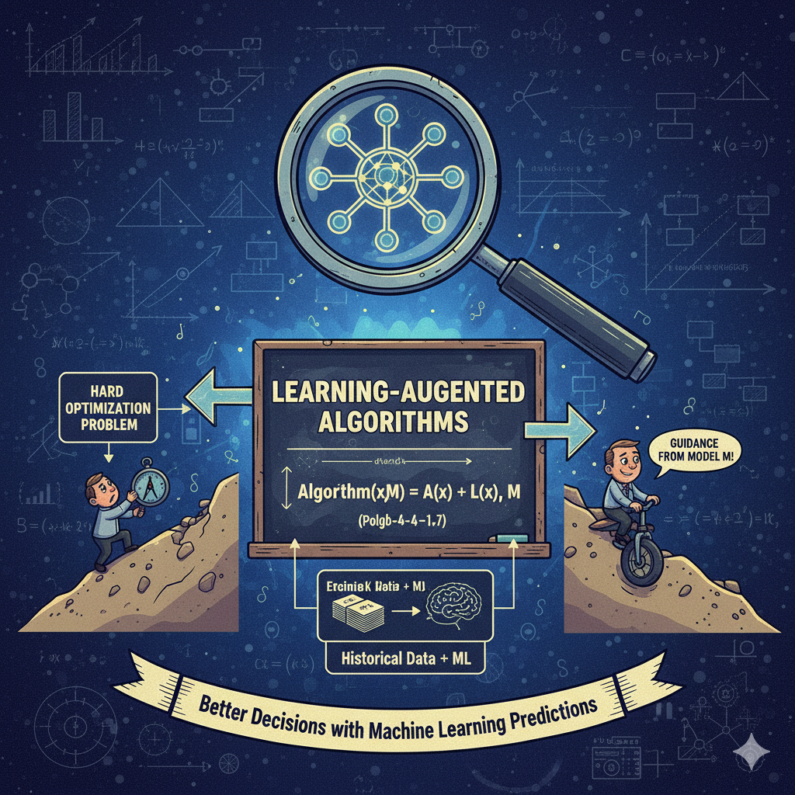
Learning-Augmented Algorithms
Decorative image generated using Nano Banana

Slide 64
Learning-Augmented Algorithms
Learning-augmented algorithm design combines traditional algorithms with machine learning (ML) predictions to achieve better performance, by balancing the speed/accuracy of ML with the robustness of classical algorithms, providing strong guarantees even when predictions are imperfect.
It uses ML to forecast future data or parameters, and the core algorithm adapts, aiming for near-optimal results with perfect predictions (consistency) but ensuring acceptable performance even with bad advice (robustness).

Slide 65
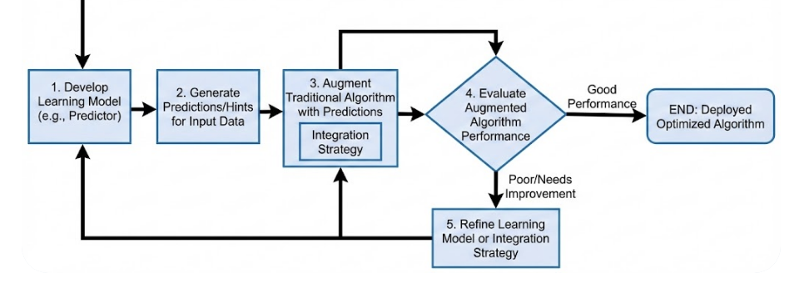
The Goal and Example Flow
The Goal: To leverage a fast ML model for a given input and reliable, worst-case algorithms, creating algorithms that are both fast and robust.
Flowchart created using Nano Banana Pro

Slide 66
How it Works
Prediction: An ML model (the "predictor") forecasts properties of the current or future problem instance (e.g., future data values, optimal parameters).
Augmentation: The online algorithm uses this prediction as extra information (advice).
Adaptation: The algorithm uses the advice to make better decisions, perhaps by computing the offline optimal solution for the predicted scenario or by using a hybrid strategy (like switching between following the prediction and a purely robust approach).

Slide 67
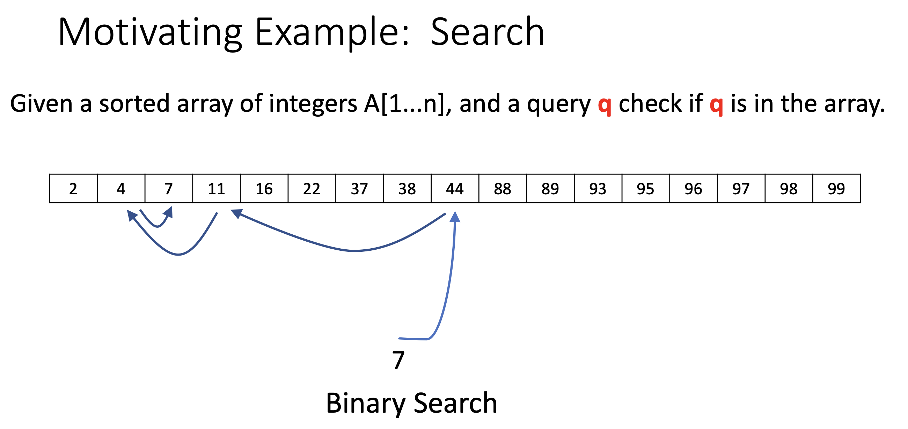
Learning-Augmented Algorithm

Slide 68
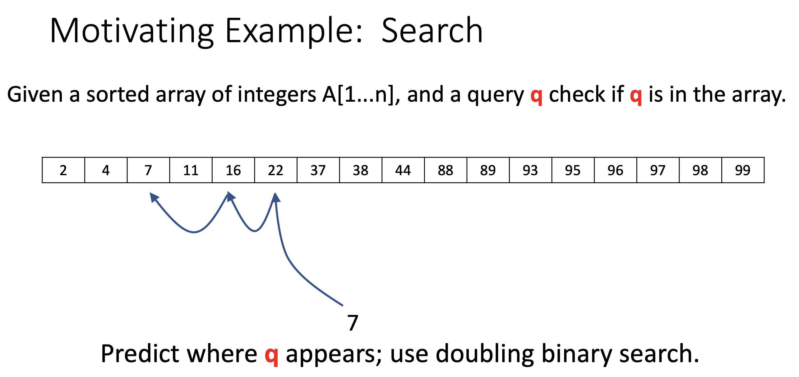
Learning-Augmented Algorithm

Slide 69
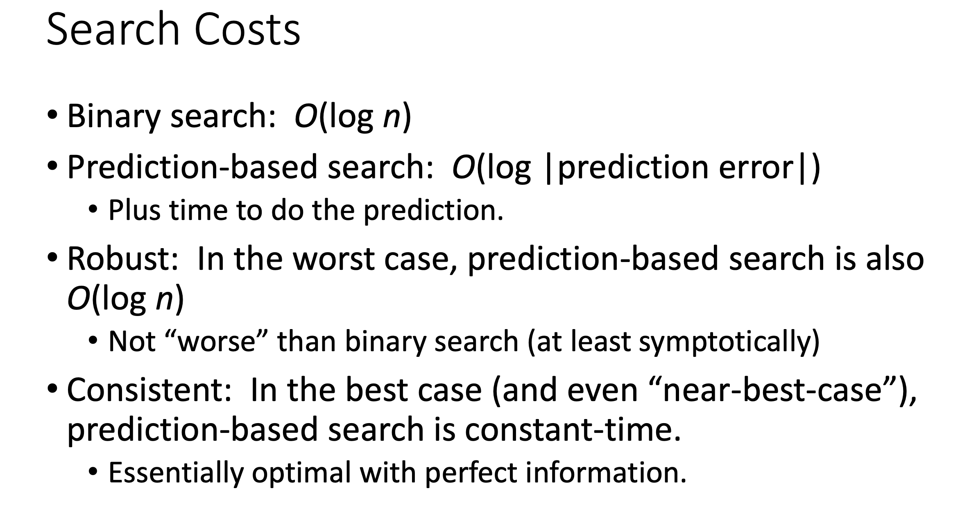
Learning-Augmented Algorithm

Slide 70
Desired Properties
Consistency: if predictions are correct, algorithm gives close to optimal solution.
Robustness: Even under adversarial predictions, algorithm maintains a worst-case guarantee (ideally comparable to best known online algorithm).
Smoothness: Performance degrades nicely in the error of the predictor.

