Slide 1
Burrows-Wheeler Transform
Michael T. Goodrich
University of California, Irvine
Burrows, M. and Wheeler, D. J. (1994). A block-sorting lossless data compression algorithm. Technical Report 124, Palo Alto, CA, Digital Equipment Corporation.
Ferragina, P. and Manzini, G. (2000). Opportunistic data structures with applications. In Foundations of Computer Science, 2000. Proceedings. 41st Annual Symposium on (pp. 390-398). IEEE.
http://www.cs.jhu.edu/~langmea/resources/bwt_fm.pdf
https://www.cs.jhu.edu/~langmea/resources/lecture_notes/bwt_and_fm_index.pdf
https://en.wikipedia.org/wiki/Burrows%E2%80%93Wheeler_transform

Slide 2
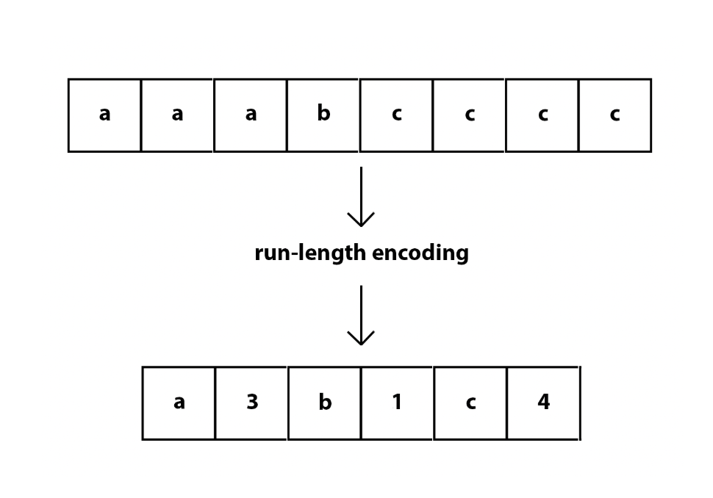
Run-Length Encoding
Run-length encoding (RLE) is a lossless compression method where sequences that display redundant data are stored as a single data value. This value represents the repeated block, and shows how many times it appears in the string.
https://api.video/what-is/run-length-encoding/

Slide 3
Burrows-Wheeler Transform (BWT)
The Burrows–Wheeler transform (BWT) rearranges a character string into runs of similar characters, in a manner that can be reversed to recover the original string.
The BWT can be used as a preparatory step to improve the efficiency of a compression algorithm, and is used this way in software such as bzip2.

Slide 4
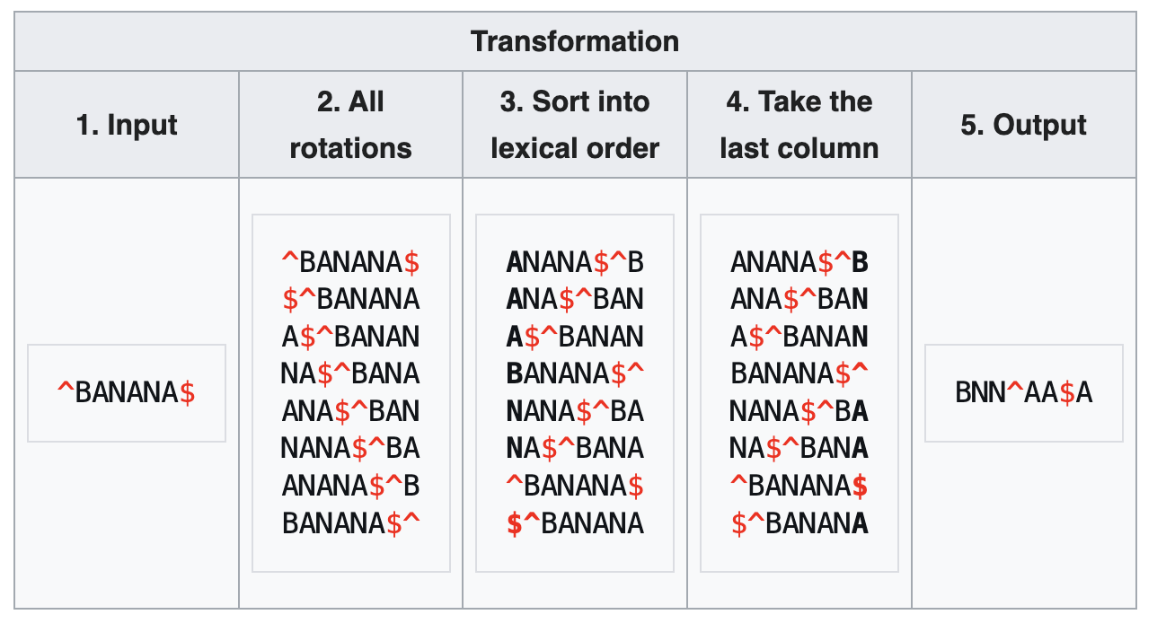
The Transform
The transform is done by constructing a matrix (known as the Burrows-Wheeler Matrix) whose rows are the circular shifts of the input text,with a start symbol ^ and/or end symbol $ added, sorted in lexicographic order, then taking the final column of that matrix.

Slide 5
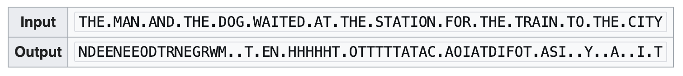
Relation to RLE
If the original string had several substrings that occurred often, then the BWT-transformed string will have several places where a single character is repeated many times in a row.

Slide 6
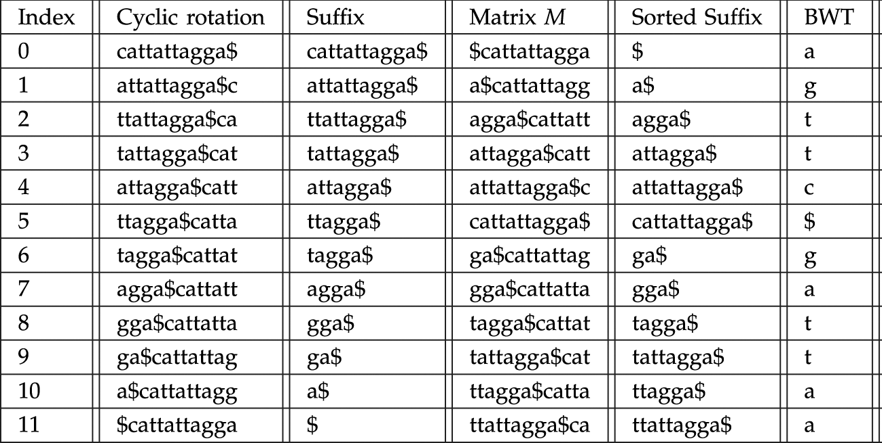
Relation to Suffix Array
Given a suffix array for a string, we can compute the BWT for the string in linear time.

Slide 7
BWT is Reversible
Take the final table in the BWT algorithm, and erase all but the last column. The last column tells you all the characters in the text, so just sort these characters alphabetically to get the first column.
Then, the last and first columns (of each row) together give you all pairs of successive characters in the document, where pairs are taken cyclically so that the last and first character form a pair. Sorting the list of pairs gives the first and second columns. To obtain the third column, the last column is again prepended to the table, and the rows are sorted lexicographically. Continuing in this manner, you can reconstruct the entire list.

Slide 8
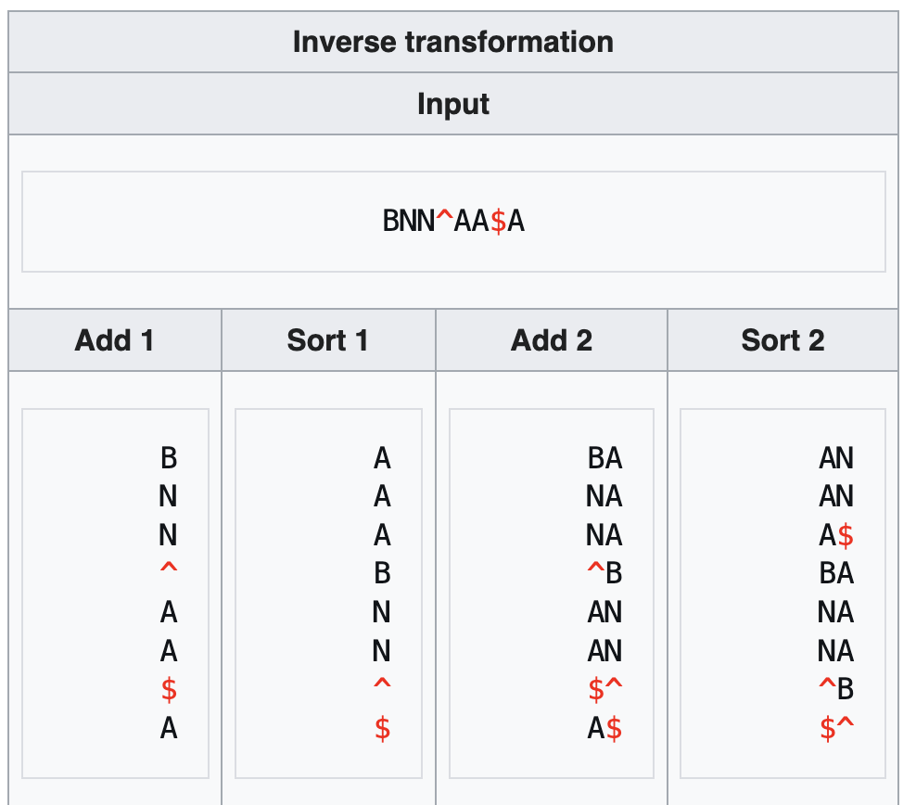
Reversing BWT Example

Slide 9
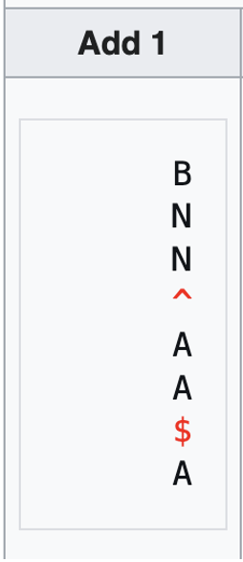
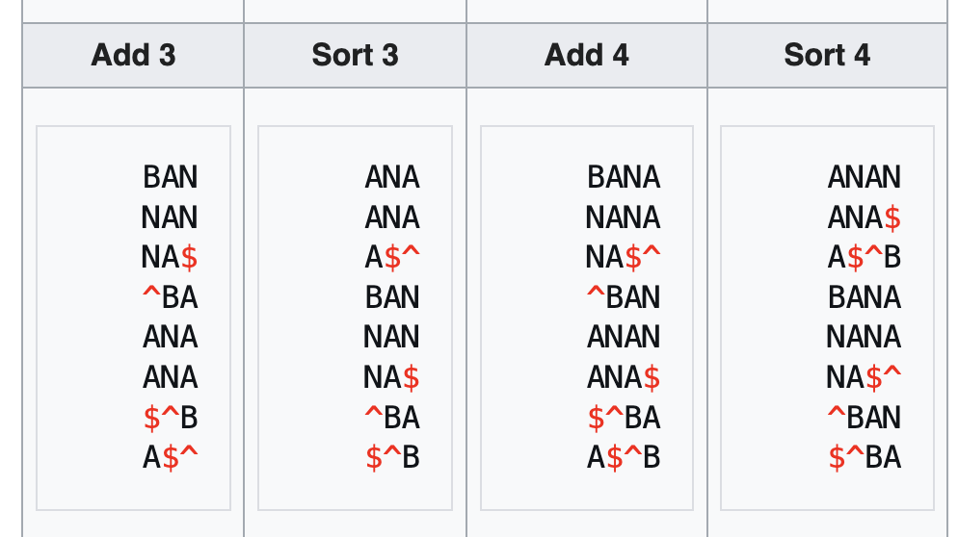
Reversing BWT Example

Slide 10
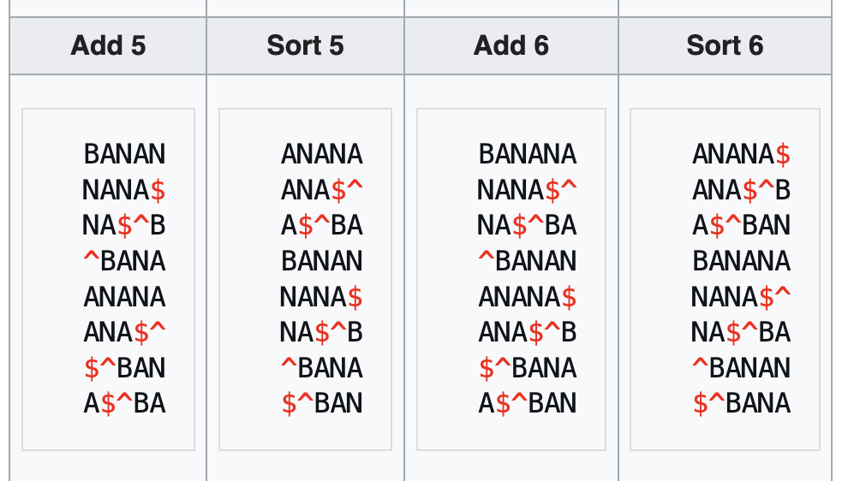
Reversing BWT Example

Slide 11
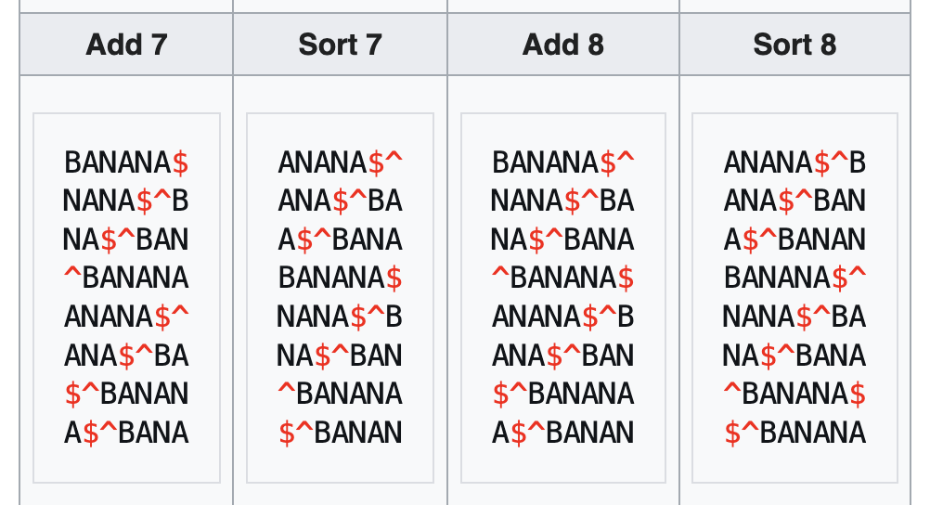
Reversing BWT Example
Output

Slide 12
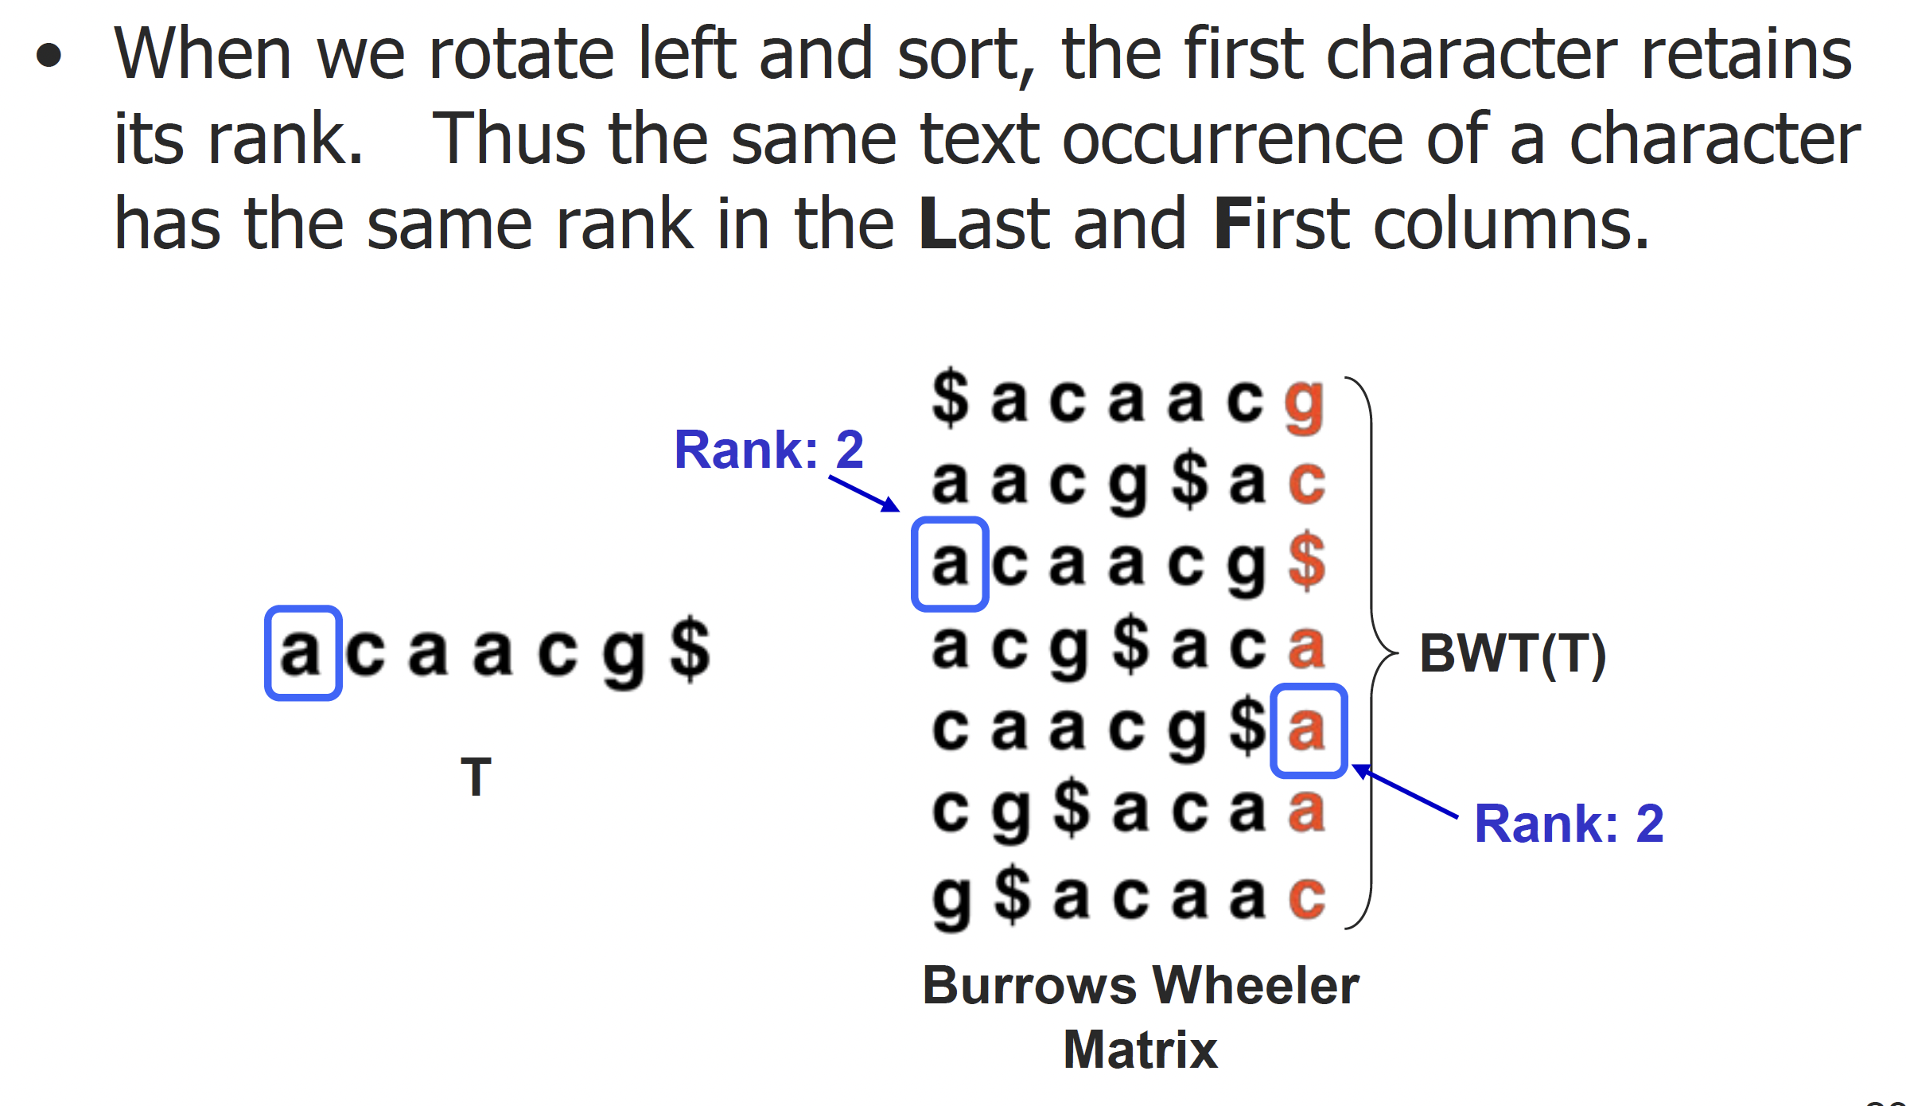
The Reversal Algorithm
We can perform this reversal in linear time, based on the following observation.

Slide 13
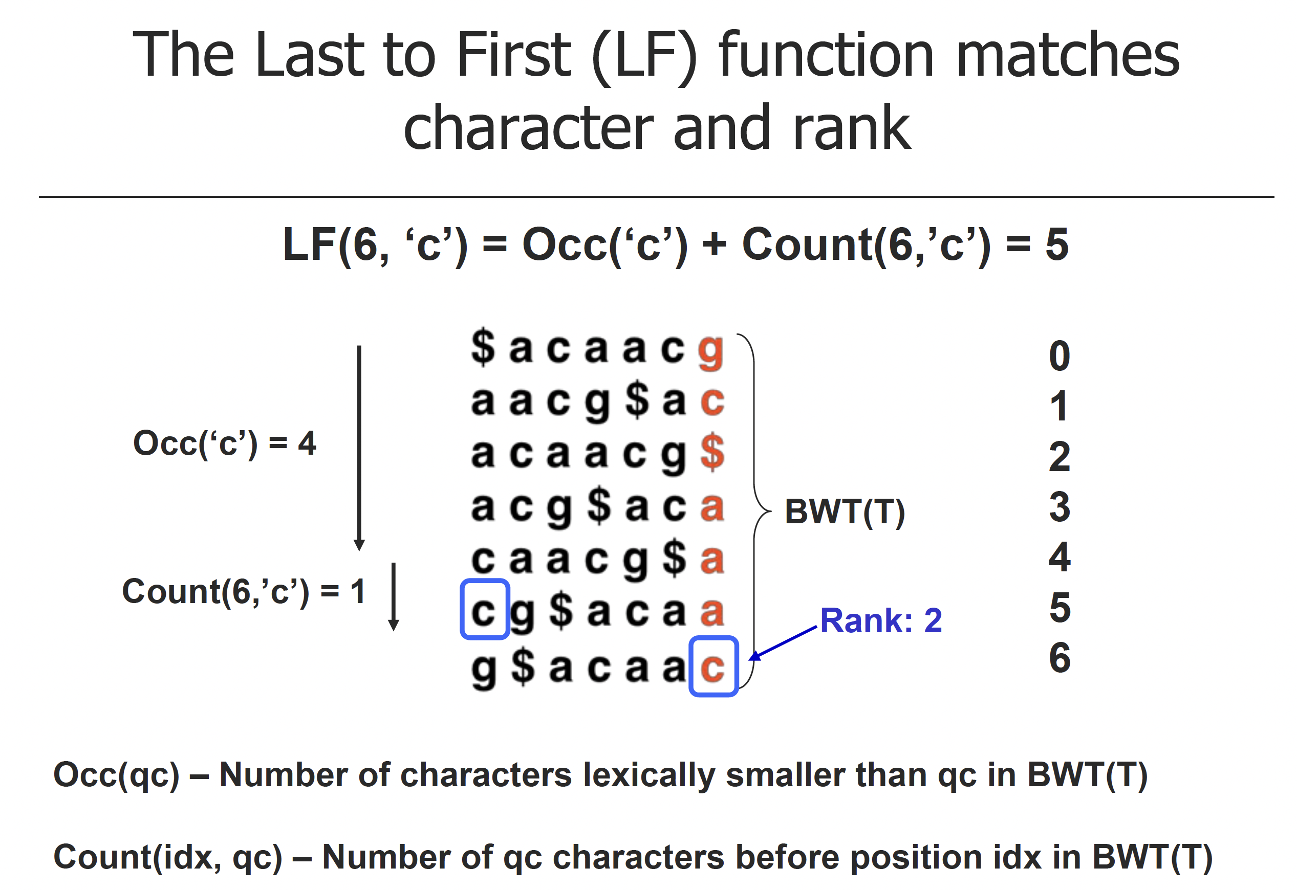

Slide 14
