Slide 1
Some slides adapted from Ofek Gila, Robert Tarjan, Caleb Levy, Stephen Timmel.
Zip-zip Trees
Michael Goodrich
CS 165

Slide 2
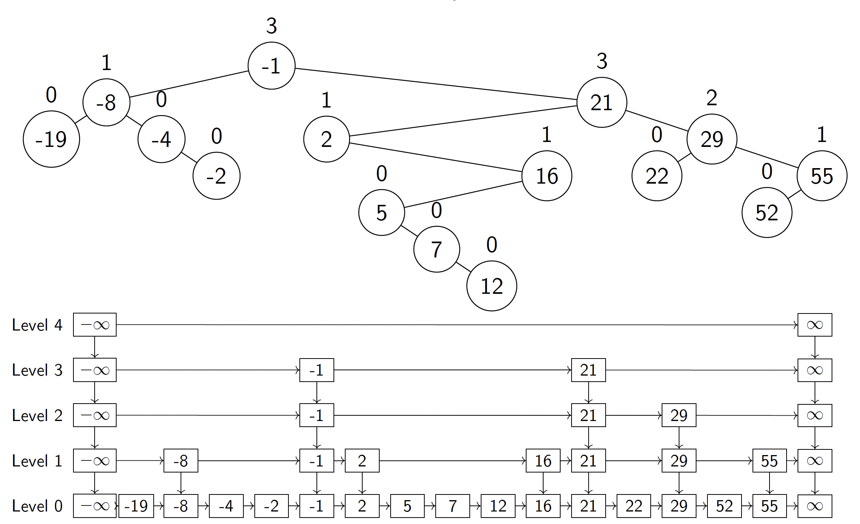
Zip Tree
A binary search tree where each node is assigned a random
rank, which is a geometric random variable with probability
parameter p=1/2 (e.g., number of times you need to flip
a fair coin until getting a “heads”).
Nodes are organized so that they have the max-heap
property with respect to these ranks, breaking ties by
the key value (so nodes with same rank form chains of
left children).

Slide 3
Duality between Zip Trees and Skip Lists
Each node is labeled with corresponding skip-list height,
which is chosen randomly, i.e., its rank.

Slide 4
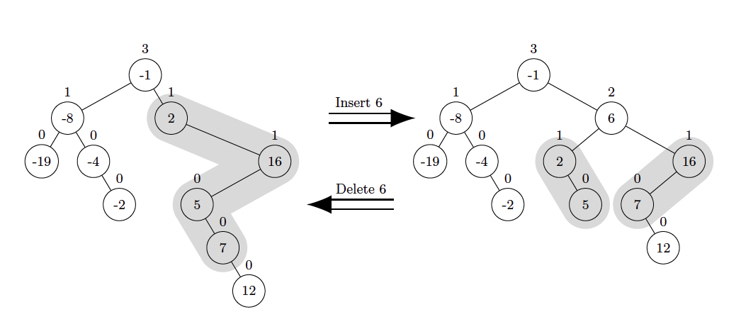
Insert Operation
To insert a node x into a zip tree, we search for x in the tree until reaching the node y that x wil replace, namely the node y such that y.rank < x.rank, with strict inequality if y.key < x.key.
From y, we follow the rest of the search path for x, unzipping it by splitting it into a path, P, containing each node with key less than x.key and a path, Q, containing each node with key greater than x.key (recall that we assume keys are distinct).

Slide 5
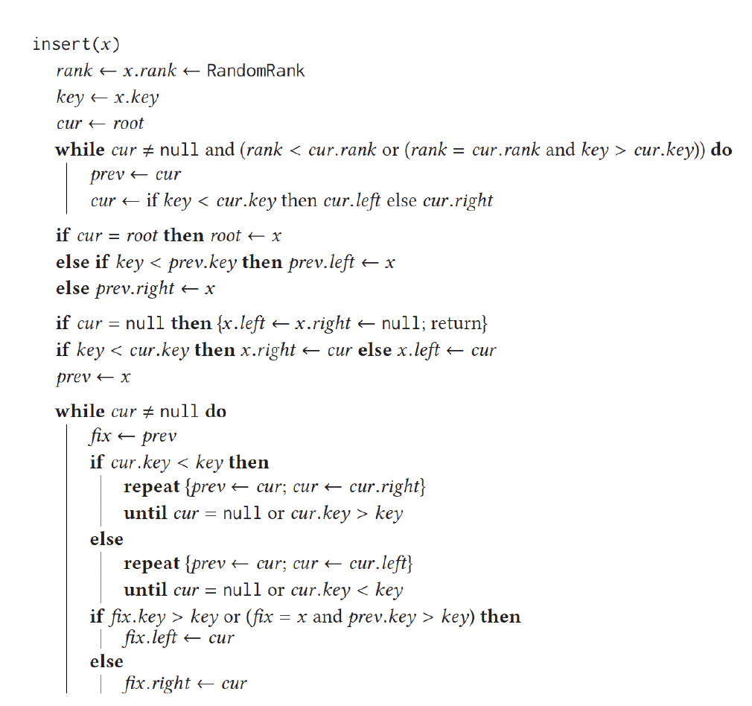
Insert Pseudo-code

Slide 6
Delete Operation
To delete a node x into a zip tree, we perform the reverse zip operation, where we do a search to find x and let P and Q be the right spine of the left subtree of x and the left spine of the right subtree of x, respectively.
Then we zip P and Q to form a single path R by merging them from top to bottom in non-increasing rank order, breaking a tie in favor of the smaller key.

Slide 7
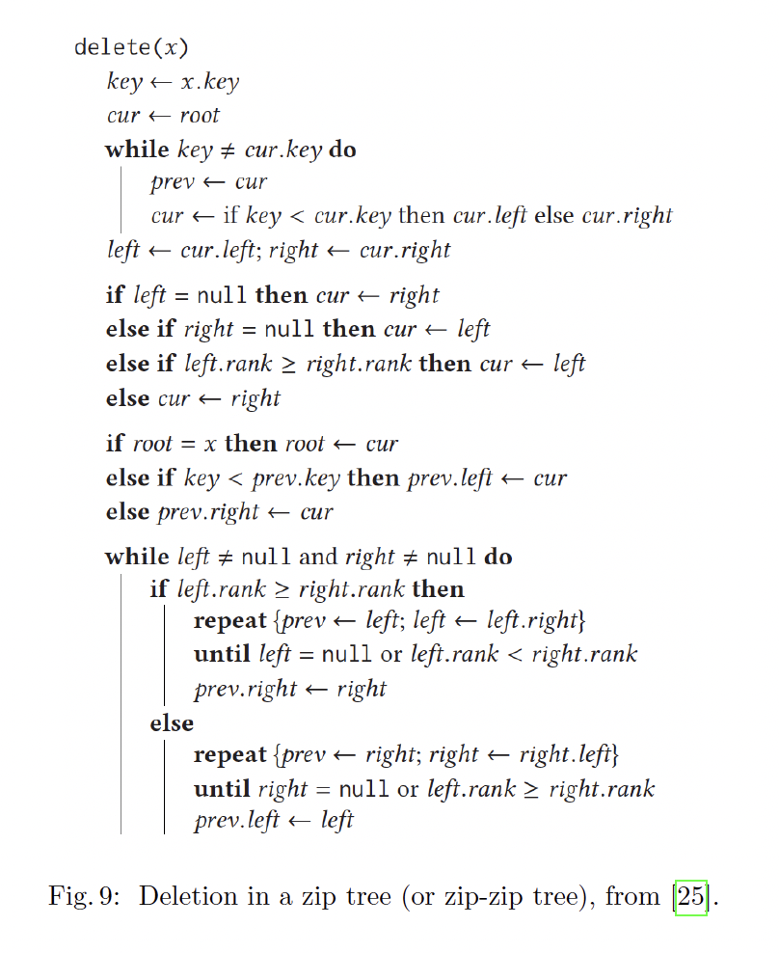
Delete Pseudo-code

Slide 8
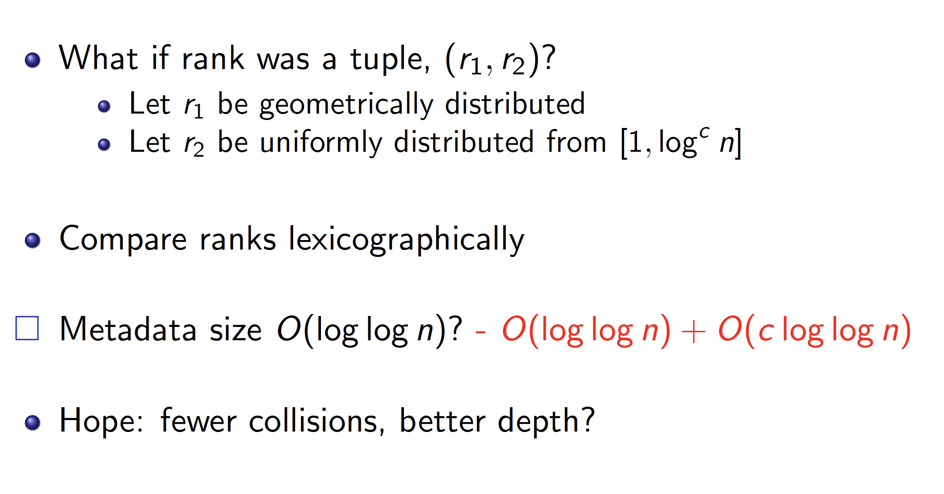
Zip-zip Trees

Slide 9
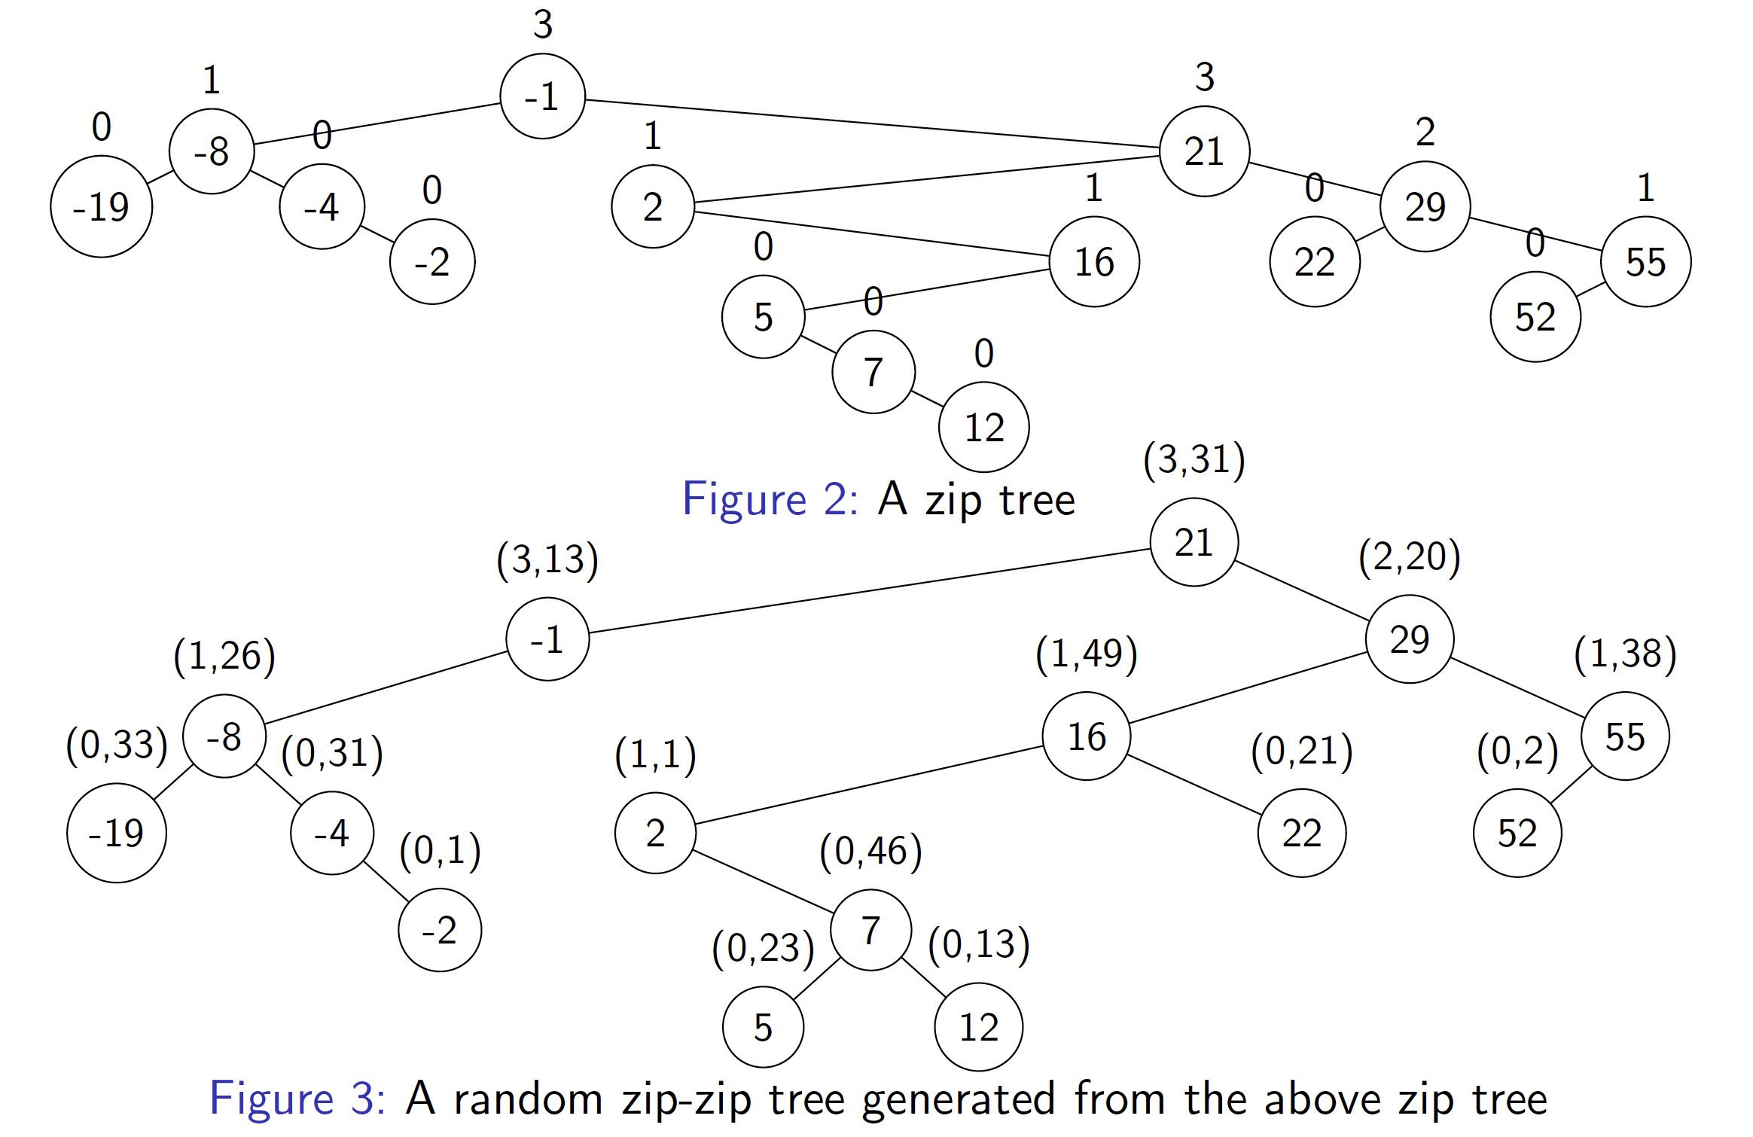
Zip Tree and Zip-zip Tree Examples

Slide 10
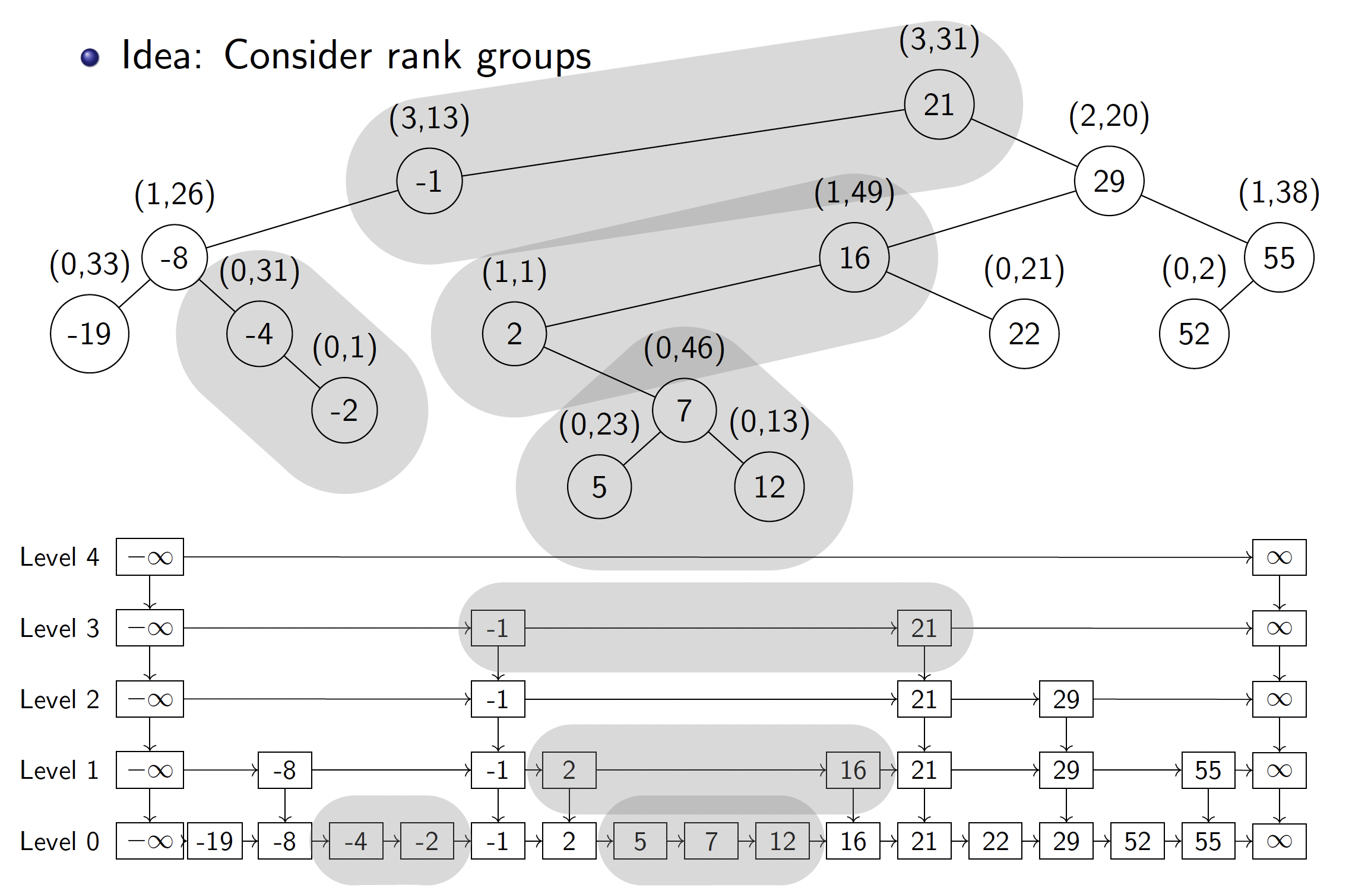
Zip-zip Trees are Dual to Skip Lists
Each rank group (nodes with same first coordinate) correspond to nodes in a skip list group on the same level.

Slide 11
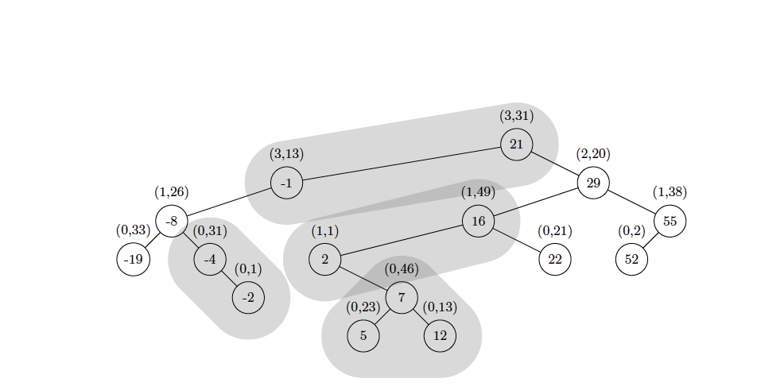
Insert and Delete Operations
Insert and delete operations are the same as in a zip tree, except that instead of just using the rank random value, we use the (r₁, r₂) random pairs to determine node heights.
That is, if there would be a tie with the r₁ value (i.e., rank in a zip tree), we break the tie using r₂.

Slide 12
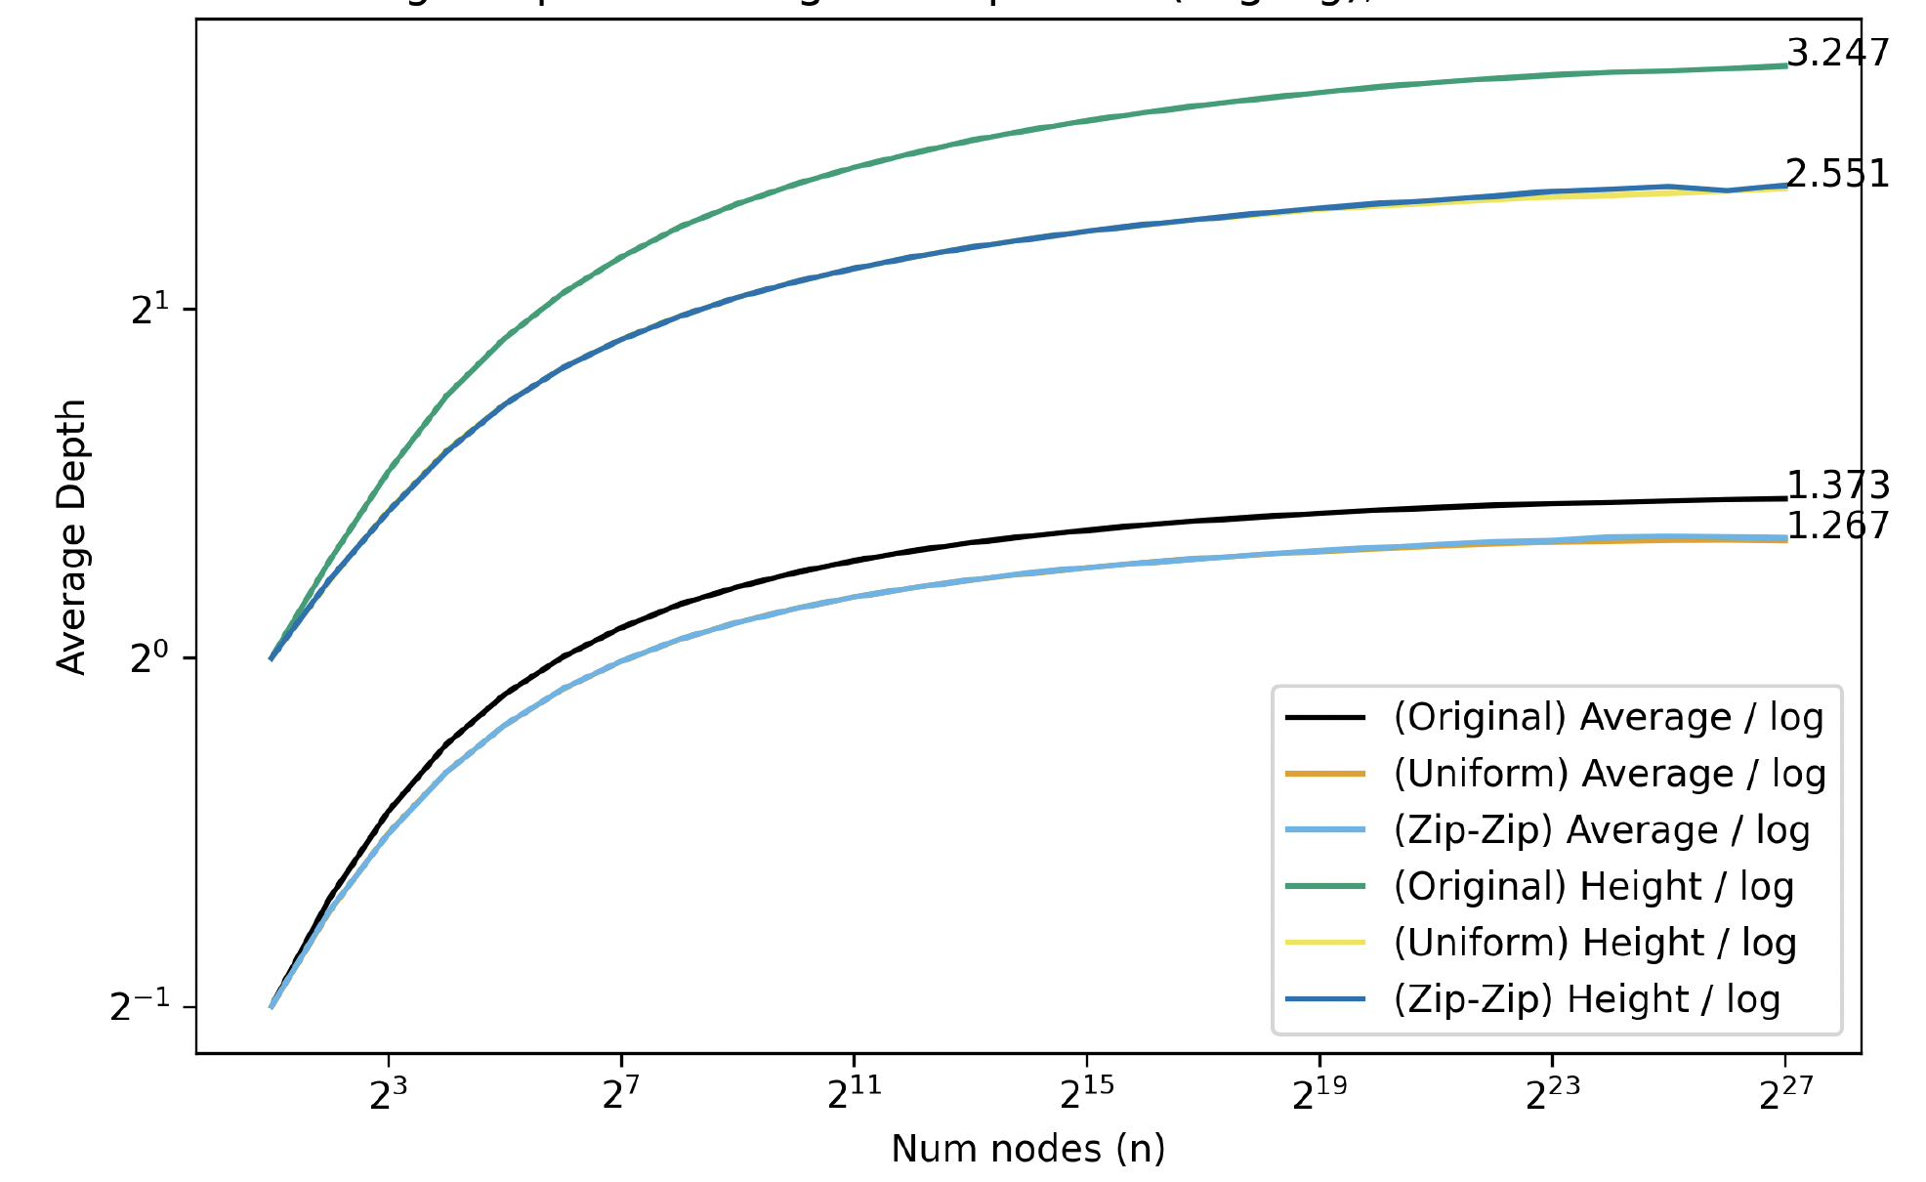
Performance
Insert, delete, and search run in O(log n) time with high probability.
The expected depth of a node in an n-node zip-zip tree is at most 1.3863 log n - 1 + o(1).
Average key depth and tree height for zip trees and zip-zip trees:

