Slide 1
Spatiotemporal Scheduling for Crowd Augmented Urban Sensing
Qiuxi Zhu, Md Yusuf Sarwar Uddin, Nalini Venkatasubramanian – Univ. California, Irvine, U.S.A.
Cheng-Hsin Hsu – National Tsing Hua Univ., Taiwan
Funded by –
CNS-1450768
MSE 446677-22553

Slide 2
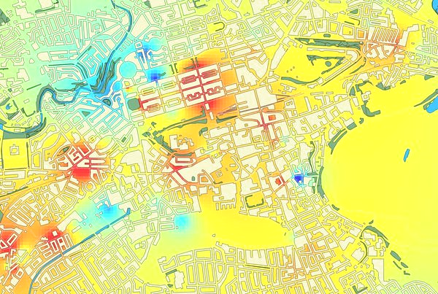
Motivation
IoT helps achieve fine-grained urban sensing and monitoring
Environmental phenomena and human activities
In-situ and mobile devices
Diverse sensing capabilities
We anticipate that a large number of devices will participate in such activities in the near future.
Redundant data may lead to
Higher energy cost
Waste of network and cloud resources
Little contribution to accuracy
Notes:
In-situ: Deployed nodes on street lamps, signal lights, etc.
Mobile: (1) Deployed nodes on buses; (2) Crowd-owned mobile devices.
The large amount of participants and devices can generate a large amount of redundant data, if we do not coordinate them carefully.
Example: Air quality, noise, trash, temperature, wireless network signal strength, etc.

Slide 3
Spatiotemporal scheduling
Make plans for devices to regulate their sensing behavior (i.e. activate/deactivate their sensors)
Acceptable space-time coverage with limited data budget
Reduced redundancy
Challenges
Device heterogeneity: Availability of multiple sensor types
Data heterogeneity: Varying spatiotemporal requirements
Crowd mobility
Scalability: Number of devices and size of maps
Applicable to other geo-correlated data generation apps
Notes:
In IoT systems, it is common that multiple types of sensors coexist on the same device.
These sensors may serve common or different IoT applications.

Slide 4
Related work
Urban crowd-sensing
S. Hachem (PerCom ‘13)
Y. Han (SECON ‘15)
A. Khan (PMC, 2015)
Y. Chen (NetGames ‘17)
M. Talasila (MobiCASE ‘14)
TRAC (INFOCOM ‘14), etc.
IoT and edge computing
SCALE2 (SMARTCOMP ‘16)
H. Hong (CloudCom ‘17)
Pollution monitoring
A. Marjovi (DCOSS ‘15)
D. Hasenfratz (PerCom ‘14)
Y. Zheng (UbiComp ‘14), etc.
Pollution severity
R. Beelen, ’14
J. Zhang, ’14
N. Kunzli, ‘00
R. T. Burnett, ’00
X. Xu, ‘94
Notes:
Urban crowd-sensing
S. Hachem (PerCom ‘13): Probabilistic registration
Y. Han (SECON ‘15): Utility-maximizing data collection in crowd sensing
A. Kahn (PMC, 2015): A novel localization and coverage framework for real-time participatory urban monitoring
Y. Cheng (NetGames ‘17): Gamifying mobile application for smartphone augmented infrastructure sensing
M. Talasila (MobiCASE ‘14): Alien vs. mobile user game: Fast and efficient area coverage in crowd-sensing
TRAC (INFOCOM ‘14): TRAC: Truthful auction for location-aware collaborative sensing in mobile crowdsourcing
Pollution monitoring
A. Marjovi (DCOSS ‘15): High resolution air pollution maps in urban environments using mobile sensor networks
D. Hasenfratz (PerCom ‘14): Pushing the spatio-temporal resolution limit of urban air pollution maps
Y. Zheng (UbiComp ‘14): Diagnosing New York City’s noises with ubiquitous data
IoT and edge computing
SCALE2 (SMARTCOMP ‘16)
H. Hong (CloudCom ‘17): Supporting internet-of-things analytics in a fog computing platform

Slide 5
Online scheduling approach
Devices report on-board sensing capability info to server.
Server collects or estimates the location of participating devices.
Server creates the plan which specifies what sensors should be active on which devices now.
Devices activate or deactivate sensors.
This is a device

Slide 6
Spatiotemporal scheduling
Problem formulation
Assumptions
Terms and notations
Spatiotemporal scheduling as multi-objective optimization
Online scheduling algorithms
Prototype platform and measurements
Performance evaluation and simulation results

Slide 7
Problem formulation
Discretize space into cells and time into time frames
$$i$$
$$i_{1}$$
Distance between cells is represented in matrix $S$
Cell $c_{i}$
Distance $S_{i_{1},i_{2}}$
$$i_{2}$$

Slide 8
Problem formulation
Sensor for $d_{k}$
Data rate $r_{k}$
Simplicity: Data are generate at constant rate
Communication error and delay are not considered
Data type $d_{k}$
Priority $p_{k}$

Slide 9
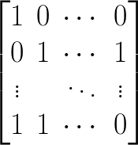
Problem formulation
$$j$$
Sensor presence binary matrix $B$
$B_{j,k}=1$ iff $d_{k}$ is present on $n_{j}$
$$k$$
Sensor for $d_{k}$
Node $n_{j}$

Slide 10
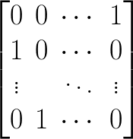
Problem formulation
$$j$$
Node placement bin. matrix $G\left[n\right]$
$G_{j,i}\left[n\right]=1$ iff $n_{j}$ is in $c_{i}$ at time $n$
$$i$$
Cell $c_{i}$
No control on the mobility of mobile nodes
$$i$$
Node $n_{j}$

Slide 11
Problem formulation
$$j$$
Activation plan bin. matrix $W\left[n\right]$
$W_{j,k}\left[n\right]=1$ iff $d_{k}$ is active on $n_{j}$ at time $n$
$$k$$
Sensor for $d_{k}$
$$i$$
Cell $c_{i}$
Node $n_{j}$
Activation state represented by $ω_{i,j,k}\left[n\right]=$ $W_{j,k}\left[n\right]⋅$ $G_{j,i}\left[n\right]$

Slide 12
Problem formulation
Node is active if any sensor on it is active; it is inactive if no sensor is active
Node is active if any sensor on it is active; it is inactive if no sensor is active
Node $n_{j}$

Slide 13
Problem formulation
Temporal impact of data type $d_{k}$ defined by impact function $$h_{k}^{T}\left(t\right)∈\left[0,1\right],t≥0$$
Spatial impact of data type $d_{k}$ defined by impact function $$h_{k}^{S}\left(s\right)∈\left[0,1\right],s≥0$$
Cell $c_{i}$
$$i$$
Node $n_{j}$

Slide 14
Performance model
Benefits
Utility: Quality of data collected in each cell in each frame
Coverage: Probability a cell is covered by some valid data
Cost
Number of active nodes: Activation overhead
Constraints
Data quota: Average data generation rate
Sensor presence: Only existing sensor can be activated
Multi-objective optimization with constraints
Notes:
Introduce the favorable decisions here –
We want our collected data be distributed in space and time more uniformly, though some regions could be more densely populated
Coverage: We want to cover more space and time
Utility: If possible, we also want to improve the quality/quantity of data we collect in each cell and time frame
Activation overhead: Human intervention and energy cost to keep device “awake”, etc.

Slide 15
Benefit: Utility
Utility $u$ measures the quality of sensor data.
The utility function $u_{i,k}\left[n\right]=u_{k}\left(ω_{i,k}\left[n\right]\right)$ is application dependent, but satisfies our assumptions and certain properties, e.g.
A set of sensors > any subset of these sensors
Many sensors ≤ sum of each sensor
Many sensors in one cell < same number but in many cells
Overall utility (i.e. spatiotemporal average)

Slide 16
Benefit: Coverage
Coverage $x$ is the probability that a cell is covered by valid sensor data, considering temporal impact (of historical data points) and spatial impact (of remote data points).
Single-cell single-frame coverage
Single-cell effective coverage (i.e. impacted coverage)
Spatial average coverage at time frame $n$
Average coverage over time frames $n^{′}$ to $n$
Overall coverage (i.e. spatiotemporal average)
$$f\left(x\right)$$

Slide 17
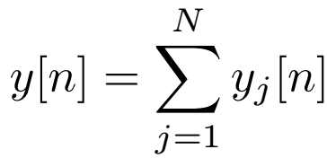
Cost: Number of active nodes
Number of active nodes captures the activation overhead (e.g. human intervention, energy consumption) of nodes. It is consistent with our assumption that
Many active sensors on one device > on many devices
Average number of active nodes (i.e. temporal average)

Slide 18
Constraint: Data quota
An application dependent quota on average data rate $D_{quota}$
Overall data generation rate (i.e. temporal average)
The data quota constraint is that $D≤D_{quota}$.
Note that
The unit of data rate and data quota is byte/sec;
The constraint applies to the overall data generation rate, not the per-frame data generation rate.

Slide 19
Multi-objective optimization
Given inputs
Presence of sensors on nodes, i.e. matrix $B_{N×K}$
Placement of nodes, i.e. matrix $G_{N×M}\left[n\right],n∈N$
Find: Plan matrix for each time frame $W_{N×K}\left[n\right],n∈N$
Optimize
Overall coverage $X$ and overall utility $U$ (maximize)
Average cost $Y$ (minimize)
Subject to
Presence constraint $W_{j,k}\left[n\right]≤B_{j,k},∀j,k,n$
Data constraint $D≤D_{quota}$
NP-hardness

Slide 20
Spatiotemporal scheduling
Problem formulation
Assumptions
Terms and notations
Spatiotemporal scheduling as multi-objective optimization
Online scheduling algorithms
Prototype platform and measurements
Performance evaluation and simulation results

Slide 21
Naïve: Activating everything
For the given set of trajectories or locations, and the given sensing capacity of nodes, activating everything gives
Maximum possible coverage
Maximum possible utility
Maximum possible number of active nodes (cost)
Meanwhile, it has
Unbounded data generation (constraint violation), hence not a valid solution when there is a data quota
Benefit objectives (i.e. coverage and utility) of this naïve approach can be used as baselines to compare with those of other algorithms, i.e. check how well they perform.

Slide 22
Naïve: “Random” (utility first)
Fill up the assigned data budget using a subset of sensors (i.e. node-type pairs)
Pick the sensors that give higher utility
Random tie breaking
A quick and valid solution when there is a data quota with certain aspects ignored
Spatiotemporal requirements of different data types
Cost of node activation
Unused data budget rolls over to the next time frame.
Notes:
The actually naïve approach is to make completely random selections, which is obviously bad.

Slide 23
Highest score first
Get higher overall performance using assigned data budget
Score of a sensor (i.e. a node-type pair) is defined as the performance gain divided by data consumption, i.e.
$$\frac{γ_{1}⋅Δx\left[n\right]+γ_{2}⋅Δu\left[n\right]−γ_{3}⋅Δy\left[n\right]}{Δd\left[n\right]}$$
Select the node-sensor pair with the highest score, add it to the plan, and loop until: (1) All sensors are active, (2) Data quota is used up, or (3) Highest score is non-positive.
Any selection could affect scores of unselected sensors.
Unused data budget rolls over to the next time frame.
Notes:
Recall that the overall performance includes three terms: Utility, coverage, and node activation.
Time complexity: O(K * M ^ 2 * N + K * M * N ^ 2 + K ^ 2 * N ^ 2)

Slide 24
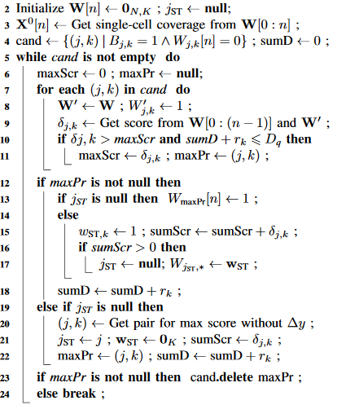
Highest score first
Start with an empty $W\left[n\right]$
For every node-sensor pair $\left(j,k\right)$ that is not marked as active and does not violate data quota constraint in $W\left[n\right]$, compute its score
Mark the $\left(j,k\right)$ pair with highest positive score as active, and loop until…
Slow termination: When highest score is negative
Unit-data performance gain, i.e.
$$\frac{γ_{1}⋅Δx\left[n\right]+γ_{2}⋅Δu\left[n\right]−γ_{3}⋅Δy\left[n\right]}{Δd\left[n\right]}$$
Notes:
There are 3 (three) ways this algorithm terminates:
All sensors are active
Data quota runs out
Highest score is non-positive

Slide 25
Lyapunov control
Match used data (actually generated) with data quota
State of the system $φ\left[n\right]$ is represented by a “queue”, the size of the queue is the total amount of data generated up to the current time frame, i.e. $φ\left[n\right]=Q\left[n\right]=n⋅d\left[0:\left(n−1\right)\right]$.
Lyapunov function $L\left(φ\left[n\right]\right)$
$$=\frac{1}{2}{\left(Q\left[n\right]−n⋅D_{quota}\right)}^{2}$$
Lyapunov drift $ΔL\left(φ\left[n\right]\right)≈\left(Q\left[n\right]−n⋅D_{quota}\right)⋅d\left[n\right]$
Minimizing “drift minus reward” is equivalent to maximizing
$$γ_{1}⋅x\left[0:n\right]+γ_{2}⋅u\left[0:n\right]−γ_{3}⋅y\left[0:n\right]−γ_{L}⋅ΔL\left(φ\left[n\right]\right)$$
Notes:
Lyapunov control allows us to over-draft data budget from future time frames when there is a good opportunity in the current one.
This is actually another way to define the “score” to use in HSF

Slide 26
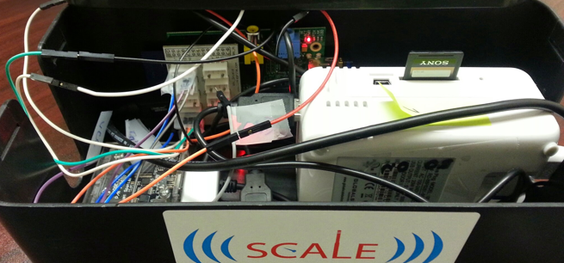
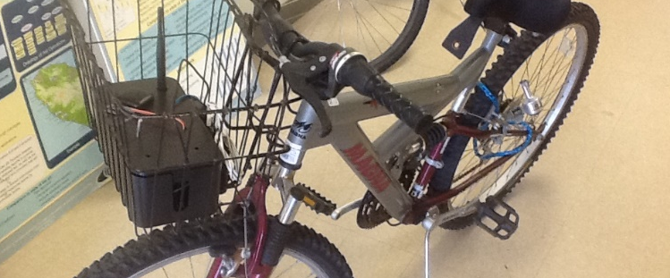
SCALECycle platform
University of California, Irvine
“UCInet Mobile Access”
Montgomery County, MD
“MCGUEST”
Donald Bren Hall
Thingstitute
IoT Lab
Victory Court Senior Apartments
Good
Poor
Notes:
SCALE multi-sensor boxes on bikes or in backpack.
Prototype: (1) Raspberry Pi Model B; (2) USB battery pack; (3) Bluetooth GPS; (4) Wi-Fi adaptor; (5) Air quality (TGS 2600)
Can be extended to support multiple types of sensors and networks.

Slide 27
SCALECycle architecture

Slide 28
Initial measurements
Sensors (NTHU testbed)
Gas sensors: MQ-5, MQ-7, MQ-131, MQ-135
Microphone: Adafruit 3367 USB Microphone
Camera: RPi Camera Module
GPS: Globalsat BU-353S4 GPS Reader
Sensors (UCI-Montgomery testbed)
Air contaminant: TGS2600
GPS: HP iPAQ Bluetooth GPS System
Wi-Fi dongle: Edimax
Initial measurements stored locally on the SD card

Slide 29
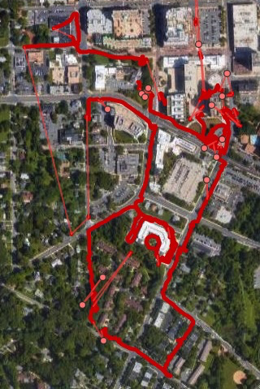
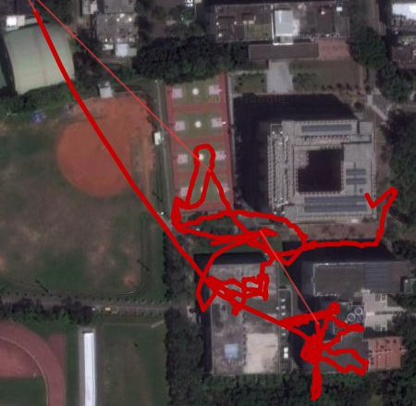
Initial measurements
Montgomery County, MD
Sensor type | Format | Sampling pattern | Sample
Analog sensors | JSON text | 1 message every 5 sec | 200 B
Microphone | WAV | 1 clip of 8 sec every minute | 800 KB
Camera | JPG | 1 picture every 20 sec | 180 KB
Wi-Fi iwlist | JSON text | 1 list of 20 items every 4 sec | 3600 B
NTHU Campus, Hsinchu City, Taiwan

Slide 30
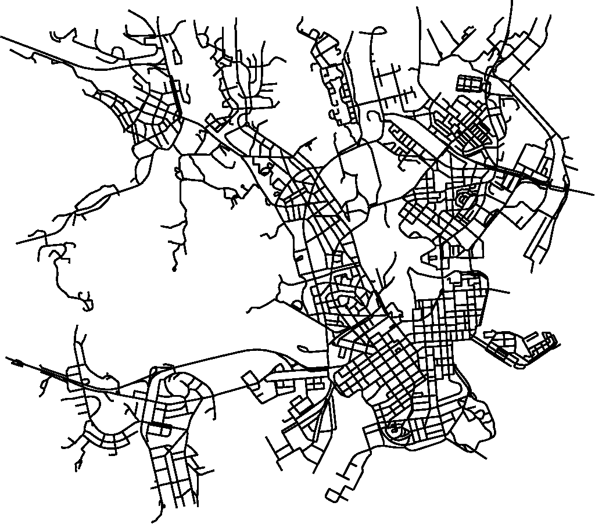
Performance evaluation
Simulation framework written in R (https://www.r-project.org/)
Mobility traces generated by the ONE Simulator (https://akeranen.github.io/the-one/) based on the built-in Helsinki map – size $4.5×3.5 km$, and pedestrian mobility – speed $v/{\left(m/s\right)}\sim U\left(0.5,1.5\right)$.
For each time frame, the simulator
Computes the placement of nodes for the time frame;
Runs the planning algorithm;
Applies the plan and computes the objectives.
Sensor types and data generation rates are driven by measurement study.

Slide 31
Simulation setup
Distance coefficient of exp. decrease func.
Time before step-down
Num. of nodes $N=100$ or $50$
Num. of mobile nodes $40\%⋅N$
Num. of cells $M=63$ ($7×9$)
Size of cells $l_{c}=500 m$
Num. of data types $K=10$
Length of time frame $T=1 min$
Length of simulation $T_{D}=3 hr$
Data quota $D_{quota}=3.5 {MB}/s$
Coefficients $γ=\left[1,{0.4}/{\ln{2}},1.2\right]$
Type | r (B/s) | Wt. | S. Imp. | T. Imp.
G1 | 40 | 8 | 550 | 20
G2 | 40 | 5 | 550 | 20
G3 | 40 | 5 | 550 | 20
G4 | 40 | 4 | 550 | 20
G5 | 40 | 4 | 550 | 20
G6 | 40 | 3 | 550 | 20
A7 | 107 K | 5 | 100 | 5
P8 | 9,000 | 7 | 10 | 60
P9 | 9,000 | 6 | 750 | 30
W10 | 900 | 3 | 20 | 60

Slide 32
Performance evaluation
Simulation
UCI ICS OpenLab Cluster
2x Quad-core Intel Xeon 3.0GHz CPU E5450 CPU
32 GB RAM
CentOS 7.3 (64-bit), Linux 3.10.0-327.22.2.el7.x86_64
R 3.3.2 (64-bit)
The ONE Simulator d7fe68e (2017-01)
Metrics
Overall performance
Individual objectives
Quota utilization
Algorithm running time
Algorithms compared
Everything (naïve)
Random (utility first)
HSF—ST
Lyapunov control
Genetic algorithm

Slide 33
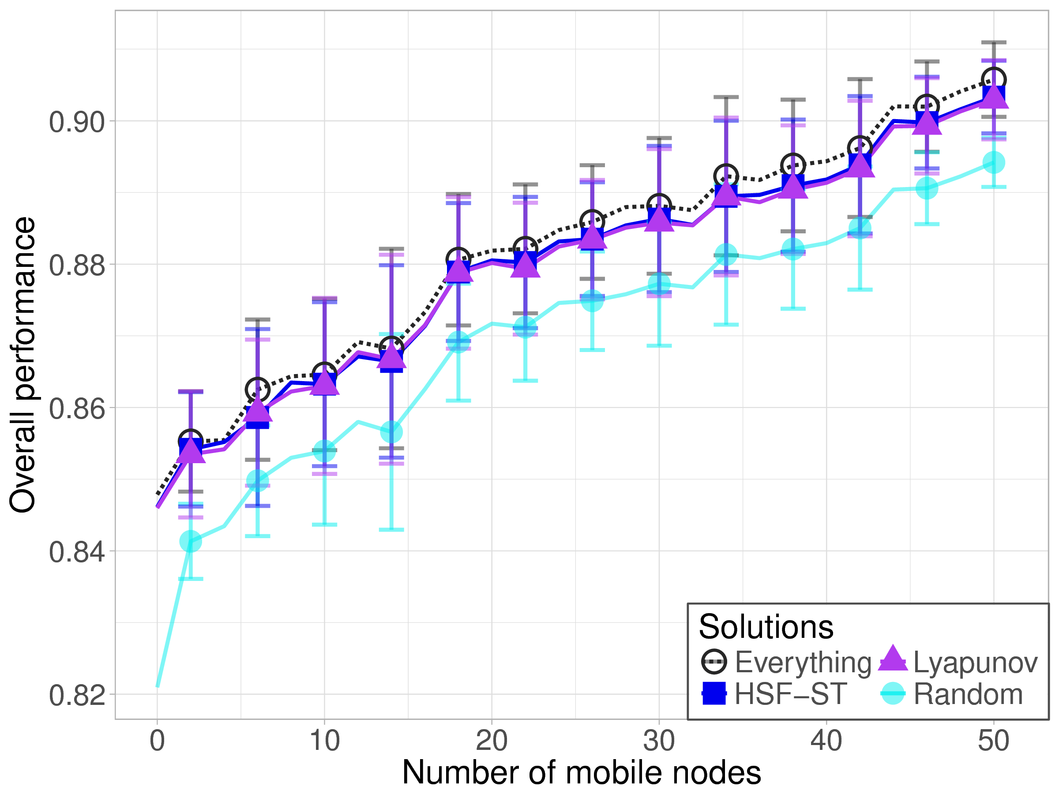
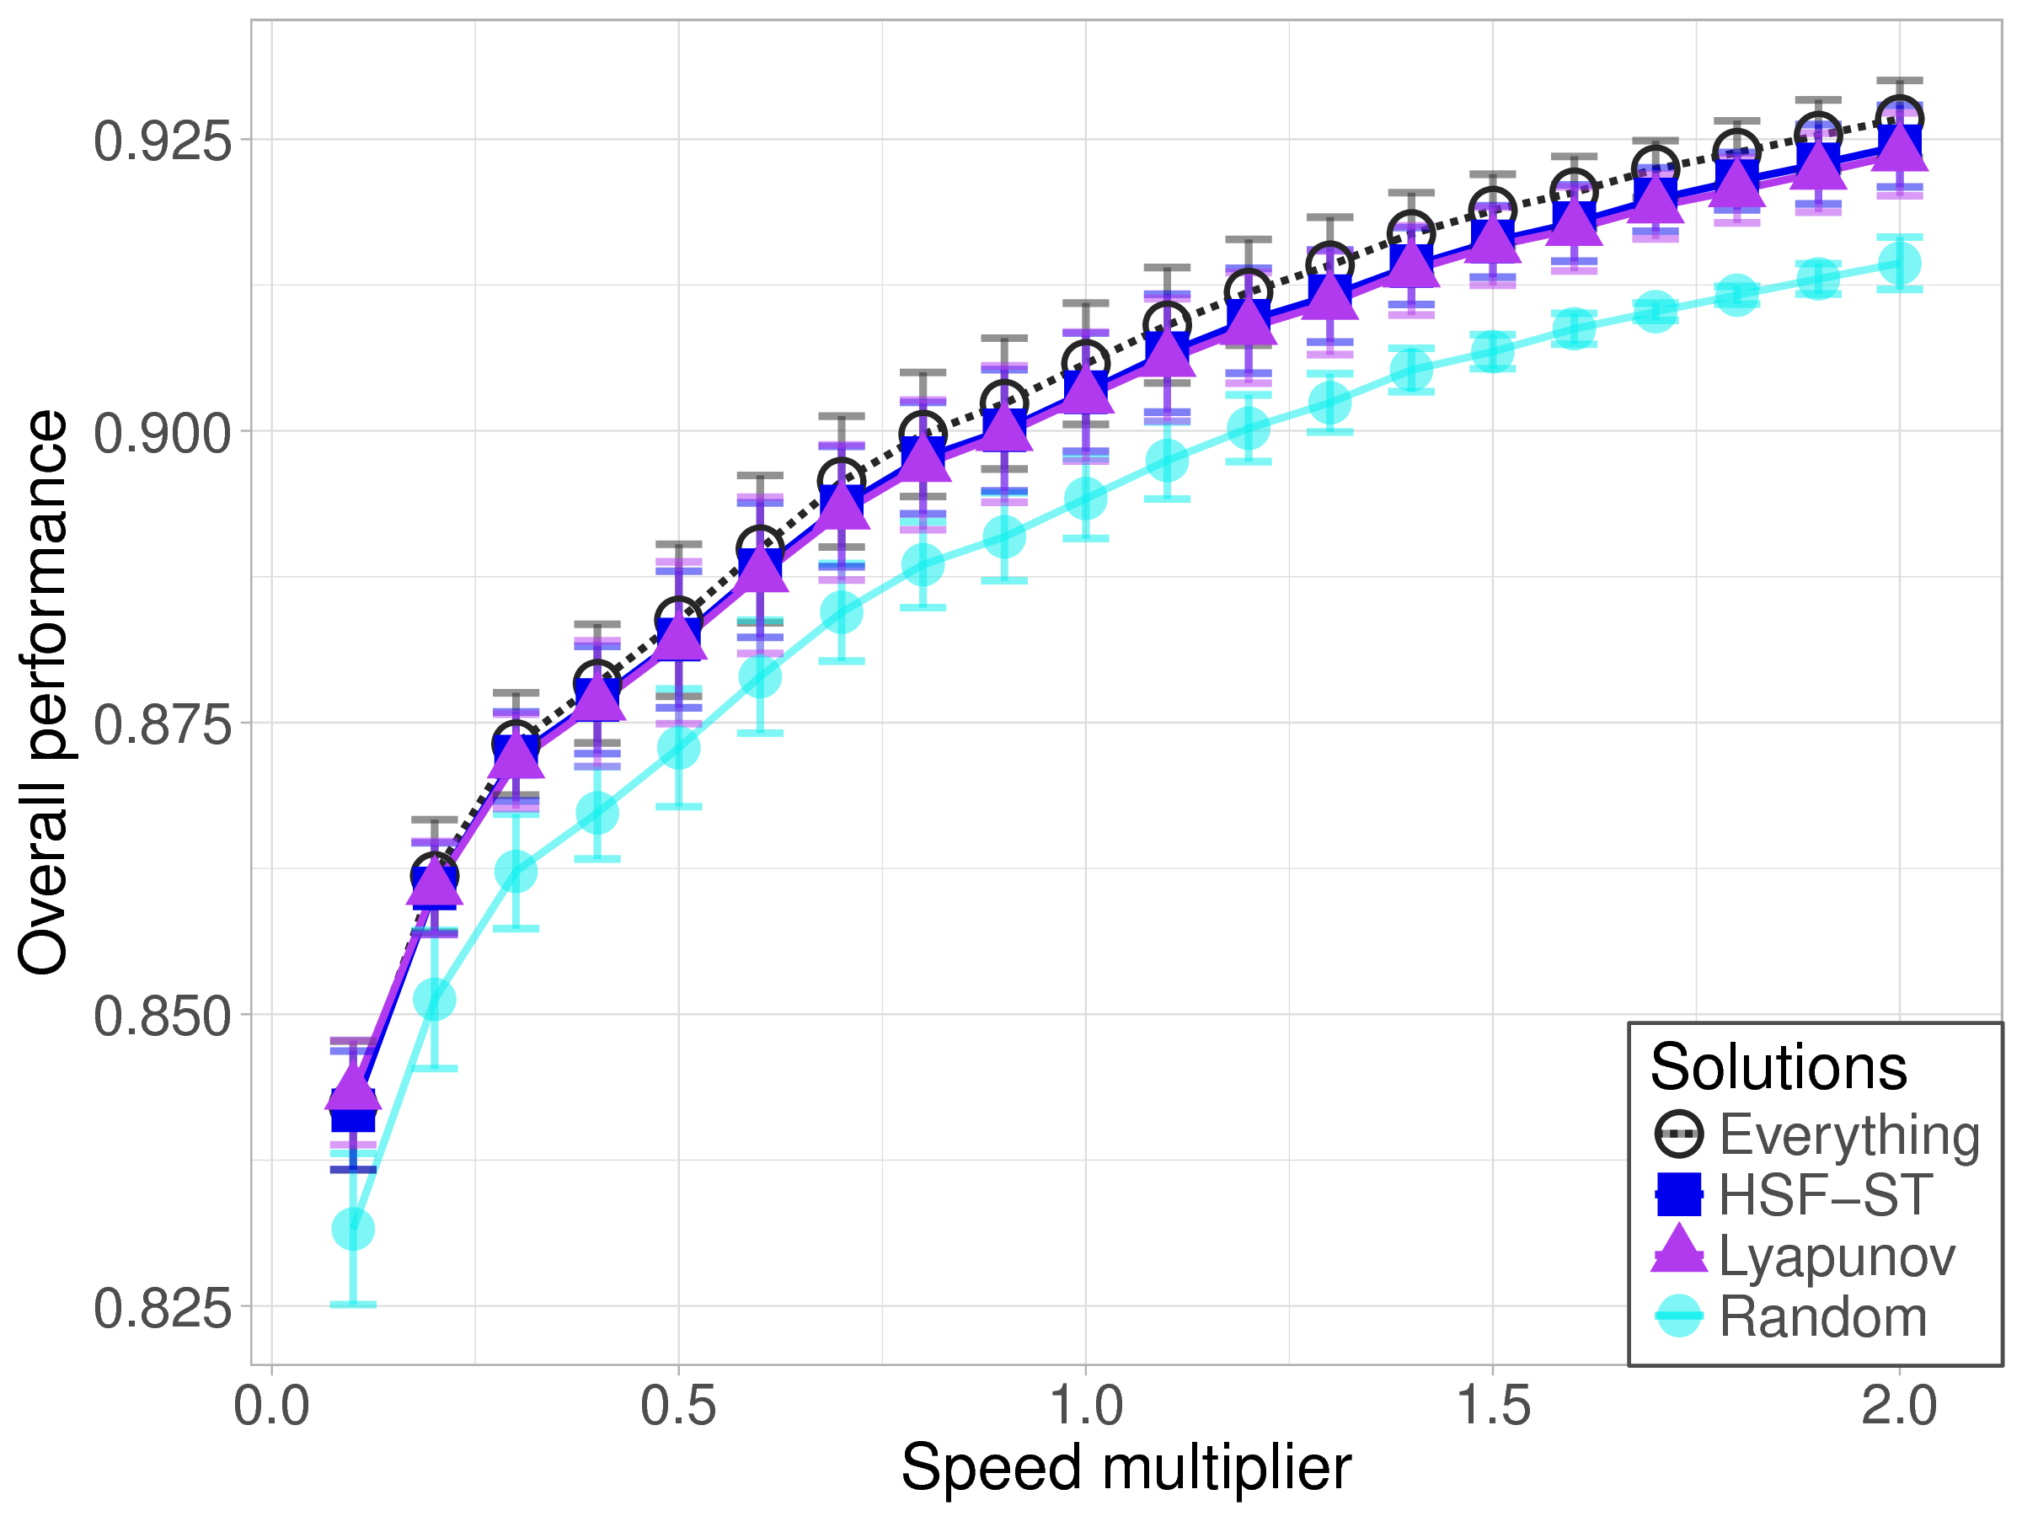
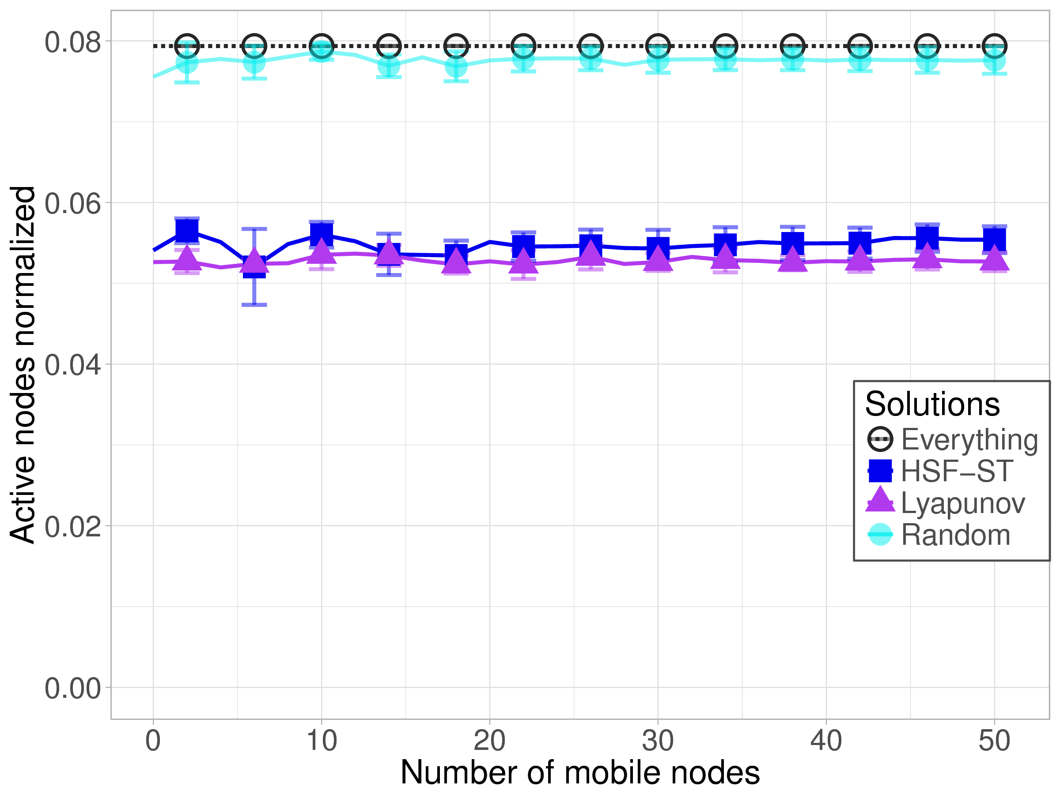
Results
Node mobility
Fixed total # nodes: 50
Varying # mobile: 0~50
Varying speed: 10~200%
Close-to-best performance
Mobile nodes (↑) → Performance (↑)
30% fewer active nodes
Speed (↑) → Performance (↑)

Slide 34
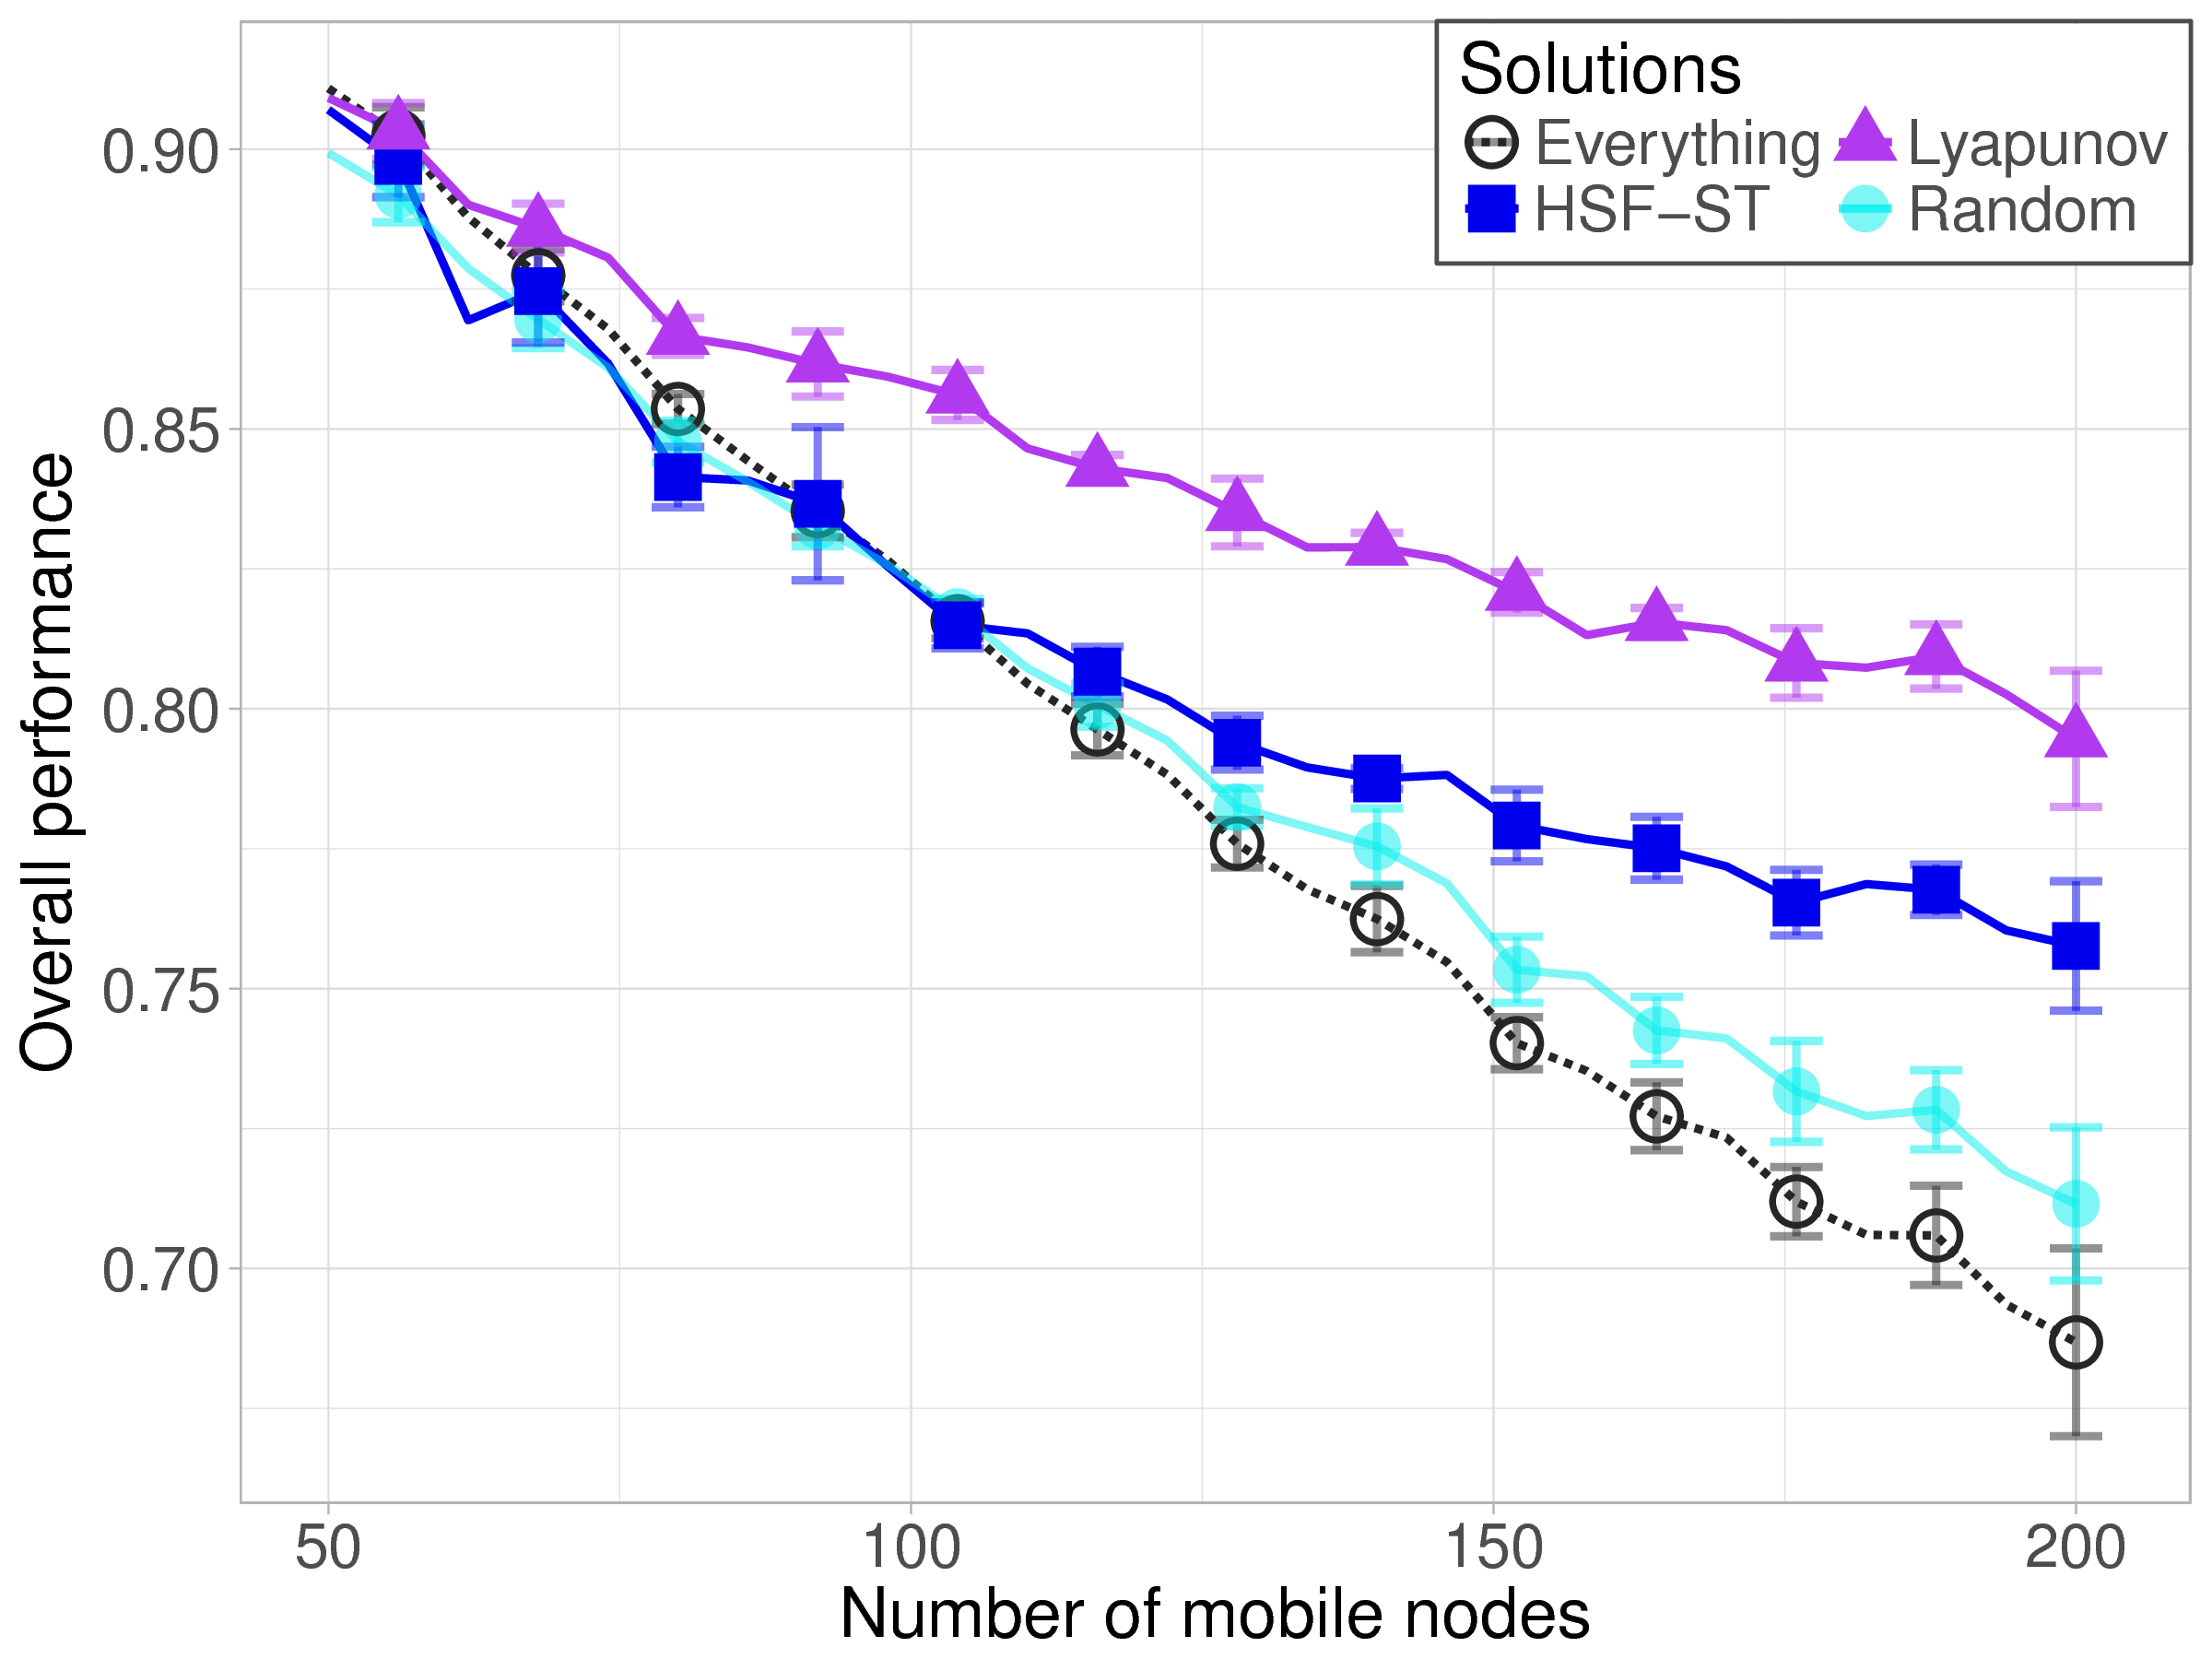
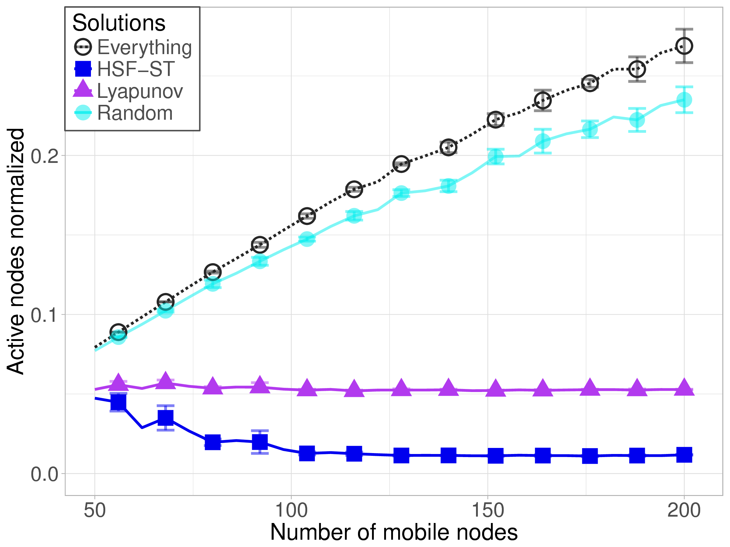
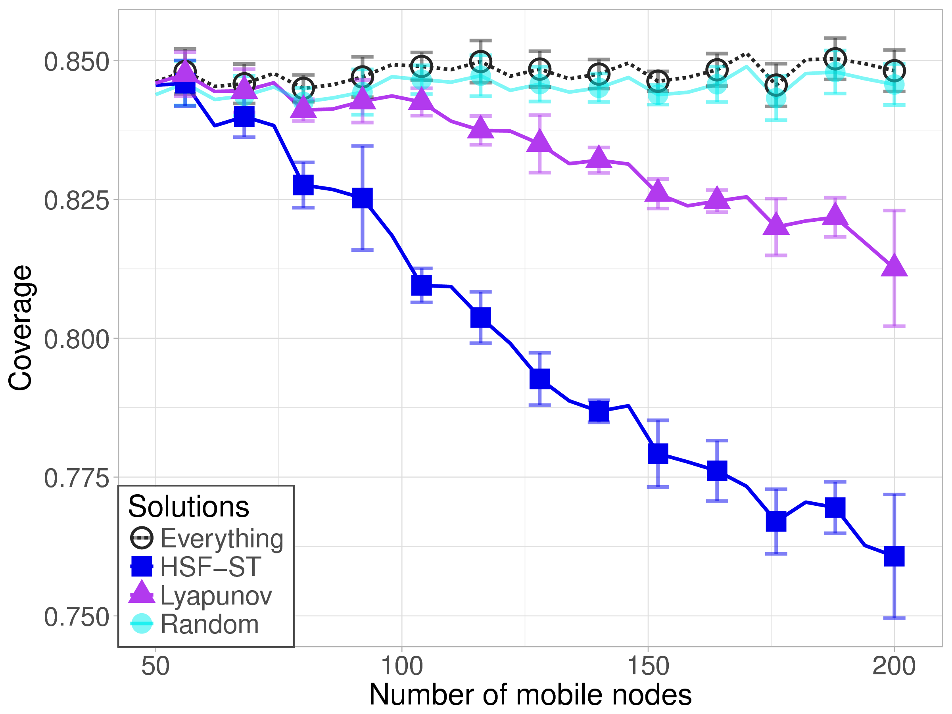
Results
Device heterogeneity
Fixed total # sensors, all mobile
Uniform dist. sensors on nodes
Varying # nodes: 50~200
Lyapunov performs better as sensors are dist. (↑) sparsely
Notes:
As sensors are distributed more sparsely over the increasing number of nodes:
It is more costly to achieve same coverage
Lyapunov performs better in terms that it balances the benefits vs. cost tradeoff better

Slide 35
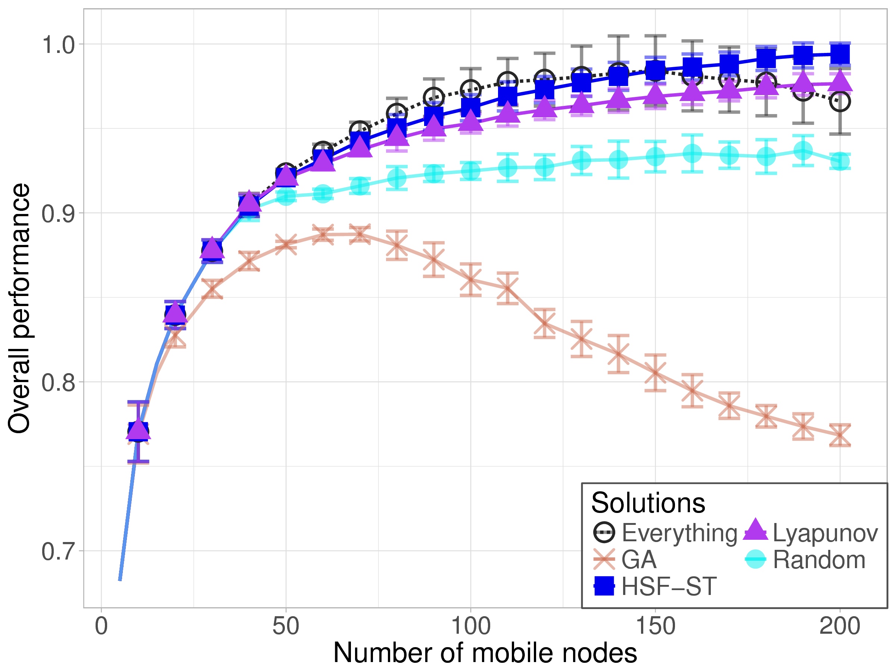
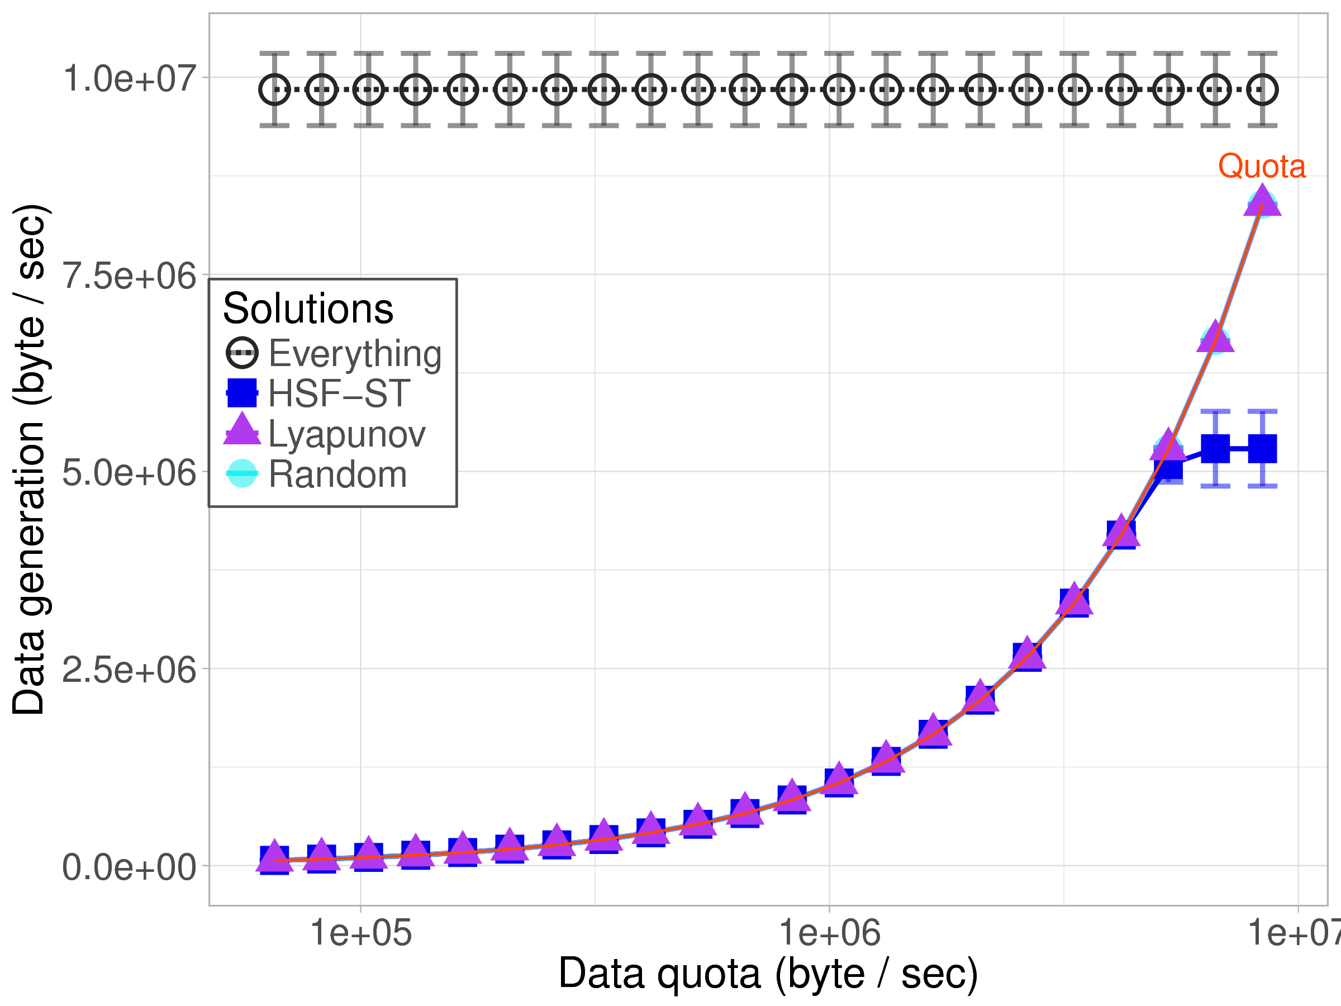
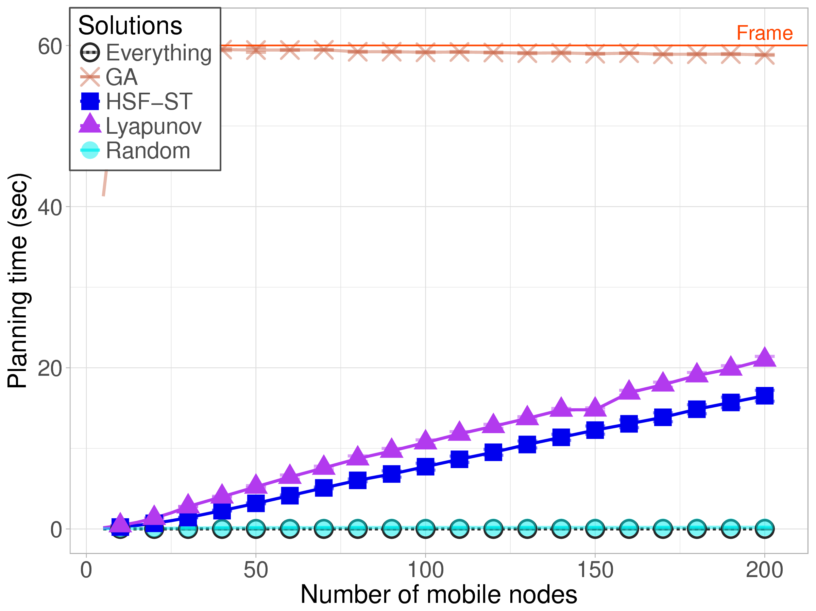
Results
Scalability
Varying # nodes: 5~200
Fixed total # nodes: 100
Varying quota: 64 KB~8 MB

Slide 36
Conclusion
Contributions
Motivated and formalized the spatiotemporal scheduling problem for crowd-augmented urban sensing;
Proposed an online framework and two algorithms;
Conducted measurement-driven simulations showing the effectiveness of proposed approach.
Achieved similar coverage (comparing to “everything”) under data constraints, with about 30% fewer active nodes.
Future works
Improve scalability with scheduling hierarchies
Study impact of network connectivity and uncertainty

Slide 37
Questions?
Distributed Systems Middleware (DSM) Group at UCI http://www.ics.uci.edu/~dsm/
Information Systems Group (ISG) at UCI https://isg.ics.uci.edu/
Networking and Multimedia Systems Lab (NMSL) at NTHU https://nmsl.cs.nthu.edu.tw/
Safe Community Awareness and Alerting (SCALE) Project http://scale.ics.uci.edu/
Qiuxi Zhu https://sites.google.com/site/zhuqiuxiuci

Slide 38
Spatiotemporal Scheduling for Crowd Augmented Urban Sensing
Thank you!
Email: qiuxiz <at> ics <dot> uci <dot> edu
Funded by –
CNS-1450768
MSE 446677-22553

