Slide 1
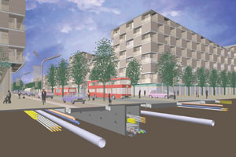

resilient Communications Middleware for IoT Data Exchange
Kyle E. Benson
University of California, Irvine
Under advisement of Nalini Venkatasubramanian

Slide 2
Dissertation Outline
Background
Proposed Middleware
Geo-aware overlays for cloud data collection
IoT Data Exchange
Our Experiences
Motivating Resilience Challenges in mission-critical scenarios
Edge fail-over and local alerting
Information prioritization to address resource constraints
Network & application-awareness, SDN & edge computing
Notes:
1) improve cloud collection
2) ensures downtime of no more than...
3) improves edge alert delivery by....
4) firedex conclusion

Slide 3


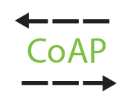


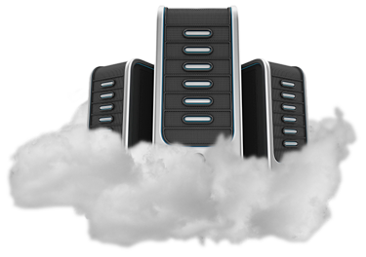


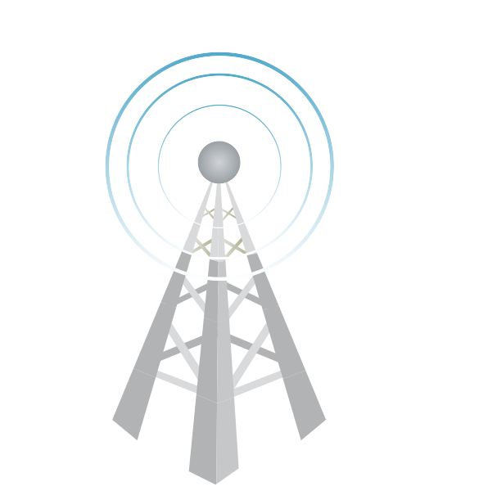

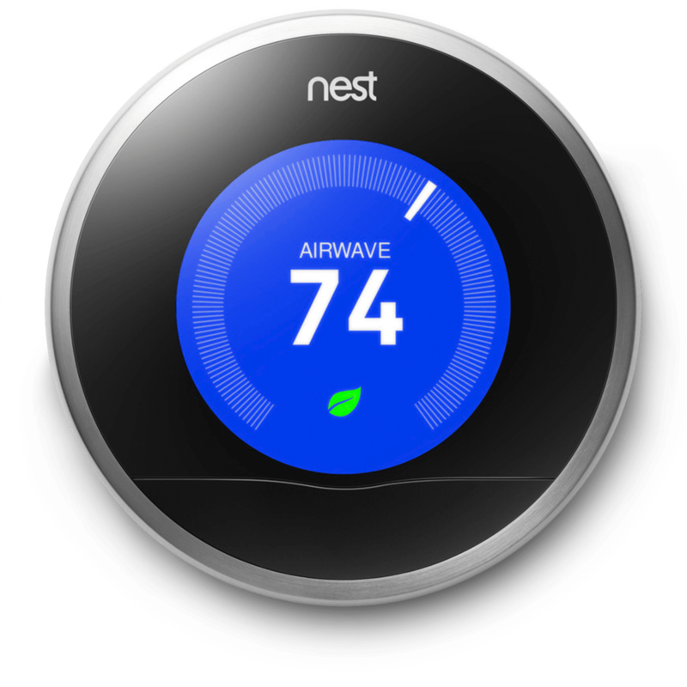

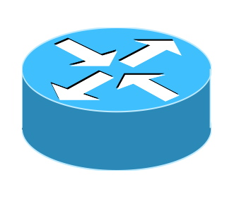




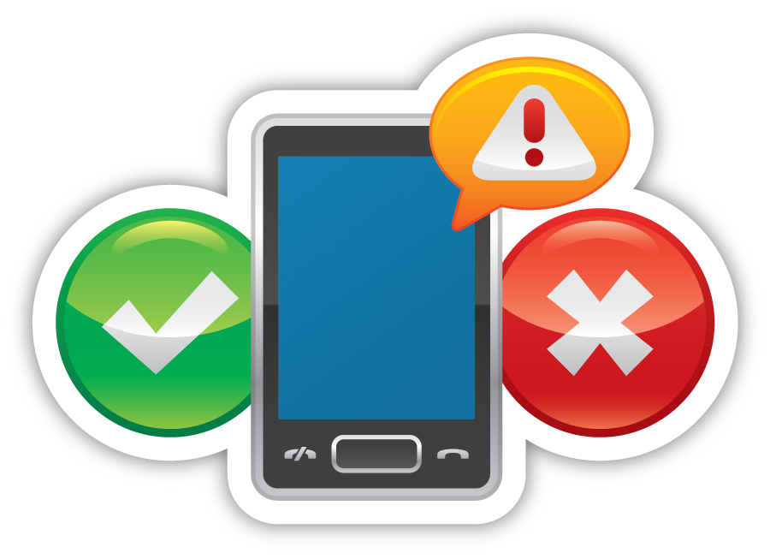

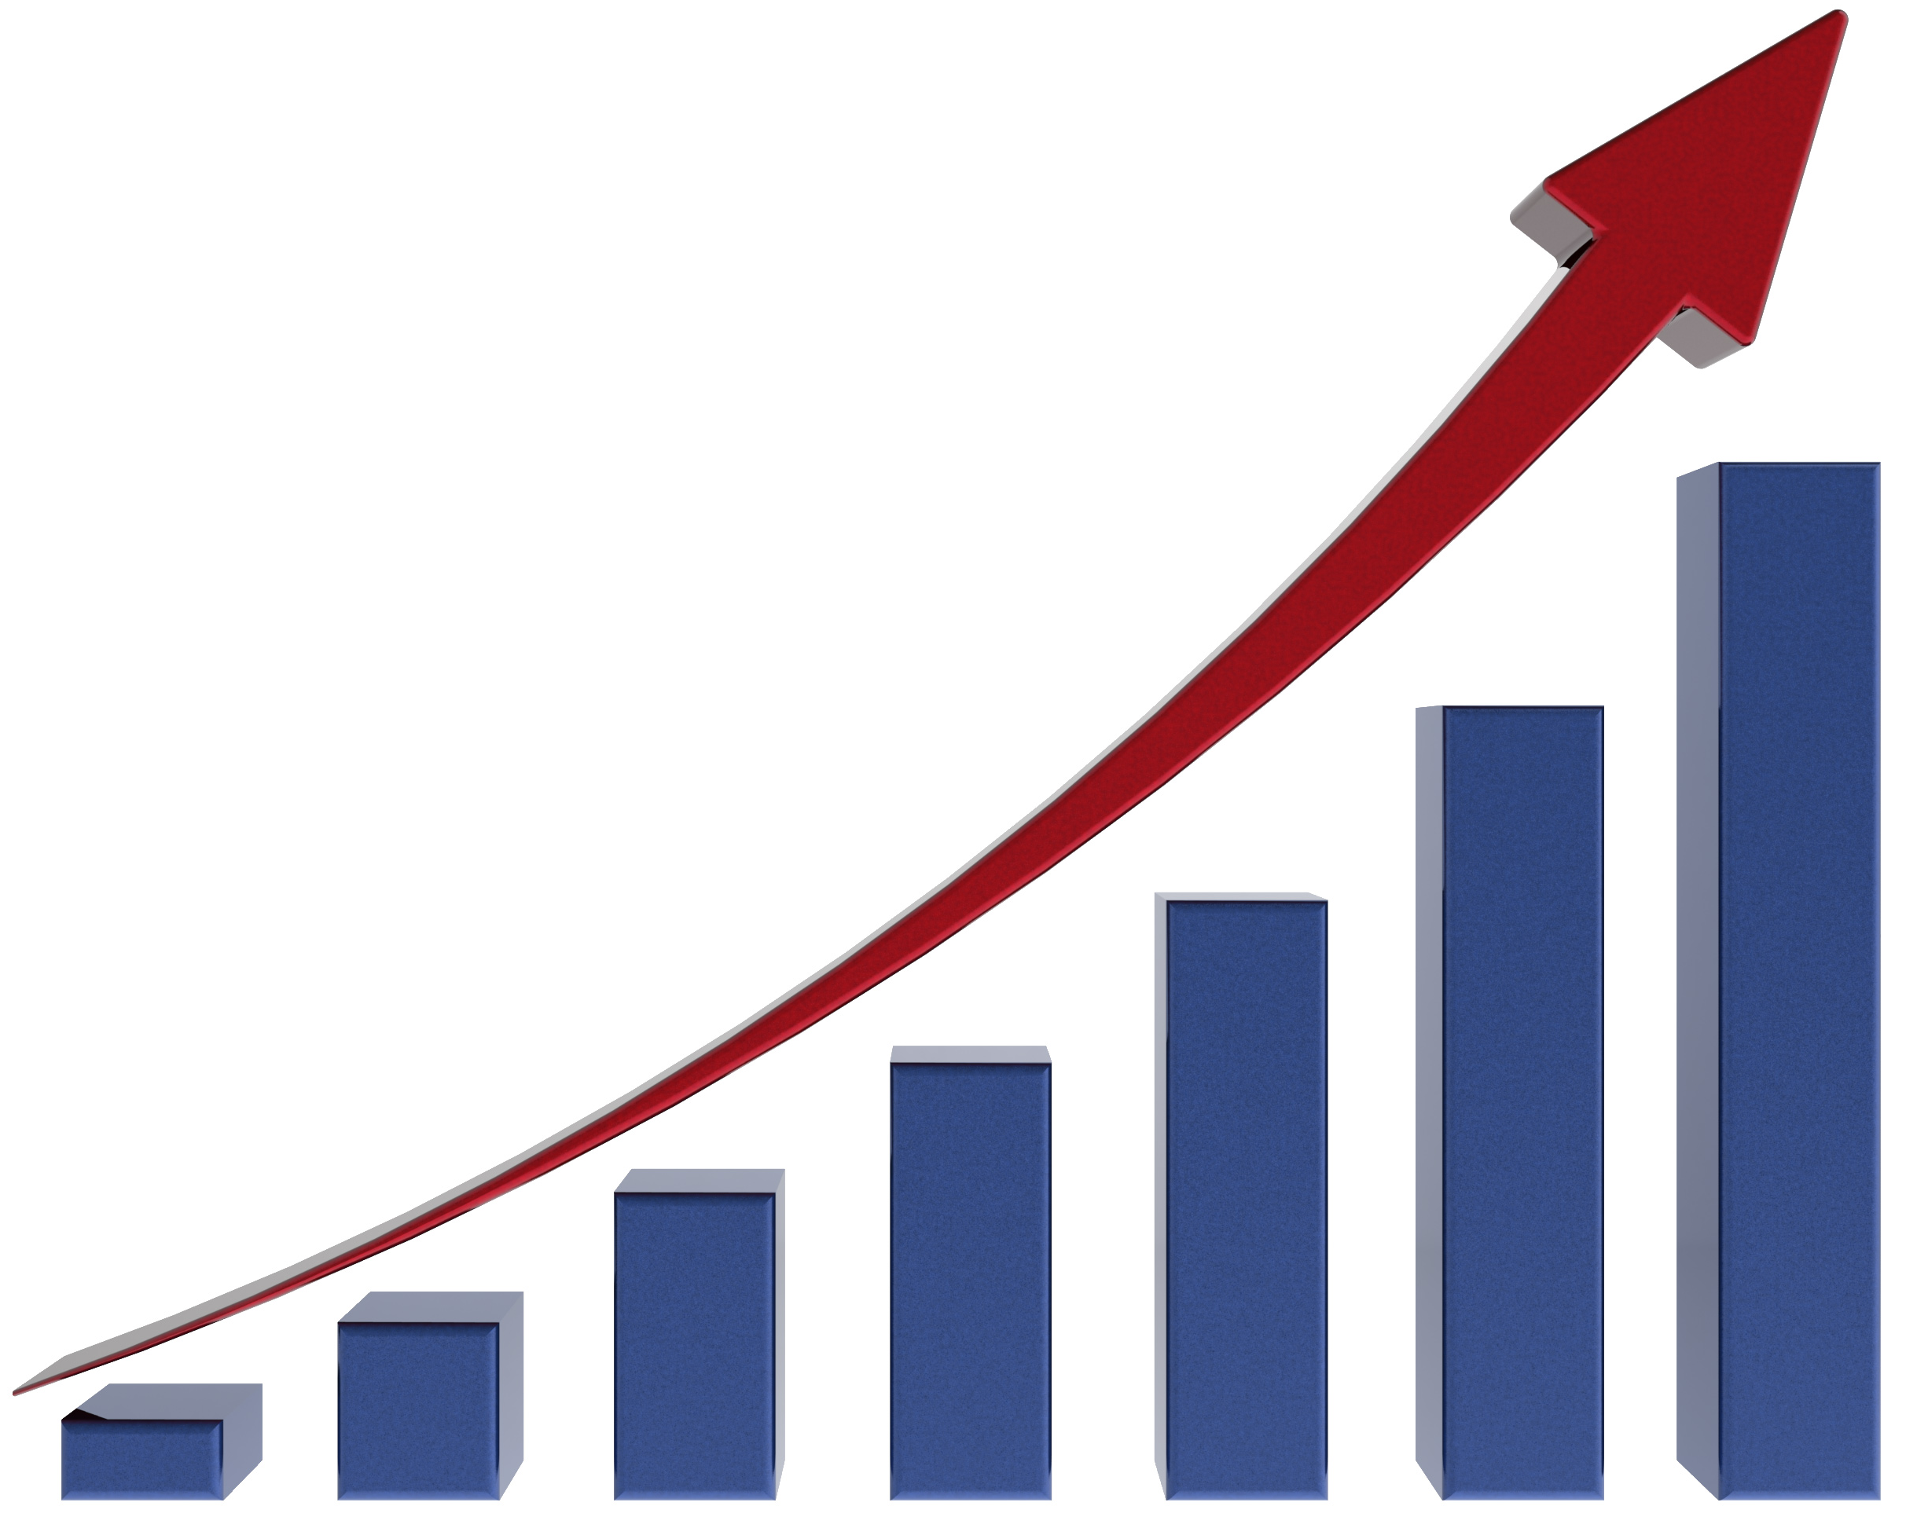



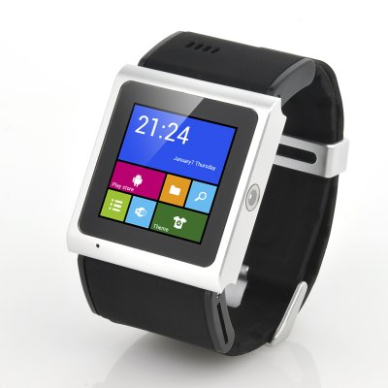
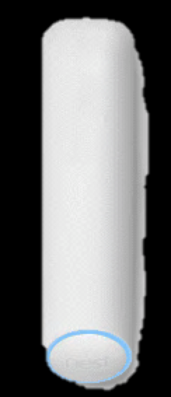
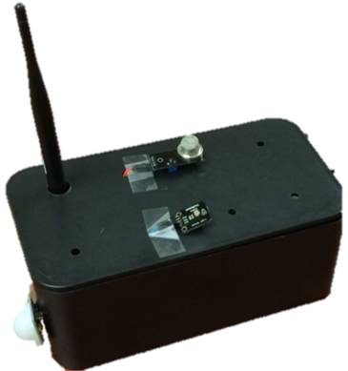

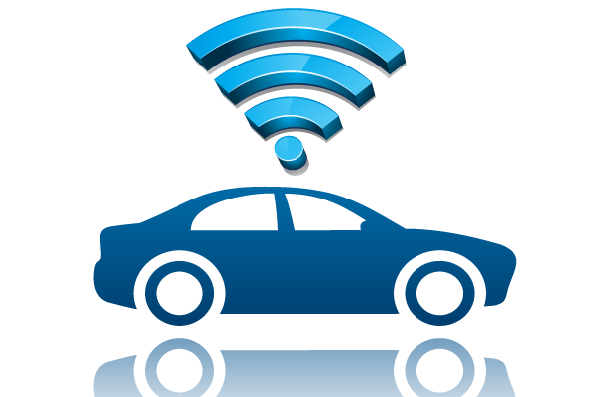

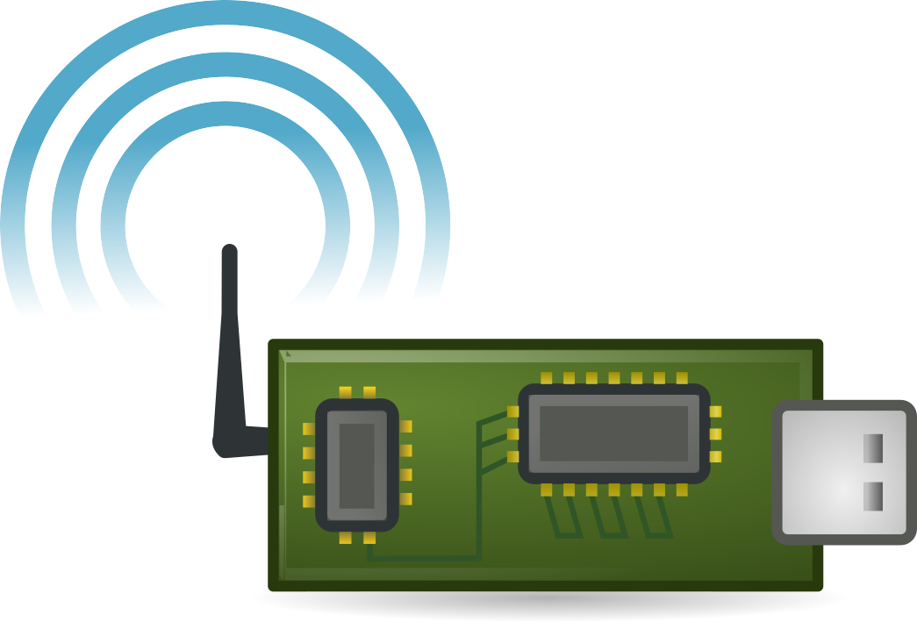




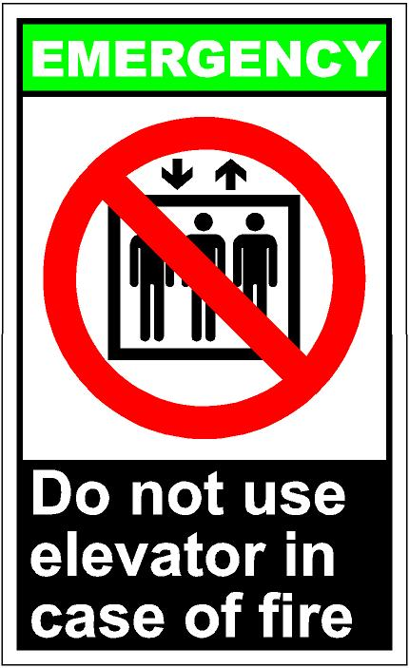

IoT Data Exchange
We assume a topic-based pub/sub model
Data
Exchange
Cloud Services
User
Applications
Communications
Networks
Constrained
devices!
Devices
Spaces
Physical Events
& Actions

Slide 4


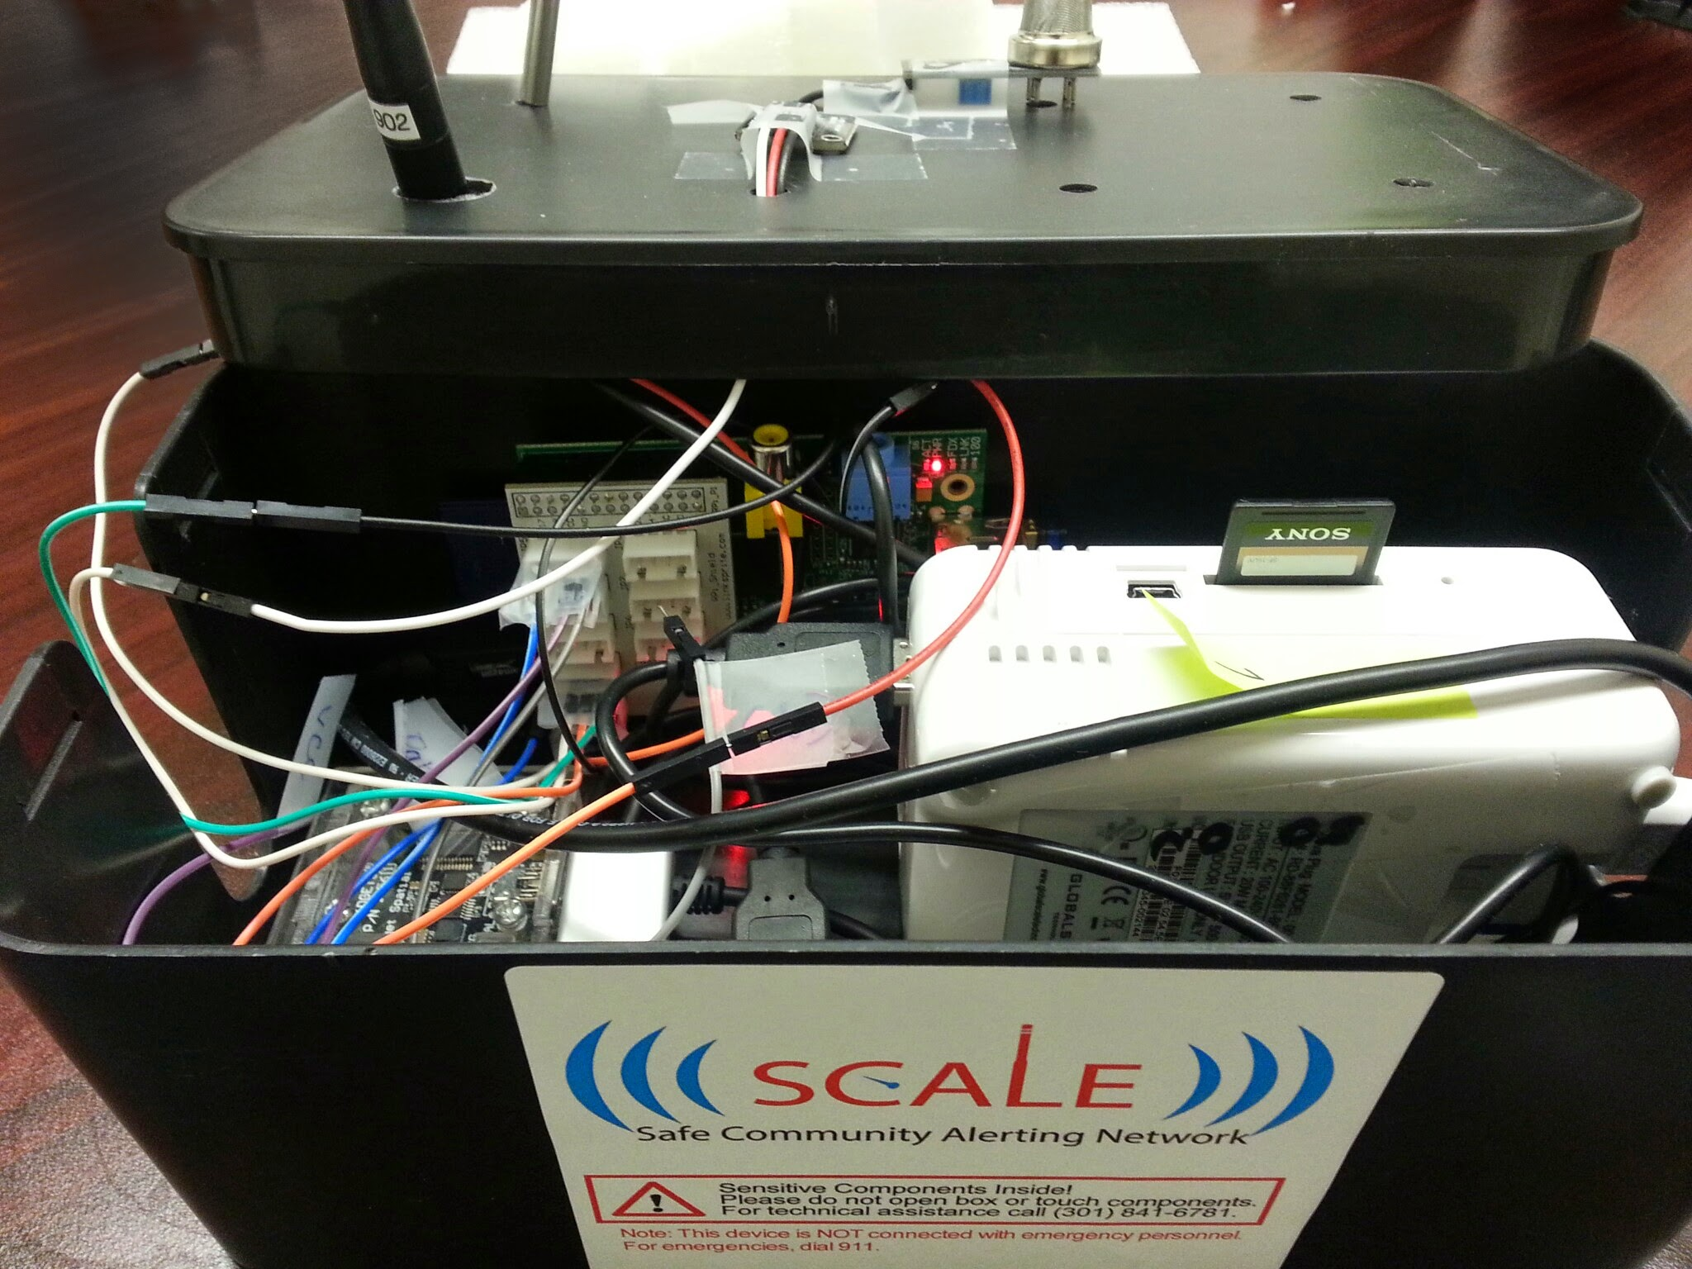

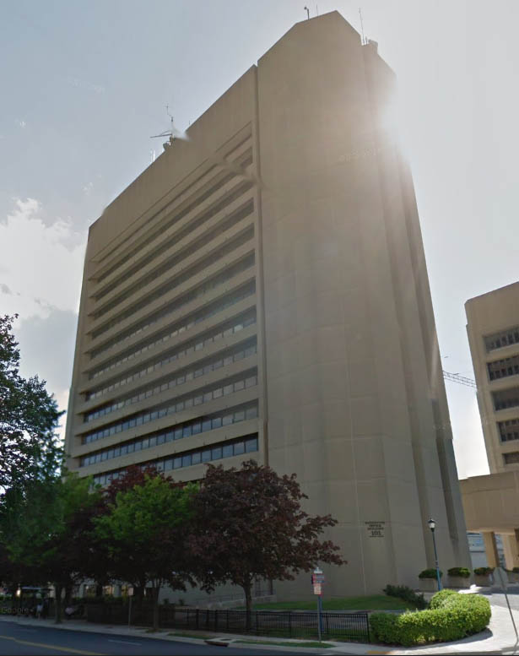

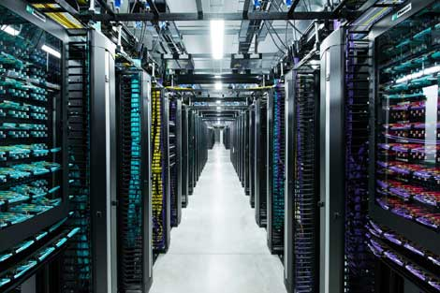


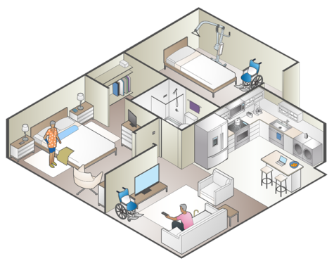
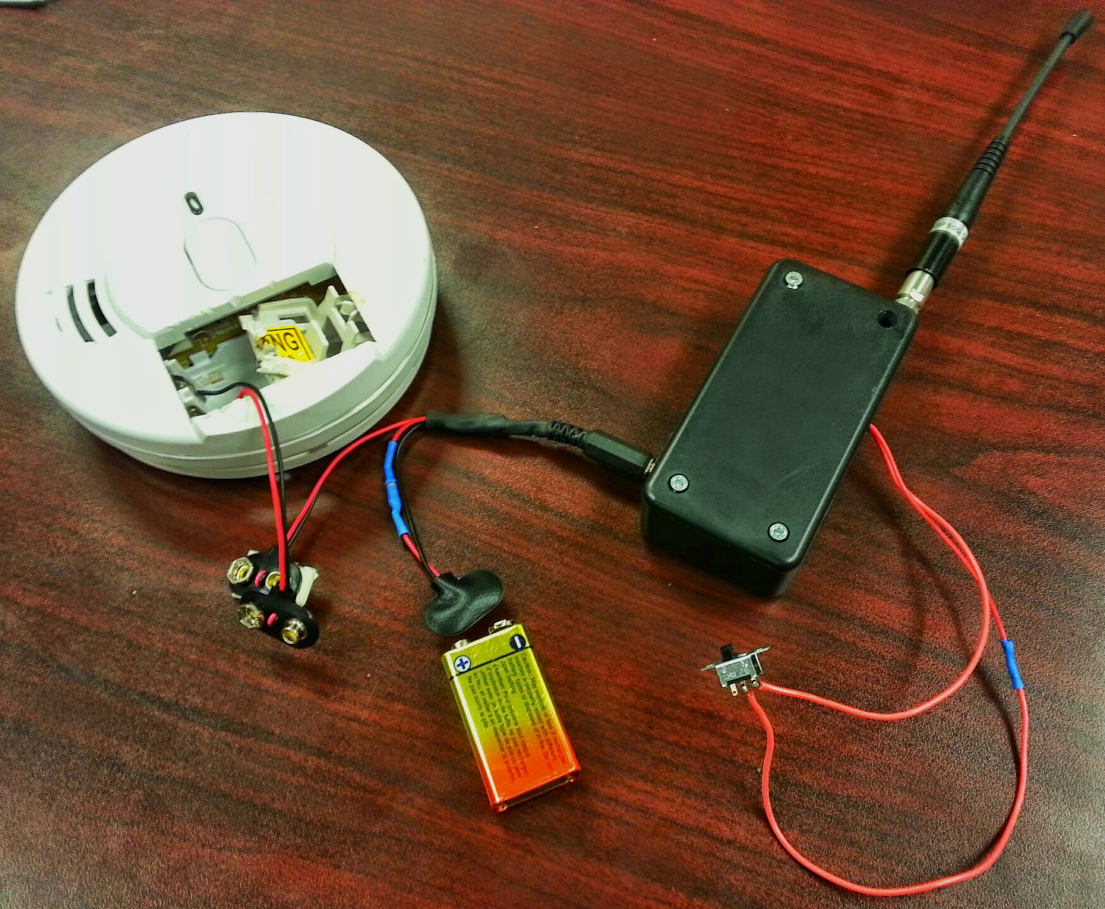

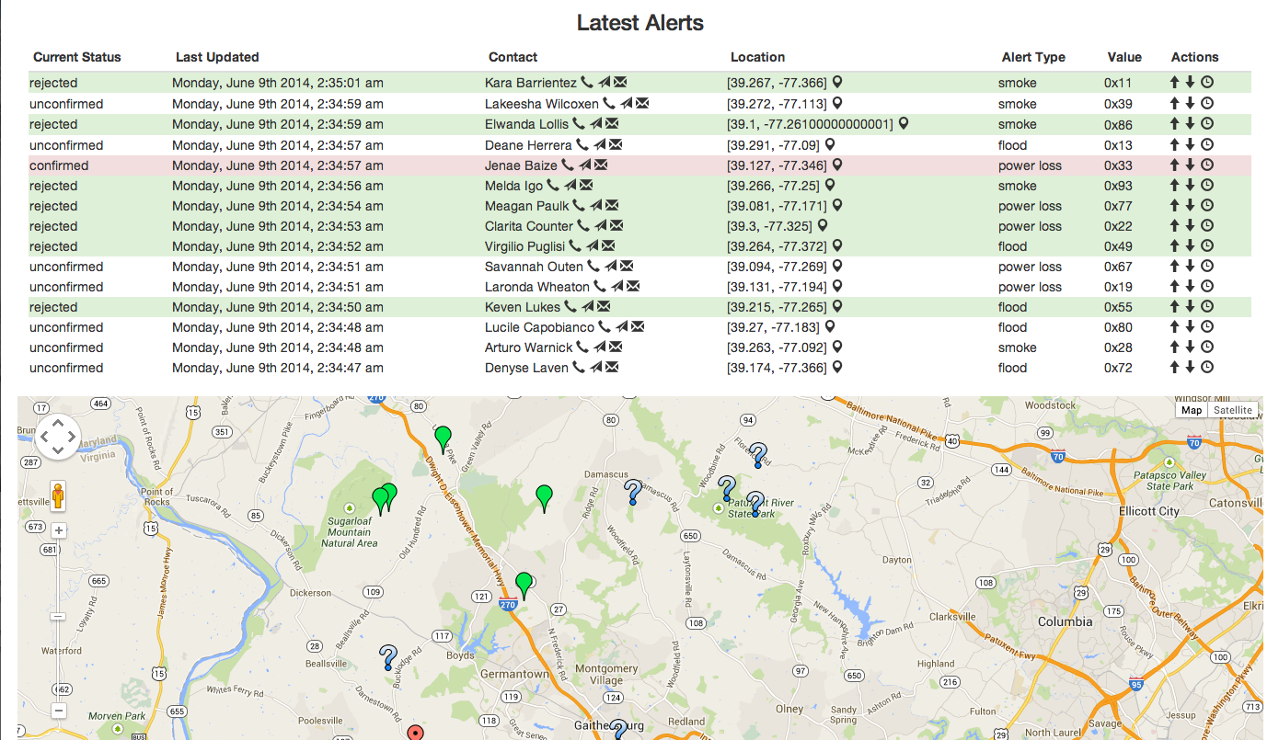

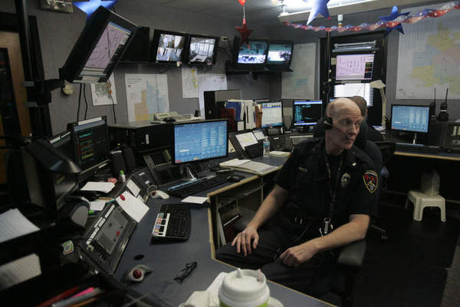

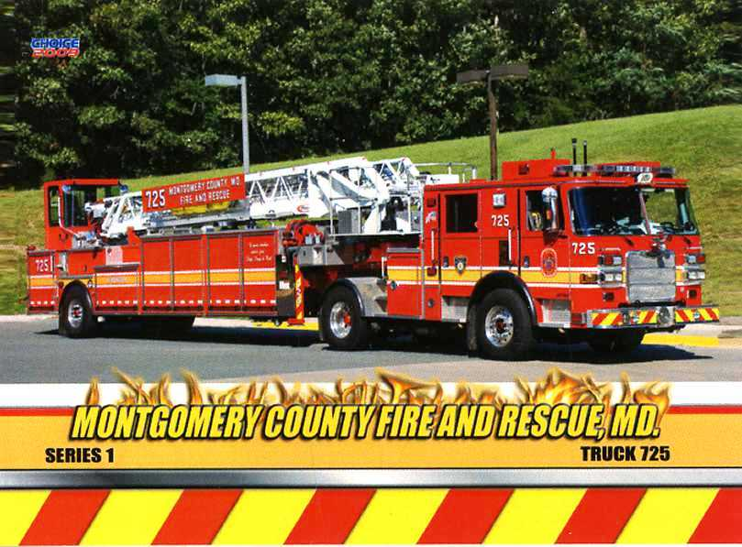


“Democratizing safety by bringing the Internet of Things (IoT) to everyone”
SCALE sends emergency message
Long-range wireless antenna
Analytics / Alerting Cloud
Emergency?
Yes!
Resident / Caretaker
Resident in distress
Dispatch Center
First responders arrive
Notes:
Inspired by IoT-enhanced emergency response possibilities, we explored the use of off-the-shelf IoT hardware in creating a smart safe home / community environment.
Multi-sector team of organizations demonstrating IoT for community safety in response to 2013 White House/NIST SmartAmerica Challenge
I led development on SCALE as an Innovation Fellow in Montgomery County, MD in Spring 2014. Many thanks to other primary devs Guoxi and Qiuxi.
[WORKFLOW OVERVIEW]
SCALE has since expanded to include many more partners and served as a testbed for various research projects in our group.

Slide 5
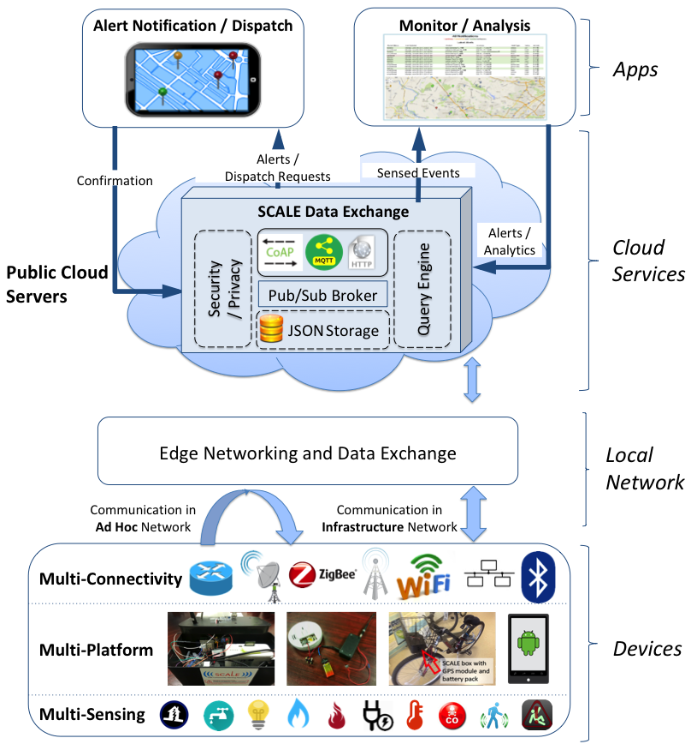
SCALE’s heterogeneous evolution
SCALE expanded and used as a test-bed in many projects:
Benson et al. “SCALE: Safe Community Awareness and Alerting Leveraging the Internet of Things”. IEEE Communications, December 2015.
Uddin et al. “The SCALE2 Multi-network Architecture for IoT-based Resilient Communities”. SMARTCOMP ’16.
Benson et al. “Resilient Overlays for IoT-based Community Infrastructure Communications”. IoTDI ’16
Zhu et al. “Upload Planning for Mobile Data Collection in Smart Community Internet-of-Things Deployments”. SMARTCOMP ‘16.
Mehrotra et al. "TIPPERS: A Privacy Cognizant IoT Environment". in First IEEE International Workshop on Security, Privacy and Trust for IoT, Sydney, Australia. 2016.
Han et al. "Toward An Integrated Approach to Localizing Failures in Community Water Networks". ICDCS ’17.
Nailah Alhassoun, Md Yusuf Sarwar Uddin, and Nalini Venkatasubramanian. “SAFER: An IoT-Based Perpetual Safe Community Awareness and Alerting Network”. IGSC ’17.
Zhu et al. "Data Collection and Upload under Dynamicity in Smart Community Internet-of-Things Deployments". Pervasive and Mobile Computing (2017).
Hera et al. "Adaptive Sensing Using Internet-of-Things with Constrained Communications". Workshop on Adaptive and Reflective Middleware (ARM), co-located with ACM/IFIP/USENIX Middleware, 2017.
Benson et al. “Ride: A Resilient IoT Data Exchange Middleware Leveraging SDN and Edge Cloud Resources”. IoTDI ‘18.
Benson et al. "FireDeX: a Prioritized IoT Data Exchange Middleware for Emergency Response". (to appear in) Middleware ’18.
Zhu et al. "Spatiotemporal Scheduling for Crowd Augmented Urban Sensing". INFOCOM ‘18.
… and hopefully many more!
Notes:
--------
Found the cloud-centric DX very flexible and easy to add new features, but still non-trivial to maintain connections

Slide 6

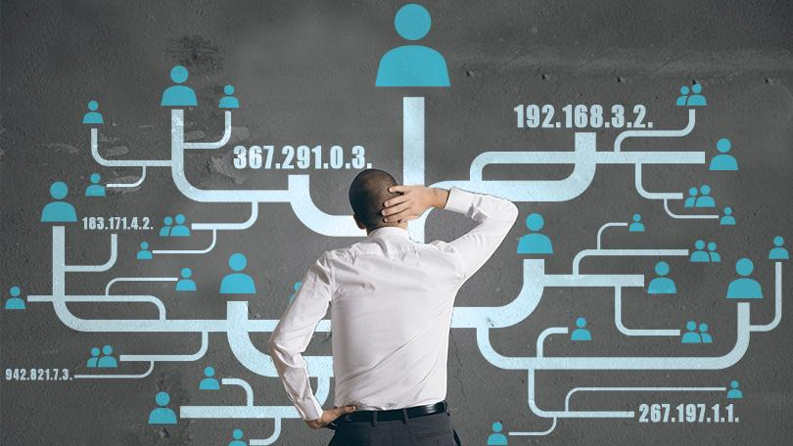
IoT Data Exchange
?
User
Applications
Data
Exchange
GET coap://
Communications
Networks
Devices &
Infrastructure
any.smoke.sensors.dbh.uci.edu
Physical Events
& Actions
/events/fire/location?room=dsm_lab
Notes:
TODO:
TODO: maybe show a step of abstracting smoke sensors into just ‘observe fire’
TODO: need to get across subscribe/publish idea here… maybe use icons to show another workflow here? E.g. querying for smoke alarms to detect a fire vs. observe a fire event that another service creates by observing the smoke events: DX!
-------
Semantic gap!
separates concerns de-coupling devices and users, locations, even time (observe)
-------

Slide 7
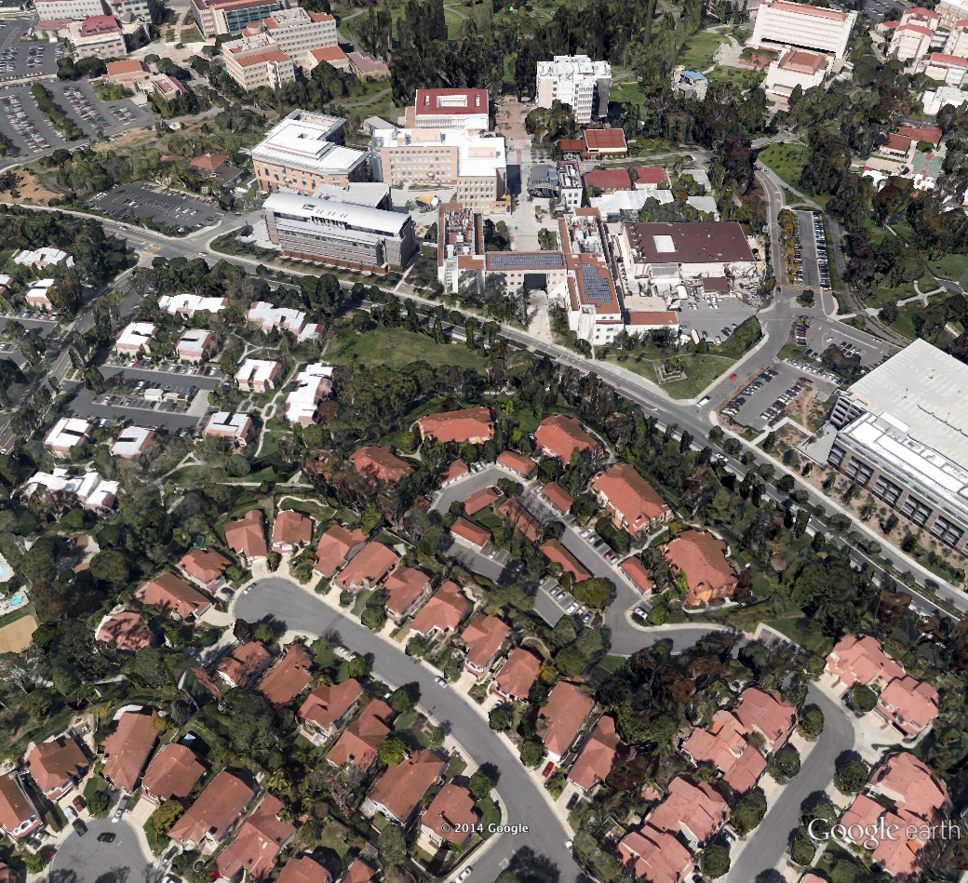


Mission-Critical IoT Scenario:
Earthquake Safety
Notes:
Alert impacted people and query if okay (didja feel it?)
Activate infrastructure: Stop elevators, (sirens, flashing lights for the deaf)
monitor environment: fires, gas leaks

Slide 8
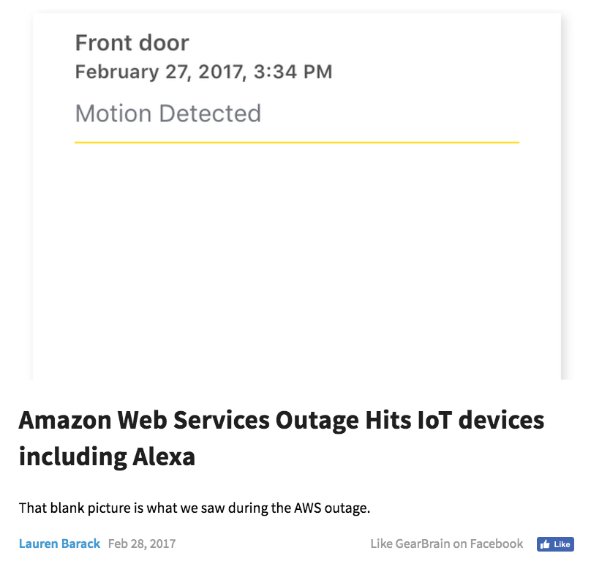
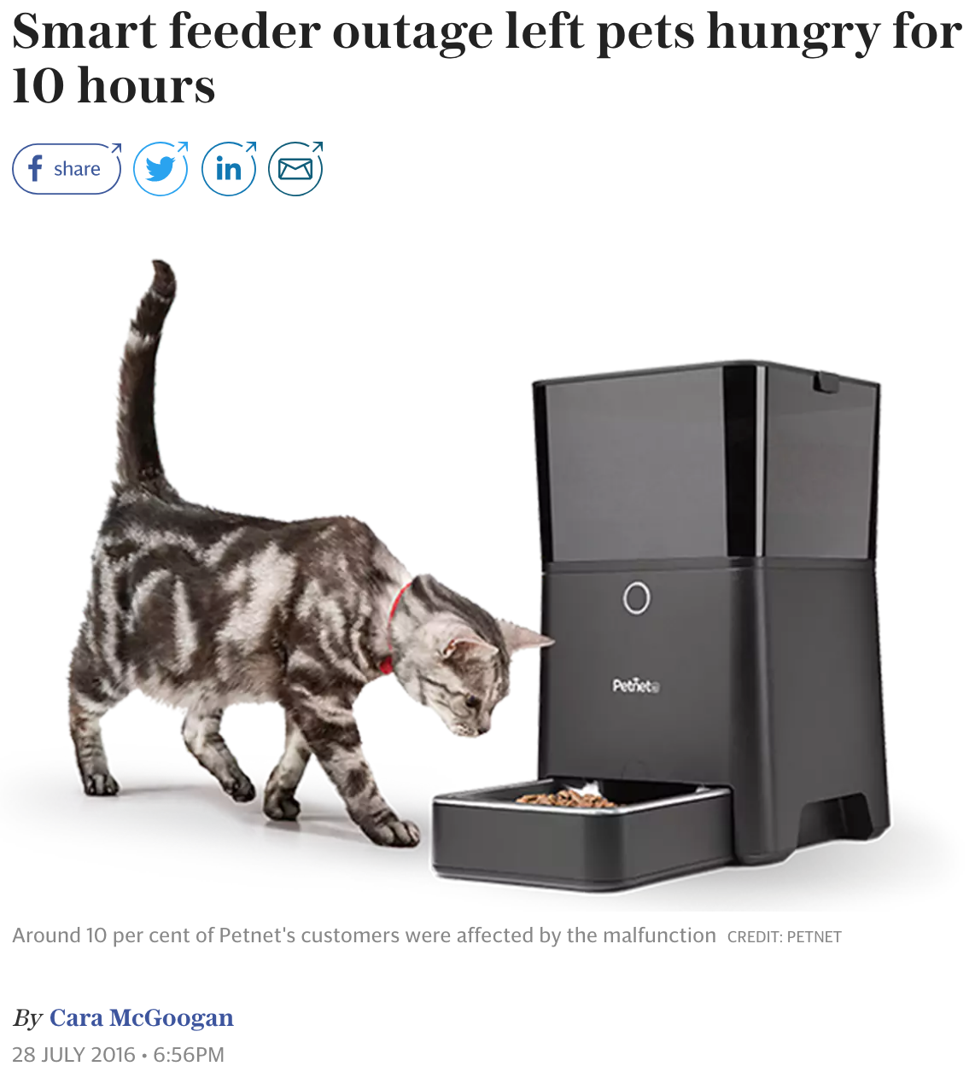
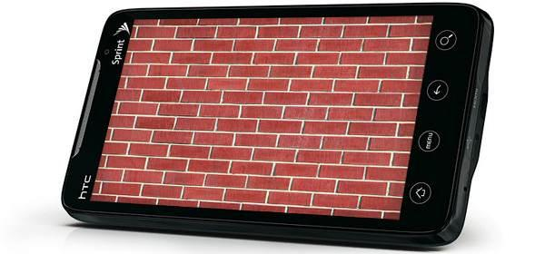
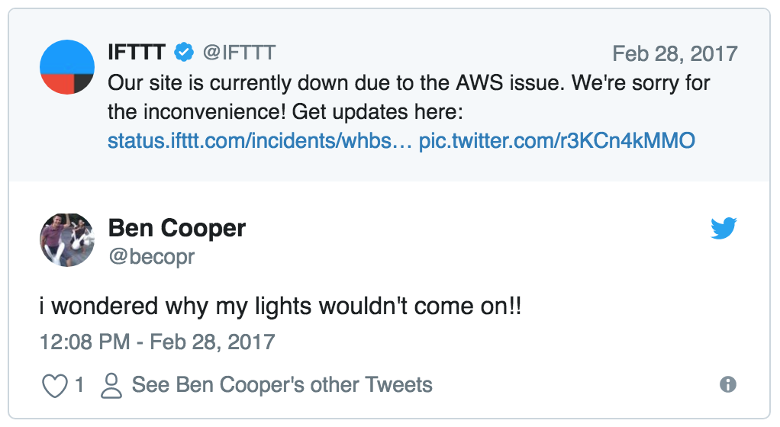
IoT Data Exchange Resilience
?
User
Applications
Ensuring operation despite challenging conditions e.g. failures.
Data
Exchange
Cloud Services
Communications
Networks
We identified this challenge during SCALE in 2014…
Devices
?
Spaces
?
?
?
?
Physical Events
& Actions

Slide 9


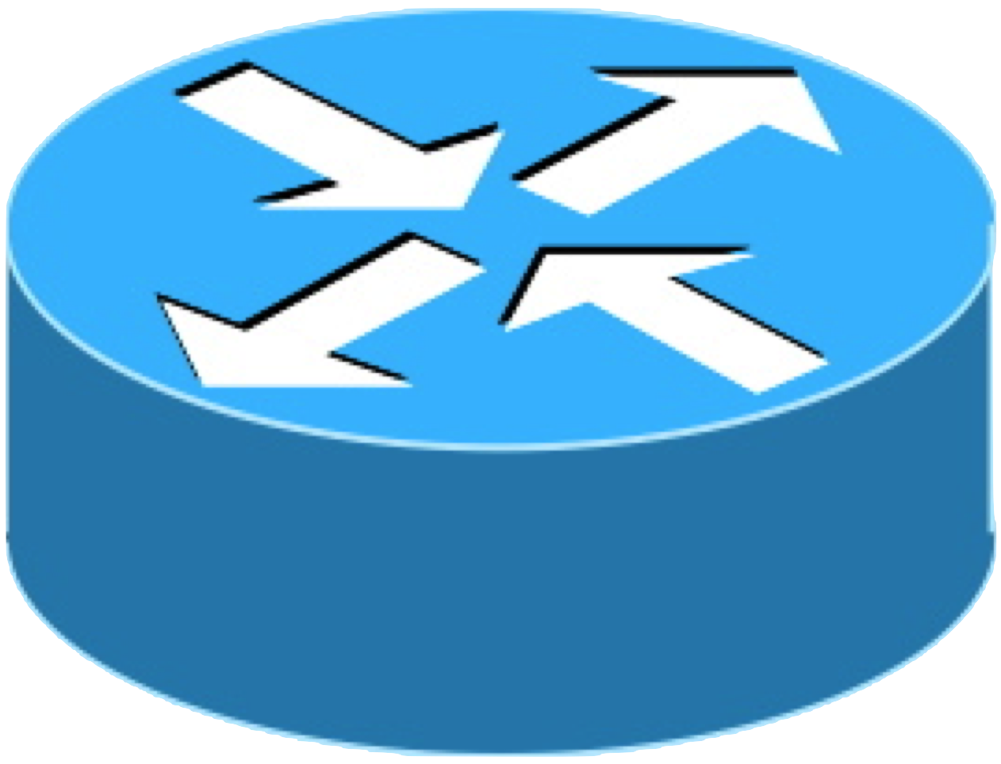
Edge Computing for IoT DX Resilience
User
Applications
Data
Exchange
Ride leverages resources at the network edge for:
Resilience to cloud disruptions e.g. edge fail-over in response to wide-area network failures
Decreased latency
Localized operation e.g. local situational awareness generation
…
Cloud Services
…
Edge Infrastructure
Diverse networking for resilience (i.e. different routes and physical networks).
Communications
Networks
Software-defined networking (SDN) enables more flexible management of these diverse networks!
IoT Devices
Notes:
-------
SPEECH
Edge computing is frequently discussed in the context of 5G, whose architecture allows running services nearer to the base stations for…
Different network routes, which may or may not mean entirely different physical network technologies.
------

Slide 10
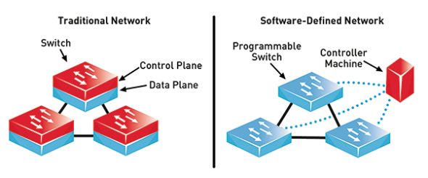


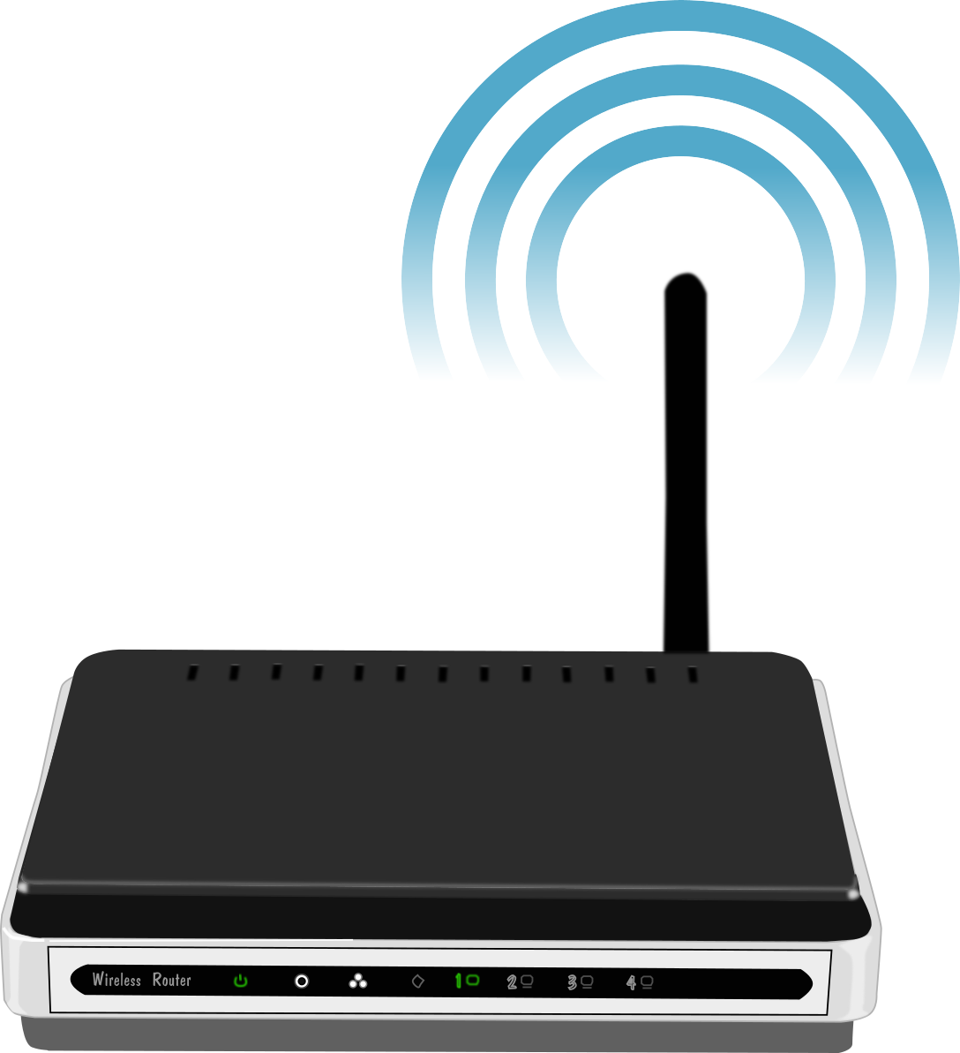
Software-Defined Networking (SDN)
Like Zhang 2013’s “big idea” paper proposed SDN-like logically-centralized control of pub/sub in combination with SDN.
Our proposal improves network-awareness, control, and resilience.
VPN, QoS, security
Proposed Middleware
Net. Services
…
Application workflows
Various APIs
source: Dungay 2016
SDN Controllers
…
Local IoT Controller
Control Plane
virtual net abstraction
Global Network State
unified APIs
Data Plane
Virtual
Switches
…
Physical
Switches
physical infrastructure
Notes:
-----
SPEECH:
Control vs. data plane… centralization
SDN lets us manage physical network infrastructure with the same abstractions / APIs used for managing virtual networks of cloud services…
Centrally viewing network state to optimize the whole IoT communications network from the SDN controllers, where we…
deploy network services such as those in our proposed m/w to centrally manage IoT networking along with IoT data exchange and application workflows…
sounds familiar? SDN-like
-------

Slide 11

Proposed Approach
Users
Seismic response& early warning
Personal safety &
alerting
Smart Fire Fighting
response
…
Interactions
Applications
Middleware extends existing IoT Data Exchange solutions for enhanced resilience.
Leverages application and network awareness.
Configures physical infrastructure through programmable network APIs / abstractions.
Edge intelligence mitigates cloud / network disruptions.
semantic notifications
actuation responses
requirements
IoT Data Exchange
protocols, brokers, algorithms, etc.
State
Aware
App
Network
Comms. Adaptation
Data Exchange
Middleware
Dev
Net
sensed events
Programmable
Networks
cloud
commands
Physical
Infrastructure
Devices
edge
Notes:
-------
SPEECH
To support mission-critical apps, they share resilience requirements
M/W gathers infrastructure info using programmable networks
Bridging network and data exchange
QUESTION: How do we bridge network and data exchange?

Slide 12
Comparing the 3 Core Chapters
GeoCRON
Ride
FireDeX
Cloud-centric data collection
Cloud vs. edge & local alerting
Satisfy information requirements
Information value and resource constraints (B/W)
App. requirements, local topology, connectivity info.
Device & router topology + node locations
Data exchange goals
Approach to resilience
Earthquake-detection
Local seismic early-warning
Smart fire fighting response
State information
Failure avoidance (geo-redundancy)
Failure recovery (edge fail-over)
Resource allocation (prioritize data)
Validation setting
“Resilient Overlays for IoT-based Community Infrastructure Communications”. IoTDI ’16
Earlier work in PerNEM ’13 workshop.
(Thanks Qing and Kyungbaek!)
“Ride: A Resilient IoT Data Exchange Middleware Leveraging SDN and Edge Cloud Resources”. IoTDI ‘18.
(Thanks Guoxi!)
"FireDeX: a Prioritized IoT Data Exchange Middleware for Emergency Response". Middleware ’18.
(Thanks Georgios & Luca!)
Notes:
--------
SPEECH
1: more edge as we evolve (IoT devs vs. edge infra vs. BMS)
2: reactive vs. proactive vs. supporting dynamics
3: progressively more semantic / high-level
4: increasing complexity of scenarios
-------
MAYBE: outline version with another row:
Community-scale geo-aware overlays
Campus-scale SDN infrastructure control
Building-scale SDN data flow management

Slide 13
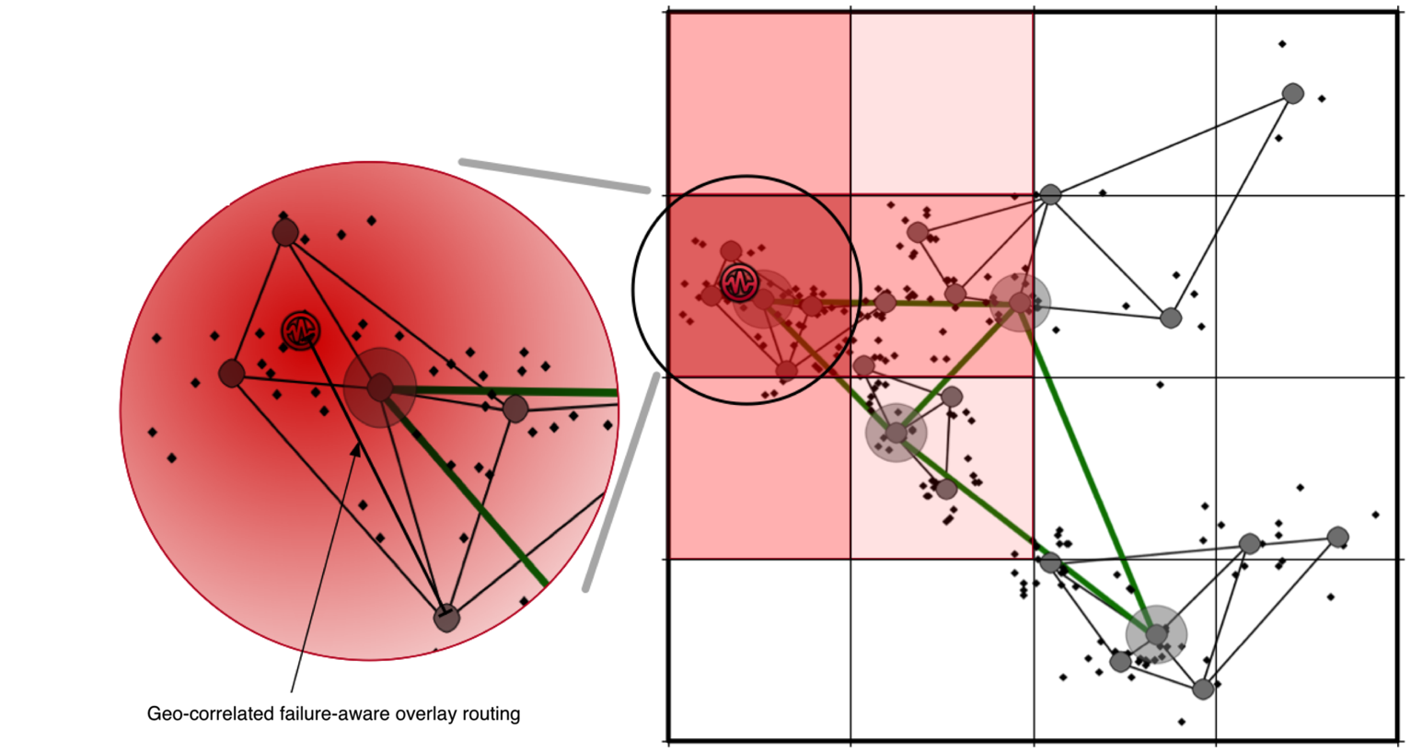
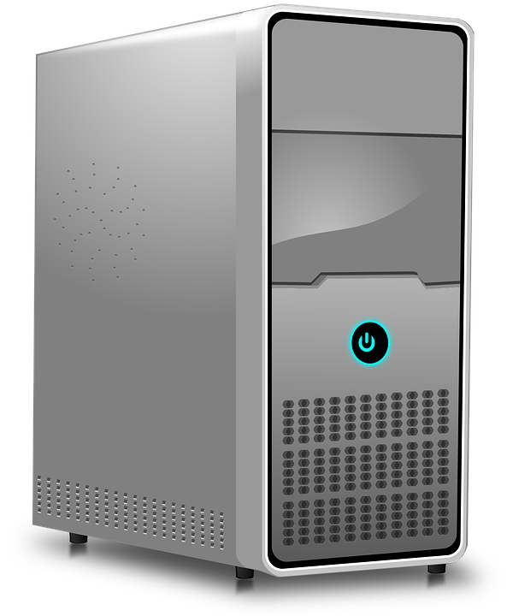



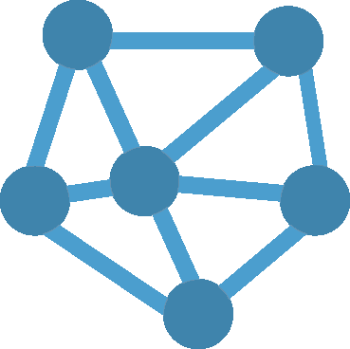
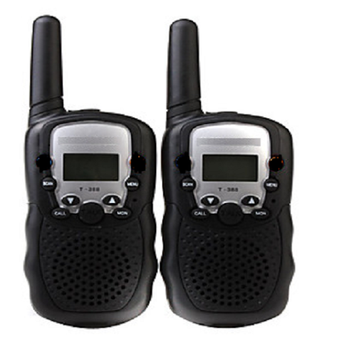
GeoCRON
- Community-scale wide-area IoT network
- Geo-aware cloud overlays
Ride
- Smart campus network
- SDN control over (local) edge infrastructure and cloud overlays
FireDeX
- Building-area
network
- SDN for data flows
Network abstractions used in each chapter
Cloud data path overlays could be created using GeoCRON.
SDN “big switch” abstracts underlying network e.g. physical link, overlay, GeoCRON , Ride etc.
SDN
“big switch”
Notes:
-------
SPEECH
more edge as we evolve (IoT devs vs. edge infra vs. BMS)
SDN abstractions each level down build on/incorporate the one above

Slide 14
Proposed Middleware Architecture
IoT Devices
IoT DX Middleware
Cloud Services
Seismic “pick”
Geo-diverse multi-path
Routing (GeoCRON)
Analytics
Producers
Resilient Overlay Networks
Ride overlay probe
Yes
Edge Services
Ride
data collection
Ride
Is
cloud
up?
No
Backup analytics
Resilient alert
Resilient alert subscription
Diverse multicast
Local Data Exchange
Prioritized subscription
SDN
FireDeX
IoT data
Consumers
Prioritization
Building Management System Interface
Differen-tiated info flow
BW Allocation

Slide 15
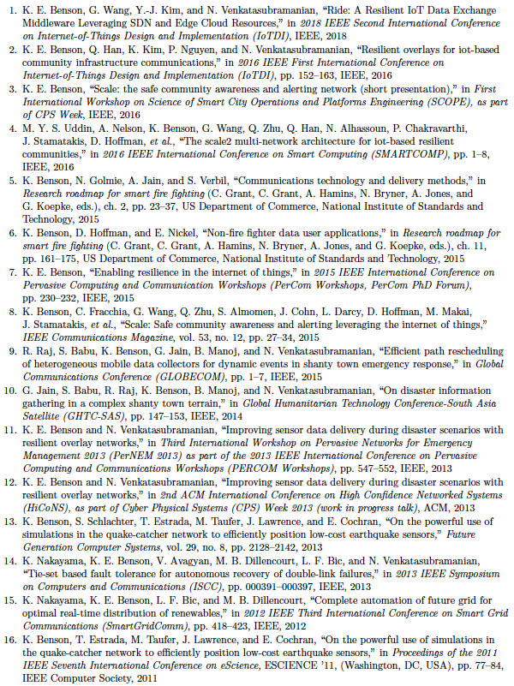
Publications,
Posters, & Presentations…
Ride
GeoCRON
Smart fire
fighting
SCALE
Shanty
town fire
"FireDeX: a Prioritized IoT Data Exchange Middleware for Emergency Response". to appear in Middleware ’18.
GeoCRON
(early)
Undergrad research
(seismic sensing
simulations)
SmartGrid
resilience

Slide 16



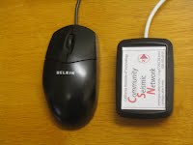

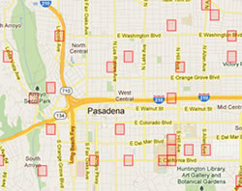
Source: csn.caltech.edu
Many thanks to CSN!
Low-cost accelerometers attached to IoT computers measure shaking and report anomalies…
We added CSN’s sensors to SCALE.
Cloud-based machine learning algorithms detect earthquakes.
CSN produces fine-grained shake maps that can aid emergency response efforts.
How to resiliently collect data in the cloud despite wide-area network failures?
Notes:
-----------
SPEECH
Overview CSN…
Gave us sensors; we added to SCALE Box, which is modeled after CSN’s deployment.
QCN asked my undergrad team to simulate expected detection during a quake…. We got to thinking about failures then but now we’re really trying to address
Thought on way back from csn meeting…
Use CSN devices as overlay nodes to route around failures?
----------

Slide 17
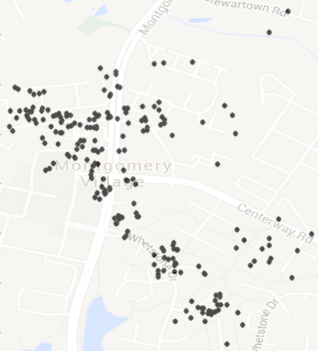
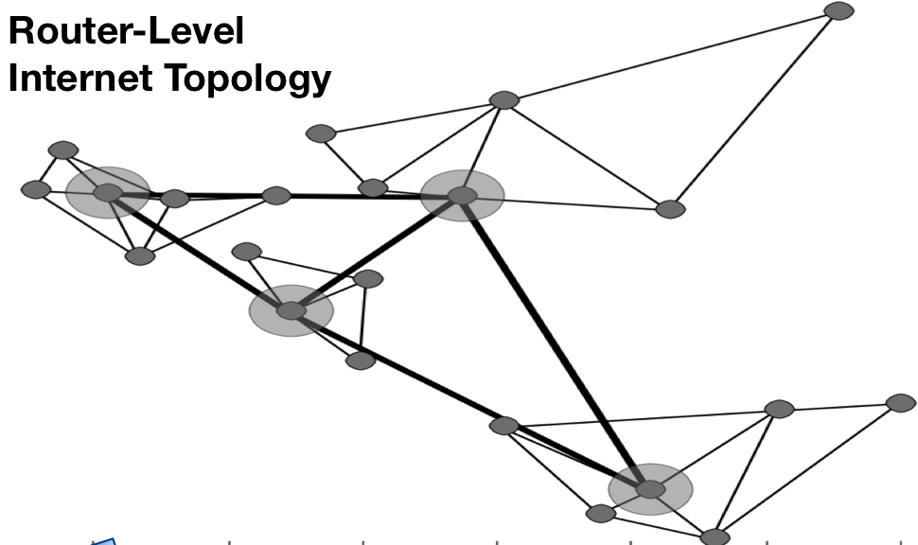
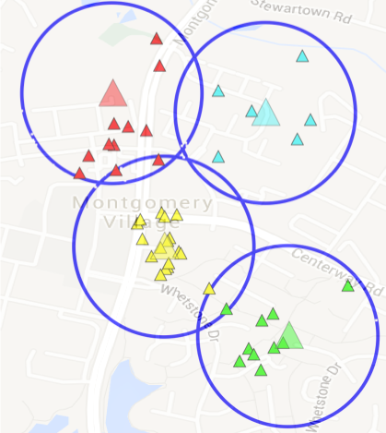
GeoCRON: Geo-correlated failure-aware Resilient Overlay Networks for IoT-based Community Infrastructure Communications
Cloud earthquake-detection service
Fine-grained shake map
Applications
seismic sensed events
P(d₁)
P(d₂)
GeoCRON
Fail-
ures
Overlay Path Configurations
P’(d₁)
Control
Algorithm
d₁
d₂
Data Exchange
Middleware
Topo
IoT Peers
seismic data
Physical Infrastructure
Seismic Sensors
Water
Sensors
Notes:
-------
Because CSN is a planned deployment (owns/manages devices), Geocron proposes leveraging edge intelligence of IoT devices
Geo-Resilient routing sort of like p2p overlay except centrally controlled and any-to-one rather than any-to-any
Peers + topology + seismic failure model (and locations of these) = overlay paths
d₁’s normal path P(d₁) to the cloud may fail during the pictured earthquake.

Slide 18
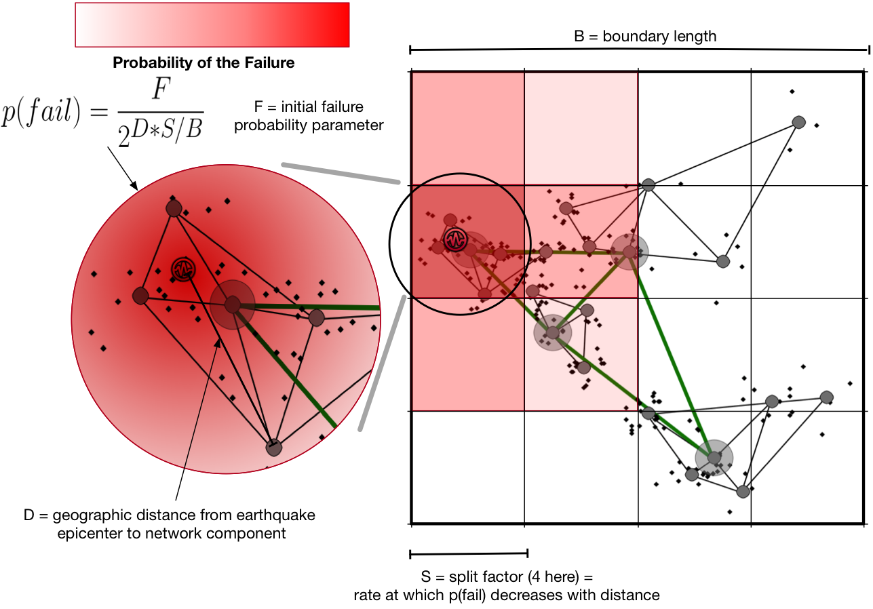
Earthquake-
Inspired
Failure
Model & Simulations
ns-3 simulations using router topologies from:
  Rocketfuel – actual country-scale AS topology estimates connecting distant cities (Spring 02)
  BRITE - random router-level AS topology generator (Medina 01)
  Our (Benson 13) community-scale IoT infrastructure topology
    Based on real water distribution network and population estimates.
    Generated with I-Gen
    (Quoitin 09)
Notes:
-------
SPEECH
Studied GeoCRON using a network simulator to which we added an earthquake-inspired failure model over various network topologies
Country-scale (USA) real-world estimations vs. randomly-generated AS’s vs. a more detailed smart city/ community-scale topology (based on real water distribution network that we used to estimate population densities, place IoT sensors, and construct a physical routing topology for)
----------
BACKUP NOTES:
TOPOLOGY: North Marin County, Novato, CA (~27 routers + ~270 sensors)

Slide 19
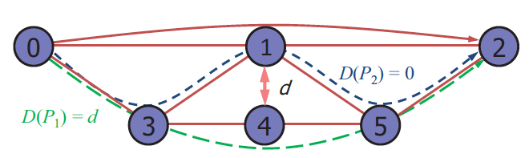
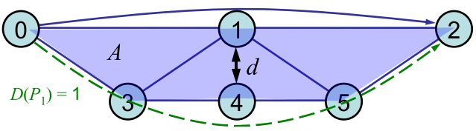
Heuristics for Constructing
Multiple Geo-diverse Paths
Uniform random (baseline)
“Ideal” oracle heuristic
Weighted combination of: (Rohrer 2014)
  Min. distance between any two pairs of nodes
  chosen from the two paths
  Area of polygon formed by paths as borders
Penalty for each proximal component
(routers or links) along paths
  Gs-Ford: proximal = within distance threshold (Kim 2010)
  Intersection: proximal = same exact component (Rohrer 2014)
Our first investigations (Benson 2013) considered
device locations only (no topology knowledge)
  Explored different distances between nodes (near vs. far), regions (breaking into a grid), and angles (similar to Rohrer 2013’s area heuristic)
  However, we determined these heuristics were all
  inferior to those with actual topology knowledge
Source: Cheng 2014
Source: Rohrer 2013

Slide 20
Simulation Results - Heuristics
Awareness about the underlying physical topology improves data collection!

Slide 21
Simulation Results – # Disjoint Paths
Diminishing returns for > 5 disjoint paths
This agrees with (Rohrer 2014) results: most topologies only show strong increases for k<7
Notes:
Diminishing returns after k=5
However, it delivers data quicker! This may be advantageous for real-time alerting…

Slide 22
Simulation Results – Failure Rate
Too many failures severely hampers data collection.
Cannot reach cloud…
But maybe the edge?
Notes:
very high failures make cloud nearly unreachable…. Maybe edge?

Slide 23
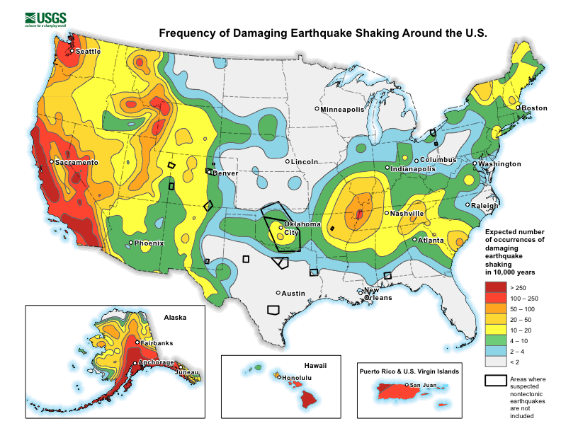
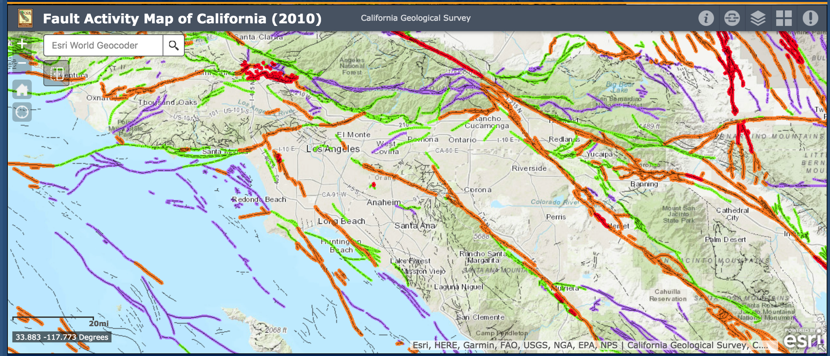
GeoCRON extra
Notes:
Show topo overlaid on these maps
Why didn’t we do this? Security/Privacy concerns for volunteers

Slide 24
Proposed Middleware Architecture
IoT Devices
IoT DX Middleware
Cloud Services
Seismic “pick”
Geo-diverse multi-path
Routing (GeoCRON)
Analytics
Producers
Resilient Overlay Networks
Ride overlay probe
Yes
Edge Services
Ride
data collection
Ride
Is
cloud
up?
No
Backup analytics
Resilient alert
Resilient alert subscription
Diverse multicast
Local Data Exchange
SDN
Consumers
What if cloud is unavailable?
Fail over to the edge!
How to improve local alerting?

Slide 25
Ride: A Resilient IoT Data Exchange Middleware
Leveraging SDN and Edge Cloud Resources
Smart (IoT) Community Safety Apps
Applications
Problem: regional infra. failures/ cloud service disruptions
  Viewed from local (campus/community) perspective.
  The organization controls local infrastructure and deploys IoT devices there…
Proposed solution: leverage local edge resources when needed
  I.e. during cloud service disruptions.
  SDN facilitates local network infrastructure awareness & control.
  Ride captures app requirements.
situational awareness
Users
app reqs.
alerts
sensed events
State Awareness
Ride-C
resilient IoT data collection
Ride-D
resilient alert dissemination
Data Exchange
Middleware
Net
App
Cloud
service
monit-
oring
Edge
fail-over
adapt net.
alerts
SDN
Physical
Infrastructure
Notes:
------
SPEECH
Treat app logic as a black box
Awareness… enables Ride to be both application and network aware
Ride-C generates network awareness as a by-product of its local data collection when in edge mode!
------------

Slide 26
Ride Research Questions
Ride-C
How to ensure cloud service stability or edge fail-over according to application-specified resilience requirements?
Without over-burdening constrained IoT devices or edge network infrastructure?
Ride-D
How to leverage network awareness for more resilient local alerting?
Without over-burdening constrained IoT devices or edge network infrastructure?

Slide 27

Ride-C: Resilient Data Collection
Cloud Alerting Server
Adaptive Probing and Failover
Edge Alerting Server
Setting Up Data Collection Routes
Path Purpose | Line
Data Collection
Probing
Failover

Slide 28
Ride-C Algorithm
  Monitors multiple Cloud Overlay Paths for resilient data collection.
Max. Detection Time
App Requirements
Probing Interval
Max. False Positive Rate
    Conserves resources e.g. bandwidth.
Adaptive Probing
Failure Detection Parameters
Average Round-trip Time
Network State
Path Loss Rate
    Meets detection
    time requirement.
  Adaptation Process:
    Number of Probes for Detection
      Maximum False Positive Rate, Link Loss Rate
    Probe Interval:
      Number of Probes for Detection, Maximum Detection Time
Notes:
OUTPUT PARAMS: # Probes that timed out after a period

Slide 29
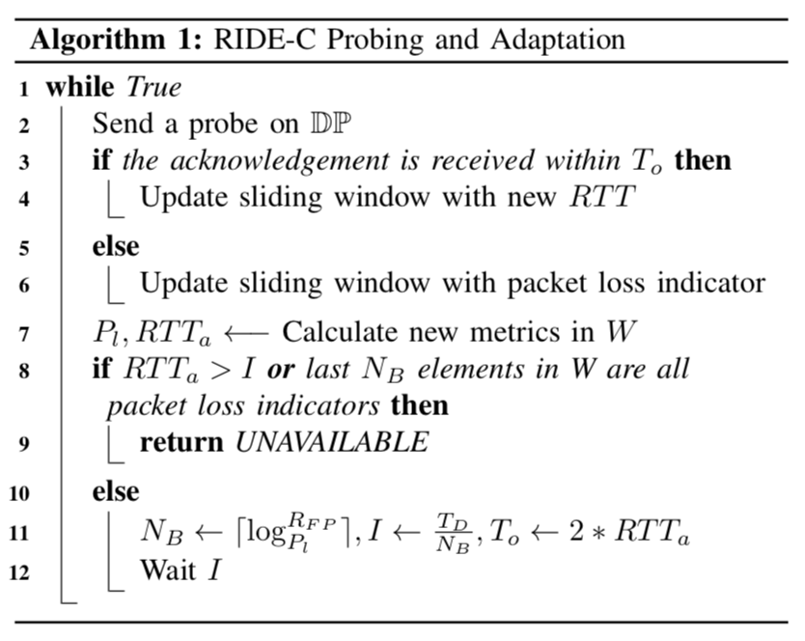
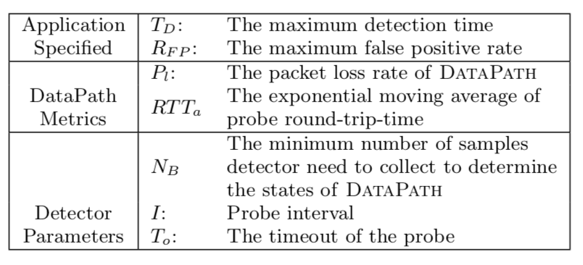
Ride-C Algorithms
  Monitors DataPaths to the cloud.
  Adaptive probing adjusts interval:
    Conserves resources e.g. bandwidth.
    Meets detection time requirement.

Slide 30
Ride-D: Resilient Alert Dissemination
sensor1
|T1 ^ STT| < |T2 ^ STT|
sensor3
Edge Alerting Service
sensor2
Data Collection path (Ride-C)
MDMT 1
MDMT 2
MDMT 1 & 2
Successfully-
Traversed
Topology*
Maximally-Disjoint Multicast Trees*
Cloud is down!
*Pre-configured via SDN
(OpenFlow flow rules)
No device burden!
Notes:
--------
Speech
Operating in edge mode, so local Time critical earthquake warning
Multicast lets us reach relevant subscribers with efficient network bandwidth usage (e.g. rich notifications)
To enhance resilience (i.e. improve reachability despite local failures), we exploit topological diversity by constructing MDMTs…
Multicast path protection is not new… but our technique for selecting the tree at alert-time rather than using one as a primary and one as backup is!
Network-aware tree selection based not on known link status, which takes time for control plane to gather, but on sensor publications recently-received via functional links:
We consider the local sensor data collection paths configured by Ride-C; produce a by-product of that phase: STT
*SDN enables STT
sensor1’s data never delivered, so MDMT 2 “overlaps” with STT more than MDMT 1

Slide 31
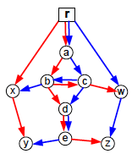
Ride-D Algorithms
MDMT
Construction
Network-aware
MDMT Selection
steiner: bounded low cost appx. (Hwang 1992)
diverse-paths: one subscriber at a time
red-blue: edge-disjoint pair of trees
Iteratively increase weight of used edges
Disjoint paths generated using (Zheng 2010)
Split topology recursively using Bejerano 2013’s skeleton list data structure
Min-cost multicast trees NP-Hard! Heuristics:
max-overlap-links with STT
min-missing-links from STT
max-link-importance: hybrid of others
Sum of STT links’ importance:
# subscriber-paths traversing the link.
STT indicates likely functional paths from Ride-C data paths → heuristics:
max-reachable-subscribers via complete STT paths
Red-blue algorithm
Source: Bejerano 2013
Notes:
---------
SPEECH
Because generating even a single multicast tree of min cost is NP-Hard, we compared several heuristics derived from existing algorithms…
One of our key contributions is the mechanism for selecting MDMTs in a network-aware manner and the following proposed policies:
- some look at the overlap of STT and MDMTs, one the # subscribers reachable via intersection of STT and MDMT, and our best policy combines these two to consider the importance of MDMT links present in STT
------
MAYBE: Pictures: could show the little ‘4 constellations’ diagram on right with big ? Mark
----------
BACKUP notes
Steiner: minimum spanning tree of the metric closure subgraph
Diverse-paths: min-cost network-flow based, start with subscriber closest to server, add paths to MDMT with max overlap to reduce cost
Red-blue: trims links to create mdmt
TODO: runtime complexities!
TODO: explain difference between min-missing and max-overlap

Slide 32



Ride-D Algorithm Details
min-missing-links
max-overlap-links
max-reachable-subscribers
max-link-importance
Notes:
---------
SPEECH
Because generating even a single multicast tree of min cost is NP-Hard, we compared several heuristics derived from existing algorithms…
One of our key contributions is the mechanism for selecting MDMTs in a network-aware manner and the following proposed policies:
- some look at the overlap of STT and MDMTs, one the # subscribers reachable via intersection of STT and MDMT, and our best policy combines these two to consider the importance of MDMT links present in STT
------
MAYBE: Pictures: could show the little ‘4 constellations’ diagram on right with big ? Mark
----------
BACKUP notes
Steiner: minimum spanning tree of the metric closure subgraph
Diverse-paths: min-cost network-flow based, start with subscriber closest to server, add paths to MDMT with max overlap to reduce cost
Red-blue: trims links to create mdmt
TODO: runtime complexities!
TODO: explain difference between min-missing and max-overlap

Slide 33

Ride Workflow
Register applications’ resilience requirements and subscriptions. Configure CDP monitoring and MDMTs.
Maintain network state awareness, cloud data paths, and MDMTs.
Adapt to failures via SDN-based CDP/edge fail-over. Gather updated network awareness for resilient local alerting.

Slide 34


Real-world Test-bed & Experiments
Unplug
Ethernet cables
Reconnect
Ethernet cables

Slide 35
Experimental Setup
Generate synthetic campus network topologies
Network failures
(uniformly-random)
Emulate an IP network (via Mininet)
Configure Ride-enabled SCALE clients as:
Event publishers & Alert subscribers
(uniformly random)
Output events → parse & plot results
Notes:
Need to talk about Mininet and get across how difficult it was to setup our test-bed environment that other group members will be using

Slide 36

End-to-end Experiments
Earthquakes trigger seismic data uploads and failures
Cloud path fail-over misses a few secs.
Edge fail-over & local net failures
Cloud path recovery
High data loss/delay during local failure and edge fail-over indicates needed improvements to SDN fail-over mechanism (e.g. partial pre-installation of fail-over routes).
Notes:
-----
SPEECH
Scenario includes several different earthquakes each of which …. To showcase different aspects of Ride
The Top bars represents alerting services’ view of received event data
Bottom bars represent alert subsribers’ view of received alert data
(Time placement of quakes not realistic: only for simplicity of demonstration….)

Slide 37

Ride-C Parameters: Detection Time / Overhead Trade-off
Ride-C meets or exceeds detection time requirement.
If app can tolerate a few seconds of failure detection time, Ride-C can significantly reduce probing overhead.

Slide 38

Ride-C Comparison with Previous Related Works
Ride-C detects failures with lower overhead while satisfying detection time requirements.
* RON FD: Andersen et al. 2001
* B-AFD: Dong et al. 2014
Notes:
-----
SPEECH
We see that the adaptive failure detectors always perform with lower overhead compared with RON

Slide 39

Ride-D MDMT-Construction
k=2 : Enyedi 2009-2011 finds 2 maximally-disjoint spanning trees in linear time
(RFC 7811 proposes using this for fast-reroute!)
k=3 : Cheriyan 1988 finds 3 independent spanning trees in 3-connected graphs by inducing cycles
k=4 : Huck 1994 find 4 independent spanning trees in planar 4-connected graphs
diminishing returns →
red-blue
for k<4
Correct selection > unicast
(rate of alert delivery to subscribers)
worse than unicast due to trees’ fragility!
Notes:
-------
Ride-D large-scale evaluations done in purely simulated setup.
K-connected means: removing k-1 vertices cannot disconnect the graph

Slide 40

Ride-D MDMT-Selection
max-link-importance
for k > 2
State-aware heuristics better
(rate of alert delivery to subscribers)
Notes:
-------
Results shown for red-blue construction, but others appear similar

Slide 41

Ride-D Overhead Improvement
Ride-D multicast improves overhead
Resilience holds with increasing subscribers
More subscribers → more improvement
Notes:
-------
LINK COST: total cost for that MDMT: metric cost for construction algs.

Slide 42
Conclusions
Future Directions
We demonstrated Ride: a Resilient IoT Data Exchange middleware
  Adapts to cloud disruptions and local failures using SDN and edge resources
  Avoids over-burdening constrained IoT devices
  Practical feasibility study
Ride shows promise; much more to explore!
Ride-C: Data collection
  Improve SDN fail-over time.
  Intelligently split data across multiple cloud data paths.
  Currently-functional topology estimation via dynamic routes using packet tagging (e.g. Gyllstrom 2014)
Ride-D: Alert dissemination
  Adaptively re-transmit by gathering further network state from alert responses (ACKs)
  Integrating P2P-style resilient application-layer multicast to forward alerts between subscribers
Notes:
Packet tagging: apply VLAN header at start of a path and count how many make it to end. Jim Kurose! Backup multicast trees
Could easily try out passing to neighbor devices using CoAP observe
Could look at MQTT “ALM” with CoAP lateral pass

Slide 43
Proposed Middleware Architecture
IoT Devices
IoT DX Middleware
Cloud Services
Seismic “pick”
Geo-diverse multi-path
Routing (GeoCRON)
Analytics
Producers
Resilient Overlay Networks
Ride overlay probe
Yes
Edge Services
Ride
data collection
Ride
Is
cloud
up?
No
Backup analytics
Resilient alert
Resilient alert subscription
Diverse multicast
Local Data Exchange
Prioritized subscription
SDN
FireDeX
IoT data
Consumers
How to balance needs of multiple emergency apps?
How to handle evolving scenarios & conditions?
Prioritization
Building Management System Interface
Differen-tiated info flow
BW Allocation

Slide 44

Research Roadmap for Smart Fire Fighting
2015 NIST/NFPA publication that “establishes the scientific and technical basis” of smart fire fighting.
It identified key challenges that motivate our Sci-Fire project.
Collaborative effort involving industry, government, fire science practitioners, and academia.
We co-authored three chapters drawing from our experiences in IoT, CPS, and smart fire fighting.
www.nfpa.org/SmartFireFighting
Notes:
Getting the right data to the right people without overloading them
----- Meeting Notes (10/26/18 15:31) -----
add actual references to the 3 chapters!

Slide 45











IoT-Enhanced Structural Fire Response
Emergency Dispatch
Fire Department
Incident
Command
Post
How to connect?
FireDeX
Information requirements
Fire fighters & Equipment
IoT-enabled Building

Slide 46






Data Exchange in Smart Fire Fighting
Raw data sources
Analytics
Stakeholders
Smart FF fuses sensor data and computing power to drive analytics
  Building management systems (BMS) grant access to data, devices, and infrastructure
  Data exchange fuses with other sources and guides information flow
Goals involve many stakeholders:
  Incident Commander (IC) guides response
  Safety/health of occupants and fire fighters
  Minimize property loss and disruption
Data-driven approach to FF:
  Post-incident forensics e.g. insurance
  Real-time data for situational awareness
Incident Commander
Data
Exchange
BMS
Forensics “Black Box”
FFs & equip.
Notes:
TODO: need to capture CPS angle a bit better… maybe bring a drone or robot in here?
We don’t really show taking actions from the data
TODO: bring hard numbers from research roadmap in to turn “goals” → improvement metrics?

Slide 47
FireDeX: a Prioritized
IoT Data Exchange Middleware for Emergency Response
Situational Awareness Apps
e.g. FF HUD, IC Dashboard, civilian alerts
Applications
info. reqs.
Problem: varying information requirements and network conditions as the scenario evolves.
Solution: middleware configures the data exchange & network with prioritization policies based on:
  Information requirements
  Network resource constraints
Approach: queueing theory to model performance and SDN to manage heterogeneous network without broker modifications.
situational awareness
Unmodified!
Use any impl…
subscribe <topic, utility>
notify <topic>
Pub/Sub Broker
Event Prioritization
subscribe
<topic>
Data Exchange
Middleware
publish <topic>
notify <subscriber, priority>
net. tuning
SDN Controller
SDN
“big switch”
BMS
Packet Drop Rates
Network
Infrastructure
Notes:
------
Info reqs: : event subscriptions with a utility function that captures the value of heterogeneous data collection and determines the priority assigned to events
Network resources:: available bandwidth, latency, loss rates, etc. → : assign available bandwidth via packet drop rates.
SDN facilitates awareness of and control over underlying heterogeneous network infrastructure.
“big switch” abstracts the underlying physical network.
DX views network connections through multiple routes and different technologies as a single programmable SDN switch that exposes aggregate state characteristics of the underlying network.
This abstraction can incorporate e.g. geo-aware overlays, resilient multicast data delivery, edge fail-over routes, etc.

Slide 48

Mapping Info. Reqs. to Network Layer
App / DX concept
Network concepts
FireDeX configurations
Topics
Notes:
Differentiating messages for different subscriptions

Slide 49

Modeling FireDeX using Queuing Theory
delivery rate and end-to-end delay of events for each subscription r_{j}
Queuing network model enables analysis & config.
Data exchange-layer queues represent distributed pub/sub.
Network-layer queues capture bandwidth constraints, error rates, latency, etc.
Only subscribers’ network configured.
Q^{out} is a new queueing model we derived (thanks Ioannis).
Topics mapped to many possible subscriptions
Enforcing priority queueing discipline
Enforcing drop rates
Notes:
------
Queue models allow us to “plug-and-play” different models to account for different scenarios:
On/Off queues for IoT device intermittent connectivity
Buffer size constraints
Reliable vs. best-effort transmission
Data exchange broker model
In queue compares publications to subscriptions, dropping unmatched and forwarding matched ones to subscriber queues and other brokers
Subscriber queues forward events to that subscriber’s SDN switch.
SDN big switch model
Every subscriber connects with one switch; shared channels captured by multiple subscribers on the same switch.
Priority queue forwards most important data first to…
…the multi-class queue captures bandwidth constraints and transmission delays

Slide 50

Prioritization Algorithm
Sort subscriptions by information value per unit of bandwidth.
Group them into approximately equal-sized network flows.
  Enables SDN network layer to differentiate subscriptions
  (e.g. by UDP/TCP port number + IP addr).
  Represents network connections for different apps, subs. within app…
Priorities assigned to approximately equal-sized groups of network flows.
Maximum utility achievable for subscription r_{j}
Serialized packet size for topic v_{j} notifications
Rate of notifications (publications) for subscription r_{j}

Slide 51

Drop Rate Algorithm
Formulated as a convex optimization problem.
  Maximize overall utility as sum of all subscriptions’ utilities.
  Enabled by choice of logarithm for utility function.
  Akin to Network Utility Max.
2nd constraint: queue stability condition
  Ensures allocated bandwidth within that available
  For each SDN switch queue
Success rate of notifications for subscription r_{j}
Utility captured by subscription r_{j}
Utility weight for subscription r_{j}
Drop rates for each network flow
“Rho tolerance” enables keeping a buffer within the bandwidth (~0.1)

Slide 52

Prototype Implementation

Slide 53

Experimental Setup
*(7 flows/prios with prototype)*
Notes:
Two event types
Random variable distributions

Slide 54

Model Validation
Compare analytical model vs. queuing network simulator vs. prototype (mininet emulation).
Under various system loads (i.e. publication rates):
  Under-loaded
  Saturated
  Overloaded
Analytical model for lowest priority class is slightly less accurate, which is normal as these models are approximations.
* Highest priority

Slide 55


Approach Evaluation
With an overloaded system, switch buffers fill up and cause high delay / packet drops.
Our approach delivers more high priority events than finite buffers only.
High priority events also delivered quicker.
Addition of drop rate policy smooths success rate while reducing end-to-end delay.

Slide 56

Scalability

Slide 57


Algorithms Comparison
Prioritization algorithms
  Our bandwidth-aware greedy strategy performs better than bandwidth-unaware version.
  Both better than no prioritization.
  But random priorities are worst: need to set priorities correctly!
Drop rate algorithms
  Convex optimization performs best.
  Compared it with policies that set the drop rates by assigned priority (i.e. linearly or exponentially proportional to priority level).
  Plot shows varying utilities of async events vs. data telemetry: simpler policies perform closer to optimal for larger differences.

Slide 58
Conclusions & Future Work
Our application-aware prioritization algorithm improves the value of exchanged information by 36% when compared with no prioritization.
Network-aware drop rate policies improve this performance by 42% over priorities only and by 94% over no prioritization.
Prototype implementation validates efficacy of our approach and accuracy of our model in an emulated network setting.
Unified queueing theory framework enables many extensions to our model:
  Priority + drop rate in same algorithm.
  Clustering-based prioritization algs.
  Alternative utility functions.
  Tuning the entire broker network.
  Multiple network interfaces/routes.
  Relaxing assumption of one packet/event used in our analysis (e.g. by using queueing theory “batch arrivals”).
  Packet retransmissions (“closed” queueing network).
  Enforcing priorities in DX broker instead of network switch.

Slide 59
Thesis Conclusion
Resilient Communications Middleware for IoT Data Exchange
Reduced downtime via overlay monitoring & edge fail-over
Increased value of information captured via event prioritization
Network & Application-awareness
Geo-aware overlays for improved cloud data collection
SDN & Edge Computing
Improved local alerting via redundant multicast
Notes:
1) improve cloud collection
2) ensures downtime of no more than...
3) improves edge alert delivery by....
4) firedex conclusion

Slide 60
Proposed Middleware Architecture
IoT Devices
IoT DX Middleware
Cloud Services
Seismic “pick”
Geo-diverse multi-path
Routing (GeoCRON)
Analytics
Producers
Resilient Overlay Networks
Ride overlay probe
Yes
Edge Services
Ride
data collection
Ride
Is
cloud
up?
No
Backup analytics
Resilient alert
Resilient alert subscription
Diverse multicast
Local Data Exchange
Prioritized subscription
SDN
FireDeX
IoT data
Consumers
Prioritization
Building Management System Interface
Differen-tiated info flow
BW Allocation
Notes:
----- Meeting Notes (10/26/18 15:31) -----
maybe a slide that just lists each of the contributions
edge network approach to resilient iot data exchange
ideas:
1) improve cloud collection
2) ensures downtime of no more than...
3) improves edge alert delivery by....
4) firedex conclusion

Slide 61
Future Research Directions
Protocol interoperability
Distributed data exchange brokers
Synchronizing edge and cloud services
Managing mobile IoT devices (esp. in SDN)
Resilient SDN controller placement
Exploiting data semantics for…

Slide 62


My Next Step
Research Engineer at Real-Time Innovations (RTI) (start Jan. 2019)
E.g. semantic data compression, Layer 7 switching, TSN…

Slide 63
Acknowledgements
Sponsorship / fellowship awards: Bren ICS, NSF, ARCS foundation, La Verne Noyes fellowship
Various co-authors, esp. Qing Han (GeoCRON), Guoxi Wang (Ride), Georgios Bouloukakis & Luca Scalzotto (FireDeX)
SCALE team, esp. Dan Hoffman / Montgomery Co., Guoxi Wang, and Qiuxi Zhu
CSN team
NIST/NFPA esp. Casey Grant
My dissertation committee
Friends & family

