Slide 1
OceanStore : An Architecture for Global-Scale Persistent Storage
Jaewoo Kim, Youngho Yi, Minsik Cho
Notes:
Hi, today we will talk about OceanStore, one of the P2P storage architectures. First we will explain P2P Storage briefly, and overview of OceanStore and then we will explain the details of the OceanStore.

Slide 2
What is P2P storage
Distributed File System (DFS) in a P2P manner
Allows users to share storages or files
Combined storage capacity of a network of storage devices (peers)
Pros
Scalable storage space, resource, persistent storage
Cons
Trust, Consistency, Security
P2P storage
Notes:
First, What is P2P storage?
P2P storage is a distributed file system with P2P network architecture. As name suggests, P2P storage allows users to share storages or files easily. The combined storage is contributed typically by autonomous end‐users.
Benefit of using P2P storage is it provides scalable storage space and resource since many peers can join and contribute their storage to the system. And the storage is also persistent.
But P2P storage has the common p2p problems such as trust issue, consistency, and security. In OceanStore case, trust and consistency issues are handled by some techniques that we will explain later.

Slide 3
Introduction
OceanStore is
A utility infrastructure which consumers pay a monthly fee
Span the globe and highly-available from anywhere in the network
Continuous access to persistent information
Untrusted servers
Notes:
Now, we will talk about OceanStore.
OceanStore is one of p2p storage architectures. It is a utility infrastructure designed to span the globe and provide continuous access to persistent information anywhere and anytime, and it is comprised of untrusted servers.

Slide 4
Two Unique Goals
The Ability to be constructed from an untrusted infrastructure
Server crashes, leaks information
Data is protected by redundancy and cryptographic
Responsible party
Support of nomadic data
Locality is important in a large system
Promiscuous caching: distinction between OceanStore and NFS
Introspective monitoring: discover tactic relationship
Prevent denial of service attack, regional outages
Notes:
There are two design goals of OceanStore.
First, How to construct infrastructure with untrusted servers,
and how to support nomadic data.
OceanStore assumes the infrastructure is fundamentally untrusted. So servers may crash without warning or leak information to third parties. To remove these issues, all information that enters the infrastructure must be encrypted, and there is one class of servers that we can trust to carry out protocols and perform consistency management.
This responsible party is also financially responsible for the integrity of the data.
In a large system, locality is very important. To support nomadic data, OceanStore has a policy called promiscuous caching meaning that data can be cached anywhere and anytime. Promiscuous caching is one of distinctions between OceanStore and other systems such as Network File System.
Additionally, introspective monitoring is used to discover tactic relationships between data. The relationship allows adaptation to regional outages and denial of service attacks.
Techniques mentioned above will be explained later with details.

Slide 5
System Overview
Fundamental Unit: Object (e.g. directories, files)
Persistent Object: named by GUID (Globally Unique, Identifier)
Replicated and stored on multiple servers
Provide availability of network partitions, and durability against failure, attack
Replica is located by
Probabilistic algorithm
Deterministic algorithm (if probabilistic algorithm fails)
Modified through update
Every update create a new version
Exist in two forms
Active(Latest Version)
Archival(Permanent, read-only)
Notes:
Ok, lets move on to the system overview.
The fundamental unit in OceanStore is persistent object. The object can be directories or files.
Each object is identified by a globally unique identifier or GUID.
To provide network partitions, and durability against failures and attacks, the objects are replicated and stored on multiple servers. And replica’s location is decided by one of two algorithms, probabilistic algorithm, or deterministic algorithm.
After the objects are stored, it is important how to manage and manipulate the object. The objects are modified through updates, in principle, every update to an object creates a new version of the object.
This consistency based on versioning provides for cleaner recovery from the system failure.
Also the objects exist in two forms, active and archival.
An active form is the latest version of its object and the archival form is a permanent read-only version of the object, and they are spread over hundreds or thousand of servers, and data can be reconstructed from any sufficiently large subset of fragments.
That means data in the OceanStore will not be easily destroyed by disaster. It is called “deep archival storage”.

Slide 6
Naming & Access Control
Objects are identified by GUID
GUID
Thought of as a pseudo-random, fixed-length bit string
Secure hash of the owner’s key and some human-readable name
Two primitive types of access control
Readers
Encrypt all data in the system -> distribute encryption key to users with read permission
Writers
Require that all writes be signed -> Server/Client can verify them against an ACL (Access Control List)
Notes:
In OceanStore, all objects such as files are identified by GUID which is unique identifier.
This is kind of a pseudo-random and fixed length string.
With GUID, all objects are controlled by access control to prevent unauthorized read and write.

Slide 7
Data Location and Routing
Two phases of routing
Probabilistic algorithm
Fully distributed and uses a constant amount of storage per server
Attenuated Bloom filter is used
Routes to entities rapidly if the entities are in the local vicinity
Global deterministic algorithm
Randomized data structure with locality properties
Used when probabilistic algorithm fails
Notes:
In order to find objects in OceanStore, we have to use routing algorithms.
There are two phases of routing algorithms to search objects in OceanStore.
The first algorithm is a probabilistic algorithm. This algorithm tries to find the object near the requesting machine. It routes to entities rapidly if the entities are in the local vicinity.
The second algorithm is a global deterministic algorithm. This algorithm is used when the probabilistic algorithm fails, which means that we need to find objects outside of local vicinity.

Slide 8
Probabilistic Algorithm
An attenuated Bloom filter is used for probabilistic algorithm
An attenuated Bloom filter of depth D can be viewed as an array of D normal Bloom filters
The first Bloom filter is a record of the objects contained locally on the current node
The ith Bloom filter is the union of all Bloom filters for all of the nodes a distance i through any path from the current node
Notes:
An attenuated bloom filter is used for probabilistic algorithm which is a set of bloom filters.
An attenuated bloom filter of depth d is an array of d normal Bloom filters.
The depth also represents all of the nodes whose distance are d from the current node.

Slide 9
OceanStore: Probabilistic Query Example
N3
11010
11010
11100
N1
10101
N2
11100
11011
00011
N4
00011
11010
11011
00011
OR
Notes:
Here is an example of how the attenuated bloom filters works in OceanStore.
We have initially 4 nodes and each nodes have its local bloom filter as you see in the below of the node name.
Neighbor filters can be constructed by neighbor nodes.
[ANI] For example, a neighbor filter from node 2 and 3 can be constructed by the local bloom filter of node 3.
[ANI] In the same way, a neighbor filter from node 2 and 4 can be constructed like this.
[ANI] a neighbor filter from node 1 and node 2 can be constructed in the same way.
[ANI] However, the 2nd depth of neighbor filter from node 1 to node 2 can be constructed by union operation of neighbor filters.
[ANI] So, the result is…

Slide 10
OceanStore: Probabilistic Query Example
1 1 0 1 1
1 0 1 0 1
1 1 1 0 0
1 1 1 0 0
1 1 0 1 0
N3
11010
N1 neighbor filter:
(Depth 2)
N1 local bloom filter:
N1 neighbor filter:
(Depth 1)
N2 local bloom filter:
N2 neighbor filter:
11010
Query: 11010
Query: 11010
11100
11011
N1
10101
N2
11100
1 1 0 1 0
1 1 0 1 0
1 1 0 1 0
1 1 0 1 0
1 1 0 1 0
Query:
Query:
Query:
Query:
Query:
Query: 11010
00011
N4
00011
Notes:
This is an example of how query can be reached at the target object.
[ANI] At first time, the query is reached to N1 and compared its value with the local bloom filter of N1.
[ANI] Only one bit of query is matched, so it means that N1 is not the object that query is looking for.
[ANI] So, it need to look into the neighbor filter. The first depth of neighbor filter indicates that N2 is not the target object because only two bits are matched.
[ANI] However, the second depth of the filter shows that one of neighboring nodes of N2 is the target node because all of the bits whose contents are one are exactly matched with the neighbor filter of N2.
[ANI] So, this time we move to N2 and in the same way, compare the query with the local bloom filter of N2. But, this result does not mean that N2 is our target object.
[ANI] So, we need to compare neighbor filter of N2, and we can find the target.

Slide 11
Global deterministic algorithm
The global algorithm is used when the probabilistic algorithm fails.
A variation on Plaxton randomized hierarchical distributed data structure
Every server in the system is assigned a random node-ID.
These node-IDs are then used to construct a mesh of neighboring links.
Each link is labeled with a level number that denotes the stage of routing that uses this link.
Notes:
Global deterministic algorithm is used when the probabilistic algorithm fails, which means that we need to find an object out side of local machines.
This algorithm is a variation on Plaxton scheme.
In that scheme,
1. Every server in the system is assigned a random node-ID.
2. These node-IDs are then used to construct a mesh of neighboring links.
3. Each link is labeled with a level number that denotes the stage of routing that uses this link.

Slide 12
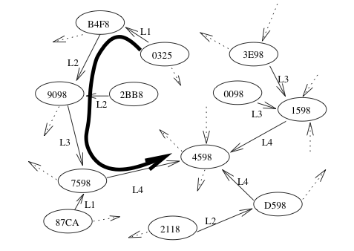
Global deterministic algorithm - Example
Notes:
Here is an example of how to find the target node.
In this example, we are going to find the node 4598 from the node 0325.
At first time, we move to B4F8 because its lowest bit matches the lowest bit of target node.
In the same way, we can move 9098 because its lowest 2 bits match the lowest two bit of target node.
We can apply this algorithm until we found the target node.

Slide 13
Update Model
Strategy: Conflict resolution, adopted from Bayou system
Dividing by blocks
Updating the modified block
Commiting the modified block
(Example: conflict resolution in SVN, Git)
Synchronization Problem with Conflict resolution
Untrusted Infrastructure
Which server is responsible to update the modified data?
Encrypted Data
How conflict resolution is implemented with encrypted data?
Notes:
Conflict resolution was introduced in the Bayou systems to allow for concurrent updates.
OceanStore adopts this model in updating.
The example of usages of conflict resolution is in SVN and Git.
You may experience the sequence of dividing and modifying source codes, and committing the updated codes.
Although conflict resolution has an advantage for flexibility, it needs server-side computation.
In OceanStore with conflict resolution, one problem arises, which server is responsible to update the modified data.
If OceanStore used exactly one main server, it would not be a problem.
But the characteristic of OceanStore is untrusted infrastructure,
it means that there is no trusted main server to control updating, encrypting and decrypting data.

Slide 14
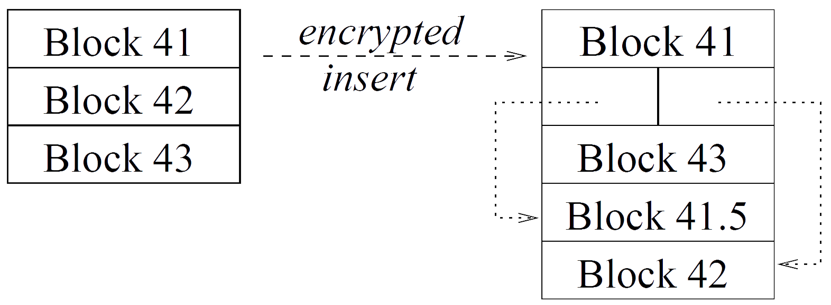
File Operations
Accessing
- Position-Based Cipher
Comparing Version
Comparing Size
Comparing Blocks
Searching
Manipulating
- Pointers and Encrypted Data Blocks
Replacing Blocks
Inserting Blocks
Deleting Blocks
Appending Data
Notes:
We can divide this problem in accessing part and manipulating part.
The issues in the accessing part are “comparing version,” “comparing size,” “comparing blocks,” and “searching data.”
The first two issues are trivial because those are not related to encryption.
And the third issue also can be solved if position-based cipher is used.
In the last issue, the ciphertext module, which is related to encryption, returns only true/false value without decrypted data.
The position based-cipher is assumed in the system.
Because of it, the issues in manipulating part are depends on blocks.
“Replacing Blocks,” “Inserting Blocks,” “Deleting Blocks,” and “Appending Data” issues arise.
These problem can be solved with the structure consisted of pointers and its data blocks.
When these four operations are needed, it can be achieved only by manipulating pointers and its data blocks.
The example of inserting block is in the figure.
A new data, block 41.5, is located between block 41 and block 42.
After the update, the old block 42 is replaced to pointers of block 41 and 41.5 that indicate to new data blocks.
Now, we know that the basic concepts to solve conflict resolution problem under untrusted infrastructure.

Slide 15
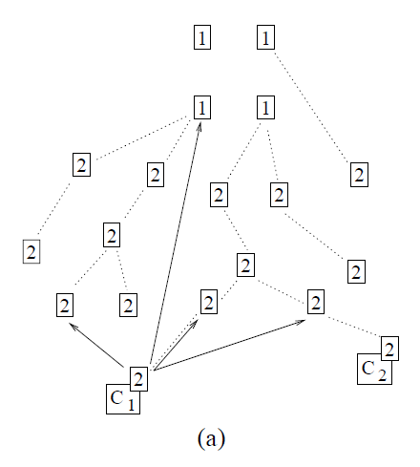
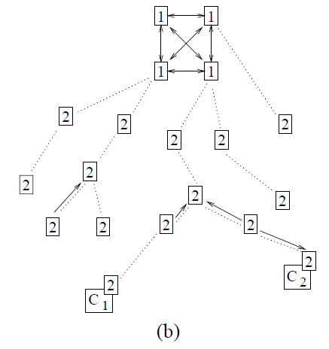
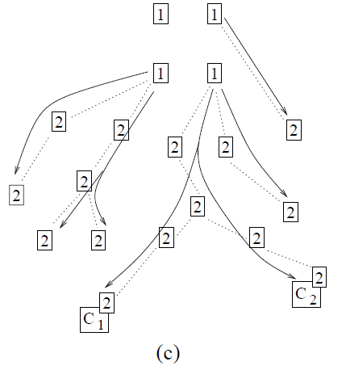
Serializing Updates
Notes:
The next problem is about how updated data can be distributed under untrusted infrastructure.
Named serializing update.
For the serializing, server groups are divided to first-tier servers and second-tier servers.
Because we don’t have trusted servers, master replica is located in several first-tier servers.
The first-tier servers are organized with high-throughput and high-connectivity.
In the figure (a), a client generates an update, and send it to the first-tier server, and the randomly chosen second-tier server.
In the figure (b), the first-tier servers commit the changes as well as the second-tier servers spread the changes to another second-tier peers.
In the last figure, the first-tier servers distribute the updated file to its descendants through multicast down channel.

Slide 16
Introspection
Cluster Recognition
It detects clusters of strongly-related objects
Replica Management
The parent of a replica tracks locally available resources
It can create additional floating replicas to alleviate load
Notes:
Because OceanStore consists of a number of servers, it uses an optimizing module.
The module analyzes past events, and predicts future events using the trends.
This can be used for cluster recognition and replica management.
In cluster recognition, clusters of strongly-related objects can be detected.
If we know the clusters of objects, we can know a few operations to access to the objects.
With replica management, we can predict how many additional replicas should be created in the different servers to alleviate load.

Slide 17
Thank you

