Slide 1
Hybrid Cellular-Ad hoc Data Network
Shuai Zhang, Ziwen Zhang, Jikai Yin

Slide 2
Outline
Overview
Scenario
Technique

Slide 3
Overview
Capacity of Hybrid Cellular-Ad hoc Data Networks

Slide 4
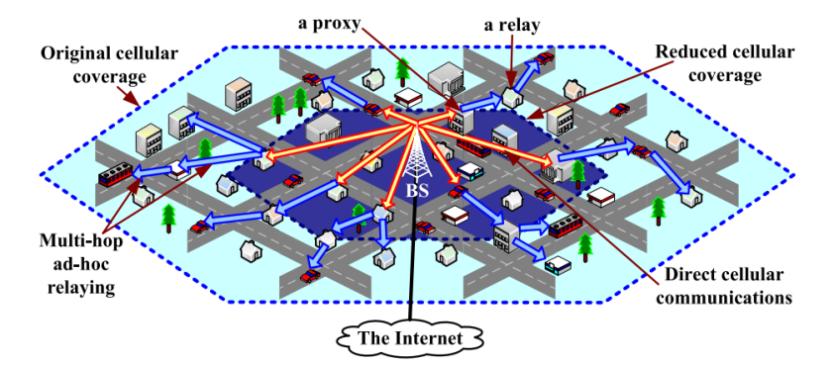
The hybrid network in brief

Slide 5
Infrastructure component
Reduced cellular coverage (dark hexagon).
User receive downlink traffic directly from the Base Station (BS).
The transmission efficiency of the BS enhanced

Slide 6
Ad hoc component
Users that are outside the reduced cellular coverage require proxies
The directly connected users act as proxies and forward traffics from BS
Only a subset of outside users may directly receive traffic from proxies.
These users act as relays and forward traffic to other users that are further away from BS

Slide 7
Scenario
Massive Live Video Distribution using Hybrid Cellular and Ad hoc Networks

Slide 8
Motivation
Today, cellular networks are unable to handle large scale live video distributions since existing cellular deployments do not natively support multicast and broadcast.
Cellular service providers solutions, such as support Multimedia Broadcast Multicast Service (MBMS) or build dedicated broadcast networks, incur high infrastructure costs and may not be compatible with current mobile devices.
A better solution: Cellular service providers may offload mobile video traffic to an auxiliary network. Mobile devices relay video data among each other using ad hoc links.

Slide 9
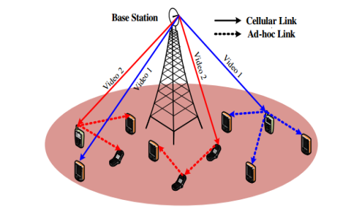
System Architecture
A hybrid cellular and ad hoc network
Consist of a base station and multiple mobile devices
Mobile devices relay video data among each other using ad hoc links

Slide 10
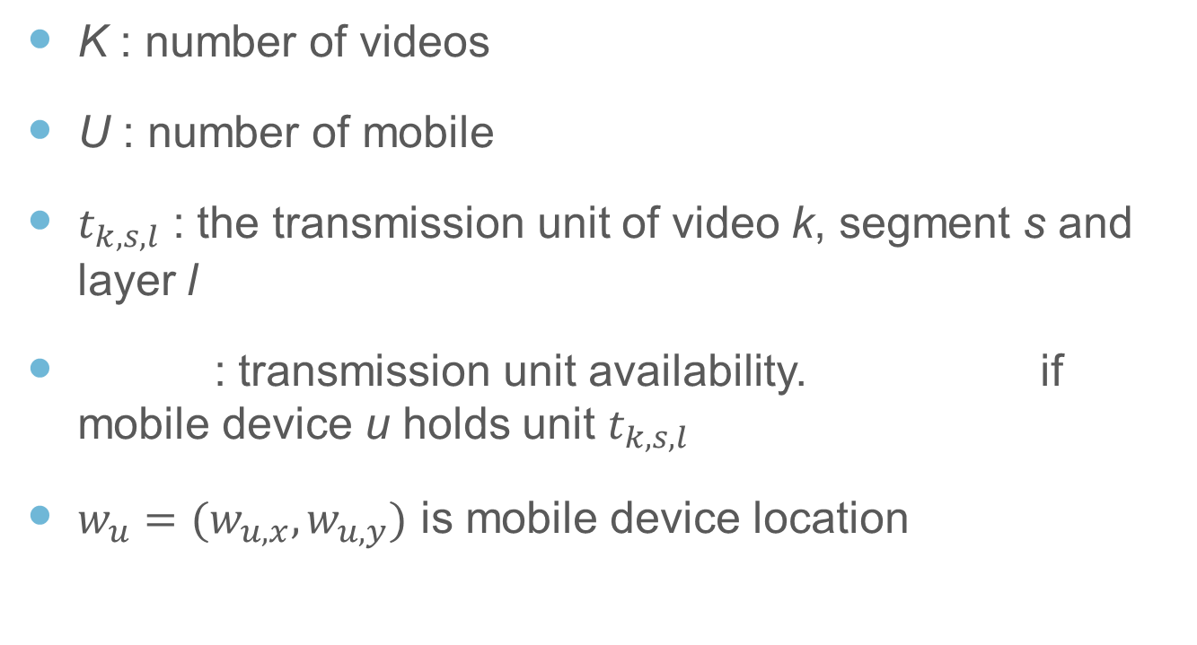
Problem
K : number of videos
U : number of mobile
$t_{k,s,l}$ : the transmission unit of video k, segment s and layer l
: transmission unit availability. if mobile device u holds unit $t_{k,s,l}$
$w_{u}=(w_{u,x}, w_{u,y})$ is mobile device location

Slide 11
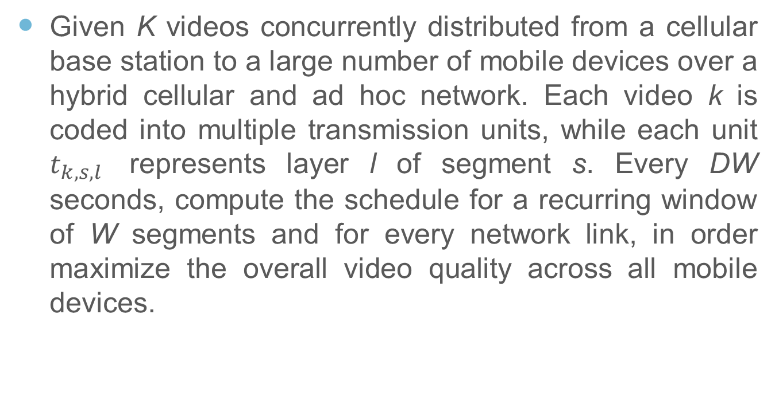
Scheduling
Given K videos concurrently distributed from a cellular base station to a large number of mobile devices over a hybrid cellular and ad hoc network. Each video k is coded into multiple transmission units, while each unit $t_{k,s,l}$ represents layer l of segment s. Every DW seconds, compute the schedule for a recurring window of W segments and for every network link, in order maximize the overall video quality across all mobile devices.

Slide 12
Solution
An MILP-based algorithm POPT
the formulation above is an MILP problem and may be solved by MILP solvers.
NP-Complete, POST algorithm may not scale well with the number of mobile devices.
A heuristic algorithm MTS
first probes the maximum feasible ad hoc network capacity based on transmission unit availability.
then greedily schedules transmission units until the ad hoc and cellular network capacities are both saturated.

Slide 13
Conclusion
Optimally leverage an auxiliary ad hoc network to boost the overall video quality of mobile users in a cellular network.
Formulated the problem as an MILP problem to jointly solve the gateway selection, ad hoc routing, and video adaptation problems for a global optimum schedule.

Slide 14
Technique
Wi-Fi Direct, also called Wi-Fi P2P

Slide 15
Definition
Wi-Fi Direct, initially called Wi-Fi P2P, is a Wi-Fi standard that enable devices to connect easily with each other
Without requiring a wireless access point
Communicate at typical Wi-Fi speeds for both file transfer to internet connectivity.

Slide 16
Implementation
Wi-Fi peer to peer allows Android 4.0 or later devices with the appropriate hardware to connect directly to each other via Wi-Fi without an intermediate access point.
Wi-Fi P2P APIs consist of three main parts:
Methods that allow to discover, request, and connect to peers
Listeners that allow to be notified of the success or failure of method calls
Intents that notify of specific event detected by the Wi-Fi P2P framework, such as a dropped connection and a newly discovered peer

Slide 17
Thanks

