Slide 1
Content Addressable Networks
CAN is a distributed infrastructure, that provides hash table-like functionality on Internet-like scales.
Keys hashed into d dimensional Cartesian coordinate space.
This coordinate space is completely logical and bears no relation to any physical coordinate system.

Slide 2
Overview
The CAN is composed of many individual nodes.
Each CAN node stores a chunk (called a zone) of the entire hash table.
A node holds information about a small number of “adjacent" zones in the table.
Given an input key, a node must be able to route messages to the node holding the key.

Slide 3
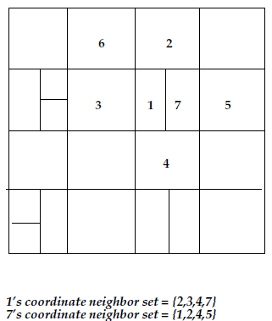
2d Coordinate overlay
y
Peer
Resource
Zone
x
State of the system at time t
In this 2 dimensional space, a key is mapped to a point (x,y)
two nodes are neighbors if their
coordinate spans overlap along
d-1 dimensions and abut along
one dimension.

Slide 4
CAN: construction*
Bootstrap
node
new node
* From slides of Santashil

Slide 5
CAN: construction
Bootstrap
node
I
new node
1) Discover some node “I” already in CAN

Slide 6
CAN: construction
(x,y)
I
new node
2) Pick random point in space

Slide 7
CAN: construction
(x,y)
J
I
new node
3) I routes to (x,y), discovers node J

Slide 8
CAN: construction
J
new
4) split J’s zone in half… new node owns one half

Slide 9
Routing
Follows Straight line path(shortest Cartesian distance) from source to destination coordinates.
Every CAN node maintains routing table.
Multiple path exists between points in the Cartesian space.

Slide 10
Failure Recovery
Use zone takeover in case of failure or leaving of a node
Send your ‘neighbor’ table to neighbors to inform that you are alive at discrete time interval t
If your neighbor does not send alive in time t, takeover its zone
Zone reassignment is needed: think of each existing zone as a leaf of a binary partition tree.

Slide 11
Zone reassignment
3
1
1
3
2
4
2
4
Partition tree
Zoning

Slide 12
Zone reassignment
3
1
1
3
4
4
Partition tree
Zoning

Slide 13
Zone reassignment
3
1
1
3
2
4
2
4
Partition tree
Zoning

Slide 14
Zone reassignment
2
1
1
2
4
4
Partition tree
Zoning

