Slide 1
POWERFUL ANDROID MONITOR
CS234 PROJECT
Boyu Sun, Dawei Ouyang, Shi Yan, Qiwei Zhang

Slide 2
VISION
Give consistent care to hospitalized
family member wherever you are:
Capture patients’situation in time
alert when dangerous signal raises
Allow remote monitor

Slide 3
Implementation
Using sensors to capture certain information of body
Sensor pass data to cellphone via bluetooth
when abnormal signal happens
invoke the loud-speaker to alert
invoke camera to all monitor
Allow other cellphones get information from the certain cellphone over wifi

Slide 4
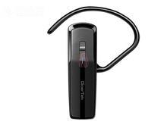
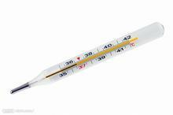

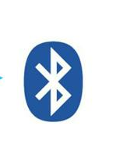
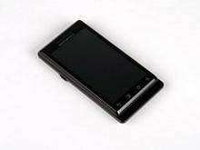
Stage 1: Sensor Cellphone communication

Slide 5
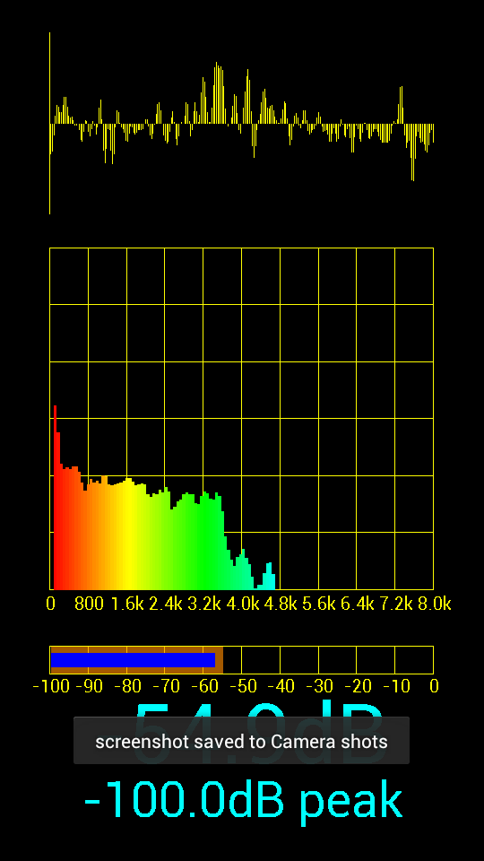
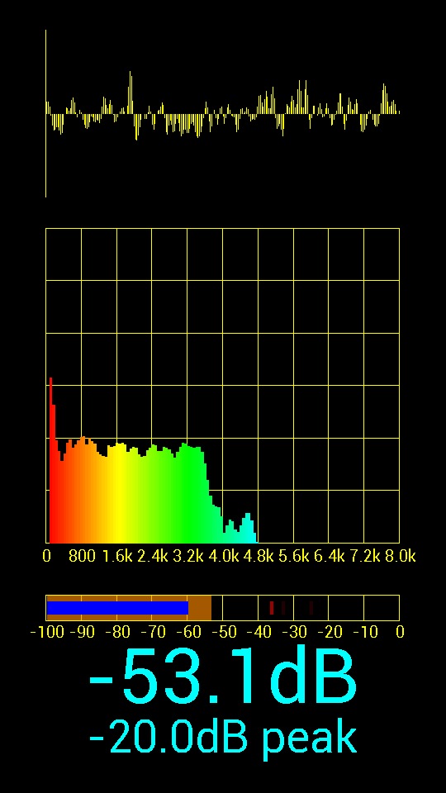
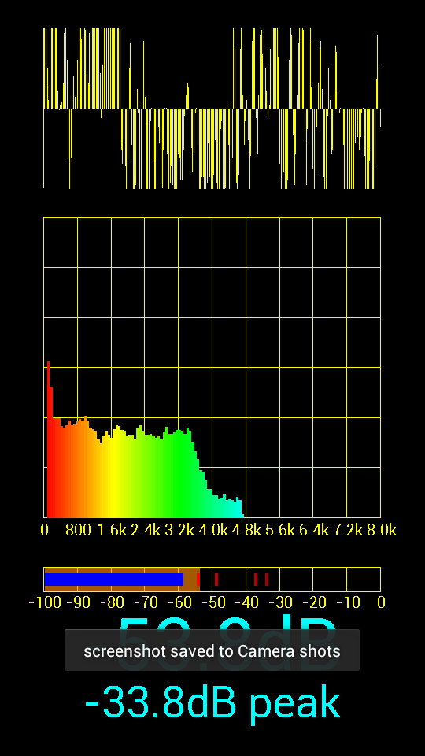
With only noise

Slide 6
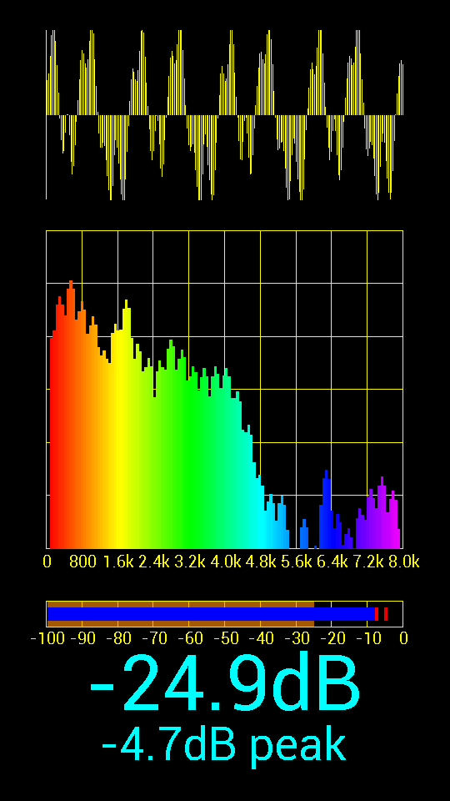
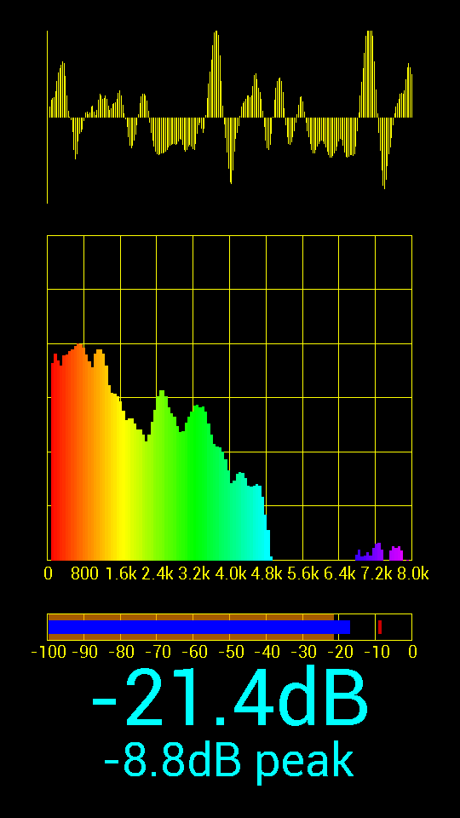
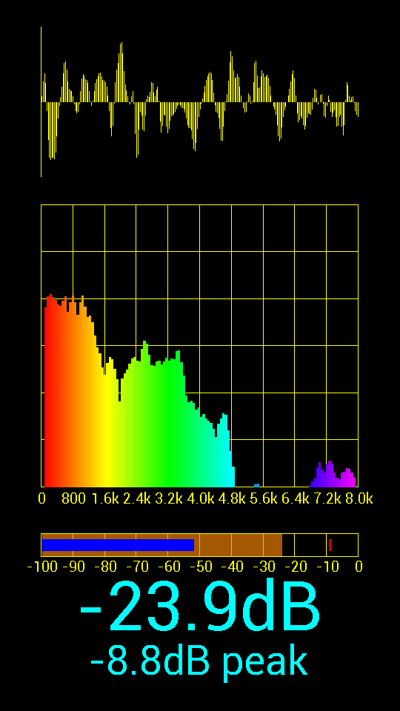
Data receiving

Slide 7
Stage2: Invoke phone device
Data Receive
Compare
Invoke speaker&camera
Deviation too significant ?

Slide 8
Video capture and deliver
Multiple capture choices:
QuickTime
Java Media Framework
Directshow
Deliver:
Real-time Transfer Protocol
(based on UDP)

Slide 9

Stage3 mobile communication
Agent cellphone send data to other mobile devices over wifi

Slide 10
Development in the future...
Upload data into database
Collect and parse the data
Add other communicate methods besides wifi to allow monitor all around the world
More...

