Slide 1
EVENT-DRIVEN DATA COLLECTION IN WIRELESS SENSOR NETWORKS WITH MOBILE SINKS
Acknowledgement
Xiujuan Yi (xyi@uci.edu)
Malini Karunagaran
Rutuja Raghoji
Ramya Tridandapani

Slide 2
Introduction
Typical sensor network applications generate large amounts of data and send that data to the base station using multihop routing.
Transporting large quantities of data to the base station can quickly drain the limited energy resources of the sensor nodes and reduce the lifetime of the sensor network.
Solution to reduce communication cost in sensor networks
  Innetwork aggregation (e.g., AVG and MIN)
  Innetwork processing (e.g., beamforming).
However, due to the inherent loss of detail, these techniques do not provide the fine data granularity desired by several sensor network applications.
Multihop routing with static sink nodes results in the early death of the one-hop neighbors of the sinks and make the sensor network unusable.
Another approach of mobile data sinks for datacollection to geographicaly balance the energy consumption among the sensor nodes throughout the network.
It is also possible to use this strategy of mobile sinks in other environments, where mobile sinks can traverse the sensor network area and collect the data based on the protocols.

Slide 3
Problem statement
Events happen in discrete locations. And they can form a particular distribution which might be arbitrarily complex. Sensors should move such that their positions will eventually approximate that distribution
Our aim is to focus on event region and data generated among the region. We will be considering temporal/spatial occurrence of events and residual energy, formulate the problem as dynamic vehicle routing with time window (DVRPTW).

Slide 4
challenges
How to model event data?
  Data in Wireless Sensor Networks are heterogeneous in nature
  It is important to maintain the quality of data is given the heterogeneity of network.
How to route event data?
  Change in location of sensors.
  Heterogeneity in quality, location and number of sensors in a network based on application.
  Redundancy in data collected by sensors geographically close to each other.
How to make a trade-off among data latency, energy, buffer overflow etc.?

Slide 5
Related work
Traditional multi-hop collection
  Imbalanced traffic load,
  heavier energy-consumption,
  redundant data transmission etc.
In-network processing: tiny model
Event driven data collection: more accurate sensing
Employing mobile data collector
  Mobile element scheduling
  HDTC
  TTDD
Aggregation

Slide 6
Algorithm
Using Mobile Data Collector to collect the Data from Stationary Sensor nodes.
This model is based on assumption that
    Events are homogeneous
    Events overlapping on both time and location are considered as a single event.
Calculating the trajectory of Mobile node is formulated as Dynamic Vehicle Routing Protocol With Time Window(DVRPTW)
This heuristic has been provided by Xiujuan Yi (xyi@uci.edu)

Slide 7
Algorithm – SYSTEM OVERVIEW
Event Data Collection in WSN
Model Event
Algorithm to DVRPTW
DVRPTW Formulation
Trajectories for MDCs

Slide 8
evaluations
Calculated the Residual energy in the system under the following scenarios:
Scenario 1:
  81 stationary Wireless Sensor Nodes
  1 Base Station
  1 Mobile Sink – Which moves according to the trajectory calculated by given heuristic
Scenario 2:
  81 stationary Wireless Sensor Nodes
  1 Base Station
  1 Mobile Sink – The sink is stationary in this case, data transmitted through multi-hop routing

Slide 9
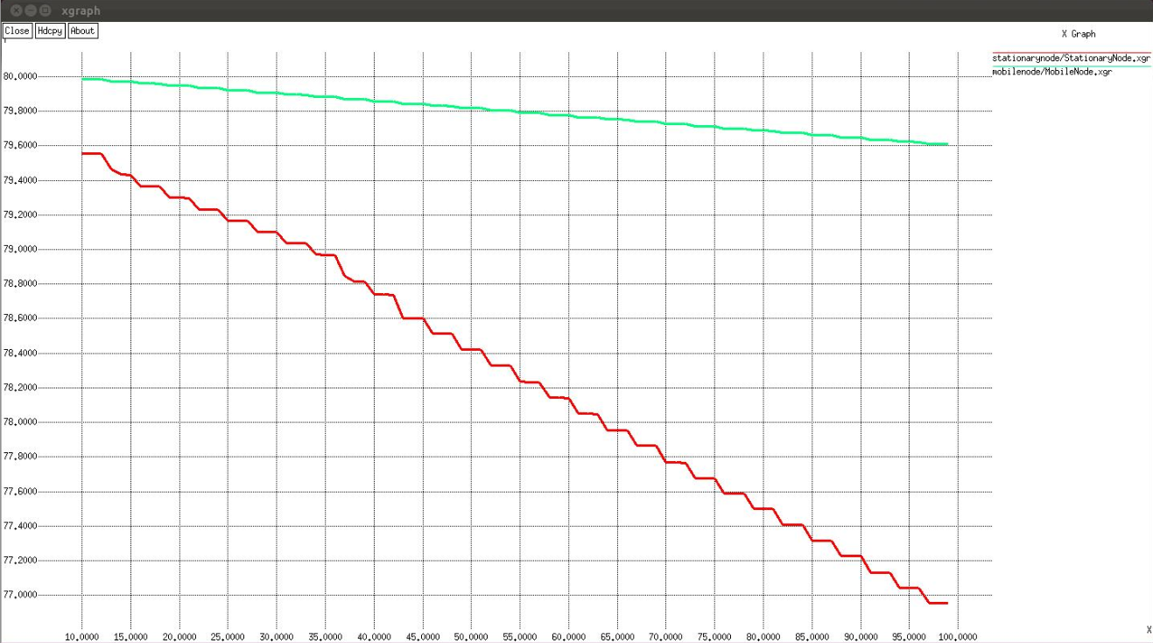
Evaluations -
Graph Residual EnerGY VS TIME

Slide 10
OTHER SIMULATIONS
Energy drop with variance in sensor communication coverage
Energy drop with variance in sensor area coverage
Trade-off value for coverage distance versus number of sensor nodes
Future work:
Develop multiple mobile sink nodes as data collectors
Develop dynamic sensor nodes for event sensing and propagation

Slide 11
references
[1] Liang Song, Member, IEEE, and Dimitrios Hatzinakos, Senior Member, IEEE. Architecture of Wireless Sensor Networks With Mobile Sinks: Sparsely Deployed Sensors. IEEE Transactions On Vehicular Technology, Vol. 56, No. 4, July 2007
[2] Yan Sun, Haiqin Liu, and Min Sik Kim School of Electrical Engineering and Computer Science Washington State University. Energy-Efficient Routing Protocol in Event-Driven Wireless Sensor Networks.
[3] Fan Ye, Haiyun Luo, Jerry Cheng, Songwu Lu, Lixia Zhang UCLA Computer Science Department. A TwoTier Data Dissemination Model for Largescale Wireless Sensor Networks
[4] Harshavardhan Sabbineni and Krishnendu Chakrabarty Department of Electrical and Computer Engineering, Duke Univeristy, Datacollection in Event-DrivenWireless Sensor Networks with Mobile Sinks

