Slide 1
Live MobiCast using node.js
Ajay Narayan (60006864)
Deepak Kumar Agarwal (71404423)
Nishchint Raina (67569992)

Slide 2
Problem Statement
How to capture live events and share them instantly with available resources (mobile and Wi-Fi)?
Mobile based webcast application
  user to capture a live video from mobile camera
  stream it on a predefined URL in the network
  no internet (just WLAN infrastructure)

Slide 3



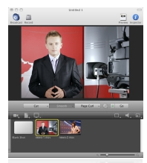


Related Work

Slide 4
Contribution
Video streaming framework
  independent of Internet
  supports multiple channel subscription
  Scalable
  stream is multicast from server
  Resource mobility support
  anywhere in WLAN range
  Social application for mobile live video sharing

Slide 5
Algorithm/Workflow
Resource connects server
  registers channel
Server (webserver) accepts request
  returns an html5 file in response
html5 file captures the live video stream
  from resource's camera device and
  sends the base64 encoded data frame to server (WebSocket)
Server (WebSocket) receives packet and
  inserts it into its buffer store (redis/mongodb)

Slide 6
Algorithm/Workflow
Client contacts the server (webserver) and
  gets the client view html file
Client opens the html file in its browser and
  subscribes to a desired channel from server (WebSocket)
Server receives packet from a resource
  broadcasts to all clients connected to same channel
Client renders the frames to form a live video stream

Slide 7
System
Server
  Node.js v0.6.19
    Express (HTTP)
    Socket.io (WebSocket)
    Mongodb (Frame buffer store)
Client Viewer
  JavaScript enabled browser (Opera, Chrome, Firefox)
Resource
  HTML5+JS Media capable browser (Opera Mini 12 for Android)
  Camera capable device (HTC Sensation)
Network
  Wi-Fi/ad-hoc intranet LAN

Slide 8

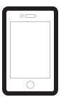
Architecture
Rx: Resource
Vx: Viewer
Cx: Channel x
V1
join(c1)
frame:c1
frame:c2
Server.js
frame:c1
V2
join(c2)
join(c1)
V3
get_frame
frame:c1
Node V8 Engine
Base64 Encoded data
Buffer
frame:c2
R1
dump_frame
R2
redis/mongodb

Slide 9
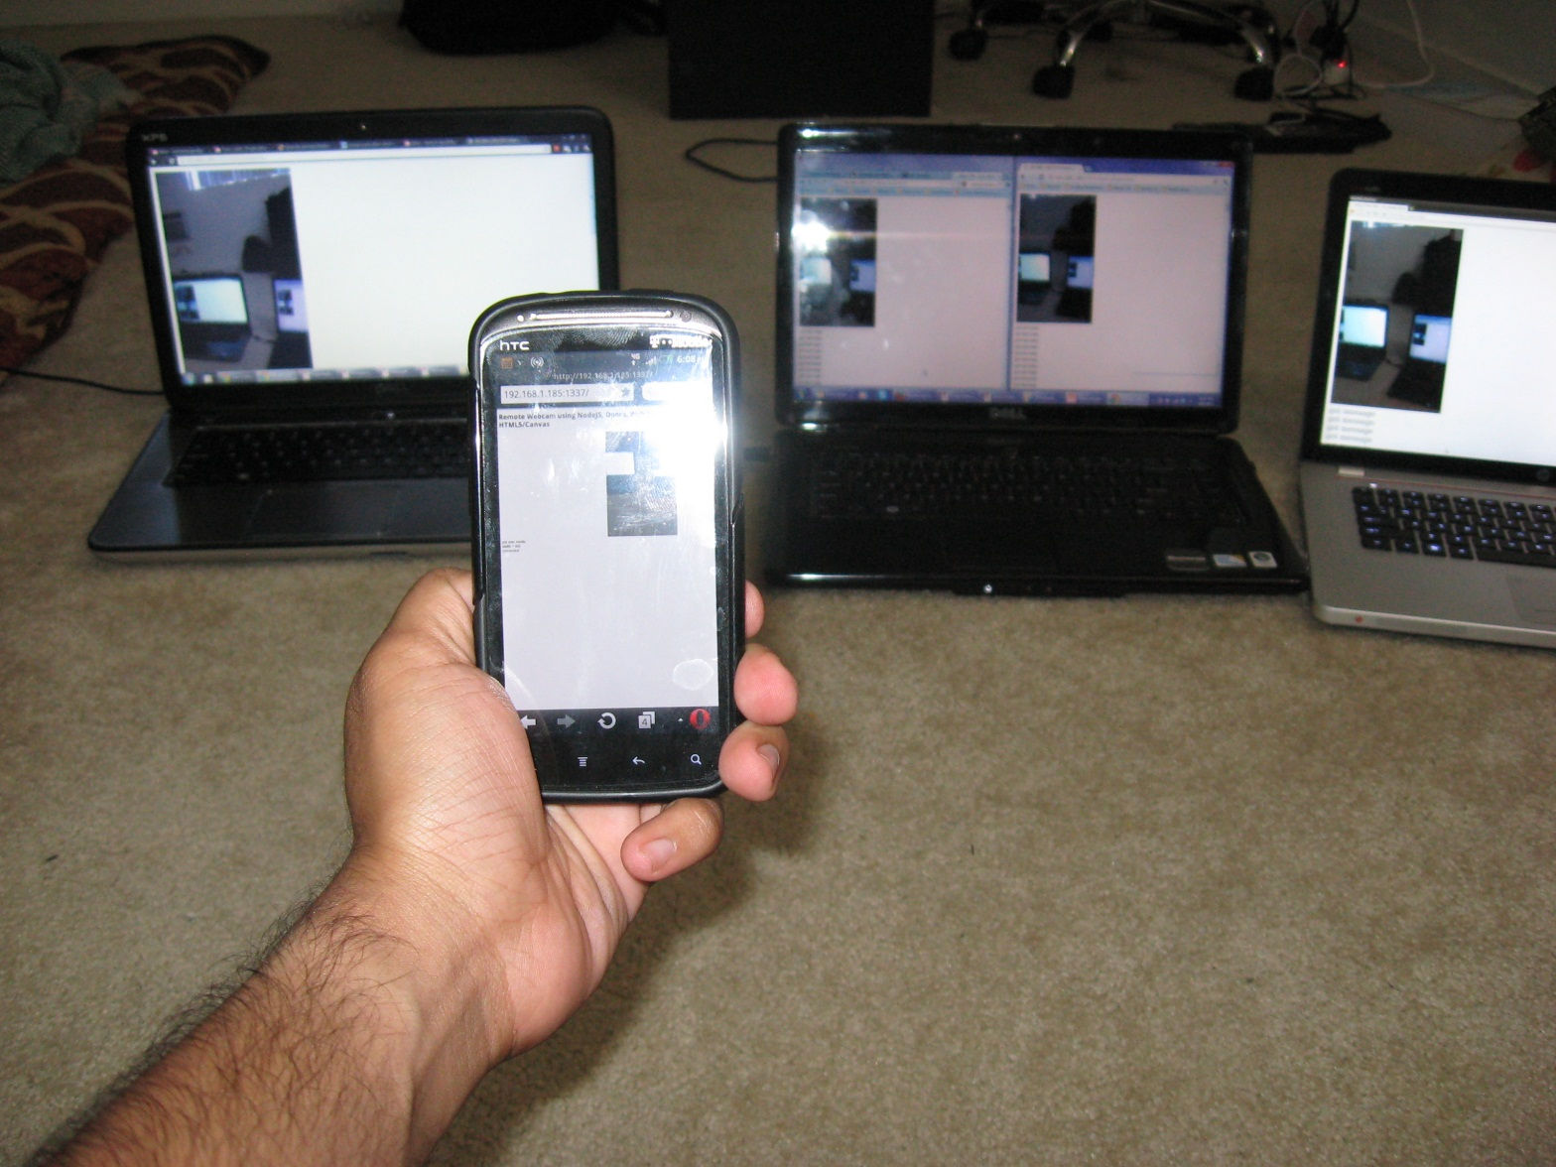
Evaluation
viewer
server
mobile resource

Slide 10
Evaluation: Performance
Server load during streaming
Memory Usage
CPU Usage

Slide 11
Conclusion
Scalable solution to stream live media
No software download required for viewers
Lossy/noisy wireless environment pose challenges (delay, jitter)
Streaming static video: quite acceptable performance
In future can implement play-pause functionality

