Slide 1
Xchange-Park: A Crowd-sourcing based parking reservation system
Aakash Therani 43406368
Ankit Jasuja 18444587
Manish Shah 56481976

Slide 2
Crowdsourcing
Crowdsourcing is a process that involves outsourcing tasks to a distributed group of people.
It may be defined as the act of taking a job traditionally performed by a designated agent (usually an employee) and outsourcing it to an undefined, generally large group of people in the form of an open call.
These applications exhibit a list of available tasks, associating with reward and time period, that are presented by requesters; and during the period, workers compete to provide the best submission.

Slide 3
Why Crowdsourcing?
Tasks that are trivial for humans but challenging for sophisticated machines can be easily solved using crowdsourcing concept by distributing it to human network. For e.g. image search and annotation.
It can help to reduce a company’s production costs and make more efficient use of labor and resources.
Humans can innovate creative ideas in a product design process but computers cannot.

Slide 4
Related Work
CrowdPark: A Crowdsourcing-based Parking Reservation System for Mobile Phones that enables users to loosely reserve parking spots.
TXTEAGLE: Doled out in Kenya and Rwanda, it is a system where people are rewarded with small amount of airtime for completing simple tasks such as translation, transcription, etc.
Product Empire: This app is available in android market and uses a social network game concept where users participate and help to build a data repository of products linked to barcodes.

Slide 5
Xchange-Park
Xchange-Park is a crowd-sourcing based parking reservation system which allows people to rent/lease or take parking space beforehand and reserve a parking spot before you reach the destination.
The purpose of the application is for people who have parking spots to lease it to people who are in need of parking. This arrangement could work both ways as people in need for parking would get assured parking and the person renting would earn money.
This application is pure use of the concept of crowdsourcing as people not related to each other help each other.

Slide 6
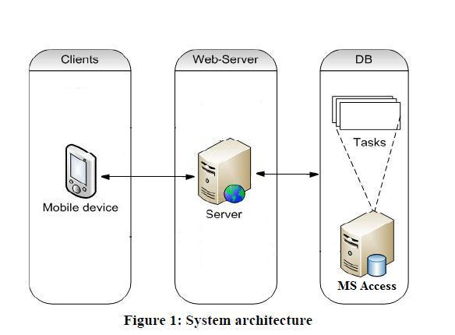
System Architecture

Slide 7
Working
Mobile Device
Interface to the application
Buyers can search nearby parking slots
Sellers can post available parking space
Server
Spawns new thread for each requesting client
Does the processing to find the nearest parking space available to the buyer
Database
Maintains tables for the buyers, sellers, available parking space and transactions.

Slide 8
Features
Dynamic Nature of Database allow more and more users to participate either to request or post the available parking space.
User can rate the person with whom he performs the transaction.
Map view allows spot the nearest parking space available.
Modular design allows scope for future extensions to the system.

Slide 9
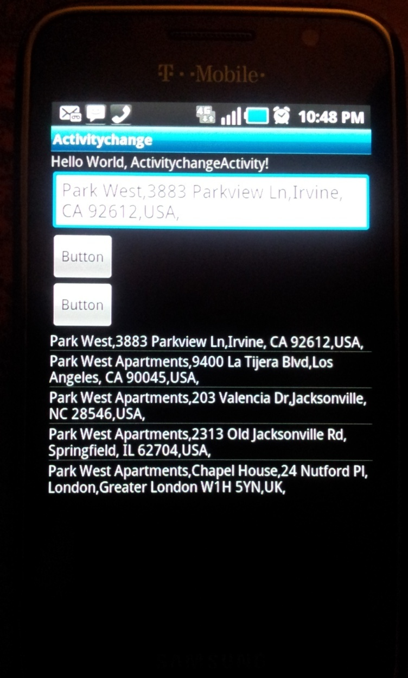
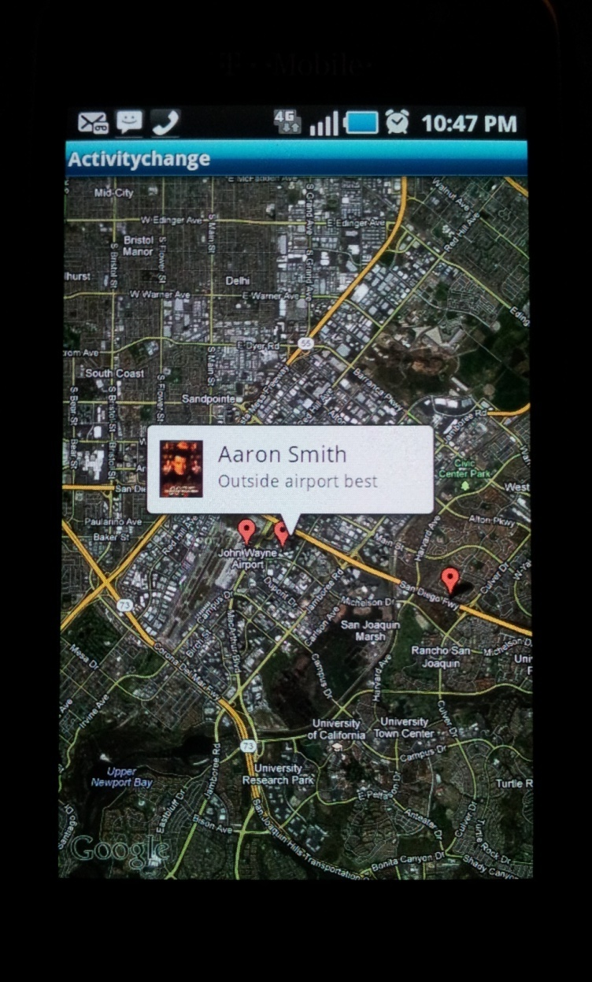
Simulation

Slide 10
Benefits
This system allows you to reserve a parking space before leaving for the destination, hence avoiding the hassle of going and searching for a parking space.
The application gives a chance to users such as students or people who have free parking space and can in turn end up earning some cash.
This application helps increasing the utilization of free parking space & is beneficial in crowded cities and downtown areas.
Dynamic nature of application allows more and more available parking space with increase in user participation.

Slide 11
Conclusion
Within a short period of time, Android has managed to overtake a significant part of the global smart-phone market.
Another revolution is the emergence of a new model of computation named crowdsourcing, where the power of crowds of people is utilized on tasks that are costly or time consuming with traditional methods.
Enormous potential can be truly unleashed when these two concurrent revolutions are combined together.
Application like ours can help to target specific problem and reduce them.

Slide 12
Thank You

