Slide 1
Separated Children Seeking Platform
Based on Location Information from Street Snap
Group 3

Slide 2
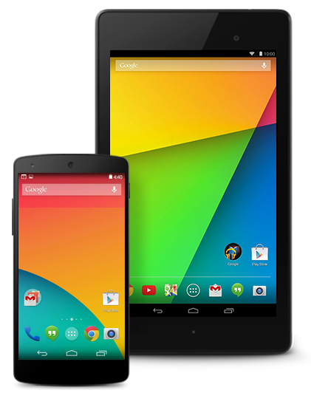



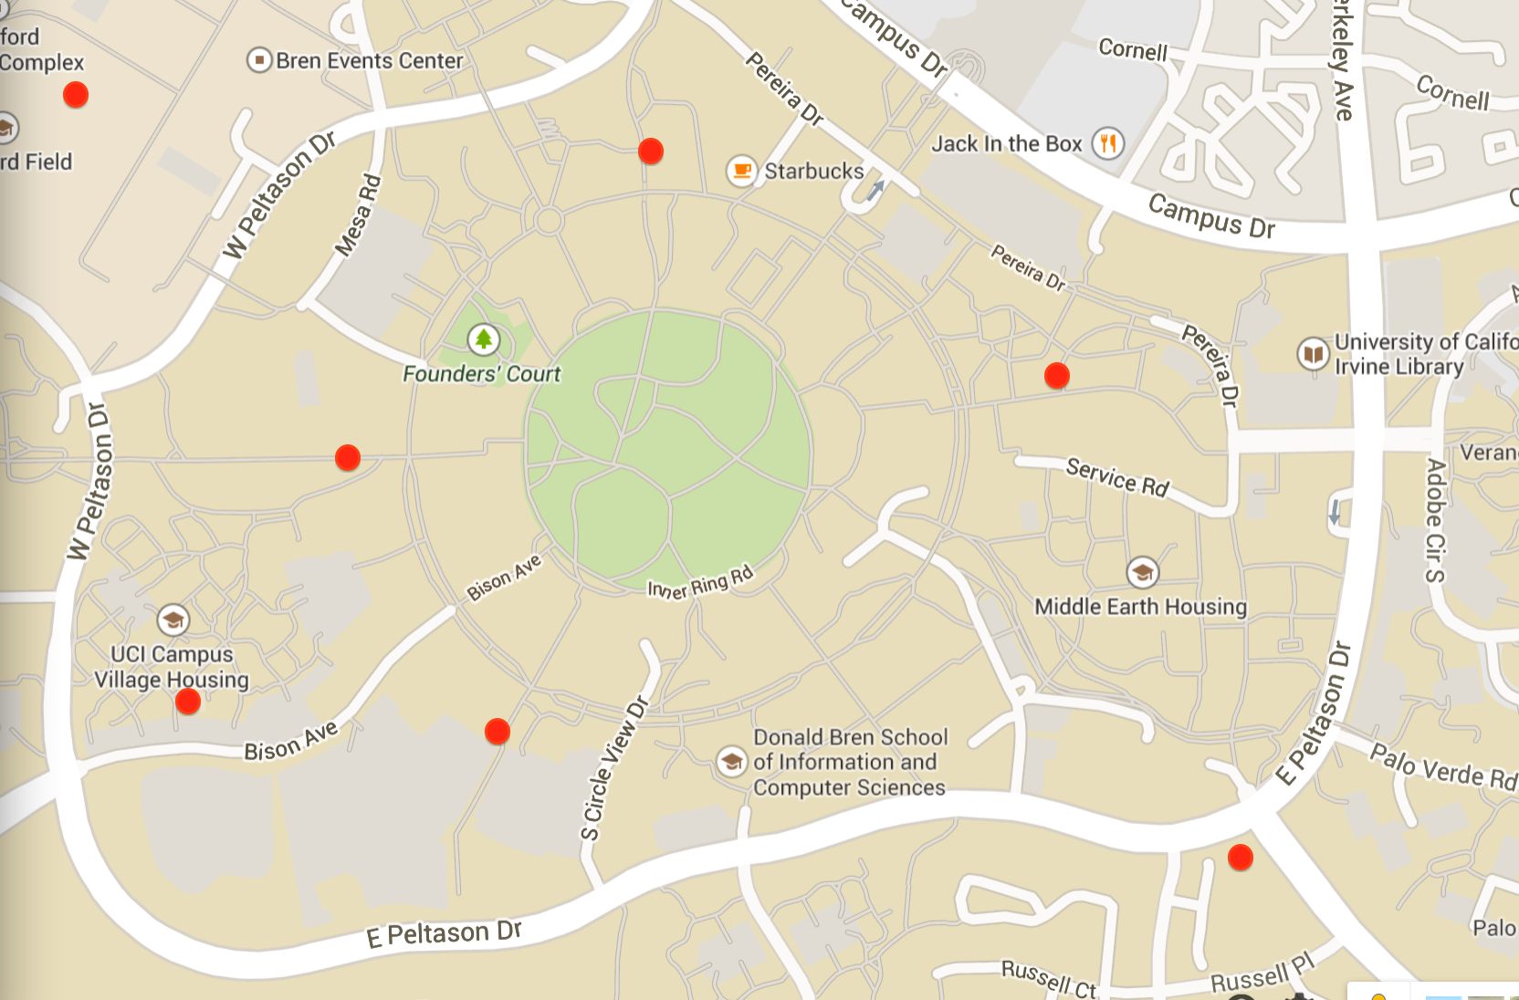
Introduction
Photos, Location, Time etc.
Apache Server
Android App
A list of photos & Location

Slide 3
Background
Now the public are commonly indifferent and unconcerned about the separate children seeking issue
unwilling to provide personal information
avoiding the touch with police
confused about what to do
We want to change this situation, and merge this
public service with game-like mobile application to encourage the participation of populace

Slide 4
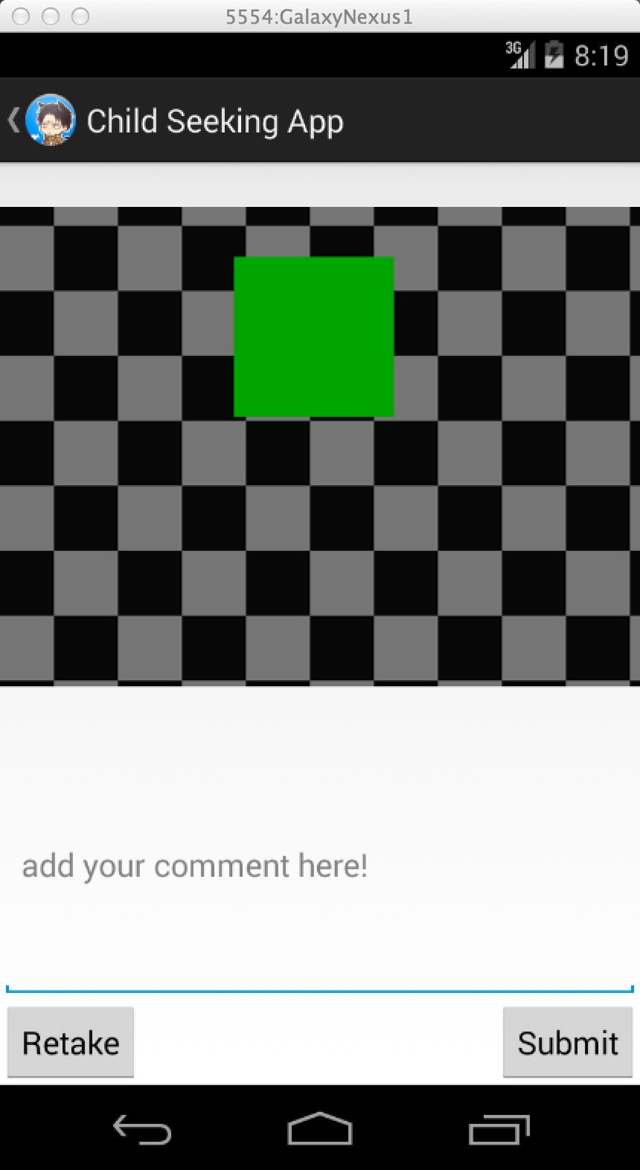
Android App
Activities
  take photo & add comments
  display similar photos
  give feedback
  display locations on map

Slide 5

Client-Server Model
JSON
insert an entry
PHP
$_POST
33.646576, -117.842793,
2014-05-20 14:01:03
MySQL
Android App
33.856147, -116.146351,
2014-05-20 10:46:42
PHP
echo json_encode()
database query
JSON

Slide 6
Server and Database
Store the images in a folder
Entry format in the database
  `id`, for every photo, INT, PRIMARY KEY
  `desc`, verbal description, VARCHAR
  `location`, location info, POINT
SPATIAL INDEX, RTREE
  `time`, TIMESTAMP
  MYISAM engine

Slide 7
Image Query Approach
Time and location matching
  Define a reasonable time interval
  Define a reasonable spatial interval
  Notice that the location information is in latitude and longitude. Translation to absolute distance should be define.
  1 degree latitude deviation = 69 miles (approx.)
  1 degree longitude deviation = 69 miles (approx.)
Face recognition
  Face recognition algorithms
  Challenge

