Slide 1
Messaging, MOMs and Group Communication
CS 237
Distributed Systems Middleware (with slides from Cambridge Univ and Petri Maaranen)

Slide 2

Message-Oriented Middleware (MOM)
cf: www.cl.cam.ac.uk/teaching/0910/ConcDistS/
Communication using messages
  Synchronouus and asynchronous communication
Messages stored in message queues
Message servers decouple client and server
Various assumptions about message content
Client App.
Server App.
Message Servers
local message
queues
message
queues
local message
queues
Network
Network
Network
Middleware
‹#›

Slide 3
Properties of MOM
cf: www.cl.cam.ac.uk/teaching/0910/ConcDistS/
Asynchronous interaction
  Client and server are only loosely coupled
  Messages are queued
  Good for application integration
Support for reliable delivery service
  Keep queues in persistent storage
Processing of messages by intermediate message server(s)
  May do filtering, transforming, logging, …
  Networks of message servers
Natural for database integration
Middleware
‹#›

Slide 4
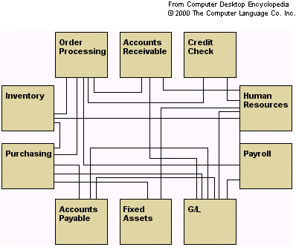
TJTST21 Spring 2006
‹#›

Slide 5
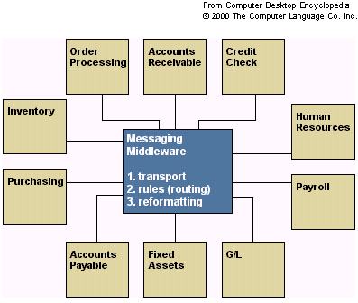
TJTST21 Spring 2006
‹#›

Slide 6
Message-Oriented Middleware (4) Message Brokers
• A message broker is a software system based
on asynchronous, store-and-forward messaging.
• It manages interactions between applications
and other information resources, utilizing
abstraction techniques.
• Simple operation: an application puts (publishes)
a message to the broker, another application
gets (subscribes to) the message. The
applications do not need to be session
connected.
TJTST21 Spring 2006
‹#›

Slide 7
(Message Brokers, MQ)
• MQ is fairly fault tolerant in the cases of
network or system failure.
• Most MQ software lets the message be declared
as persistent or stored to disk during a commit at
certain intervals. This allows for recovery on
such situations.
• Each MQ product implements the notion of
messaging in its own way.
• Widely used commercial examples include IBM’s
MQSeries and Microsoft’s MSMQ.
TJTST21 Spring 2006
‹#›

Slide 8
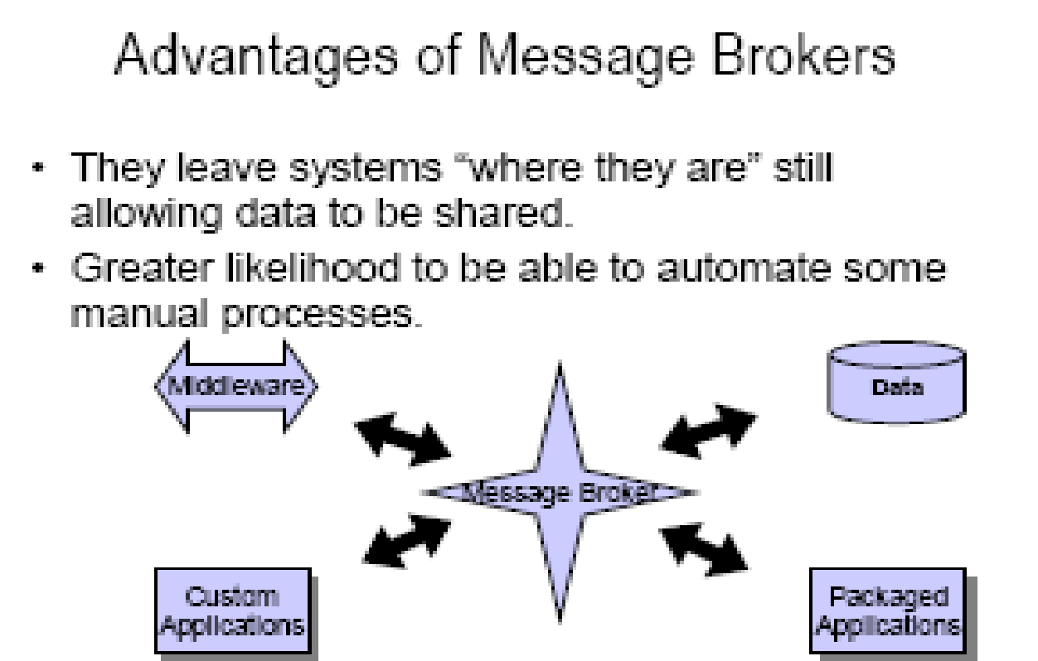
TJTST21 Spring 2006
‹#›

Slide 9
Message Brokers
Any-to-any
The ability to connect diverse applications and other
information resources
– The consistency of the approach
– Common look-and-feel of all connected resources
• Many-to-many
– Once a resource is connected and publishing
information, the information is easily reusable by any
other application that requires it.
TJTST21 Spring 2006
‹#›

Slide 10
Standard Features of Message Brokers
• Message transformation engines
– Allow the message broker to alter the way information is presented for each application.
• Intelligent routing capabilities
– Ability to identify a message, and an ability to route them to appropriate location.
• Rules processing capabilities
– Ability to apply rules to the transformation and routing of information.
TJTST21 Spring 2006
‹#›

Slide 11
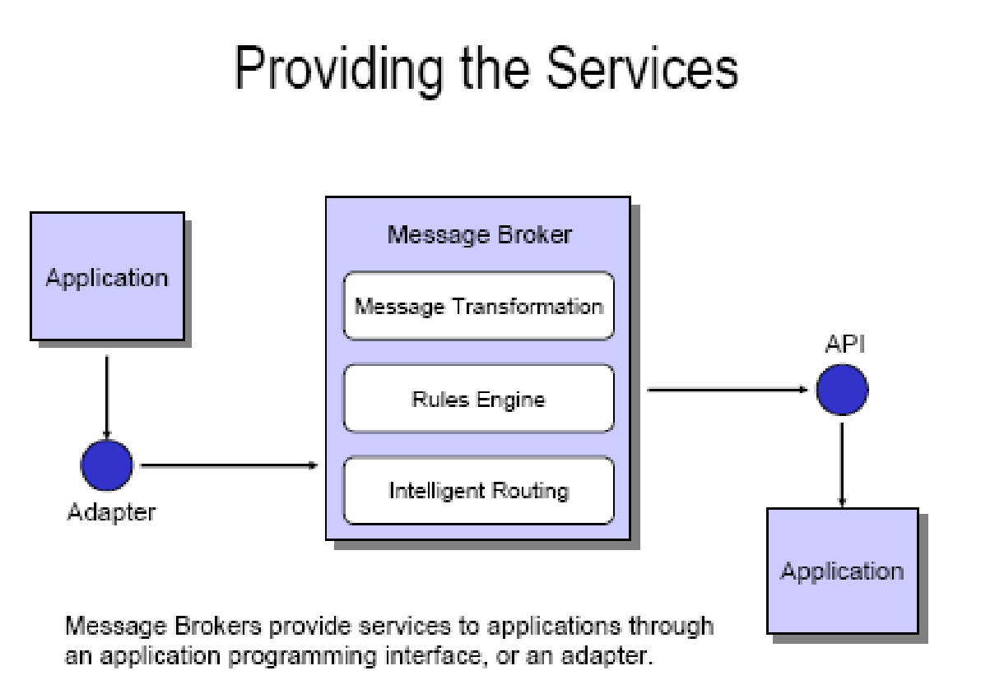
TJTST21 Spring 2006
‹#›

Slide 12
Vendors
Adea Solutions[2]: Adea ESB Framework
ServiceMix[3]: ServiceMix (Apache)
[4]: Synapse (Apache Incubator)
BEA: AquaLogic Service Bus
BIE: Business integration Engine
Cape Clear Software: Cape Clear 6
CordysCordys: Cordys ESB
Fiorano Software Inc.Fiorano Software Inc. Fiorano ESB™ 2006
IBMIBM: WebSphere Platform (specifically WebSphere Message Broker or WebSphere ESB)
IONA TechnologiesIONA Technologies: Artix
iWay Software: iWay Adaptive Framework for SOA
MicrosoftMicrosoft: .NETMicrosoft: .NET Platform Microsoft BizTalk ServerMicrosoft: .NET Platform Microsoft BizTalk Server [5]
ObjectWebObjectWeb: Celtix (Open Source, LGPL)
Oracle: Oracle Integration products
Petals Services Platform: EBM WebSourcing & Fossil E-Commerce (Open Source)
PolarLake: Integration Suite
LogicBlaze: ServiceMix ESB (Open Source, Apache Lic.)
Software AG: EntireX
Sonic Software: Sonic ESB
SymphonySoftSymphonySoft: Mule (Open Source)
TIBCO Software
Virtuoso Universal Server
webMethods: webMethods Fabric
TJTST21 Spring 2006
‹#›

Slide 13
Conclusions
Message oriented middleware ->
Message brokers-> ESB
Services provided by Message Brokers
Common characteristics of ESB
Products and vendors
TJTST21 Spring 2006
‹#›

Slide 14
IBM MQSeries
cf: www.cl.cam.ac.uk/teaching/0910/ConcDistS/
One-to-one reliable message passing using queues
  Persistent and non-persistent messages
  Message priorities, message notification
Queue Managers
  Responsible for queues
  Transfer messages from input to output queues
  Keep routing tables
Message Channels
  Reliable connections between queue managers
Messaging API:
MQopen | Open a queue
MQclose | Close a queue
MQput | Put message into opened queue
MQget | Get message from local queue
Middleware
‹#›

Slide 15
Java Message Service (JMS)
cf: www.cl.cam.ac.uk/teaching/0910/ConcDistS/
API specification to access MOM implementations
Two modes of operation *specified*:
  Point-to-point
    one-to-one communication using queues
  Publish/Subscribe
    cf. Event-Based Middleware
JMS Server implements JMS API
JMS Clients connect to JMS servers
Java objects can be serialised to JMS messages
A JMS interface has been provided for MQ
pub/sub (one-to-many) - just a specification?
Middleware
‹#›

Slide 16
Disadvantages of MOM
cf: www.cl.cam.ac.uk/teaching/0910/ConcDistS/
Poor programming abstraction (but has evolved)
  Rather low-level (cf. Packets)
  Request/reply more difficult to achieve, but can be done
Message formats originally unknown to middleware
  No type checking (JMS addresses this – implementation?)
Queue abstraction only gives one-to-one communication
  Limits scalability (JMS pub/sub – implementation?)
Middleware
‹#›

Slide 17
Generalizing communication
Group communication
  Synchrony of messaging is a critical issue
Publish-subscribe systems
  A form of asynchronous messaging

Slide 18
Group Communication
Communication to a collection of processes – process group
Group communication can be exploited to provide
  Simultaneous execution of the same operation in a group of workstations
  Software installation in multiple workstations
  Consistent network table management
Who needs group communication ?
  Highly available servers
  Conferencing
  Cluster management
  Distributed Logging….

Slide 19
Group communication - Types
Peer
  All members are equal
  All members send messages to the group
  All members receive all the messages
Client-Server
  Common communication pattern
    replicated servers
  Client may or may not care which server answers
Diffusion group
  Servers sends to other servers and clients
Hierarchical
  Highly and easy scalable
Svrs
Clients

Slide 20
Message Passing Basics
A system is said to be asynchronous if there is no fixed upper bound on how long it takes a message to be delivered or how much time elapses between consecutive steps
Point-to-point messages
  snd_{i}(m)
  rcv_{i}(m,j)
Group communication
  Broadcast
    one-to-all relationship
  Multicast
    one-to-many relationship
    A variation of broadcast where an object can target its messages to a specified subset of objects

Slide 21
Using Traditional Transport Protocols
  TCP/IP
    Automatic flow control, reliable delivery, connection service, complexity
      linear degradation in performance
  Unreliable broadcast/multicast
    UDP, IP-multicast - assumes h/w support
    message losses high(30%) during heavy load
      Reliable IP-multicast very expensive

Slide 22
Modeling Message Passing Systems
A system consist of n objects a₀, …, a_{n-1}
Each object a_{i} is modeled as a (possible infinite) state machine with state set Q_{i}
The edges incident on a_{i} are labeled arbitrarily with integers 1 through r, where r is the degree of a_{i}
Each state of a_{i} contains 2r special components, outbuf_{i}[l], inbuf_{i}[l], for every 1 ≤ l ≤ r
A configuration is a vector C=(q_{o},…,q_{n-1}), where q_{i} is the state of a_{i}
a₁
a₀
1
2
2
3
1
1
2
1
a₃
a₂

Slide 23
Group Communication Issues
Ordering
Delivery Guarantees
Membership
Failure

Slide 24
Ordering Service
Unordered
Single-Source FIFO (SSF)
  For all messages m₁, m₂ and all objects a_{i}, a_{j}, if a_{i} sends m₁ before it sends m₂, then m₂ is not received at a_{j} before m₁ is
Totally Ordered
  For all messages m₁, m₂ and all objects a_{i}, a_{j}, if m₁ is received at a_{i} before m₂ is, the m₂ is not received at a_{j} before m₁ is
Causally Ordered
  For all messages m₁, m₂ and all objects a_{i}, a_{j}, if m₁ happens before m₂, then m₂ is not received at a_{i} before m₁ is

Slide 25
Delivery guarantees
  Agreed Delivery
      guarantees total order of message delivery and allows a message to be delivered as soon as all of its predecessors in the total order have been delivered.
  Safe Delivery
      requires in addition, that if a message is delivered by the GC to any of the processes in a configuration, this message has been received and will be delivered to each of the processes in the configuration unless it crashes.

Slide 26
Membership
Messages addressed to the group are received by all group members
If processes are added to a group or deleted from it (due to process crash, changes in the network or the user's preference), need to report the change to all active group members, while keeping consistency among them
Every message is delivered in the context of a certain configuration, which is not always accurate. However, we may want to guarantee
  Failure atomicity
  Uniformity
  Termination

Slide 27
Failure Model
Failures types
  Message omission and delay
    Discover message omission and (usually) recovers lost messages
  Processor crashes and recoveries
  Network partitions and re-merges
Assume that faults do not corrupt messages ( or that message corruption can be detected)
Most systems do not deal with Byzantine behavior
Faults are detected using an unreliable fault detector, based on a timeout mechanism

Slide 28
Some GC Properties
  Atomic Multicast
    Message is delivered to all processes or to none at all. May also require that messages are delivered in the same order to all processes.
  Failure Atomicity
    Failures do not result in incomplete delivery of multicast messages or holes in the causal delivery order
  Uniformity
    A view change reported to a member is reported to all other members
  Liveness
    A machine that does not respond to messages sent to it is removed from the local view of the sender within a finite amount of time.

Slide 29
Virtual Synchrony
Virtual Synchrony
  Introduced in ISIS, orders group membership changes along with the regular messages
  Ensures that failures do not result in incomplete delivery of multicast messages or holes in the causal delivery order(failure atomicity)
  Ensures that, if two processes observe the same two consecutive membership changes, receive the same set of regular multicast messages between the two changes
    A view change acts as a barrier across which no multicast can pass
  Does not constrain the behavior of faulty or isolated processes

Slide 30
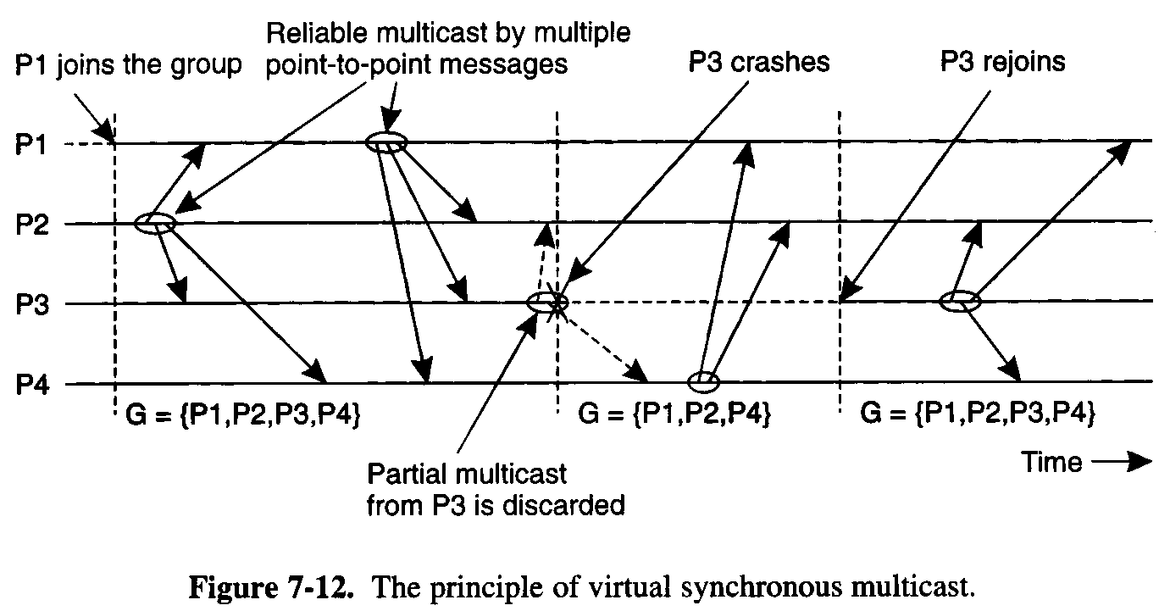

Slide 31
More Interesting GC Properties
There exists a mapping k from the set of messages appearing in all rcv_{i}(m) for all i, to the set of messages appearing in snd_{i}(m) for all i, such that each message m in a rcv() is mapped to a message with the same content appearing in an earlier snd() and:
Integrity
  k is well defined. i.e. every message received was previously sent.
No Duplicates
  k is one to one. i.e. no message is received more than once
Liveness
  k is onto. i.e. every message sent is received

Slide 32
Reliability Service
A service is reliable (in presence of f faults) if exists a partition of the object indices into faulty and non-faulty such that there are at most f faulty objects and the mapping of k must satisfy:
  Integrity
  No Duplicates
    no message is received more than once at any single object
  Liveness
    Non-faulty liveness
      When restricted to non-faulty objects, k is onto. i.e. all messages broadcast by a non-faulty object are eventually received by all non-faulty objects
    Faulty liveness
      Every message sent by a faulty object is either received by all non-faulty objects or by none of them

Slide 33
Faults and Partitions
When detecting a processor P from which we did not hear for a certain timeout, we issue a fault message
When we get a fault message, we adopt it (and issue our copy)
Problem: maybe P is only slow
When a partition occurs, we can not always completely determine who received which messages (there is no solution to this problem)

Slide 34
Extended virtual synchrony
  Failures
    Processes can fail and recover
    Networks can partition and remerge
  Virtual synchrony handles recovered processes as new processes
    Can cause inconsistencies with network partitions
  Network partitions are real
    Gateways, bridges, wireless communication
  Extended VS (introduced in Totem)
    Does not solve all the problems of recovery in fault-tolerant distributed systems, but avoids inconsistencies

Slide 35
Extended Virtual Synchrony Model
Network may partition into finite number of components
  Two or more may merge to form a larger component
Each membership with a unique identifier is a configuration.
    Membership ensures that all processes in a configuration agree on the membership of that configuration

Slide 36
Regular and Transitional Configurations
To achieve safe delivery with partitions and remerges, the EVS model defines:
  Regular Configuration
    New messages are broadcast and delivered
    Sufficient for FIFO and causal communication modes
  Transitional Configuration
    No new messages are broadcast, only remaining messages from prior regular configuration are delivered.
  Regular configuration may be followed and preceeded by several transitional configurations.

Slide 37
Configuration change
  Process in a regular or transitional configuration can deliver a configuration change message s.t.
      Follows delivery of every message in the terminated configuration and precedes delivery of every message in the new configuration.
  Algorithm for determining transitional configuration
    When a membership change is identified
      Regular conf members (that are still connected) start exchanging information
      If another membership change is spotted (e.g. failure cascade), this process is repeated all over again.
      Upon reaching a decision (on members and messages) – process delivers transitional configuration message to members with agreed list of messages.
      After delivery of all messages, new configuration is delivered.

Slide 38

Totem
Provides a Reliable totally ordered multicast service over LAN
Intended for complex applications in which fault-tolerance and soft real-time performance are critical
  High throughput and low predictable latency
  Rapid detection of, and recovery from, faults
  System wide total ordering of messages
  Scalable via hierarchical group communication
  Exploits hardware broadcast to achieve high-performance
Provides 2 delivery services
  Agreed
  Safe
Use timestamp to ensure total order and sequence numbers to ensure reliable delivery

Slide 39

ISIS
Tightly coupled distributed system developed over loosely coupled processors
Provides a toolkit mechanism for distributing programming, whereby a DS is built by interconnecting fairly conventional non-distributed programs, using tools drawn from the kit
Define
  how to create, join and leave a group
  group membership
  virtual synchrony
Initially point-to-point (TCP/IP)
Fail-stop failure model

Slide 40

Horus
Aims to provide a very flexible environment to configure group of protocols specifically adapted to problems at hand
Provides efficient support for virtual synchrony
Replaces point-to-point communication with group communication as the fundamental abstraction, which is provided by stacking protocol modules that have a uniform (upcall, downcall) interface
Not every sort of protocol blocks make sense
HCPI - Horus Common Protocol Interface for protocol composition
  Stability of messages
  membership
Electra
  CORBA-Compliant interface
  method invocation transformed into multicast

Slide 41
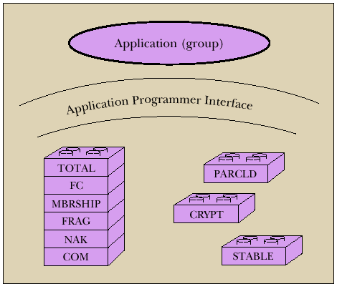

Slide 42

Transis
How different components of a partition network can operate autonomously and then merge operations when they become reconnected ?
Are different protocols for fast-local and slower-cluster communication needed ?
A large-scale multicast service designed with the following goals
  Tackling network partitions and providing tools for recovery from them
  Meeting needs of large networks through hierarchical communication
  Exploiting fast-clustered communication using IP-Multicast
Communication modes
  FIFO
  Causal
  Agreed
  Safe

Slide 43
Other Challenges
Secure group communication architecture
Formal specifications of group communication systems
Support for CSCW and multimedia applications
Dynamic Virtual Private Networks
Next Generations
  Spread
  Ensemble
  MaelStrom, Ricochet - for cloud data centers
Wireless networks
  Group based Communication with incomplete spatial coverage
  Dynamic membership
*VSync - ISIS2 (VS + Paxos) https://www.youtube.com/watch?v=3o81K1olx0Q

Slide 44
Distributed Publish/Subscribe
Nalini Venkatasubramanian
(with slides from Roberto Baldoni, Pascal Felber, Hojjat Jafarpour etc.)

Slide 45





Publish/Subscribe (pub/sub) systems
Asynchronous communication
Selective dissemination
Push model
Decoupling publishers and subscribers
What is Publish/Subscribe (pub/sub)?
Stock ( Name=‘IBM’; Price < 100 ; Volume>10000 )
Stock ( Name=‘IBM’; Price =95 ; Volume=50000 )
Pub/Sub Service
Stock ( Name=‘IBM’; Price =95 ; Volume=50000 )
Stock ( Name=‘IBM’; Price =95 ; Volume=50000 )
Stock ( Name=‘HP’; Price < 50 ; Volume >1000 )
Football( Team=‘USC’; Event=‘Touch Down’)
Stock ( Name=‘IBM’; Price < 110 ; Volume>10000 )
Hojjat Jafarpour
CCD: Efficient Customized Content Dissemination in Distributed Pub/Sub
‹#›

Slide 46





Publish/Subscribe (pub/sub) systems
Applications:
  News alerts
  Online stock quotes
  Internet games
  Sensor networks
  Location-based services
  Network management
  Internet auctions
  …
Hojjat Jafarpour
CCD: Efficient Customized Content Dissemination in Distributed Pub/Sub
‹#›

Slide 47







Publish/subscribe architectures
Centralized
  Single matching engine
  Limited scalability
Broker overlay
  Multiple P/S brokers
  Participants connected to some broker
  Events routed through overlay
Peer-to-peer
  Publishers & subscribers connected in P2P network
  Participants collectively filter/route events, can be both producer & consumer
  …….
Scalable Publish/Subscribe Architectures & Algorithms — P. Felber
‹#›

Slide 48






Distributed pub/sub systems
Broker – based pub/sub
  A set of brokers forming an overlay
    Clients use system through brokers
    Benefits
      Scalability, Fault tolerance, Cost efficiency
Dissemination Tree

Slide 49

Challenges in distributed pub/sub systems
Broker Responsibility
Subscription Management
Matching: Determining the recipients for an event
Routing: Delivering a notification to all the recipients
Broker internal operations
Subscription management
  How to store subscriptions in brokers
Content matching in brokers
  How to match a publication against subscriptions
Broker overlay architecture
How to form the broker network
How to route subscriptions and publications
‹#›

Slide 50
EVENT vs SUBSCRIPTION ROUTING
Extreme solutions
  Sol 1 (event flooding)
    flooding of events in the notification event box
    each subscription stored only in one place within the notification event box
    Matching operations equal to the number of brokers
  Sol 2 (subscription flooding)
    each subscription stored at any place within the notification event box
    each event matched directly at the broker where the event enters the notification event box
MINEMA Summer School - Klagenfurt (Austria) July 11-15, 2005
‹#›

Slide 51
Major distributed pub/sub approaches
Tree-based
  Brokers form a tree overlay [SIENA, PADRES, GRYPHON]
DHT-based:
  Brokers form a structured P2P overlay [Meghdoot, Baldoni et al.]
Channel-based:
  Multiple multicast groups [Phillip Yu et al.]
Probabilistic:
  Unstructured overlay [Picco et al.]
‹#›

Slide 52
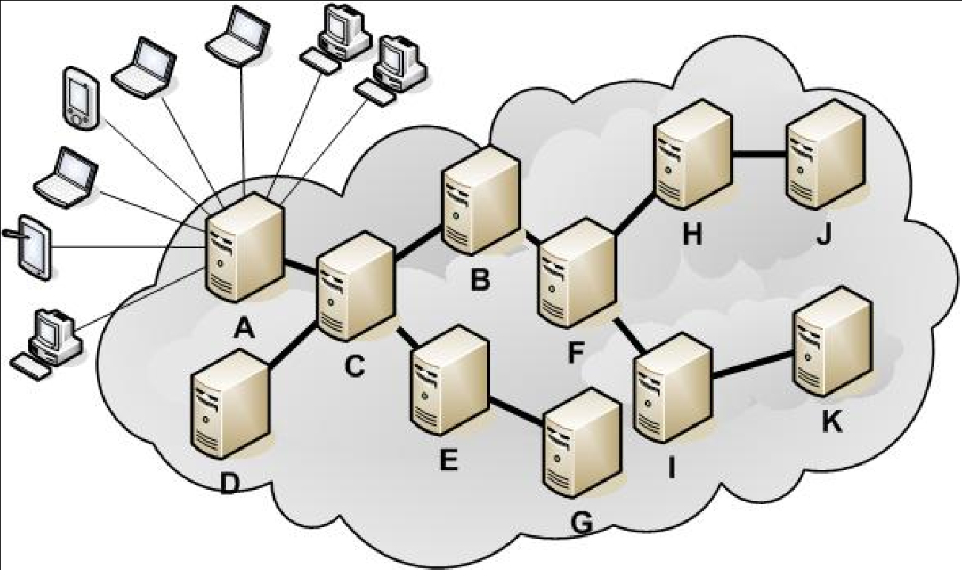
Tree-based
Brokers form an acyclic graph
Subscriptions are broadcast to all brokers
Publications are disseminated along the tree with applying subscriptions as filters
‹#›

Slide 53
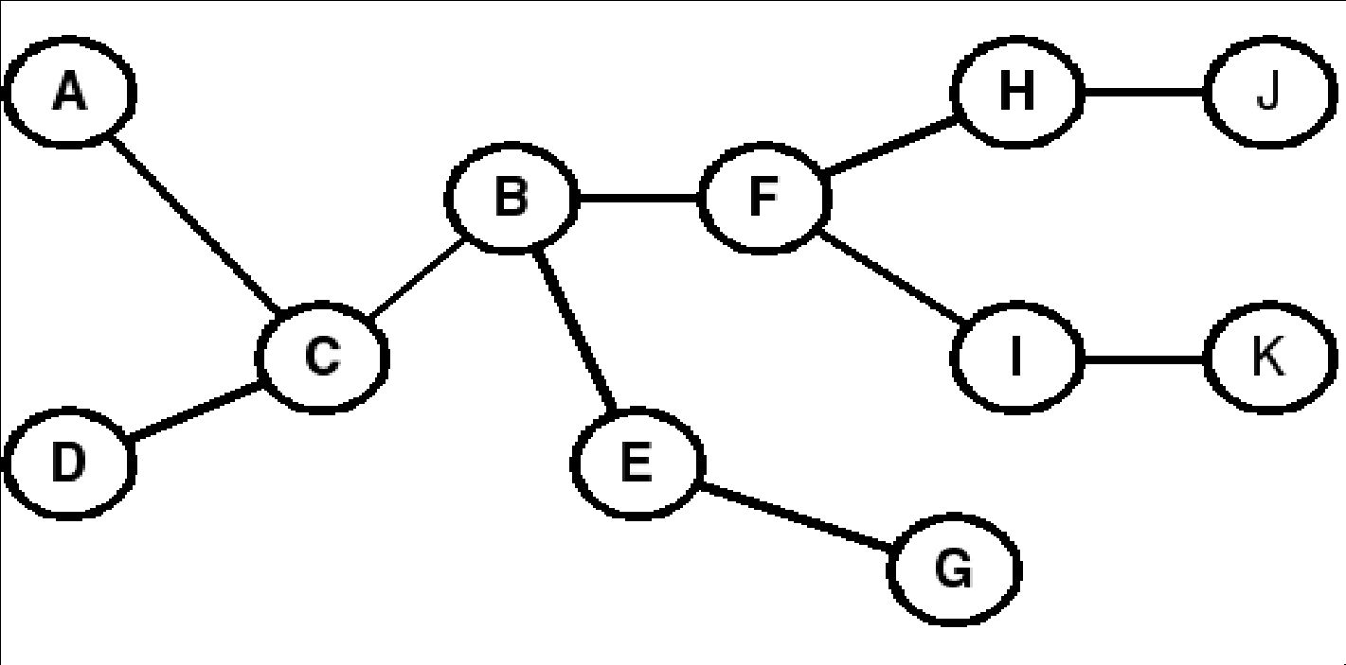
Tree-based
Subscription dissemination load reduction
  Subscription Covering
  Subscription Subsumption
Publication matching
  Index selection
‹#›

Slide 54
Pub/Sub Sysems: Tib/RV [Oki et al 03]
Topic Based
Two level hierarchical architecture of brokers (deamons) on TCP/IP
Event routing is realized through one diffusion tree per subject
Each broker knows the entire network topology and current subscription configuration
MINEMA Summer School - Klagenfurt (Austria) July 11-15, 2005
‹#›

Slide 55
Pub/Sub systems: Gryphon [IBM 00]
Content based
Hierarchical tree from publishers to subscribers
Filtering-based routing
Mapping content-based to network level multicast
MINEMA Summer School - Klagenfurt (Austria) July 11-15, 2005
‹#›

Slide 56
DHT Based Pub/Sub:
SCRIBE [Castro et al. 02]
Topic Based
Based on DHT (Pastry)
Rendez-vous event routing
A random identifier is assigned to each topic
The pastry node with the identifier closest to the one of the topic becomes responsible for that topic
MINEMA Summer School - Klagenfurt (Austria) July 11-15, 2005
‹#›

Slide 57
DHT-based pub/sub MEGHDOOT
Content Based
Based on Structured Overlay CAN
Mapping the subscription language and the event space to CAN space
Subscription and event Routing exploit CAN routing algorithms
MINEMA Summer School - Klagenfurt (Austria) July 11-15, 2005
‹#›

Slide 58
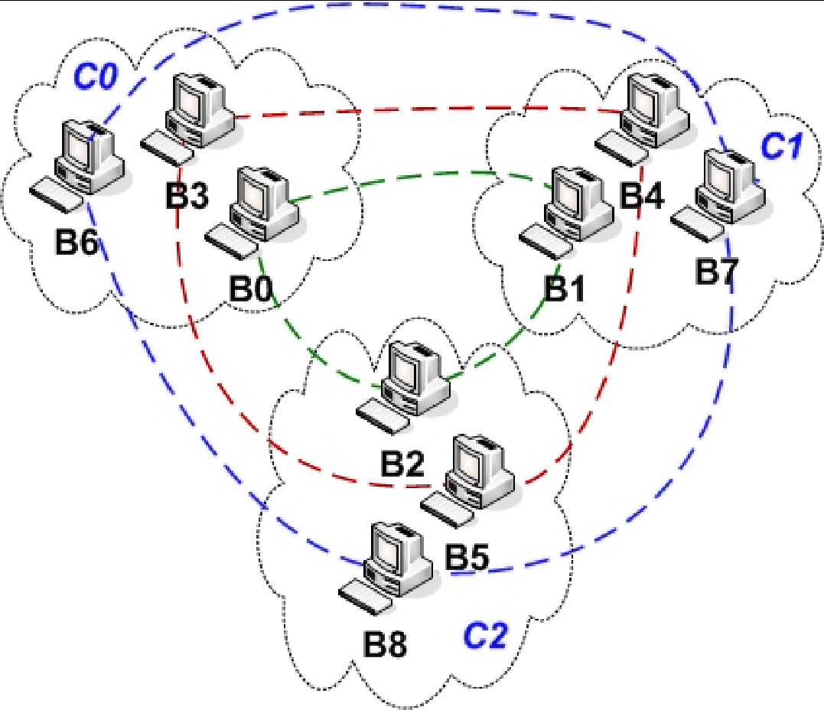
Fault-tolerance Pub/Sub architecture
Brokers are clustered
Each broker knows all brokers in its own cluster and at least one broker from every other clusters
Subscriptions are broadcast just in clusters
Every brokers just have the subscriptions from brokers in the same cluster
Subscription aggregation is done based on brokers
‹#›

Slide 59
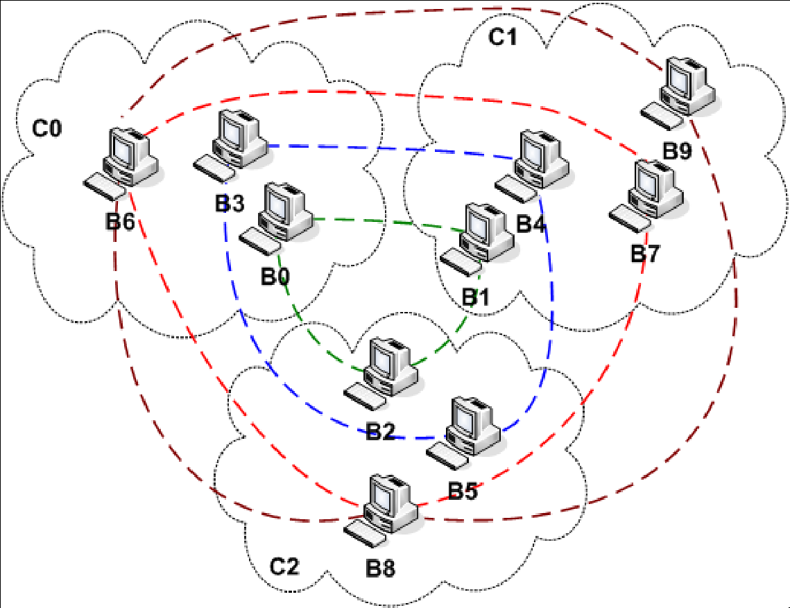
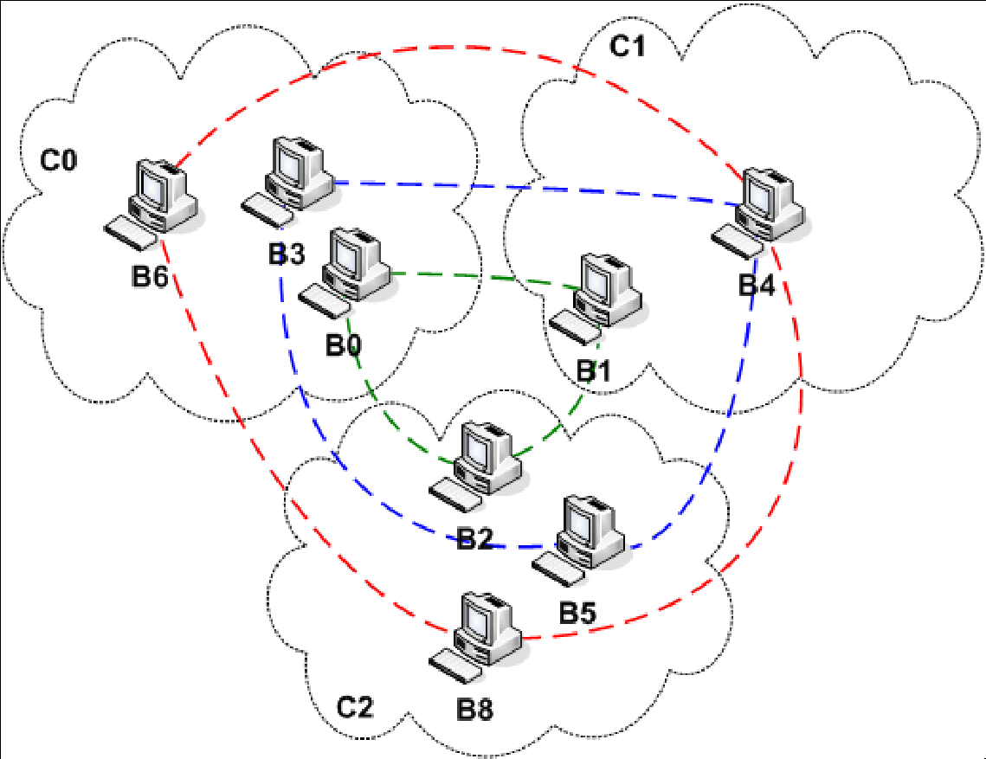
Fault-tolerance Pub/Sub architecture
Broker overlay
  Join
  Leave
  Failure
    Detection
    Masking
    Recovery
Load Balancing
  Ring publish load
  Cluster publish load
  Cluster subscription load
‹#›

Slide 60







Customized content delivery with pub/sub
Customize content to the required formats before delivery!
Español Español!!!
Hojjat Jafarpour
CCD: Efficient Customized Content Dissemination in Distributed Pub/Sub
‹#›

Slide 61
Motivation
Leveraging pub/sub framework for dissemination of rich content formats, e.g., multimedia content.
Same content format may not be consumable by all subscribers!!!
Hojjat Jafarpour
CCD: Efficient Customized Content Dissemination in Distributed Pub/Sub
‹#›

Slide 62
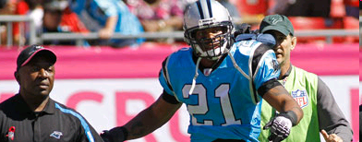


Content customization
How content customization is done?
  Adaptation operators
Original content
Size: 28MB
Transcoder
Operator
Low resolution and small
content suitable for
mobile clients
Size: 8MB
Hojjat Jafarpour
CCD: Efficient Customized Content Dissemination in Distributed Pub/Sub
‹#›

Slide 63

Challenges
How to do customization in distributed pub/sub?
Hojjat Jafarpour
CCD: Efficient Customized Content Dissemination in Distributed Pub/Sub
‹#›

Slide 64






Challenges
Option 1: Perform all the required customizations in the sender broker
28MB
28+12+8 = 48MB
28+12+8 = 48MB
8MB
15MB
8MB
12MB
8MB
12MB
28MB
15MB
28MB
8MB
8MB
Hojjat Jafarpour
CCD: Efficient Customized Content Dissemination in Distributed Pub/Sub
‹#›

Slide 65
Challenges
Option 2: Perform all the required customization in the proxy brokers (leaves)
28MB
28MB
28MB
Repeated Operator
8MB
15MB
28MB
8MB
12MB
28MB
15MB
28MB
8MB
8MB
Hojjat Jafarpour
CCD: Efficient Customized Content Dissemination in Distributed Pub/Sub
‹#›

Slide 66
Challenges
Option 3: Perform all the required customization in the broker overlay network
28MB
8MB
15MB
8MB
12MB
28MB
15MB
28MB
8MB
8MB
Hojjat Jafarpour
CCD: Efficient Customized Content Dissemination in Distributed Pub/Sub
‹#›

Slide 67



















Publisher of C
[(Shelter Info, Santa Ana, School),(Spanish,Voice)]
1130
1130
1230
Translation
Super Peer Network
RP Peer for C
1030
2130
2330
2130
Speech to text
2230
0130
0330
1330
2330
Speech to text
3130
1130
[(Shelter Information, Irvine, School), (English,Text)]
[(Shelter Information, Irvine, School), (English,Text)]
‹#›

Slide 68
Publisher of C
[(Shelter Info, Santa Ana, School),(Spanish,Voice)]
Translation
1130
1130
1230
Super Peer Network
RP Peer for C
1030
2130
2330
2130
2230
0130
0330
Speech to text
1330
2330
3130
1130
[(Shelter Information, Irvine, School), (English,Text)]
[(Shelter Information, Irvine, School), (English,Text)]
‹#›

Slide 69
Publisher of C
[(Shelter Info, Santa Ana, School),(Spanish,Voice)]
1130
1130
1230
Super Peer Network
RP Peer for C
1030
Translation
2130
2330
2130
Speech to text
2230
0130
0330
1330
2330
3130
1130
[(Shelter Information, Irvine, School), (English,Text)]
[(Shelter Information, Irvine, School), (English,Text)]
‹#›

Slide 70

DHT-based pub/sub
DHT-based routing schema,
  We use Tapestry [ZHS04]
Rendezvous
Point
Hojjat Jafarpour
CCD: Efficient Customized Content Dissemination in Distributed Pub/Sub
‹#›

Slide 71
Example using DHT based pub-sub
Tapestry (DHT-based) pub/sub and routing framework
  Event space is partitioned among peers
    Single content matching
  Each partition is assigned to a peer (RP)
  Publications and subscriptions are matched in RP
    All receivers and preferences are detected after matching
  Content dissemination among matched subscribers are done through a dissemination tree rooted at RP where leaves are subscribers.
‹#›

Slide 72
Videos..
Twitter experiences
https://www.youtube.com/watch?v=zwo3ipH4LZU

Slide 73
Extra Slides

Slide 74
Details on GC and P/S systems

Slide 75
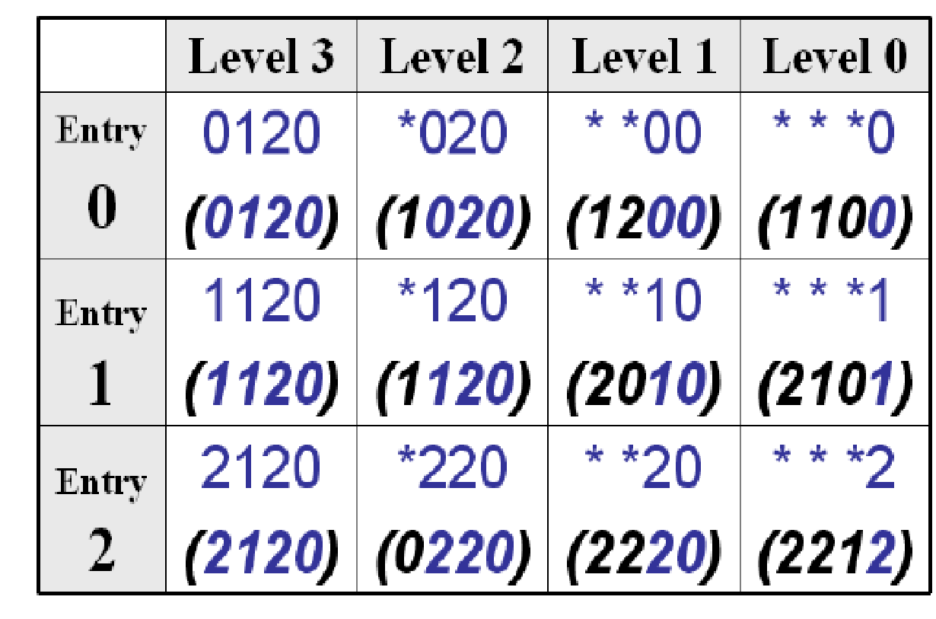
CCD: Customized Content Dissemination in Pub/Sub
Tapestry DHT-based overlay
  Each node has a unique L-digit ID in base B
  Each node has a neighbor map table (LxB)
  Routing from one node to another node is done by resolving one digit in each step
  Sample routing map table for 2120
‹#›

Slide 76
Dissemination tree
For a published content we can estimate the dissemination tree in broker overlay network
  Using DHT-based routing properties
  The dissemination tree is rooted at the corresponding rendezvous broker
Rendezvous
Point
Hojjat Jafarpour
CCD: Efficient Customized Content Dissemination in Distributed Pub/Sub
‹#›

Slide 77
Subscriptions in CCD
Subscription:
Team: USC
Video: Touch Down
How to specify required formats?
Receiving context:
  Receiving device capabilities
    Display screen, available software,…
  Communication capabilities
    Available bandwidth
  User profile
    Location, language,…
Context: PC, DSL, AVI
Subscription:
Team: USC
Video: Touch Down
Context: Phone, 3G, FLV
Subscription:
Team: USC
Video: Touch Down
Context: Laptop, 3G, AVI,
Spanish subtitle
Hojjat Jafarpour
CCD: Efficient Customized Content Dissemination in Distributed Pub/Sub
‹#›

Slide 78

Content Adaptation Graph (CAG)
All possible content formats in the system
All available adaptation operators in the system
Size: 28MB
Frame size: 1280x720
Frame rate: 30
Size: 15MB
Frame size: 704x576
Frame rate: 30
Size: 8MB
Frame size: 128x96
Frame rate: 30
Size: 10MB
Frame size: 352x288
Frame rate: 30
Hojjat Jafarpour
CCD: Efficient Customized Content Dissemination in Distributed Pub/Sub
‹#›

Slide 79



Content Adaptation Graph (CAG)
A transmission (communication) cost is associated with each format
  Sending content in format F_{i} from a broker to another one has the transmission cost of
A computation cost is associated with each operator
  Performing operator O_{(i,j)} on content has the computation cost of
F₁/28
  V={F₁,F₂,F₃,F₄}
  E={O_{(1,2)},O_{(1,3)},O_{(1,4)},O_{(2,3)},O_{(2,4)},O_{(3,4)}}
60
60
60
F₂/15
25
F₃/12
25
F₄/8
25
Hojjat Jafarpour
CCD: Efficient Customized Content Dissemination in Distributed Pub/Sub
‹#›

Slide 80
CCD plan
A CCD plan for a content is the dissemination tree:
  Each node (broker) is annotated with the operator(s) that are performed on it
  Each link is annotated with the format(s) that are transmitted over it
{O_{(1,2)},O_{(2,4)}}
F₁/28
{F₂}
{F₂}
{F₄}
60
60
60
{}
{O_{(2,3)}}
{}
F₂/15
25
F₃/12
25
F₄/8
{F₂}
{F₃}
{F₄}
25
{}
{}
{}
Hojjat Jafarpour
CCD: Efficient Customized Content Dissemination in Distributed Pub/Sub
‹#›

Slide 81
CCD algorithm
Input:
  A dissemination tree
  A CAG
  The initial format
  Requested formats by each broker
Output:
  The minimum cost CCD plan
Hojjat Jafarpour
CCD: Efficient Customized Content Dissemination in Distributed Pub/Sub
‹#›

Slide 82
CCD Problem is NP-hard
Directed Steiner tree problem can be reduced to CCD
  Given a directed weighted graph G(V,E,w) , a specified root r and a subset of its vertices S, find a tree rooted at r of minimal weight which includes all vertices in S.
Hojjat Jafarpour
CCD: Efficient Customized Content Dissemination in Distributed Pub/Sub
‹#›

Slide 83
CCD algorithm
Based on dynamic programming
Annotates the dissemination tree in a bottom-up fashion
For each broker:
  Assume all the optimal sub plans are available for each child
  Find the optimal plan for the broker accordingly
N_{i}
….
N_{j}
N_{k}
Hojjat Jafarpour
CCD: Efficient Customized Content Dissemination in Distributed Pub/Sub
‹#›

Slide 84
CCD algorithm
F₁
F₁/28
F₂
60
F₄
60
60
F₂/15
25
F₃/12
25
F₄/8
F₄
F₄
F₃
F₁
F₂
F₁
25
Hojjat Jafarpour
CCD: Efficient Customized Content Dissemination in Distributed Pub/Sub
‹#›

Slide 85
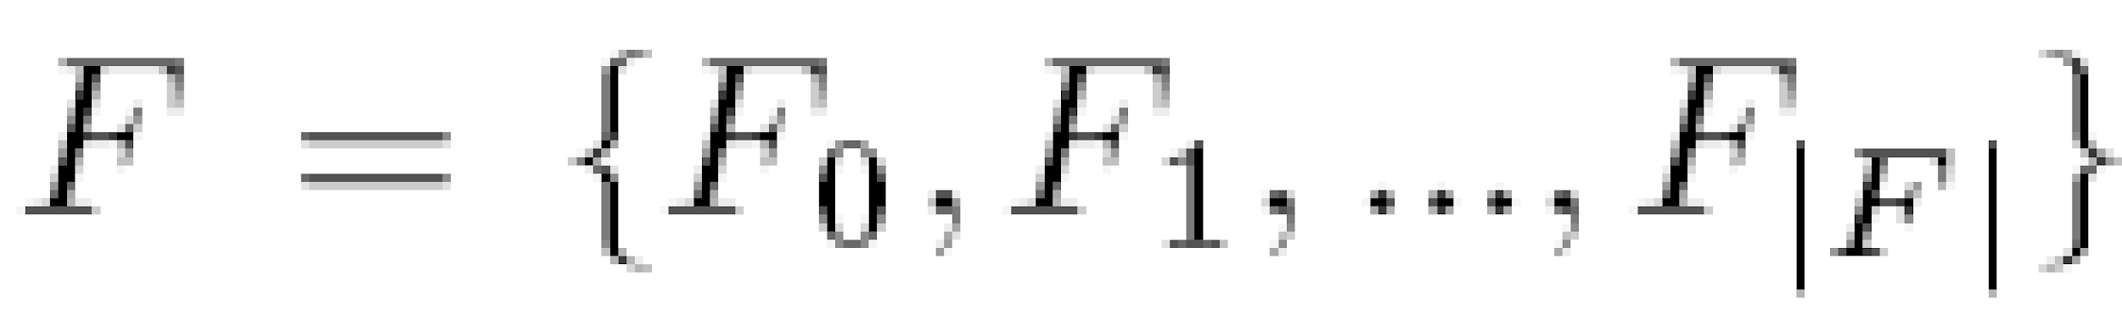



System model
Set of supported formats and communication cost for transmitting content in each format
Set of operators with cost of performing each operator
Operators are available is all brokers
‹#›

Slide 86

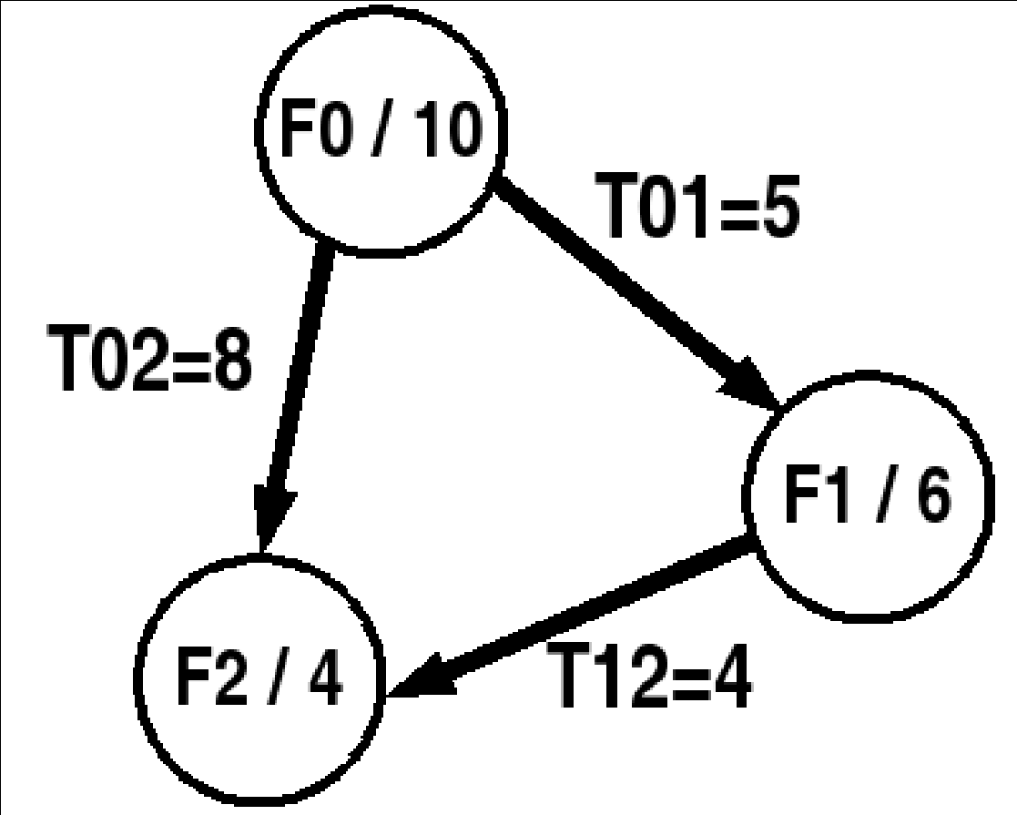
System model
Content Adaptation Graph
  Represents available formats and operators and their relation
  G = (V , E) where V = F and E = O FxF
Optimal content adaptation is NP-Hard
  Steiner tree problem
For a given CAG and dissemination tree, , find CCD plan with minimum total cost.
‹#›

Slide 87
System model
Subscription model:
  [S_{C},S_{F} ] where S_{C} is the content subscription and S_{F} corresponds to the format in which the matching publication is to be delivered.
    S=[{S_{C}:Type = ’image’, Location = ’Southern California’, Category = ’Wild Fire’},{Format = ’PDA-Format’}]
Publication model:
  A publication P = [P_{C},P_{F} ] also consists of two parts. P_{C} contains meta data about the content and the content itself. The second part represents the format of the content.
    [{Location = ’Los Angeles County’ , Category =’Fire,Wildfire, Burning’, image},{Format = ’PC-Format’}]
‹#›

Slide 88

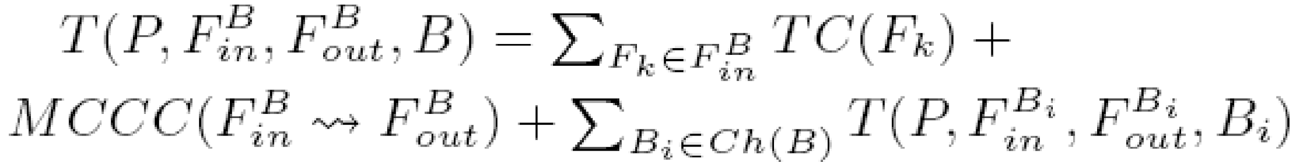
Customized dissemination in homogeneous overlay
Optimal operator placement
  Results in minimum dissemination cost
  Needs to know the dissemination tree for the published content
  Assumes small adaptation graphs (Needs enumeration of different subsets of formats)
Observation:
  If B is a leaf in dissemination tree
  Otherwise
‹#›

Slide 89
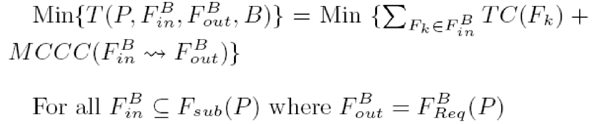
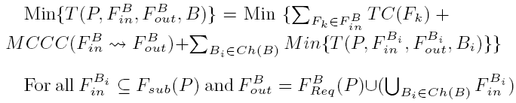
Customized dissemination in homogeneous overlay
The minimum cost for customized dissemination tree in node B is computed as follow.
  If B is a leaf in the dissemination tree then
  Otherwise
‹#›

Slide 90
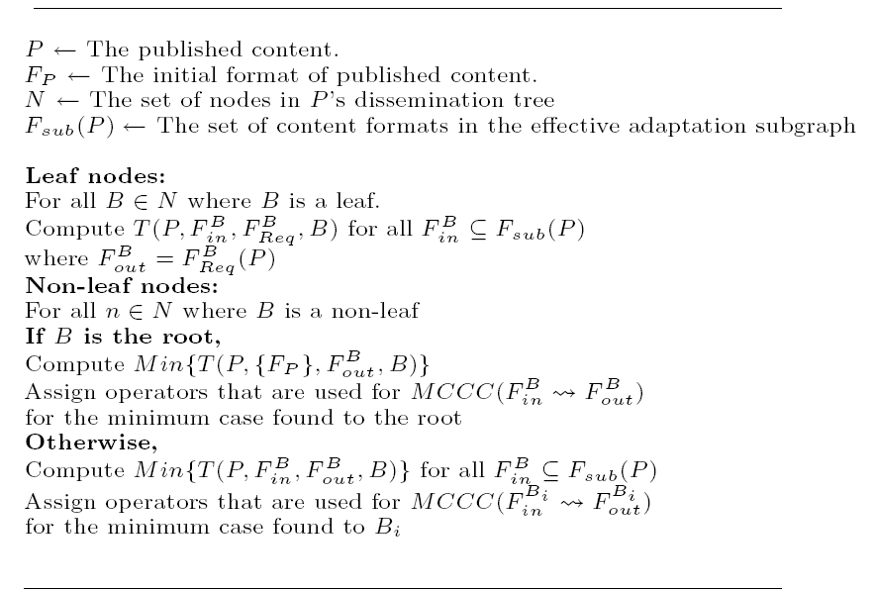
Operator placement in homogeneous overlay
Optimal operator placement
‹#›

Slide 91
Experimental evaluation
Implemented scenarios
  Homogeneous overlay
    Optimal
    Only root
    TRECC
    All in root
    All in leaves
  Heterogeneous
    Optimal
    All in root
    All in leaves
‹#›

Slide 92
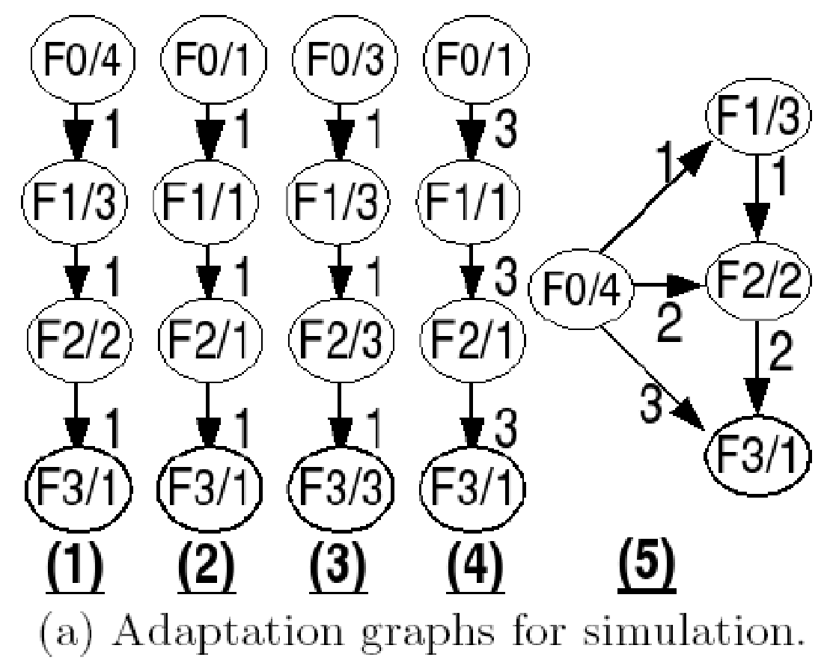
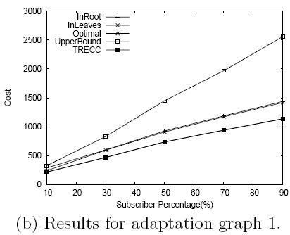
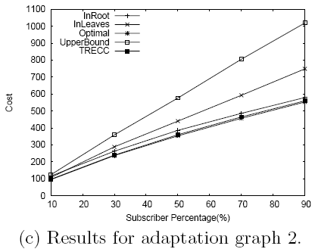
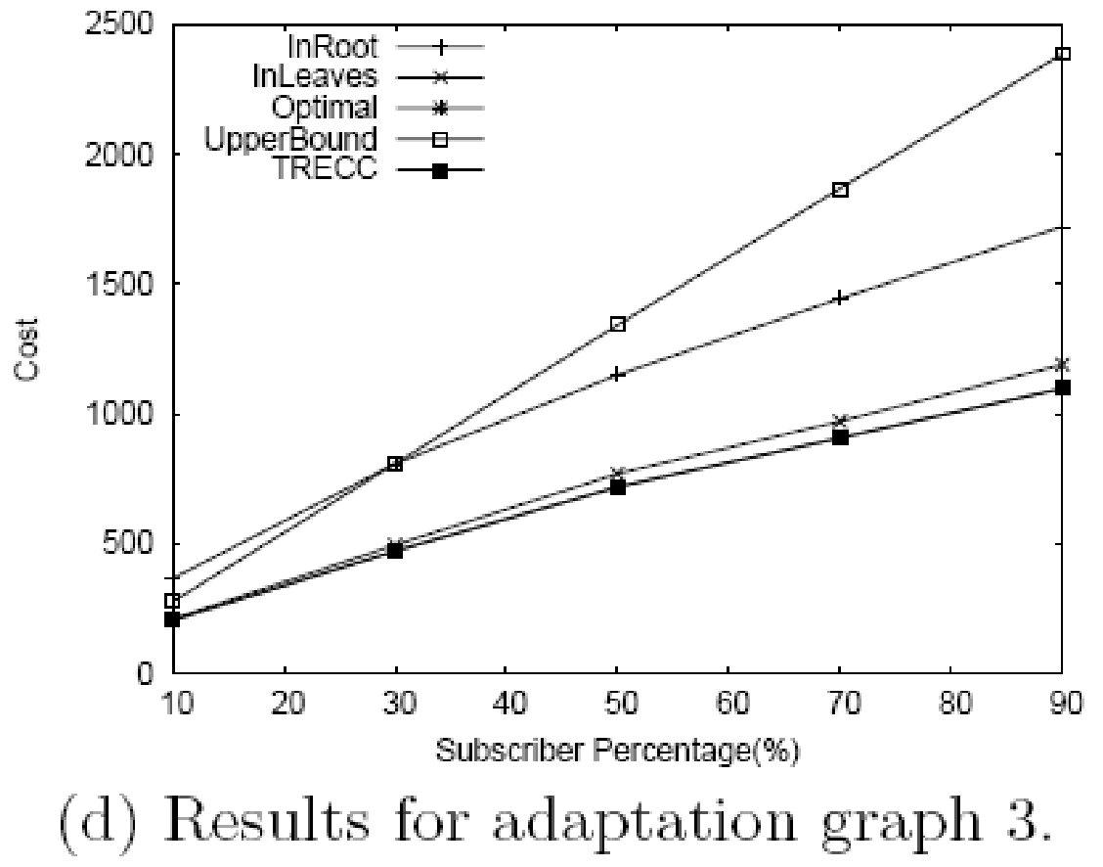
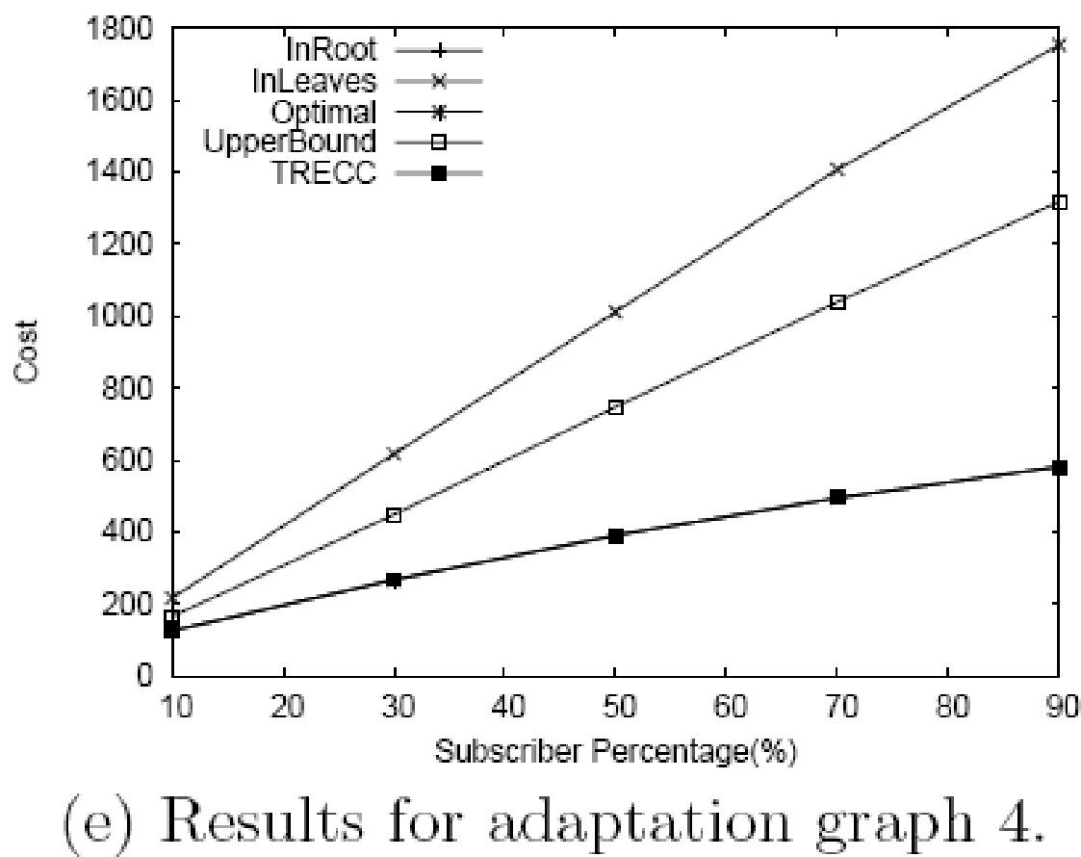
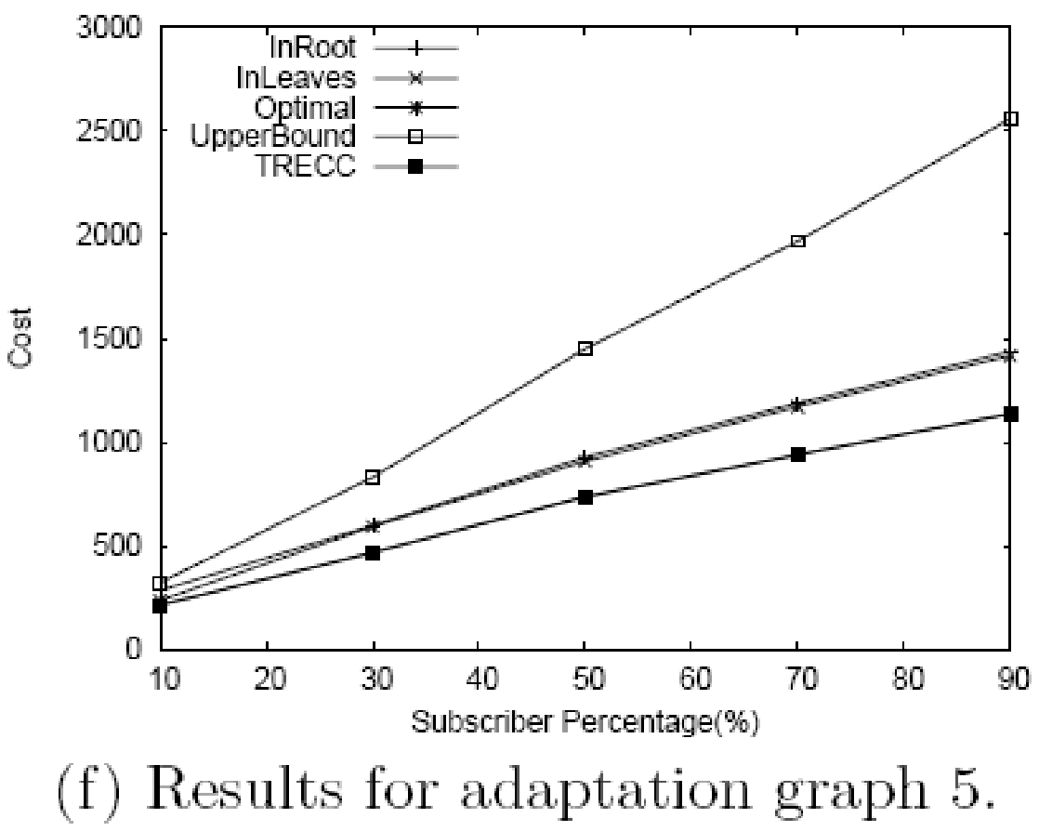
Experimental evaluation
‹#›

Slide 93
Extensions
Extending the CAG to represent parameterized adaption
Heuristics for larger CAGs and parameterized adaptations
‹#›

Slide 94
Fast and scalable notification using Pub/Sub
A general purpose notification system
  On line deals, news, traffic, weather,…
Supporting heterogeneous receivers
User Profile
Pub/Sub
Server
Web
Client
User Subscriptions
Notifications
‹#›

Slide 95
User profile
Personal information
  Name
  Location
  Language
Receiving modality
  PC, PDA
    Email
    Live notification
    IM (Yahoo Messenger, Google Talk, AIM, MSN)
  Cell phone
    SMS
    Call
‹#›

Slide 96
Subscription
Subscription language in the system
  SQL
Subscriptions language for clients
  Attribute value
    E.g.,
      Website = www.dealsea.com
      Keywords = Laptop, Notebook
      Price <= $1000
      Brand = Dell, HP, Toshiba, SONY
‹#›

Slide 97
Notifications
Customized for the receiving device
Includes
  Title
  URL
  Short description
  May include multimedia content too.
‹#›

Slide 98
Client application
A stand alone java-based client
  JMS client for communications
  Must support many devices
‹#›

Slide 99
Experimental evaluation
System setup
  1024 brokers
  Matching ratio: percentage of brokers with matching subscription for a published content
    Zipf and uniform distributions
  Communication and computation costs are assigned based on profiling
Hojjat Jafarpour
CCD: Efficient Customized Content Dissemination in Distributed Pub/Sub
‹#›
‹#›

Slide 100
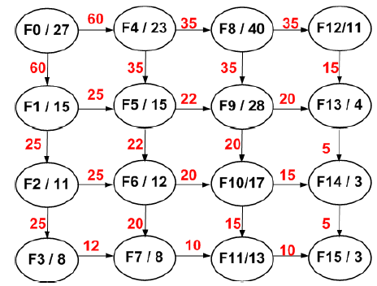
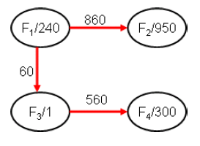
Experimental evaluation
Dissemination scenarios
  Annotated map
  Customized video dissemination
  Synthetic scenarios
Hojjat Jafarpour
CCD: Efficient Customized Content Dissemination in Distributed Pub/Sub
‹#›
‹#›

Slide 101
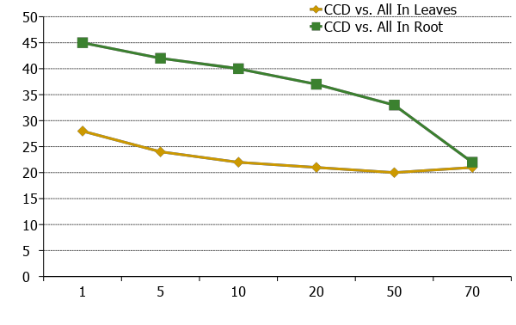
Cost reduction in CCD algorithm
Cost reduction percentage (%)
Matching Ratio
Hojjat Jafarpour
CCD: Efficient Customized Content Dissemination in Distributed Pub/Sub
‹#›

Slide 102
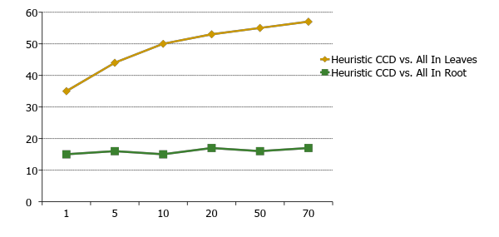
Cost reduction in Heuristic CCD
Cost reduction percentage (%)
Matching Ratio
Hojjat Jafarpour
CCD: Efficient Customized Content Dissemination in Distributed Pub/Sub
‹#›

Slide 103
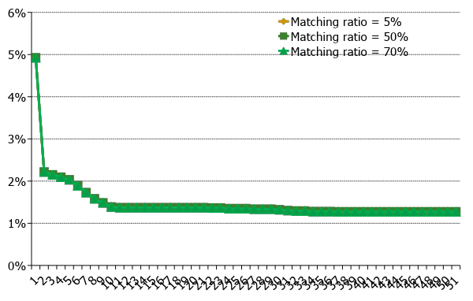
CCD vs. heuristic CCD
Cost reduction percentage (%)
Iteration number
Hojjat Jafarpour
CCD: Efficient Customized Content Dissemination in Distributed Pub/Sub
‹#›

Slide 104
References
[AT06] Ioannis Aekaterinidis, Peter Triantafillou: PastryStrings: A Comprehensive Content-Based Publish/Subscribe DHT Network. IEEE ICDCS 2006.
[CRW04] A. Carzaniga, M.J. Rutherford, and A.L. Wolf: A Routing Scheme for Content-Based Networking. IEEE INFOCOM 2004.
[DRF04] Yanlei Diao, Shariq Rizvi, Michael J. Franklin: Towards an Internet-Scale XML Dissemination Service. VLDB 2004.
[GSAE04] Abhishek Gupta, Ozgur D. Sahin, Divyakant Agrawal, Amr El Abbadi: Meghdoot: Content-Based Publish/Subscribe over P2P Networks. ACM Middleware 2004
[JHMV08] Hojjat Jafarpour, Bijit Hore, Sharad Mehrotra and Nalini Venkatasubramanian. Subscription Subsumption Evaluation for Content-based Publish/Subscribe Systems, ACM/IFIP/USENIX Middleware 2008.
[JHMV09] Hojjat Jafarpour, Bijit Hore, Sharad Mehrotra and Nalini Venkatasubramanian.CCD: Efficient Customized Content Dissemination in Distributed Publish/Subscribe. ACM/IFIP/USENIX Middleware 2009.
[JMV08] Hojjat Jafarpour, Sharad Mehrotra and Nalini Venkatasubramanian. A Fast and Robust Content-based Publish/Subscribe Architecture, IEEE NCA 2008.
[JMV09] Hojjat Jafarpour, Sharad Mehrotra and Nalini Venkatasubramanian.Dynamic Load Balancing for Cluster-based Publish/Subscribe System, IEEE SAINT 2009.
[JMVM09] Hojjat Jafarpour, Sharad Mehrotra, Nalini Venkatasubramanian and Mirko Montanari, MICS: An Efficient Content Space Representation Model for Publish/Subscribe Systems, ACM DEBS 2009.
[OAABSS00] Lukasz Opyrchal, Mark Astley, Joshua S. Auerbach, Guruduth Banavar, Robert E. Strom, Daniel C. Sturman: Exploiting IP Multicast in Content-Based Publish-Subscribe Systems. Middleware 2000.
[ZHS04] Ben Y. Zhao, Ling Huang, Jeremy Stribling, Sean C. Rhea, Anthony D. Joseph, John Kubiatowicz: Tapestry: a resilient global-scale overlay for service deployment. IEEE Journal on Selected Areas in Communications 22(1).
Hojjat Jafarpour
CCD: Efficient Customized Content Dissemination in Distributed Pub/Sub
‹#›

Slide 105
Horus
A Flexible Group Communication Subsystem

Slide 106
Horus: A Flexible Group Communication System
Flexible group communication model to application developers.
  System interface
  Properties of Protocol Stack
  Configuration of Horus
    Run in userspace
    Run in OS kernel/microkernel

Slide 107
Architecture
Central protocol => Lego Blocks
Each Lego block implements a communication feature.
Standardized top and bottom interface (HCPI)
  Allow blocks to communicate
  A block has entry points for upcall/downcall
  Upcall=receive mesg, Downcall=send mesg.
Create new protocol by rearranging blocks.

Slide 109
Message_send
Lookup the entry in topmost block and invokes the function.
Function adds header
Message_send is recursively sent down the stack
Bottommost block invokes a driver to send message.

Slide 110
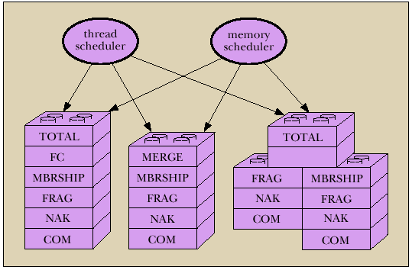
Each stack shielded from each other.
Have own threads and memory scheduler.

Slide 111
Endpoints, Group, and Message Objects
Endpoints
  Models the communicating entity
  Have address (used for membership), send and receive messages
Group
  Maintain local state on an endpoint.
  Group address: to which message is sent
  View: List of destination endpoint addr of accessible group members
Message
  Local storage structure
  Interface includes operation pop/push headers
  Passed by reference

Slide 112
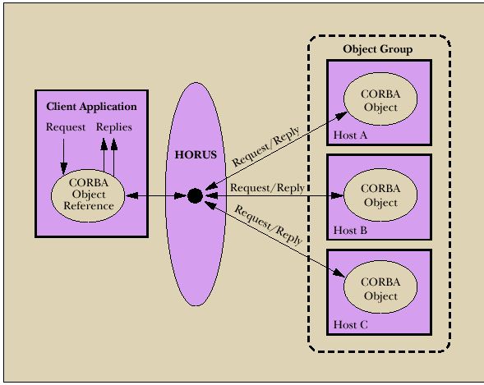
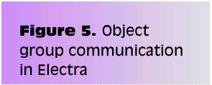

Slide 113
Transis
A Group Communication Subsystem

Slide 114
Transis : Group Communication System
Network partitions and recovery tools.
  Multiple disconnected components in the network operate autonomously.
  Merge these components upon recovery.
Hierachical communication structure.
Fast cluster communication.

Slide 115
Systems that depend on primary component:
Isis System: Designate 1 component as primary and shuts down non-primary.
  Period before partition detected, non-primaries can continue to operate.
  Operations are inconsistent with primary
Trans/Total System and Amoeba:
  Allow continued operations
  Inconsistent Operations may occur in different parts of the system.
  Don’t provide recovery mechanism

Slide 116
Group Service
Work of the collection of group modules.
Manager of group messages and group views
A group module maintains
  Local View: List of currently connected and operational participants
  Hidden View: Like local view, indicated the view has failed but may have formed in another part of the system.

Slide 117
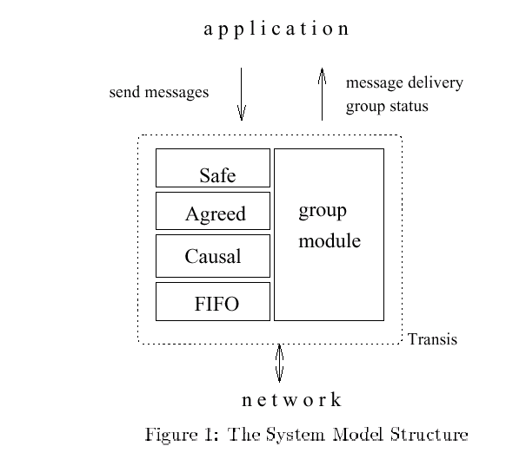

Slide 118
Network partition wishlist
At least one component of the network should be able to continue making updates.
Each machine should know about the update messages that reached all of the other machines before they were disconnected.
Upon recovery, only the missing messages should be exchanged to bring the machines back into a consistent state.

Slide 119
Transis supports partition
Not all applications progress is dependent on a primary component.
In Transis, local views can be merged efficiently.
  Representative replays messages upon merging.
Support recovering a primary component.
  Non-primary can remain operational and wait to merge with primary
  Non-primary can generate a new primary if it is lost.
    Members can totally-order past view changes events. Recover possible loss.
    Transis report Hidden-views.

Slide 120
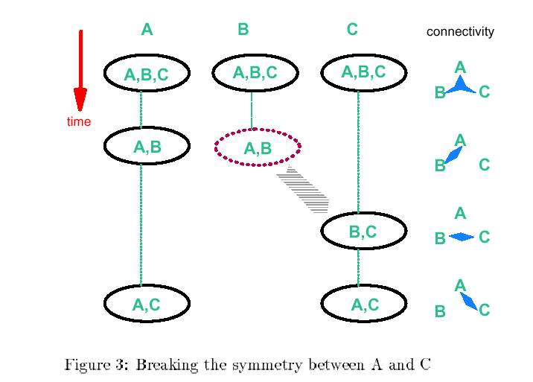

Slide 121
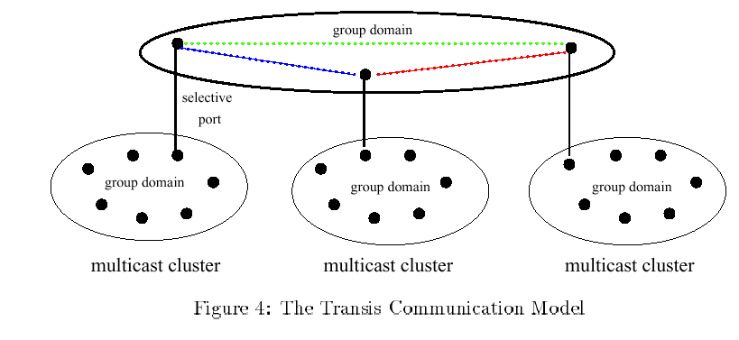
Hierarchical Broadcast

Slide 122

Reliable Multicast Engine
In system that do not lose messages often
  Use negative-ack
    Messages not retransmitted
    Positive ack are piggybacked into regular mesg
Detection of lost messages detected ASAP
Under high network traffic, network and underlying protocol is driven to high loss rate.

Slide 123
Group Communication as an Infrastructure for Distributed System Management
Table Management
  User accounts, network tables
Software Installation and Version Control
  Speed up installation, minimize latency and network load during installation
Simultaneous Execution
  Invoke same commands on several machines

Slide 124
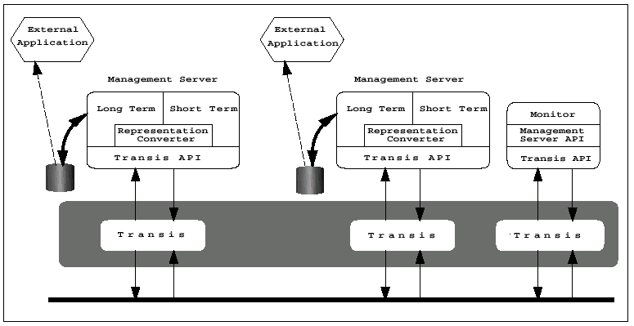

Slide 125
Management Server API
Status: Return status of server and its host machines
Chdir: Change the server’s working directory
Simex: Execute a command simultaneously
Siminist: Install a software package
Update-map: Update map while preserving consistency between replicas
Query-map: Retrieve information from the map
Exit: Terminate the management server process.

Slide 126
Simultaneous Execution
Identical management command on many machines.
  Activate a daemon, run a script
Management Server maintains
  Set M: most recent membership of the group reported by transis
  Set NR: set of currently connected servers not yet reported the outcome of a command execution to the monitor

Slide 127
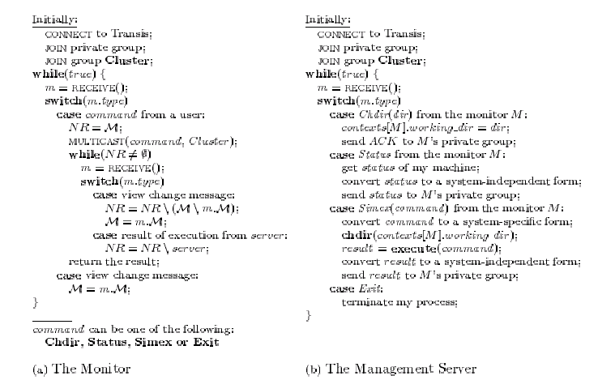

Slide 128
Software Installation
Transis disseminate files to group members.
  Monitor multicasts a msg advertising
    package P
    set of installation requirements Rp
    installation multicast group Gp
    target list Tp.
  Management server joins Gp if belongs to Rp and Tp.
  Status of all Management server reported to Monitor
Use technique in “Simultaneous Execution” to execute installation commands.

Slide 129
Table Management
Consistent management of replicated network tables.
Servers sharing replicas of tables form Service Group
1 Primary Server
  Enforces total order of update mesg
  If network partition, one component (containing Primary) can perform updates

Slide 130
Questions...
Could provide tolerance for malicious intrusion
  Many mechanisms for enforcing security policy in distributed systems rely on trusted nodes
  While no single node need to be fully trusted, the function performed by the group can be
Problems
  Network partitions and re-merges
  Messages omissions and delays
  Communication primitives available in distributed systems are too weak (i.e. there is no guarantee regarding ordering or reliability)
How can we achieve group communication ?
  Extending point-to-point networks

Slide 131
From Group Communication to Transactions...
Adequate group communication can support a specific class of transactions in asynchronous distributed systems
Transaction is a sequence of operations on objects (or on data) that satisfies
  Atomicity
  Permanence
  Ordering
Group for fault-tolerance
  Share common state
  Update of the common state requires
    Delivery permanence (majority agreement)
    All-or-none delivery (multicast to multiple groups)
    Ordered delivery (serializability of multiples groups)
Transactions-based on group communication primitives represents an important step toward extending the power and generality of GComm

