Slide 1
Distributed Operating Systems - Introduction
Prof. Nalini Venkatasubramanian
(includes slides borrowed from Prof. Petru Eles, lecture slides from Coulouris, Dollimore and Kindberg textbook)

Slide 2
What does an OS do?
Process/Thread Management
  Scheduling
  Communication
  Synchronization
Memory Management
Storage Management
FileSystems Management
Protection and Security
Networking

Slide 3
Distributed Operating Systems
Manages a collection of independent computers and makes them appear to the users of the system as if it were a single computer
Multiprocessors
  Tightly coupled
  Shared memory
Multicomputers
  Loosely coupled
  Private memory
  Autonomous
CPU
Memory
CPU
CPU
CPU
CPU
Memory
Memory
Memory
Cache
Cache
Parallel Architecture
Distributed Architecture

Slide 4
Workstation Model
How to find an idle workstation?
How is a process transferred from one workstation to another?
What happens to a remote process if a user logs onto a workstation that was idle, but is no longer idle now?
Other models - processor pool, workstation server...
ws1
ws5
ws2
Communication Network
ws3
ws4

Slide 5
Distributed Operating System (DOS) Types
Distributed OSs vary based on
    System Image
    Autonomy
    Fault Tolerance Capability
Multiprocessor OS
    Looks like a virtual uniprocessor, contains only one copy of the OS, communicates via shared memory, single run queue
Network OS
    Does not look like a virtual uniprocessor, contains n copies of the OS, communicates via shared files, n run queues
Distributed OS
    Looks like a virtual uniprocessor (more or less), contains n copies of the OS, communicates via messages, n run queues

Slide 6
Design Issues
Transparency
Performance
Scalability
Reliability
Flexibility (Micro-kernel architecture)
  IPC mechanisms, memory management, Process management/scheduling, low level I/O
Heterogeneity
Security

Slide 7
Design Issues (cont.)
Transparency
  Location transparency
    processes, cpu’s and other devices, files
  Replication transparency (of files)
  Concurrency transparency
    (user unaware of the existence of others)
  Parallelism
    User writes serial program, compiler and OS do the rest
Performance
  Throughput - response time
  Load Balancing (static, dynamic)
  Communication is slow compared to computation speed
    fine grain, coarse grain parallelism

Slide 8
Design Elements
Process Management
  Task Partitioning, allocation, synchronization, load balancing, migration
Communication
  Two basic IPC paradigms used in DOS
    Message Passing (RPC) and Shared Memory
  synchronous, asynchronous
FileSystems
  Naming of files/directories
  File sharing semantics
  Caching/update/replication

Slide 9
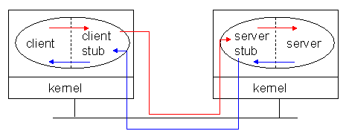
Remote Procedure Call
A convenient way to construct a client-server connection without explicitly writing send/ receive type programs (helps maintain transparency).
Ideas initiated by RFCs in the 70s
Landmark paper by Birrell and Nelson in 1980’s
Basis of 2 tier client/server systems

Slide 10
Remote Procedure Calls (RPC)
General message passing model for execution of remote functionality.
  Provides programmers with a familiar mechanism for building distributed applications/systems
Familiar semantics (similar to LPC)
  Simple syntax, well defined interface, ease of use, generality and IPC between processes on same/different machines.
It is generally synchronous
Can be made asynchronous by using multi-threading
Caller Process
Request Message
(contains Remote
Procedure’s parameters)
Receive request
(procedure
executes)
Send reply and
wait
For next message
Resume
Execution
Reply Message
( contains result of procedure
execution)

Slide 11
RPC Needs and challenges
Needs – Syntactic and Semantic Transparency
  Resolve differences in data representation
  Support a variety of execution semantics
  Support multi-threaded programming
  Provide good reliability
  Provide independence from transport protocols
  Ensure high degree of security
  Locate required services across networks
Challenges
  Unfortunately achieving exactly the same semantics for RPCs and LPCs is close to impossible
    Disjoint address spaces
    More vulnerable to failure
    Consume more time (mostly due to communication delays)

Slide 12
Implementing RPC Mechanism
Uses the concept of stubs; A perfectly normal LPC abstraction by concealing from programs the interface to the underlying RPC
Involves the following elements
  The client
  The client stub
  The RPC runtime
  The server stub
  The server

Slide 13
RPC – How it works II
client process
server process
client
procedure call
server
procedure
dispatcher
selects stub
server stub
(un)marshal
(de)serialize
receive (send)
client stub
locate
(un)marshal
(de)serialize
send (receive)
communication module
communication module
Wolfgang Gassler, Eva Zangerle

Slide 14
Remote Procedure Call (cont.)
Client procedure calls the client stub in a normal way
Client stub builds a message and traps to the kernel
Kernel sends the message to remote kernel
Remote kernel gives the message to server stub
Server stub unpacks parameters and calls the server
Server computes results and returns it to server stub
Server stub packs results in a message and traps to kernel
Remote kernel sends message to client kernel
Client kernel gives message to client stub
Client stub unpacks results and returns to client

Slide 15
RPC - binding
Static binding
  hard coded stub
    Simple, efficient
    not flexible
  stub recompilation necessary if the location of the server changes
  use of redundant servers not possible
Dynamic binding
  name and directory server
    load balancing
  IDL used for binding
  flexible
  redundant servers possible

Slide 16
RPC - dynamic binding
client process
server process
client
procedure call
server
procedure
3
13
11
10
client stub
bind
(un)marshal
(de)serialize
Find/bind
send
receive
8
server stub
register
(un)marshal
(de)serialize
receive
send
communication module
1
communication module
dispatcher
selects stub
12
4
9
7
12
12
5
6
2
name and directory server
Wolfgang Gassler, Eva Zangerle

Slide 17
RPC - Extensions
conventional RPC: sequential
execution of routines
client blocked until response of server
asynchronous RPC – non blocking
  client has two entry points(request and response)
  server stores result in shared memory
  client picks it up from there

Slide 18
RPC servers and protocols…
RPC Messages (call and reply messages)
Server Implementation
  Stateful servers
  Stateless servers
Communication Protocols
  Request(R)Protocol
  Request/Reply(RR) Protocol
  Request/Reply/Ack(RRA) Protocol
RPC Semantics
  At most once (Default)
  Idempotent: at least once, possibly many times
  Maybe semantics - no response expected (best effort execution)

Slide 19
How Stubs are Generated
Through a compiler
  e.g. DCE/CORBA IDL – a purely declarative language
  Defines only types and procedure headers with familiar syntax (usually C)
It supports
  Interface definition files (.idl)
  Attribute configuration files (.acf)
Uses Familiar programming language data typing
Extensions for distributed programming are added

Slide 20
RPC - IDL Compilation - result
development
environment
client process
server process
IDL
client code
IDL
sources
server code
language specific call interface
IDL compiler
language specific call interface
client stub
server stub
interface
headers
Wolfgang Gassler, Eva Zangerle

Slide 21
RPC NG: DCOM & CORBA
Object models allow services and functionality to be called from distinct processes
DCOM/COM+(Win2000) and CORBA IIOP extend this to allow calling services and objects on different machines
More OS features (authentication,resource management,process creation,…) are being moved to distributed objects.

Slide 22
Sample RPC Middleware Products
JaRPC (NC Laboratories)
  libraries and development system provides the tools to develop ONC/RPC and extended .rpc Client and Servers in Java
powerRPC (Netbula)
  RPC compiler plus a number of library functions. It allows a C/C++ programmer to create powerful ONC RPC compatible client/server and other distributed applications without writing any networking code.
Oscar Workbench (Premier Software Technologies)
  An integration tool. OSCAR, the Open Services Catalog and Application Registry is an interface catalog. OSCAR combines tools to blend IT strategies for legacy wrappering with those to exploit new technologies (object oriented, internet).
NobleNet (Rogue Wave)
  simplifies the development of business-critical client/server applications, and gives developers all the tools needed to distribute these applications across the enterprise. NobleNet RPC automatically generates client/server network code for all program data structures and application programming interfaces (APIs)— reducing development costs and time to market.
NXTWare TX (eCube Systems)
  Allows DCE/RPC-based applications to participate in a service-oriented architecture. Now companies can use J2EE, CORBA (IIOP) and SOAP to securely access data and execute transactions from legacy applications. With this product, organizations can leverage their current investment in existing DCE and RPC applications

Slide 23
Some recent views on RPC
RPC vs. REST
http://steve.vinoski.net/pdf/IEEE-Convenience_Over_Correctness.pdf
New messaging formats
-- Google ProtoBuf
-- Apache Thrift (Facebook)

Slide 24
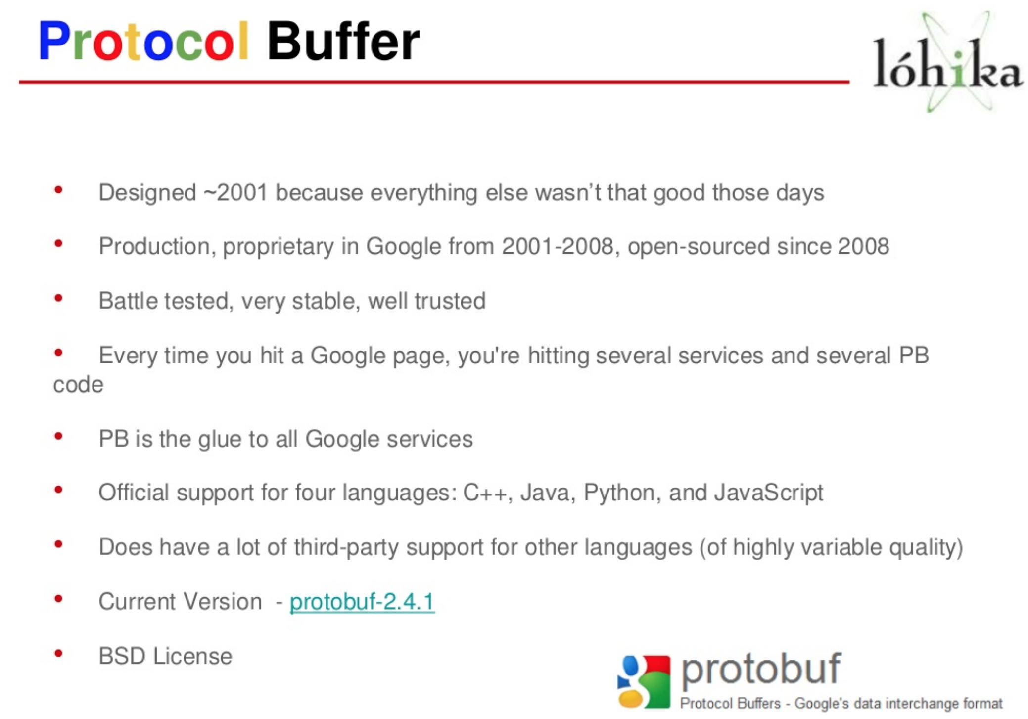

Slide 25
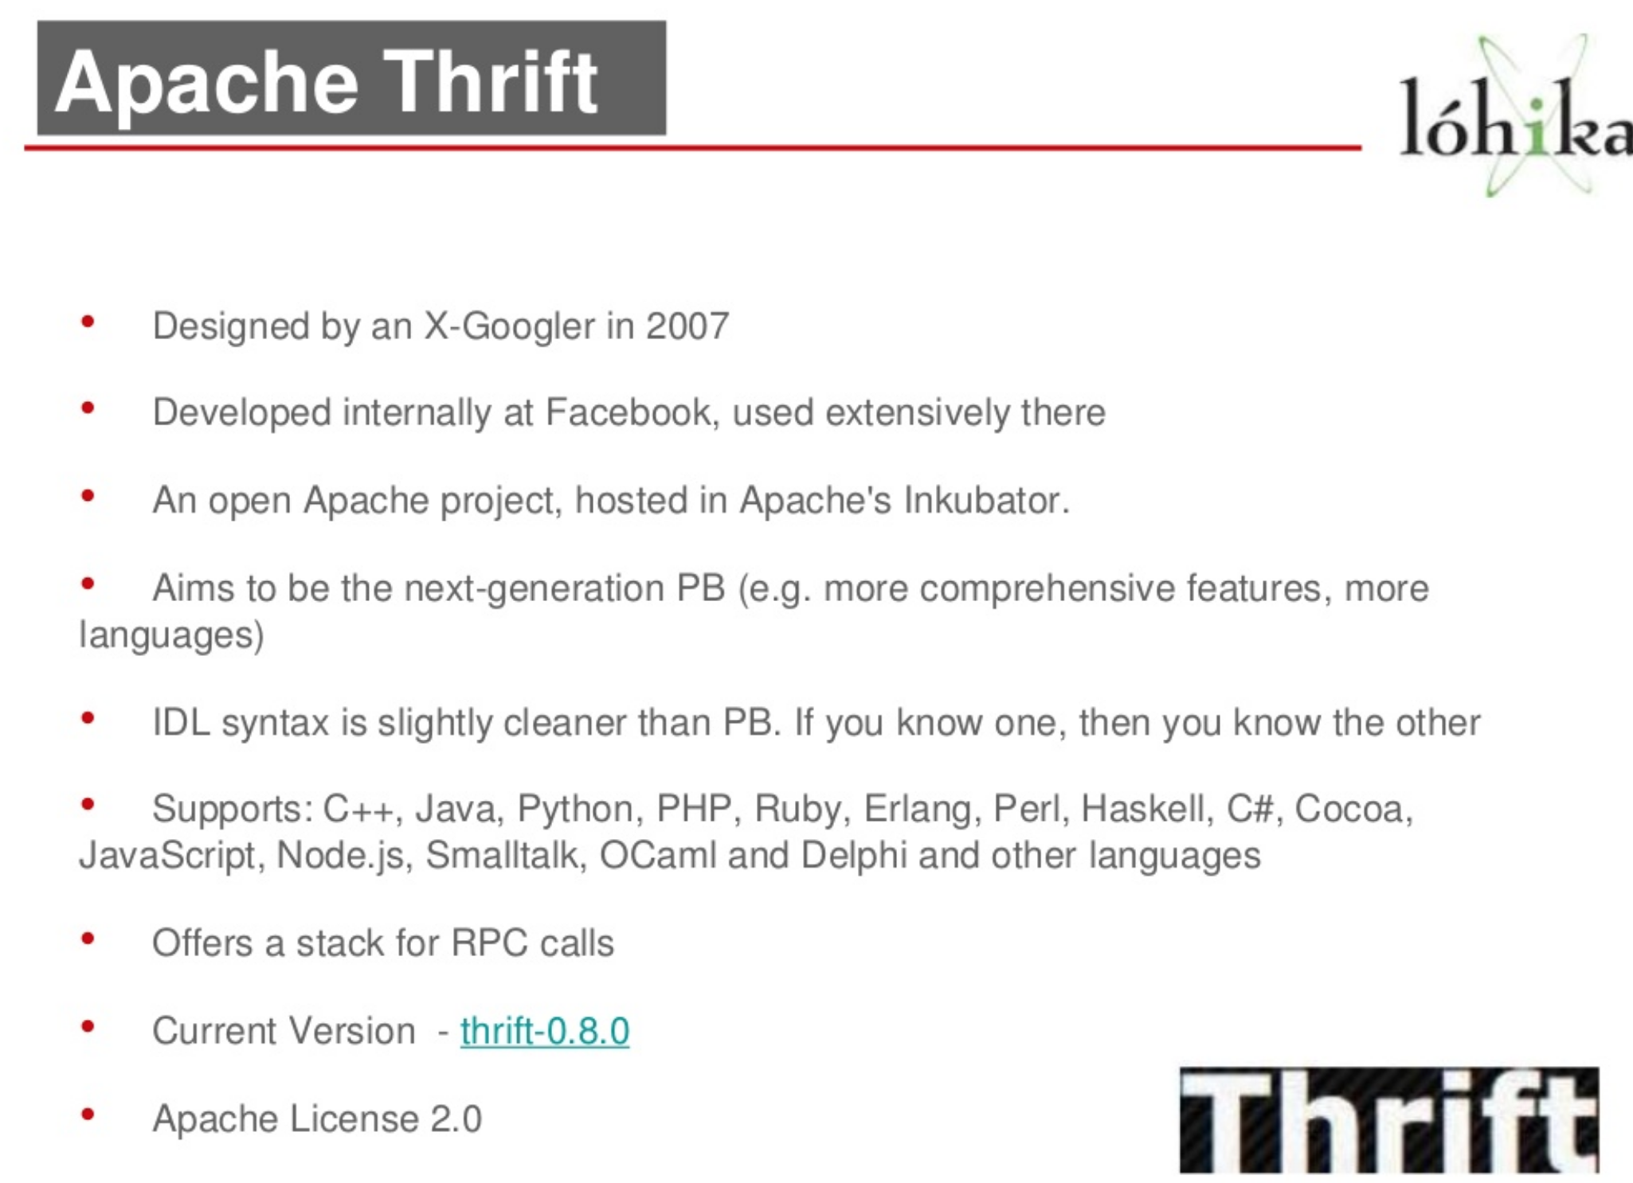

Slide 26
Distributed Shared Memory (DSM)
Tightly coupled systems
Use of shared memory for IPC is natural
Distributed Shared Memory
(exists only virtually)
CPU1
Memory
CPU1
Memory
CPU1
Memory
Memory
CPU n
CPU n
…
CPU n
Loosely coupled
distributed-memory processors
Use DSM – distributed shared memory
A middleware solution that provides a shared-memory abstraction.
MMU
MMU
MMU
Node 1
Node n
Communication Network

Slide 27
Issues in designing DSM
Synchronization
Granularity of the block size
Memory Coherence (Consistency models)
Data Location and Access
Replacement Strategies
Thrashing
Heterogeneity

Slide 28
Synchronization
Inevitable in Distributed Systems where distinct processes are running concurrently and sharing resources.
Synchronization related issues
  Clock synchronization/Event Ordering (recall happened before relation)
  Mutual exclusion
  Deadlocks
  Election Algorithms

Slide 29
Distributed Mutual Exclusion
Mutual exclusion
    ensures that concurrent processes have serialized access to shared resources - the critical section problem
  Shared variables (semaphores) cannot be used in a distributed system
      Mutual exclusion must be based on message passing, in the context of unpredictable delays and incomplete knowledge
    In some applications (e.g. transaction processing) the resource is managed by a server which implements its own lock along with mechanisms to synchronize access to the resource.

Slide 30
Distributed Mutual Exclusion
Basic requirements
  Safety
    At most one process may execute in the critical section (CS) at a time
  Liveness
    A process requesting entry to the CS is eventually granted it (as long as any process executing in its CS eventually leaves it.
    Implies freedom from deadlock and starvation

Slide 31
Mutual Exclusion Techniques
Non-token Based Approaches
  Each process freely and equally competes for the right to use the shared resource; requests are arbitrated by a central control suite or by distributed agreement
    Central Coordinator Algorithm
    Ricart-Agrawala Algorithm
Token-based approaches
  A logical token representing the access right to the shared resource is passed in a regulated fashion among processes; whoever holds the token is allowed to enter the critical section.
    Token Ring Algorithm
    Ricart-Agrawala Second Algorithm

Slide 32
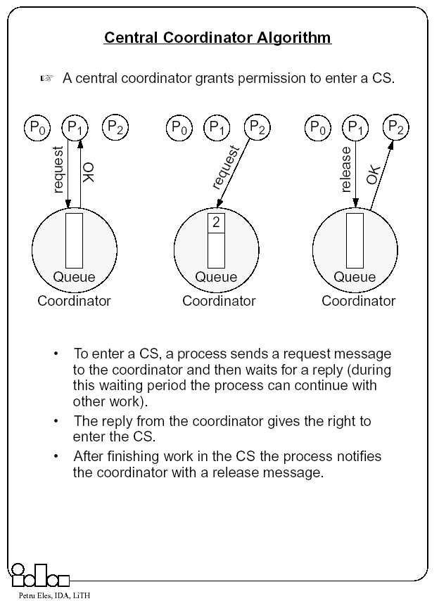

Slide 33
Central Coordinator Algorithm
Advantages
  Scheme is easy to implement
  Requires only 3 messages to get access to a critical section (request, OK, release)
Issues with centralized coordinator
  A performance bottleneck
  Critical point of Failure
    New coordinator must be elected when existing coordinator fails
    New coordinator can be one of the processes competing for access to the CS
    A leader election algorithm must select one and only one coordinator.

Slide 34
Ricart-Agrawala Algorithm
In a distributed environment it seems more natural to implement mutual exclusion, based upon distributed agreement - not on a central coordinator.
It is assumed that all processes keep a (Lamport’s) logical clock which is updated according to the clock rules.
  The algorithm requires a total ordering of requests. Requests are ordered according to their global logical timestamps; if timestamps are equal, process identifiers are compared to order them.
The process that requires entry to a CS multicasts the request message to all other processes competing for the same resource.
  Process is allowed to enter the CS when all processes have replied to this message.
  The request message consists of the requesting process’ timestamp (logical clock) and its identifier.
Each process keeps its state with respect to the CS: released, requested, or held.

Slide 35
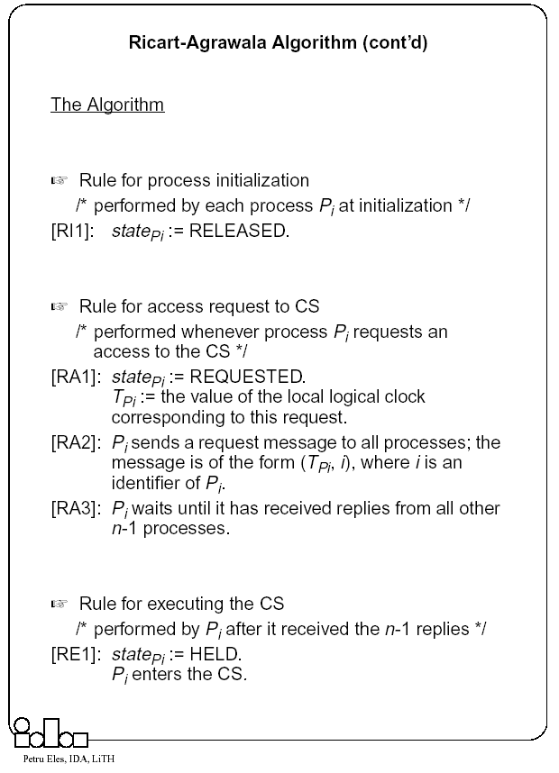

Slide 36
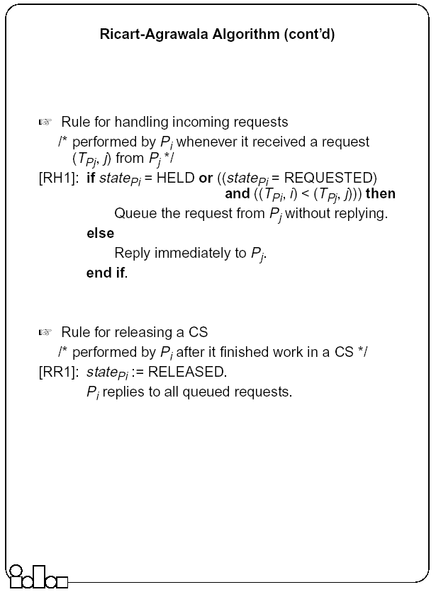

Slide 37
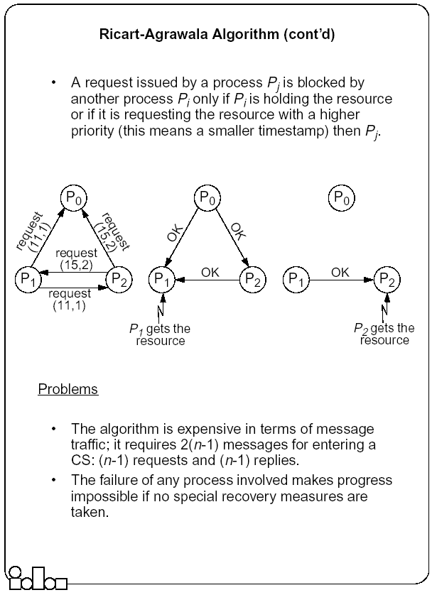

Slide 38
Token-Based Mutual Exclusion
Token Ring Algorithm
Ricart-Agrawala Second Algorithm

Slide 39
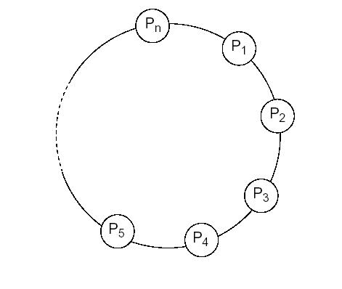
Token Ring Algorithm
Simple - arrange the n processes in a logical ring.
The logical ring topology is created by giving each process the address of one other process which is its neighbor in the clockwise direction.
Logical ring topology is unrelated to the physical interconnection between computers.

Slide 40
Token Ring Algorithm
The token is initially given to one process.
The token is passed from one process to its neighbor around the ring.
When a process requires entry to the CS, it waits to receive a token from its neighbor (right) and retains it; enters the CS; when done, it passes the token to its left neighbor (clockwise).
When a process receives the token, but does not require entry to CS, it passes it along the ring.

Slide 41
Token Ring Algorithm
It can take from 1 to n-1 messages to obtain a token. Messages are sent around the ring even when no process requires the token (additional load on network).
Works well in heavily loaded situations when there is a high probability that the process which gets the token wants to enter the CS. Works poorly in lightly loaded cases.
If a process fails → no progress can be made until a reconfiguration is applied to extract the process from the ring.
If the process holding the token fails → a unique process has to be picked to regenerate token and pass it along the ring (election algorithm).

Slide 42
Ricart-Agrawala Second Algorithm
A process is allowed to enter the critical section when it gets the token.
  Initially the token is assigned arbitrarily to one of the processes.
In order to get the token it sends a request to all other processes competing for the same resource.
  The request message consists of the requesting process’ timestamp (logical clock) and its identifier.
When a process Pi leaves a critical section
  it passes the token to one of the processes which are waiting for it; this will be the first process Pj, where j is searched in order [ i+1, i+2, ..., n, 1, 2, ..., i-2, i-1] for which there is a pending request.
  If no process is waiting, Pi retains the token (and is allowed to enter the CS if it needs); it will pass over the token as result of an incoming request.
How does Pi find out if there is a pending request?
  Each process Pi records the timestamp corresponding to the last request it got from process Pj, in requestPi[ j]. In the token itself, token[ j] records the timestamp (logical clock) of Pj’s last holding of the token. If requestPi[ j] > token[ j] then Pj has a pending request.

Slide 43
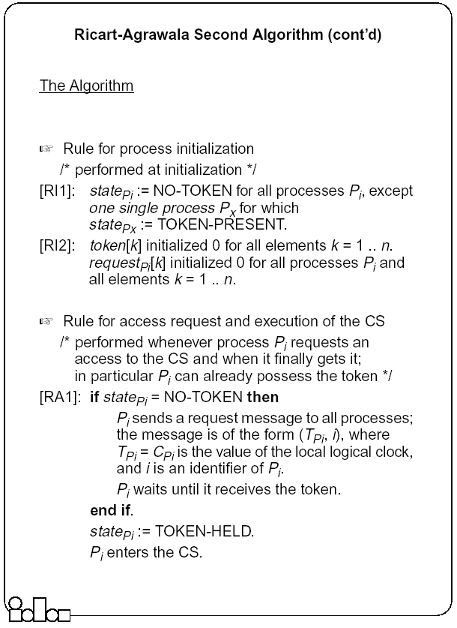

Slide 44
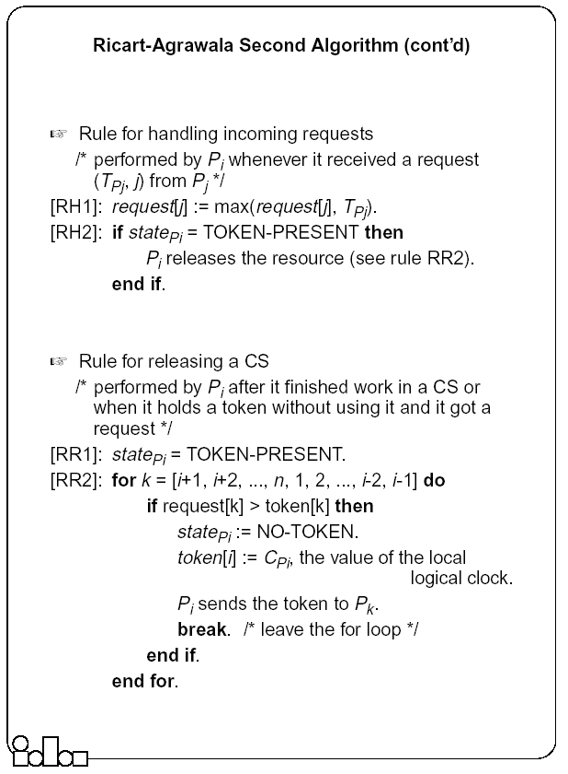

Slide 45
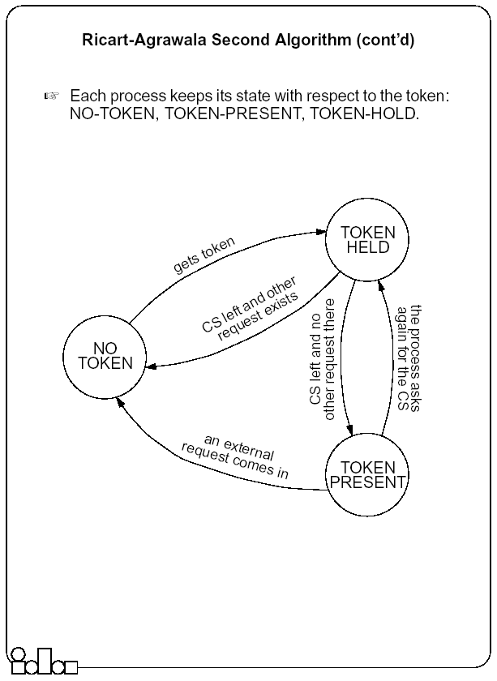

Slide 46
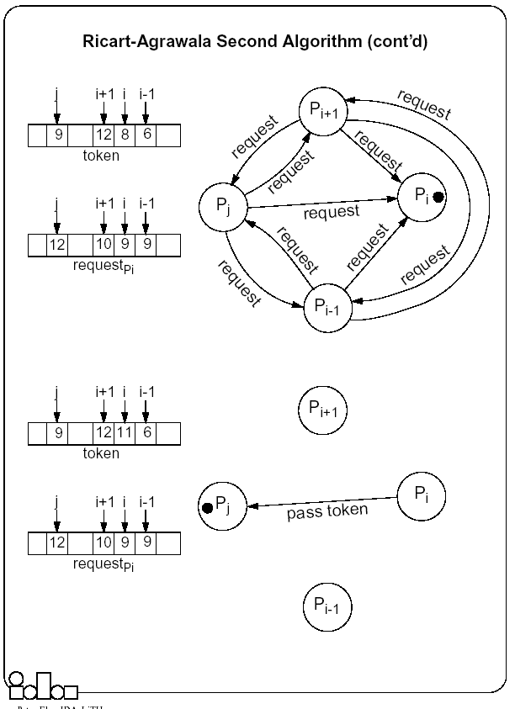

Slide 47
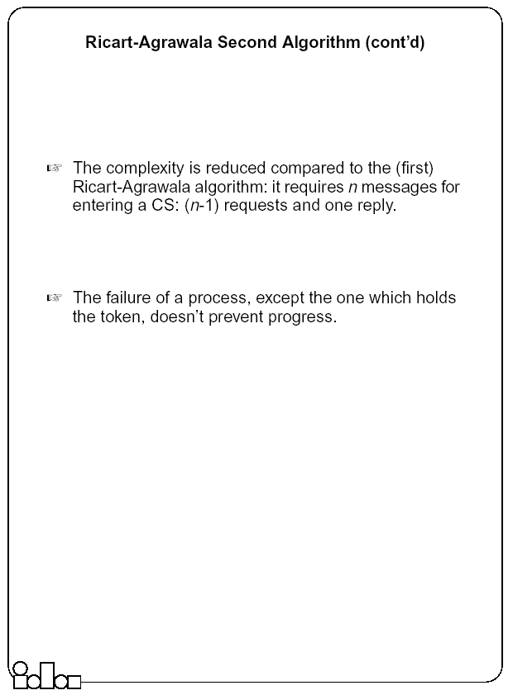

Slide 48
Election Algorithms
Many distributed algorithms require one process to act as a coordinator or, in general, perform some special role.
Examples with mutual exclusion
  Central coordinator algorithm
    At initialization or whenever the coordinator crashes, a new coordinator has to be elected.
  Token ring algorithm
    When the process holding the token fails, a new process has to be elected which generates the new token.

Slide 49
Election Algorithms
It doesn’t matter which process is elected.
  What is important is that one and only one process is chosen (we call this process the coordinator) and all processes agree on this decision.
Assume that each process has a unique number (identifier).
  In general, election algorithms attempt to locate the process with the highest number, among those which currently are up.
Election is typically started after a failure occurs.
  The detection of a failure (e.g. the crash of the current coordinator) is normally based on time-out 🡪 a process that gets no response for a period of time suspects a failure and initiates an election process.
An election process is typically performed in two phases:
  Select a leader with the highest priority.
  Inform all processes about the winner.

Slide 50
The Bully Algorithm
A process has to know the identifier of all other processes
  (it doesn’t know, however, which one is still up); the process with the highest identifier, among those which are up, is selected.
Any process could fail during the election procedure.
When a process Pi detects a failure and a coordinator has to be elected
  It sends an election message to all the processes with a higher identifier and then waits for an answer message:
  If no response arrives within a time limit
    Pi becomes the coordinator (all processes with higher identifier are down)
    it broadcasts a coordinator message to all processes to let them know.
  If an answer message arrives,
    Pi knows that another process has to become the coordinator 🡪 it waits in order to receive the coordinator message.
    If this message fails to arrive within a time limit (which means that a potential coordinator crashed after sending the answer message) Pi resends the election message.
When receiving an election message from Pi
  a process Pj replies with an answer message to Pi and
  then starts an election procedure itself( unless it has already started one) it sends an election message to all processes with higher identifier.
Finally all processes get an answer message, except the one which becomes the coordinator.

Slide 51
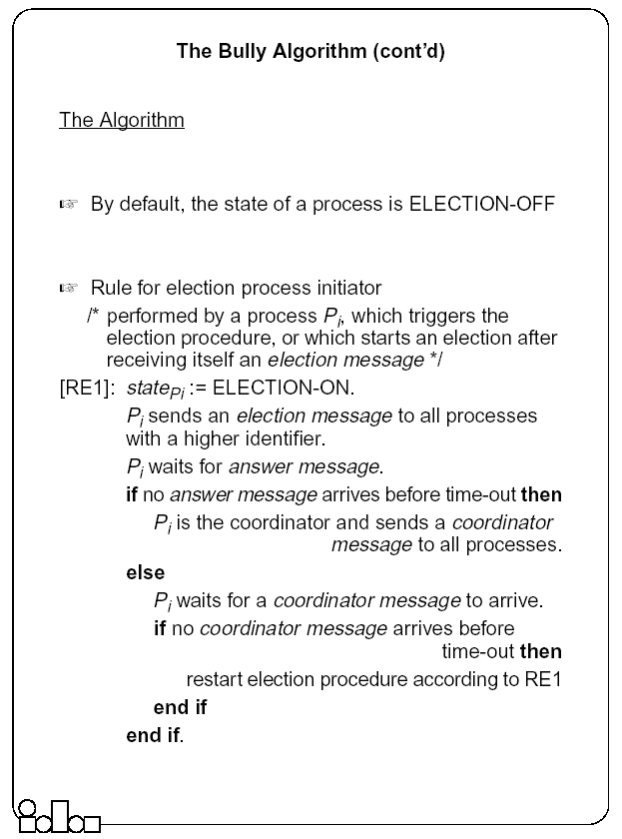

Slide 52
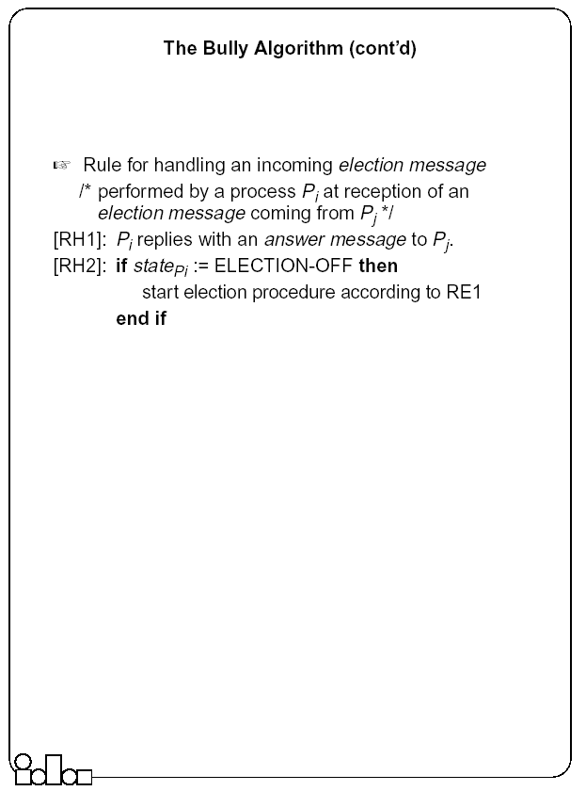

Slide 53
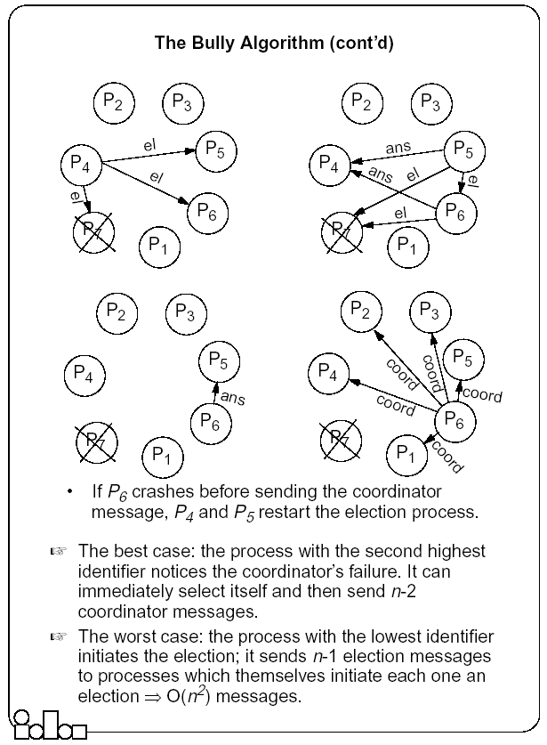

Slide 54
The Ring-based Algorithm
We assume that the processes are arranged in a logical ring
    Each process knows the address of one other process, which is its neighbor in the clockwise direction.
The algorithm elects a single coordinator, which is the process with the highest identifier.
Election is started by a process which has noticed that the current coordinator has failed.
  The process places its identifier in an election message that is passed to the following process.
  When a process receives an election message
    It compares the identifier in the message with its own.
    If the arrived identifier is greater, it forwards the received election message to its neighbor
    If the arrived identifier is smaller it substitutes its own identifier in the election message before forwarding it.
    If the received identifier is that of the receiver itself 🡪 this will be the coordinator.
The new coordinator sends an elected message through the ring.

Slide 55
The Ring-based Algorithm- An Optimization
Several elections can be active at the same time.
    Messages generated by later elections should be killed as soon as possible.
Processes can be in one of two states
  Participant or Non-participant.
    Initially, a process is non-participant.
The process initiating an election marks itself participant.
Rules
  For a participant process, if the identifier in the election message is smaller than the own, does not forward any message (it has already forwarded it, or a larger one, as part of another simultaneously ongoing election).
  When forwarding an election message, a process marks itself participant.
  When sending (forwarding) an elected message, a process marks itself non-participant.

Slide 56
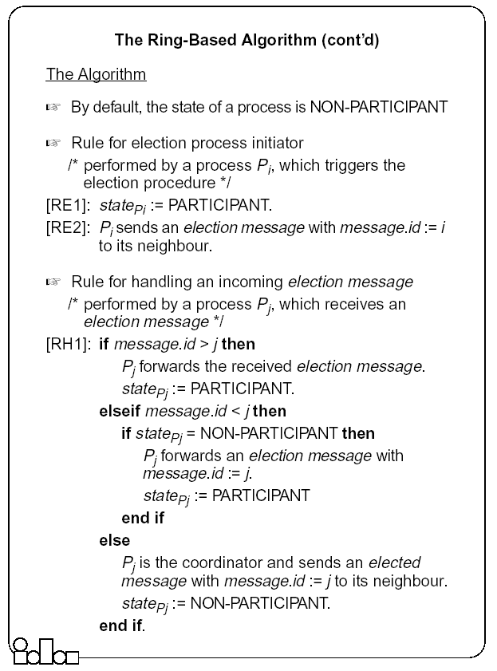

Slide 57
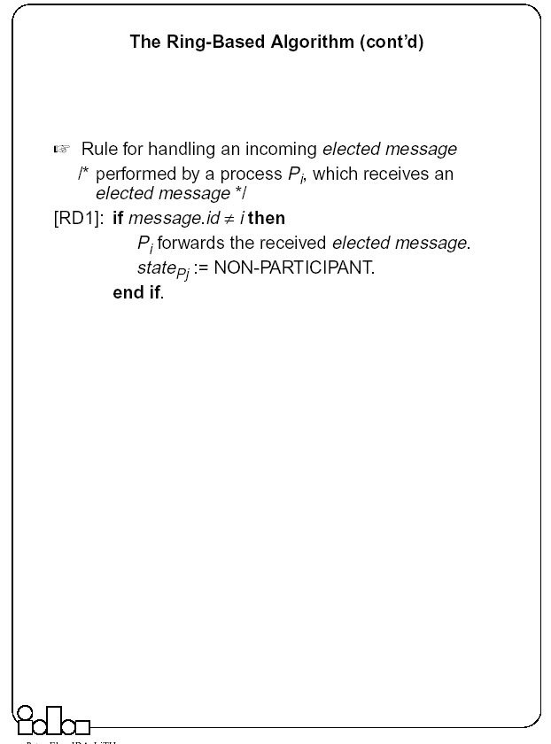

Slide 58
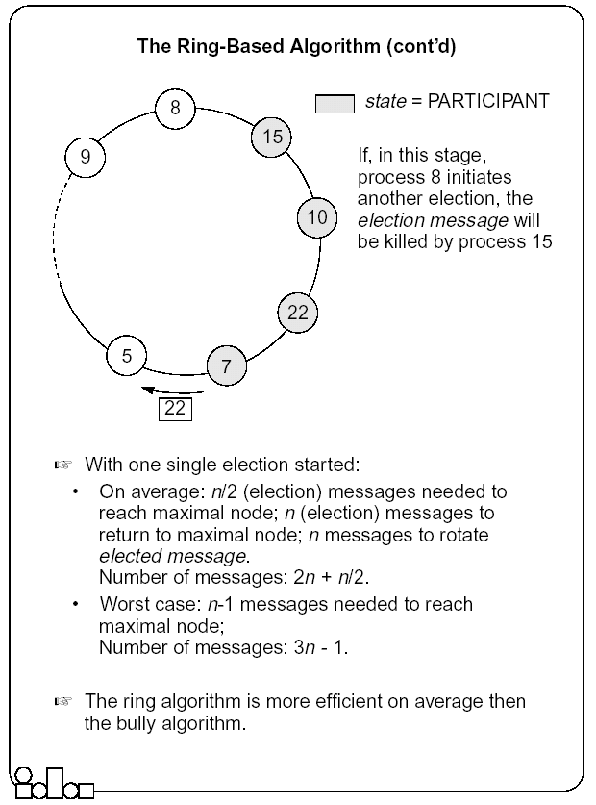

Slide 59
Summary (Distributed Mutual Exclusion)
In a distributed environment no shared variables (semaphores) and local kernels can be used to enforce mutual exclusion. Mutual exclusion has to be based only on message passing.
There are two basic approaches to mutual exclusion: non-token-based and token-based.
The central coordinator algorithm is based on the availability of a coordinator process which handles all the requests and provides exclusive access to the resource. The coordinator is a performance bottleneck and a critical point of failure. However, the number of messages exchanged per use of a CS is small.
The Ricart-Agrawala algorithm is based on fully distributed agreement for mutual exclusion. A request is multicast to all processes competing for a resource and access is provided when all processes have replied to the request. The algorithm is expensive in terms of message traffic, and failure of any process prevents progress.
Ricart-Agrawala’s second algorithm is token-based. Requests are sent to all processes competing for a resource but a reply is expected only from the process holding the token. The complexity in terms of message traffic is reduced compared to the first algorithm. Failure of a process (except the one holding the token) does not prevent progress.

Slide 60
Summary (Distributed Mutual Exclusion)
The token-ring algorithm very simply solves mutual exclusion. It is requested that processes are logically arranged in a ring. The token is permanently passed from one process to the other and the process currently holding the token has exclusive right to the resource. The algorithm is efficient in heavily loaded situations.
For many distributed applications it is needed that one process acts as a coordinator. An election algorithm has to choose one and only one process from a group, to become the coordinator. All group members have to agree on the decision.
The bully algorithm requires the processes to know the identifier of all other processes; the process with the highest identifier, among those which are up, is selected. Processes are allowed to fail during the election procedure.
The ring-based algorithm requires processes to be arranged in a logical ring. The process with the highest identifier is selected. On average, the ring based algorithm is more efficient then the bully algorithm.

Slide 61
Deadlocks
Mutual exclusion, hold-and-wait, No-preemption and circular wait.
Deadlocks can be modeled using resource allocation graphs
Handling Deadlocks
  Avoidance (requires advance knowledge of processes and their resource requirements)
  Prevention (collective/ordered requests, preemption)
  Detection and recovery (local/global WFGs, local/centralized deadlock detectors; Recovery by operator intervention, termination and rollback)

Slide 62
Distributed Operating Systems
Distributed Resource Management
(File and Process)
YUSUF SARWAR
Postdoctoral Researcher

Slide 63
Distributed Process Management

Slide 64
Distributed Process and Resource Management
Determining when and where to execute processes in distributed systems
  Useful for load balancing, reliability
Need multiple policies for process migration for load balancing
  Load Estimation Policy
    How to estimate the workload of a node
  Process Transfer Policy
    Whether to execute a process locally or remotely
  Location Policy
    Which node to run the remote process on
  Priority Assignment Policy
    Which processes have more priority (local or remote)
  Migration Limiting policy
    Number of times a process can migrate

Slide 65
Load Balancing in Distributed Systems
Load balancing intends to distribute “load” across all participants “uniformly”
Load Balancing
  Can be thought of as “distributed scheduling”
    Deals with distribution of processes among processors connected by a network
  Can also be influenced by “distributed placement”
    Especially in data intensive applications
Load balancing is a computationally hard problem (NP-Complete)

Slide 66
Load Balancing Issues
How
  To search for lightly loaded machines
When
  should load balancing decisions be made
  to migrate processes or forward requests?
Which
  processes should be moved off a computer?
  processor should be chosen to handle a given process or request
What should be taken into account when making the above decisions? How should old data be handled?
Should
  load balancing data be stored and utilized centrally, or in a distributed manner
  prevent overloading a lightly loaded computer
  What is the performance/overhead tradeoff incurred by load balancing?

Slide 67
Static vs. Dynamic Load Balancing
Static load balancing - CPU is determined at process creation.
Dynamic load balancing - processes dynamically migrate to other computers to balance the CPU (or memory) load.
    Parallel machines - dynamic balancing schemes seek to minimize total execution time of a single application running in parallel on a multiple nodes
    Web servers - scheduling client requests among multiple nodes in a transparent way to improve response times for interaction
    Multimedia servers - resource optimization across streams and servers for QoS; may require admission control

Slide 68
Dynamic Load Balancing
Dynamic Load Balancing on Highly Parallel Computers
- dynamic balancing schemes which seek to minimize total execution time of a single application running in parallel on a multiprocessor system
1. Sender Initiated Diffusion (SID)
2. Receiver Initiated Diffusion(RID)
3. Hierarchical Balancing Method (HBM)
4. Gradient Model (GM)
5. Dynamic Exchange method (DEM)
Dynamic Load Balancing on Web Servers
dynamic load balancing techniques in distributed web-server architectures , by scheduling client requests among multiple nodes in a transparent way
1. Client-based approach
2. DNS-Based approach
3. Dispatcher-based approach
4. Server-based approach

Slide 69
Load Balancing Techniques in Web Servers
Web server system
Provides web services
Becomes loaded with ---
  Increasing number of clients
  Growing complexity of web applications
Scalable web server systems
The ability to support large numbers of accesses and resources while still providing adequate performance
?
?
?
Cardellini, Valeria, et al. "The state of the art in locally distributed Web-server systems." ACM Computing Surveys (CSUR) 34.2 (2002): 263-311.

Slide 70
Load Balancing Techniques in Web Servers
Cluster Based Web System
the server nodes mask their IP addresses to clients, using a Virtual IP address corresponding to one device (web switch) in front of the set of the servers – Web switch receives all packets and then sends them to server nodes
Distributed Web System
the IP addresses of the web server nodes are visible to clients. No web switch, just a layer 3 router may be employed to route the requests

Slide 71
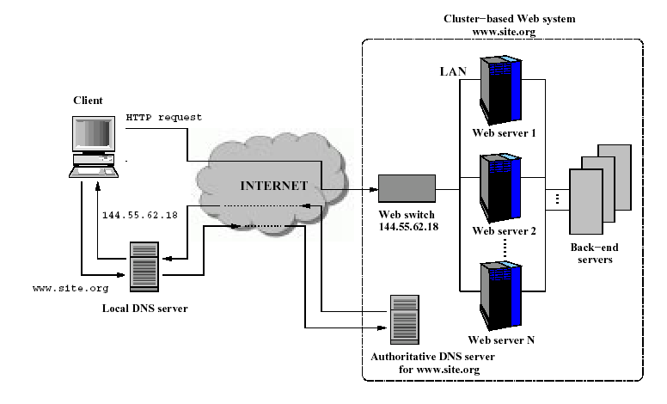
Cluster based Architecture

Slide 72
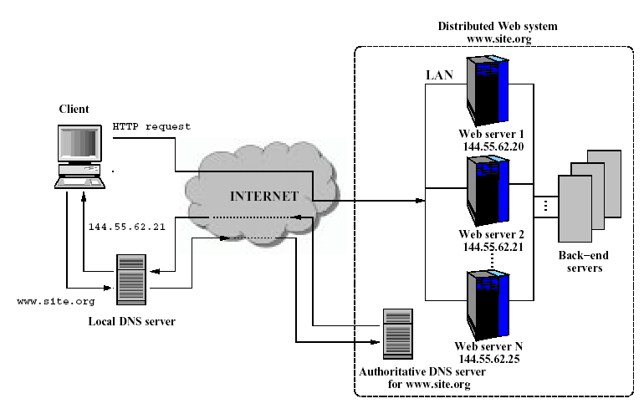
Distributed Architecture

Slide 73
Request Dispatching Algorithms
Strategies to select the target server of the web clusters
Strategies can be Content-blind and Content-aware
Static: Fastest solution to prevent web switch bottleneck, but do not consider the current state of the servers
Dynamic: Outperform static algorithms by using intelligent decisions, but collecting state information and analyzing them cause expensive overheads
  Requirements:
    Low computational complexity
    Full compatibility with web standards
    State information must be readily available without much overhead

Slide 74
Content Blind Approaches
Static policies
  Random
    Distributes the incoming requests uniformly with equal probability of reaching any server
  Round Robin (RR)
    Use a circular list and a pointer to the last selected server to make the decision
  Static Weighted RR (For heterogeneous severs)
    A variation of RR, where each server is assigned a weight Wi depending on its capacity

Slide 75
Content Blind Approaches
Dynamic Policies
  Client state aware
    Static partitioning the server nodes and to assign group of clients identified through the clients information, such as source IP address
  Server state aware
    Least Loaded: the server with the lowest load
    Least Connection: fewest active connection first
    Fastest Response : responding fastest
    Weighted Round Robin: Variation of static RR, associates each server with a dynamically evaluated weight that is proportional to the server load
  Client and server state aware
    Client affinity: consecutive connections from the same client can be assigned to the same server

Slide 76
Content Blind Approaches
Static approach is the fastest, easy to implement, but may make poor assignment decision
Dynamic approach has the potential to make better decision, but it needs to collect and analyze state information, may cause high overhead
Overall, simple server state aware algorithm is the best choice, least loaded algorithm is commonly used in commercial products

Slide 77
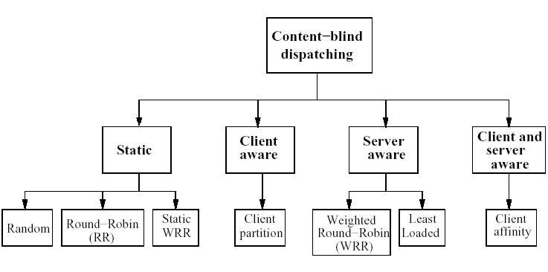
Content Blind Approaches
Cardellini, Valeria, et al. "The state of the art in locally distributed Web-server systems." ACM Computing Surveys (CSUR) 34.2 (2002): 263-311.

Slide 78
Content Aware Approaches
Server state aware
  Cache Affinity
    The file space is partitioned among the server nodes
  Load Sharing
    SITEA (Size Interval Task Assignment with Equal Load)
      Switch determines the size of the requested file and selects the target server based on this information
    CAP (Client-Aware Policy)
      Web requests are classified based on their impact on system resources: such as I/O bound, CPU bound

Slide 79
Content Aware Approaches
Client state aware
  Service Partitioning
    Employ specialized servers for certain type of requests
  Client Affinity
    Using session identifier to assign all web transactions from the same client to the same server
Client and server state aware
  LARD (Locality aware request distribution)
    Direct all requests to the same web object to the same server node as long as its utilization is below a given threshold
  Cache Manager
    A cache manager is aware of the cache content of all web servers

Slide 80
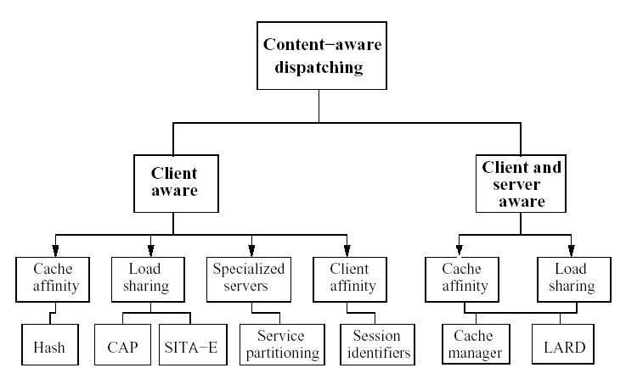
Content Aware Approaches
Cardellini, Valeria, et al. "The state of the art in locally distributed Web-server systems." ACM Computing Surveys (CSUR) 34.2 (2002): 263-311.

Slide 81
Load Balancing in MM Servers
Adapts to statistical fluctuations and changing access patterns
Adaptive Scheduling
  Assigns requests to servers based on demand and load factors
  Invokes replication-on-demand, request migration
  Load factor(LF) for a request represents how far a server is from request admission threshold
  LF (Ri, Sj) = max (DBi/DBj , Mi/Mj , CPUi/CPUj , Xi/Xj)
Dynamic Migration - Deals with poor initial placement
Predictive Placement through Replication
  Dynamic Segment Replication
    partial replication
    quick response, less expensive
  Total Replication
    on-demand vs. predictive
  Eager Replication, Lazy Dereplication
Data
Source
S1
Data
Source
S2
Storage:
8 objects
Bandwidth:
3 requests
Storage:
2 objects
Bandwidth:
8 requests
Access Network
...

Slide 82
Process Migration

Slide 83
Process Migration
Process migration mechanism
  Freeze the process on the source node and restart it at the destination node
  Transfer of the process address space
  Forwarding messages meant for the migrant process
  Handling communication between cooperating processes separated as a result of migration
  Handling child processes
Migration architectures
  One image system
  Point of entrance dependent system (the deputy concept)

Slide 84

A Mosix Cluster
Mosix (from Hebrew U): Kernel level enhancement to Linux that provides dynamic load balancing in a network of workstations.
Dozens of PC computers connected by local area network (Fast-Ethernet or Myrinet).
Any process can migrate anywhere anytime.

Slide 85
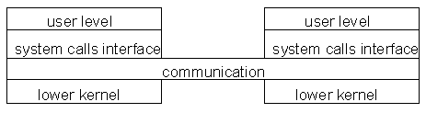
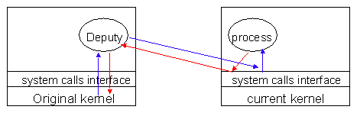
Architectures for Migration
Architecture that fits one system image.
Needs location transparent file system.
(Mosix early versions)
Architecture that fits entrance dependant systems.
Easier to implement based on current Unix.
(Mosix later versions)

Slide 86
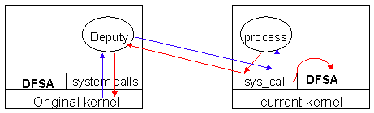
Mosix: Migration and File Access
Each file access must go back to deputy…
= = Very Slow for I/O apps.
Solution: Allow processes to access a distributed file system through the current kernel.

Slide 87
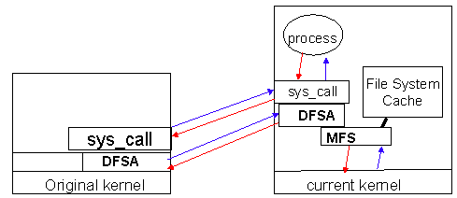
Mosix: File Access
DFSA
  Direct File System Access
  Requirements (cache coherent, monotonic timestamps, files not deleted until all nodes finished)
  Bring the process to the files.
MFS
  Single cache (on server)
  /mfs/1405/var/tmp/myfiles

Slide 88
Process Migration: Other Factors
Not only CPU load!!!
Memory.
I/O - where is the physical device?
Communication - which processes communicate with which other processes?

Slide 89
Process Migration and Heterogeneous Systems
Converts usage of heterogeneous resources (CPU, memory, IO) into a single, homogeneous cost using a specific cost function.
Assigns/migrates a job to the machine on which it incurs the lowest cost.
  Can design online job assignment policies based on multiple factors - economic principles, competitive analysis.
  Aim to guarantee near-optimal global lower-bound performance.

Slide 90
Distributed File Systems

Slide 91
Distributed File Systems
File systems provide a convenient programming interface to disk storage (or hardware resources)
  Were originally developed for centralized systems
  Later features like access-control and file-locking are added
Distributed file systems support similar functionalities throughout an intranet (a local area network)
  Provide access to files stored at a server with performance and reliability similar to, and in some cases better than, files stored on local disks
  Basically, files are stored in a server (instead of in local disks) and clients access them

Slide 92
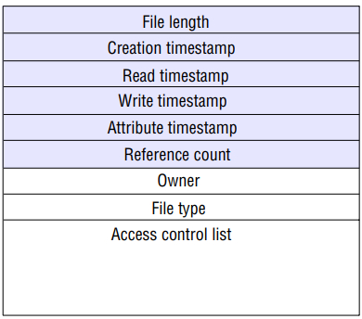
Files and File System
File systems are responsible for the organization, storage, retrieval, naming, sharing and protection of files
Files contain both data and attributes
  The data consist of a sequence of data items (typically 8-bit bytes), accessible by operations to read and write any portion of the sequence
  The attributes contain metadata
File attribute record structure

Slide 93
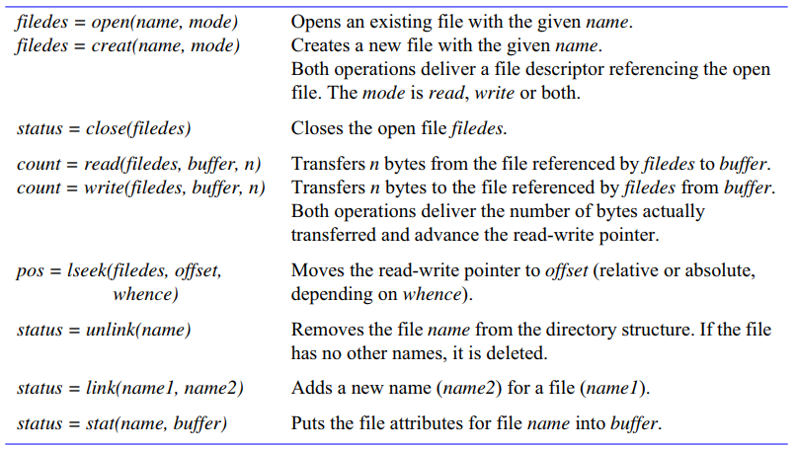
File System Operations
UNIX file system operations
Distributed Systems Concepts and Design (Coulouris, Dollimore)

Slide 94
Distributed File System Requirements
Transparency: client programs should be unaware of
  Access, location, mobility, scale
Concurrency: allowing concurrent updates
Replication: several copies at different locations
  Two benefits: share loads and enhances fault-tolerance
Hardware and operating system heterogeneity
Fault tolerance: should work amid server and client failures
Consistency: One-copy update semantics
Security: access-control mechanisms
Efficiency: performance comparable to the conventional one

Slide 95
Distributed File System Issues
File and directory naming – Locating the file
Semantics – client/server operations, file sharing
Performance and scalability
Fault tolerance
  Deal with remote server failures
Implementation considerations
  Caching
  Replication
  Update protocols

Slide 96
DFS Issues (File and Directory Naming)
Explicit Naming
  Machine + path /machine/path
  one namespace but not transparent
Implicit naming
  Location transparency
    File name does not include name of the server where the file is stored
  Mounting remote filesystems onto the local file hierarchy
    View of the filesystem may be different at each computer
  Full naming transparency
    A single namespace that looks the same on all machines

Slide 97
DFS Issues (Semantic - Operational)
Support fault-tolerant operation
  At-most-once semantics for file operations
  At-least-once semantics with a server protocol designed in terms of idempotent file operations
  Replication (stateless, so that servers can be restarted after failure)

Slide 98
DFS Issues (Semantic - File Sharing)
One-copy semantics
  Updates are written to the single copy and are available immediately
  All clients see contents of file identically as if only one copy of file existed
  If caching is used: after an update operation, no program can observe a discrepancy between data in cache and stored data
Serializability
  Transaction semantics (file locking protocols implemented - share for read, exclusive for write).
Session semantics
  Copy file on open, work on local copy and copy back on close

Slide 99
File Service Architecture
A file service architecture offers a clear separation of the main concerns in providing access to files
Architecture has three components:
  a flat file service and a directory service
    export an interface for use by client programs, and their RPC interfaces, taken together, provide a comprehensive set of operations for access to files
  a client module
    provides a single programming interface with operations on files similar to those found in conventional file systems

Slide 100
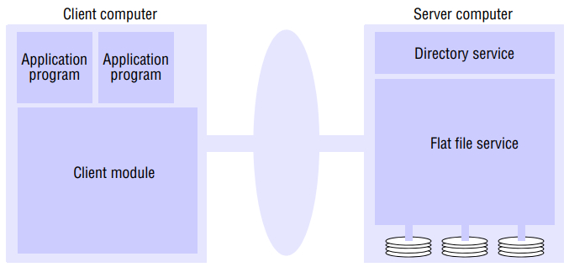
File Service Architecture
Flat file service and directory service export an interface for use by client programs, and their RPC interfaces, taken together, provide a comprehensive set of operations for access to files
The client module provides a single programming interface with operations on files similar to those found in conventional file systems

Slide 101
File Service Architecture
(Flat File Service)
Implements operations on the contents of files
Uses Unique file identifiers (UFIDs) to refer to files
  UFIDs are long sequences of bits, unique per file
A new UFID is generated when a file creation is requested

Slide 102
File Service Architecture
(Directory Service)
Provides a mapping between text names for files and their UFIDs
Clients may obtain the UFID of a file by quoting its text name to the directory service
Provides functions to generate directories, to add new file names to directories and to obtain UFIDs from directories.

Slide 103
File Service Architecture
(Client Module)
Runs in client machines
Provides APIs (application program interfaces) for user-level programs for accessing file and directory services
Holds information about the network locations of the file and directory server processes
Caches file blocks for improved performance

Slide 104
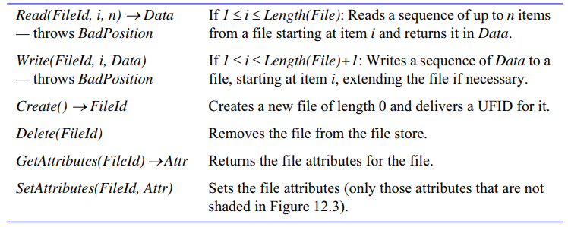
File Service Architecture
Flat file service operations
Looks very much alike UNIX file system operations with some differences
  No open or close functions (why?)
  All operations except create are repeatable (idempotent), allows to use at-least-once RPC semantic
  The operations can be implemented by a stateless server

Slide 105
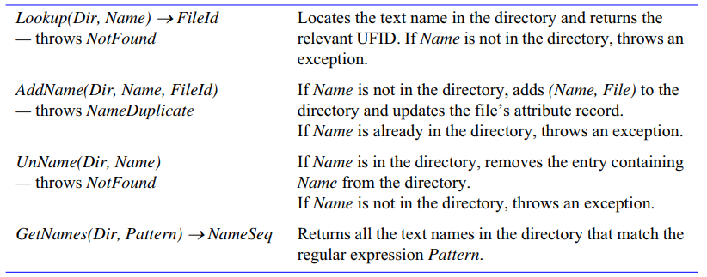
File Service Architecture
Directory service operations
Distributed Systems Concepts and Design (Coulouris, Dollimore)

Slide 106
Distributed File Systems
SUN’s Network File System (NFS)
CMU’s Andrew File System (AFS)
Hadoop Distributed File Systems (HDFS)
Google File System (GFS)

Slide 107
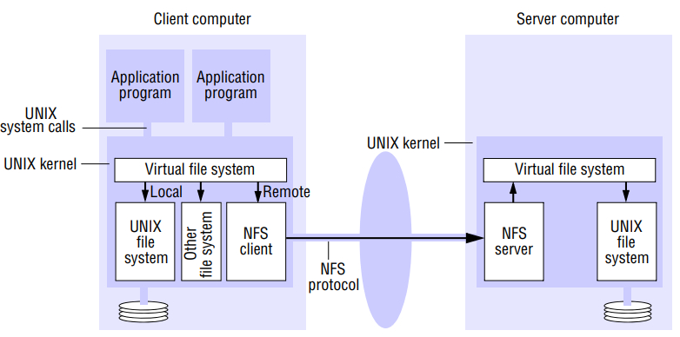
SUN Network File System (NFS)
NFS Architecture
All client-server communication happens through SUN’s RPC
Distributed Systems Concepts and Design (Coulouris, Dollimore)

Slide 108
NFS Virtual File System
NFS provides access transparency
  User programs issue file operations on local/remote files without distinction
VFS enables remote files to appear as local files
The file identifiers are called file handles
  Handle = FS identifier + i-node number + i-node gen number
VFS layer contains v-node per open file (like i-node in UNIX)
  For local files v-nodes are i-nodes, otherwise they are file handles

Slide 109
NFS Client Integration
The client modules emulates the semantics of the standard UNIX file system primitives precisely and is integrated with the UNIX kernel
  No need to provide any client library, instead of user programs can access files via UNIX system calls without recompilation or reloading

Slide 110
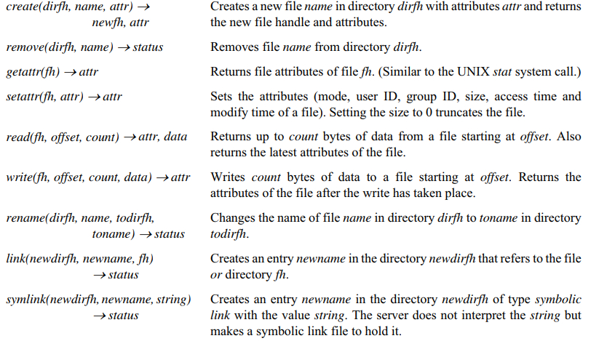
NFS Server Interface
Distributed Systems Concepts and Design (Coulouris, Dollimore)

Slide 111
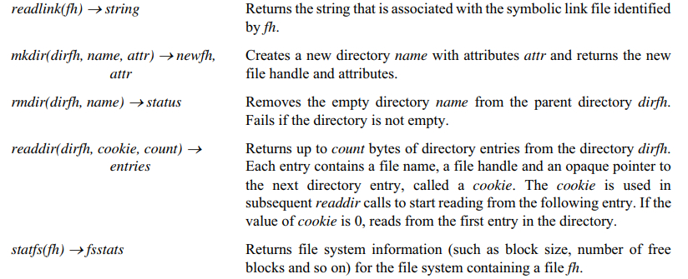
NFS Server Interface
Distributed Systems Concepts and Design (Coulouris, Dollimore)

Slide 112
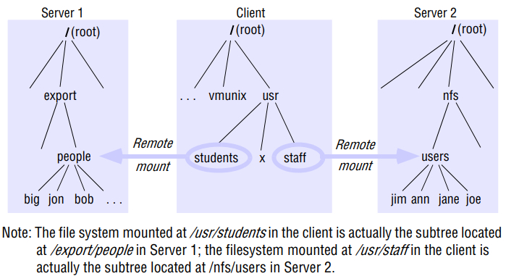
NFS Mount Service
Makes remote file system available to a local client by specifying remote host name and pathname of the directory
Distributed Systems Concepts and Design (Coulouris, Dollimore)

Slide 113
NFS Mount Service
Each NFS server runs a separate (user-level) mount service process
Clients use mount command to request mounting
  By specifying the remote host’s name, the pathname of a directory in the remote filesystem and the local name with which it is to be mounted
Mount command uses an RPC-based mount protocol
  Takes a directory pathname and returns the file handle
  The location (IP and port) of the server and the file handle for the remote directory are passed on to the VFS layer and the NFS client
Mounting can be two types:
  Hard mounted (user program is suspended until operation completes)
  Soft mounted (an error is returned after a couple of retries)

Slide 114
NFS Server Caching
A feature to enhance performance
Conventional UNIX uses buffer cache to hold disk blocks
  Two operations: read-ahead and delayed-write
NFS servers use the cache at the server machine
  No consistency issues for reads, but for writes there are
Two options for writes (in NFS version 3)
  Write-through: write in memory and also to the disk and reply to the client
  Write-commit: Write in memory but to the disk only when a commit is requested (usually made when the file is closed)

Slide 115

NFS Client Caching
NFS client module caches the results of read, write, getattr, lookup and readdir operations
Client caching may allow different versions of files to exist in different client nodes
  Writes by a client do not update cached copies of other clients
  Clients need to check with the server (and pull updated ones)
A timestamp-based validation is used
  A cached block is valid if it wasn’t updated since cached
  Only checks after a certain interval (called freshness, t) is elapsed
Validity condition:
Current time
Last validated
Last modified

Slide 116
NFS Summary
Transparency
  Access, location, mobility, scalability
Replication
  Read-only file stores can be replicated on several NFS servers, but NFS does not support file replication with updates
  Separate service, Network Information System (NIS), for key-value database
Hardware and operating system heterogeneity
Fault -tolerance
  Server failures may suspend clients (except for soft-mounting)
  NFS access protocol is stateless and idempotent (no state, easy recovery)
Consistency (approximate one-copy semantic, not fully)

Slide 117
Andrew File System (AFS)

Slide 118
Andrew File System (AFS)
A distributed file system developed at CMU
  Clients use normal UNIX file primitives
Two issues differ from NFS
  Whole-file serving: The entire contents of directories and files are transmitted to client computers by AFS servers
  Whole-file caching: Once a copy of a file or a chunk has been transferred to a client computer it is stored in a cache on the local disk.
    The cache contains several hundred of the files most recently used on that computer
    The cache is permanent, surviving reboots of the client computer
    Local copies of files are used to satisfy clients’ open requests in preference to remote copies whenever possible

Slide 119
Andrew File System (AFS)
Supports information sharing on a large scale
Uses a session semantics
  Entire file is copied to the local machine (Venus) from the server (Vice) when open. If file is changed, it is copied to server when closed.
    Works because in practice, most files are changed by one user
File validation
  On open: Venus accesses Vice to see if its copy of the file is still valid. Causes a substantial delay even if the copy is valid.
  Vice is stateless

Slide 120
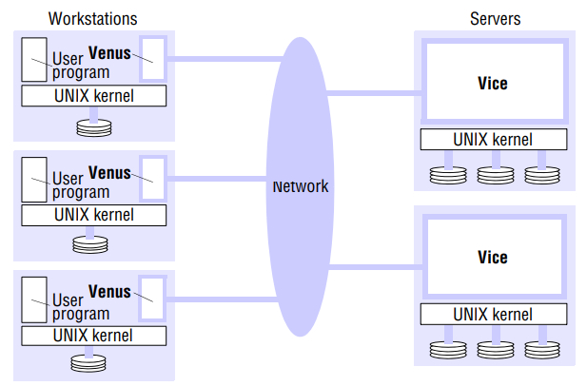
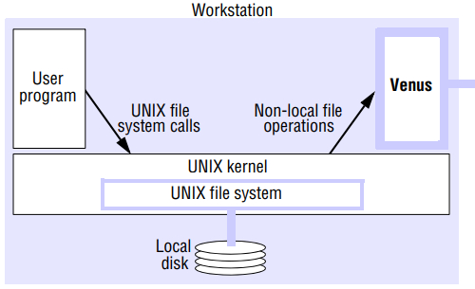
AFS Architecture
Distributed Systems Concepts and Design (Coulouris, Dollimore)

Slide 121
AFS Working Scenario
When a user process in a client computer issues an open system call for a file in the shared file space and there is not a current copy in the local cache, the server holding the file is located and is sent a request for a copy of the file
The copy is stored in the local UNIX file system in the client computer. The copy is then opened and the resulting UNIX file descriptor is returned to the client
Subsequent read, write and other operations on the file by processes in the client computer are applied to the local copy
When the process in the client issues a close system call, if the local copy has been updated its contents are sent back to the server. The server updates the file contents and the timestamps on the file. The copy on the client’s local disk is retained in case it is needed again by a user-level process on the same workstation.

Slide 122
AFS Cache Consistency
AFS does not required client modules (Venus) to pull for updates
  Instead, the Vice process passes a callback promise (an RPC handle) to notify clients (Venus) when a file is updated
Callback promises are stored with the cached files
When Vice updates a file, it invokes the callbacks to Venuses
  On receiving the callback, the Venus process invalidates callback promise token for the relevant file (indicating that the file needs to be retrieved again when opened next)
close
callback
Venus
Vice
Venus
callback
Venus

Slide 123
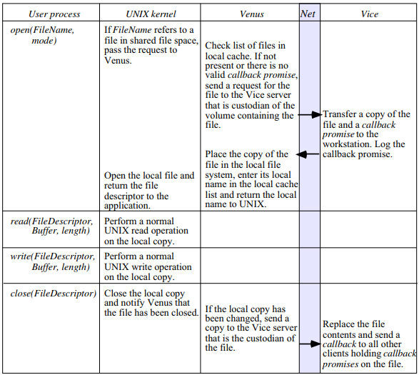
AFS Cache Consistency
open
callback
Venus
close
Vice
Venus
callback
Venus
Distributed Systems Concepts and Design (Coulouris, Dollimore)

Slide 124
AFS Update Semantics
AFS provides cache consistency only on open and close operations
  Once a file has been opened, the client may access and update the local copy in any way it chooses
  When the file is closed, a copy is returned to the server, replacing the current version
If clients in different workstations open, write and close the same file concurrently, all but the last close will be silently lost (no error report is given)
  Weaker consistency
Strict one-copy semantics requires results of each write to be distributed to all sites holding the file in their cache before any further accesses can occur (not practical in large-scale systems)

Slide 125
Hadoop Distributed File System (HDFS)
Slides are adapted from https://www.slideshare.net/rutvikbapat/hadoop-distributed-file-system-62531028

Slide 126

Hadoop Distributed File System (HDFS)
Hadoop is an open-source software for storing data and running applications on clusters
Hadoop provides:
  Massive storage of any kind of data
  Large number of concurrent tasks/jobs
  Ability of run/host things on commodity hardware
Two key components
  Storage (HDFS)
  Processing (mapreduce)

Slide 127
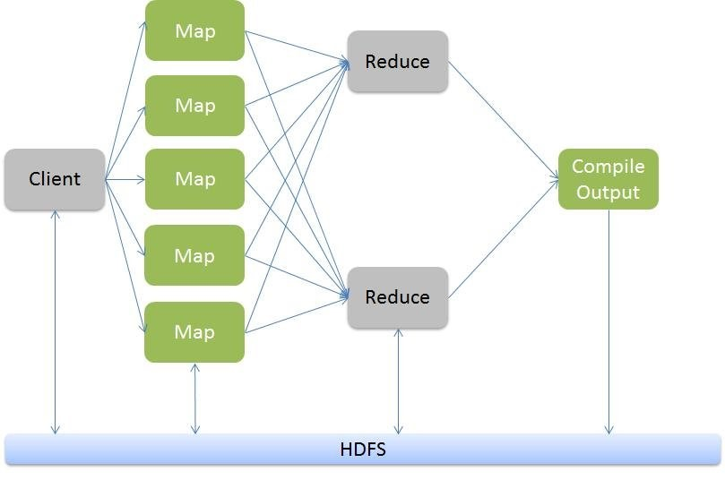
HADOOP -- Mapreduce

Slide 128
HDFS: Terms
A Rack is a collection of nodes that closely located and are usually in the same network
A Cluster is a collection of racks
NameNode – manages the file system’s namespace and regulates access to clients. There is a single NameNode per cluster
DataNode – Serves read, write requests, creates blocks, replicates or delete them
A file is split into blocks (each 64MB) and blocks are stored in DataNodes

Slide 129
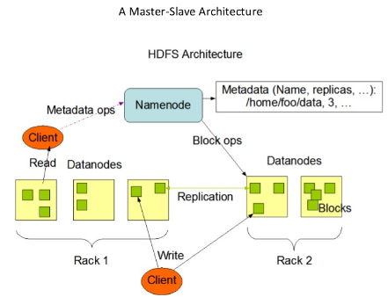
HDFS Architecture

Slide 130
HDFS: NameNode
Stores the HDFS namespace (e.g., directory structure)
Record every change to the file system metadata in a transaction log
The namespace contains file system properties and the mapping of blocks to files
Both transaction log and namespace are stored on NameNode’s local file system
  Maintains an in-memory copy all the time

Slide 131
HDFS: DataNode
Stores HDFS data blocks in its local file system
  Each block in a separate file in the local file system
DataNode knows its data blocks, but not the actual HDFS file
  That mapping is maintained by the NameNode
On startup
  Scans through the local file system
  Generates a list of all HDFS data blocks
  Sends the report (blockreport) to the NameNode

Slide 132
HDFS: Data Replication
Each data blocks are replicated into multiple copies
  Number of replicas can be specified by the application when the file is created
  Usually, it is three
Default rule for replica count 3
  One replicate at the node
  One at another node in the same rack
  One at a node in another rack
HDFS tries to read from the replica nearest to the reader

Slide 133
HDFS Goals
Write-once-read-many access model for files
Computing task are located closer to data
Provide high data bandwidth and scale to hundreds of nodes in a single cluster
Detection of faults and automatic recovery
Easily portable

Slide 134
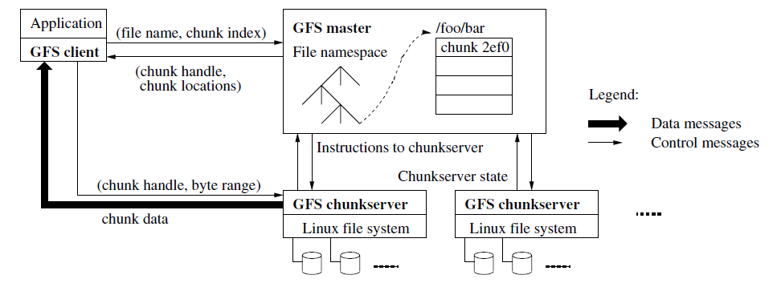
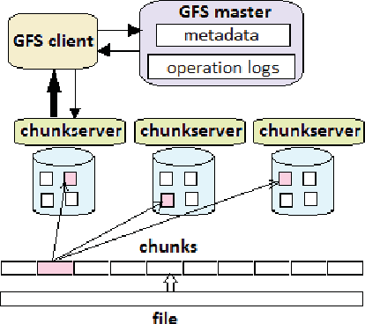
Google File System
GFS Architecture
https://research.google.com/archive/gfs-sosp2003.pdf

Slide 135
Thanks

Slide 136
Distributed Process and Resource Management
Need multiple policies to determine when and where to execute processes in distributed systems – useful for load balancing, reliability
  Load Estimation Policy
    How to estimate the workload of a node
  Process Transfer Policy
    Whether to execute a process locally or remotely
  Location Policy
    Which node to run the remote process on
  Priority Assignment Policy
    Which processes have more priority (local or remote)
  Migration Limiting policy
    Number of times a process can migrate

Slide 137
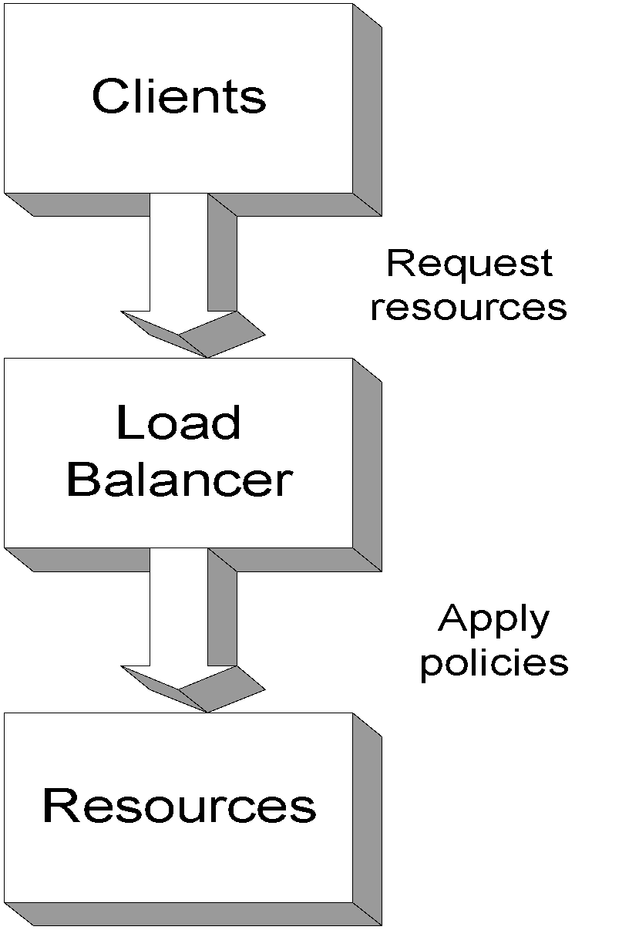
Load Balancing
Computer overloaded
  Decrease load maintain scalability, performance, throughput - transparently
  Load Balancing
    Can be thought of as “distributed scheduling”
      Deals with distribution of processes among processors connected by a network
    Can also be influenced by “distributed placement”
      Especially in data intensive applications
  Load Balancer
  Manages resources
  Policy driven Resource assignment
Global Distributed Systems and Multimedia
137

Slide 138
Load Balancing Issues
How
  To search for lightly loaded machines
When
  should load balancing decisions be made
  to migrate processes or forward requests?
Which
  processes should be moved off a computer?
  processor should be chosen to handle a given process or request
What should be taken into account when making the above decisions? How should old data be handled
Should
  load balancing data be stored and utilized centrally, or in a distributed manner
  What is the performance/overhead tradeoff incurred by load balancing
  Prevention of overloading a lightly loaded computer
Global Distributed Systems and Multimedia
138

Slide 139
Static vs. dynamic
Static load balancing - CPU determined at process creation.
Dynamic load balancing - processes dynamically migrate to other computers to balance the CPU (or memory) load.
    Parallel machines - dynamic balancing schemes seek to minimize total execution time of a single application running in parallel on a multiple nodes
    Web servers - scheduling client requests among multiple nodes in a transparent way to improve response times for interaction
    Multimedia servers - resource optimization across streams and servers for QoS; may require admission control

Slide 140
Dynamic Load Balancing
Dynamic Load Balancing on Highly Parallel Computers
- dynamic balancing schemes which seek to minimize total execution time of a single application running in parallel on a multiprocessor system
1. Sender Initiated Diffusion (SID)
2. Receiver Initiated Diffusion(RID)
3. Hierarchical Balancing Method (HBM)
4. Gradient Model (GM)
5. Dynamic Exchange method (DEM)
Dynamic Load Balancing on Web Servers
dynamic load balancing techniques in distributed web-server architectures , by scheduling client requests among multiple nodes in a transparent way
1. Client-based approach
2. DNS-Based approach
3. Dispatcher-based approach
4. Server-based approach

Slide 141
Dynamic Load Balancing – MM Servers
Adapts to statistical fluctuations and changing access patterns
Adaptive Scheduling
  Assigns requests to servers based on demand and load factors.
  Invokes replication-on-demand, request migration
  Load factor(LF) for a request represents how far a server is from request admission threshold.
  LF (Ri, Sj) = max (Dbi/DBj , Mi/Mj , CPUi/CPUj , Xi/Xj)
Dynamic Migration - Deals with poor initial placement
Predictive Placement through Replication
  Dynamic Segment Replication
    partial replication
    quick response, less expensive
  Total Replication
    on-demand vs. predictive
  Eager Replication, Lazy Dereplication
Data
Source
S1
Data
Source
S2
Storage:
8 objects
Bandwidth:
3 requests
Storage:
2 objects
Bandwidth:
8 requests
Access Network
...
Global Distributed Systems and Multimedia
141

Slide 142
Process Migration
Process migration mechanism
  Freeze the process on the source node and restart it at the destination node
  Transfer of the process address space
  Forwarding messages meant for the migrant process
  Handling communication between cooperating processes separated as a result of migration
  Handling child processes
Migration architectures
  One image system
  Point of entrance dependent system (the deputy concept)

Slide 143
A Mosix Cluster
Mosix (from Hebrew U): Kernel level enhancement to Linux that provides dynamic load balancing in a network of workstations.
Dozens of PC computers connected by local area network (Fast-Ethernet or Myrinet).
Any process can migrate anywhere anytime.

Slide 144
Architectures for Migration
Architecture that fits one system image.
Needs location transparent file system.
(Mosix early versions)
Architecture that fits entrance dependant systems.
Easier to implement based on current Unix.
(Mosix later versions)

Slide 145
Mosix: Migration and File Access
Each file access must go back to deputy…
= = Very Slow for I/O apps.
Solution: Allow processes to access a distributed file system through the current kernel.

Slide 146
Mosix: File Access
DFSA
  Requirements (cache coherent, monotonic timestamps, files not deleted until all nodes finished)
  Bring the process to the files.
MFS
  Single cache (on server)
  /mfs/1405/var/tmp/myfiles

Slide 147
Process Migration: Other Factors
Not only CPU load!!!
Memory.
I/O - where is the physical device?
Communication - which processes communicate with which other processes?

Slide 148
Process Migration and Heterogeneous Systems
Converts usage of heterogeneous resources (CPU, memory, IO) into a single, homogeneous cost using a specific cost function.
Assigns/migrates a job to the machine on which it incurs the lowest cost.
  Can design online job assignment policies based on multiple factors - economic principles, competitive analysis.
  Aim to guarantee near-optimal global lower-bound performance.

Slide 149
Distributed File Systems (DFS)
A distributed implementation of the classical file system model
Requirements
  Transparency: Access, Location, Mobility, Performance, Scaling
  Allow concurrent access
  Allow file replication
  Tolerate hardware and operating system heterogeneity
  Security - Access control, User authentication
Issues
  File and directory naming – Locating the file
  Semantics – client/server operations, file sharing
  Performance
  Fault tolerance – Deal with remote server failures
  Implementation considerations - caching, replication, update protocols

Slide 150
Issues: File and Directory Naming
Explicit Naming
  Machine + path /machine/path
    one namespace but not transparent
Implicit naming
  Location transparency
    file name does not include name of the server where the file is stored
  Mounting remote filesystems onto the local file hierarchy
    view of the filesystem may be different at each computer
  Full naming transparency
    A single namespace that looks the same on all machines

Slide 151
Semantics - Operational
Support fault tolerant operation
  At-most-once semantics for file operations
  At-least-once semantics with a server protocol designed in terms of idempotent file operations
  Replication (stateless, so that servers can be restarted after failure)

Slide 152
Semantics – File Sharing
  One-copy semantics
    Updates are written to the single copy and are available immediately
    all clients see contents of file identically as if only one copy of file existed
    if caching is used: after an update operation, no program can observe a discrepancy between data in cache and stored data
  Serializability
    Transaction semantics (file locking protocols implemented - share for read, exclusive for write).
  Session semantics
    Copy file on open, work on local copy and copy back on close

Slide 153
DFS Performance
Efficiency Needs
  Latency of file accesses
  Scalability (e.g., with increase of number of concurrent users)
RPC Related Issues
  Use RPC to forward every file system request (e.g., open, seek, read, write, close, etc.) to the remote server
    Remote server executes each operation as a local request
    Remote server responds back with the result
  Advantage:
    Server provides a consistent view of the file system to distributed clients.
  Disadvantage:
    Poor performance
    Solution: Caching

Slide 154
Traditional File system Operations
EXTRA Slide
filedes = open(name, mode) Opens an existing file with the given name.
filedes = creat(name, mode) Creates a new file with the given name.
Both operations deliver a file descriptor referencing the open file. The mode is read, write or both.
status = close(filedes) Closes the open file filedes.
count = read(filedes, buffer, n) Transfers n bytes from the file referenced by filedes to buffer.
count = write(filedes, buffer, n) Transfers n bytes to the file referenced by filedes from buffer.
Both operations deliver the number of bytes actually transferred and advance the read-write pointer.
pos = lseek(filedes, offset, whence) Moves the read-write pointer to offset (relative or absolute, depending on whence).
status = unlink(name) Removes the file name from the directory structure. If the file has no other names, it is deleted.
status = link(name1, name2) Adds a new name (name2) for a file (name1).
status = stat(name, buffer) Gets the file attributes for file name into buffer.

Slide 155
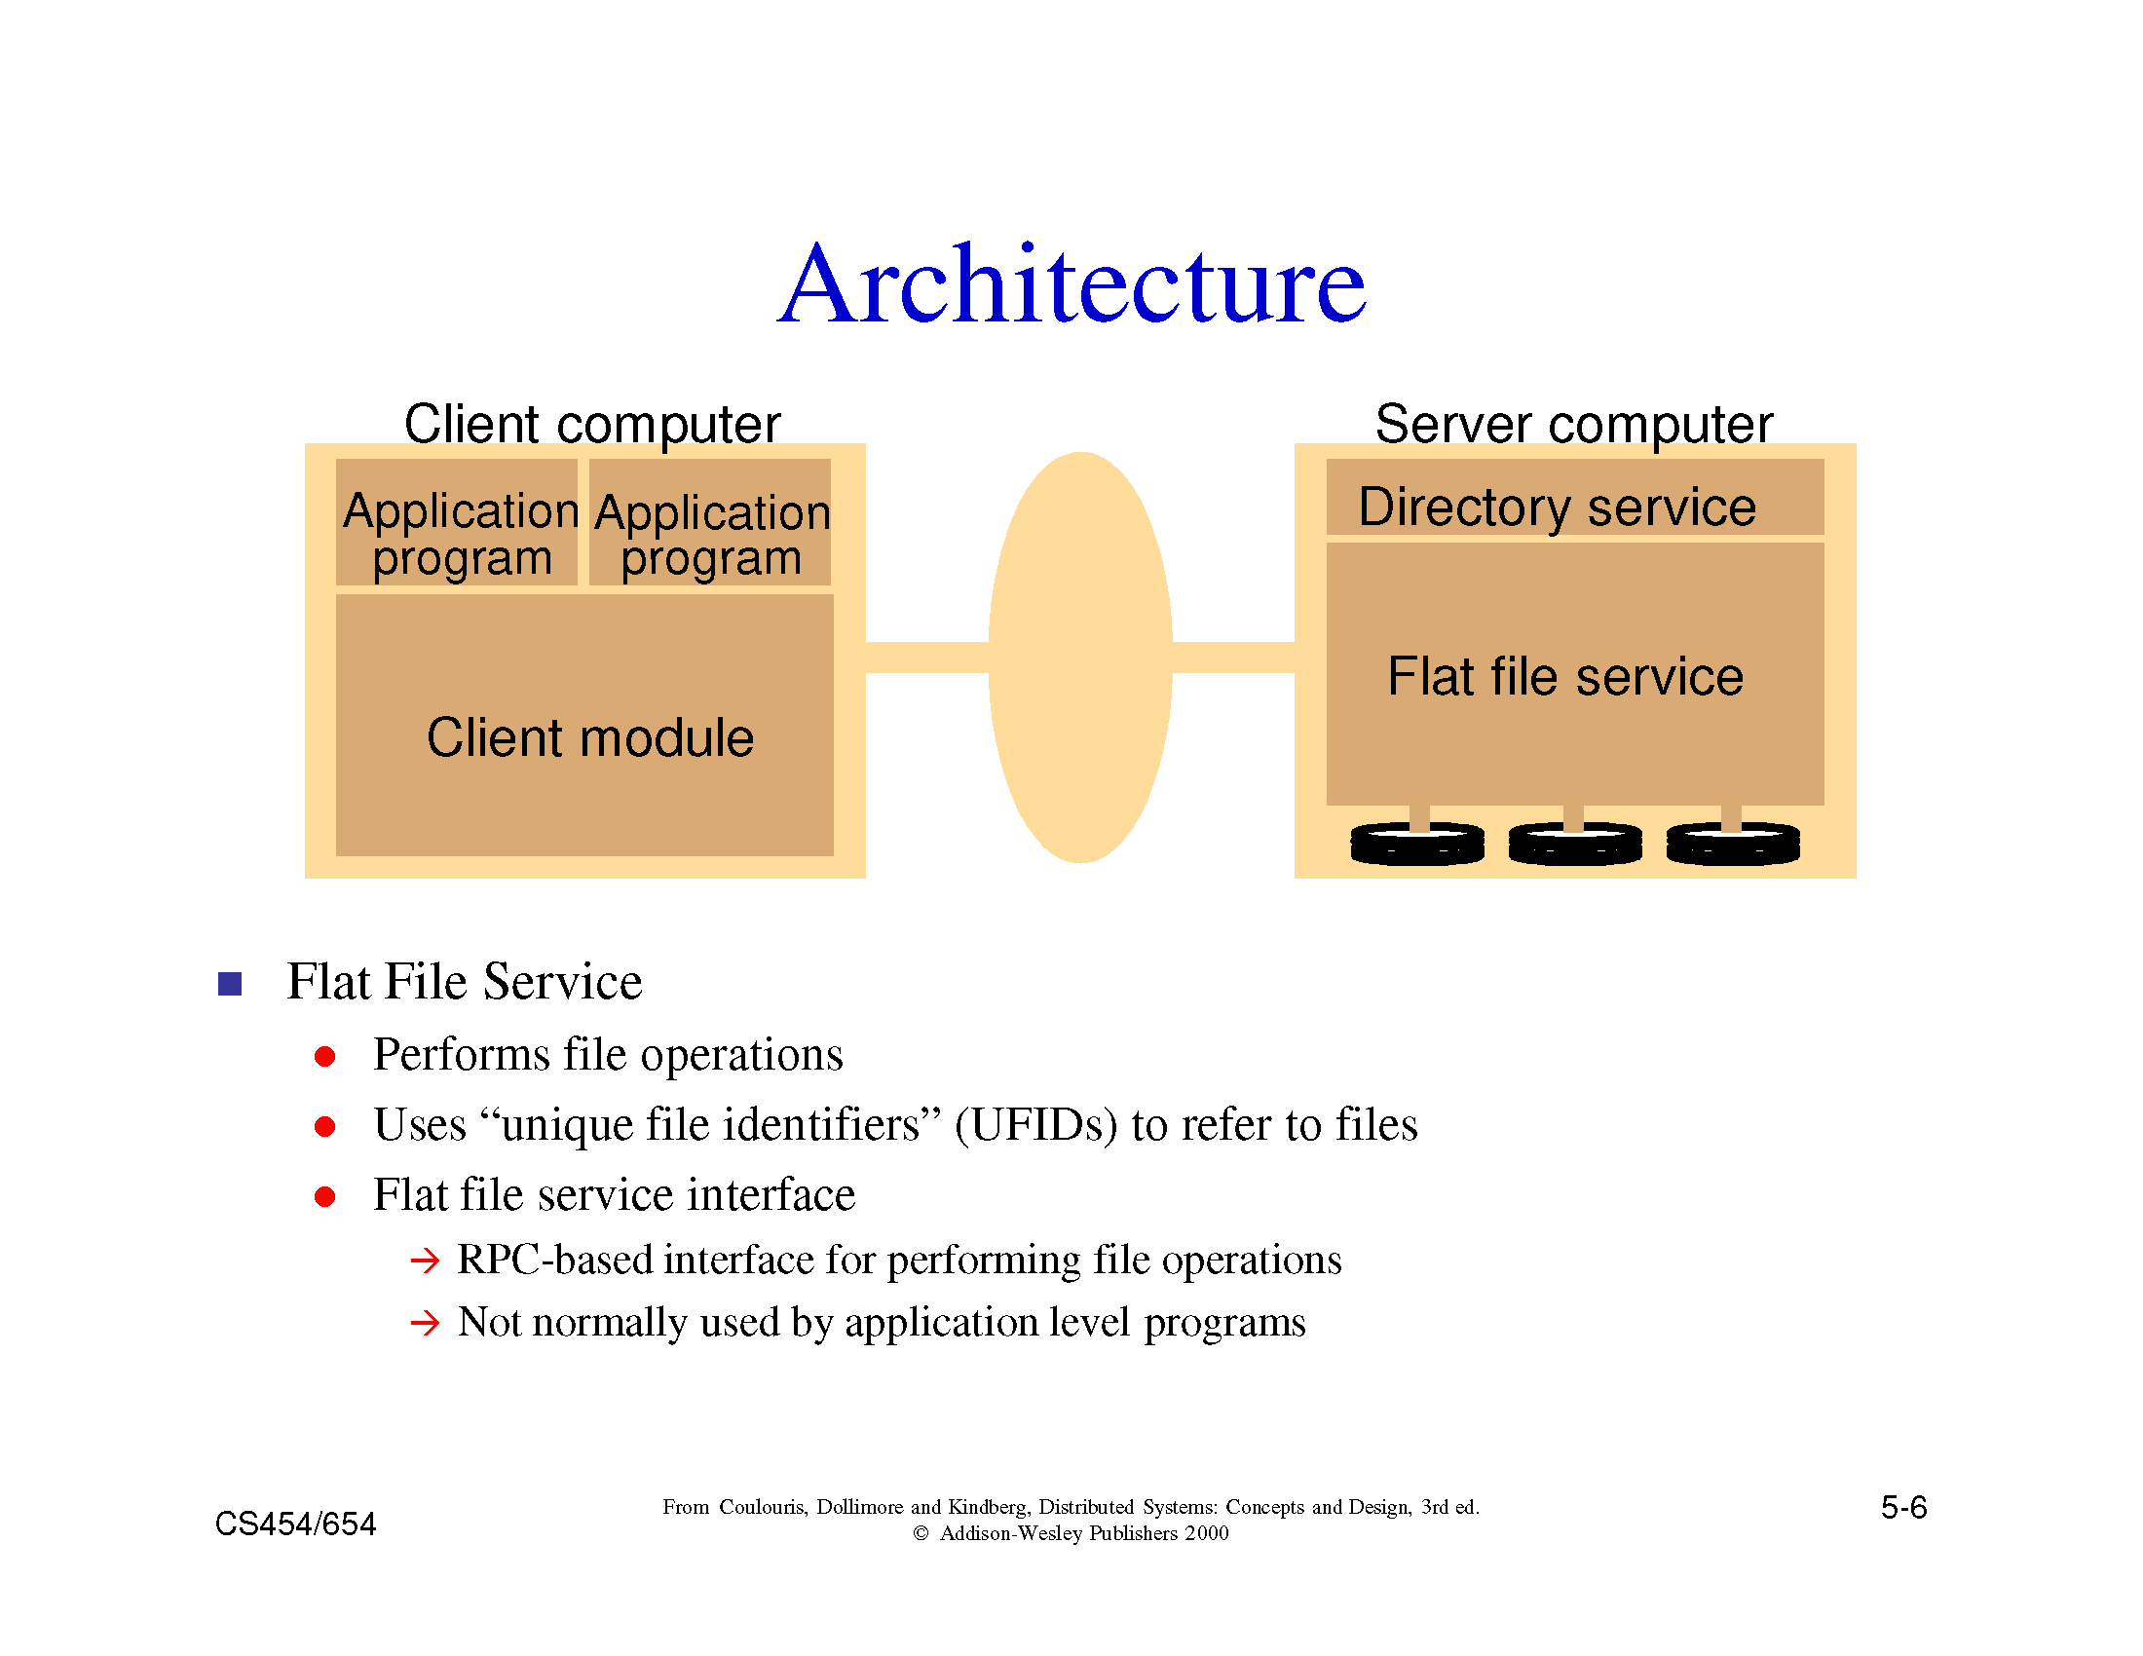

Slide 156
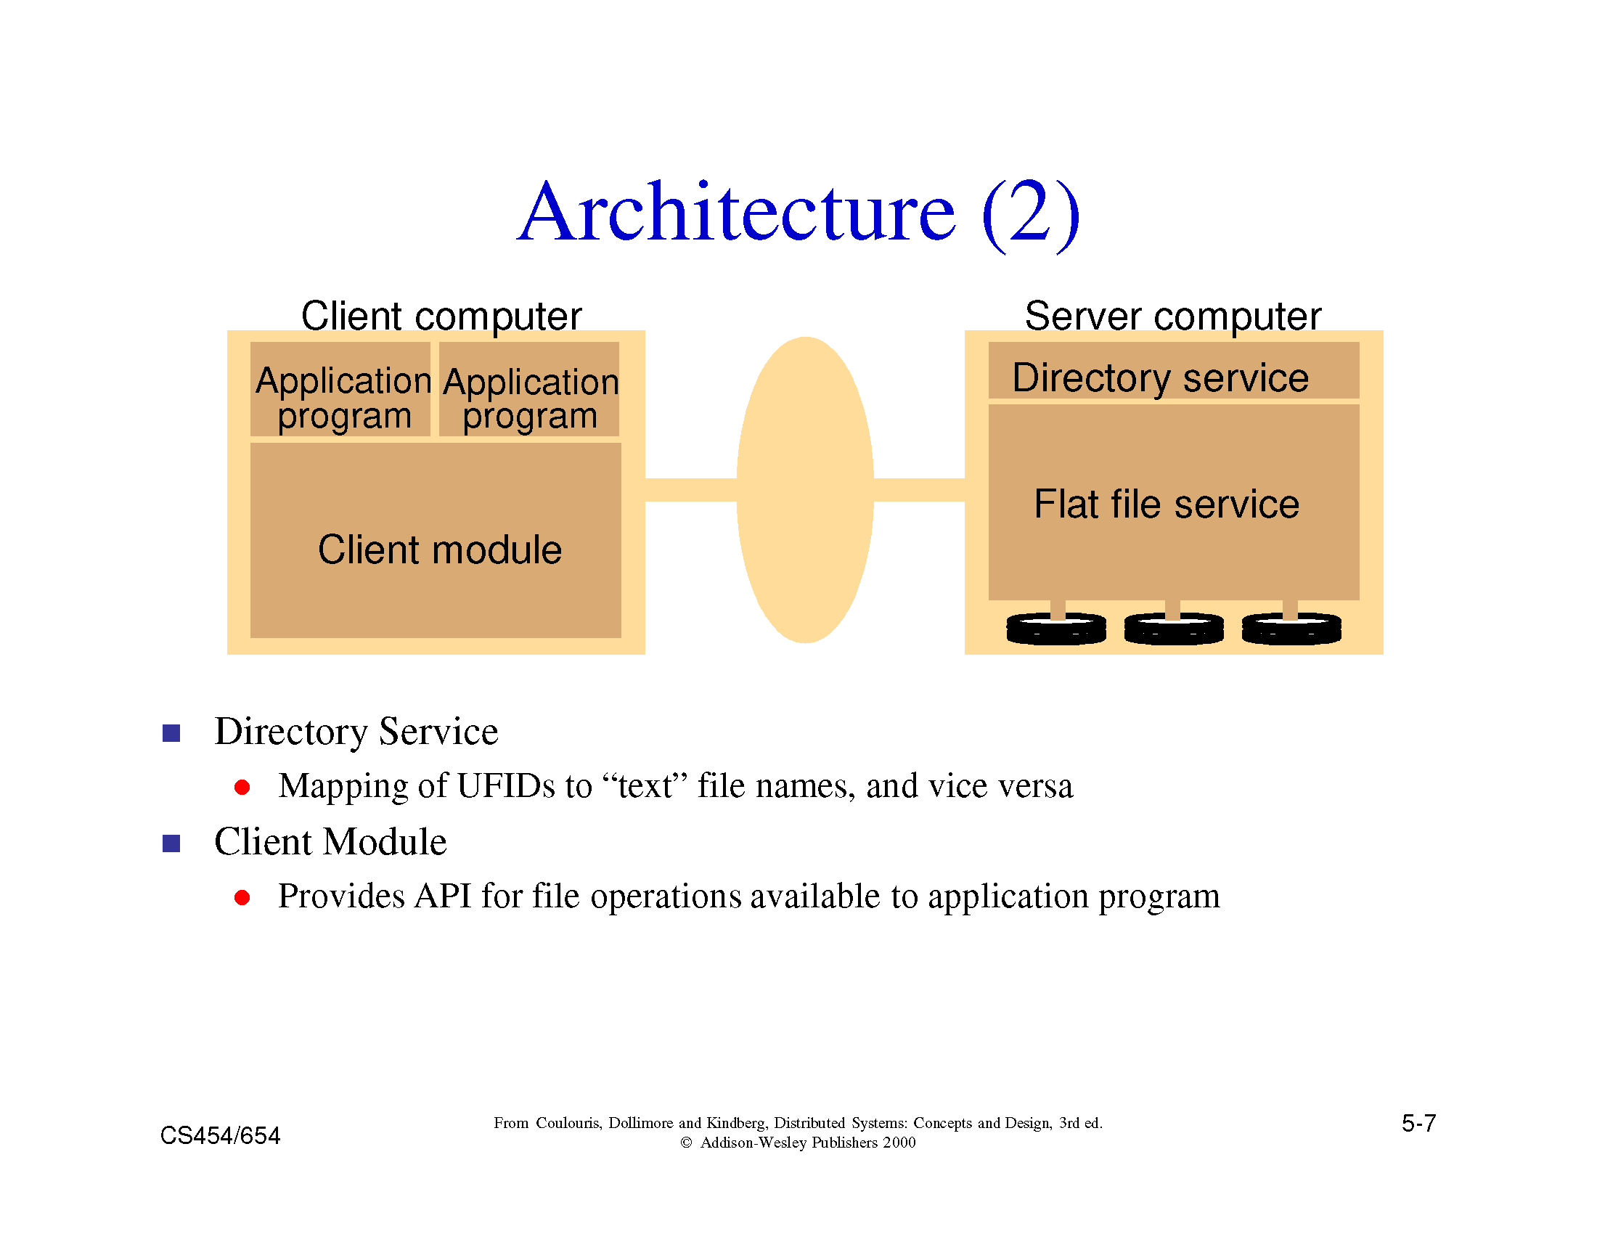

Slide 157
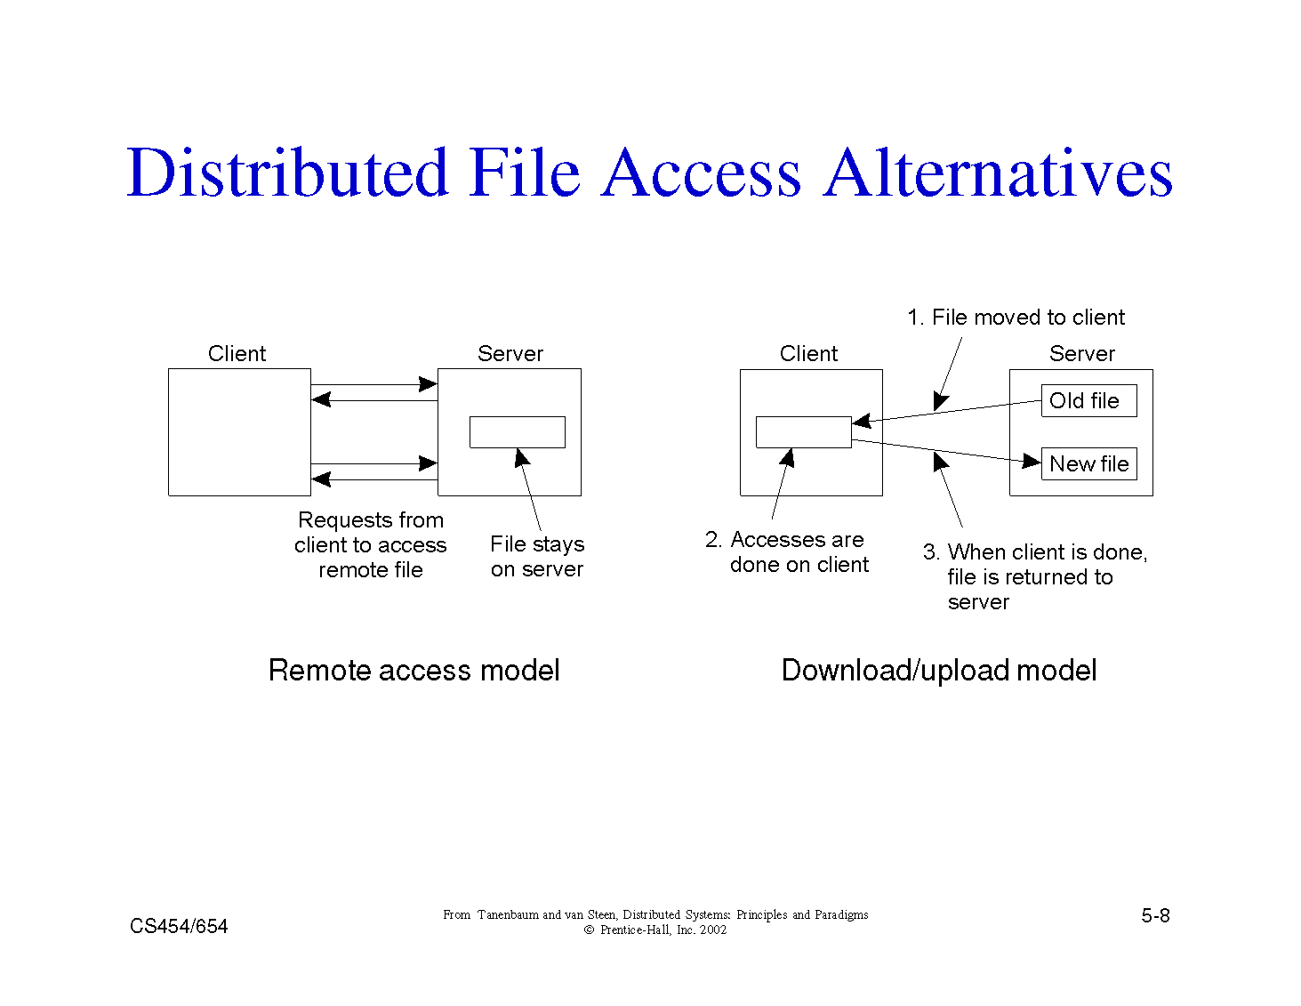

Slide 158
Example 1: Sun-NFS
Supports heterogeneous systems
  Architecture
    Server exports one or more directory trees for access by remote clients
    Clients access exported directory trees by mounting them to the client local tree
    Diskless clients mount exported directory to the root directory
  Protocols
    Mounting protocol
    Directory and file access protocol - stateless, no open-close messages, full access path on read/write
  Semantics - no way to lock files

Slide 159
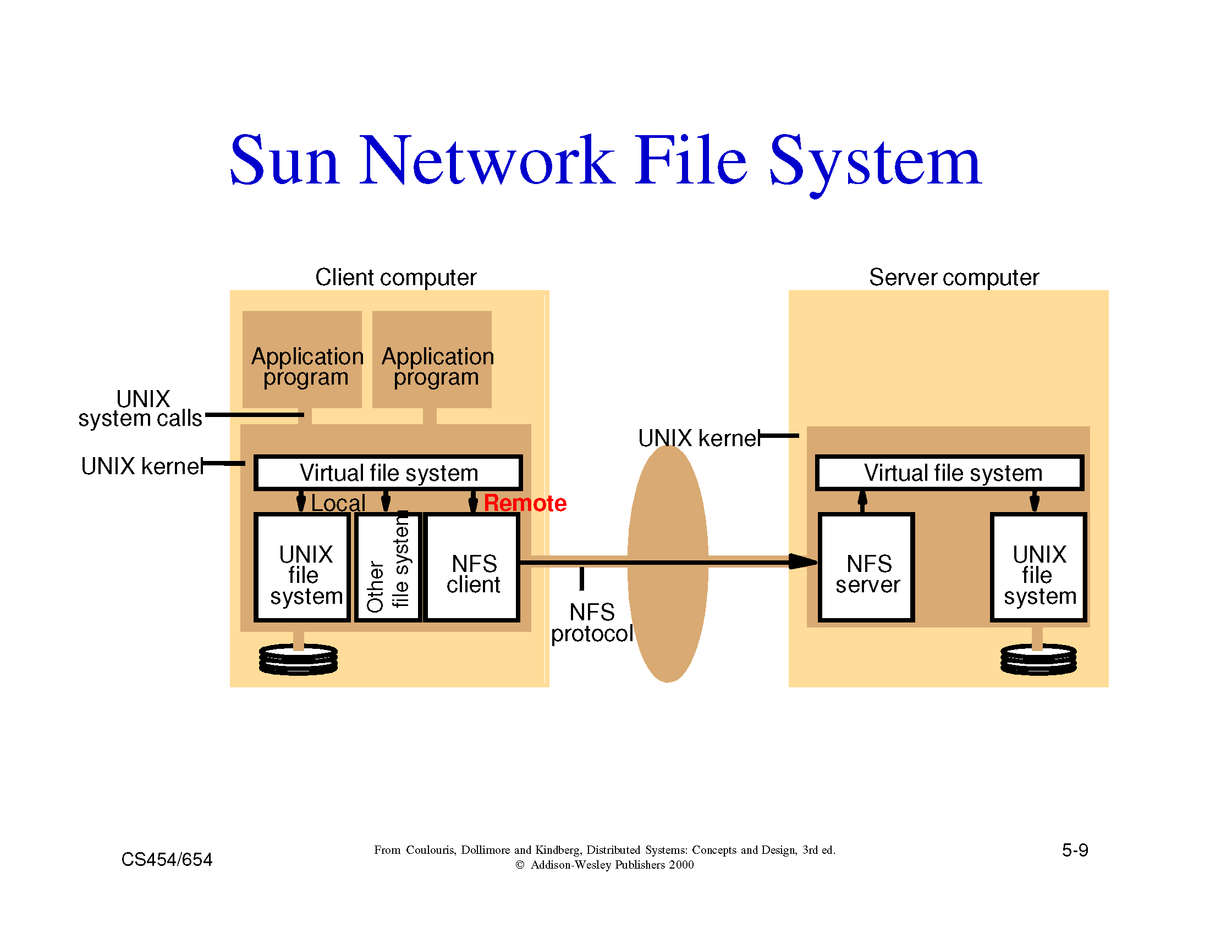

Slide 160
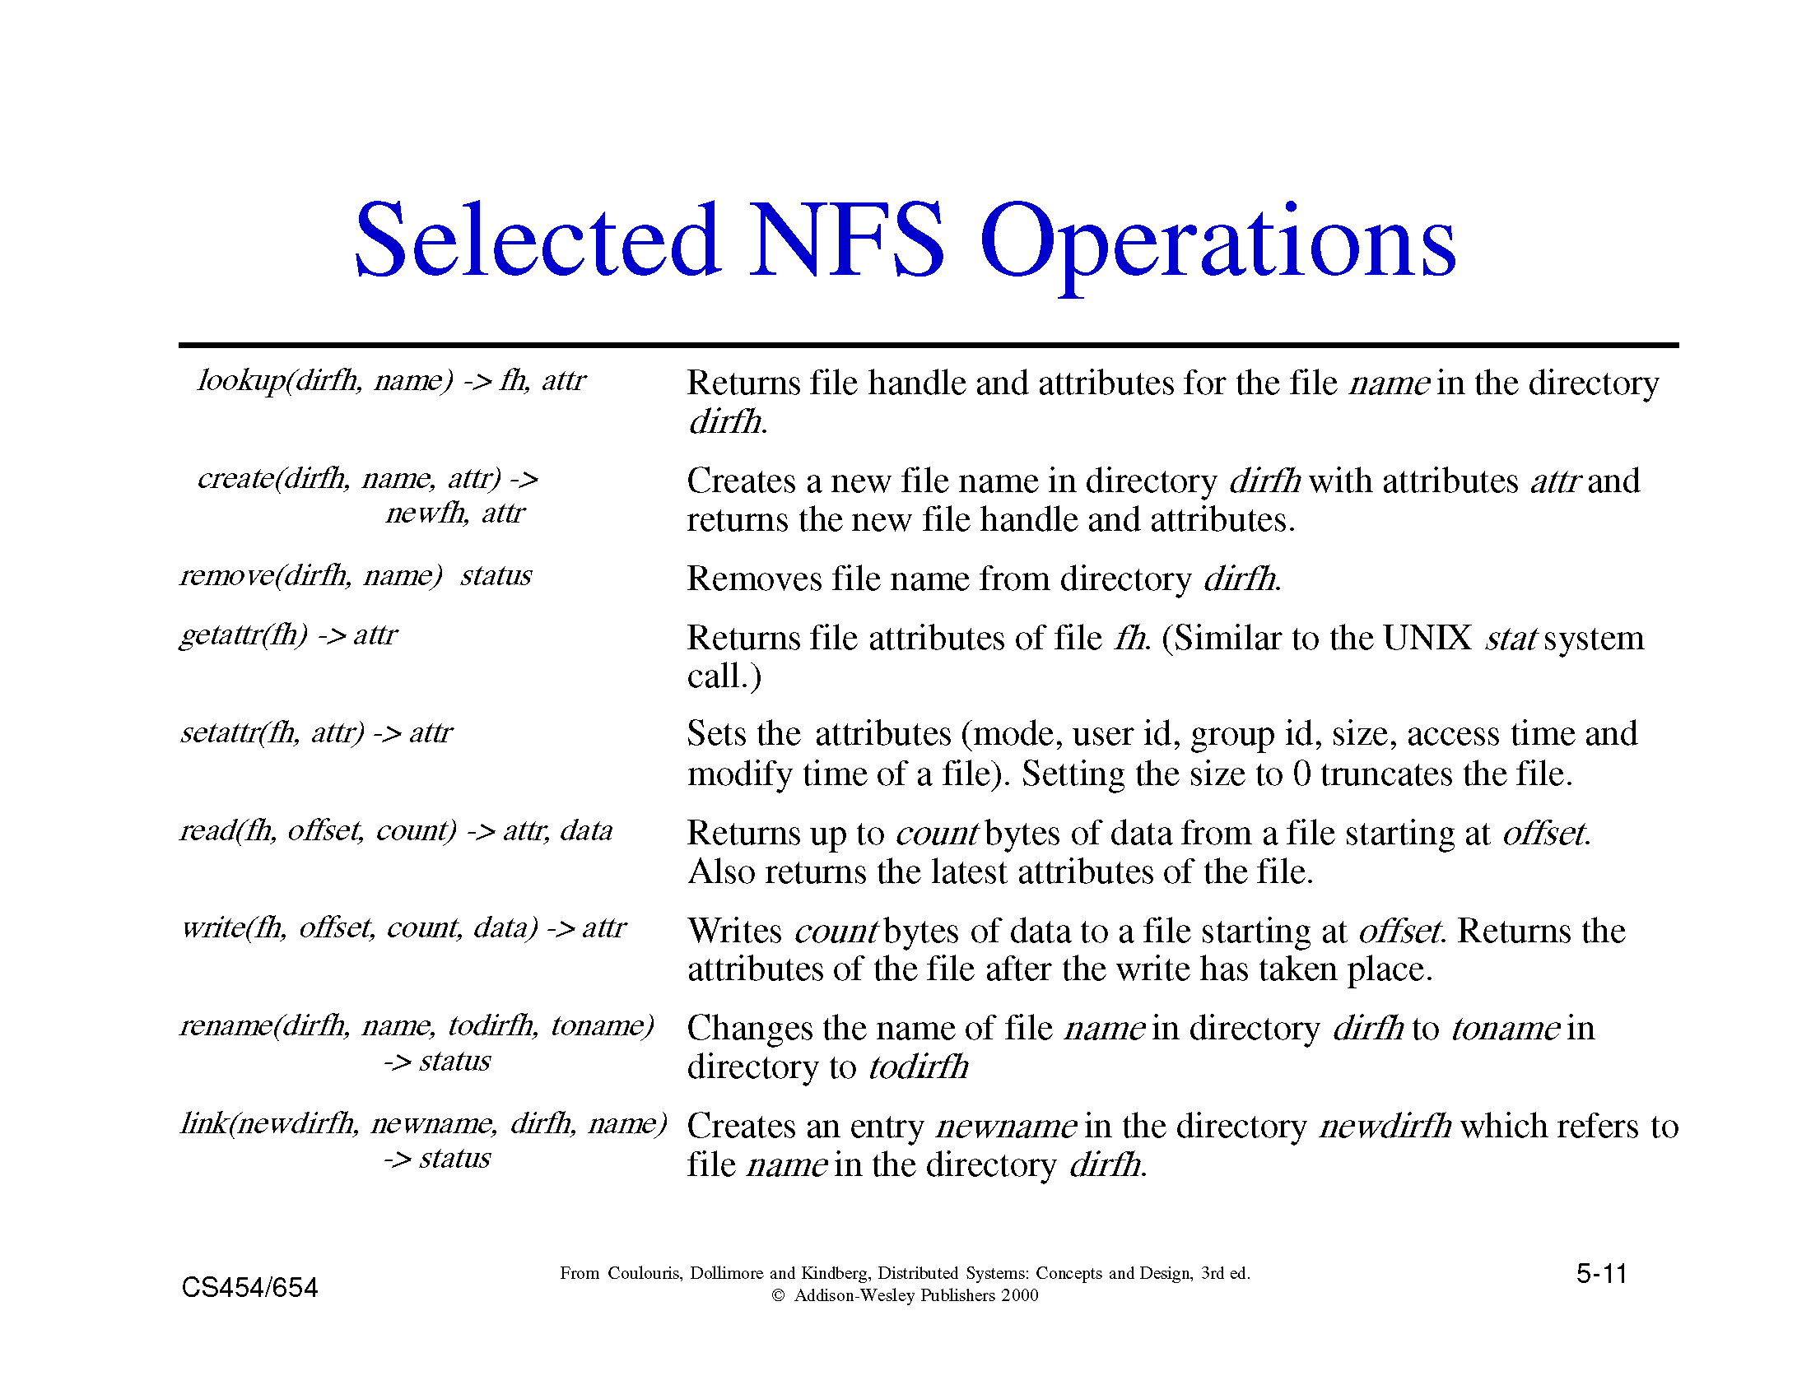
EXTRA Slide

Slide 161
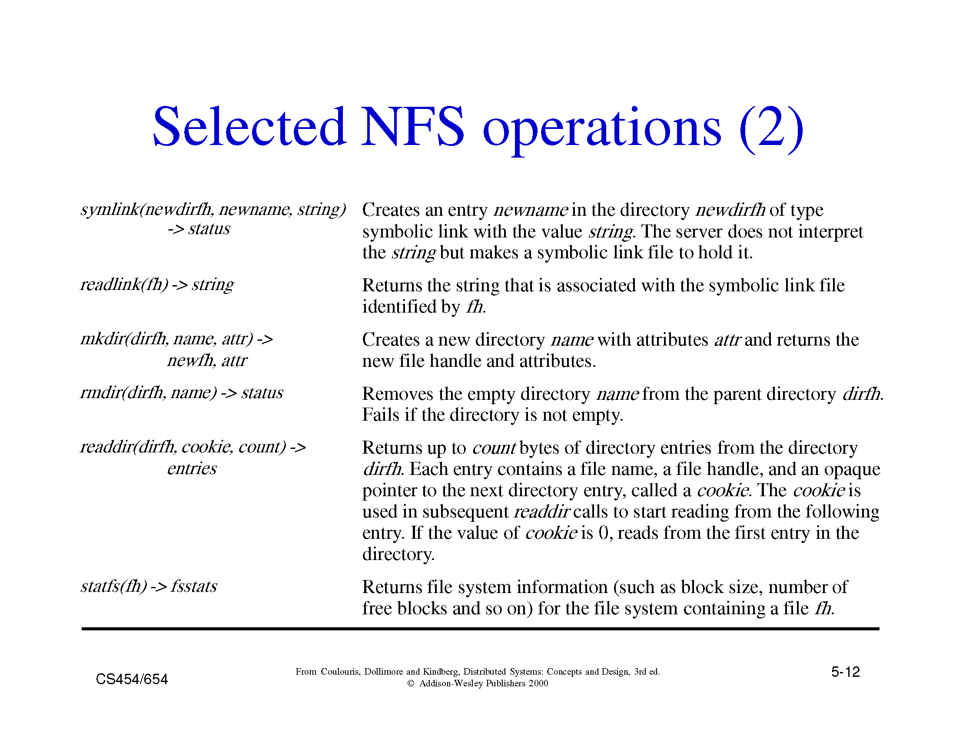
EXTRA Slide

Slide 162


Slide 163


Slide 164

EXTRA Slide

Slide 165

EXTRA Slide

Slide 166
Example 2: Andrew File System
Supports information sharing on a large scale
Uses a session semantics
  Entire file is copied to the local machine (Venus) from the server (Vice) when open. If file is changed, it is copied to server when closed.
    Works because in practice, most files are changed by one person
AFS File Validation (older versions)
  On open: Venus accesses Vice to see if its copy of the file is still valid. Causes a substantial delay even if the copy is valid.
  Vice is stateless

Slide 167
Example 3: The Coda Filesystem
Descendant of AFS that is substantially more resilient to server and network failures.
General Design Principles
  know the clients have cycles to burn, cache whenever possible, exploit usage properties, minimize system wide change, trust the fewest possible entries and batch if possible
Directories are replicated in several servers (Vice)
Support for mobile users
  When the Venus is disconnected, it uses local versions of files. When Venus reconnects, it reintegrates using optimistic update scheme.

Slide 168
Other DFS Challenges
Naming
  Important for achieving location transparency
  Facilitates Object Sharing
  Mapping is performed using directories. Therefore name service is also known as Directory Service
Security
  Client-Server model makes security difficult
  Cryptography based solutions

