Slide 1
Distributed Computing Concepts - Global Time and State in Distributed Systems
Prof. Nalini Venkatasubramanian
Distributed Systems Middleware - Lecture 2

Slide 2
Global Time & Global States of Distributed Systems
Asynchronous distributed systems consist of several processes without common memory which communicate (solely) via messages with unpredictable transmission delays
Global time & global state are hard to realize in distributed systems
  Rate of event occurrence is very high
  Event execution times are very small
We can only approximate the global view
  Simulate synchronous distributed system on a given asynchronous system
  Simulate a global time – Clocks (Physical and Logical)
  Simulate a global state – Global Snapshots

Slide 3
Simulate Synchronous
Distributed Systems
Synchronizers [Awerbuch 85]
  Simulate clock pulses in such a way that a message is only generated at a clock pulse and will be received before the next pulse
  Drawback
    Very high message overhead

Slide 4
The Concept of Time in Distributed Systems
A standard time is a set of instants with a temporal precedence order < satisfying certain conditions [Van Benthem 83]:
    Irreflexivity
    Transitivity
    Linearity
    Eternity (∀x∃y: x<y)
    Density (∀x,y: x<y → ∃z: x<z<y)
  Transitivity and Irreflexivity imply asymmetry
A linearly ordered structure of time is not always adequate for distributed systems
  Captures dependence, not independence of distributed activities
Time as a partial order
  A partially ordered system of vectors forming a lattice structure is a natural representation of time in a distributed system.

Slide 5
Global time in distributed systems
An accurate notion of global time is difficult to achieve in distributed systems.
  Uniform notion of time is necessary for correct operation of many applications (mission critical distributed control, online games/entertainment, financial apps, smart environments etc.)
Clocks in a distributed system drift
  Relative to each other
  Relative to a real world clock
    Determination of this real world clock itself may be an issue
Clock synchronization is needed to simulate global time
  Physical Clocks vs. Logical clocks
    Physical clocks are logical clocks that must not deviate from the real-time by more than a certain amount.
We often derive causality of events from loosely synchronized clocks

Slide 6
Physical Clock Synchronization

Slide 7
Physical Clocks
How do we measure real time?
  17th century - Mechanical clocks based on astronomical measurements
    Solar Day - Transit of the sun
    Solar Seconds - Solar Day/(3600*24)
  Problem (1940) - Rotation of the earth varies (gets slower)
  Mean solar second - average over many days
  UT1 -- astronomical observation at 0 deg. longitude (GMT)
Date | Duration in mean solar time
February 11 | 24 hours
March 26 | 24 hours − 18.1 seconds
May 14 | 24 hours
June 19 | 24 hours + 13.1 seconds
July 26 | 24 hours
September 16 | 24 hours − 21.3 seconds
November 3 | 24 hours
December 22 | 24 hours + 29.9 seconds
Length of apparent solar day (1998) – (cf: wikipedia ⁾

Slide 8
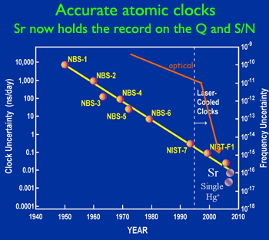
Atomic Clocks
1948 - Counting transitions of a crystal (Cesium 133, quartz) used as atomic clock
  crystal oscillates at a well known frequency
2014 – NIST-F2 Atomic clock
  Accuracy: ± 1 sec in 300 mil years
  NIST-F2 measures particular transitions in Cesium atom (9,192,631,770 vibrations per second), in much colder environment, minus 316F, than NIST-F1
TAI - International Atomic Time
  9,192,631,779 transitions = 1 mean solar second in 1958
UTC (Universal Coordinated Time)
From time to time, UTC skips a solar second to stay in phase with the sun (30+ times since 1958)
UTC is broadcast by several sources (satellites…)

Slide 9
How Clocks Work in Computers
Holding register
Quartz crystal
Oscillation at a well-defined frequency
Each crystal oscillation decrements the counter by 1
When counter gets 0, its value reloaded from the holding register
Counter
When counter is 0, an interrupt is generated, which is call a clock tick
CPU
At each clock tick, an interrupt service procedure add 1 to time stored in memory
Memory
From Distributed Systems (cs.nju.edu.cn/distribute-systems/lecture-notes/
‹#›

Slide 10
Accuracy of Computer Clocks
Modern timer chips have a relative error of 1/100,000 - 0.86 seconds a day
To maintain synchronized clocks
  Can use UTC source (time server) to obtain current notion of time (use RPC)
  Use solutions without UTC.

Slide 11
Cristian’s (Time Server) Algorithm
Uses a time server to synchronize clocks
  Time server keeps the reference time (say UTC)
  A client asks the time server for time, the server responds with its current time, and the client uses the received value to set its clock
But network round-trip time introduces errors…
  Let RTT = response-received-time – request-sent-time (measurable at client),
  If we know (a) min = minimum client-server one-way transmission time and (b) that the server timestamped the message at the last possible instant before sending it back
  Then, the actual time could be between [T+min,T+RTT— min]

Slide 12
Cristian’s Algorithm
Client sets its clock to halfway between T+min and T+RTT— min i.e., at T+RTT/2
  ☹ Expected (i.e., average) skew in client clock time = (RTT/2 – min)
Can increase clock value, should never decrease it.
Can adjust speed of clock too (either up or down is ok)
Multiple requests to increase accuracy
  For unusually long RTTs, repeat the time request
  For non-uniform RTTs
    Drop values beyond threshold; Use averages (or weighted average)

Slide 13
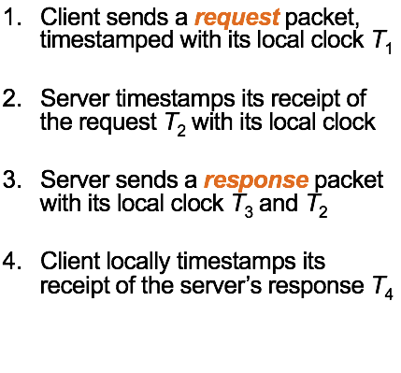
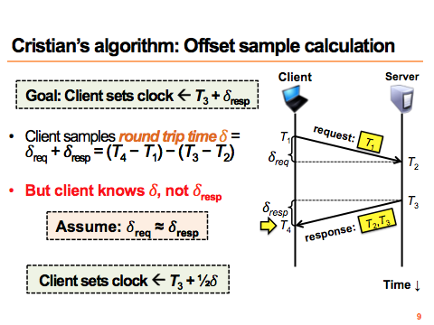

Cristian’s Algorithm - Summary (cf. Princeton course)

Slide 14
Berkeley UNIX algorithm
One Version
  One daemon without UTC
  Periodically, this daemon polls and asks all the machines for their time
  The machines respond.
  The daemon computes an average time and then broadcasts this average time.
Another Version
  Master/daemon uses Cristian’s algorithm to calculate time from multiple sources, removes outliers, computes average and broadcasts

Slide 15
Decentralized Averaging Algorithm
Each machine has a daemon without UTC
Periodically, at fixed agreed-upon times, each machine broadcasts its local time.
Each of them calculates the average time by averaging all the received local times.

Slide 16
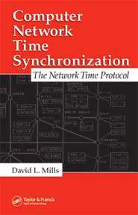
Network Time Protocol (NTP)
Most widely used physical clock synchronization protocol on the Internet (http://www.ntp.org)
  Currently used: NTP V3 and V4
10-20 million NTP servers and clients in the Internet
Claimed Accuracy (Varies)
  milliseconds on WANs, submilliseconds on LANs, submicroseconds using a precision timesource
  Nanosecond NTP in progress

Slide 17
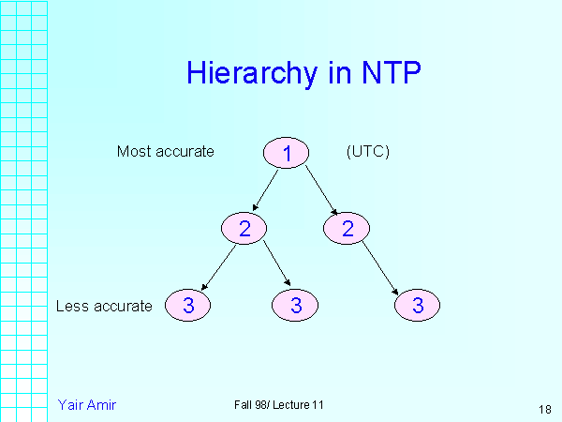
NTP Design
Hierarchical tree of time servers.
  The primary server at the root synchronizes with the UTC.
  The next level contains secondary servers, which act as a backup to the primary server.
  At the lowest level is the synchronization subnet which has the clients.
  Variant of Cristian’s algorithm that does not use RTT’s, but multiple 1-way messages

Slide 18
DCE Distributed Time Service
Software service that provides precise, fault-tolerant clock synchronization for systems in local area networks (LANs) and wide area networks (WANs).
determine duration, perform event sequencing and scheduling.
  Each machine is either a time server or a clerk
software components on a group of cooperating systems;
  client obtains time from DTS entity
  DTS entities
    DTS server
    DTS clerk that obtain time from DTS servers on other hosts

Slide 19
Clock Synchronization in DCE
DCE’s time model is actually in an interval
  I.e. time in DCE is actually an interval
  Comparing 2 times may yield 3 answers
    t1 < t2, t2 < t1, not determined
  Periodically a clerk obtains time-intervals from several servers ,e.g. all the time servers on its LAN
  Based on their answers, it computes a new time and gradually converges to it.
    Compute the intersection where the intervals overlap. Clerks then adjust the system clocks of their client systems to the midpoint of the computed intersection.
    When clerks receive a time interval that does not intersect with the majority, the clerks declare the non-intersecting value to be faulty.
    Clerks ignore faulty values when computing new times, thereby ensuring that defective server clocks do not affect clients.

Slide 20
Spanner: Google's Globally Distributed Database
and the TrueTime Architecture
https://youtu.be/NthK17nbpYs

Slide 21
Logical Clock Synchronization

Slide 22
Causal Relations
Distributed application results in a set of distributed events
  Induces a partial order 🡪 causal precedence relation
Knowledge of this causal precedence relation is useful in reasoning about and analyzing the properties of distributed computations
  Liveness and fairness in mutual exclusion
  Consistency in replicated databases
  Distributed debugging, checkpointing

Slide 23
Logical Clocks
Used to determine causality in distributed systems
Time is represented by non-negative integers
Event structures represent distributed computation (in an abstract way)
  A process can be viewed as consisting of a sequence of events, where an event is an atomic transition of the local state which happens in no time
  Process Actions can be modeled using the 3 types of events
    Send Message
    Receive Message
    Internal (change of state)

Slide 24
Logical Clocks
A logical Clock C is some abstract mechanism which assigns to any event e∈E the value C(e) of some time domain T such that certain conditions are met
    C:E→T :: T is a partially ordered set : e<e’→C(e)<C(e’) holds
Consequences of the clock condition [Morgan 85]:
  Events occurring at a particular process are totally ordered by their local sequence of occurrence
    If an event e occurs before event e’ at some single process, then event e is assigned a logical time earlier than the logical time assigned to event e’
  For any message sent from one process to another, the logical time of the send event is always earlier than the logical time of the receive event
    Each receive event has a corresponding send event
    Future can not influence the past (causality relation)

Slide 25
Event Ordering
Lamport defined the “happens before” (=>) relation
  If a and b are events in the same process, and a occurs before b, then a => b.
  If a is the event of a message being sent by one process and b is the event of the message being received by another process, then a => b.
  If X =>Y and Y=>Z then X => Z.
  If a => b then time (a) => time (b)

Slide 26
Event Ordering- the example
Processor Order: e precedes e’ in the same process
Send-Receive: e is a send and e’ is the corresponding receive
Transitivity: exists e’’ s.t. e < e’’ and e’’< e’
Example:
global time
P1
e11
e12
e13
e14
Program order: e13 < e14
Send-Receive: e23 < e12
Transitivity: e21 < e32
e21
e22
e23
P2
e31
e32
P3

Slide 27
Causal Ordering
“Happens Before” also called causal ordering
Possible to draw a causality relation between 2 events if
  They happen in the same process
  There is a chain of messages between them
“Happens Before” notion is not straightforward in distributed systems
  No guarantees of synchronized clocks
  Communication latency

Slide 28
Implementation of Logical Clocks
Requires
  Data structures local to every process to represent logical time and
  a protocol to update the data structures to ensure the consistency condition.
Each process Pi maintains data structures that allow it the following two capabilities:
  A local logical clock, denoted by LC_i , that helps process Pi measure its own progress.
  A logical global clock, denoted by GCi , that is a representation of process Pi ’s local view of the logical global time. Typically, lci is a part of gci
The protocol ensures that a process’s logical clock, and thus its view of the global time, is managed consistently.
  The protocol consists of the following two rules:
    R1: This rule governs how the local logical clock is updated by a process when it executes an event.
    R2: This rule governs how a process updates its global logical clock to update its view of the global time and global progress.

Slide 29
Types of Logical Clocks
Systems of logical clocks differ in their representation of logical time and also in the protocol to update the logical clocks.
3 kinds of logical clocks
  Scalar
  Vector
  Matrix

Slide 30
Scalar Logical Clocks - Lamport
Proposed by Lamport in 1978 as an attempt to totally order events in a distributed system.
Time domain is the set of non-negative integers.
The logical local clock of a process pi and its local view of the global time are squashed into one integer variable Ci .
Monotonically increasing counter
  No relation with real clock
Each process keeps its own logical clock used to timestamp events

Slide 31
Consistency with Scalar Clocks
To guarantee the clock condition, local clocks must obey a simple protocol:
  When executing an internal event or a send event at process P_{i} the clock C_{i} ticks
      C_{i} += d (d>0)
  When P_{i} sends a message m, it piggybacks a logical timestamp t which equals the time of the send event
  When executing a receive event at P_{i} where a message with timestamp t is received, the clock is advanced
      C_{i} = max(C_{i},t)+d (d>0)
Results in a partial ordering of events.

Slide 32
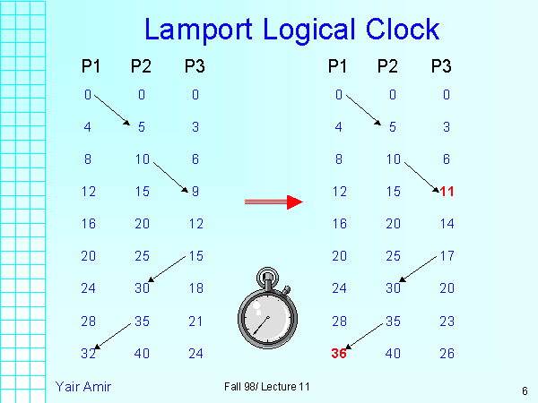

Slide 33
Total Ordering
Extending partial order to total order
Global timestamps:
  (Ta, Pa) where Ta is the local timestamp and Pa is the process id.
  (Ta,Pa) < (Tb,Pb) iff
    (Ta < Tb) or ( (Ta = Tb) and (Pa < Pb))
  Total order is consistent with partial order.
time
Proc_id

Slide 34
Properties of Scalar Clocks
Event counting
  If the increment value d is always 1, the scalar time has the following interesting property: if event e has a timestamp h, then h-1 represents the minimum logical duration, counted in units of events, required before producing the event e;
  We call it the height of the event e.
  In other words, h-1 events have been produced sequentially before the event e regardless of the processes that produced these events.

Slide 35
Properties of Scalar Clocks
No Strong Consistency
The system of scalar clocks is not strongly consistent; that is, for two events ei and ej , C(ei ) < C(ej ) does not imply ei → ej .
Reason: In scalar clocks, logical local clock and logical global clock of a process are squashed into one, resulting in the loss of causal dependency information among events at different processes.

Slide 36
Independence
Two events e,e’ are mutually independent (i.e. e||e’) if ~(e<e’)∧~(e’<e)
  Two events are independent if they have the same timestamp
  Events which are causally independent may get the same or different timestamps
By looking at the timestamps of events it is not possible to assert that some event could not influence some other event
  If C(e)<C(e’) then ~(e’<e) however, it is not possible to decide whether e<e’ or e||e’
  C is an order homomorphism which preserves < but it does not preserves negations (i.e. obliterates a lot of structure by mapping E into a linear order)

Slide 37
Problems with Total Ordering
A linearly ordered structure of time is not always adequate for distributed systems
  captures dependence of events
  loses independence of events - artificially enforces an ordering for events that need not be ordered – loses information
Mapping partial ordered events onto a linearly ordered set of integers is losing information
    Events which may happen simultaneously may get different timestamps as if they happen in some definite order.
A partially ordered system of vectors forming a lattice structure is a natural representation of time in a distributed system

Slide 38
Vector Clocks
Independently developed by Fidge, Mattern and Schmuck.
Aim: To construct a mechanism by which each process gets an optimal approximation of global time
Time representation
  Set of n-dimensional non-negative integer vectors.
  Each process has a clock C_{i} consisting of a vector of length n, where n is the total number of processes vt[1..n], where vt[j ] is the local logical clock of Pj and describes the logical time progress at process Pj .
  A process P_{i} ticks by incrementing its own component of its clock
    C_{i}[i] += 1
  The timestamp C(e) of an event e is the clock value after ticking
  Each message gets a piggybacked timestamp consisting of the vector of the local clock
    The process gets some knowledge about the other process’ time approximation
    C_{i}=sup(C_{i},t):: sup(u,v)=w : w[i]=max(u[i],v[i]), ∀i

Slide 39
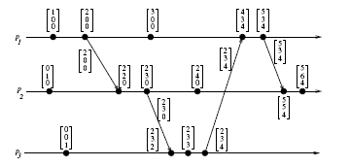
Vector Clocks example
Figure 3.2: Evolution of vector time.
From A. Kshemkalyani and M. Singhal (Distributed Computing)

Slide 40
Vector Times (cont)
Because of the transitive nature of the scheme, a process may receive time updates about clocks in non-neighboring process
Since process P_{i} can advance the i^{th} component of global time, it always has the most accurate knowledge of its local time
    At any instant of real time ∀i,j: C_{i}[i]≥ C_{j}[i]

Slide 41
Structure of the Vector Time
For two time vectors u,v
    u≤v iff ∀i: u[i]≤v[i]
    u<v iff u≤v ∧ u≠v
    u||v iff ~(u<v) ∧~(v<u) :: || is not transitive
For an event set E,
    ∀e,e’∈E:e<e’ iff C(e)<C(e’) ∧ e||e’ iff iff C(e)||C(e’)
In order to determine if two events e,e’ are causally related or not, just take their timestamps C(e) and C(e’)
  if C(e)<C(e’) ∨ C(e’)<C(e), then the events are causally related
  Otherwise, they are causally independent

Slide 42
Matrix Time
Vector time contains information about latest direct dependencies
  What does Pi know about Pk
Also contains info about latest direct dependencies of those dependencies
  What does Pi know about what Pk knows about Pj
Message and computation overheads are high
Powerful and useful for applications like distributed garbage collection

Slide 43
Time Manager Operations
Logical Clocks
  C.adjust(L,T)
    adjust the local time displayed by clock C to T (can be gradually, immediate, per clock sync period)
  C.read
    returns the current value of clock C
Timers
  TP.set(T) - reset the timer to timeout in T units
Messages
  receive(m,l); broadcast(m); forward(m,l)

Slide 44
Simulate A Global State
The notions of global time and global state are closely related
A process can (without freezing the whole computation) compute the best possible approximation of a global state [Chandy & Lamport 85]
A global state that could have occurred
  No process in the system can decide whether the state did really occur
  Guarantee stable properties (i.e. once they become true, they remain true)

Slide 45
Event Diagram
Time
P1
e11
e12
e13
P2
e21
e22
e23
e24
e25
P3
e32
e33
e34
e31

Slide 46
Equivalent Event Diagram
Time
P1
e11
e12
e13
P2
e21
e22
e23
e24
e25
P3
e32
e33
e34
e31

Slide 47
Rubber Band Transformation
Time
P1
e11
e12
P2
e21
e22
P3
e31
P4
e41
e42
cut

Slide 48
Poset Diagram
e34
e13
e33
e12
e25
e32
e24
e23
e22
e11
e21
e31

Slide 49
Poset Diagram
e22
e12
e21
e42
e31
Past
e41
e21

Slide 50
Consistent Cuts
A cut (or time slice) is a zigzag line cutting a time diagram into 2 parts (past and future)
  E is augmented with a cut event c_{i} for each process P_{i}:E’ =E ∪ {c_{i},…,c_{n}} ∴
    A cut C of an event set E is a finite subset C⊆E: e∈C ∧ e’<_{l}e →e’∈C
    A cut C₁ is later than C₂ if C₁⊇C₂
    A consistent cut C of an event set E is a finite subset C⊆E : e∈C ∧ e’<e →e’ ∈C
      i.e. a cut is consistent if every message received was previously sent (but not necessarily vice versa!)

Slide 51
Cuts (Summary)
Instant of local
observation
Time
P1
5
8
3
initial
value
P2
5
2
3
7
4
1
P3
5
4
0
ideal
(vertical)
cut
consistent
cut
inconsistent
cut
not attainable
equivalent to a vertical cut
(rubber band transformation)
can’t be made vertical
(message from the future)

Slide 52
Consistent Cuts
Some Theorems
  For a consistent cut consisting of cut events c_{i},…,c_{n}, no pair of cut events is causally related. i.e ∀c_{i},c_{j} ~(c_{i}< c_{j}) ∧ ~(c_{j}< c_{i})
  For any time diagram with a consistent cut consisting of cut events c_{i},…,c_{n}, there is an equivalent time diagram where c_{i},…,c_{n} occur simultaneously. i.e. where the cut line forms a straight vertical line
    All cut events of a consistent cut can occur simultaneously

Slide 53
Global States of Consistent Cuts
The global state of a distributed system is a collection of the local states of the processes and the channels.
A global state computed along a consistent cut is correct
The global state of a consistent cut comprises the local state of each process at the time the cut event happens and the set of all messages sent but not yet received
The snapshot problem consists in designing an efficient protocol which yields only consistent cuts and to collect the local state information
    Messages crossing the cut must be captured
    Chandy & Lamport presented an algorithm assuming that message transmission is FIFO

Slide 54
System Model for Global Snapshots
The system consists of a collection of n processes p1, p2, ..., pn that are connected by channels.
There is no globally shared memory and physical global clock and processes communicate by passing messages through communication channels.
No failures in the system.
Messages are not lost, duplicated or altered.
C_{ij} denotes the channel from process pi to process pj and its state is denoted by SC_{ij} .
The actions performed by a process are modeled as three types of events:
  Internal events,the message send event and the message receive event.
  For a message mij that is sent by process pi to process pj , let send(m_{ij}) and rec(m_{ij} ) denote its send and receive events.

Slide 55
Process States and Messages in transit
At any instant, the state of process pi , denoted by LSi , is a result of the sequence of all the events executed by pi till that instant.
For an event e and a process state LSi , e∈LSi iff e belongs to the sequence of events that have taken process pi to state LSi .
For an event e and a process state LSi , e (not in) LSi iff e does not belong to the sequence of events that have taken process pi to state LSi .
For a channel Cij , the following set of messages can be defined based on the local states of the processes pi and pj
Transit: transit(LSi , LSj ) = {mij |send(mij ) ∈ LSi V
rec(mij ) (not in) LSj }

Slide 56
Chandy-Lamport Distributed Snapshot Algorithm
Assumes FIFO communication in channels
Uses a control message, called a marker to separate messages in the channels.
  After a site has recorded its snapshot, it sends a marker, along all of its outgoing channels before sending out any more messages.
  The marker separates the messages in the channel into those to be included in the snapshot from those not to be recorded in the snapshot.
A process must record its snapshot no later than when it receives a marker on any of its incoming channels.
The algorithm terminates after each process has received a marker on all of its incoming channels.
All the local snapshots get disseminated to all other processes and all the processes can determine the global state.

Slide 57
Chandy-Lamport Distributed Snapshot Algorithm
Initiator Process
Records its process state
Creates a special “marker” message
Sends a “marker” message to all outgoing processes
Turns on recording of messages arriving over all incoming channels

Slide 58
Chandy-Lamport Distributed Snapshot Algorithm
Marker receiving rule for Process Pi
If (Pi has not yet recorded its state) it
records its process state now
records the state of c as the empty set
turns on recording of messages arriving over other channels
else
Pi records the state of c as the set of messages received over c
since it saved its state
Marker sending rule for Process Pi
After Pi has recorded its state,for each outgoing channel c:
Pi sends one marker message over c
(before it sends any other message over c)

Slide 59
Computing Global States without
FIFO Assumption - Lai-Yang Algorithm
Uses a coloring scheme that works as follows
  White (before snapshot); Red (after snapshot)
  Every process is initially white and turns red while taking a snapshot. The equivalent of the “Marker Sending Rule” (virtual broadcast) is executed when a process turns red.
  Every message sent by a white (red) process is colored white (red).
  Thus, a white (red) message is a message that was sent before (after) the sender of that message recorded its local snapshot.
  Every white process takes its snapshot at its convenience, but no later than the instant it receives a red message.

Slide 60
Computing Global States without
FIFO Assumption -
Lai-Yang Algorithm (cont.)
  Every white process records a history of all white messages sent or received by it along each channel.
  When a process turns red, it sends these histories along with its snapshot to the initiator process that collects the global snapshot.
  Determining Messages in transit ( i.e. White messages received by red process)
    The initiator process evaluates transit(LSi, LSj) to compute the state of a channel Cij as given below:
    SCij = {white messages sent by pi on Cij −
    white messages received by pj on Cij}
    = { send (Mij)|send(mij)∈LSi} − {rec(mij)| rec(mij)∈LSj}.

Slide 61
Computing Global States without FIFO Assumption: Termination
First method
  Each process I keeps a counter cntri that indicates the difference between the number of white messages it has sent and received before recording its snapshot, i.e number of messages still in transit.
  It reports this value to the initiator along with its snapshot and forwards all white messages, it receives henceforth, to the initiator.
  Snapshot collection terminates when the initiator has received Σi cntri number of forwarded white messages.
Second method
  Each red message sent by a process piggybacks the value of the number of white messages sent on that channel before the local state recording. Each process keeps a counter for the number of white messages received on each channel.
  Termination – Process receives as many white messages on each channel as the value piggybacked on red messages received on that channel.

Slide 62
Computing Global States without
FIFO Assumption: Mattern’s Algorithm
Uses Vector Clocks
  All process agree on some future virtual time s or a set of virtual time instants s₁,…s_{n} which are mutually concurrent and did not yet occur
  A process takes its local snapshot at virtual time s
  After time s the local snapshots are collected to construct a global snapshot
    P_{i} ticks and then fixes its next time s=C_{i} +(0,…,0,1,0,…,0) to be the common snapshot time
    P_{i} broadcasts s
    P_{i} blocks waiting for all the acknowledgements
    P_{i} ticks again (setting C_{i}=s), takes its snapshot and broadcast a dummy message (i.e. force everybody else to advance their clocks to a value ≥ s)
    Each process takes its snapshot and sends it to P_{i} when its local clock becomes ≥ s

Slide 63
Computing Global States without FIFO Assumption (Mattern cont)
Inventing a n+1 virtual process whose clock is managed by P_{i}
P_{i} can use its clock and because the virtual clock C_{n+1} ticks only when P_{i} initiates a new run of snapshot :
  The first n components of the vector can be omitted
  The first broadcast phase is unnecessary
  Counter modulo 2
Termination
  Distributed termination detection algorithm [Mattern 87]

