Slide 1
Middleware for Networked &
Distributed Systems
Prof. Nalini Venkatasubramanian
Dept. of Information & Computer Science
University of California, Irvine
‹#›
Notes:
‹#›

Slide 2
CS 237/NetSys 260
Distributed Systems Middleware
Spring 2019
Lecture 1 - Introduction to Distributed Systems Middleware
MW 5:00 - 6:20 p.m., zoom
Nalini Venkatasubramanian
nalini@uci.edu
Intro to Distributed Systems Middleware
‹#›

Slide 3
Course logistics and details
Course Web page -
  http://www.ics.uci.edu/~cs237
Lectures – MW 5:00 – 6:20 p.m
Reading List
    Technical papers and reports
    Reference Books
Reader for Course
  TBD
Intro to Distributed Systems Middleware
‹#›

Slide 4
Course logistics and details
Homeworks
  Homeworks (2 papers per topic)
Class Presentation (group presentation)
  Potential topics/systems will be announced
Course Project
  In groups of 3
  Initial project proposal
  Project Survey Paper
  Past projects available on webpage to give you an idea
Intro to Distributed Systems Middleware
‹#›

Slide 5
CompSci 237 Grading Policy
Homeworks - 40% of final grade
      4 homeworks with summary sets based on reading list
      A summary set due approximately every 2 weeks (usually 2 papers in each summary)
      Each summary set worth 10% of the final grade
      Make sure to follow instructions while writing and creating summary sets.
Class Presentation (as a group) – 10% of final grade
Project Survey Paper (group) -- 10% of final grade
Class Project - 40% of final grade
Final assignment of grades will be based on a curve.
Intro to Distributed Systems Middleware
‹#›
Notes:
Zookeeper, Kafka, Spark, Storm, Pulsar, Flink, Google Cloud, Amazon Dynamo, Spanner, Memcached, Docker/Kubernetes, CloudNative,
P2P Systems: Pastry,Chord, BitTorrent
PubSub: Amazon PubSub --

Slide 6
Course Events and Schedules
Week | Dates | Tentative submission | Tasks
1 | Apr 3 |  | Project group formation
2 | Apr 10 | Initial Project proposal due | Project proposals complete
3 | Apr 17 | HW1: Paper Reviews | System architecture complete
4 | Apr 24 |  | Project meetings 1
5 | May 1 | HW2: Paper Reviews | Implementation initiated
6 | May 8 | Project survey due | Project survey complete
7 | May 15 | HW3: Paper Reviews
8 | May 22 |  | Implementation done?
9 | May 29 | Initial project presentation | Project meetings 2
10 | Jun 5 | HW 4: Paper Reviews | Experimental Validation
11 | Jun 9 - week | Project demos, reports, slides
Project meeting

Slide 7
Lecture schedule
Distributed Middleware Concepts
  Distributed Computing Architectures: Client-server systems, P2P systems, cluster computing platforms (Pastry, BitTorrent)
  Time, State and Coordination in Distributed Systems (Spanner, Zookeeper,Chubby, VM Migration)
  Messaging Middlewares, Pub/Sub systems, Streaming Systems and Complex Event Processing (DDS, Kafka, Pulsar, Storm, Flink)
  Fault Tolerance: Practical Consensus, Practical Failure Detectors (Paxos, Raft)
Middleware Frameworks
  DCE, CORBA, Hadoop, Spark, Storm
  Java-based Technologies: RMI, JINI, EJB, J2EE
  Service-Oriented Technologies: XML, Web Services, .NET
  Cloud Computing Platforms: AWS, Azure, Google Cloud Services etc.
  Container Technologies: Docker, Kubernetes, Cloud Native
Middleware for Target Application Environments
  Real-time and QoS based Middleware, Mobile and pervasive computing, wireless sensor networks, CPS/IoT
Notes:
Concepts
Time and State - Spanner, distributed state capture
Distributed Systems coordination (distributed OS) - synchronization, leader election (Zookeeper), virtual machines, VM migration, load balancing
Architectures - P2P, data center systems, cluster-based and data center systems, Stream processing systems,
Messaging -- message brokers (ZeroMQ, MQTT), ALM, Pub/sub, Apache Kafka, DDS, Apache Pulsar, complex event processsing systems,
Fault Tolerance - Replication, Logging, Paxos , Raft, Byzantine FT/Blockchains
Frameworks
DCE, CORBA, Hadoop, Apache Spark, Apache Storm
Java Based Middlewares
Service oriented architectures - Web services
Cloud Computing --AWS/EMR, Microsoft Azure, GCS
Big Data Technologies --
Container Technologies -- Docker, Kubernetes
Edge Computing
Real-time Systems Middleware
Mobile Middleware, Mobile Cloud Computing
Middleware for IoT and Sensor Systems
Middleware for distributed and Big Data Systems
Guest lectures -- Kyle, Ray, Hojjat, karthik, roman, mo, sangeetha

Slide 8













What is a Distributed System?

Slide 9
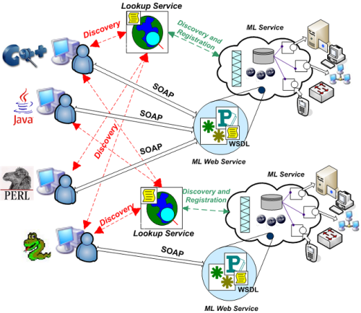
What is a Distributed System?

Slide 10
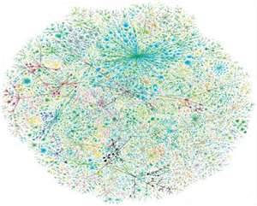
What is a Distributed System?
Internet
Banking systems, Communication (messaging, email), Distributed information systems (WWW, federated DBs, Manufacturing and process control, Inventory systems, ecommerce, Cloud platforms, mobile computing infrastructures, pervasive/IoT systems

Slide 11
Distributed Systems
Lamport’s Definition
  “ You know you have one when the crash of a computer you have never heard of stops you from getting any work done.”
  “A number of interconnected autonomous computers that provide services to meet the information processing needs of modern enterprises.”
Andrew Tanenbaum
  A distributed system is a collection of independent computers that appear to the users of the system as a single computer
FOLDOC (Free on-line Dictionary)
  A collection of (probably heterogeneous) automata whose distribution is transparent to the user so that the system appears as one local machine. This is in contrast to a network, where the user is aware that there are several machines, and their location, storage replication, load balancing and functionality is not transparent. Distributed systems usually use some kind of “client-server organization”
Intro to Distributed Systems Middleware
‹#›

Slide 12
Characterizing Distributed Systems
Multiple Computers
  each consisting of CPU’s, local memory, stable storage, I/O paths connecting to the environment
Interconnections
  some I/O paths interconnect computers that talk to each other
Shared State
  systems cooperate to maintain shared state
  maintaining global invariants requires correct and coordinated operation of multiple computers.
Intro to Distributed Systems Middleware
‹#›

Slide 13
Why Distributed Computing?
Inherent distribution
  Bridge customers, suppliers, and companies at different sites.
Speedup - improved performance
Fault tolerance
Resource Sharing
  Exploitation of special hardware
Scalability
Flexibility
Intro to Distributed Systems Middleware
‹#›

Slide 14
Why are Distributed Systems Hard?
Scale
  numeric, geographic, administrative
Loss of control over parts of the system
Unreliability of message passing
  unreliable communication, insecure communication, costly communication
Failure
  Parts of the system are down or inaccessible
  Independent failure is desirable
Intro to Distributed Systems Middleware
‹#›

Slide 15
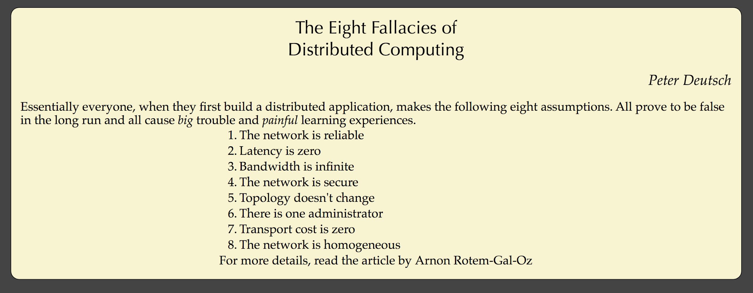

Slide 16
Design goals of a distributed system
Sharing
  HW, SW, services, applications
Openness(extensibility)
  use of standard interfaces, advertise services, microkernels
Concurrency
  compete vs. cooperate
Scalability
  avoids centralization
Fault tolerance/availability
Transparency
  location, migration, replication, failure, concurrency
Intro to Distributed Systems Middleware
‹#›

Slide 17
END-USER
Personalized Environment
Predictable Response
Location Independence
Platform Independence
Code Reusability
Interoperability
Portability
Reduced
Complexity
System Administrator
Flexibility
Real-Time Access
to information
Scalability
Faster Developmt.
and deployment of
Business Solutions
Reduce
Complexity
Better Mgmt.
Tools
Deal w/ changing
technology
Application Developer
ORGANIZATION
[cf: Khanna94]
Intro to Distributed Systems Middleware
‹#›

Slide 18
What is Middleware?
Middleware is the software between the application programs and the Operating System/base networking.
  An Integration Fabric that knits together applications, devices, systems software, data
Distributed Middleware
  Provides a comprehensive set of higher-level distributed computing capabilities and a set of interfaces to access the capabilities of the system.
  Includes software technologies to help manage complexity and heterogeneity inherent to the development of distributed systems/applications/information systems
  Higher-level programming abstraction for developing distributed applications
    Higher than “lower” level abstractions, such as sockets, monitors provided by the OS operating system
    Socket: a communication end-point from which data can be read or onto which data can be written
Intro to Distributed Systems Middleware
‹#›
cf: Arno Jacobsen lectures, Univ. of Toronto

Slide 19
Middleware Systems Views
An operating system is “the software that makes the underlying hardware usable”
Similarly, a middleware system makes the distributed system programmable and manageable
Bare machines without an OS could be programmed
  programs could be written in assembly, but higher-level languages are far more productive for this purpose
Distributed applications can be developed without middleware
  But far more cumbersome
cf: Arno Jacobsen lectures, Univ. of Toronto

Slide 20












The Evergrowing Alphabet Soup
Distributed
Computing
Environment (DCE)‏
WS-BPEL
WSIL
Java Transaction API (JTA)‏
Orbix
WSDL
LDAP
JNDI
JMS
IOP
IIOP
GIOP
BPEL
BEA Tuxedo®
EAI
Object Request Broker
(ORB)‏
RTCORBA
SOAP
Message Queuing (MSMQ)‏
Distributed Component
Object Model (DCOM)
XQuery
XPath
opalORB
IDL
ZEN
Remote Method
Invocation
(RMI)‏
JINITM
Rendezvous
ORBlite
Encina/9000
Enterprise
JavaBeans
Technology
(EJB)‏
BEA WebLogic®
Remote Procedure Call
(RPC)‏
Extensible Markup Language (XML)‏
Borland® VisiBroker®

Slide 21

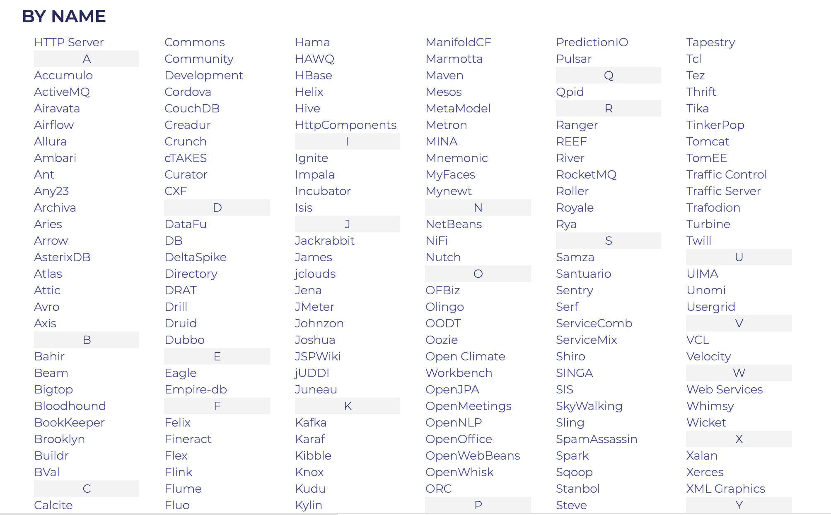






Just Apache Platforms

Slide 22
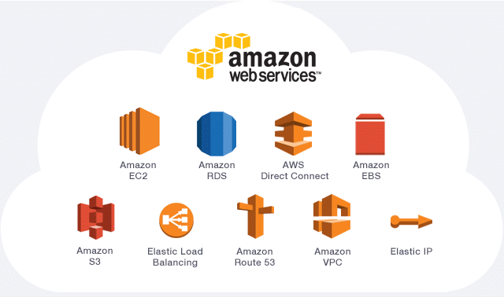
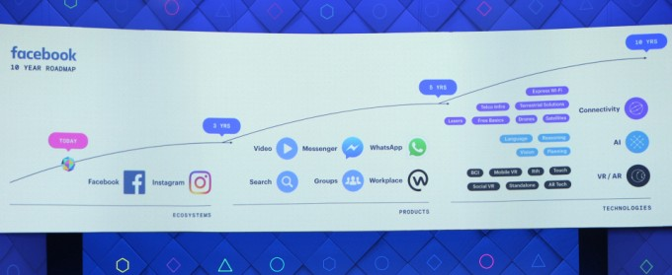
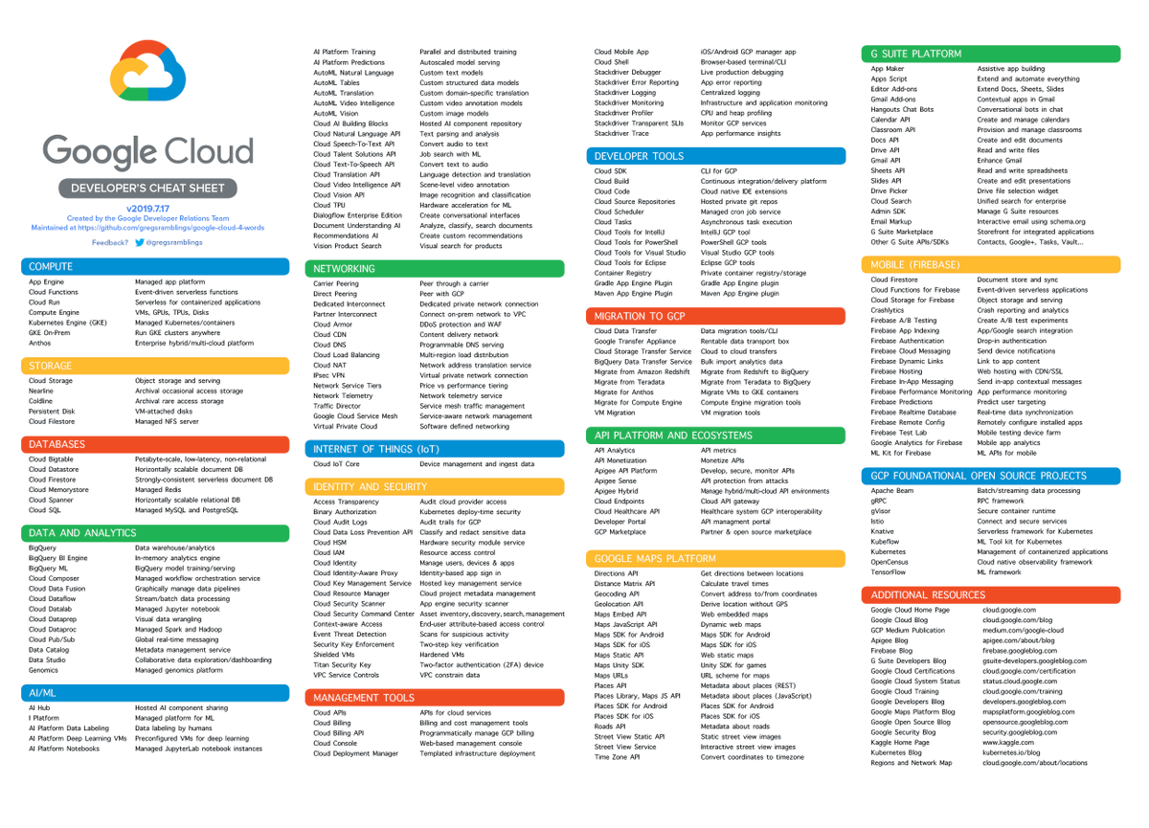
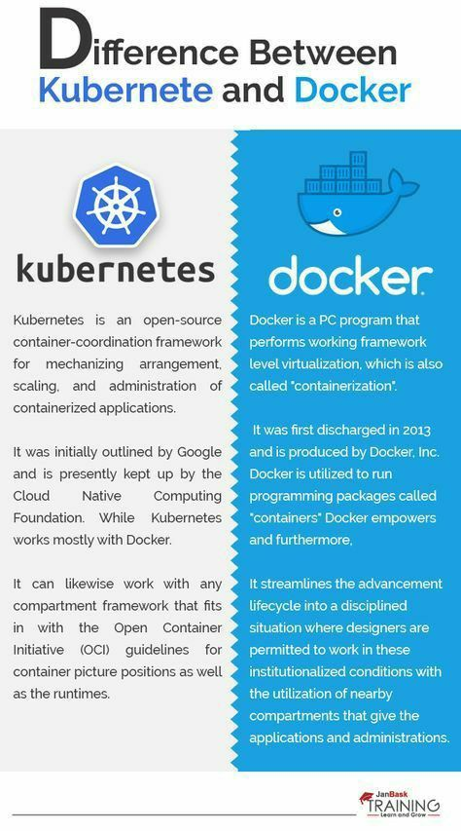
Amazon, Google, Microsoft
Notes:
Amazon: AWS, S3, EMR, Dynamo,
Microsoft: Windows-NT, Azure,
Google:

Slide 23
More Middlewares…
DCE,CORBA, OMG, CanCORBA, ORBIX, JavaORB, ORBLite, TAO, Zen, RTCORBA, FTCORBA,DCOM, POA,IDL,IOP,IIOP, ObjectBroker, Visibroker, Orbix, ObjectBus,ESBs
MOM – TIBCO TIB/Rendezvous, BEA MessageQ, Microsoft MSMQ, ActiveWorks
JVM, JINI, RMI, J2EE, EJB,J2ME, JDBC,JTA, JTS,JMS, JNDI,
Enterprise Middleware Technologies -- BEA WebLogic, IBM WebSphere, TivoliBeans
ENCINA, Tuxedo, CICS
SOAP, Web Services, WSDL, BPEL
XML, XQuery, XPath, JSON, MQTT, CoAP
Hadoop, MapReduce, VM, IaaS, PaaS, NaaS, DAS
Cassandra, Dynamo,
Intro to Distributed Systems Middleware
‹#›

Slide 24
Distributed Systems Middleware
  Enables the modular interconnection of distributed software (typically via services)
    abstract over low level mechanisms used to implement management services.
Application Program
API
API
API
Middleware
Service 1
Middleware
Service 2
Middleware
Service 3
Intro to Distributed Systems Middleware
‹#›

Slide 25
Useful Middleware Services
  Naming and Directory Service
  State Capture Service
  Event Service
  Transaction Service
  Fault Detection Service
  Trading Service
  Replication Service
  Migration Service
Intro to Distributed Systems Middleware
‹#›

Slide 26
Traditional Systems - Client/Server Computing
Client/server computing allocates application processing between the client and server processes.
A typical application has three basic components:
  Presentation logic
  Application logic
  Data management logic
Intro to Distributed Systems Middleware
‹#›

Slide 27
Enterprise Systems:
Perform enterprise activities
Management
and Support
Application Systems:
support enterprise systems
Interoperability
Distributed Computing Platform
Application Support Services (OS,
DB support, Directories, RPC)
Communication Network Services
(Network protocols, Physical devices)
Hardware
Portability
Integration
Network
Management
‹#›
Intro to Distributed Systems Middleware

Slide 28
Enterprise Systems:
Engineering systems
Business systems
Manufacturing
Office systems
Management
and Support
Interoperability
Application Systems:
User
Interfaces
Processing
programs
Data files &
Databases
Portability
Distributed Computing Platform
Application Support Services
Integration
C/S Support
Dist. Data
Trans. Mgmt.
Distributed
OS
Network
Management
Common Network Services
Network protocols & interconnectivity
OSI
protocols
TCP/IP
Intro to Distributed Systems Middleware
‹#›

Slide 29
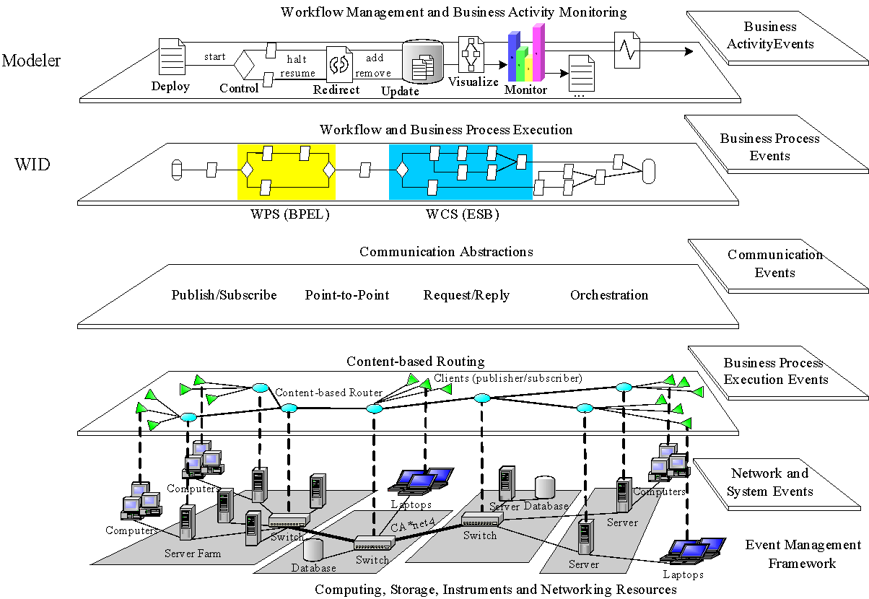
Event-driven Architecture for a Real-time Enterprise

Slide 30

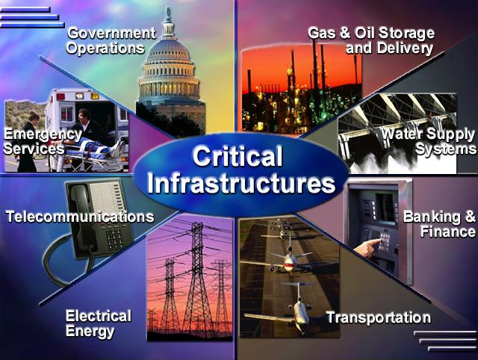
New application domains
cf: Doug Schmidt
Key problem space challenges
Highly dynamic behavior
Transient overloads
Time-critical tasks
Context-specific requirements
Resource conflicts
Interdependence of (sub)systems
Integration with legacy (sub)systems

Slide 31
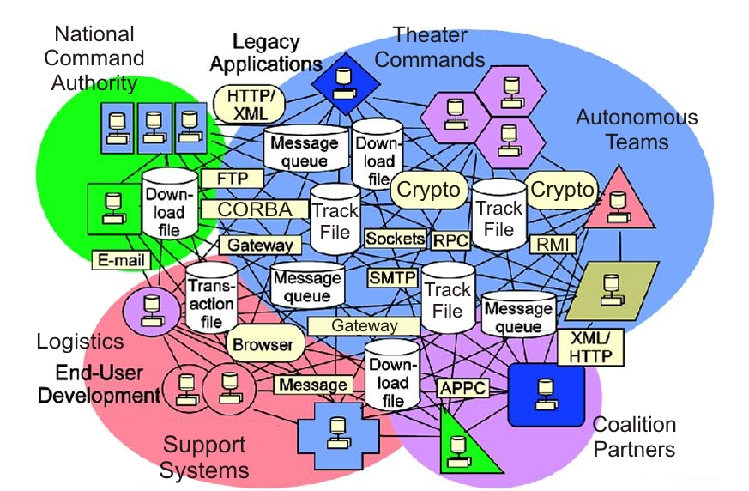
New application domains
cf: Doug Schmidt
Key problem space challenges
Highly dynamic behavior
Transient overloads
Time-critical tasks
Context-specific requirements
Resource conflicts
Interdependence of (sub)systems
Integration with legacy (sub)systems
Key solution space challenges
Enormous accidental & inherent complexities
Continuous evolution & change
Highly heterogeneous platform, language, & tool environments

Slide 32
New application domains
Key problem space challenges
Highly dynamic behavior
Transient overloads
Time-critical tasks
Context-specific requirements
Resource conflicts
Interdependence of (sub)systems
Integration with legacy (sub)systems
Key solution space challenges
Enormous accidental & inherent complexities
Continuous evolution & change
Highly heterogeneous platform, language, & tool environments
Mapping problem space requirements to solution space artifacts is very hard!

Slide 33


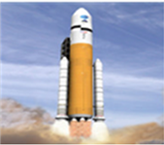






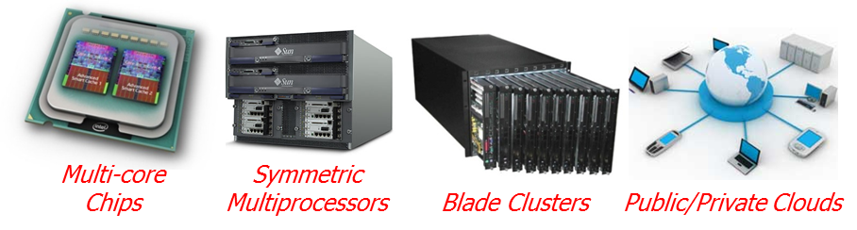
Extending the OSI Layering for the Software Infrastructure
SCADA infrastructure Systems
Air Traffic Mgmt
Aerospace
Mission critical applications
Encapsulates & enhances native OS mechanisms to create reusable network programming components
Domain-Specific
Services
Common
Middleware Services
Distribution
Middleware
Software stack
Host Infrastructure
Middleware
Operating Systems &
Protocols
Hardware
infrastructure

Slide 34
Types of Middleware
Integrated Sets of Services -- DCE
Domain Specific Integration frameworks
Distributed Object Frameworks
Component services and frameworks
Web-Services and Service-Oriented Frameworks
Virtualization
Cloud Based (Elastic) Frameworks
Container Technologies
Intro to Distributed Systems Middleware
‹#›

Slide 35
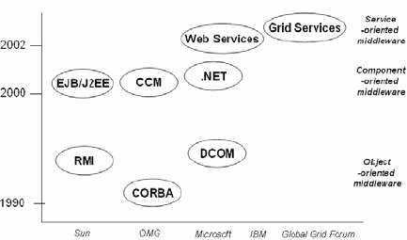
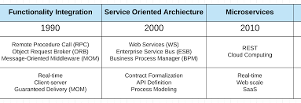
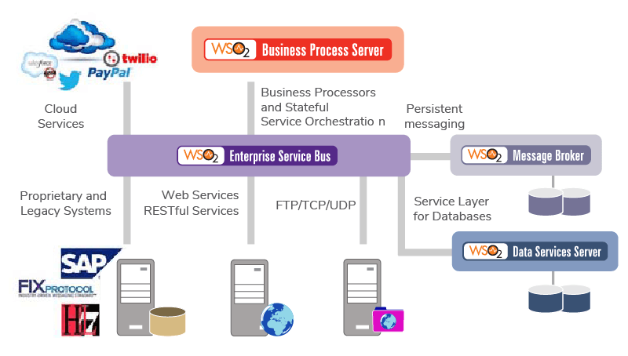
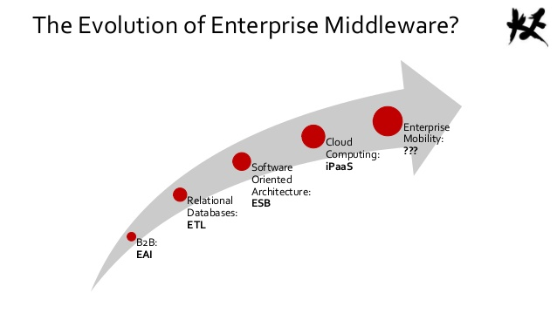
Middleware Evolution (views)
Notes:
https://slideplayer.com/slide/4917395/

Slide 36
Integrated Sets Middleware
An Integrated set of services consist of a set of services that take significant advantage of each other.
Example: DCE
Intro to Distributed Systems Middleware
‹#›

Slide 37
Distributed Computing Environment (DCE)
DCE - from the Open Software Foundation (OSF), offers an environment that spans multiple architectures, protocols, and operating systems (supported by major software vendors)
  It provides key distributed technologies, including RPC, a distributed naming service, time synchronization service, a distributed file system, a network security service, and a threads package.
DCE
Security
Service
Applications
DCE Distributed File Service
DCE
Distributed
Time Service
DCE
Directory
Service
Other Basic
Services
Management
DCE Remote Procedure Calls
DCE Threads Services
Operating System Transport Services
Intro to Distributed Systems Middleware
‹#›

Slide 38
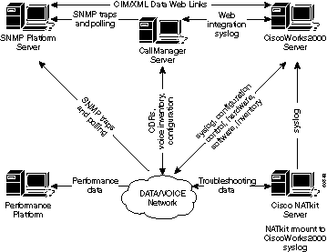
Integration Frameworks Middleware (Domain-specific)
Integration frameworks are integration environments that are tailored to the needs of a specific application domain.
  Workgroup framework - for workgroup computing.
  Transaction Processing monitor frameworks
  Network management frameworks
Fault Management—Detect, isolate, notify, and correct faults encountered in the network.
Configuration Management—Configuration of network devices, configuration file management, software
Performance Management—Monitor and measure various aspects of performance
Security Management—Provide access to network devices and corporate resources to authorized individuals.
Accounting Management—Usage information of network resources.
ISO Model for Network Management Services
Intro to Distributed Systems Middleware
‹#›

Slide 39
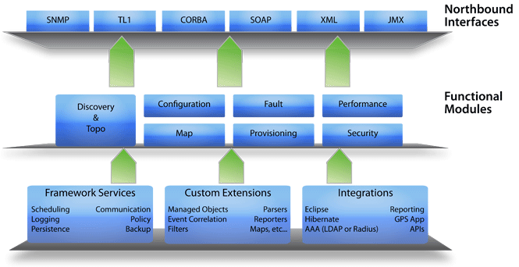
A Sample Network Management Framework (WebNMS)
http://www.webnms.com/webnms/ems.html
Intro to Distributed Systems Middleware
‹#›

Slide 40
Distributed Object Computing
Combining distributed computing with an object model.
  More abstract level of programming
  The use of a broker like entity or bus that keeps track of processes, provides messaging between processes and other higher level services
    CORBA, COM, DCOM, JINI, EJB, J2EE
    . Note: DCE uses a procedure-oriented distributed systems model, not an object model.
Intro to Distributed Systems Middleware
‹#›

Slide 41
Objects and Threads
C++ Model
  Objects and threads are tangentially related
  Non-threaded program has one main thread of control
    Pthreads (POSIX threads)
      Invoke by giving a function pointer to any function in the system
      Threads mostly lack awareness of OOP ideas and environment
      Partially due to the hybrid nature of C++?
Java Model and Concurrency
  Objects and threads are separate entities
    Primitive control over interactions
    Properties of connection between object and thread are not well-defined or understood
  Synchronization capabilities primitive
    “Synchronized keyword” guarantees safety but not liveness
    Deadlock is easy to create
    Fair scheduling is not an option

Slide 42
Distributed Objects
Issues with Distributed Objects
  Abstraction
  Performance
  Latency
  Partial failure
  Synchronization
  Complexity
  …..
Techniques
  Message Passing
    Object knows about network;
    Network data is minimum
  Argument/Return Passing
    Like RPC.
    Network data = args + return result + names
  Serializing and Sending Object
    Actual object code is sent. Might require synchronization.
    Network data = object code + object state + sync info
  Shared Memory
    based on DSM implementation
    Network Data = Data touched + synchronization info
Intro to Distributed Systems Middleware
‹#›

Slide 43
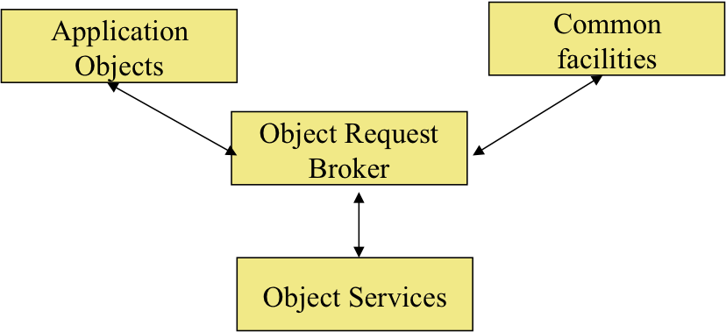
The Object Management Architecture (OMA)
Application objects: document handling objects.
Common facilities: accessing databases, printing files, etc.
ORB: the communication hub for all objects in the system
Object Services: object events, persistent objects, etc.
Intro to Distributed Systems Middleware
‹#›

Slide 44
CORBA
CORBA is a standard specification for developing object-oriented applications.
CORBA was defined by OMG in 1990.
OMG is dedicated to popularizing Object-Oriented standards for integrating applications based on existing standards.
Intro to Distributed Systems Middleware
‹#›

Slide 45
Distributed Object Models
Combine techniques
Goal: Merge parallelism and OOP
  Object Oriented Programming
    Encapsulation, modularity
    Separation of concerns
  Concurrency/Parallelism
    Increased efficiency of algorithms
    Use objects as the basis (lends itself well to natural design of algorithms)
  Distribution
    Build network-enabled applications
    Objects on different machines/platforms communicate

Slide 46
Actors:
A Model of Distributed Objects
Interface
Thread
State
Interface
Procedure
Actor system - collection of independent agents interacting via message passing
State
Messages
Thread
Interface
Procedure
State
Thread
Features
Acquaintances
  initial, created, acquired
History Sensitive
Asynchronous communication
Procedure
An actor can do one of three things:
Create a new actor and initialize its behavior
Send a message to an existing actor
Change its local state or behavior

Slide 47
Distributed Systems & Middleware Research at UC Irvine
Adaptive and Reflective Middleware
Contessa, CompOSE|Q: Adaptive System Interoperability, Composable Open Software Environment with QoS
MIRO: Adaptive Middleware for a Mobile Internet Robot Laboratory
MetaSIM: Reflective Middleware Solutions for Integrated Simulation Environmetns
Pervasive and Ubiquitous Computing
SIGNAL: Societal Scale Geographical Notification and Alerting
PC3: Pervasive Computing for Developing Nations
SATWARE:A Middleware for Sentient Spaces ,
Quasar: Quality Aware Sensing Architecture,
SUGA:Middleware Support for Cross-Disability Access
Emergency Response
RESCUE: Responding to Crises and Unexpected Events,
Customized Dissemination in the Large
SAFIRE: Situational Awareness for Firefighters
Responsphere: An Testbed for Responding to the Unexpected
Cyber Physical Systems and IoT
Cypress: CYber Physical RESilliance and Sustainability
I-sensorium: A shared experimental laboratory housing state-of-the-art sensing, actuation, networking and mobile computing devices
SCALE – IoT-based smart and resilient communities
AquaSCALE – A Water IoT Project
TIPPERS – IoT and Privacy
Middleware Support for Mobile Applications
FORGE: A Framework for Optimization of Distributed Embedded Systems Software
Dynamo: Power Aware Middleware for Distributed Mobile Computing
MAPGrid: Mobile Applications Powered by Grids
Xtune: Cross Layer Tuning of Mobile Embedded Systems
Intro to Distributed Systems Middleware
‹#›

Slide 48
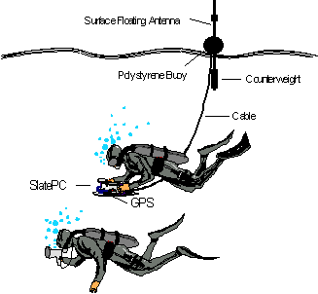
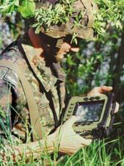
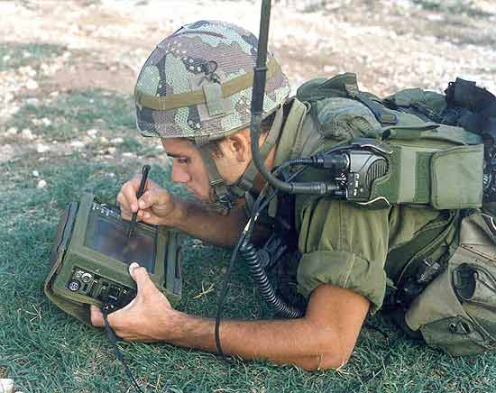
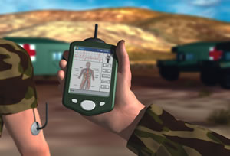
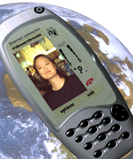
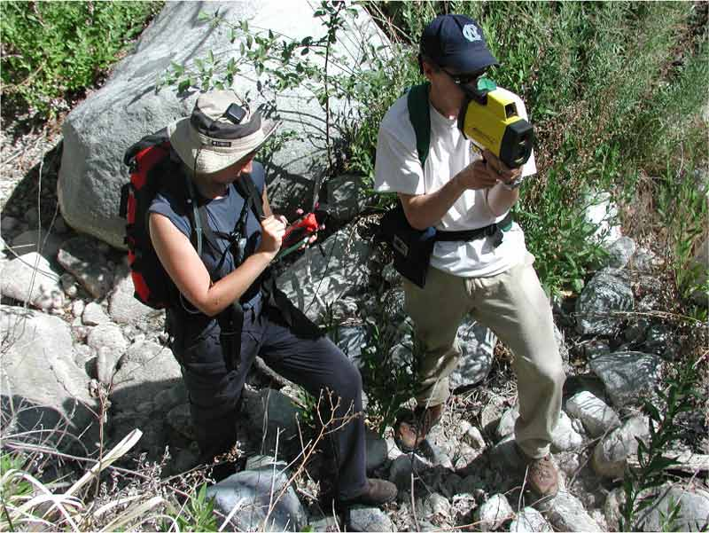
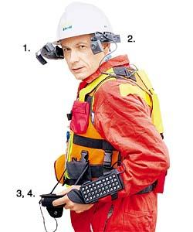

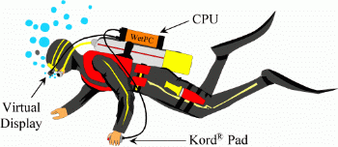
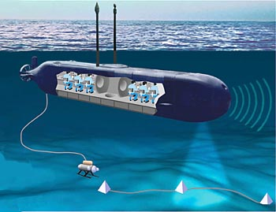
Mobile Middleware
‹#›

Slide 49
Dynamo: Power Aware Mobile Middleware
To build a power-cognizant distributed middleware framework that can
  exploit global changes (network congestion, system loads, mobility patterns)
  co-ordinate power management strategies at different levels
(application, middleware, OS, architecture)
  maximize the utility (application QoS, power savings) of a low-power device.
  study and evaluate cross layer adaptation techniques for performance vs. quality vs. power tradeoffs for mobile handheld devices.
Network Infrastructure
Caching
Compress
Encryption
Decryption
Compositing
Transcode
Execute Remote Tasks
Low-power
mobile device
Wide Area
Network
Wireless
Network
proxy
Use a Proxy-Based Architecture
‹#›

Slide 50
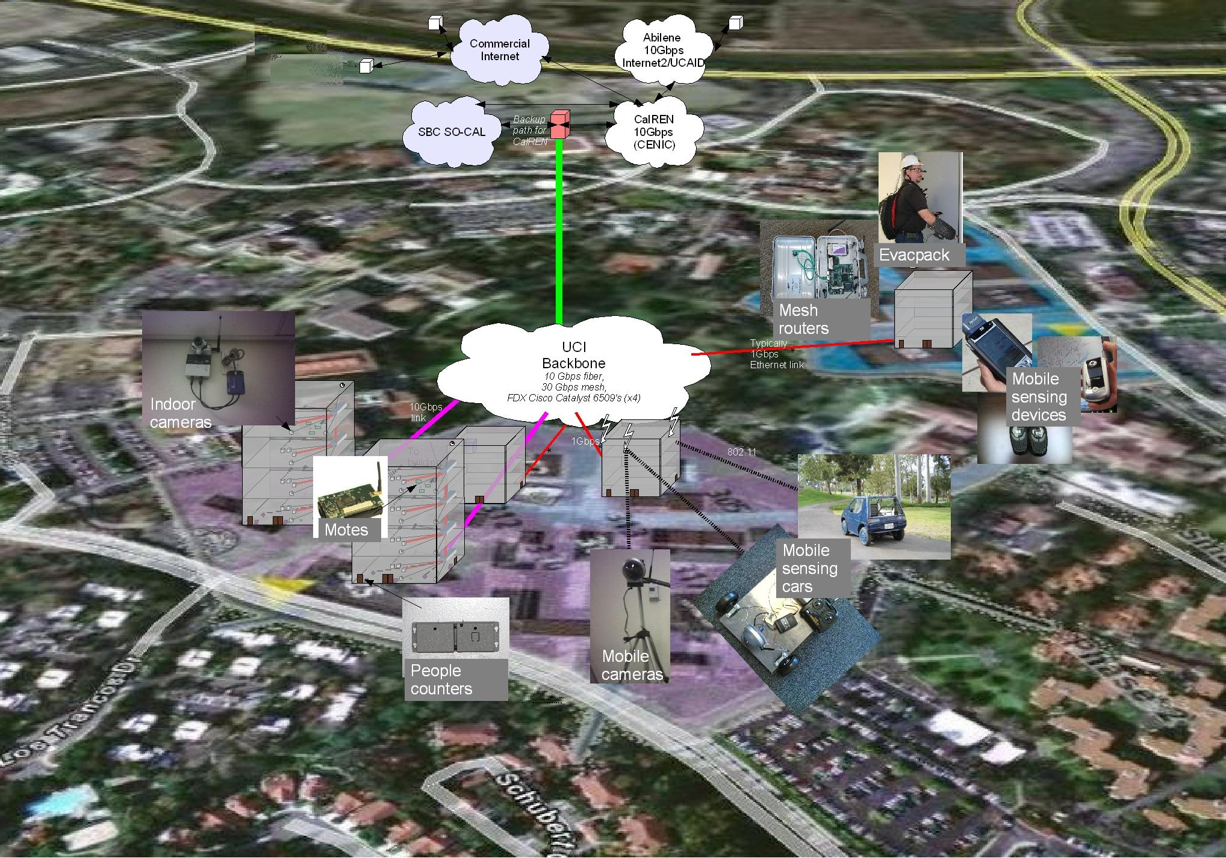

Middleware for Pervasive Systems - UCI I-Sensorium Infrastructure
Campus-wide infrastructure to instrument, experiments, monitor, disaster drills & to validate technologies
sensing, communicating, storage & computing infrastructure
Software for real-time collection, analysis, and processing of sensor information
used to create real time information awareness & post-drill analysis
‹#›
‹#›

Slide 51


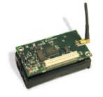
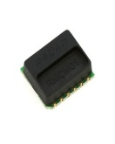
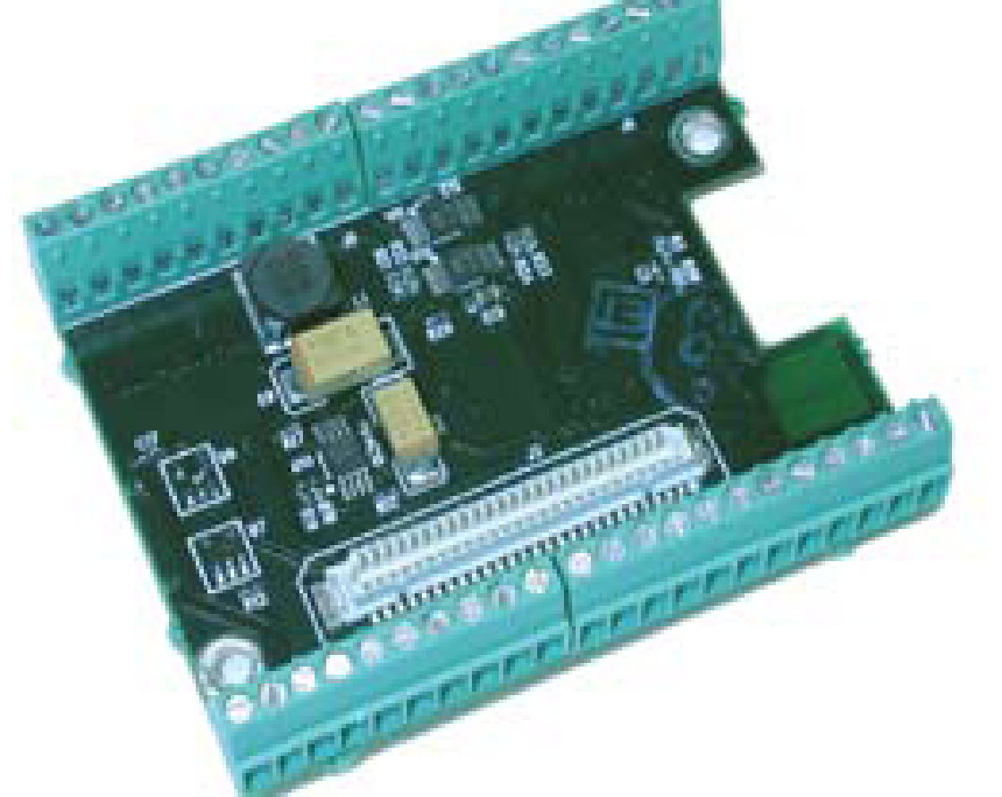
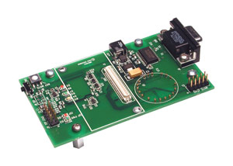
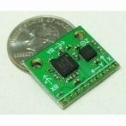
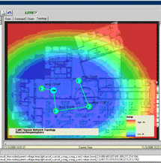

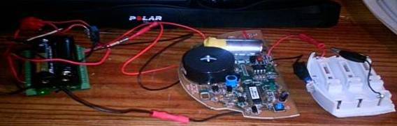


Mote Sensor Deployment
Heart Rate
Proprietary EMF transmission
Polar T31 Heart rate strap transmitter
Polar Heart Rate Module
Crossbow MIB510 Serial Gateway
Inertial positioning
Crossbow MDA 300CA Data Acquisition board on MICAz 2.4Ghz Mote
IMU (5 degrees of freedom)
IEEE 802.15.4 (zigbee)
To SAFIRE Server
Carbon monoxide
Temperature, humidity
Carboxyhaemoglobin, light
‹#›

Slide 52


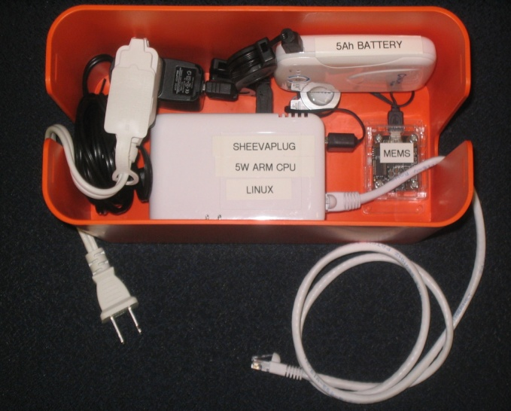
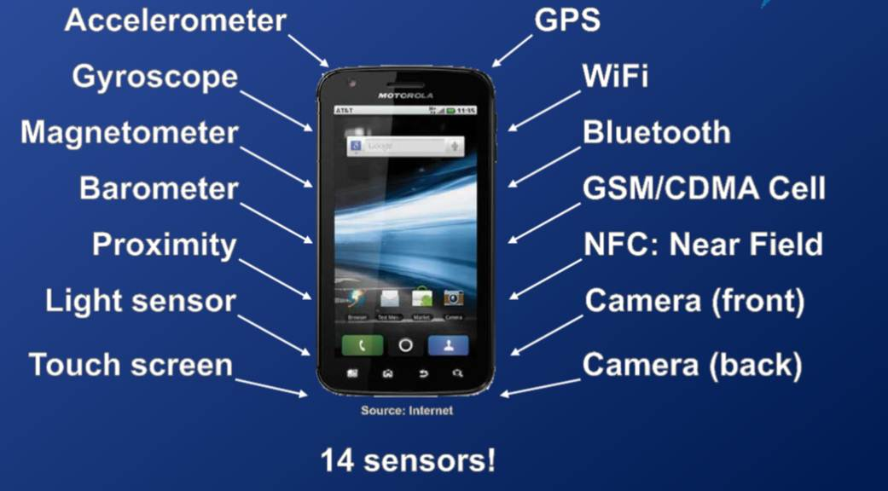
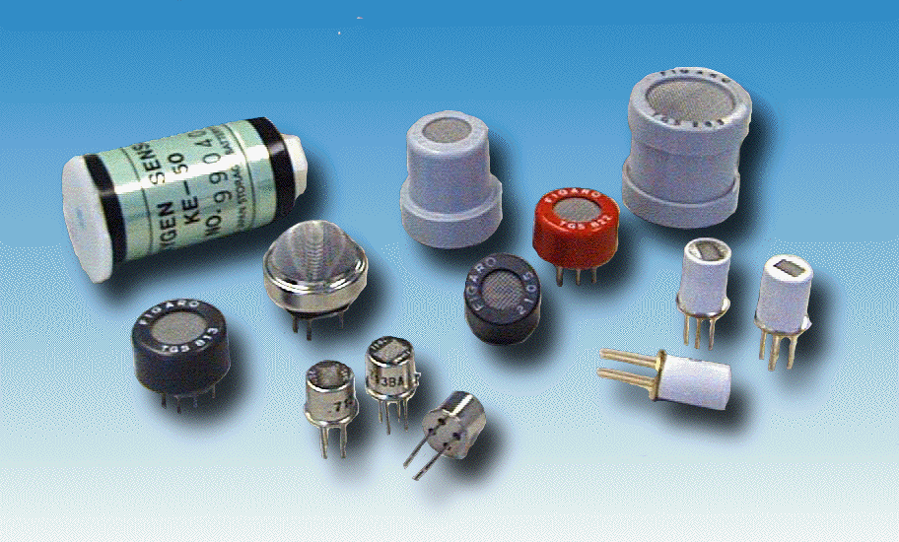
UC Irvine Sensorium Boxes
(building on Caltech CSN project)
Humidity
  control (de)humidifer, particularly for individuals with respiratory ailments
Camera
  boiling pot, monitor pet's food and water, face recognition
Microphone / accelerometer
  detect gunshot in an apartment building / complex
Microphone / light sensor
  monitor thunderstorm activity
SheevaPlug computer
Accelerometer
Ethernet
Battery backup
Additional Sensors
  Wi-Fi dongle, Smoke, Toxic gases (e.g. CO), Radiation, Humidity, Microphone, Camera

Slide 53
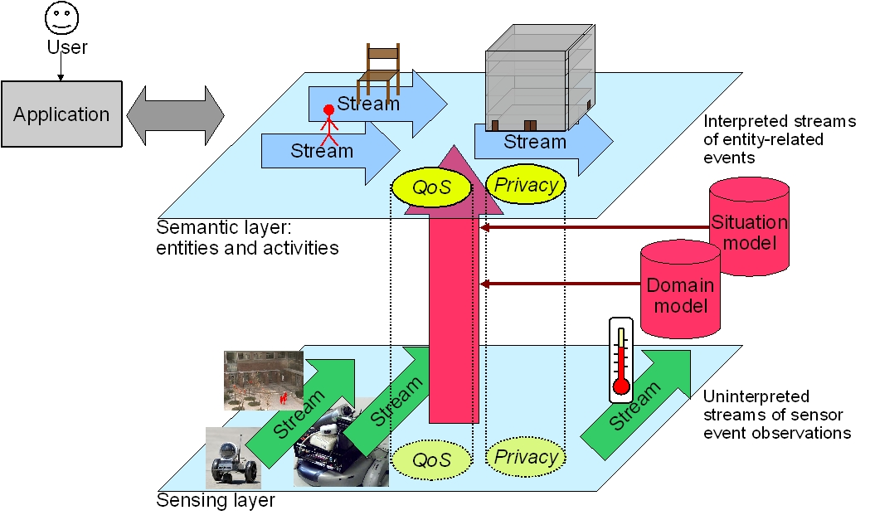
SATware: A semantic middleware for multisensor applications
Abstraction
- makes programming easy
- hides heterogeneity, failures, concurrency
Provides core services across sensors
- alerts, triggers, storage, queries
Mediates app needs and resource constraints
- networking, computation, device
‹#›

Slide 54
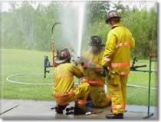
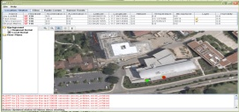


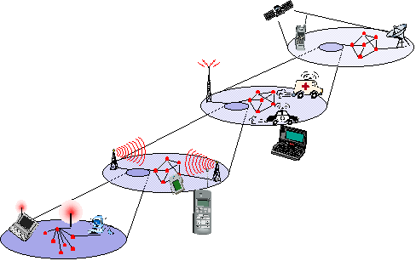
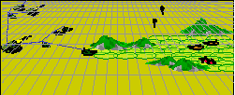
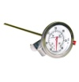









SAFIRENET – Next Generation MultiNetworks
Information need
Multitude of technologies
  WiFi (infrastructure, ad-hoc), WSN, UWB, mesh networks, DTN, zigbee
SAFIRE Data needs
  Timeliness
    immediate medical triage to a FF with significant CO exposure
  Reliability
    accuracy levels needed for CO monitoring
Limitations
  Resource Constraints
    Video, imagery
    Transmission Power, Coverage,
  Failures and Unpredictability
Goal
  Reliable delivery of data over unpredictable infrastructure
DATA
Multiple networks
NEEDS
Sensors
Dead Reckoning
(don’t send
Irrelevant data)
‹#›

Slide 55
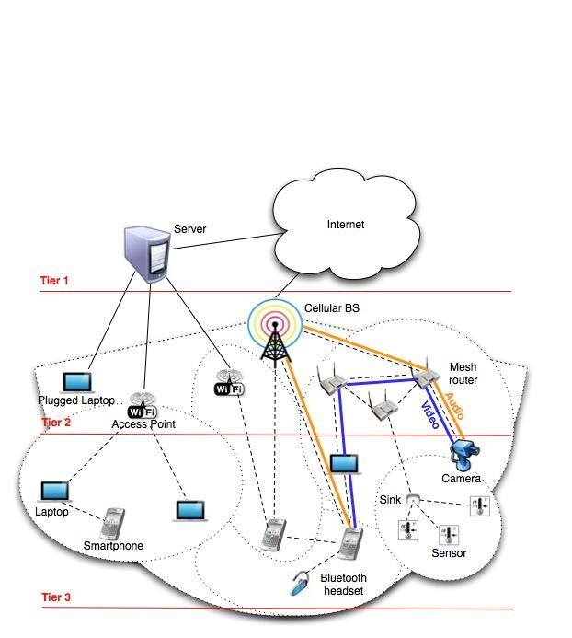
MINA: A Multinetwork Information Architecture
1. Tier based overlay architecture
(Using Network centrality, clustering )
2. Heterogeneous Networks and devices
3. Diverse services and applications

Slide 56




Societal Scale Information Sharing
Societal scale instant information sharing
Societal scale delay-tolerant information sharing
DYNATOPS: efficient Pub/Sub under societal scale dynamic information needs
Efficient mobile information crowdsourcing and querying
Information Layer
Dissemination Layer
GSFord: Reliable information delivery under regional failures
OFacebook: efficient offline access to online social media on mobile devices
‹#›

Slide 57

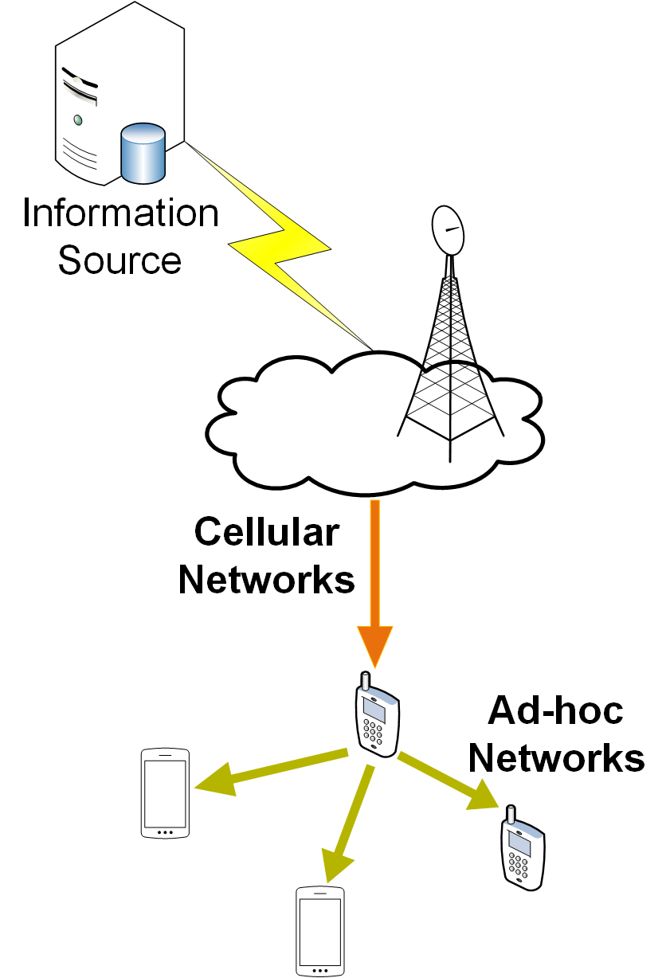






Next Generation Notification Systems
Content Delivery
Non-Cooperative
Cooperative
Cost-Driven Content Delivery
Delay- Guaranteed Content Delivery
Reliable and Fast Content Delivery
Massive Video Streaming
Infrastructure Networks
Content Delivery with
Hybrid Networks

Slide 58
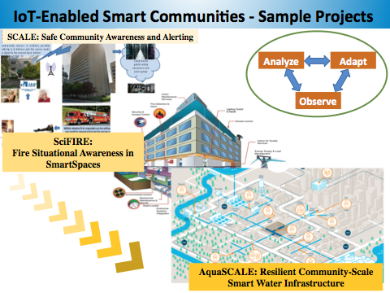

Slide 59
Topics for presentations
Pastry,Chord, BitTorrent
Google Spanner
Apache Spark
Google Chubby, Apache Zookeeper,
Amazon Pub/Sub, Apache Kafka,
Storm,
Pulsar,
Flink,
Amazon Dynamo
Facebook Memcached
Docker/Kubernetes
CloudNative

Slide 60
Distributed System Basics

Slide 61
Modeling Distributed Systems
  Key Questions
  What are the main entities in the system?
  How do they interact?
  How does the system operate?
  What are the characteristics that affect their individual and collective behavior?

Slide 62
Classifying Distributed Systems
Based on Architectural Models
  Client-Server, Peer-to-peer, Proxy based,…
Based on computation/communication - degree of synchrony
  Synchronous, Asynchronous
Based on communication style
  Message Passing, Shared Memory
Based on Fault model
  Crash failures, Omission failures, Byzantine failures
  how to handle failure of processes/channels
Intro to Distributed Systems Middleware
‹#›

Slide 63
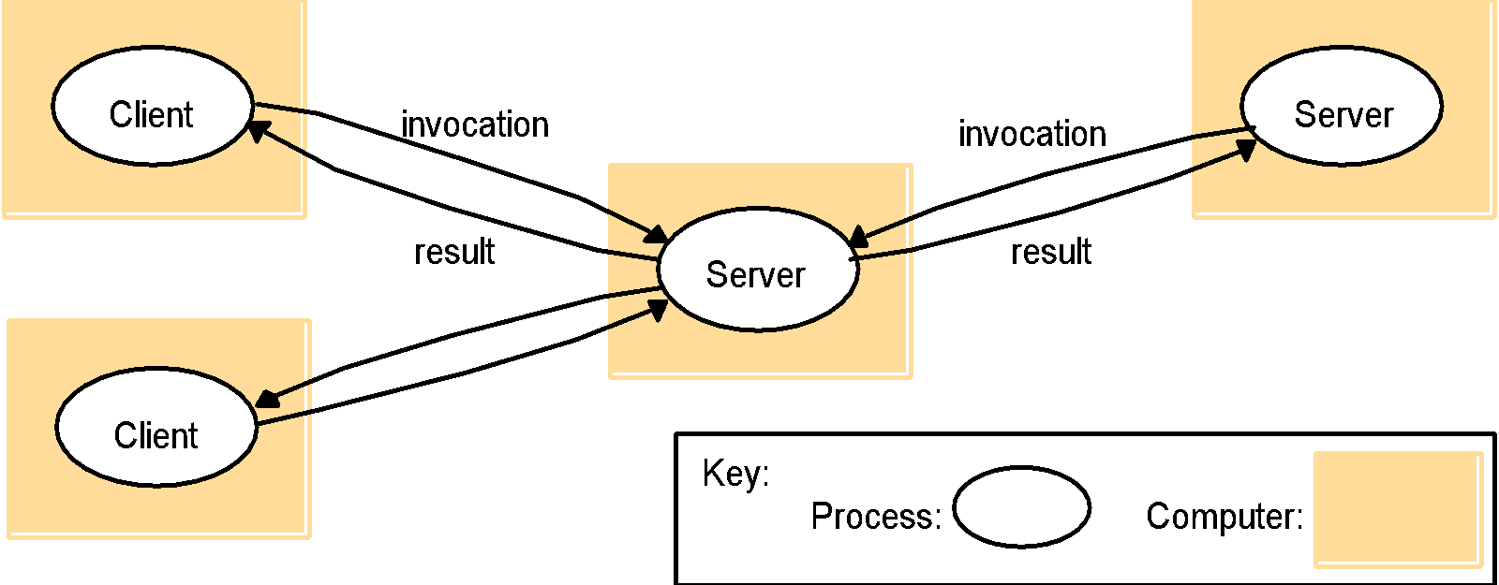
Architectural Models
Client-Server
Request-response paradigm

Slide 64
Client/Server Models
There are at least three different models for distributing these functions:
  Presentation logic module running on the client system and the other two modules running on one or more servers.
  Presentation logic and application logic modules running on the client system and the data management logic module running on one or more servers.
  Presentation logic and a part of application logic module running on the client system and the other part(s) of the application logic module and data management module running on one or more servers
Intro to Distributed Systems Middleware
‹#›

Slide 65

Architectural Models
Peer-to-Peer
No single node server as a server
All nodes act as client (and server) at a time

Slide 66



Architectural Models
Multiple servers, proxy servers and caches, mobile code, …
Mobile code
Multiple servers
Proxy

Slide 67
Computation in distributed systems
Two variants based on bound on timing of events
Asynchronous system
  no assumptions about process execution speeds and message delivery delays
Synchronous system
  make assumptions about relative speeds of processes and delays associated with communication channels
  constrains implementation of processes and communication
Concurrent Programming Models
  Communicating processes, Functions, Logical clauses, Passive Objects, Active objects, Agents
Intro to Distributed Systems Middleware
‹#›

Slide 68
Concurrency issues
Consider the requirements of transaction based systems
  Atomicity - either all effects take place or none
  Consistency - correctness of data
  Isolated - as if there were one serial database
  Durable - effects are not lost
General correctness of distributed computation
  Safety
  Liveness
Intro to Distributed Systems Middleware
‹#›

Slide 69
Flynn’s Taxonomy for Parallel Computing
Instructions
Single (SI)
Multiple (MI)
SISD Single-threaded process | MISD Pipeline architecture
SIMD Vector Processing | MIMD Multi-threaded Programming
Single (SD)
Data
Multiple (MD)
Parallelism – A Practical Realization of Concurrency

Slide 70
SISD (Single Instruction Single Data Stream)
Processor
D
D
D
D
D
D
D
Instructions
A sequential computer which exploits no parallelism in either the
instruction or data streams.
Examples of SISD architecture are the traditional uniprocessor machines
(currently manufactured PCs have multiple processors) or old mainframes.

Slide 71
SIMD
Processor
D₀
D₀
D₀
D₀
D₀
D₀
D₀
D₁
D₁
D₁
D₁
D₁
D₁
D₁
D₂
D₂
D₂
D₂
D₂
D₂
D₂
D₃
D₃
D₃
D₃
D₃
D₃
D₃
D₄
D₄
D₄
D₄
D₄
D₄
D₄
…
…
…
…
…
…
…
D_{n}
D_{n}
D_{n}
D_{n}
D_{n}
D_{n}
D_{n}
Instructions
A computer which exploits multiple data streams against a single instruction
stream to perform operations which may be naturally parallelized.
For example, an array processorFor example, an array processor or GPU.

Slide 72
MISD (Multiple Instruction Single Data)
D
Instructions
D
Instructions
Multiple instructions operate on a single data stream.
Uncommon architecture which is generally used for fault tolerance.
Heterogeneous systems operate on the same data stream and
aim to agree on the result.
Examples include the Space Shuttle flight control computer.
Intro to Distributed Systems Middleware
‹#›

Slide 73
MIMD
Processor
D
D
D
D
D
D
D
Instructions
Processor
D
D
D
D
D
D
D
Instructions
Multiple autonomous processors simultaneously executing different instructions on different data.
Distributed systems are generally recognized to be MIMD architectures;
either exploiting a single shared memory space or a distributed memory space.

Slide 74
Communication in Distributed Systems
Provide support for entities to communicate among themselves
  Centralized (traditional) OS’s - local communication support
  Distributed systems - communication across machine boundaries (WAN, LAN).
2 paradigms
  Message Passing
    Processes communicate by sharing messages
  Distributed Shared Memory (DSM)
    Communication through a virtual shared memory.
Intro to Distributed Systems Middleware
‹#›

Slide 75

Message Passing
State
State
Message
Basic primitives
  Send message, Receive message
Properties of communication channel
    Latency, bandwidth and jitter

Slide 76
Messaging issues
Synchronous
  atomic action requiring the participation of the sender and receiver.
  Blocking send: blocks until message is transmitted out of the system send queue
  Blocking receive: blocks until message arrives in receive queue
Asynchronous
  Non-blocking send:sending process continues after message is sent
  Blocking or non-blocking receive: Blocking receive implemented by timeout or threads. Non-blocking receive proceeds while waiting for message. Message is queued(BUFFERED) upon arrival.
Unreliable communication
  Best effort, No ACK’s or retransmissions
  Application programmer designs own reliability mechanism
Reliable communication
  Different degrees of reliability
  Processes have some guarantee that messages will be delivered.
  Reliability mechanisms - ACKs, NACKs.
Intro to Distributed Systems Middleware
‹#›

Slide 77
Synchronous vs. Asynchronous
Communication | Type (sync/async)
Personal greetings | Sync
Email | Async
Voice call | Sync
Online messenger/chat | Sync ?
Letter correspondence | Async
Skype call | Sync
Voice mail/voice SMS | Async
Text messages | Async

Slide 78
Remote Procedure Call
Builds on message passing
  extend traditional procedure call to perform transfer of control and data across network
  Easy to use - fits well with the client/server model.
  Helps programmer focus on the application instead of the communication protocol.
  Server is a collection of exported procedures on some shared resource
  Variety of RPC semantics
    “maybe call”
    “at least once call”
    “at most once call”
Intro to Distributed Systems Middleware
‹#›

Slide 79
Distributed Shared Memory
Abstraction used for processes on machines that do not share memory
  Motivated by shared memory multiprocessors that do share memory
Processes read and write from virtual shared memory.
  Primitives - read and write
  OS ensures that all processes see all updates
Caching on local node for efficiency
  Issue - cache consistency
Intro to Distributed Systems Middleware
‹#›

Slide 80
Fault Models in Distributed Systems
Crash failures
  A processor experiences a crash failure when it ceases to operate at some point without any warning. Failure may not be detectable by other processors.
    Failstop - processor fails by halting; detectable by other processors.
Byzantine failures
  completely unconstrained failures
  conservative, worst-case assumption for behavior of hardware and software
  covers the possibility of intelligent (human) intrusion.
Intro to Distributed Systems Middleware
‹#›

Slide 81
Other Fault Models in Distributed Systems
Dealing with message loss
  Crash + Link
    Processor fails by halting. Link fails by losing messages but does not delay, duplicate or corrupt messages.
  Receive Omission
    processor receives only a subset of messages sent to it.
  Send Omission
    processor fails by transmitting only a subset of the messages it actually attempts to send.
  General Omission
    Receive and/or send omission
Intro to Distributed Systems Middleware
‹#›

Slide 82
Failure Models
Omission and arbitrary failures
Class of failure
Affects
Description
Fail-stop
Process
Process halts and remains halted. Other processes may
detect this state.
Crash
Process
Process halts and remains halted. Other processes may
not be able to detect this state.
Omission
Channel
A message inserted in an outgoing message buffer never
arrives at the other end’s incoming message buffer.
Send-omission
Process
A process completes a
send,
but the message is not put
in its outgoing message buffer.
Receive-omission
Process
A message is put in a process’s incoming message
buffer, but that process does not receive it.
Arbitrary
Process or
Process/channel exhibits arbitrary behaviour: it may
(Byzantine)
channel
send/transmit arbitrary messages at arbitrary times,
commit omissions; a process may stop or take an
incorrect step.

Slide 83
Failure Models
Timing failures
Class of Failure
Affects
Description
Clock
Process
Process’s local clock exceeds the bounds on its
rate of drift from real time.
Performance
Process
Process exceeds the bounds on the interval
between two steps.
Performance
Channel
A message’s transmission takes longer than the
stated bound.

Slide 84
Other distributed system issues
Concurrency and Synchronization
Distributed Deadlocks
Time in distributed systems
Naming
Replication
  improve availability and performance
Migration
  of processes and data
Security
  eavesdropping, masquerading, message tampering, replaying
Intro to Distributed Systems Middleware
‹#›

