Slide 1
Cloud
Computing

Slide 2
What is Cloud Computing?
Cloud computing is a model for enabling convenient, on-demand network access to a shared pool of configurable computing resources (e.g., networks, servers, storage, applications, and services) [Mell_2009], [Berkely_2009].
It can be rapidly provisioned and released with minimal management effort.
It provides high level abstraction of computation and storage model.
It has some essential characteristics, service models, and deployment models.

Slide 3
Essential Characteristics
On-Demand Self Service:
  A consumer can unilaterally provision computing capabilities, automatically without requiring human interaction with each service’s provider.
Heterogeneous Access:
  Capabilities are available over the network and accessed through standard mechanisms that promote use by heterogeneous thin or thick client platforms.

Slide 4
Essential Characteristics (cont.)
Resource Pooling:
  The provider’s computing resources are pooled to serve multiple consumers using a multi-tenant model.
  Different physical and virtual resources dynamically assigned and reassigned according to consumer demand.
Measured Service:
  Cloud systems automatically control and optimize resources used by leveraging a metering capability at some level of abstraction appropriate to the type of service.
  It will provide analyzable and predictable computing platform.

Slide 5
Service Models
Cloud Software as a Service (SaaS):
  The capability provided to the consumer is to use the provider’s applications running on a cloud infrastructure.
  The applications are accessible from various client devices such as a web browser (e.g., web-based email).
  The consumer does not manage or control the underlying cloud infrastructure including network, servers, operating systems, storage,…
  Examples: Caspio, Google Apps, Salesforce, Nivio, Learn.com.

Slide 6
Service Models (cont.)
Cloud Platform as a Service (PaaS):
  The capability provided to the consumer is to deploy onto the cloud infrastructure consumer-created or acquired applications created using programming languages and tools supported by the provider.
  The consumer does not manage or control the underlying cloud infrastructure.
  Consumer has control over the deployed applications and possibly application hosting environment configurations.
  Examples: Windows Azure, Google App.

Slide 7
Service Models (cont.)
Cloud Infrastructure as a Service (IaaS):
  The capability provided to the consumer is to provision processing, storage, networks, and other fundamental computing resources.
  The consumer is able to deploy and run arbitrary software, which can include operating systems and applications.
  The consumer does not manage or control the underlying cloud infrastructure but has control over operating systems, storage, deployed applications, and possibly limited control of select networking components (e.g., host firewalls).
  Examples: Amazon EC2, GoGrid, iland, Rackspace Cloud Servers, ReliaCloud.

Slide 8
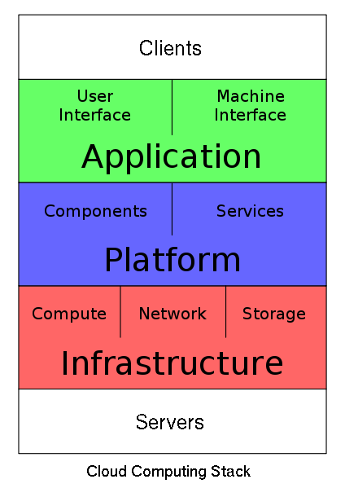
Service Models (cont.)
Service Model at a glance: Picture From http://en.wikipedia.org/wiki/File:Cloud_Computing_Stack.svg

Slide 9
Deployment Models

Slide 10
Private Cloud:
  The cloud is operated solely for an organization. It may be managed by the organization or a third party and may exist on premise or off premise.
Community Cloud:
  The cloud infrastructure is shared by several organizations and supports a specific community that has shared concerns.
  It may be managed by the organizations or a third party and may exist on premise or off premise

Slide 11
Public Cloud:
  The cloud infrastructure is made available to the general public or a large industry group and it is owned by an organization selling cloud services.
Hybrid cloud:
  The cloud infrastructure is a composition of two or more clouds (private, community, or public).

Slide 12
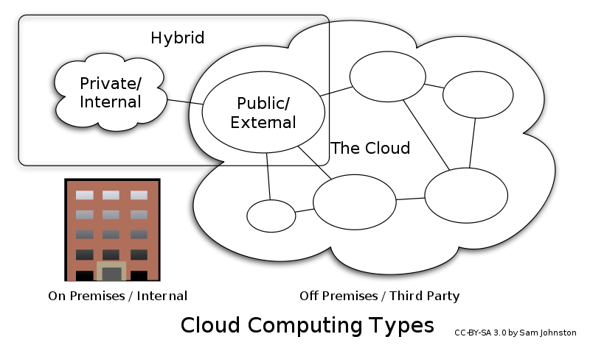

Slide 13
Advantages of Cloud Computing
Cloud computing do not need high quality equipment for user, and it is very easy to use.
Provides dependable and secure data storage center.
Reduce run time and response time.
Cloud is a large resource pool that you can buy on-demand service.
Scale of cloud can extend dynamically providing nearly infinite possibility for users to use internet.

Slide 14
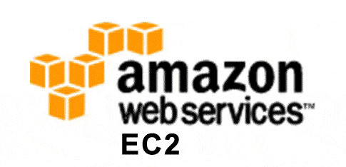
Amazon EC2

Slide 15
What is EC2 ?
Amazon Elastic Compute Cloud (EC2) is a web service that provides resizeable computing capacity that one uses to build and host different software systems.
Designed to make web-scale computing easier for developers.
A user can create, launch, and terminate server instances as needed, paying by the hour for active servers, hence the term "elastic".

Slide 16
EC2 Infrastructure Concepts

Slide 17
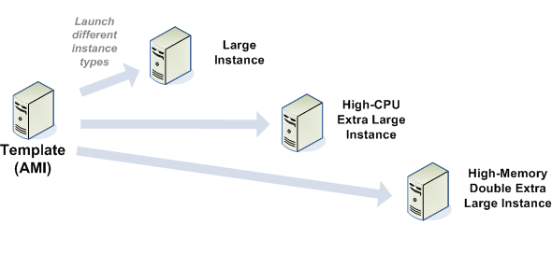
Amazon Machine Images (AMI)
Is an immutable representation of a set of disks that contain an operating system, user applications and/or data.
From an AMI, one can launch multiple instances, which are running copies of the AMI.

Slide 18
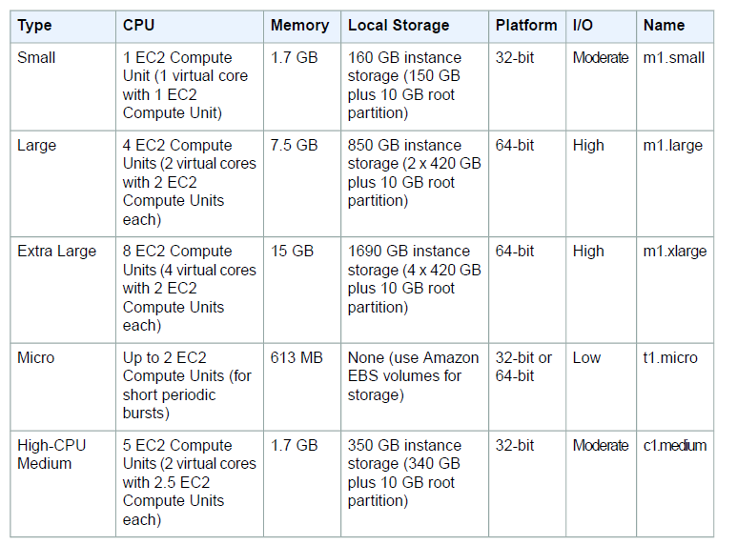

Slide 19
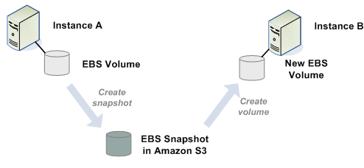
Elastic Block Store(EBS) volume
An EBS volume is a read/write disk that can be created by an AMI and mounted by an instance.
Volumes are suited for applications that require a database, a file system, or access to raw block-level storage.

Slide 20
Amazon S3
S3 = Simple storage Service
A SOA – Service Oriented Architecture which provides online storage using web services.
Allows read, write and delete permissions on objects.
Uses REST and SOAP protocols for messaging.

Slide 21
Amazon SimpleDB
Amazon SimpleDB is a highly available, flexible, and scalable non-relational data store that offloads the work of database administration.
Creates and manages multiple geographically distributed replicas of your data automatically to enable high availability and data durability.
The service charges you only for the resources actually consumed in storing your data and serving your requests.

Slide 22
Networking
Each instance launched is assigned two addresses a private address and a public IP address.
A replacement instance has a different public IP address.
Amazon EC2 offers Elastic IP addresses (static IP addresses) for dynamic cloud computing.

Slide 23
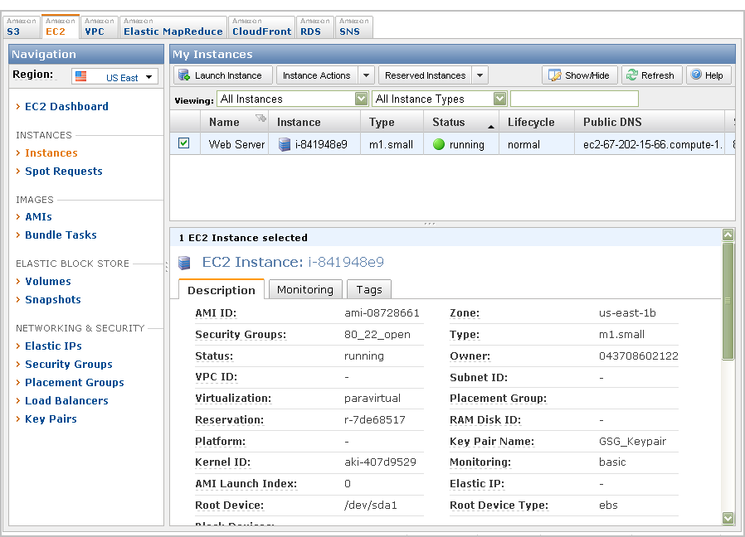
AWS Management Console

Slide 24
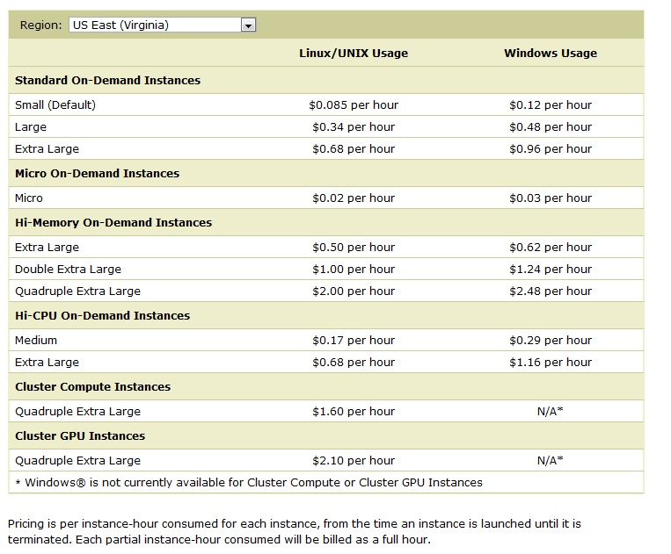

Slide 25
References
Mobile cloud computing: Big Picture by M. Reza Rahimi
http://aws.amazon.com/ec2/
Amazon Elastic Compute Cloud – User Guide, API Version 2011-02-28.

