Slide 1
Midterm Review
CS 230 – Distributed Systems
(http://www.ics.uci.edu/~cs230)
Nalini Venkatasubramanian
nalini@ics.uci.edu

Slide 2
Characterizing Distributed Systems
Multiple Autonomous Computers
  each consisting of CPU’s, local memory, stable storage, I/O paths connecting to the environment
  Geographically Distributed
Interconnections
  some I/O paths interconnect computers that talk to each other
Shared State
  No shared memory
  systems cooperate to maintain shared state
  maintaining global invariants requires correct and coordinated operation of multiple computers.

Slide 3
Classifying Distributed Systems
Based on degree of synchrony
  Synchronous
  Asynchronous
Based on communication medium
  Message Passing
  Shared Memory
Fault model
  Crash failures
  Byzantine failures

Slide 4
Computation in distributed systems
Asynchronous system
  no assumptions about process execution speeds and message delivery delays
Synchronous system
  make assumptions about relative speeds of processes and delays associated with communication channels
  constrains implementation of processes and communication
Models of concurrency
  Communicating processes
  Functions, Logical clauses
  Passive Objects
  Active objects, Agents

Slide 5
Communication in Distributed Systems
Provide support for entities to communicate among themselves
  Centralized (traditional) OS’s - local communication support
  Distributed systems - communication across machine boundaries (WAN, LAN).
2 paradigms
  Message Passing
    Processes communicate by sharing messages
  Distributed Shared Memory (DSM)
    Communication through a virtual shared memory.

Slide 6
Fault Models in Distributed Systems
Crash failures
  A processor experiences a crash failure when it ceases to operate at some point without any warning. Failure may not be detectable by other processors.
    Failstop - processor fails by halting; detectable by other processors.
Byzantine failures
  completely unconstrained failures
  conservative, worst-case assumption for behavior of hardware and software
  covers the possibility of intelligent (human) intrusion.

Slide 7
Client/Server Computing
Client/server computing allocates application processing between the client and server processes.
A typical application has three basic components:
  Presentation logic
  Application logic
  Data management logic

Slide 8
Distributed Systems Middleware
Middleware is the software between the application programs and the operating System and base networking
Integration Fabric that knits together applications, devices, systems software, data
Middleware provides a comprehensive set of higher-level distributed computing capabilities and a set of interfaces to access the capabilities of the system.

Slide 9
Virtual Time and Global States in Distributed Systems
Prof. Nalini Venkatasubramanian
Distributed Systems Middleware - Lecture 2
Includes slides modified from :
A. Kshemkalyani and M. Singhal (Book slides: Distributed Computing: Principles, Algorithms, and Systems

Slide 10
Global Time & Global State of Distributed Systems
Asynchronous distributed systems consist of several processes without common memory which communicate (solely) via messages with unpredictable transmission delays
Global time & global state are hard to realize in distributed systems
  Processes are distributed geographically
  Rate of event occurrence can be high (unpredictable)
  Event execution times can be small
We can only approximate the global view
  Simulate synchronous distributed system on given asynchronous systems
  Simulate a global time – Logical Clocks
  Simulate a global state – Global Snapshots

Slide 11
Simulating global time
An accurate notion of global time is difficult to achieve in distributed systems.
  We often derive “causality” from loosely synchronized clocks
Clocks in a distributed system drift
  Relative to each other
  Relative to a real world clock
    Determination of this real world clock itself may be an issue
  Clock Skew versus Drift
    Clock Skew = Relative Difference in clock values of two processes
    Clock Drift = Relative Difference in clock frequencies (rates) of two processes
Clock synchronization is needed to simulate global time
  Correctness – consistency, fairness
Physical Clocks vs. Logical clocks
    Physical clocks - must not deviate from the real-time by more than a certain amount.

Slide 12
Physical Clocks
How do we measure real time?
  17th century - Mechanical clocks based on astronomical measurements
  Problem (1940) - Rotation of the earth varies (gets slower)
  Mean solar second - average over many days
1948
  counting transitions of a crystal (Cesium 133) used as atomic clock
  TAI - International Atomic Time
    9192631779 transitions = 1 mean solar second in 1948
  UTC (Universal Coordinated Time)
    From time to time, we skip a solar second to stay in phase with the sun (30+ times since 1958)
    UTC is broadcast by several sources (satellites…)

Slide 13
Cristian’s (Time Server) Algorithm
Uses a time server to synchronize clocks
  Time server keeps the reference time (say UTC)
  A client asks the time server for time, the server responds with its current time, and the client uses the received value T to set its clock
But network round-trip time introduces errors…
  Let RTT = response-received-time – request-sent-time (measurable at client),
  If we know (a) min = minimum client-server one-way transmission time and (b) that the server timestamped the message at the last possible instant before sending it back
  Then, the actual time could be between [T+min,T+RTT— min]

Slide 14
Berkeley UNIX algorithm
One daemon without UTC
Periodically, this daemon polls and asks all the machines for their time
The machines respond.
The daemon computes an average time and then broadcasts this average time.

Slide 15
Decentralized Averaging Algorithm
Each machine has a daemon without UTC
Periodically, at fixed agreed-upon times, each machine broadcasts its local time.
Each of them calculates the average time by averaging all the received local times.

Slide 16
Clock Synchronization in DCE
DCE’s time model is actually in an interval
  I.e. time in DCE is actually an interval
  Comparing 2 times may yield 3 answers
    t1 < t2
    t2 < t1
    not determined
  Each machine is either a time server or a clerk
  Periodically a clerk contacts all the time servers on its LAN
  Based on their answers, it computes a new time and gradually converges to it.

Slide 17
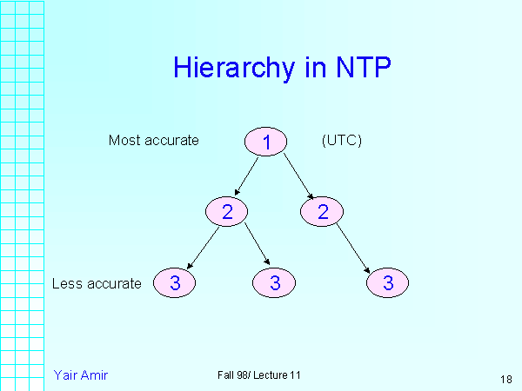
Network Time Protocol (NTP)
Most widely used physical clock synchronization protocol on the Internet
10-20 million NTP servers and clients in the Internet
Claimed Accuracy (Varies)
  milliseconds on WANs, submilliseconds on LANs
Hierarchical tree of time servers.
  The primary server at the root synchronizes with the UTC.
  Secondary servers - backup to primary server.
  Lowest
    synchronization subnet with clients.

Slide 18
Logical Time

Slide 19
Causal Relations
Distributed application results in a set of distributed events
  Induces a partial order → causal precedence relation
Knowledge of this causal precedence relation is useful in reasoning about and analyzing the properties of distributed computations
  Liveness and fairness in mutual exclusion
  Consistency in replicated databases
  Distributed debugging, checkpointing

Slide 20
Event Ordering
Lamport defined the “happens before” (<) relation
  If a and b are events in the same process, and a occurs before b, then a<b.
  If a is the event of a message being sent by one process and b is the event of the message being received by another process, then a < b.
  If X <Y and Y<Z then X < Z.
  If a < b then time (a) < time (b)

Slide 21
Causal Ordering
“Happens Before” also called causal ordering
Possible to draw a causality relation between 2 events if
  They happen in the same process
  There is a chain of messages between them
“Happens Before” notion is not straightforward in distributed systems
  No guarantees of synchronized clocks
  Communication latency

Slide 22
Implementing Logical Clocks
Requires
  Data structures local to every process to represent logical time and
  a protocol to update the data structures to ensure the consistency condition.
Each process Pi maintains data structures that allow it the following two capabilities:
  A local logical clock, denoted by LCi , that helps process Pi measure its own progress.
  A logical global clock, denoted by GCi , that is a representation of process Pi ’s local view of the logical global time. Typically, LCi is a part of GCi
The protocol ensures that a process’s logical clock, and thus its view of the global time, is managed consistently.
  The protocol consists of the following two rules:
    R1: This rule governs how the local logical clock is updated by a process when it executes an event.
    R2: This rule governs how a process updates its global logical clock to update its view of the global time and global progress.

Slide 23
Types of Logical Clocks
Systems of logical clocks differ in their representation of logical time and also in the protocol to update the logical clocks.
3 kinds of logical clocks
  Scalar
  Vector
  Matrix

Slide 24
Scalar Logical Clocks - Lamport
Proposed by Lamport in 1978 as an attempt to totally order events in a distributed system.
Time domain is the set of non-negative integers.
The logical local clock of a process Pi and its local view of the global time are squashed into one integer variable Ci .
Monotonically increasing counter
  No relation with real clock
Each process keeps its own logical clock used to timestamp events

Slide 25
Consistency with Scalar Clocks
Local clocks must obey a simple protocol:
  When executing an internal event or a send event at process P_{i} the clock C_{i} ticks
      C_{i} += d (d>0)
  When P_{i} sends a message m, it piggybacks a logical timestamp t which equals the time of the send event
  When executing a receive event at P_{i} where a message with timestamp t is received, the clock is advanced
      C_{i} = max(C_{i},t)+d (d>0)
Results in a partial ordering of events.

Slide 26
Total Ordering
Extending partial order to total order
Global timestamps:
  (Ta, Pa) where Ta is the local timestamp and Pa is the process id.
  (Ta,Pa) < (Tb,Pb) iff
    (Ta < Tb) or ( (Ta = Tb) and (Pa < Pb))
  Total order is consistent with partial order.
time
Proc_id

Slide 27
Vector Times
The system of vector clocks was developed independently by Fidge, Mattern and Schmuck.
In the system of vector clocks, the time domain is represented by a set of n-dimensional non-negative integer vectors.
Each process has a clock C_{i} consisting of a vector of length n, where n is the total number of processes vt[1..n], where vt[j ] is the local logical clock of Pj and describes the logical time progress at process Pj .
  A process P_{i} ticks by incrementing its own component of its clock
    C_{i}[i] += 1
  The timestamp C(e) of an event e is the clock value after ticking
  Each message gets a piggybacked timestamp consisting of the vector of the local clock
    The process gets some knowledge about the other process’ time approximation
    C_{i}=sup(C_{i},t):: sup(u,v)=w : w[i]=max(u[i],v[i]), ∀i

Slide 28
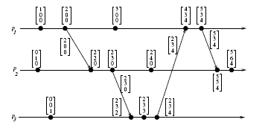
Vector Clocks example
Figure 3.2: Evolution of vector time.
From A. Kshemkalyani and M. Singhal (Distributed Computing)

Slide 29
Matrix Time
Vector time contains information about latest direct dependencies
  What does Pi know about Pk
Also contains info about latest direct dependencies of those dependencies
  What does Pi know about what Pk knows about Pj
Message and computation overheads are high
Powerful and useful for applications like distributed garbage collection

Slide 30
Simulate A Global State
Recording the global state of a distributed system on-the-fly is an important paradigm.
  Challenge: lack of globally shared memory, global clock and unpredictable message delays in a distributed system
Notions of global time and global state closely related
A process can (without freezing the whole computation) compute the best possible approximation of global state
A global state that could have occurred
  No process in the system can decide whether the state did really occur
  Guarantee stable properties (i.e. once they become true, they remain true)

Slide 31
Consistent Cuts
A cut (or time slice) is a zigzag line cutting a time diagram into 2 parts (past and future)
  E is augmented with a cut event c_{i} for each process P_{i}:E’ =E ∪ {c_{i},…,c_{n}} ∴
    A cut C of an event set E is a finite subset C⊆E: e∈C ∧ e’<_{l}e →e’∈C
    A cut C₁ is later than C₂ if C₁⊇C₂
    A consistent cut C of an event set E is a finite subset C⊆E : e∈C ∧ e’<e →e’ ∈C
      i.e. a cut is consistent if every message received was previously sent (but not necessarily vice versa!)

Slide 32
Cuts (Summary)
Instant of local
observation
Time
P1
5
8
3
initial
value
P2
5
2
3
7
4
1
P3
5
4
0
ideal
(vertical)
cut
(15)
consistent
cut
(15)
inconsistent
cut
(19)
not attainable
equivalent to a vertical cut
(rubber band transformation)
can’t be made vertical
(message from the future)
“Rubber band transformation” changes metric, but keeps topology

Slide 33
System Model for Global Snapshots
The system consists of a collection of n processes p1, p2, ..., pn that are connected by channels.
There are no globally shared memory and physical global clock and processes communicate by passing messages through communication channels.
C_{ij} denotes the channel from process pi to process pj and its state is denoted by SC_{ij} .
The actions performed by a process are modeled as three types of events:
  Internal events,the message send event and the message receive event.
  For a message mij that is sent by process pi to process pj , let send(m_{ij} ) and rec(m_{ij} ) denote its send and receive events.

Slide 34
Process States and Messages in transit
At any instant, the state of process pi , denoted by LSi , is a result of the sequence of all the events executed by pi till that instant.
For an event e and a process state LSi , e∈LSi iff e belongs to the sequence of events that have taken process pi to state LSi .
For an event e and a process state LSi , e (not in) LSi iff e does not belong to the sequence of events that have taken process pi to state LSi .
For a channel Cij , the following set of messages can be defined based on the local states of the processes pi and pj
Transit: transit(LSi , LSj ) = {mij |send(mij ) ∈ LSi V
rec(mij ) (not in) LSj }

Slide 35
Global States of Consistent Cuts
The global state of a distributed system is a collection of the local states of the processes and the channels.
A global state computed along a consistent cut is correct
The global state of a consistent cut comprises the local state of each process at the time the cut event happens and the set of all messages sent but not yet received
The snapshot problem consists in designing an efficient protocol which yields only consistent cuts and to collect the local state information
    Messages crossing the cut must be captured
    Chandy & Lamport presented an algorithm assuming that message transmission is FIFO

Slide 36
Chandy-Lamport Distributed Snapshot Algorithm
Assumes FIFO communication in channels
Uses a control message, called a marker to separate messages in the channels.
  After a site has recorded its snapshot, it sends a marker, along all of its outgoing channels before sending out any more messages.
  The marker separates the messages in the channel into those to be included in the snapshot from those not to be recorded in the snapshot.
A process must record its snapshot no later than when it receives a marker on any of its incoming channels.
The algorithm terminates after each process has received a marker on all of its incoming channels.
All the local snapshots get disseminated to all other processes and all the processes can determine the global state.

Slide 37
Chandy-Lamport Distributed Snapshot Algorithm
Marker receiving rule for Process Pi
If (Pi has not yet recorded its state) it
records its process state now
records the state of c as the empty set
turns on recording of messages arriving over other channels
else
Pi records the state of c as the set of messages received over c
since it saved its state
Marker sending rule for Process Pi
After Pi has recorded its state,for each outgoing channel c:
Pi sends one marker message over c
(before it sends any other message over c)

Slide 38
Chandy-Lamport Extensions: Spezialetti-Kerns and others
    Exploit concurrently initiated snapshots to reduce overhead of local snapshot exchange
  Snapshot Recording
    Markers carry identifier of initiator – first initiator recorded in a per process “master” variable.
    Region - all the processes whose master field has same initiator.
    Identifiers of concurrent initiators recorded in “id-border-set.”
  Snapshot Dissemination
    Forest of spanning trees is implicitly created in the system. Every Initiator is root of a spanning tree; nodes relay snapshots of rooted subtree to parent in spanning tree
    Each initiator assembles snapshot for processes in its region and exchanges with initiators in adjacent regions.
Others: multiple repeated snapshots; wave algorithm

Slide 39
Computing Global States without FIFO Assumption
In a non-FIFO system, a marker cannot be used to delineate messages into those to be recorded in the global state from those not to be recorded in the global state.
In a non-FIFO system, either some degree of inhibition or piggybacking of control information on computation messages to capture out-of-sequence messages.

Slide 40
Non-FIFO Channel Assumption:
Lai-Yang Algorithm
Emulates marker by using a coloring scheme
  Every Process: White (before snapshot); Red (after snapshot).
  Every message sent by a white (red) process is colored white (red) indicating if it was sent before(after) snapshot.
  Each process (which is initially white) becomes red as soon as it receives a red message for the first time and starts a virtual broadcast algorithm to ensure that all processes will eventually become red
    Get Dummy red messages to all processes (Flood neighbors)
Determining Messages in transit
  White process records history of white msgs sent/received on each channel.
  When a process turns red, it sends these histories along with its snapshot to the initiator process that collects the global snapshot.
  Initiator process evaluates transit(LSi , LSj ) to compute state of a channel Cij :
  SCij = white messages sent by pi on Cij − white messages received by pj on Cij = \
  {send(mij )|send(mij ) ∈ LSi } − {rec(mij )|rec(mij ) ∈ LSj }.

Slide 41
Non-FIFO Channel Assumption:
Termination Detection
Required to detect that no white messages are in transit.
Method 1: Deficiency Counting
  Each process Pi keeps a counter cntri that indicates the difference between the number of white messages it has sent and received before recording its snapshot.
  It reports this value to the initiator process along with its snapshot and forwards all white messages, it receives henceforth, to the initiator.
  Snapshot collection terminates when the initiator has received Σi cntri number of forwarded white messages.
Method 2
  Each red message sent by a process carries a piggybacked value of the number of white messages sent on that channel before the local state recording.
  Each process keeps a counter for the number of white messages received on each channel.
  A process can detect termination of recording the states of incoming channels when it receives as many white messages on each channel as the value piggybacked on red messages received on that channel.

Slide 42
Non-FIFO Channel Assumption: Mattern Algorithm
Uses Vector Clocks and assumes a single initiator
  All process agree on some future virtual time s or a set of virtual time instants s₁,…s_{n} which are mutually concurrent and did not yet occur
  A process takes its local snapshot at virtual time s
  After time s the local snapshots are collected to construct a global snapshot
    P_{i} ticks and then fixes its next time s=C_{i} +(0,…,0,1,0,…,0) to be the common snapshot time
    P_{i} broadcasts s
    P_{i} blocks waiting for all the acknowledgements
    P_{i} ticks again (setting C_{i}=s), takes its snapshot and broadcast a dummy message (i.e. force everybody else to advance their clocks to a value ≥ s)
    Each process takes its snapshot and sends it to P_{i} when its local clock becomes ≥ s

Slide 43
Non-FIFO Channel Assumption:
Mattern Algorithm
Inventing a n+1 virtual process whose clock is managed by P_{i}
P_{i} can use its clock and because the virtual clock C_{n+1} ticks only when P_{i} initiates a new run of snapshot :
  The first n component of the vector can be omitted
  The first broadcast phase is unnecessary
  Counter modulo 2

Slide 44
Distributed Operating Systems - Introduction
Prof. Nalini Venkatasubramanian
(includes slides from Prof. Petru Eles and Profs. textbook slides by Kshemkalyani/Singhal)

Slide 45
What does an OS do?
Process/Thread Management
  Scheduling
  Communication
  Synchronization
Memory Management
Storage Management
FileSystems Management
Protection and Security
Networking

Slide 46
Operating System Types
  Multiprocessor OS
    Looks like a virtual uniprocessor, contains only one copy of the OS, communicates via shared memory, single run queue
  Network OS
    Does not look like a virtual uniprocessor, contains n copies of the OS, communicates via shared files, n run queues
  Distributed OS
    Looks like a virtual uniprocessor (more or less), contains n copies of the OS, communicates via messages, n run queues

Slide 47
Design Elements
Communication
  Two basic IPC paradigms used in DOS
    Message Passing (RPC) and Shared Memory
  synchronous, asynchronous
Process Management
  Process synchronization
    Coordination of distributed processes is inevitable
    mutual exclusion, deadlocks, leader election
  Task Partitioning, allocation, load balancing, migration
FileSystems
  Naming of files/directories
  File sharing semantics
  Caching/update/replication

Slide 48
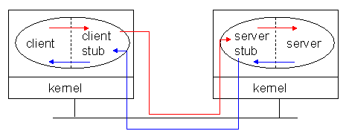
Remote Procedure Call
A convenient way to construct a client-server connection without explicitly writing send/ receive type programs (helps maintain transparency).

Slide 49
Remote Procedure Call (cont.)
Client procedure calls the client stub in a normal way
Client stub builds a message and traps to the kernel
Kernel sends the message to remote kernel
Remote kernel gives the message to server stub
Server stub unpacks parameters and calls the server
Server computes results and returns it to server stub
Server stub packs results in a message and traps to kernel
Remote kernel sends message to client kernel
Client kernel gives message to client stub
Client stub unpacks results and returns to client

Slide 50
Distributed Shared Memory
Provides a shared-memory abstraction in the loosely coupled distributed-memory processors.
Issues
  Granularity of the block size
  Synchronization
  Memory Coherence (Consistency models)
  Data Location and Access
  Replacement Strategies
  Thrashing
  Heterogeneity

Slide 51
Distributed Mutual Exclusion
Mutual exclusion
    ensures that concurrent processes have serialized access to shared resources - the critical section problem.
    At any point in time, only one process can be executing in its critical section.
  Shared variables (semaphores) cannot be used in a distributed system
      Mutual exclusion must be based on message passing, in the context of unpredictable delays and incomplete knowledge
    In some applications (e.g. transaction processing) the resource is managed by a server which implements its own lock along with mechanisms to synchronize access to the resource.

Slide 52
Approaches to Distributed Mutual Exclusion
Central coordinator based approach
  A centralized coordinator determines who enters the CS
Distributed approaches to mutual exclusion
  Token based approach
    A unique token is shared among the sites. A site is allowed to enter its CS if it possesses the token.
    Mutual exclusion is ensured because the token is unique.
  Non-token based approach
    Two or more successive rounds of messages are exchanged among the sites to determine which site will enter the CS next.
  Quorum based approach
    Each site requests permission to execute the CS from a subset of sites (called a quorum).
    Any two quorums contain a common site. This common site is responsible to make sure that only one request executes the CS at any time.

Slide 53
Requirements/Conditions
Safety Property (Mutual Exclusion)
  At any instant, only one process can execute the critical section.
Liveness Property (Progress)
  This property states the absence of deadlock and starvation. Two or more sites should not endlessly wait for messages which will never arrive.
Fairness (Bounded Waiting)
  Each process gets a fair chance to execute the CS. Fairness property generally means the CS execution requests are executed in the order of their arrival (time is determined by a logical clock) in the system.

Slide 54
Performance Metrics for Mutual Exclusion Algorithms
Message complexity
  The number of messages required per CS execution by a site.
Synchronization delay
  After a site leaves the CS, it is the time required before the next site enters the CS
Response time
  The time interval a request waits for its CS execution to be over after its request messages have been sent out
System throughput
  The rate at which the system executes requests for the CS.
System throughput=1/(SD+E)
  where SD is the synchronization delay and E is the average critical section execution time

Slide 55
Mutual Exclusion Techniques Covered
Central Coordinator Algorithm
In a distributed environment it seems more natural to implement mutual exclusion, based upon distributed agreement - not on a central coordinator.
Distributed Non-token based (Timestamp-Based Algorithms)
  Lamport’s Algorithm
  Ricart-Agrawala1 Algorithm
  Variation – Quorum based (Maekawa’s Algorithm)
Distributed Token Based
  Ricart-Agrawala Second Algorithm
  Token Ring Algorithm

Slide 56
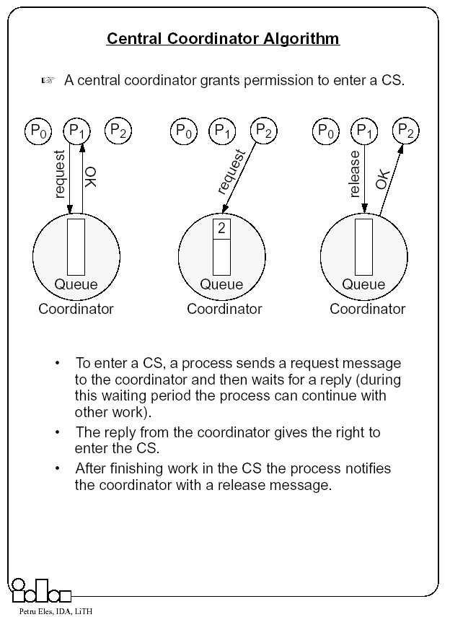

Slide 57
Lamport’s Algorithm
Basic Idea
  Requests for CS are executed in the increasing order of timestamps and time is determined by logical clocks.
  Every site S_i keeps a queue, request queue_i , which contains mutual exclusion requests ordered by their timestamps.
  This algorithm requires communication channels to deliver messages the FIFO order.

Slide 58
Lamport’s Algorithm
Requesting the critical section
  When a site Si wants to enter the CS, it broadcasts a REQUEST(ts_i , i ) message to all other sites and places the request on request queuei . ((ts_i , i ) denotes the timestamp of the request.)
  When a site Sj receives the REQUEST(ts_i , i ) message from site Si , it places site Si ’s request on request queue of j and returns a timestamped REPLY message to Si
Executing the critical section
  Site Si enters the CS when the following two conditions hold:
    L1: Si has received a message with timestamp larger than (ts_i, i)from all other sites.
    L2: Si ’s request is at the top of request queue_i .
Releasing the critical section
  Site Si , upon exiting the CS, removes its request from the top of its request queue and broadcasts a timestamped RELEASE message to all other sites.
  When a site Sj receives a RELEASE message from site Si , it removes Si ’s request from its request queue.
  When a site removes a request from its request queue, its own request may come at the top of the queue, enabling it to enter the CS.

Slide 59
Performance – Lamport’s Algorithm
For each CS execution Lamport’s algorithm requires
  (N − 1) REQUEST messages, (N − 1) REPLY messages, and (N − 1) RELEASE messages.
  Thus, Lamport’s algorithm requires 3(N − 1) messages per CS invocation.
Optimization
  In Lamport’s algorithm, REPLY messages can be omitted in certain situations.
  For example, if site Sj receives a REQUEST message from site Si after it has sent its own REQUEST message with timestamp higher than the timestamp of site Si ’s request, then site Sj need not send a REPLY message to site Si .
  This is because when site Si receives site Sj ’s request with timestamp higher than its own, it can conclude that site Sj does not have any smaller timestamp request which is still pending.
  With this optimization, Lamport’s algorithm requires between 3(N − 1) and 2(N − 1) messages per CS execution.

Slide 60
Ricart-Agrawala Algorithm
Uses only two types of messages – REQUEST and REPLY.
It is assumed that all processes keep a (Lamport’s) logical clock which is updated according to the clock rules.
  The algorithm requires a total ordering of requests. Requests are ordered according to their global logical timestamps; if timestamps are equal, process identifiers are compared to order them.
The process that requires entry to a CS multicasts the request message to all other processes competing for the same resource.
  Process is allowed to enter the CS when all processes have replied to this message.
  The request message consists of the requesting process’ timestamp (logical clock) and its identifier.
Each process keeps its state with respect to the CS: released, requested, or held.

Slide 61
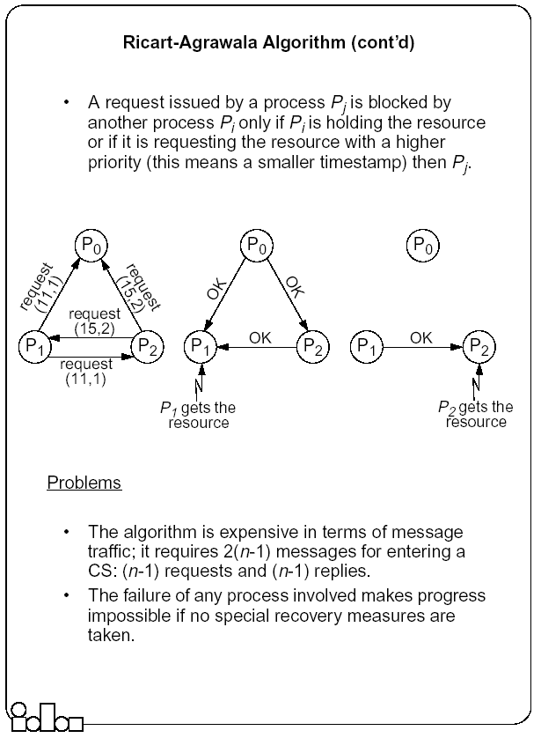

Slide 62
Quorum-Based Consensus – Maekawa’s Algorithm
Site obtains permission only from a subset of sites to enter CS
Multicasts messages to a voting subset of processes’
  Each process p_{i} is associated with a voting set v_{i} (of processes)
    Each process belongs to its own voting set
    The intersection of any two voting sets is non-empty
    Each voting set is of size K
    Each process belongs to M other voting sets
  To access a critical section, p_{i} requests permission from all other processes in its own voting set v_{i}
    Voting set member gives permission to only one requestor at a time, and queues all other requests
    Guarantees safety
    May not guarantee liveness (may deadlock)
    Maekawa showed that K=M=√N works best
      One way of doing this is to put N processes in a √N by √N matrix and take union of row & column containing p_{i} as its voting set.

Slide 63
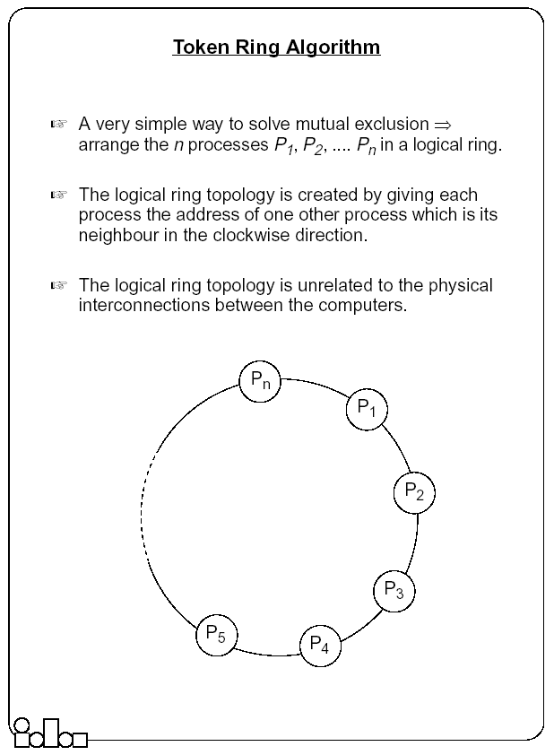

Slide 64
Ricart-Agrawala Second Algorithm
A process is allowed to enter the critical section when it gets the token.
  Initially the token is assigned arbitrarily to one of the processes.
In order to get the token it sends a request to all other processes competing for the same resource.
  The request message consists of the requesting process’ timestamp (logical clock) and its identifier.
When a process Pi leaves a critical section
  it passes the token to one of the processes which are waiting for it; this will be the first process Pj, where j is searched in order [ i+1, i+2, ..., n, 1, 2, ..., i-2, i-1] for which there is a pending request.
  If no process is waiting, Pi retains the token (and is allowed to enter the CS if it needs); it will pass over the token as result of an incoming request.
How does Pi find out if there is a pending request?
  Each process Pi records the timestamp corresponding to the last request it got from process Pj, in request Pi[ j]. In the token itself, token[ j] records the timestamp (logical clock) of Pj’s last holding of the token. If requestPi[ j] > token[ j] then Pj has a pending request.

Slide 65
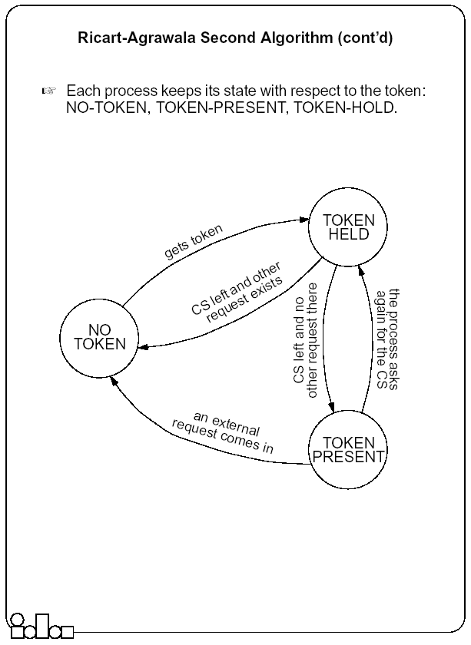

Slide 66
Suzuki-Kazami Broadcast Algorithm
If a site wants to enter the CS and it does not have the token, it broadcasts a REQUEST message for the token to all other sites.
A site which possesses the token sends it to the requesting site upon the receipt of its REQUEST message.
If a site receives a REQUEST message when it is executing the CS, it sends the token only after it has completed the execution of the CS.
Two Issues
  Outdated Requests: Due to variable message delays, site may receive token request message after request has been satisfied. Token to outdated requestor results in poor performance
  When a process is done, which of the outstanding requests should it satisfy?

Slide 67
Election Algorithms
It doesn’t matter which process is elected.
  What is important is that one and only one process is chosen (we call this process the coordinator) and all processes agree on this decision.
Assume that each process has a unique number (identifier).
  In general, election algorithms attempt to locate the process with the highest number, among those which currently are up.
Election is typically started after a failure occurs.
  The detection of a failure (e.g. the crash of the current coordinator) is normally based on time-out → a process that gets no response for a period of time suspects a failure and initiates an election process.
An election process is typically performed in two phases:
  Select a leader with the highest priority.
  Inform all processes about the winner.

Slide 68
The Bully Algorithm
A process has to know the identifier of all other processes
  (it doesn’t know, however, which one is still up); the process with the highest identifier, among those which are up, is selected.
Any process could fail during the election procedure.
When a process Pi detects a failure and a coordinator has to be elected
  it sends an election message to all the processes with a higher identifier and then waits for an answer message:
  If no response arrives within a time limit
    Pi becomes the coordinator (all processes with higher identifier are down)
    it broadcasts a coordinator message to all processes to let them know.
  If an answer message arrives,
    Pi knows that another process has to become the coordinator → it waits in order to receive the coordinator message.
    If this message fails to arrive within a time limit (which means that a potential coordinator crashed after sending the answer message) Pi resends the election message.
When receiving an election message from Pi
  a process Pj replies with an answer message to Pi and
  then starts an election procedure itself( unless it has already started one) it sends an election message to all processes with higher identifier.
Finally all processes get an answer message, except the one which becomes the coordinator.

Slide 69
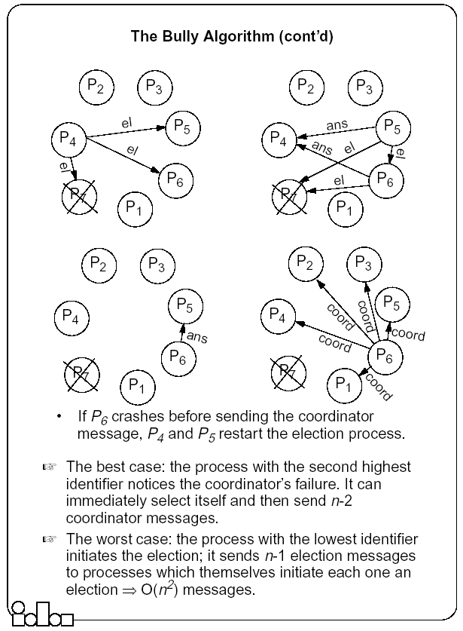

Slide 70
The Ring-based Algorithm
We assume that the processes are arranged in a logical ring
    Each process knows the address of one other process, which is its neighbor in the clockwise direction.
The algorithm elects a single coordinator, which is the process with the highest identifier.
Election is started by a process which has noticed that the current coordinator has failed.
  The process places its identifier in an election message that is passed to the following process.
  When a process receives an election message
    It compares the identifier in the message with its own.
    If the arrived identifier is greater, it forwards the received election message to its neighbor
    If the arrived identifier is smaller it substitutes its own identifier in the election message before forwarding it.
    If the received identifier is that of the receiver itself → this will be the coordinator.
The new coordinator sends an elected message through the ring.

Slide 71
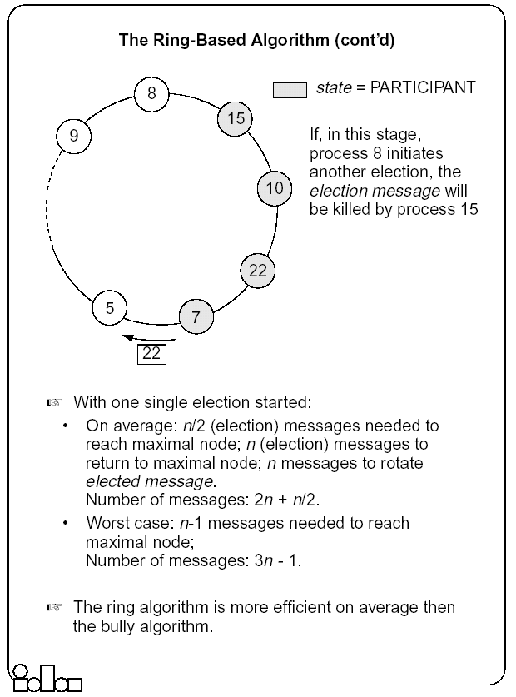

Slide 72
Distributed Deadlocks
Deadlocks is a fundamental problem in distributed systems.
A process may request resources in any order, which may not be known a priori and a process can request resource while holding others.
If the sequence of the allocations of resources to the processes is not controlled, deadlocks can occur.
A deadlock is a state where a set of processes request resources that are held by other processes in the set.
Conditions for a deadlocks
  Mutual exclusion, hold-and-wait, No-preemption and circular wait.

Slide 73
Modeling Deadlocks
In addition to the standard assumptions (no shared memory, no global clock, no failures), we make the following assumptions:
The systems have only reusable resources.
Processes are allowed to make only exclusive access to resources.
There is only one copy of each resource.
A process can be in two states: running or blocked.
  In the running state (also called active state), a process has all the needed resources and is either executing or is ready for execution.
  In the blocked state, a process is waiting to acquire some resource.
The state of the system can be modeled by directed graph, called a wait for graph (WFG).
  In a WFG , nodes are processes and there is a directed edge from node P1 to mode P2 if P1 is blocked and is waiting for P2 to release some resource.
A system is deadlocked if and only if there exists a directed cycle or knot in the WFG.

Slide 74
Techniques for Handling Deadlocks
Note: No site has accurate knowledge of the current state of the system
Techniques
  Deadlock Prevention (collective/ordered requests, preemption)
    Inefficient, impractical
  Deadlock Avoidance
    A resource is granted to a process if the resulting global system state is safe
    Requires advance knowledge of processes and their resource requirements
    Impractical
  Deadlock Detection and Recovery
    Maintenance of local/global WFG and searching of the WFG for the presence of cycles (or knots), local/centralized deadlock detectors
    Recovery by operator intervention, break wait-for dependencies, termination and rollback

Slide 75
Classes of Deadlock Detection Algorithms
Path-pushing
    distributed deadlocks are detected by maintaining an explicit global WFG (constructed locally and pushed to neighbors)
Edge-chasing (single resource model, AND model)
    the presence of a cycle in a distributed graph structure is be verified by propagating special messages called probes, along the edges of the graph. The formation of cycle can be detected by a site if it receives the matching probe sent by it previously.
Diffusion computation (OR model, AND-OR model)
    deadlock detection computation is diffused through the WFG of the system.
Global state detection (Unrestricted, P-out-of-Q model)
    Take a snapshot of the system and examining it for the condition of a deadlock.

Slide 76
Process Management
Process migration
  Freeze the process on the source node and restart it at the destination node
  Transfer of the process address space
  Forwarding messages meant for the migrant process
  Handling communication between cooperating processes separated as a result of migration
  Handling child processes
Process migration in heterogeneous systems

Slide 77
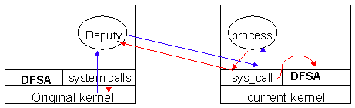
Mosix: File Access
Each file access must go back to deputy…
= = Very Slow for I/O apps.
Solution: Allow processes to access a distributed file system through the current kernel.

Slide 78
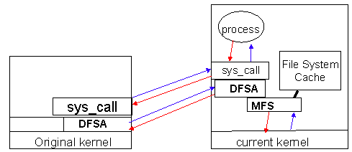
Mosix: File Access
DFSA
  Requirements (cache coherent, monotonic timestamps, files not deleted until all nodes finished)
  Bring the process to the files.
MFS
  Single cache (on server)
  /mfs/1405/var/tmp/myfiles

Slide 79
Dynamic Load Balancing
Dynamic Load Balancing on Highly Parallel Computers
  Seek to minimize total execution time of a single application running in parallel on a multiprocessor system
    Sender Initiated Diffusion (SID), Receiver Initiated Diffusion(RID), Hierarchical Balancing Method (HBM), Gradient Model (GM), Dynamic Exchange method (DEM)
Dynamic Load Balancing on Web Servers
  Seek to improve response time using distributed web-server architectures , by scheduling client requests among multiple nodes in a transparent way
    Client-based approach, DNS-Based approach, Dispatcher-based approach, Server-based approach
Dynamic Load Balancing on Multimedia Servers
  Aim to maximize requests and preserve QoS for admitted requests by adaptively scheduling requests given knowledge of where objects are placed
    Adaptive Scheduling of Video Objects, Predictive Placement of Video Objects

Slide 80
Distributed File Systems (DFS)
DFS is a distributed implementation of the classical file system model
  Issues - File and directory naming, semantics of file sharing
Important features of DFS
  Transparency, Fault Tolerance
Implementation considerations
  caching, replication, update protocols
The general principle of designing DFS: know the clients have cycles to burn, cache whenever possible, exploit usage properties, minimize system wide change, trust the fewest possible entries and batch if possible.

Slide 81
File Sharing Semantics
One-copy semantics
    Updates are written to the single copy and are available immediately
Serializability
    Transaction semantics (file locking protocols implemented - share for read, exclusive for write).
Session semantics
    Copy file on open, work on local copy and copy back on close

Slide 82
Example: Sun-NFS
    Supports heterogeneous systems
    Architecture
      Server exports one or more directory trees for access by remote clients
      Clients access exported directory trees by mounting them to the client local tree
      Diskless clients mount exported directory to the root directory
    Protocols
      Mounting protocol
      Directory and file access protocol - stateless, no open-close messages, full access path on read/write
    Semantics - no way to lock files

Slide 83
Example: Andrew File System
Supports information sharing on a large scale
Uses a session semantics
  Entire file is copied to the local machine (Venus) from the server (Vice) when open. If file is changed, it is copied to server when closed.
    Works because in practice, most files are changed by one person

Slide 84
The Coda File System
Descendant of AFS that is substantially more resilient to server and network failures.
Support for “mobile” users.
Directories are replicated in several servers (Vice)
When the Venus is disconnected, it uses local versions of files. When Venus reconnects, it reintegrates using optimistic update scheme.

Slide 85
Messaging and Group Communication
ICS 230 Distributed Systems
(with some slides modified from S.Ghosh’s classnotes)

Slide 86
What type of group communication ?
Open group (anyone can join, customers of Walmart)
Closed groups (closed membership, class of 2000)
Peer
  All members are equal, All members send messages to the group
  All members receive all the messages
  E.g. UCI students, UCI faculty
Client-Server
  Common communication pattern
    replicated servers
  Client may or may not care which server answers
Diffusion group
  Servers sends to other servers and clients
Hierarchical (one or more members are diff. from the rest)
  Highly and easy scalable
Svrs
Clients

Slide 87
Multicast
Basic Multicast: Does not consider failures
    Liveness: Each process must receive every message
    Integrity : No spurious message received
    No duplicates: Accepts exactly one copy of a message
  Reliable multicast: tolerates (certain kinds of) failures.
  Atomic Multicast:
    A multicast is atomic, when the message is delivered to every correct member, or to no member at all.
    In general, processes may crash, yet the atomicity of the multicast is to be guaranteed.
  Reliable Atomic Multicast
    Scalability a key issue

Slide 88
Steiner Trees and Core Based Trees
Given a weighted graph (N, L) and a subset N’ in N, identify a subset L’ in L such that (N’ ,L’) is a subgraph of (N,L) that connects all the nodes of N’.
  A minimal Steiner tree is a minimal weight subgraph (N’; L’).
  NP-complete ; need heuristics
Core-based Trees
  Multicast tree constructed dynamically, grows on demand.
  Each group has a core node(s)
  A node wishing to join the tree as a receiver sends a unicast join message to the core node.
  The join marks the edges as it travels; it either reaches the core node, or some node already part of the tree. The path followed by the join till the core/multicast tree is grafted to the multicast tree.
  A node on the tree multicasts a message by using flooding on the core tree.
  A node not on the tree sends a message towards the core node; as soon as the message reaches any node on the tree, it is flooded on the tree.

Slide 89
Using Traditional Transport Protocols
  TCP/IP
    Automatic flow control, reliable delivery, connection service, complexity
      linear degradation in performance
  Unreliable broadcast/multicast
    UDP, IP-multicast - assumes h/w support
    IP-multicast
      A bandwidth-conserving technology where the router reduces traffic by replicating a single stream of information and forwarding them to multiple clients.
      Sender sends a single copy to a special multicast IP address (Class D) that represents a group, where other members register.
    message losses high(30%) during heavy load
      Reliable IP-multicast very expensive

Slide 90
Group Communication Issues
Ordering
Delivery Guarantees
Membership
Failure

Slide 91
Ordering Service
Unordered
Single-Source FIFO (SSF)
  For all messages m₁, m₂ and all objects a_{i}, a_{j}, if a_{i} sends m₁ before it sends m₂, then m₂ is not received at a_{j} before m₁ is
Totally Ordered
  For all messages m₁, m₂ and all objects a_{i}, a_{j}, if m₁ is received at a_{i} before m₂ is, the m₂ is not received at a_{j} before m₁ is
Causally Ordered
  For all messages m₁, m₂ and all objects a_{i}, a_{j}, if m₁ happens before m₂, then m₂ is not received at a_{i} before m₁ is

Slide 92
Delivery guarantees
  Agreed Delivery
      guarantees total order of message delivery and allows a message to be delivered as soon as all of its predecessors in the total order have been delivered.
  Safe Delivery
      requires in addition, that if a message is delivered by the GC to any of the processes in a configuration, this message has been received and will be delivered to each of the processes in the configuration unless it crashes.

Slide 93
Membership
Messages addressed to the group are received by all group members
If processes are added to a group or deleted from it (due to process crash, changes in the network or the user's preference), need to report the change to all active group members, while keeping consistency among them
Every message is delivered in the context of a certain configuration, which is not always accurate. However, we may want to guarantee
  Failure atomicity
  Uniformity
  Termination

Slide 94
Some GC Properties
  Atomic Multicast
    Message is delivered to all processes or to none at all. May also require that messages are delivered in the same order to all processes.
  Failure Atomicity
    Failures do not result in incomplete delivery of multicast messages or holes in the causal delivery order
  Uniformity
    A view change reported to a member is reported to all other members
  Liveness
    A machine that does not respond to messages sent to it is removed from the local view of the sender within a finite amount of time.

Slide 95
Virtual Synchrony
Virtual Synchrony
  Introduced in ISIS, orders group membership changes along with the regular messages
  Ensures that failures do not result in incomplete delivery of multicast messages or holes in the causal delivery order(failure atomicity)
  Ensures that, if two processes observe the same two consecutive membership changes, receive the same set of regular multicast messages between the two changes
    A view change acts as a barrier across which no multicast can pass
  Does not constrain the behavior of faulty or isolated processes

Slide 96
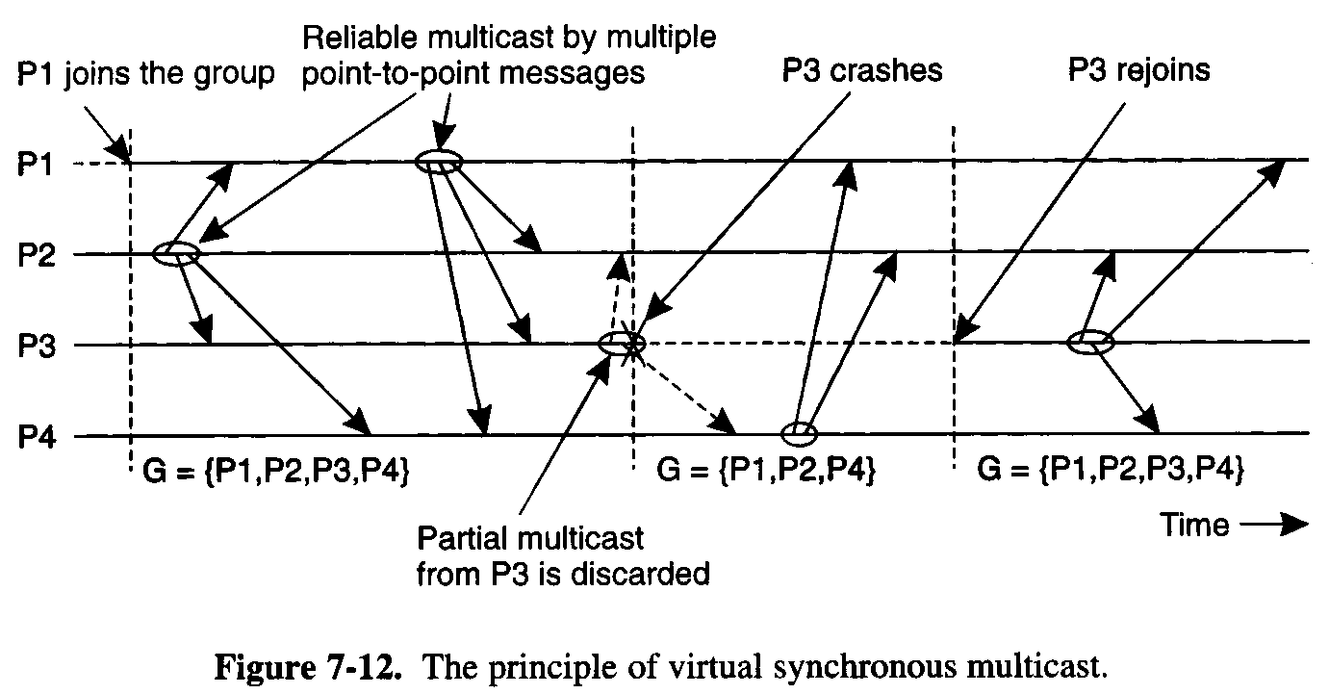

Slide 97
Faults and Partitions
When detecting a processor P from which we did not hear for a certain timeout, we issue a fault message
When we get a fault message, we adopt it (and issue our copy)
Problem: maybe P is only slow
When a partition occurs, we can not always completely determine who received which messages (there is no solution to this problem)

Slide 98
Extended Virtual Synchrony(cont.)
Virtual synchrony handles recovered processes as new processes
  Can cause inconsistencies with network partitions
Network partitions are real
  Gateways, bridges, wireless communication

Slide 99
Extended Virtual Synchrony Model
Network may partition into finite number of components
  Two or more may merge to form a larger component
Each membership with a unique identifier is a configuration.
    Membership ensures that all processes in a configuration agree on the membership of that configuration

Slide 100
Regular and Transitional Configurations
To achieve safe delivery with partitions and remerges, the EVS model defines:
  Regular Configuration
    New messages are broadcast and delivered
    Sufficient for FIFO and causal communication modes
  Transitional Configuration
    No new messages are broadcast, only remaining messages from prior regular configuration are delivered.
  Regular configuration may be followed and preceeded by several transitional configurations.

Slide 101

Totem
Provides a Reliable totally ordered multicast service over LAN
Intended for complex applications in which fault-tolerance and soft real-time performance are critical
  High throughput and low predictable latency
  Rapid detection of, and recovery from, faults
  System wide total ordering of messages
  Scalable via hierarchical group communication
  Exploits hardware broadcast to achieve high-performance
Provides 2 delivery services
  Agreed
  Safe
Use timestamp to ensure total order and sequence numbers to ensure reliable delivery

Slide 102

ISIS
Tightly coupled distributed system developed over loosely coupled processors
Provides a toolkit mechanism for distributing programming, whereby a DS is built by interconnecting fairly conventional non-distributed programs, using tools drawn from the kit
Define
  how to create, join and leave a group
  group membership
  virtual synchrony
Initially point-to-point (TCP/IP)
Fail-stop failure model

Slide 103

Horus
Aims to provide a very flexible environment to configure group of protocols specifically adapted to problems at hand
Provides efficient support for virtual synchrony
Replaces point-to-point communication with group communication as the fundamental abstraction, which is provided by stacking protocol modules that have a uniform (upcall, downcall) interface
Not every sort of protocol blocks make sense
HCPI
  Stability of messages
  membership
Electra
  CORBA-Compliant interface
  method invocation transformed into multicast

Slide 104

Transis
How different components of a partitioned network can operate autonomously and then merge operations when they become reconnected ?
Are different protocols for fast-local and slower-cluster communication needed ?
A large-scale multicast service designed with the following goals
  Tackling network partitions and providing tools for recovery from them
  Meeting needs of large networks through hierarchical communication
  Exploiting fast-clustered communication using IP-Multicast
Communication modes
  FIFO
  Causal
  Agreed
  Safe

Slide 105
Fault Tolerant
Distributed Systems
ICS 230
Prof. Nalini Venkatasubramanian
(with some slides modified from Prof. Ghosh, University of Iowa and Indranil Gupta, UIUC)

Slide 106
Classification of failures
Crash failure
Security failure
Omission failure
Temporal failure
Byzantine failure
Transient failure
Software failure
Environmental perturbations

Slide 107
Crash failures
Crash failure = the process halts. It is irreversible.
In synchronous system, it is easy to detect crash failure (using heartbeat signals and timeout). But in asynchronous systems, it is never accurate, since it is not possible to distinguish between a process that has crashed, and a process that is running very slowly.
Some failures may be complex and nasty. Fail-stop failure is a simple abstraction that mimics crash failure when program execution becomes arbitrary. Implementations help detect which processor has failed. If a system cannot tolerate fail-stop failure, then it cannot tolerate crash.

Slide 108
Transient failure
(Hardware) Arbitrary perturbation of the global state. May be induced by power surge, weak batteries, lightning, radio-frequency interferences, cosmic rays etc.
(Software) Heisenbugs are a class of temporary internal faults and are intermittent. They are essentially permanent faults whose conditions of activation occur rarely or are not easily reproducible, so they are harder to detect during the testing phase.
Over 99% of bugs in IBM DB2 production code are non-deterministic and transient (Jim Gray)
Not Heisenberg

Slide 109
Temporal failures
Inability to meet deadlines – correct results are generated, but too late to be useful. Very important in real-time systems.
May be caused by poor algorithms, poor design strategy or loss of synchronization among the processor clocks

Slide 110
Byzantine failure
Anything goes! Includes every conceivable form of erroneous behavior. The weakest type of failure
Numerous possible causes. Includes malicious behaviors (like a process executing a different program instead of the specified one) too.
Most difficult kind of failure to deal with.

Slide 111
Hardware Errors and Error Control Schemes
111
Failures | Causes | Metrics | Traditional Approaches
Soft Errors, Hard Failures, System Crash | External Radiations, Thermal Effects, Power Loss, Poor Design, Aging | FIT, MTTF, MTBF | Spatial Redundancy (TMR, Duplex, RAID-1 etc.) and Data Redundancy (EDC, ECC, RAID-5, etc.)
Hardware failures are increasing as technology scales
  (e.g.) SER increases by up to 1000 times [Mastipuram, 04]
Redundancy techniques are expensive
  (e.g.) ECC-based protection in caches can incur 95% performance penalty [Li, 05]
FIT: Failures in Time (10⁹ hours)
MTTF: Mean Time To Failure
MTBF: Mean Time b/w Failures
TMR: Triple Modular Redundancy
EDC: Error Detection Codes
ECC: Error Correction Codes
RAID: Redundant Array of
Inexpensive Drives
Notes:
There are soft errors, permanent failures and system crash, which result from external radiations such as alpha particles and neutrons, high temperature, battery out, poor design, and aging.
Metrics to measure the reliability for hardware components include FIT, MTTF, and MTBF in general.
FIT standing fro Failures in Time is to measure a number of errors in one billion operation hours.
MTTF indicates how long it takes to meet a failure and MTBF indicates how long it takes from a failure to the next failure.
To recover those failures, we can think about spatial redundancy technique and data redundancy technique.
Spatial redundancy techniques include TMR, duplex, RAID, etc.
Data redundancy includes error detection codes, error correction codes, etc.
These hardware failures increase as technology scales and integration increases. For example, SER increases by several orders of magnitude times every technology.
These redundancy techniques are effective but expensive. For instance, ECC for caches incur up to 95% performance penalty, and up to 22% power overhead. Thus, processors for high reliability protects just L2 and L3 caches, but not L1 cache, since it is so sensitive to processors’ performance and power.
111

Slide 112
Software Errors and Error Control Schemes
112
Failures | Causes | Metrics | Traditional Approaches
Wrong outputs, Infinite loops, Crash | Incomplete Specification, Poor software design, Bugs, Unhandled Exception | Number of Bugs/Klines, QoS, MTTF, MTBF | Spatial Redundancy (N-version Programming, etc.), Temporal Redundancy (Checkpoints and Backward Recovery, etc.)
Software errors become dominant as system’s complexity increases
  (e.g.) Several bugs per kilo lines
Hard to debug, and redundancy techniques are expensive
  (e.g.) Backward recovery with checkpoints is inappropriate for real-time applications
QoS: Quality of Service
Notes:
Examples of failures at software are wrong outputs, infinite loops, and crashes, which come from mostly designer or programmer’s errors such as incomplete specification, poor software design, programming bugs, unhandled exceptions.
To measure reliability of software, there are number of bugs/kilo lines, which is a measure of QoS in programs. Also MTTF and MTBF are used.
Traditional approaches include spatial redundancies such as N-programming, and temporal redundancy technique such as recovery with checkpoints.
As system’s complexity increases, software errors become dominant. And it’s hard to debug and fault tolerant techniques are expensive. For example, backward error recovery with checkpoints are inappropriate for real-time applications.
112

Slide 113
Network Errors and Error Control Schemes
113
Failures | Causes | Metrics | Traditional Approaches
Data Losses, Deadline Misses, Node (Link) Failure, System Down | Network Congestion, Noise/Interference, Malicious Attacks | Packet Loss Rate, Deadline Miss Rate, SNR, MTTF, MTBF, MTTR | Resource Reservation, Data Redundancy (CRC, etc.), Temporal Redundancy (Retransmission, etc.), Spatial Redundancy (Replicated Nodes, MIMO, etc.)
Omission Errors – lost/dropped messages
Network is unreliable (especially, wireless networks)
  Buffer overflow, Collisions at the MAC layer, Receiver out of range
Joint approaches across OSI layers have been investigated for minimal costs [Vuran, 06][Schaar, 07]
SNR: Signal to Noise Ratio
MTTR: Mean Time To Recovery
CRC: Cyclic Redundancy Check
MIMO: Multiple-In Multiple-Out
Notes:
It is another huge area to cover network reliability since network is unreliable.
Briefly, they consider data losses, deadline misses, node or link failures, and system down, which result from congested network, noisy and interfered channels, and also malicious attacks.
As quality metrics to measure reliability of networks, there are SNR standing for Signal to Noise Ratio and loss or miss rates other than MTTF, MTBF, and MTTR. MTTR is a metric how long it takes to recover system from failures.
In network, there are tons of approaches and some examples are resource reservation protocols, data redundancy techniques such as CRC, temporal redundancy techniques such as retransmission, and spatial redundancy such as node replication and multiple radios.
Interestingly, there have been a lot of work to combine multiple approaches across OSI 7 layers for optimal solutions.
113

Slide 114
Classifying fault-tolerance
Fail-safe tolerance
Given safety predicate is preserved, but liveness may be affected
Example. Due to failure, no process can enter its critical section for an indefinite period. In a traffic crossing, failure changes the traffic in both directions to red.
Graceful degradation
Application continues, but in a “degraded” mode. Much depends on what kind of degradation is acceptable.
Example. Consider message-based mutual exclusion. Processes will enter their critical sections, but not in timestamp order.

Slide 115
Conventional Approaches
115
Build redundancy into hardware/software
    Modular Redundancy, N-Version ProgrammingConventional TRM (Triple Modular Redundancy) can incur 200% overheads without optimization.
    Replication of tasks and processes may result in overprovisioning
    Error Control Coding
Checkpointing and rollbacks
    Usually accomplished through logging (e.g. messages)
    Backward Recovery with Checkpoints cannot guarantee the completion time of a task.
Hybrid
    Recovery Blocks
Notes:
Conventional approaches incur overheads.
At the end of this talk, this thesis shows the effectiveness of our approach, which even improves the performance and energy consumption rather than incurring overheads.
115

Slide 116
Defining Consensus
N processes
Each process p has
  input variable xp : initially either 0 or 1
  output variable yp : initially b (b=undecided) – can be changed only once
Consensus problem: design a protocol so that either
  all non-faulty processes set their output variables to 0
  Or non-faulty all processes set their output variables to 1
  There is at least one initial state that leads to each outcomes 1 and 2 above

Slide 117
Solving Consensus
No failures – trivial
  All-to-all broadcast
With failures
  Assumption: Processes fail only by crash-stopping
Synchronous system: bounds on
  Message delays
  Max time for each process step
  e.g., multiprocessor (common clock across processors)
Asynchronous system: no such bounds!
e.g., The Internet! The Web!

Slide 118
Asynchronous Consensus
Messages have arbitrary delay, processes arbitrarily slow
Impossible to achieve!
  a slow process indistinguishable from a crashed process
Theorem: In a purely asynchronous distributed system, the consensus problem is impossible to solve if even a single process crashes
Result due to Fischer, Lynch, Patterson (commonly known as FLP 85).

Slide 119
Failure detection
The design of fault-tolerant algorithms will be simple if processes can detect failures.
In synchronous systems with bounded delay channels, crash failures can definitely be detected using timeouts.
In asynchronous distributed systems, the detection of crash failures is imperfect.
Completeness – Every crashed process is suspected
Accuracy – No correct process is suspected.

Slide 120
Classification of completeness
Strong completeness. Every crashed process is eventually suspected by every correct process, and remains a suspect thereafter.
Weak completeness. Every crashed process is eventually suspected by at least one correct process, and remains a suspect thereafter.
Strong accuracy. No correct process is ever suspected.
Weak accuracy. There is at least one correct process that is never suspected.
Note that we don’t care what mechanism is used for suspecting a process.

Slide 121
Classifying failure detectors
Perfect P. (Strongly) Complete and strongly accurate
Strong S. (Strongly) Complete and weakly accurate
Eventually perfect ◊P.
(Strongly) Complete and eventually strongly accurate
Eventually strong ◊S
(Strongly) Complete and eventually weakly accurate
Other classes are feasible: W (weak completeness) and
weak accuracy) and ◊W

Slide 122
Replication
Enhances a service by replicating data
  Increased Availability
    Of service. When servers fail or when the network is partitioned.
  Fault Tolerance
    Under the fail-stop model, if up to f of f+1 servers crash, at least one is alive.
  Load Balancing
    One approach: Multiple server IPs can be assigned to the same name in DNS, which returns answers round-robin.
P: probability that one server fails= 1 – P= availability of service. e.g. P = 5% => service is available 95% of the time.
P^{n}: probability that n servers fail= 1 – P^{n}= availability of service. e.g. P = 5%, n = 3 => service available 99.875% of the time

Slide 123
Replication Management
Request Communication
  Requests can be made to a single RM or to multiple RMs
Coordination: The RMs decide
  whether the request is to be applied
  the order of requests
    FIFO ordering: If a FE issues r then r’, then any correct RM handles r and then r’.
    Causal ordering: If the issue of r “happened before” the issue of r’, then any correct RM handles r and then r’.
    Total ordering: If a correct RM handles r and then r’, then any correct RM handles r and then r’.
Execution: The RMs execute the request (often they do this tentatively).

Slide 124
Passive Replication
(Primary-Backup)
Client
Front End
primary
RM
RM
Backup
….
RM
Request Communication: the request is issued to the primary RM and carries a unique request id.
Coordination: Primary takes requests atomically, in order, checks id (resends response if not new id.)
Execution: Primary executes & stores the response
Agreement: If update, primary sends updated state/result, req-id and response to all backup RMs (1-phase commit enough).
Response: primary sends result to the front end
Client
Front End
RM
Backup
Backup

Slide 125
Active Replication
Client
Front End
RM
Request Communication: The request contains a unique identifier and is multicast to all by a reliable totally-ordered multicast.
Coordination: Group communication ensures that requests are delivered to each RM in the same order (but may be at different physical times!).
Execution: Each replica executes the request. (Correct replicas return same result since they are running the same program, i.e., they are replicated protocols or replicated state machines)
Agreement: No agreement phase is needed, because of multicast delivery semantics of requests
Response: Each replica sends response directly to FE
….
RM
Client
Front End
RM

Slide 126
Message Logging
  Tolerate crash failures
  Each process periodically records its local state and log messages received after
    Once a crashed process recovers, its state must be consistent with the states of other processes
    Orphan processes
      surviving processes whose states are inconsistent with the recovered state of a crashed process
    Message Logging protocols guarantee that upon recovery no processes are orphan processes
    Pessimistic Logging – avoid creation of orphans
    Optimistic Logging – eliminate orphans during recovery
    Causal Logging -- no orphans when failures happen and do not block processes when failures do not occur (add info to messages)

