Slide 1
The Case for a Signal-Oriented Data Stream Management Systems
M. REZA RAHIMI, ATHENA AHMADI,
ADVANCES IN DATABASE MANAGEMENT SYSTEM TECHNOLOGY,
SPRING 2010.

Slide 2
Outline
Introduction
Typical Application
Data and Programming Model
System Architecture
Optimizations
Conclusion

Slide 3
Introduction
There is a need for Data Management system that integrates high data rate sensor data and signal processing operations into single system.
The WaveScope project aim to design an optimal event-stream signal processing systems.
The project aims to:
  Programming Language (WaveScript): In the category of Domain Specific Language.
  High Performance execution engine.
  The WaveScript program could be distributed over PCs and Sensors.

Slide 4
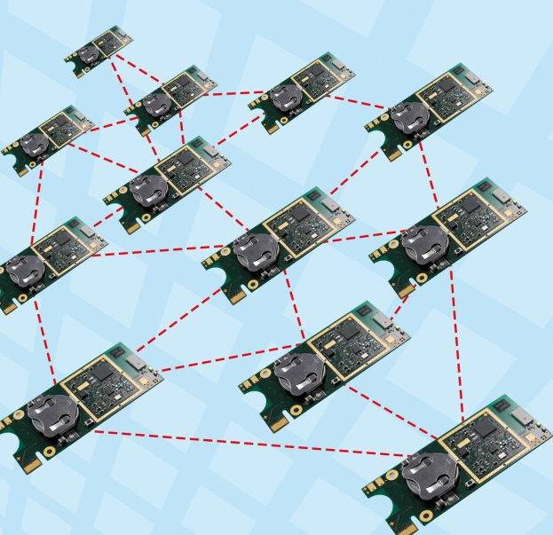
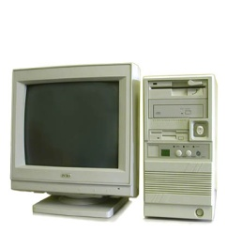
Sensor Data
Signal Processing
WaveScript (Queries + User define functions(UDF))
Execution Engine (scheduler and optimization)

Slide 5

Typical Application
To understand better consider the following application:
Biologist used the sensor network for study the behavior of Marmot.
The Idea is to use audio sensors to study the behavior of Marmot.
They want to gather information to answer the following queries:

Slide 6
Query 1: Is there current activity (energy) in the frequency band corresponding to the marmot alarm call?
Query 2: If so which direction is the call coming from? (use beam forming to enhance the signal quality).
Query 3: Is the call that of male or female?
Query 4: Where is the individual marmot located over time?
…..

Slide 7
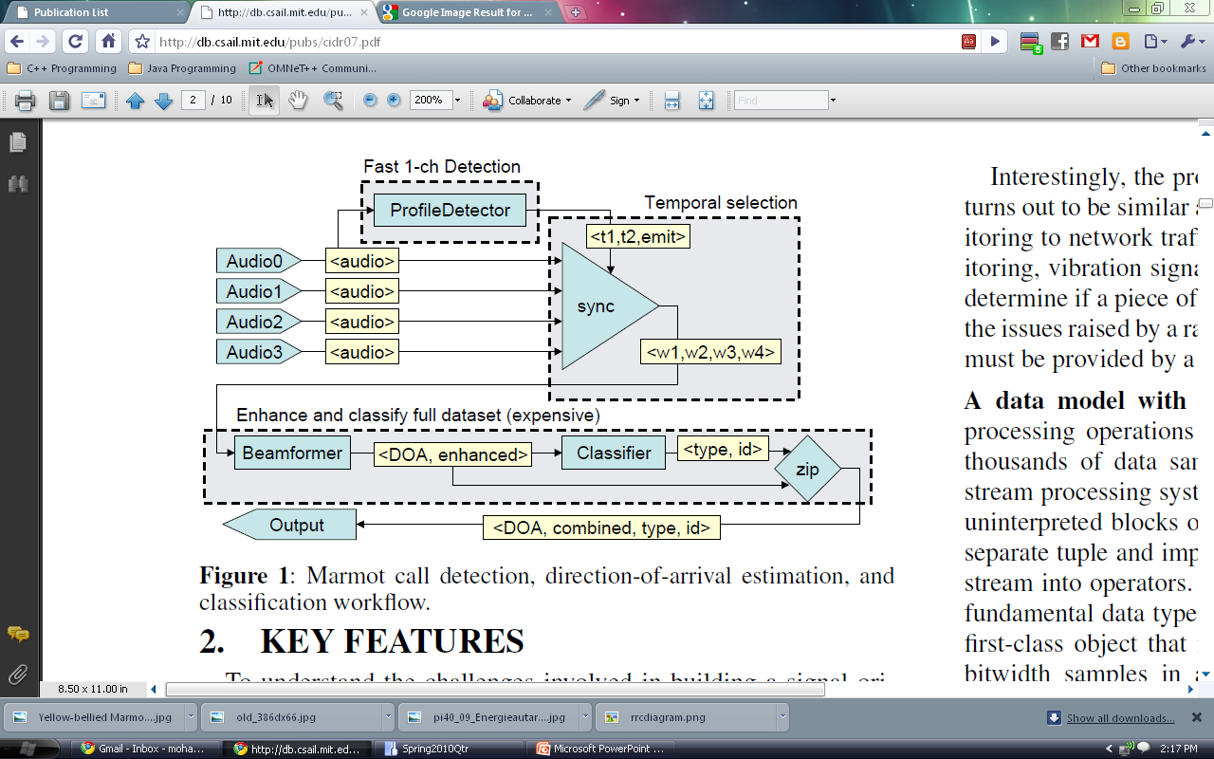
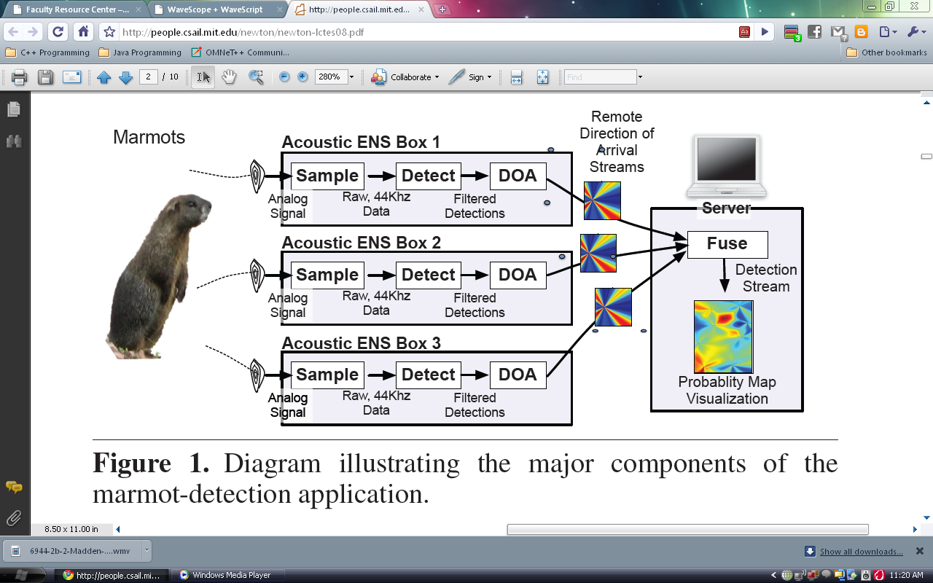
The following workflow is for answering the first 3 queries?
Query 1
Query 2
Query 3

Slide 8
Data and Programming Model
Data Types: Integer, float, characters, string, array, sets, SigSeg (signal segments).
SigSeg: Represents a window into a signal that are regularly spaced in time.
It also contains information about sampling rates.
It will provide efficient indexing for getting historical data.
SigSeg could be easily expanded to support multidimensional signals like image and video.

Slide 9
Programming elements in query work flow:
In the following we will consider the programming language through sample application.
Class | Examples
POD (Plain Old Data Function) Functions | Arithmetic, SigSeg Operations, timebase operations, FFT/IFFT
Subquery Constructors | profileDetect, Classify , beamForm, Sync, Zip
Fundamental Stream Operators | Iterate, union

Slide 10
fun profileDetect (S, scorefun, <winsize, step>, threshsettings)
  wins = rewindow(S, winsize, step);
  scores : Stream< float >
  scores = iterate(w in hanning(wins)) {
  freq = fft(w);
  emit (scorefun(freq)); };
  withscores : Stream<float, SigSeg<int16>>
  withscores = zip2(scores, wins);
  return threshFilter(withscores, threshsettings)
  Window input stream, ensuring that we will hit each event according to the event sample rate.
Example Iterate:
Running Database Aggregate
3 Functions: init(),aggregate(),out()
Average:
1. init(A,val){A.sum=val; A.count=1;}
2. aggr(A1,A2){A1.sum+=A2.sum;
A1.count+=A2.count;}
3. Out(A){return A.sum/A.count}
Subquery running_agg(S, init,aggr,out)
{ s2=iterate(x in S)
{state{acc=init();}
Acc=aggr(acc,x); emit out(x);} return s2
}
  Take a hanning window and convert to frequency domain.
  Frequency Decomposition using FFT
  Score each frequency-domain window
Query 1:
Filtering
  Associate each original window with its score, and merge them together.
  Find time-ranges where scores are above threshold. ThreshFilter returns <bool, starttime, endtime> tuples.

Slide 11
control = profileDetect (Ch0, marmotScore, <64,192>, <16.0, 0.999, 40, 2400, 48000>);
datawindows = sync4(control, Ch0, Ch1, Ch2, Ch4);
beam<doa,enhanced> = beamform(datawindows, arrayGeometry);
marmots = classify(beam.enhanced, marmotClassifier);
return zip2(beam, marmots);
  The snapshot of the detected call <bool, time1,time2>
  Use the control stream to extract actual data windows.
Query 2
  Beam forming.
  Classifying Marmot.

Slide 12
System Architecture
Syntax Check
Inline all query plan(expand sub query, POD,…)
Preprocessor
Stream and Signal Processing Optimizer
Expander
Query Plan in Low-Level Language such as C.
Optimizer
Run Time Library
Compiler
Runtime

Slide 13
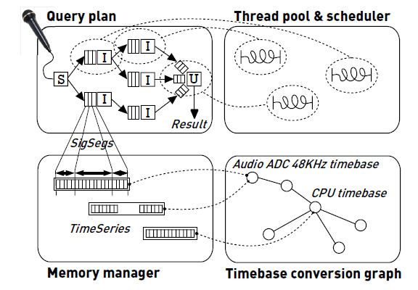
Query Plan: The final query plan is an imperative program corresponding to Aurora directed graph with iterate, Union, and source as basic operators
Scheduler: It chooses which operator in query to run next.
Memory Manager: due to limit in memory for embedded application, memory manager manage the memory resource, caching, garbage collection,…
But what does timebase conversion graph mean?

Slide 14
Scheduler
Which operators in query to run next,
Tuple passing mechanism
Assiging threads
Compact memory footprint, Cache locality, Fairness, Scalability, High throuput tuple passing
Memory manegment
To scale high data rates, instead of passed by values, passed by reference with copy-on-write
Garbage collect : reference counting

Slide 15
Managing timing information corresponding to signal data is a common problem in signal processing applications.
Signal processing operators typically process vectors of samples with sequence numbers, leaving the application developer to determine how to interpret those samples temporally.
WaveScope introduces the concept of a timebase, a dynamic data structure that represents and maintains a mapping between sample sequence numbers and time units.
Based on input from signal source drivers and other WaveScope components, the timebase manager maintains a conversion graph that denotes which conversions are possible.
In this graph, every node is a timebase, and an edge indicates the capability to convert from one timebase to another.

Slide 16
The graph may contain cycles as well as redundant paths.
Conversions may be composed along any path through the graph; when redundant paths exist, a weighted average of the results from each path may result in higher accuracy .
Node to node time conversion

Slide 17
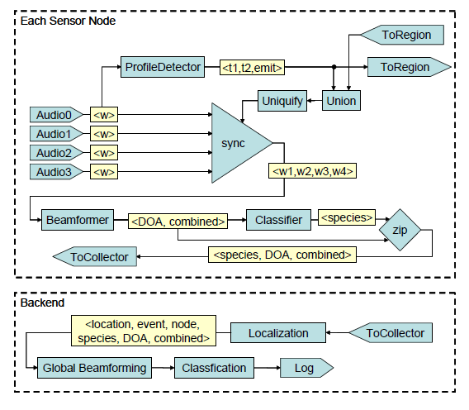
Distributed Query Execution
The query plan could be executed in a distributed fashion.
Sensor Node
PCs

Slide 18
Query Stored Data
In addition to handling streaming data, many WaveScope applications will need to query a pre-existing stored database, or historical data archived on secondary storage (e.g., disk or flash memory).
Two special WaveScope library functions that will support archiving and querying stored data declaratively:
DiskArchive: which consumes tuples from its input stream and writes them to a named relational table on disk.
DiskSource: which reads tuples from a named relational table on disk and feeds them upstream.

Slide 19
Optimizations
Two category of optimization could be done.
One in data stream optimization and the other is signal processing optimization.
The database optimization techniques has been used for example merging adjacent iterate operators.
For signal processing by using the relation between operators the optimization could be done as follows:

Slide 20
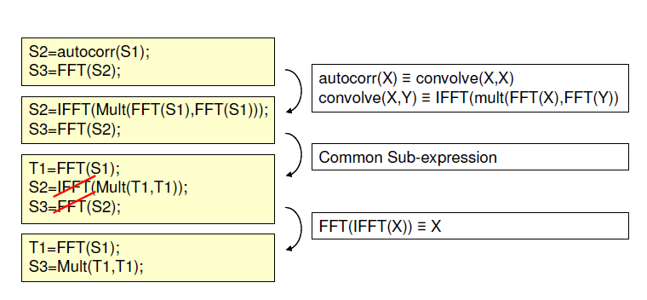
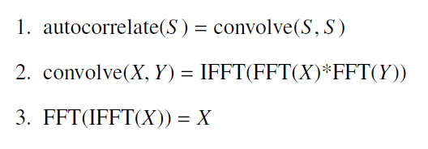

Slide 21
Conclusion
The paper talked about how optimally define query language that merges signal and stream processing concepts.
We think several gap should be filled:
  It considers the stream and signal procesing optimization but for special application that they considered (sensor networks) they should define Power-aware query optimizer.

Slide 22
Conclusion
  The saving data is an issue in these applications. One of the main issues is handling these large amounts of data and retrieve them efficiently.
    indexing

Slide 23
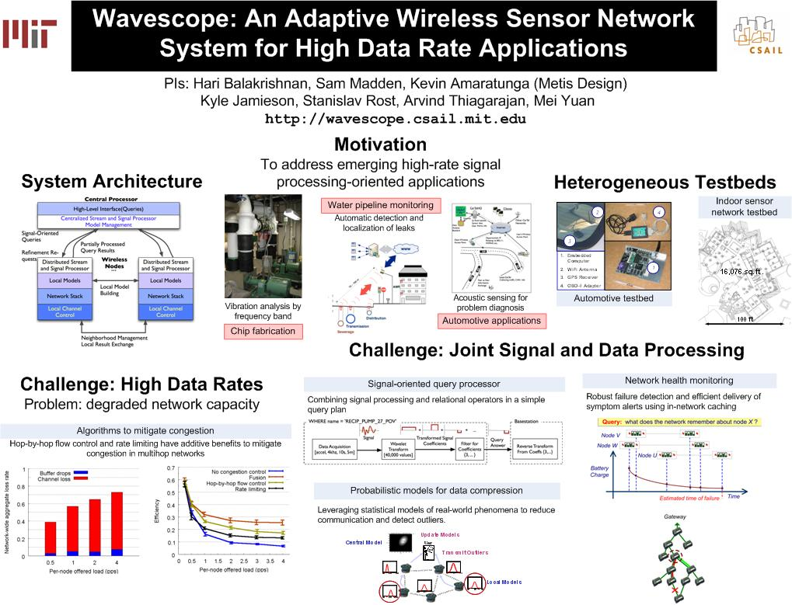

Slide 24
