Slide 1
TSQL 2 : Query Language for Temporal DatA
CS 224 : Advanced Topics in Data Management

Slide 2
tem·po·ral :
of or pertaining to time

Slide 3
Introduction
Element of TIME in DB
Queries like…
What happened at that time? (Simple)
e.g What was Mark’s salary when he joined?
What has happened from then till now? (Complex)
e.g Which employees got a raise in past year?

Slide 4
Terminology
VALID TIME of a fact; is the time in the real world when the fact is valid
TRANSACTION TIME of a fact: when it was recorded in the database

Slide 5
Types of Relation
  SNAPSHOT relation
    Standard database
  VALID-TIME (historical) relation - When did it rain? When did the soccer world cup happen?
  TRANSACTION-TIME(rollback) relation – What was Tom’s salary on October 1?
  BI – TEMPORAL relation
    Supports both valid time and transaction time

Slide 6
Temporal database (DBMS)
is a database (DBMS) that supports valid time and/or transaction time

Slide 7



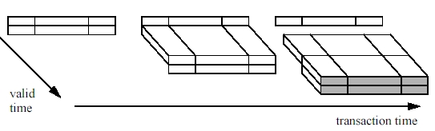
Time Dimension: Temporal Relations
Snapshot relation
Valid-time relation
Transaction-time
relation
Bitemporal relation

Slide 8
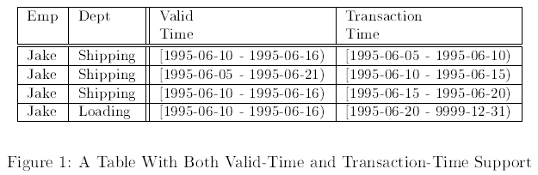
Bi-Temporal Data
Jake hiring – reflects single hiring but changes in the modeled reality and the transaction time

Slide 9
TSQL2 (Valid-Time Relation)
QUICK TOUR

Slide 10
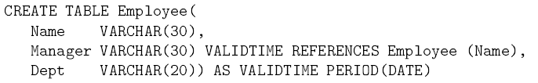
Valid-Time Relation
VALIDTIME : At each point in time…. POINT: DATE in above example…

Slide 11
Valid-Time Relation
LIST ALL EMPLOYES WHO WERE NOT MANAGERS
VALIDTIME : At each point in time…. POINT: DATE in above example…

Slide 12

Valid-Time Relation
EXTRACT THE SIZE HISTORY OF THE DEPARTMENT
VALIDTIME : At each point in time…. POINT: DATE in above example…

Slide 13

Valid-Time Relation
CHANGE THE MANAGER OF TOOLS DEPT FOR 1994 to BOB
VALIDTIME : At each point in time…. POINT: DATE in above example…

Slide 14
TSQL2 (Validtime Relation)
How to think about it?

Slide 15
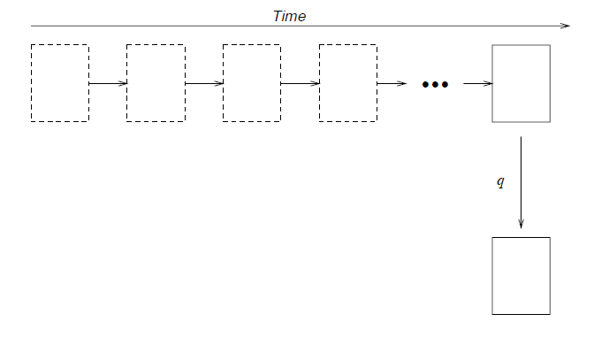
SNAPSHOT RELATION
q: STANDARD SQL QUERY

Slide 16
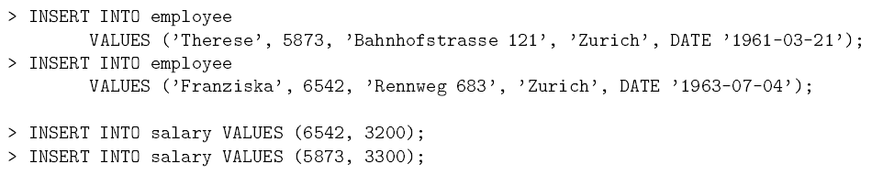
SNAPSHOT RELATION

Slide 17
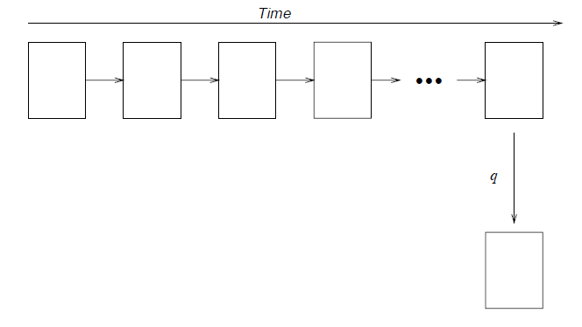
TEMPORAL (Valid-Time) RELATION
q: STANDARD SQL QUERY

Slide 18

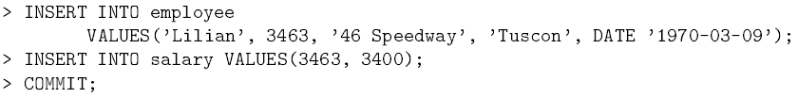
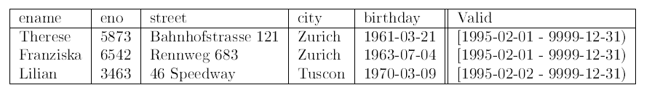
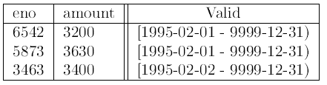

TEMPORAL (Valid-Time) RELATION

Slide 19
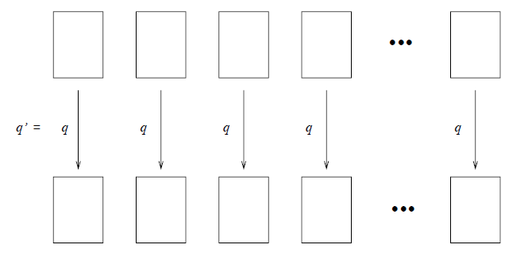
TEMPORAL (Valid-Time) RELATION
q: HISTORICAL TSQL QUERY : Give history of monthly salaries paid to employees (Sequence Query)

Slide 20
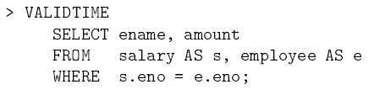
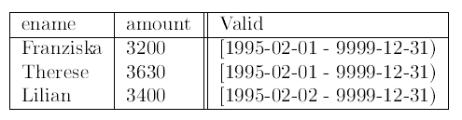
TEMPORAL (Valid-Time) RELATION

Slide 21
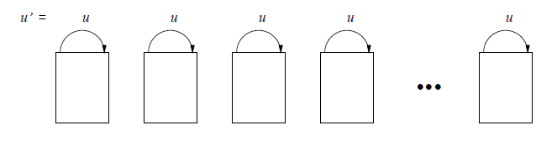
TEMPORAL (Valid-Time) RELATION
u: TSQL UPDATE QUERY : Change the town named ‘ TUSCON ‘ to ‘ TUCSON’ (Sequence Query)

Slide 22
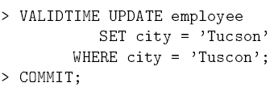
TEMPORAL (Valid-Time) RELATION

Slide 23
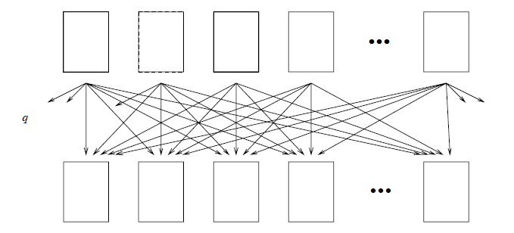
TEMPORAL (Valid-Time) RELATION
q: Who was given SALARY raises ? (Non Sequence Query)

Slide 24
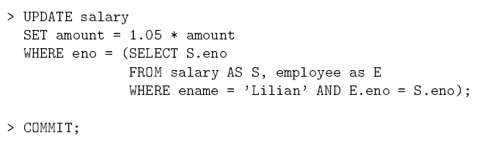
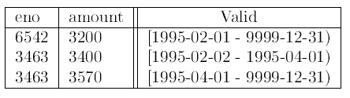
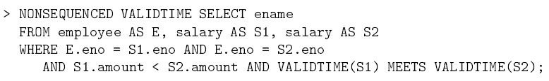

TEMPORAL (Valid-Time) RELATION

Slide 25
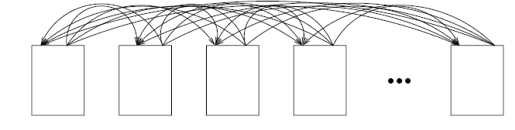
TEMPORAL (Valid-Time) RELATION
U: Give employees 5% raise if they never had a raise before? (Non Sequence Query)

Slide 26
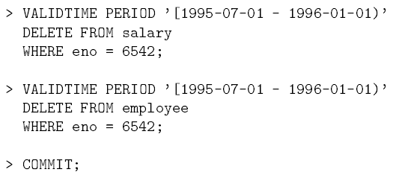
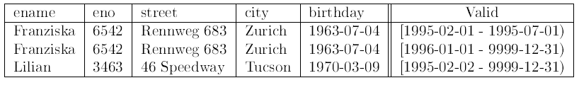
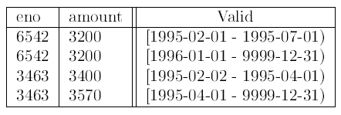
TEMPORAL (Valid-Time) RELATION

Slide 27
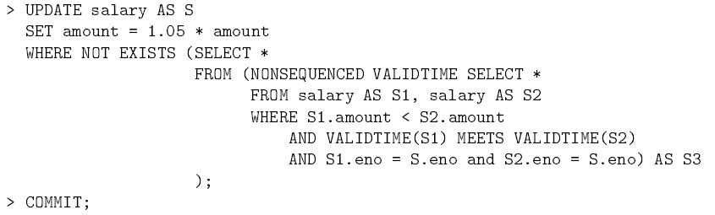
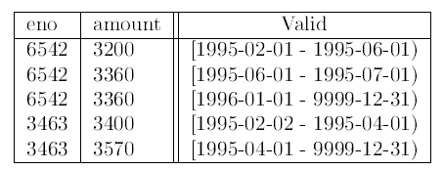
TEMPORAL (Valid-Time) RELATION

Slide 28
TSQL2(Transaction Time)
Problem Definition

Slide 29
Transaction Time
What is the need?
  Applications need to keep track of the past states of the database, often for auditing requirements
  Changes are not allowed on the past states; that would prevent secure auditing. Instead, compensating transactions are used to correct errors.

Slide 30
Transaction Time
What is the need?
  We find out that the telephone bill for a department is unusually high, so we ask “How many employees have been in each department" to get a start.

Slide 31
Transaction Time
What is the need?
  It turns out that one of the departments shows an unreasonable number of current employees (more than 25).
  When was the error introduced?
  How long has the database been incorrect? The query “When did we think that departments are overly large?“ provides an initial answer, but is also very difficult to express in SQL.

Slide 32
TSQL2 (Transaction Time Relations)
Quick Tour

Slide 33

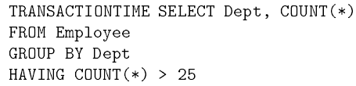
TEMPORAL RELATION(Transaction Time)

Slide 34
TEMPORAL RELATION(Transaction Time)
Jake hiring – reflects single hiring but changes in the modeled reality and the transaction time

Slide 35
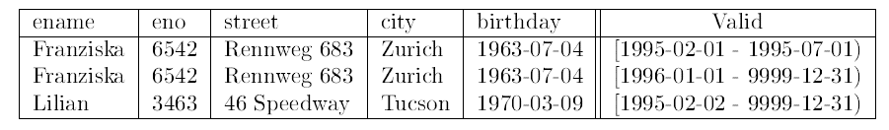

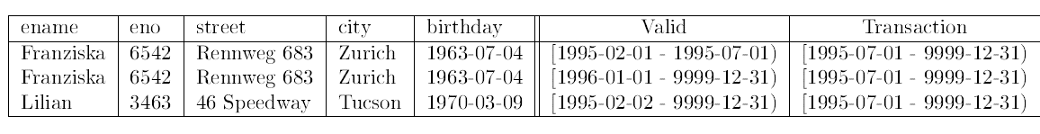
TEMPORAL RELATION(Transaction Time)

Slide 36
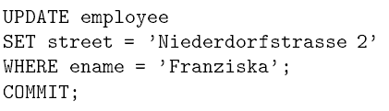
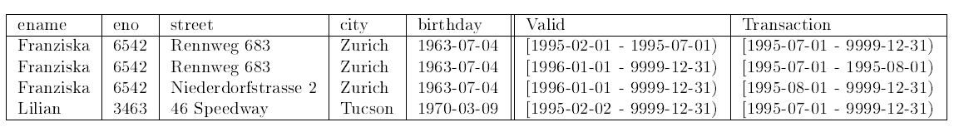
TEMPORAL RELATION(Transaction Time)

Slide 37
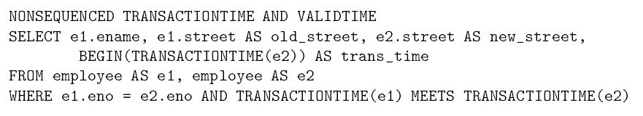
TEMPORAL RELATION(Transaction Time)
When was the street corrected, and what were the old and new values? (Nonsequence tx time & sequenced vt time)

Slide 38

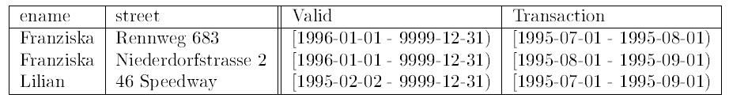
TEMPORAL RELATION(Transaction Time)
When did we think that someone lived somewhere for more than six months?

Slide 39
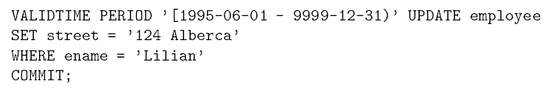
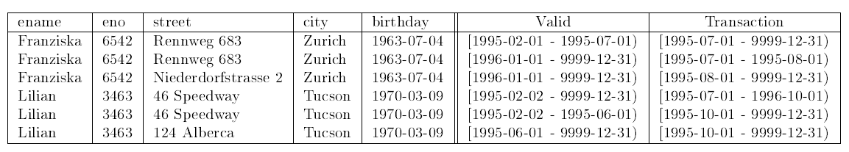
TEMPORAL RELATION(Transaction Time)
Assume it is now October 1, 1995. Lilian moved last June 1.
(PostActive update)

Slide 40
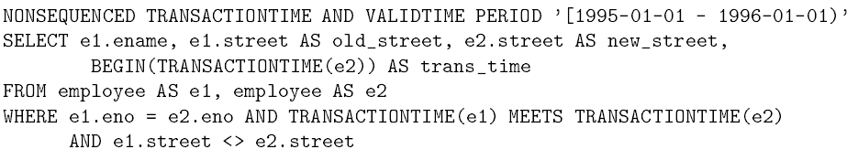
TEMPORAL RELATION(Transaction Time)
“When was an employee's address for 1995 corrected?"
(run on Nov 1 95)

Slide 41
QUESTIONS ?
Prepared by Puneet Mehta

