Slide 1
SAFIRE Project
DHS Update – July 15, 2009
Introductions
  Update since last teleconference
Demo Video - Fire Incident Command Board (FICB)
SAFIRE Streams Research
Speech Research
Testing, Validation, and Outreach

Slide 2
SAFIRE – Project Focusing
Following our May teleconference, development effort was refocused on two key infrastructure components:
  Fire Incident Command Board (FICB)
  SAFIRE Streams
Other modules still very important for SAFIRE system but sufficiently developed to complete current effort.
  Networking and Sensing
  Acoustic Sensing / Speech
  EBox
  Localization Framework
Final integration work of these being completed this summer.
Projects will be well positioned to pursue future funding.

Slide 3

SAFIRE Streams Architecture
Policy
DB
Query
(entity,
attribute,
value)
Query results
FICB / SAFIRE Server
.
.
.
Semantic
knowledge
Semantic context
SATQL
Convert
Query -> VS -> opGraph
Semantic
DB
(entities,
Relationships,
VS)
SATRepository
<opGraph>
Query i
VS
VS
<opGraph>
context1
SATMonitor
SATScheduler
SATDeployer
Operator
DB
Deployment of operators
Schedule
to meet QoS
SATRuntime
Distributed Mobile-agent based runtime
Infrastructure
DB
Sensor and computing infrastructure
Heterogeneous sensors and processing nodes
Notes:
3

Slide 4
SAFIRE Streams: A Semantic Middleware for Multi Sensor Applications
Sharad Mehrotra

Slide 5
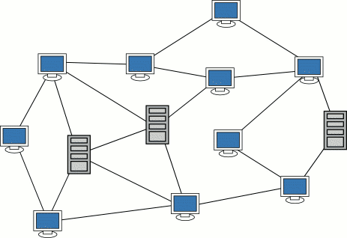
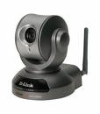
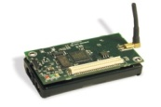
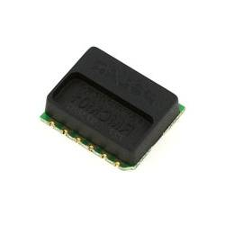

SAFIRE Stream Middleware
Stream Middleware Goals
Writing sensor applications is hard:
  Continuous data
  Sensor heterogeneity
  Diversity of platforms
  Tolerance to failures
Powerful programming abstractions to ease application development
  Hide heterogeneity, failures, concurrency
Core Services
  alerting, triggering, data & stream management, queries.
Mediation
  application needs with resource constraints of devices & networks
SA Applications
FICB
Alerts
Filters
Analysis
Middleware – glue between H/w, networks, OS and applications
Networks
Networks
Sensor

Slide 6
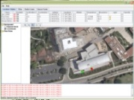
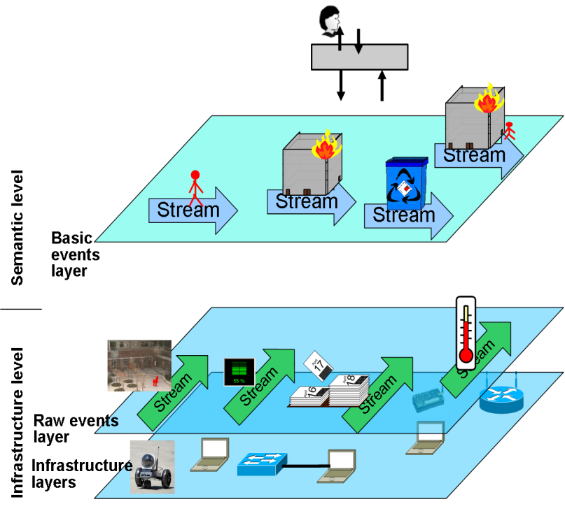
Key Concepts Driving SAFIRE Streams
SAFIRE Streams models sensor embedded spaces at two levels
sentient Applications
Semantic Level:
Entities -- people, appliances, and buildings, rooms; Relationships – interactions.
Infrastructure Level:
sensing devices, computing devices, network devices.
Virtual Sensors:
maps data captured by sensors into events in the semantic world.
Event Logs:
evolution of physical world as observed by the sentient system
High level stream language like CQL
Virtual Sensor
Notes:
represents the physical world constituting the sentient space – entities, objects, interactions, relationships that exist in the
physical world.
represents the infrastructure constituting the sentient space --

Slide 7

Key Concept: Virtual Sensors
Provide the “bridge” between sensors & the semantic “real” world concepts.
WiFi fingerprints, t>
AP Readings Listener
AP Readings to location
Translate Location to Lon./Lat.
L, Room12, t>
Filter
[L=Room1]
Location Virtual Sensor
Finger
print
DB

Slide 8


Virtual Sensors: Multi-Sensor Fusion to improve quality
AP Readings Listener
AP Readings to location
Location Virtual Sensor
Using fingerprints
<Peter, L, PDF, t>
Finger
print
DB
Merge
<Person, L,
Room12, t>
<Peter, L, PDF, t>
Signal strength Listener
Signal strength triagulation
Location Virtual Sensor
Using signal Strength
triangulation
AP
locations

Slide 9

Virtual Sensors: Speech illustrating how semantics can help improve quality
Location Virtual Sensor
Using speech recognition
<n-best-list>
Data Cleaning using semantics
Speech recognizer
<victim, fire, help>
Audio
stream
speech
DB
Audio listeners
Merge
Acoustic
analysis
<loud, fast>
Location Virtual Sensor
Using acoustic
analysis

Slide 10
Building Applications using Semantic Model
Virtual Sensors “hide” complexity of sensor programming from application developers
  Convert heterogeneous sensor streams into semantic event streams
  Hide sensor failures / imprecision through
    Noise reduction (e.g., averaging over multiple samples)
    multi-sensor fusion (e.g., multiple location sensing technologies provide more accurate location assessment)
    Semantics (e.g., speech sensors exploit word correlation to improve on ASR)
Applications can view the system as consisting of high level concepts such as entities, events, artifacts, spaces, etc.
SAFIRE Streams supports high level query languages for implementing queries & triggers:
  SQL style stream language (at design stage – not yet implemented)
  Event graph based language

Slide 11

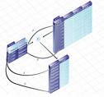
Event Graphs in SAFIRE Streams
Loc
operator
[FF1]
Filter
[L=first floor]
Detect when Fire Fighter 1 is on the 1st floor
<FF1, L, Room12, t>
Detect when FF1 & FF2 are near each other
<FF1, L, Room12, t>
{<FF1, L, Room12,t>
<FF2, L, Room15, t>}
Loc
operator
[FF2]
Join
[t]
Near
[5 Rooms]
<FF2, L, Room15, t>
Triggers/continuous queries are converted into an event graph network.
SATWARE Deployer submits the resulting event graph into an executable pipeline based on available resources, machines and networks.
  Mediates with resources to guarantee application needs are met
  Multiple optimizations possible in executing such networks.
Notes:
Optimizations:
Operator sharing, operator reordering, operator tuning, etc

Slide 12
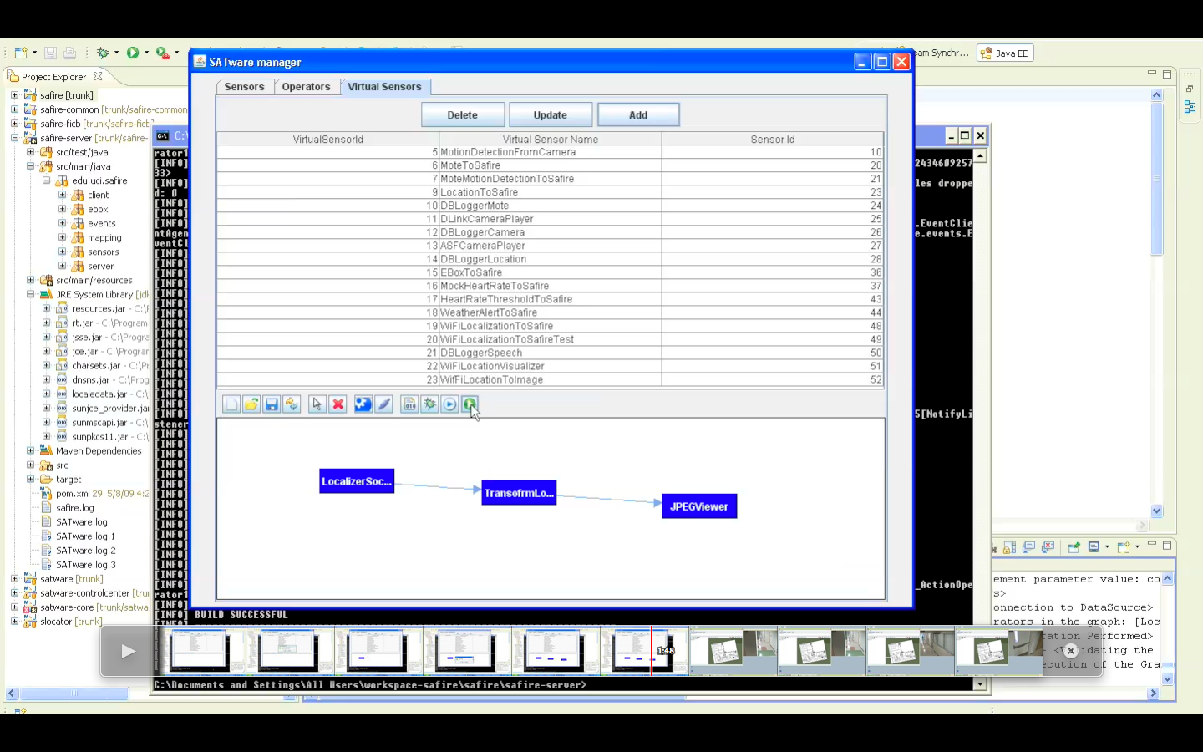
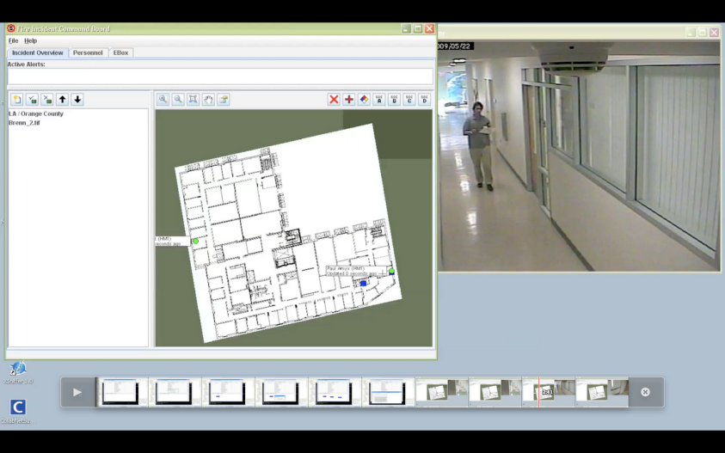
Demo
Programming
Execution

Slide 13
SAFIRE Streams Summary
Middleware to ease multi-sensor applications
  provides a powerful semantic interface for complex multi-sensor applications
    this feature used extensively in building SAFIRE SA Applications
  Supports core services
    Alerts, triggers, storage, archival, & replay capabilities.
  Mediation between application needs & system resources
    E.g., sensor stream scheduling based on application quality requirement

