Slide 1
ICS 143 - Principles of Operating Systems
Lecture Set 6 Part 2 - Virtual Memory
Prof. Nalini Venkatasubramanian
nalini@ics.uci.edu

Slide 2
Virtual Memory
Background
Demand paging
Performance of demand paging
Page Replacement
Page Replacement Algorithms
Allocation of Frames
Thrashing
Demand Segmentation

Slide 3
Need for Virtual Memory
Virtual Memory
Separation of user logical memory from physical memory.
Only PART of the program needs to be in memory for execution.
Logical address space can therefore be much larger than physical address space.
Need to allow pages to be swapped in and out.
Virtual Memory can be implemented via
Paging
Segmentation

Slide 4
Paging/Segmentation Policies
Fetch Strategies
When should a page or segment be brought into primary memory from secondary (disk) storage?
Demand Fetch
Anticipatory Fetch
Placement Strategies
When a page or segment is brought into memory, where is it to be put?
Paging - trivial
Segmentation - significant problem
Replacement Strategies
Which page/segment should be replaced if there is not enough room for a required page/segment?

Slide 5
Demand Paging
Bring a page into memory only when it is needed.
Less I/O needed
Less Memory needed
Faster response
More users
The first reference to a page will trap to OS with a page fault.
OS looks at another table to decide
Invalid reference - abort
Just not in memory.

Slide 6
Valid-Invalid Bit
With each page table entry a valid-invalid bit is associated (1 ⇒ in-memory, 0 ⇒ not in memory).
Initially, valid-invalid bit is set to 0 on all entries.
During address translation, if valid-invalid bit in page table entry is 0 --- page fault occurs.
Example of a page-table snapshot
 | 1
 | 1
 | 1
 | 1
 | 0
 | 0
 | 0
Frame #
Valid-invalid bit
Page Table

Slide 7
Handling a Page Fault
Page is needed - reference to page
Step 1: Page fault occurs - trap to OS (process suspends).
Step 2: Check if the virtual memory address is valid. Kill job if invalid reference. If valid reference, and page not in memory, continue.
Step 3: Bring into memory - Find a free page frame, map address to disk block and fetch disk block into page frame. When disk read has completed, add virtual memory mapping to indicate that page is in memory.
Step 4: Restart instruction interrupted by illegal address trap. The process will continue as if page had always been in memory.

Slide 8
What happens if there is no free frame?
Page replacement - find some page in memory that is not really in use and swap it.
Need page replacement algorithm
Performance Issue - need an algorithm which will result in minimum number of page faults.
Same page may be brought into memory many times.

Slide 9
Performance of Demand Paging
Page Fault Ratio - 0 ≤ p ≤ 1.0
If p = 0, no page faults
If p = 1, every reference is a page fault
Effective Access Time
EAT = (1-p) * memory-access +
p * (page fault overhead +
swap page out +
swap page in +
restart overhead)

Slide 10
Demand Paging Example
Memory Access time = 1 microsecond
50% of the time the page that is being replaced has been modified and therefore needs to be swapped out.
Swap Page Time = 10 msec = 10,000 microsec
EAT = (1-p) *1 + p (15000) ≈1 + 15000p microsec
EAT is directly proportional to the page fault rate.

Slide 11
Page Replacement
Prevent over-allocation of memory by modifying page fault service routine to include page replacement.
Use modify(dirty) bit to reduce overhead of page transfers - only modified pages are written to disk.
Page replacement
large virtual memory can be provided on a smaller physical memory.

Slide 12
Page Replacement Algorithms
Want lowest page-fault rate.
Evaluate algorithm by running it on a particular string of memory references (reference string) and computing the number of page faults on that string.
Assume reference string in examples to follow is
1, 2, 3, 4, 1, 2, 5, 1, 2, 3, 4, 5.

Slide 13
Page Replacement Strategies
The Principle of Optimality
Replace the page that will not be used again the farthest time into the future.
Random Page Replacement
Choose a page randomly
FIFO - First in First Out
Replace the page that has been in memory the longest.
LRU - Least Recently Used
Replace the page that has not been used for the longest time.
LFU - Least Frequently Used
Replace the page that is used least often.
NUR - Not Used Recently
An approximation to LRU
Working Set
Keep in memory those pages that the process is actively using

Slide 14
First-In-First-Out (FIFO) Algorithm
Reference String: 1,2,3,4,1,2,5,1,2,3,4,5
Assume x frames ( x pages can be in memory at a time per process)
3 frames
9 Page faults
10 Page faults
4 frames
FIFO Replacement - Belady’s Anomaly -- more frames does not mean less page faults

Slide 15
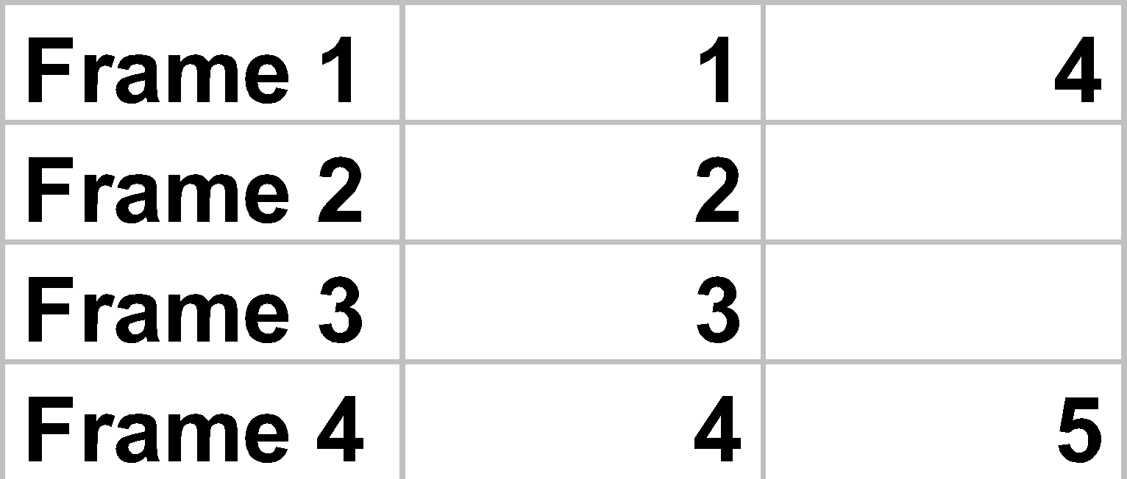
Optimal Algorithm
Replace page that will not be used for longest period of time.
How do you know this???
Generally used to measure how well an algorithm performs.
6 Page faults
4 frames

Slide 16
Least Recently Used (LRU) Algorithm
Use recent past as an approximation of near future.
Choose the page that has not been used for the longest period of time.
May require hardware assistance to implement.
Reference String: 1,2,3,4,1,2,5,1,2,3,4,5
4 frames
8 Page faults

Slide 17
Implementation of LRU algorithm
Counter Implementation
Every page entry has a counter; every time page is referenced through this entry, copy the clock into the counter.
When a page needs to be changes, look at the counters to determine which page to change (page with smallest time value).
Stack Implementation
Keeps a stack of page numbers in a doubly linked form
Page referenced
move it to the top
requires 6 pointers to be changed
No search required for replacement

Slide 18
LRU Approximation Algorithms
Reference Bit
With each page, associate a bit, initially = 0.
When page is referenced, bit is set to 1.
Replace the one which is 0 (if one exists). Do not know order however.
Additional Reference Bits Algorithm
Record reference bits at regular intervals.
Keep 8 bits (say) for each page in a table in memory.
Periodically, shift reference bit into high-order bit, I.e. shift other bits to the right, dropping the lowest bit.
During page replacement, interpret 8bits as unsigned integer.
The page with the lowest number is the LRU page.

Slide 19
LRU Approximation Algorithms
Second Chance
FIFO (clock) replacement algorithm
Need a reference bit.
When a page is selected, inspect the reference bit.
If the reference bit = 0, replace the page.
If page to be replaced (in clock order) has reference bit = 1, then
set reference bit to 0
leave page in memory
replace next page (in clock order) subject to same rules.

Slide 20
LRU Approximation Algorithms
Enhanced Second Chance
Need a reference bit and a modify bit as an ordered pair.
4 situations are possible:
(0,0) - neither recently used nor modified - best page to replace.
(0,1) - not recently used, but modified - not quite as good, because the page will need to be written out before replacement.
(1,0) - recently used but clean - probably will be used again soon.
(1,1) - probably will be used again, will need to write out before replacement.
Used in the Macintosh virtual memory management scheme

Slide 21
Counting Algorithms
Keep a counter of the number of references that have been made to each page.
LFU (least frequently used) algorithm
replaces page with smallest count.
Rationale : frequently used page should have a large reference count.
Variation - shift bits right, exponentially decaying count.
MFU (most frequently used) algorithm
replaces page with highest count.
Based on the argument that the page with the smallest count was probably just brought in and has yet to be used.

Slide 22
Page Buffering Algorithm
Keep pool of free frames
Solution 1
When a page fault occurs, choose victim frame.
Desired page is read into free frame from pool before victim is written out.
Allows process to restart soon, victim is later written out and added to free frame pool.
Solution 2
Maintain a list of modified pages. When paging device is idle, write modified pages to disk and clear modify bit.
Solution 3
Keep frame contents in pool of free frames and remember which page was in frame.. If desired page is in free frame pool, no need to page in.

Slide 23
Protection Bits
Page Protection
Segmentation Protection
Reference - Page has been accessed
Valid - Page exists
Resident - Page is cached in primary memory
Dirty - Page has been changed since page in

Slide 24
Allocation of Frames
Single user case is simple
User is allocated any free frame
Problem: Demand paging + multiprogramming
Each process needs minimum number of pages based on instruction set architecture.
Example IBM 370: 6 pages to handle MVC (storage to storage move) instruction
Instruction is 6 bytes, might span 2 pages.
2 pages to handle from.
2 pages to handle to.
Two major allocation schemes:
Fixed allocation
Priority allocation

Slide 25
Fixed Allocation
Equal Allocation
E.g. If 100 frames and 5 processes, give each 20 pages.
Proportional Allocation
Allocate according to the size of process
Sj = size of process Pj
S = ∑Sj
m = total number of frames
aj = allocation for Pj = Sj/S * m
If m = 64, S1 = 10, S2 = 127 then
a1 = 10/137 * 64 ≈ 5
a2 = 127/137 * 64 ≈ 59

Slide 26
Priority Allocation
May want to give high priority process more memory than low priority process.
Use a proportional allocation scheme using priorities instead of size
If process Pi generates a page fault
select for replacement one of its frames
select for replacement a frame form a process with lower priority number.

Slide 27
Global vs. Local Allocation
Global Replacement
Process selects a replacement frame from the set of all frames.
One process can take a frame from another.
Process may not be able to control its page fault rate.
Local Replacement
Each process selects from only its own set of allocated frames.
Process slowed down even if other less used pages of memory are available.
Global replacement has better throughput
Hence more commonly used.

Slide 28
Thrashing
If a process does not have enough pages, the page-fault rate is very high. This leads to:
low CPU utilization.
OS thinks that it needs to increase the degree of multiprogramming
Another process is added to the system.
System throughput plunges...
Thrashing
A process is busy swapping pages in and out.
In other words, a process is spending more time paging than executing.

Slide 29
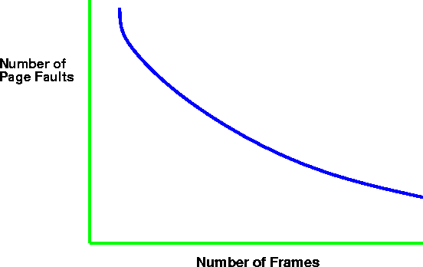
Thrashing (cont.)
Why does paging work?
Locality Model - computations have locality!
Locality - set of pages that are actively used together.
Process migrates from one locality to another.
Localities may overlap.
29

Slide 30
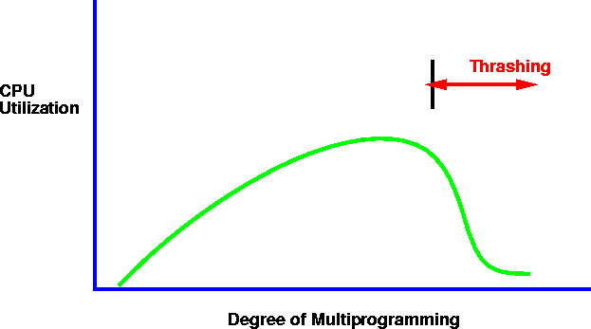
Thrashing
Why does thrashing occur?
∑ (size of locality) > total memory size

Slide 31
Working Set Model
Δ ≡ working-set window
a fixed number of page references, e.g. 10,000 instructions
WSSj (working set size of process Pj) - total number of pages referenced in the most recent Δ (varies in time)
If Δ too small, will not encompass entire locality.
If Δ too large, will encompass several localities.
If Δ = ∞, will encompass entire program.
D = ∑ WSSj ≡ total demand frames
If D > m (number of available frames) ⇒thrashing
Policy: If D > m, then suspend one of the processes.

Slide 32
Keeping Track of the Working Set
Approximate with
interval timer + a reference bit
Example: Δ = 10,000
Timer interrupts after every 5000 time units.
Whenever a timer interrupts, copy and set the values of all reference bits to 0.
Keep in memory 2 bits for each page (indicated if page was used within last 10,000 to 15,000 references).
If one of the bits in memory = 1 ⇒ page in working set.
Not completely accurate - cannot tell where reference occurred.
Improvement - 10 bits and interrupt every 1000 time units.

Slide 33
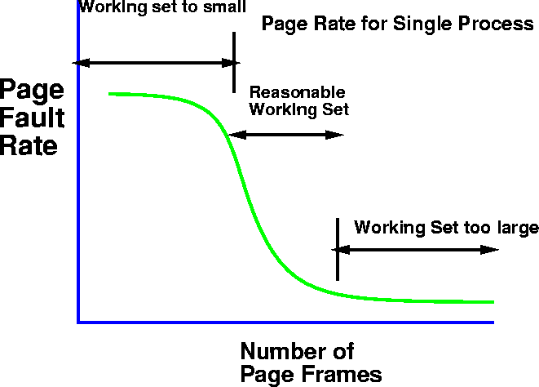
Page fault Frequency Scheme
Control thrashing by establishing acceptable page-fault rate.
If page fault rate too low, process loses frame.
If page fault rate too high, process needs and gains a frame.
33

Slide 34
Demand Paging Issues
Prepaging
Tries to prevent high level of initial paging.
E.g. If a process is suspended, keep list of pages in working set and bring entire working set back before restarting process.
Tradeoff - page fault vs. prepaging - depends on how many pages brought back are reused.
Page Size Selection
fragmentation
table size
I/O overhead
locality

Slide 35
Demand Paging Issues
Program Structure
Array A[1024,1024] of integer
Assume each row is stored on one page
Assume only one frame in memory
Program 1
for j := 1 to 1024 do
for i := 1 to 1024 do
A[i,j] := 0;
1024 * 1024 page faults
Program 2
for i := 1 to 1024 do
for j:= 1 to 1024 do
A[i,j] := 0;
1024 page faults

Slide 36
Demand Paging Issues
I/O Interlock and addressing
Say I/O is done to/from virtual memory. I/O is implemented by I/O controller.
Process A issues I/O request
CPU is given to other processes
Page faults occur - process A’s pages are paged out.
I/O now tries to occur - but frame is being used for another process.
Solution 1: never execute I/O to memory - I/O takes place into system memory. Copying Overhead!!
Solution 2: Lock pages in memory - cannot be selected for replacement.

Slide 37
Demand Segmentation
Used when there is insufficient hardware to implement demand paging.
OS/2 allocates memory in segments, which it keeps track of through segment descriptors.
Segment descriptor contains valid bit to indicate whether the segment is currently in memory.
If segment is in main memory, access continues.
If not in memory, segment fault.

