Slide 1
QuickHull Algorithms
Michael T. Goodrich

Slide 2
QuickHull
Find a point, p ∈ S, with minimum x-coordinate, and a point, r ∈ S, with maximum x-coordinate. Clearly, p and r are on the convex hull of S.
For each recursive call, we have a set of points, S′ ⊆ S, inside a triangle with base pr, for which Quickhull determines the point, q in S′, that is farthest from the segment pr. Then we prune away points inside the triangle (p, q, r)
Partition the remaining points of S′ into those above pq and qr and in bounding triangles defined by the tangents,respectively, and we recursively solve the problem for each of these subsets if they are nonempty.
recursive calls
in these triangles
q
r
p
r
prune away
points inside
this triangle
p

Slide 3
QuickHull Analysis
Hopefully, we split evenly in each recursive call, which would lead to a running time of O(n log n), but this is not guaranteed.
Worst-case running time: O(nh).
Example: (x,x²) for x=2^{i}, i=1,2,3,…
recursive calls
in these triangles
q
r
p
r
prune away
points inside
this triangle
p

Slide 4
Randomized QuickHull
Find a point, p ∈ S, with minimum x-coordinate, and a point, r ∈ S, with maximum x-coordinate. Clearly, p and r are on the convex hull of S.
For each recursive call, choose a point, q, uniformly at random.
Shoot a ray perpendicular to pr and find the bridge edge, (s,t), intersected by this ray.
Partition the remaining points of S′ into those above ps and qt and in bounding triangles and we recursively solve the problem for each of these subsets if they are nonempty.
recursive calls
in these triangles
r
R
t
s
p
q
r
prune away
points inside
this region
p

Slide 5
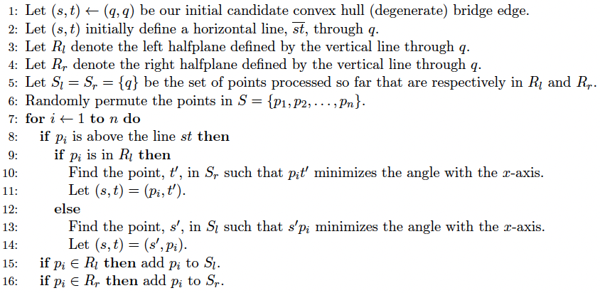
Ray Shooting – Randomized
p_{i}
R
p_{i}
R
t
t’
s
q
q
p
r
p
r

Slide 6
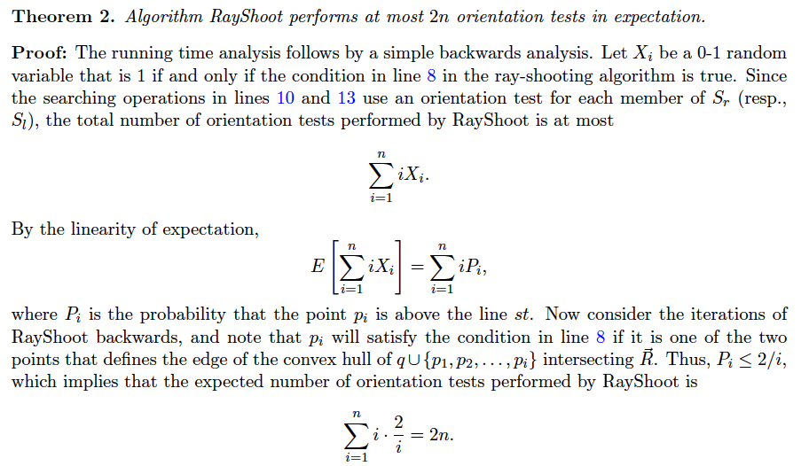
Ray Shooting – Analysis
p_{i}
R
p_{i}
R
t
t’
s
q
q
p
r
p
r

Slide 7
