Slide 1
Computational Geometry
d-Dimensional Linear Programming
Michael T. Goodrich
with some slides adapted from David Eppstein, licensed under Creative Commons Attribution 4.0 International License

Slide 2
Review: 2D Linear Programming

Slide 3
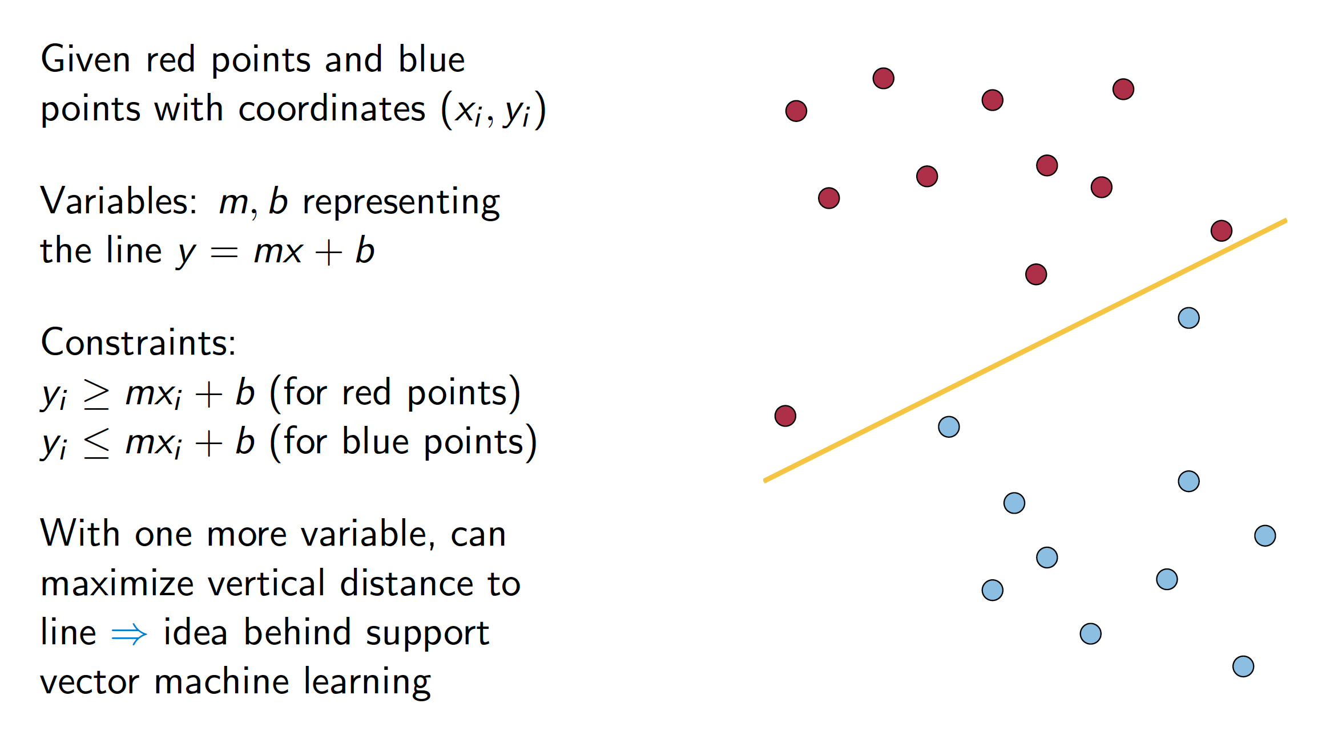
Application – Machine Learning

Slide 4
3-Dimensional Linear Programming
Image from https://people.richland.edu/james/ictcm/2006/3dsimplex.html

Slide 5
Application – Linear Regression

Slide 6
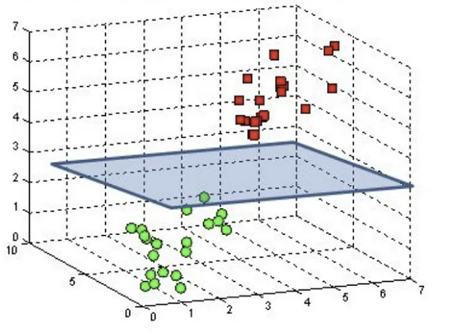
Application – 3D Machine Learning
Given red points and green points with coordinates (x_{i}, y_{i}, z_{i})
Variables: s, t, b representing the plane z = sx + ty + b
Constraints:
z_{i} ≥ sx_{i} + ty_{i} + b (for red points)
z_{i} ≤ sx_{i} + ty_{i} + b (for green points)
With one more variable (in 4D), we can maximize vertical distance to plane
Image from https://towardsdatascience.com/support-vector-machine-introduction-to-machine-learning-algorithms-934a444fca47

Slide 7
Seidel’s Algorithm for d-dimensional LP

Slide 8
Backwards Analysis

Slide 9
Expected Running Time

Slide 10
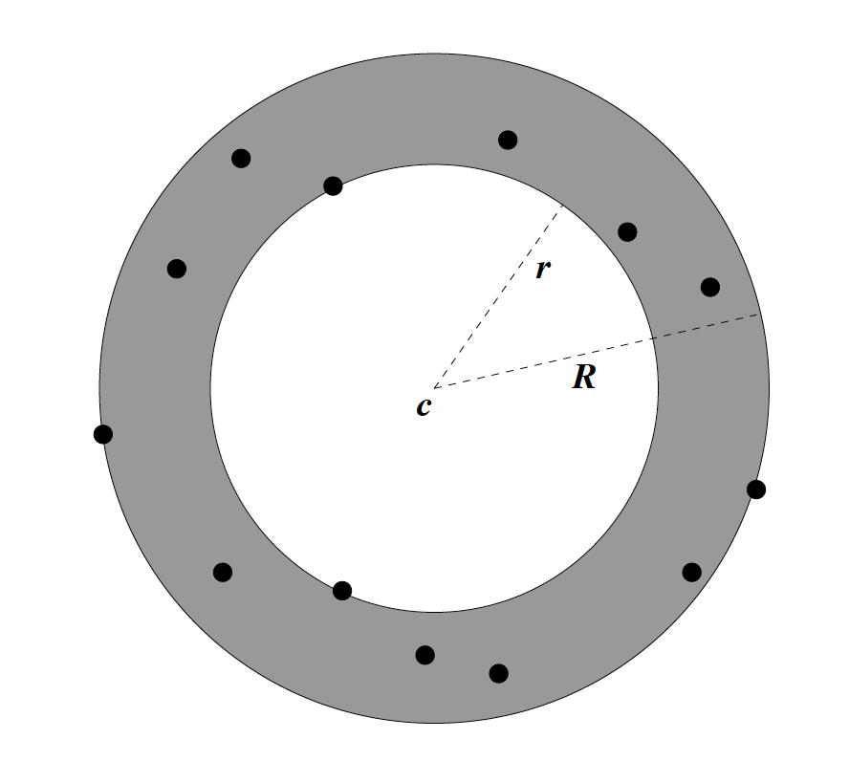
Minimum-area Enclosing Annulus
Find the minimum-area annulus, which is defined by 2 concentric circles, such that all n points are between the two circles.
P = 2D point set

Slide 11
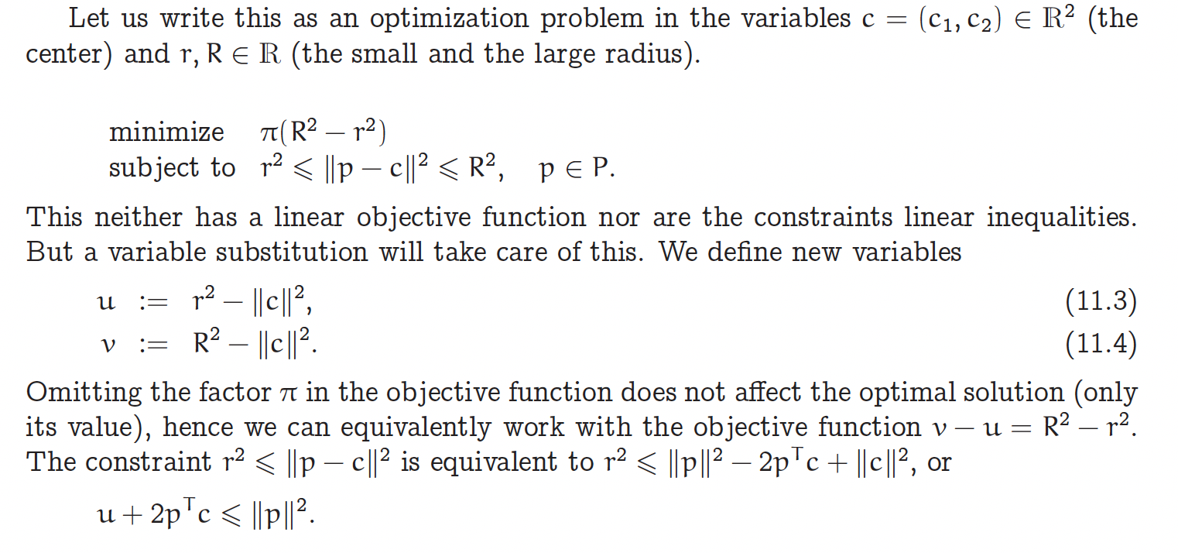
Minimum-area Enclosing Annulus
P = 2D point set
(by squaring the distance)
from https://ti.inf.ethz.ch/ew/lehre/CG12/lecture/Chapter%2011%20and%2012.pdf

Slide 12
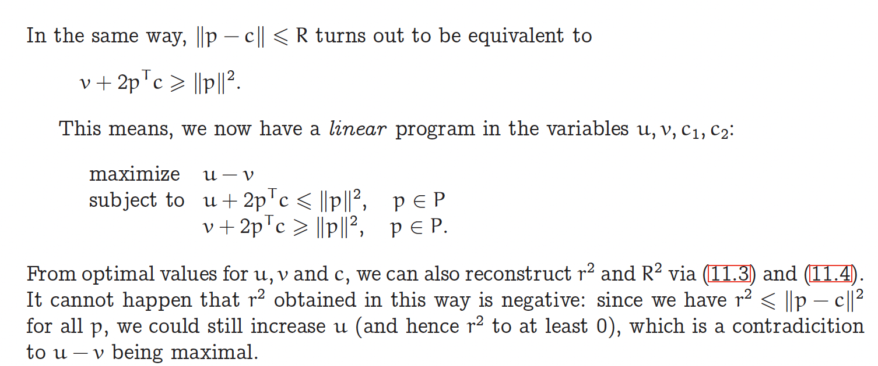
Minimum-area Enclosing Annulus
P = 2D point set
from https://ti.inf.ethz.ch/ew/lehre/CG12/lecture/Chapter%2011%20and%2012.pdf

Slide 13
Reference
Raimund Seidel. Small-dimensional linear programming and convex hulls made easy. Discrete & Computational Geometry, 6(5):423–434, 1991. doi: 10.1007/BF02574699.

