Slide 1
Computational Geometry
Michael T. Goodrich
Introduction
Convex Hulls

Slide 2
Definition
Computational geometry involves the design, analysis and implementation of efficient algorithms for solving geometric problems, e.g., problems involving points, lines, segments, triangles, polygons, etc.

Slide 3
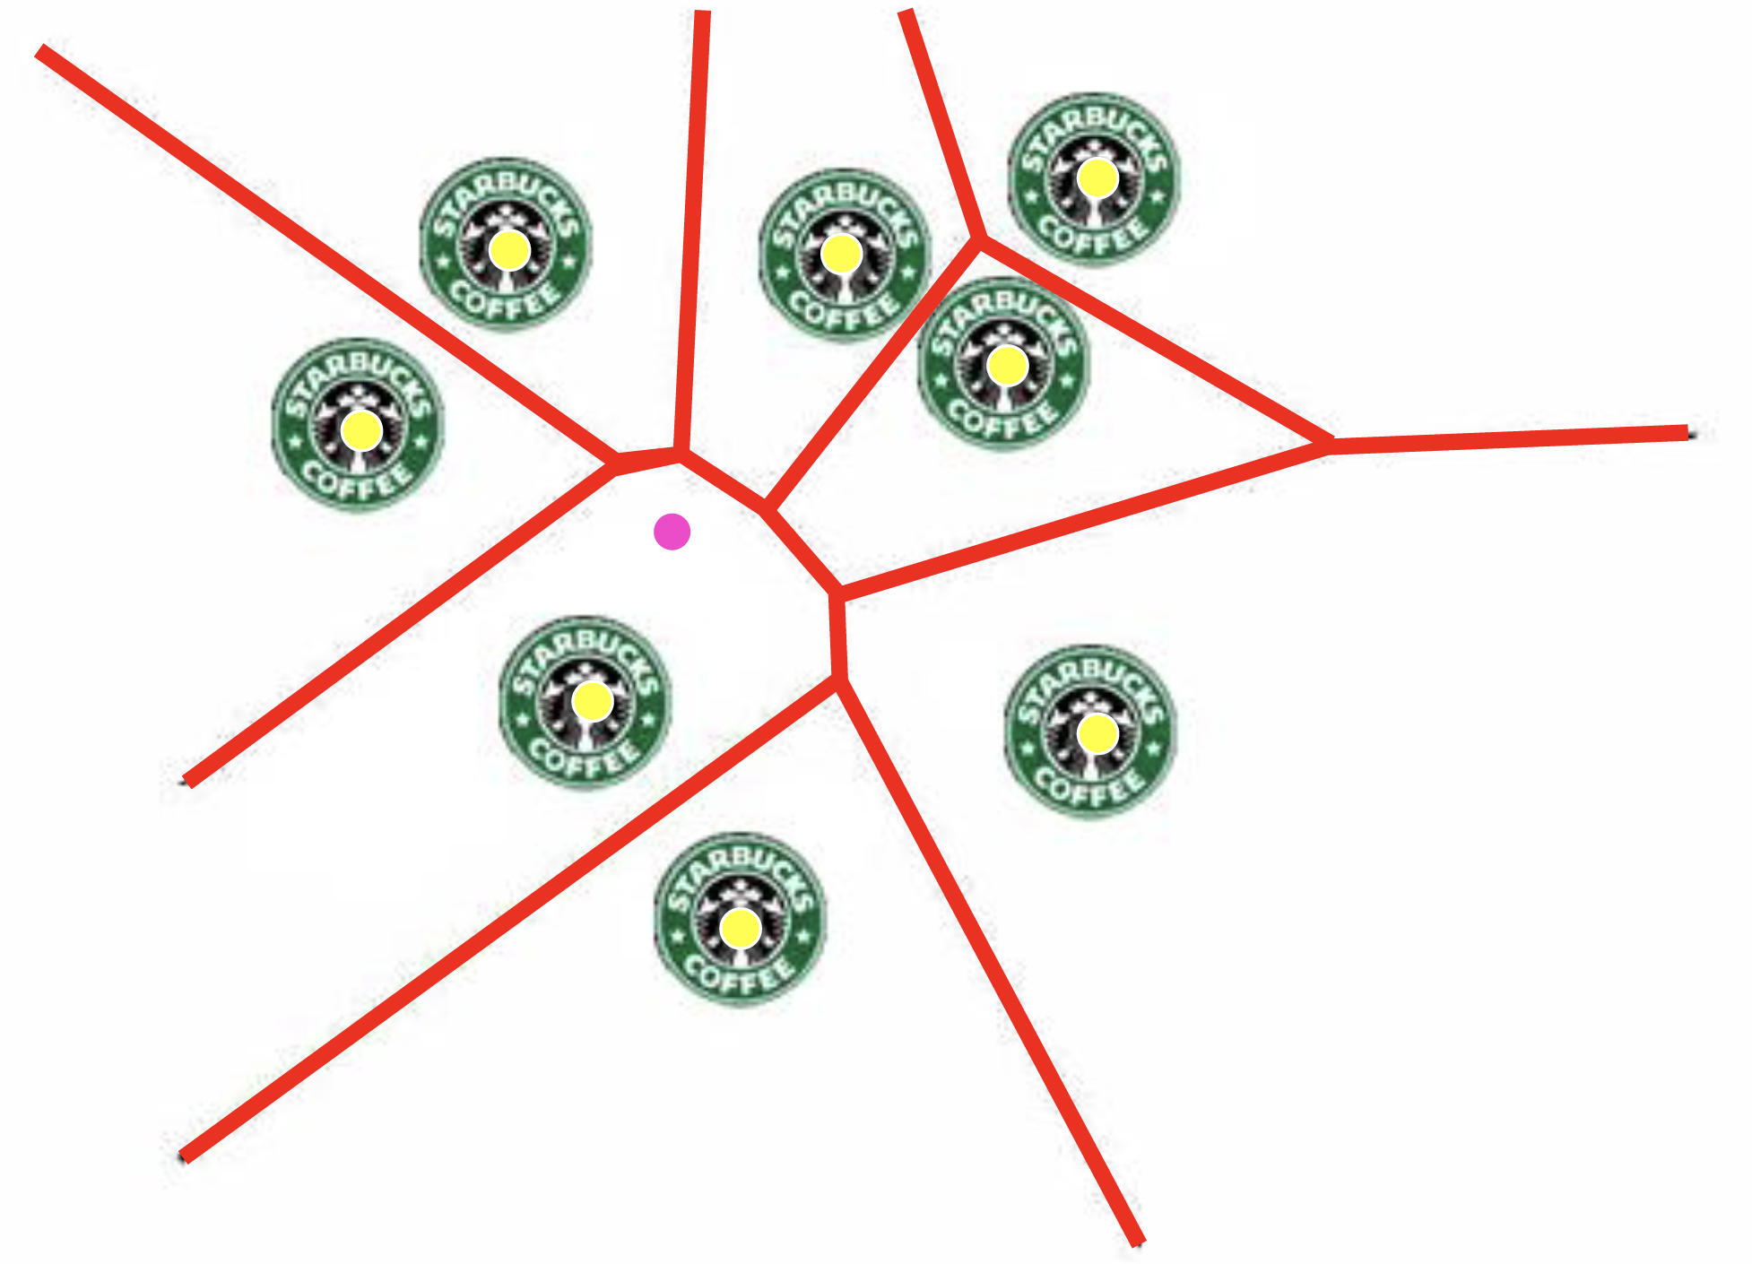
Application: Location Data

Slide 4
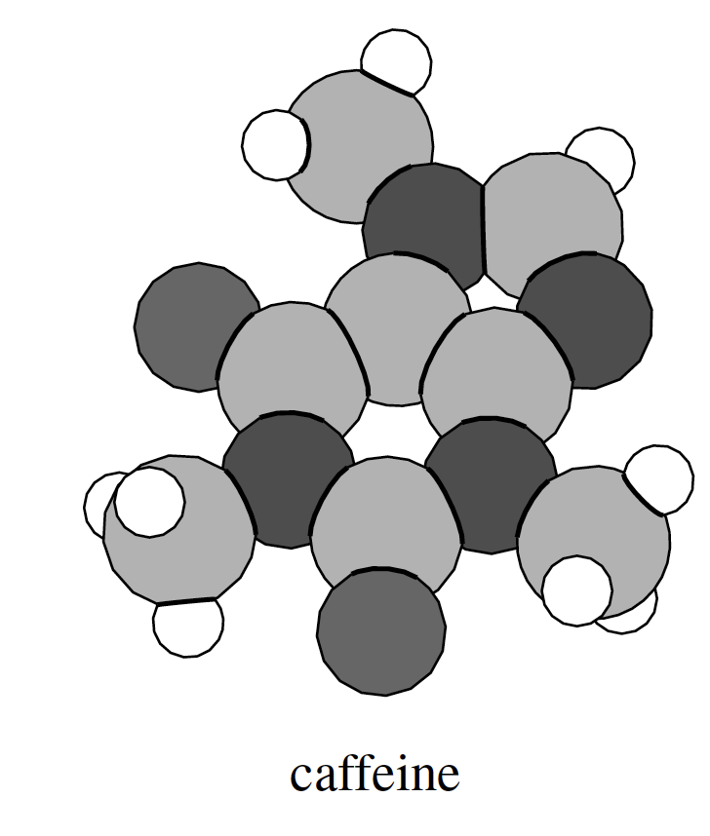
Application: Science

Slide 5
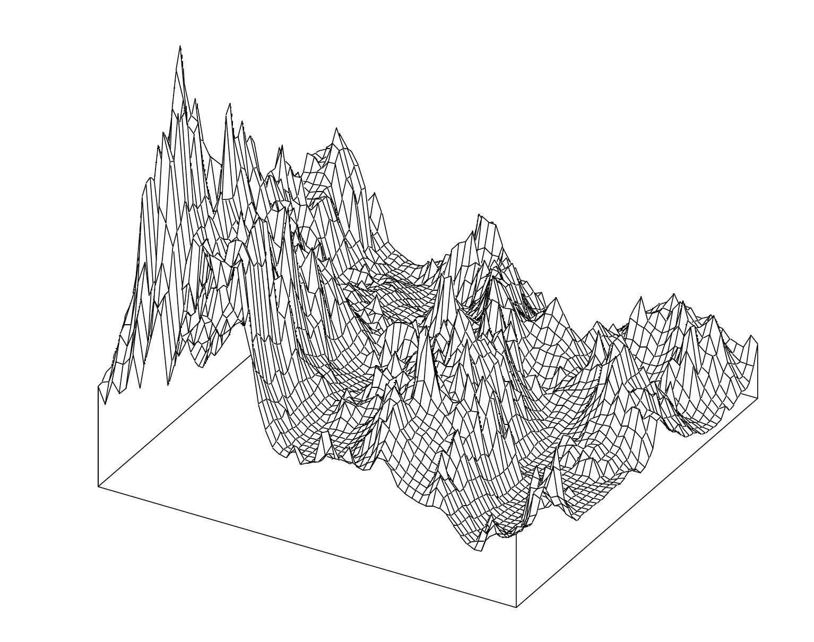
Application: Geographic Information Systems (GIS)

Slide 6
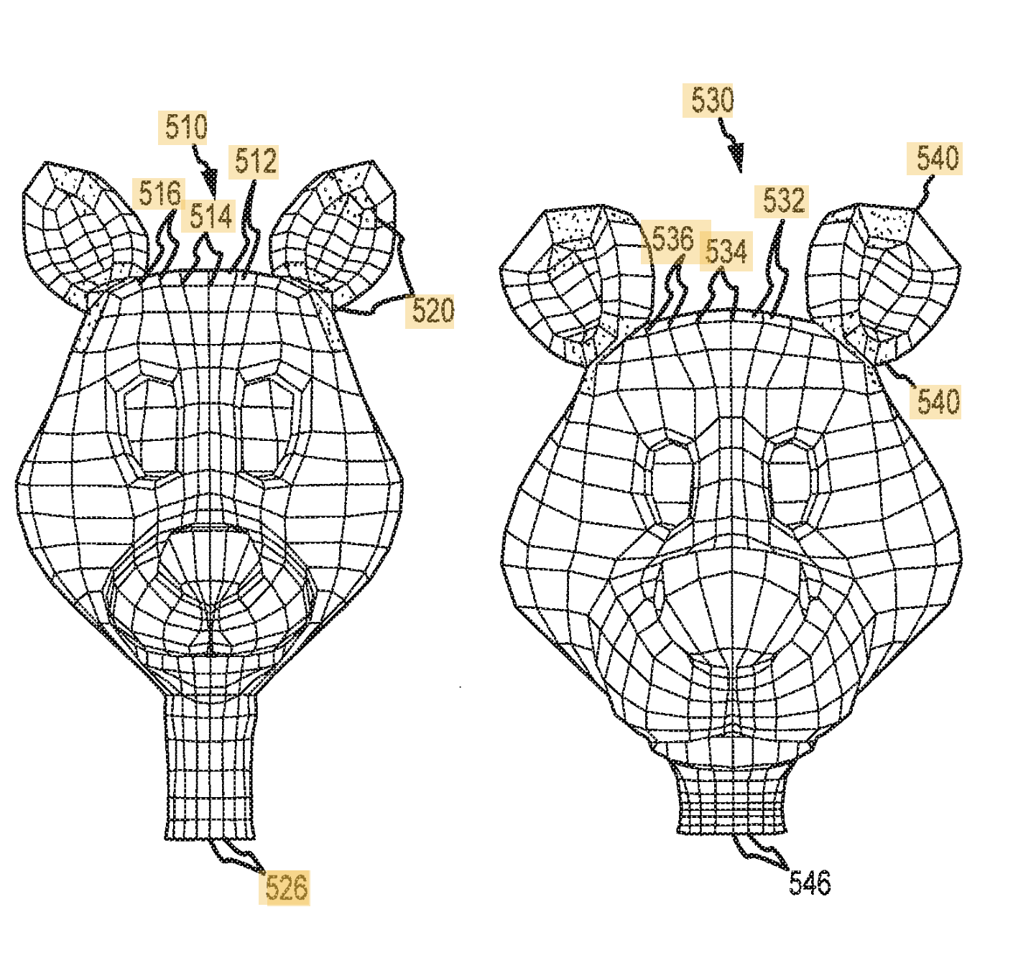
Application: Solid Modeling

Slide 7
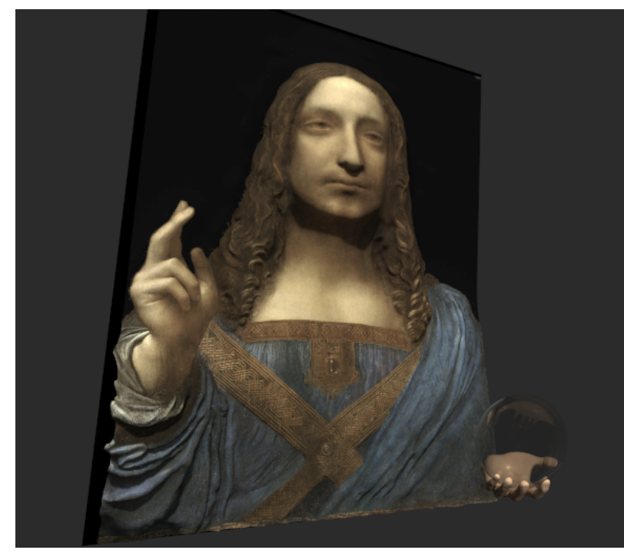
Application: Computer Graphics

Slide 8
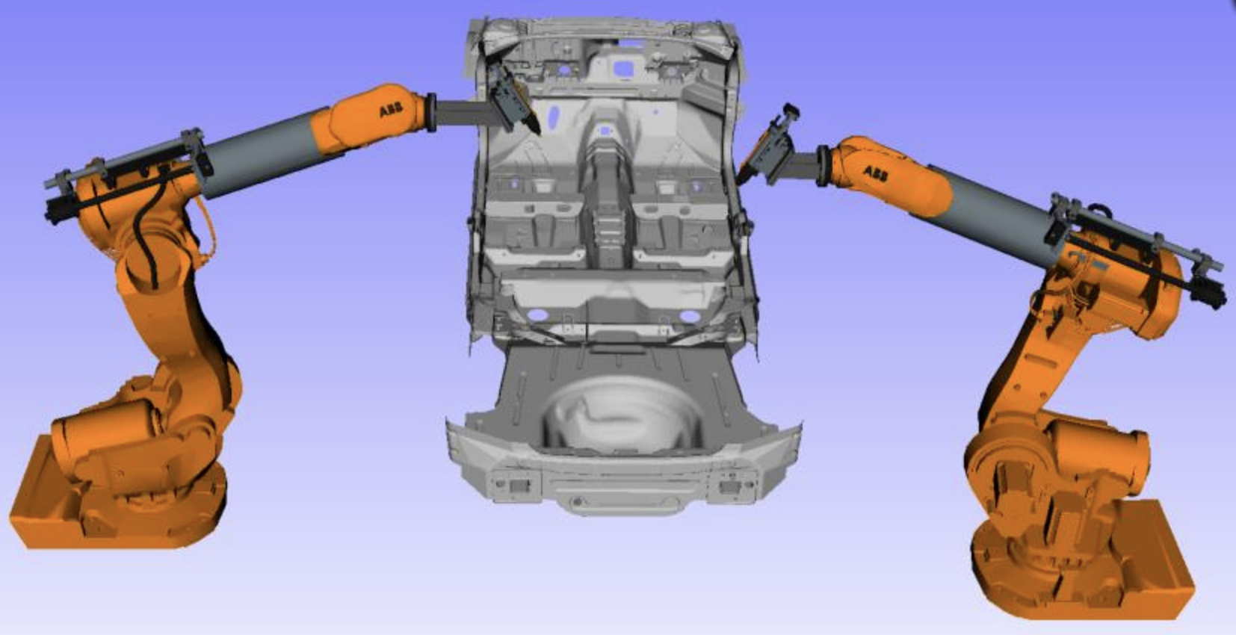
Application: Motion Planning and Robotics

Slide 9
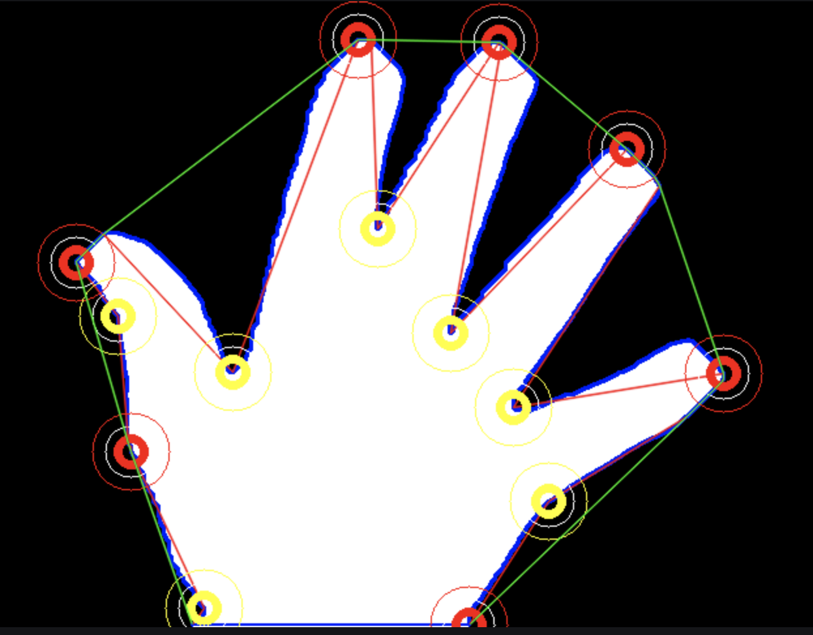
Application: Shape Analysis and Computer Vision

Slide 10
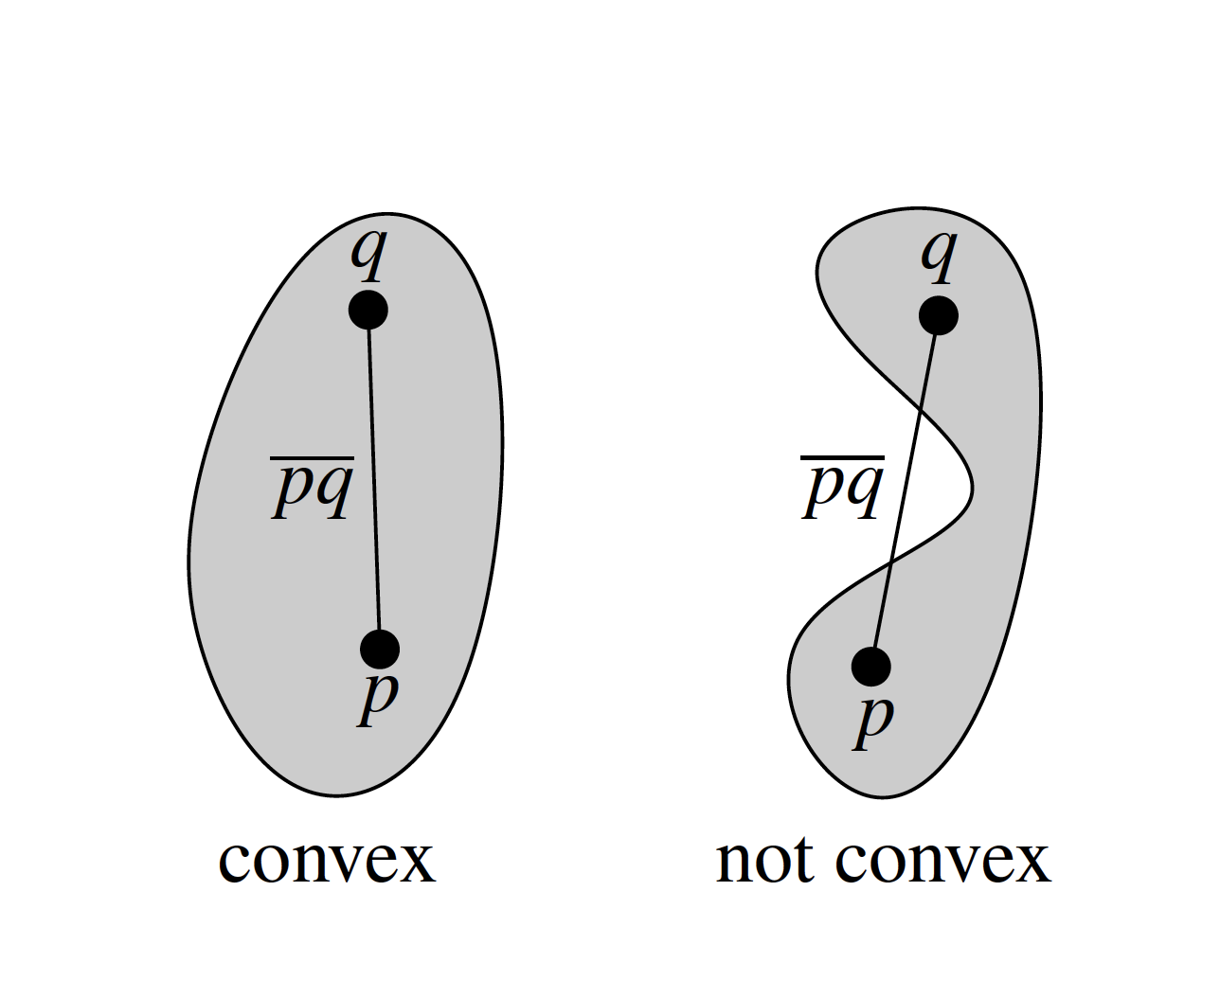
Convexity

Slide 11
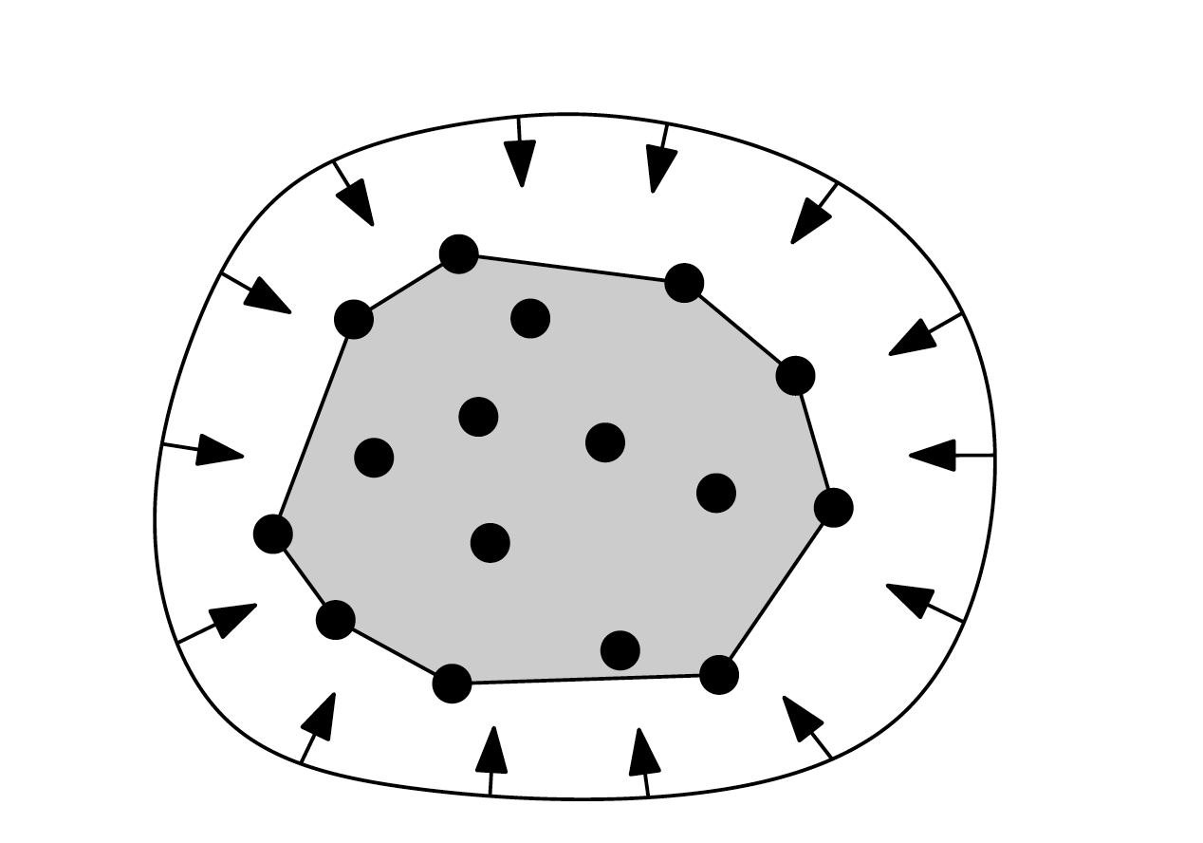
Convex hull
Smallest convex set containing all n points

Slide 12
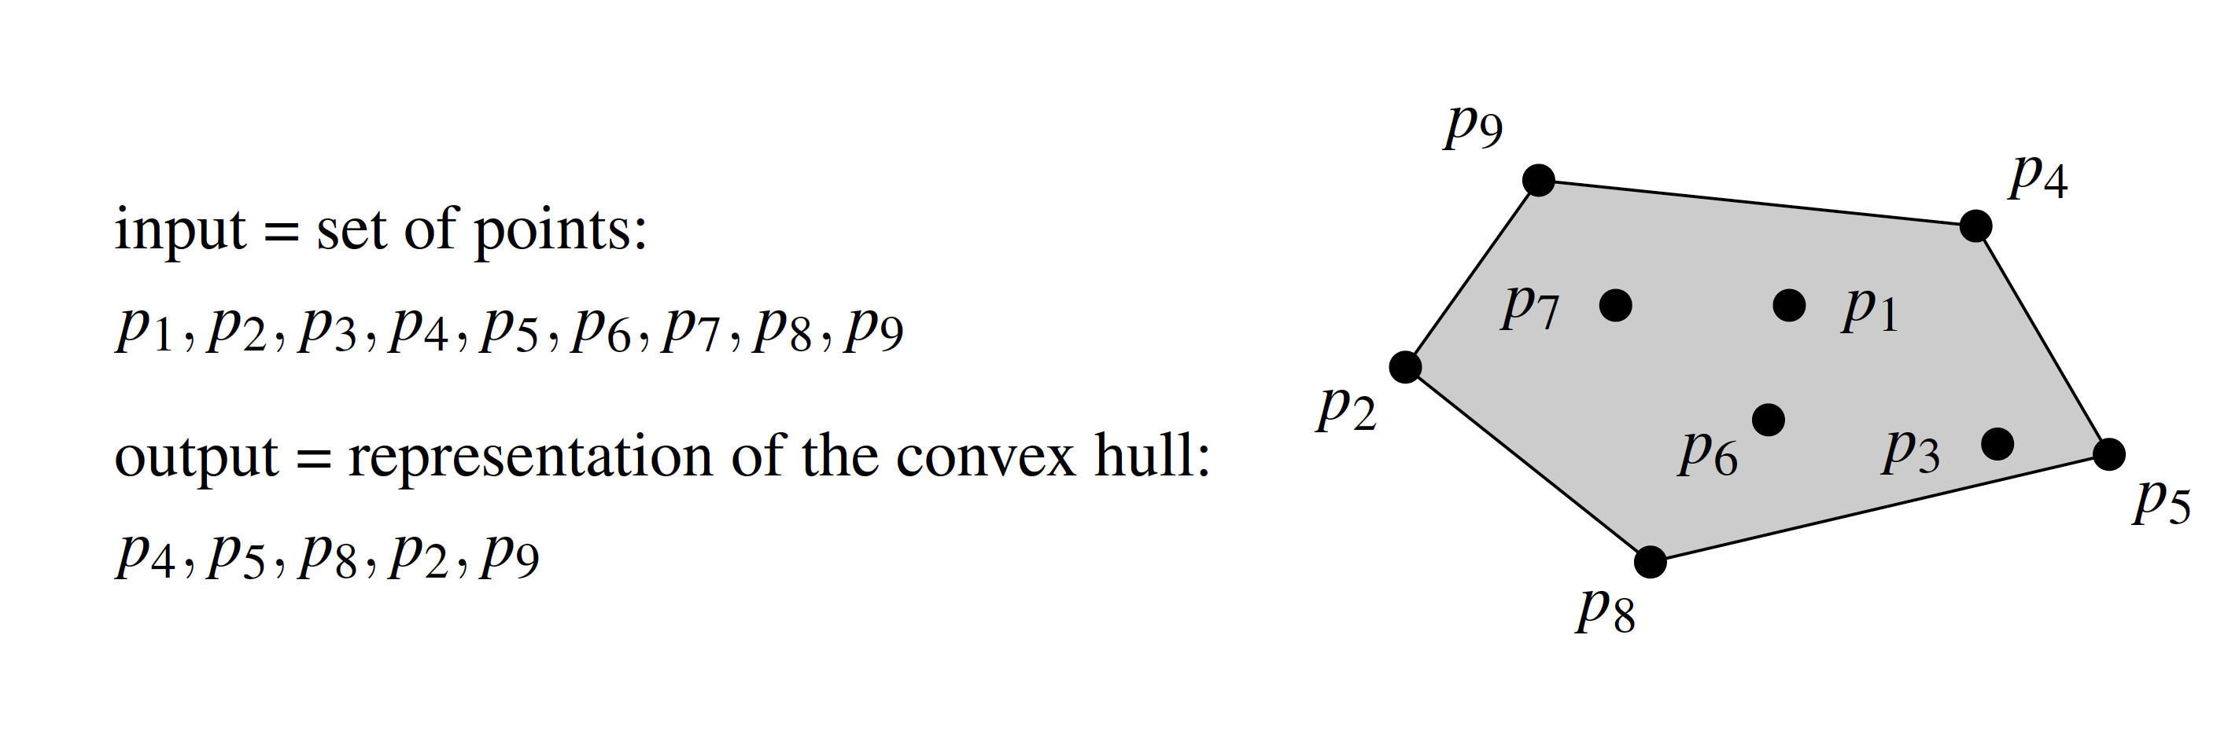
Convex hull
Smallest convex set containing all n points

Slide 13
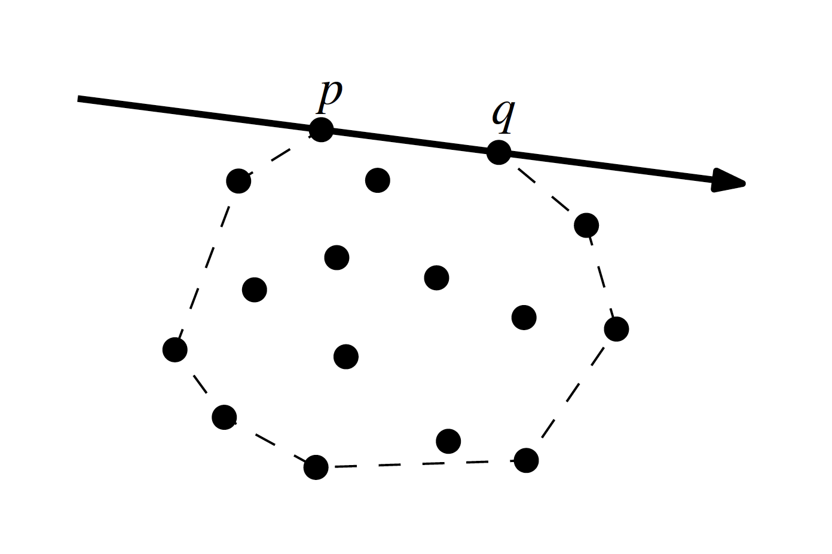
Useful Primitives
Sidedness

Slide 14
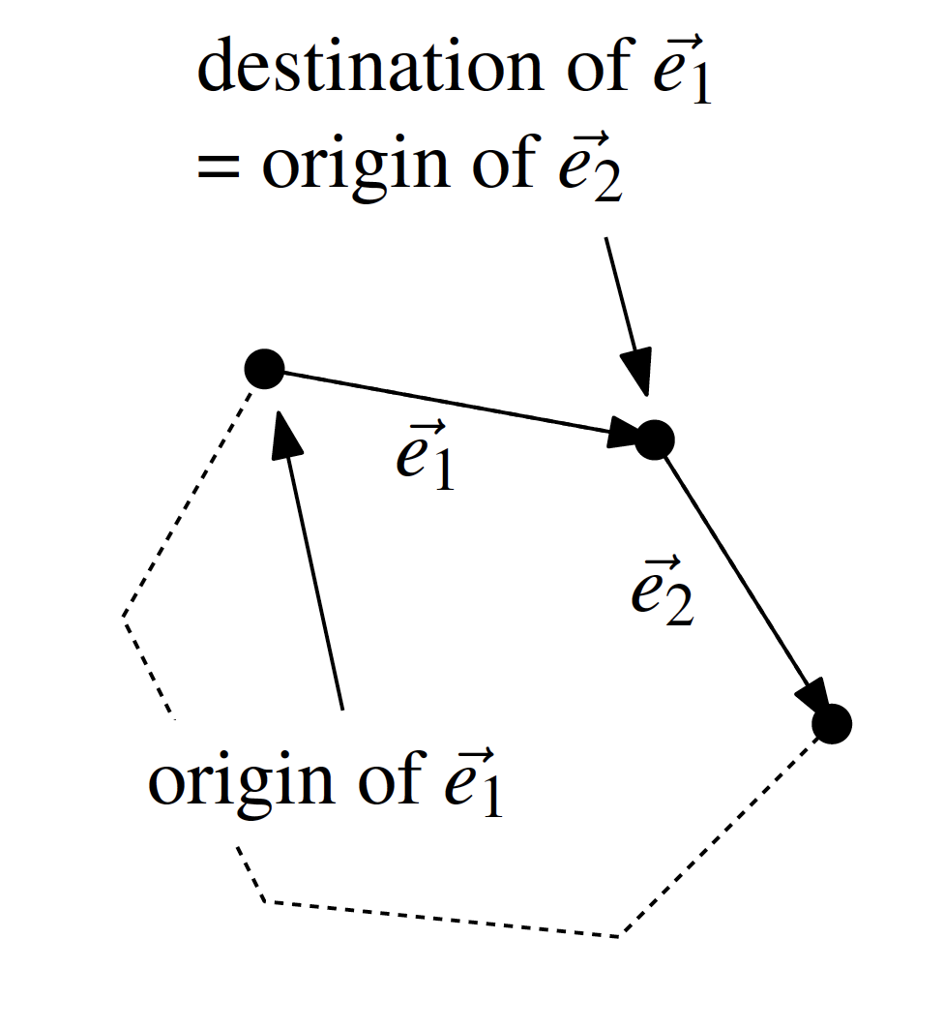
Useful Primitives
Orientation test: right turn or left turn

Slide 15
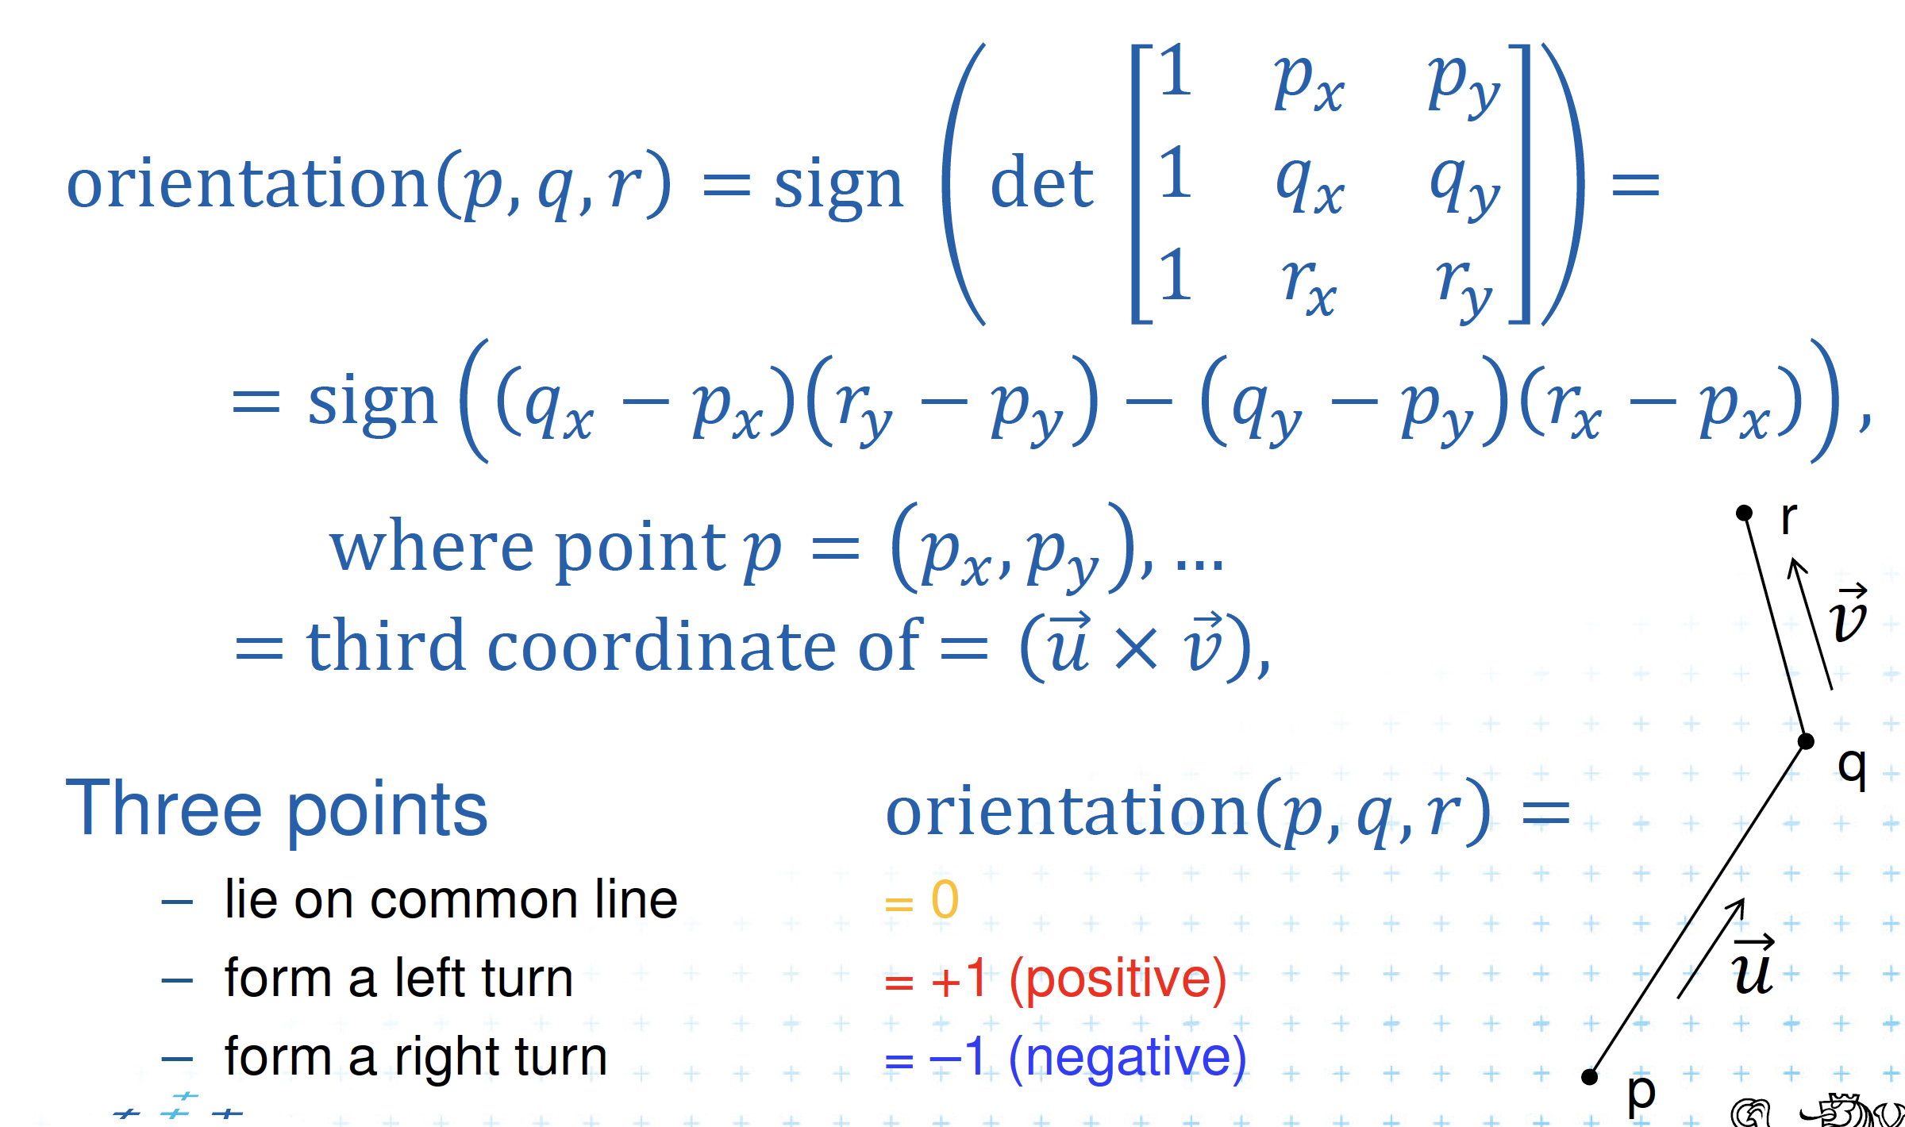
Computing Orientations

Slide 16
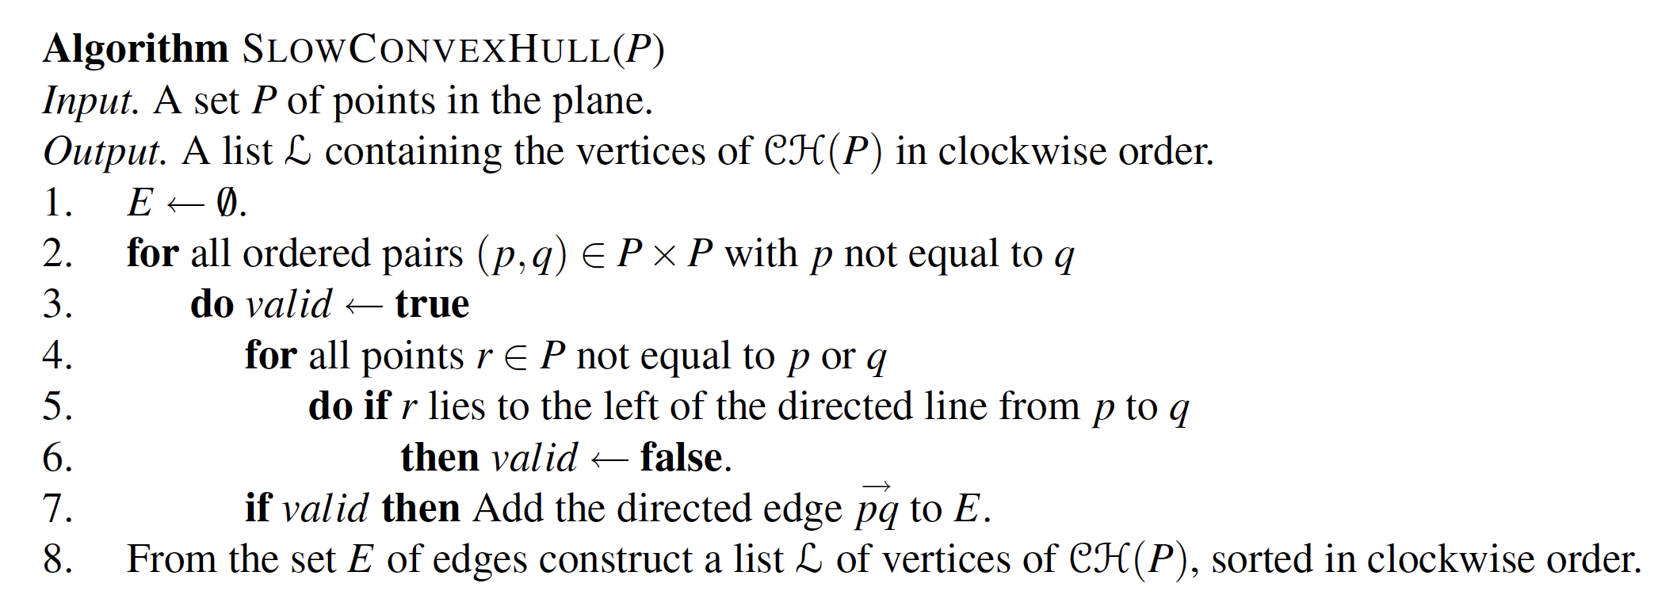
A First Convex Hull Algorithm

Slide 17
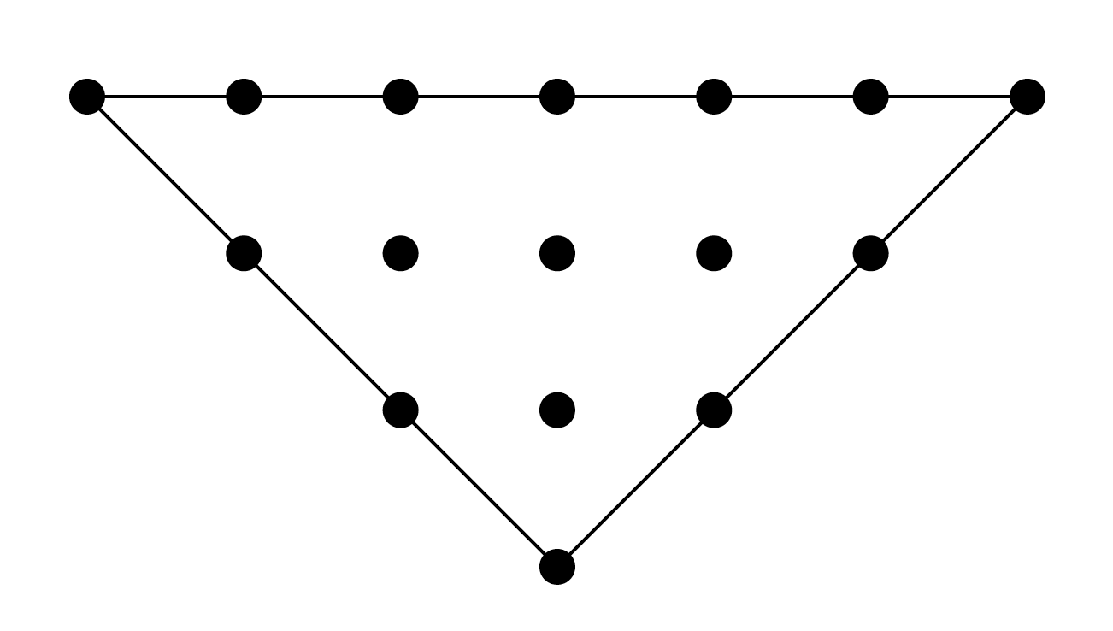
Degeneracies

Slide 18
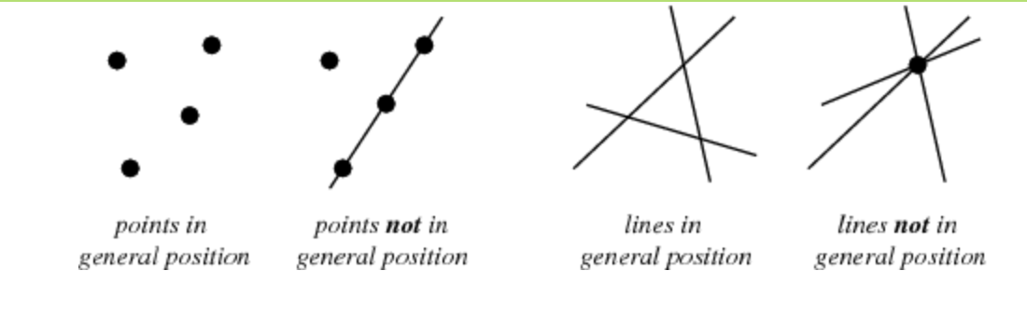
Dealing with Degeneracies
Assume input is in general position and go back later to deal with degeneracies

Slide 19
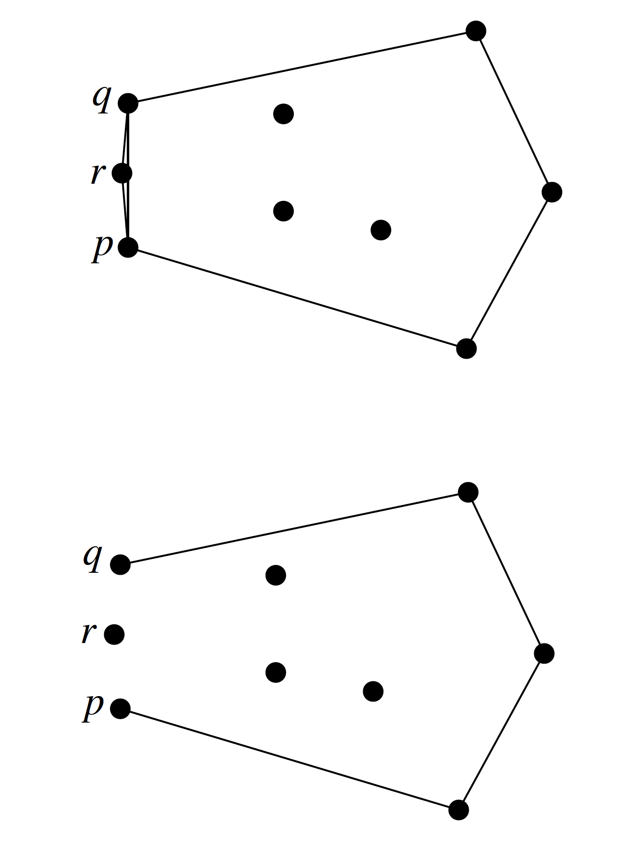
Robustness
Computing geometric primitives can introduce errors, e.g., if computations are done using floating point

Slide 20
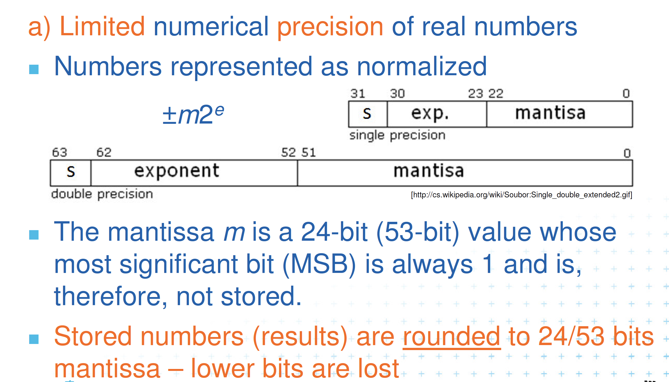
Floating Point Numbers are not exact

Slide 21
Dealing with Robustness
Assume all arithmetic is exact.
  Can be simulated using floating point filters, which we might discuss later if there is time
  Gives rise to a computational model known as the Real RAM

Slide 22

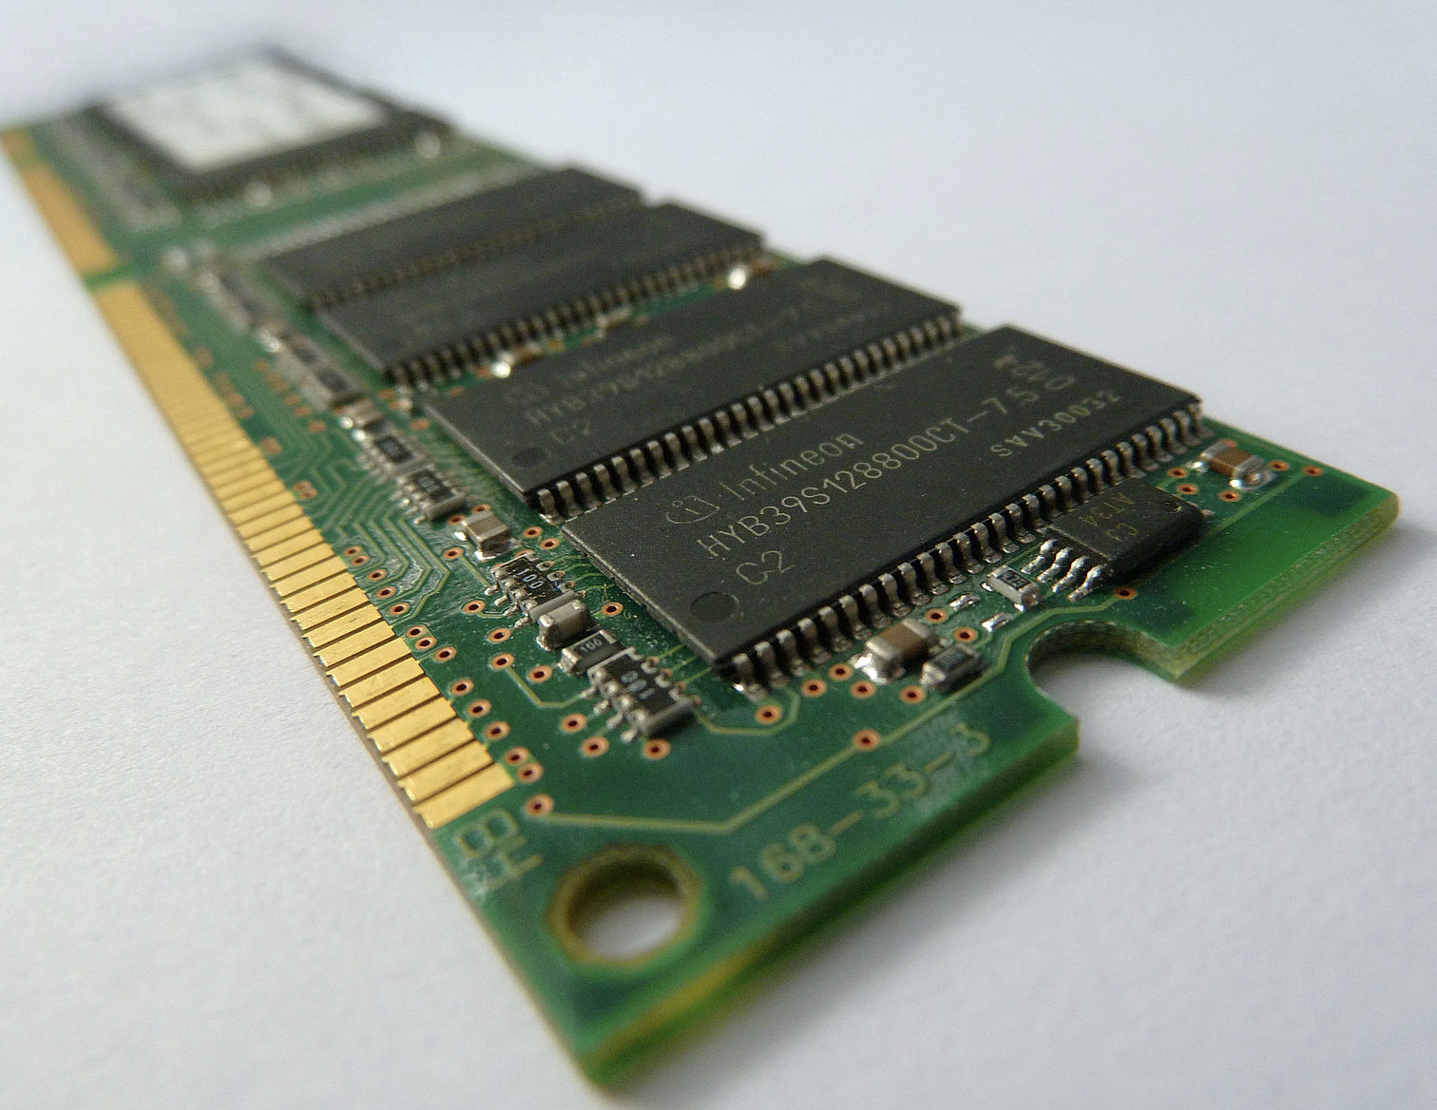

Real RAM Model
Not:

Slide 23
Real RAM Model
A “Random Access Machine”:
  a stored program
  a computer memory: an array of cells
  a central processing unit
  Each memory cell or register can store a real number.
Allowed operations include addition, subtraction, multiplication, and division, as well as comparisons.
Some people also include things like square-roots and rounding to integers, but this is sometimes considered “cheating”.
When analyzing algorithms for the real RAM, each allowed operation is typically assumed to take constant time.

