Slide 1
Computational Geometry
Delaunay Triangulations
Michael Goodrich
with slides from Carola Wenk and David Eppstein

Slide 2
Triangulation
Let $P=\left\{p_{1},…,p_{n}\right\}⊆R^{2}$ be a finite set of points in the plane.
A triangulation of P is a simple, plane (i.e., planar embedded), connected graph T=(P,E) such that
every edge in E is a line segment,
the outer face is bounded by edges of CH(P),
all inner faces are triangles.

Slide 3
Dual Graph
Let $G=(V,E)$ be a plane graph. The dual graph G* has
a vertex for every face of G,
an edge for every edge of G, between the two faces incident to the original edge

Slide 4
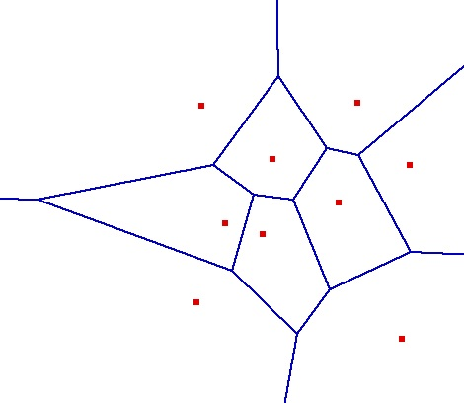
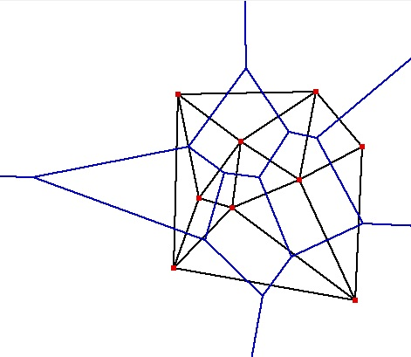
Delaunay Triangulation
Let G be the plane graph for the Voronoi diagram VD(P) . Then the dual graph G* is called the Delaunay Triangulation DT(P).
Canonical straight-line embedding for DT(P):
VD(P)
P
DT(P)
If P is in general position (no three points on a line, no four points on a circle) then every inner face of DT(P) is indeed a triangle.
DT(P) can be stored as an abstract graph, without geometric information. (No such obvious storing scheme for VD(P).)

Slide 5
Delaunay Triangulation
Let G be the plane graph for the Voronoi diagram VD(P) . Then the dual graph G* is called the Delaunay Triangulation DT(P).
Canonical straight-line embedding for DT(P):
P
DT(P)
If P is in general position (no three points on a line, no four points on a circle) then every inner face of DT(P) is indeed a triangle.
DT(P) can be stored as an abstract graph, without geometric information. (No such obvious storing scheme for VD(P).)

Slide 6
Straight-Line Embedding
Lemma: DT(P) is a plane graph, i.e., the straight-line edges do not intersect.
Proof:
q
p
pp’ is an edge of DT(P) ⇔ There is an empty closed disk D_{p} with p and p’ on its boundary, and its center c on the bisector.
Let qq’ be another Delaunay edge that intersects pp’
⇒ q and q’ lie outside of D_{p} , therefore qq’ also intersects pc or p’c
Symmetrically, pp’ also intersects qc’ or q’c’
(pc or p’c’) and (qc’ or q’c’) intersect
The edges do not lie in different Voronoi cells.
Contradiction
D_{p}
pc ⊂ V(p) p’c ⊂ V(p’)
c
p’
q’
p
q
qc' ⊂ V(q) q’c’ ⊂ V(q’)
D_{q}
c’
q’
p’

Slide 7
Characterization of DT(P)
Lemma: Let p,q,r∈P let Δ be the triangle they define. Then the following statements are equivalent:
Δ belongs to DT(P)
The circumcenter c of Δ is a vertex in VD(P)
The circumcircle of Δ is empty (i.e., contains no other point of P)
Proof sketch: All follow directly from the definition of DT(P) in VD(P). By definition of VD(P), we know that p,q,r are c’s nearest neighbors.
Characterization I: Let T be a triangulation of P. Then T=DT(P) ⇔ The circumcircle of any triangle in T is empty.
non-empty circumcircle
p_{l}
p_{i}
p_{j}
p_{k}

Slide 11
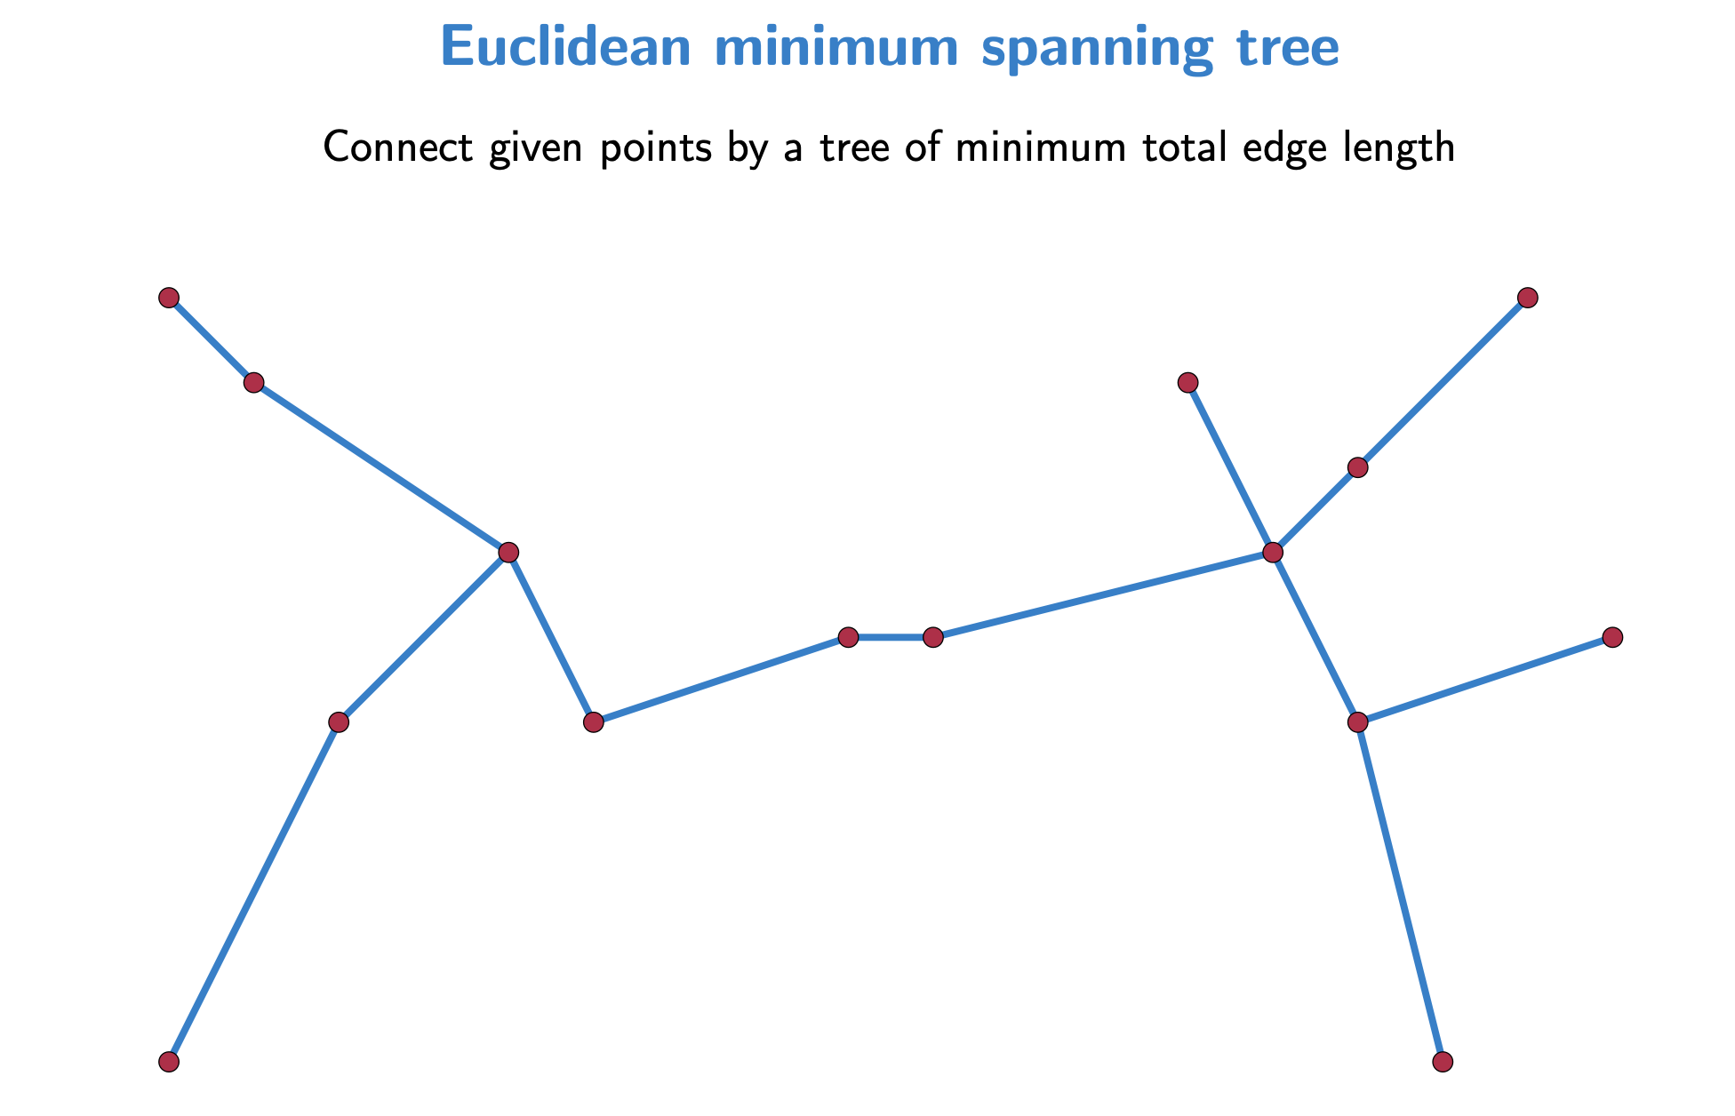

Slide 13
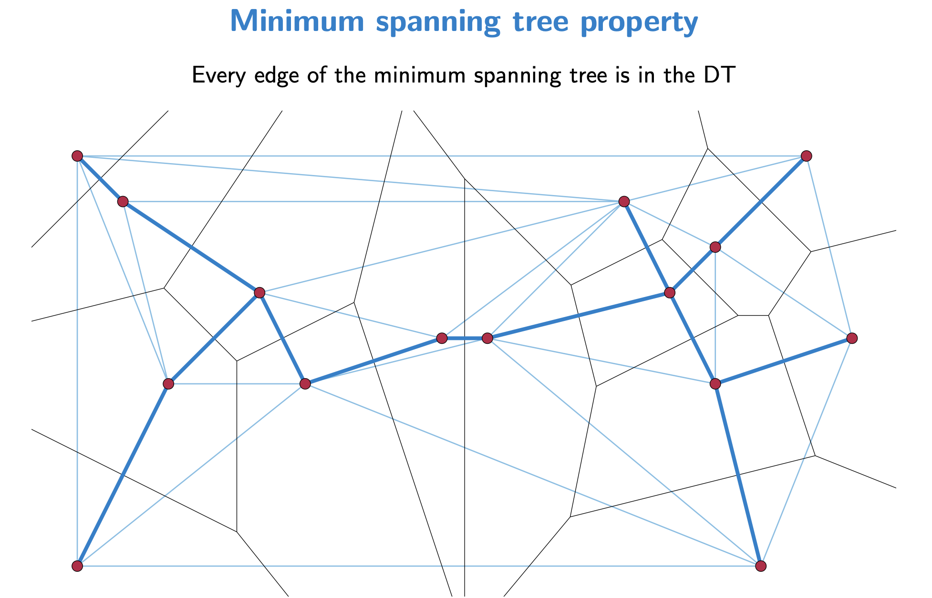

Slide 14
All Nearest Neighbors
All nearest neighbors: Find for each p∈P its nearest neighbor q∈P; q≠p.
Empty circle property: p,q∈P are connected by an edge in DT(P) ⇔ there exists an empty circle passing through p and q. Proof: “⇒”: For the Delaunay edge pq there must be a Voronoi edge. Center a circle through p and q at any point on the Voronoi edge, this circle must be empty. “⇐”: If there is an empty circle through p and q, then its center c has to lie on the Voronoi edge because it is equidistant to p and q and there is no site closer to c.
Claim: In DT(P), every p∈P is adjacent to its nearest neighbors. Proof: Let q∈P be a nearest neighbor adjacent to p in DT(P). Then the circle centered at p with q on its boundary has to be empty, so the circle with diameter pq is empty and pq is a Delaunay edge.
Algorithm: Find all nearest neighbors in O(n) time: Check for each p∈P all points connected to p with a Delaunay edge.
p
q
p
q

Slide 15
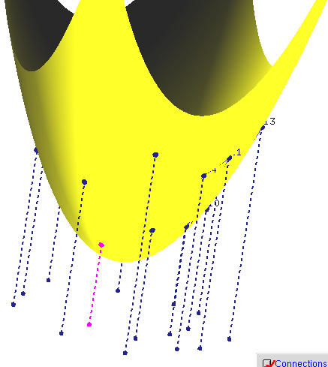
DT and 3D CH
Theorem: Let P={p₁,…,p_{n}} with p_{i}=(a_{i}, b_{i},0). Let p*_{i} =(a_{i}, b_{i}, a²_{i}+ b²_{i}) be the vertical projection of each point p_{i} onto the paraboloid z=x²+ y². Then DT(P) is the orthogonal projection onto the plane z=0 of the lower convex hull of P*={p*₁,…,p*_{n}} .
P*
P
Pictures generated with Hull2VD tool available at http://www.cs.mtu.edu/~shene/NSF-2/DM2-BETA

Slide 16
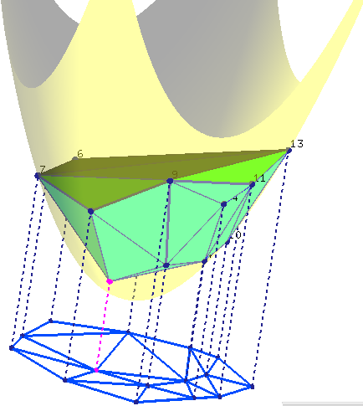
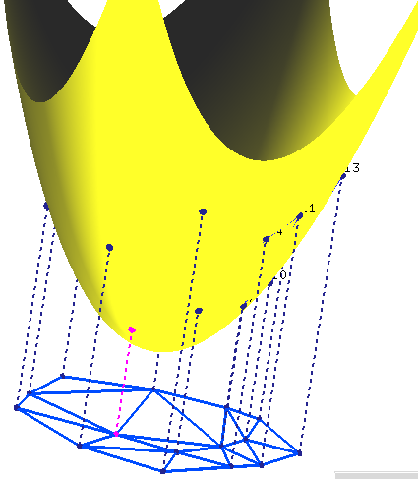
DT and 3D CH
Theorem: Let P={p₁,…,p_{n}} with p_{i}=(a_{i}, b_{i},0). Let p’_{i} =(a_{i}, b_{i}, a²_{i}+ b²_{i}) be the vertical projection of each point p_{i} onto the paraboloid z=x²+ y². Then DT(P) is the orthogonal projection onto the plane z=0 of the lower convex hull of P’={p’₁,…,p’_{n}} .
Pictures generated with Hull2VD tool available at http://www.cs.mtu.edu/~shene/NSF-2/DM2-BETA

Slide 17
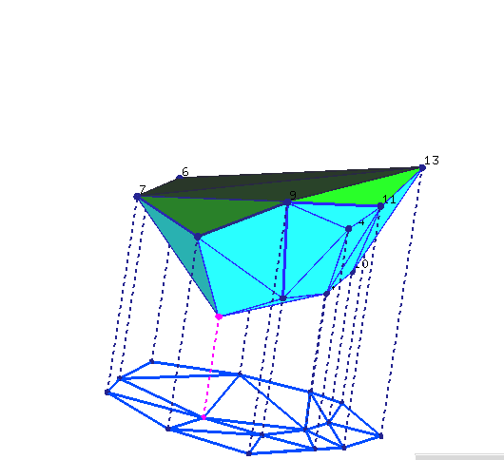
DT and 3D CH
Theorem: Let P={p₁,…,p_{n}} with p_{i}=(a_{i}, b_{i},0). Let p’_{i} =(a_{i}, b_{i}, a²_{i}+ b²_{i}) be the vertical projection of each point p_{i} onto the paraboloid z=x²+ y². Then DT(P) is the orthogonal projection onto the plane z=0 of the lower convex hull of P’={p’₁,…,p’_{n}} .
Pictures generated with Hull2VD tool available at http://www.cs.mtu.edu/~shene/NSF-2/DM2-BETA

Slide 18
DT and 3D CH
Theorem: Let P={p₁,…,p_{n}} with p_{i}=(a_{i}, b_{i},0). Let p’_{i} =(a_{i}, b_{i}, a²_{i}+ b²_{i}) be the vertical projection of each point p_{i} onto the paraboloid z=x²+ y². Then DT(P) is the orthogonal projection onto the plane z=0 of the lower convex hull of P’={p’₁,…,p’_{n}} .
p’_{i,} p’_{j,} p’_{k} form a (triangular) face of LCH(P’)
⇔
The plane through p’_{i,} p’_{j,} p’_{k} leaves all remaining points of P above it ⇔
The circle through p_{i,} p_{j,} p_{k} leaves all remaining points of P in its exterior ⇔
p_{i,} p_{j,} p_{k} form a triangle of DT(P)
property of unit paraboloid
Slide adapted from slides by Vera Sacristan.

