Slide 1
Convex Hulls
Michael T. Goodrich

Slide 2
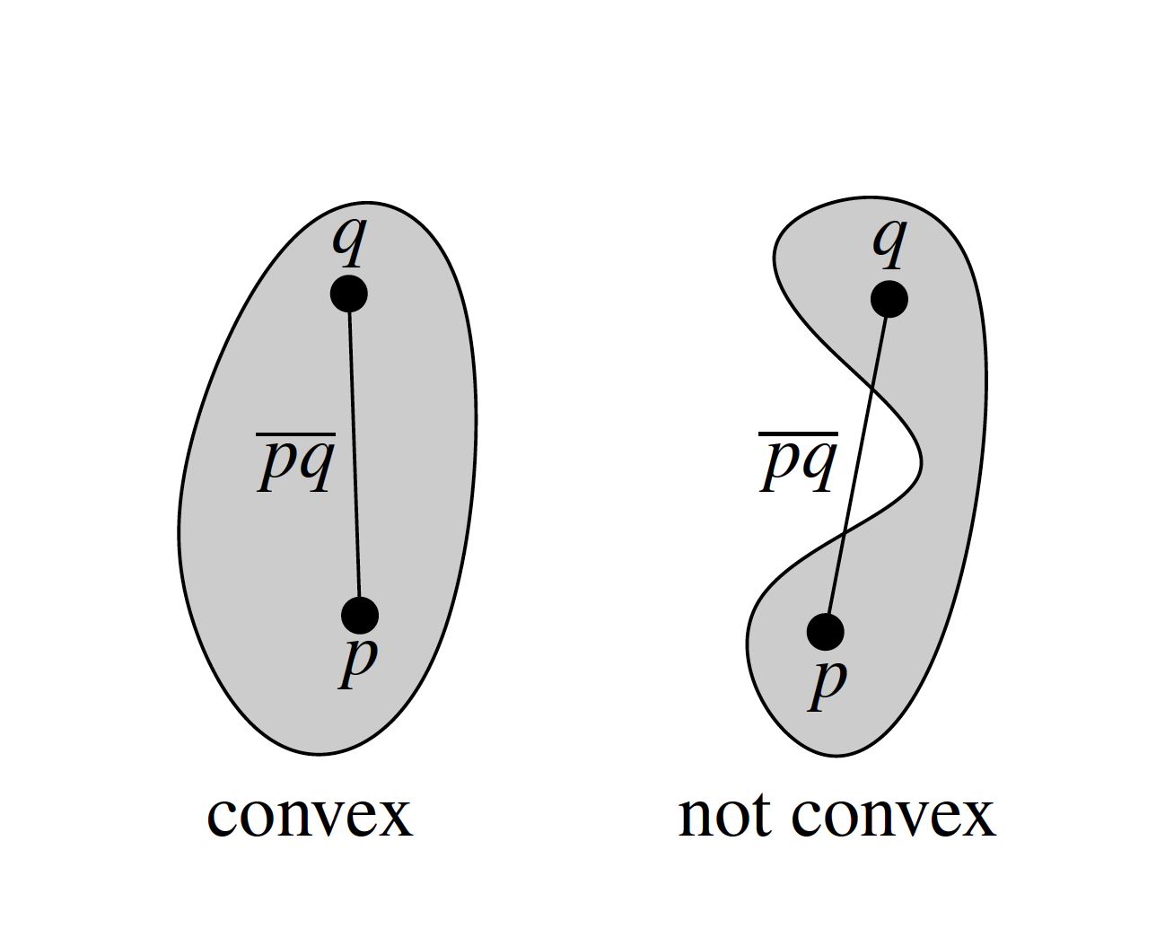
Review: Convexity

Slide 3
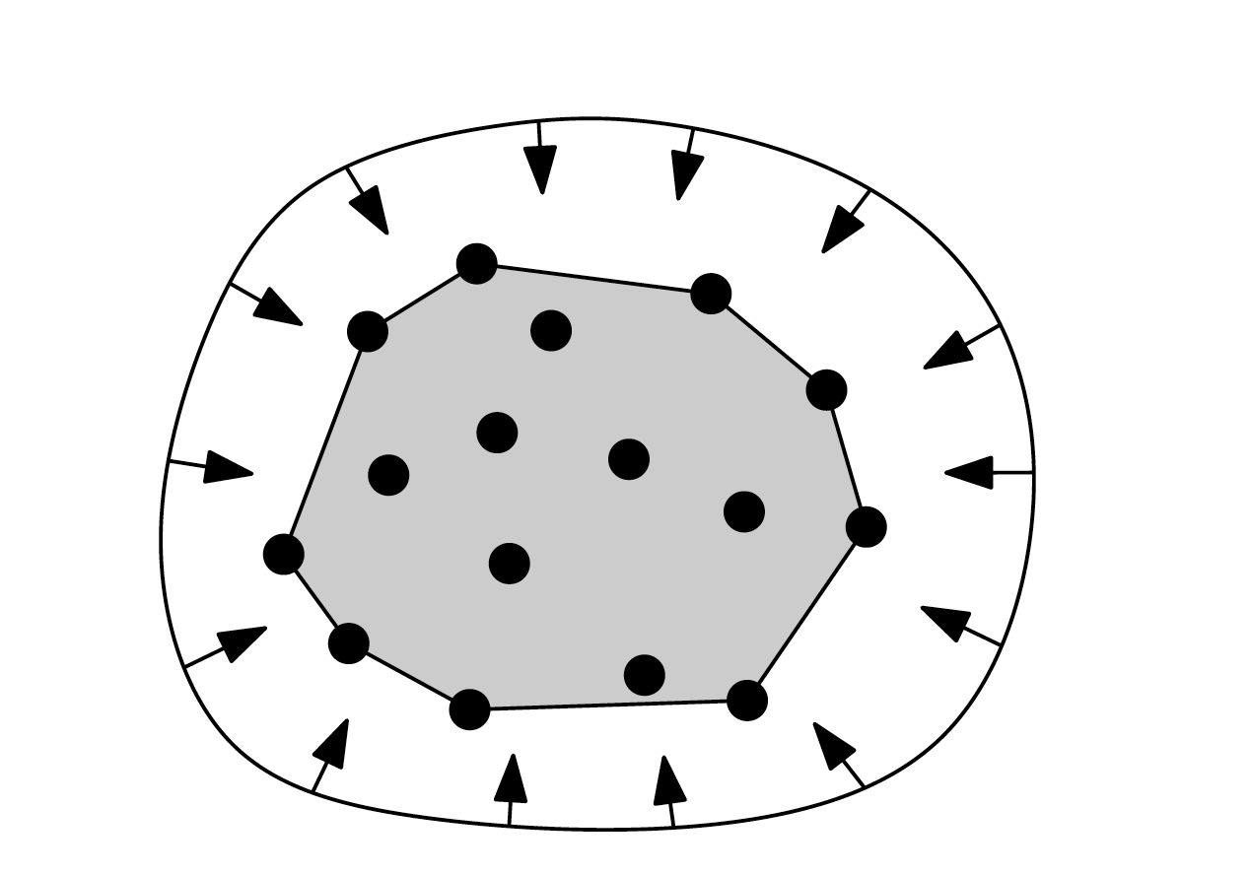
Convex hull
Smallest convex set containing all n points

Slide 4
Convex hull
Smallest convex set containing all n points

Slide 5
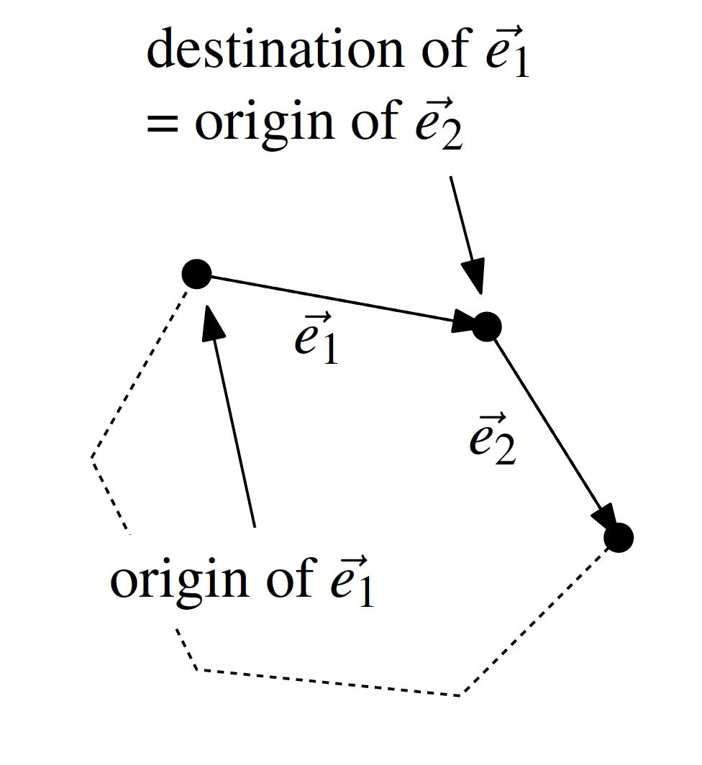
Orientation Test
right turn or left turn (or straight line)

Slide 6
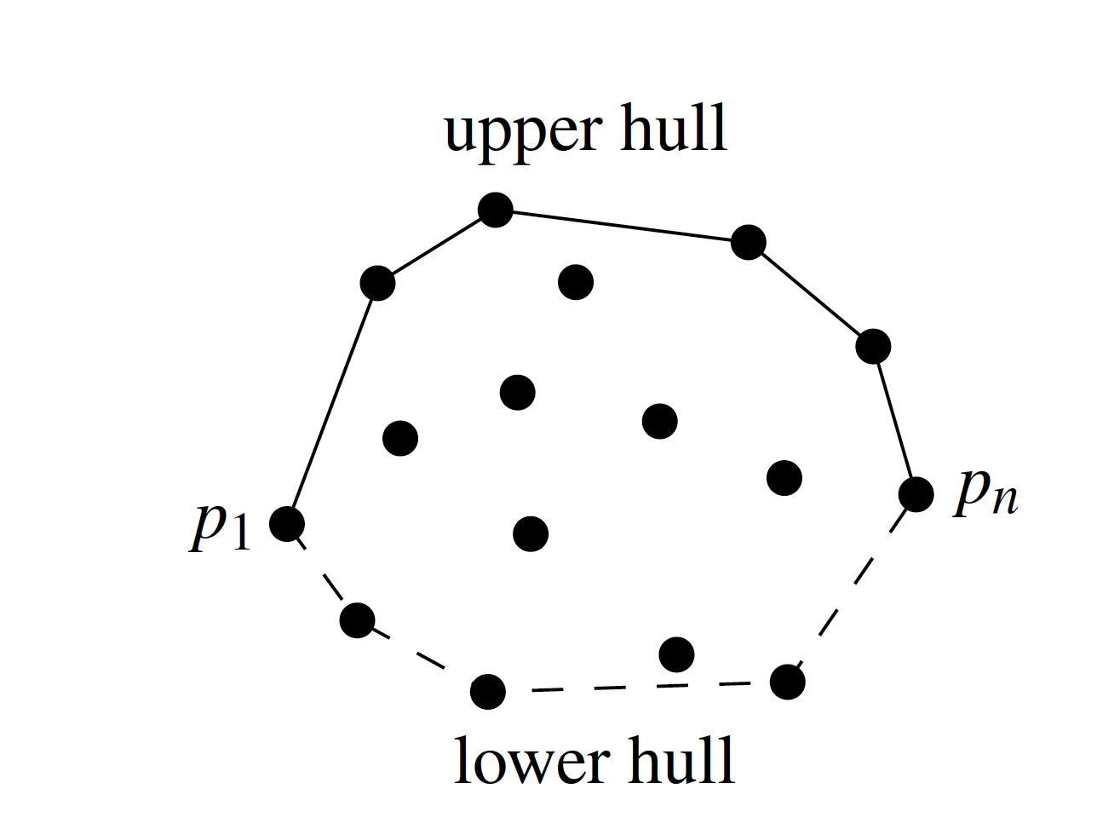
A Better Convex Hull Algorithm

Slide 7
Plane-Sweep Technique
We “sweep” the plane with a vertical line
Stop at event points
Maintain a partial solution for the swept-over area

Slide 8
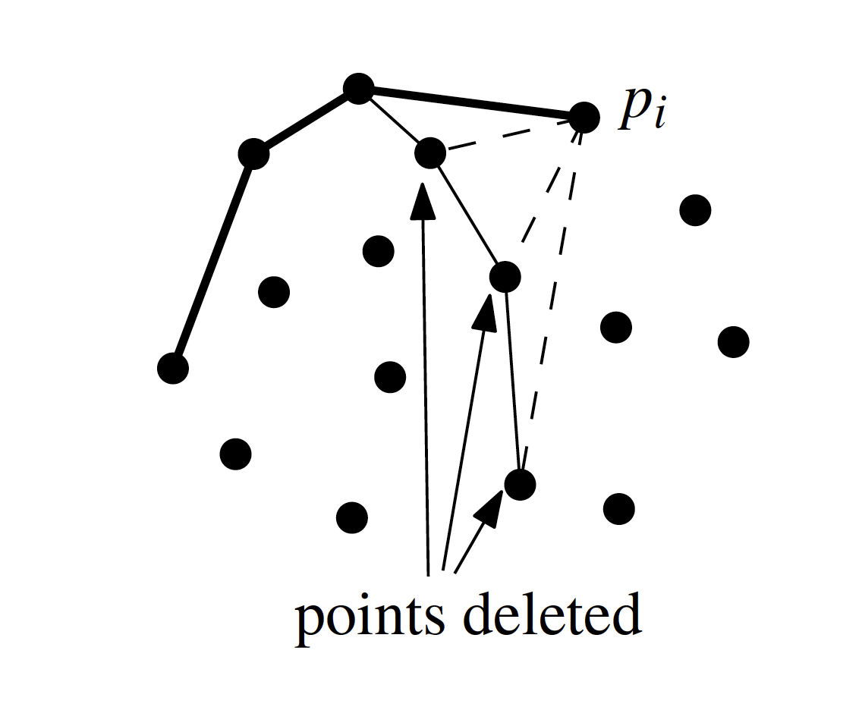
Graham Scan Algorithm
Each point determines an event

Slide 9
Graham Scan Upper Hull Algorithm
What is the running time?
What if the points are already sorted and we can skip step 1?

Slide 10
Lower Bound for Convex Hull
A reduction from sorting to convex hull is:
Given n real values x_{i}, generate n 2D points on the graph of a convex function, e.g. (x_{i},x_{i}²).
Compute the (ordered) convex hull of the points.
The order of the convex hull points is the numerical order of the x_{i}.
So CH time is Ω(n log n)

Slide 11
Convex Hull – Gift Wrapping
Jarvis March Algorithm:
Find a point p₁ on the convex hull (e.g. the lowest point).
Rotate counterclockwise a line through p₁ until it touches one of the other points (start from a horizontal orientation).
Repeat the last step for the new point.
Stop when p₁ is reached again.

Slide 12
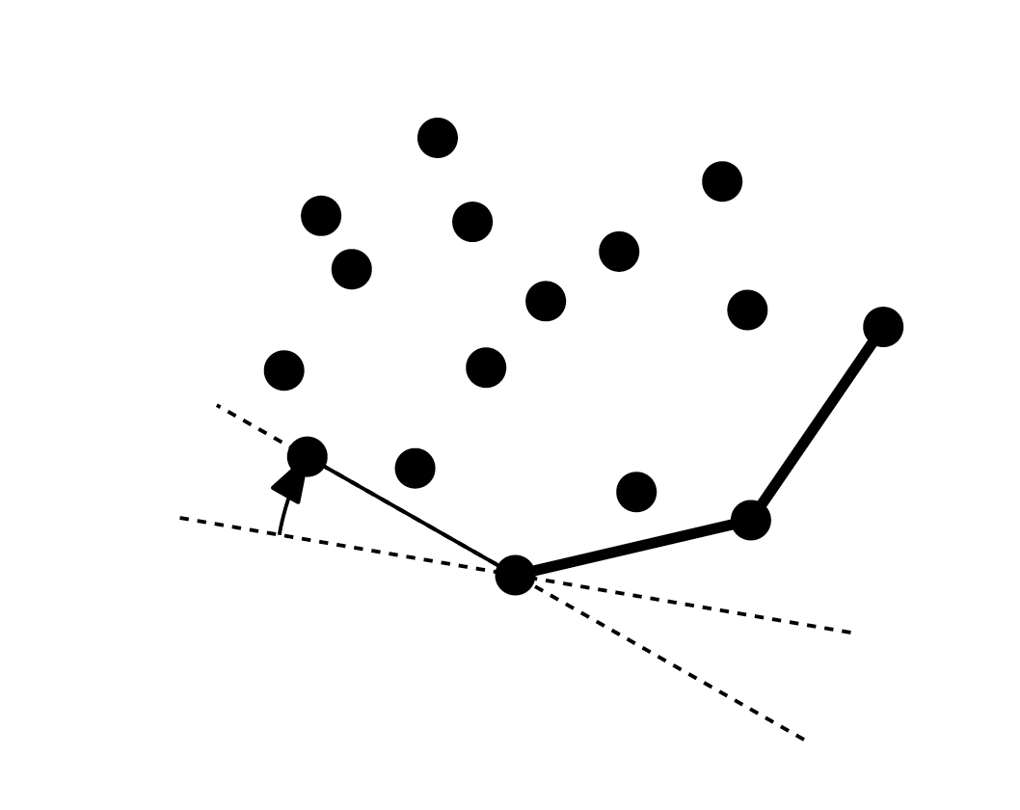
Jarvis March Gift Wrapping
Running time is output sensitive
The time depends on both the size of the input and the size of the output
Time Complexity: O(nh), where n is the input size and h is the output (hull) size.

Slide 13
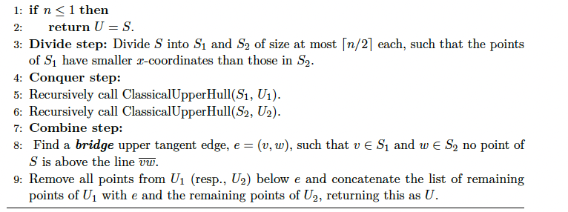
Divide-and-Conquer Convex Hull

Slide 14
Divide-and-Conquer Analysis
Assume we can find the bridge edge in O(n) time (more on this later):
T(n) = 2T(n/2) + n
Implies T(n) is O(n log n)

Slide 15
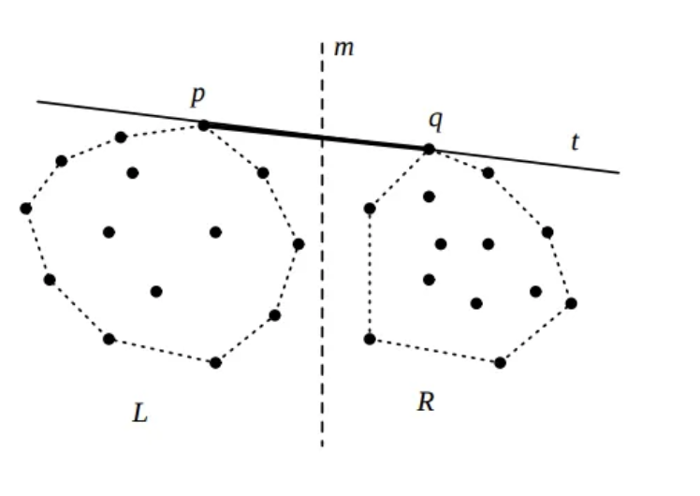
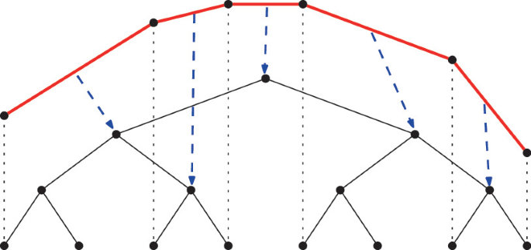
Dynamic Upper Hulls
Insert or delete points
Maintain a tree of the recursive calls made in the divide-and-conquer algorithm

Slide 16
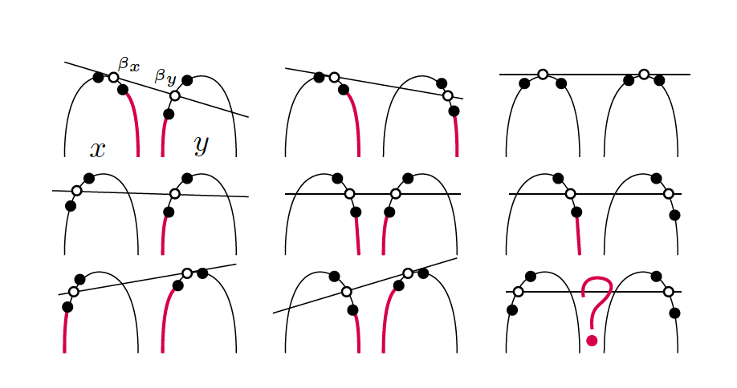
Double Binary Search Upper Hull
Compute the bridge edge in O(log n) time given two upper hulls:

Slide 17
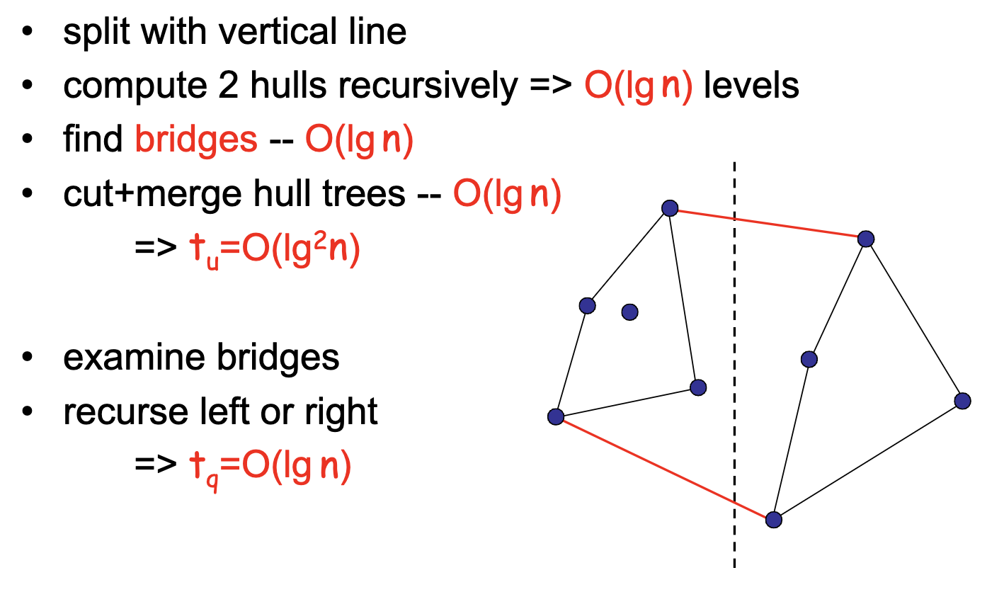
Dynamic Convex Hulls
Insert/delete in O(log² n) time
Upper hull queries in O(log n) time

