Slide 1
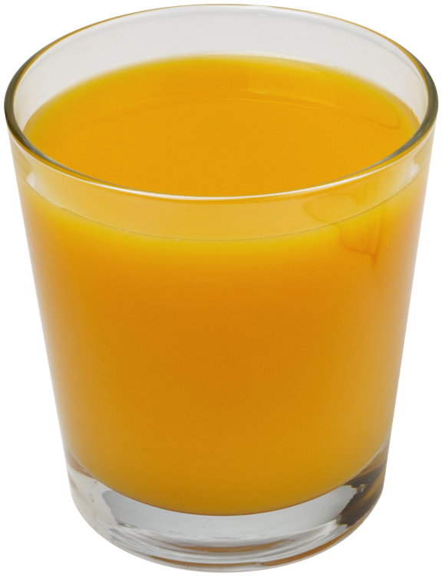
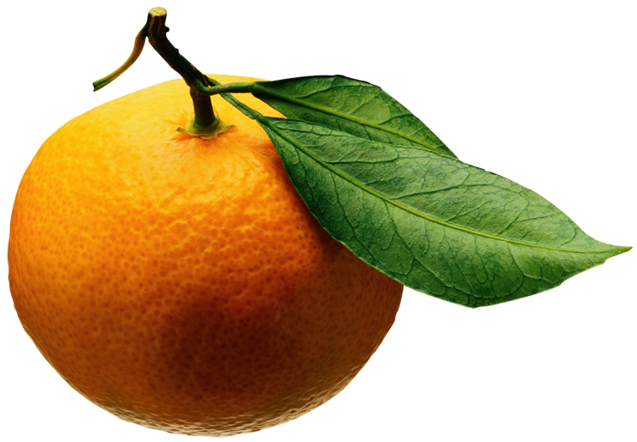
Algorithm Analysis
Input
Algorithm
Output

Slide 2
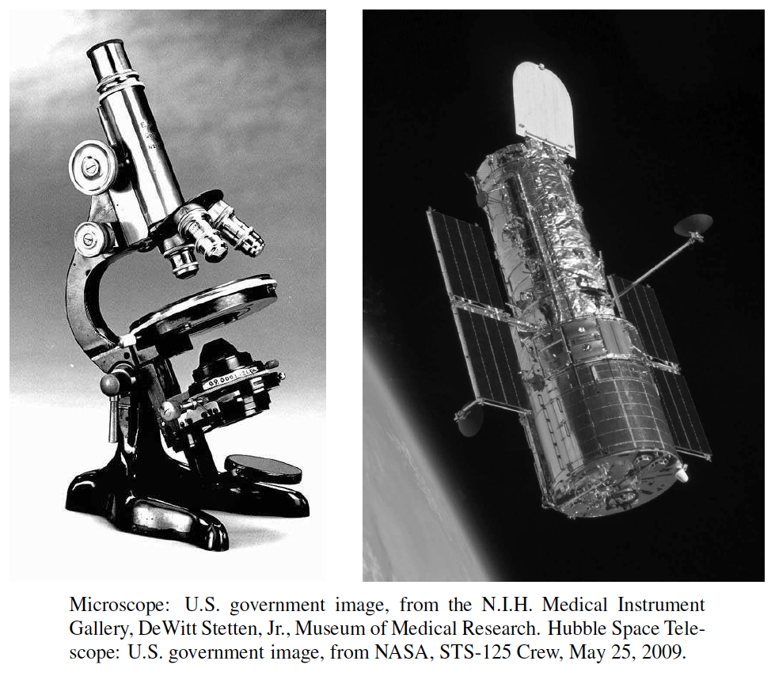
Scalability
Scientists often have to deal with differences in scale, from the microscopically small to the astronomically large.
Computer scientists must also deal with scale, but they deal with it primarily in terms of data volume rather than physical object size.
Scalability refers to the ability of a system to gracefully accommodate growing sizes of inputs or amounts of workload.

Slide 3
Algorithms and Data Structures
An algorithm is a step-by-step procedure for performing some task in a finite amount of time.
Typically, an algorithm takes input data and produces an output based upon it.
A data structure is a systematic way of organizing and accessing data.
Input
Algorithm
Output

Slide 4
Running Times
Most algorithms transform input objects into output objects.
The running time of an algorithm typically grows with the input size.
Average case time is often difficult to determine.
We focus primarily on the worst case running time.
Theoretical analysis
Might not capture real-world performance

Slide 5
Experimental Studies
Write a program implementing the algorithm
Run the program with inputs of varying size and composition, noting the time needed:
Plot the results
Try to match a curve to the times

Slide 6
Seven Important Functions
Seven functions that often appear in algorithm analysis:
Constant ≈ 1
Logarithmic ≈ log n
Linear ≈ n
N-Log-N ≈ n log n
Quadratic ≈ n²
Cubic ≈ n³
Exponential ≈ 2^{n}
In a log-log chart, the slope of the line corresponds to the exponent in the growth rate

Slide 7
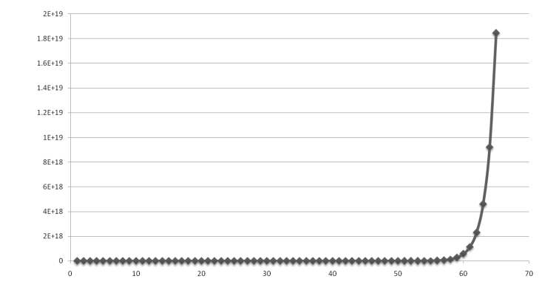
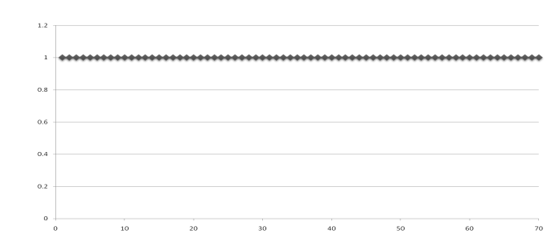
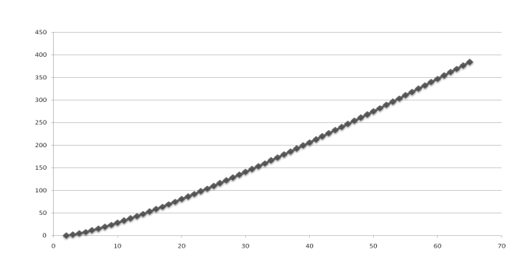
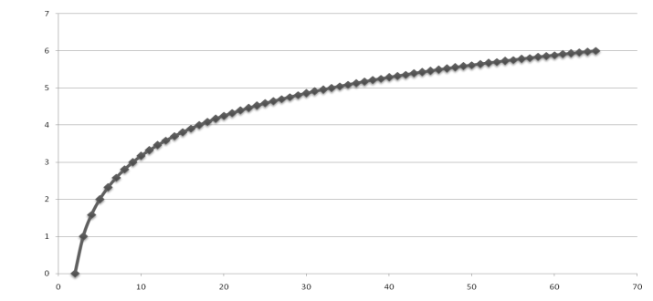
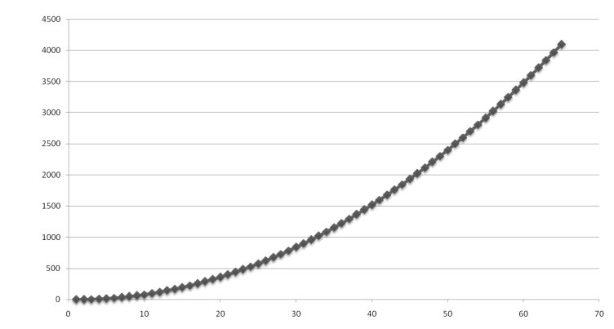
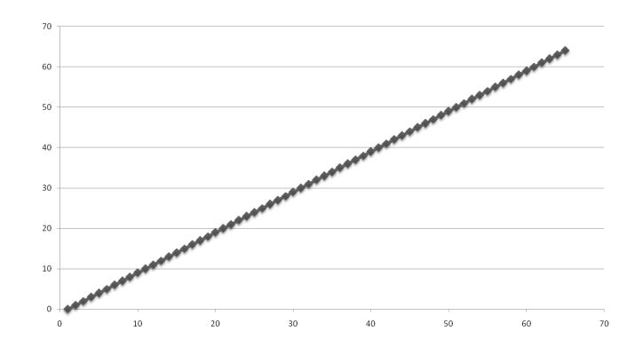
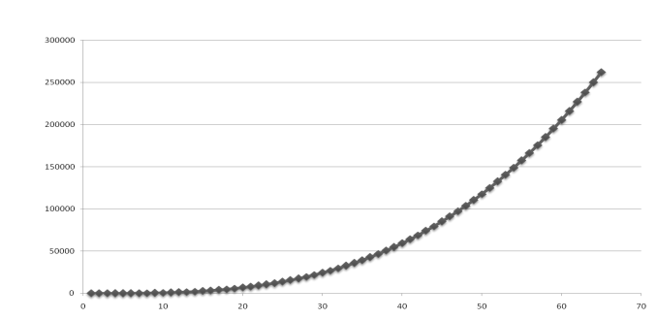
Functions Graphed Using “Normal” Scale
Slide by Matt Stallmann included with permission.
g(n) = n lg n
g(n) = 1
g(n) = 2^{n}
g(n) = n²
g(n) = lg n
g(n) = n
g(n) = n³

Slide 8
Why Growth Rate Matters
Slide by Matt Stallmann included with permission.
if runtime is... | time for n + 1 | time for 2 n | time for 4 n
c lg n | c lg (n + 1) | c (lg n + 1) | c(lg n + 2)
c n | c (n + 1) | 2c n | 4c n
c n lg n | ~ c n lg n + c n | 2c n lg n + 2cn | 4c n lg n + 4cn
c n² | ~ c n² + 2c n | 4c n² | 16c n²
c n³ | ~ c n³ + 3c n² | 8c n³ | 64c n³
c 2^{n} | c 2 ^{n+1} | c 2 ^{2n} | c 2 ^{4n}
runtime
quadruples
when problem
size doubles

Slide 9
Constant Factors
The growth rate is minimally affected by
constant factors or
lower-order terms
Examples
10²n + 10⁵ is a linear function
10⁵n² + 10⁸n is a quadratic function

Slide 10
Big-Oh Notation
Given functions f(n) and g(n), we say that f(n) is O(g(n)) if there are positive constants c and n₀ such that
f(n) ≤ cg(n) for n ≥ n₀
Example: 2n + 10 is O(n)
2n + 10 ≤ cn
(c − 2) n ≥ 10
n ≥ 10/(c − 2)
Pick c = 3 and n₀ = 10

Slide 11
Big-Oh Example
Example: the function n² is not O(n)
n² ≤ cn
n ≤ c
The above inequality cannot be satisfied since c must be a constant

Slide 12
Big-Oh Rules
If is f(n) a polynomial of degree d, then f(n) is O(n^{d}), i.e.,
Drop lower-order terms
Drop constant factors
Use the smallest possible class of functions
Say “2n is O(n)” instead of “2n is O(n²)”
Use the simplest expression of the class
Say “3n + 5 is O(n)” instead of “3n + 5 is O(3n)”

Slide 13
Relatives of Big-Oh
big-Omega
f(n) is Ω(g(n)) if there is a constant c > 0 and an integer constant n₀ ≥ 1 such that
f(n) ≥ c g(n) for n ≥ n₀
big-Theta
f(n) is Θ(g(n)) if there are constants c’ > 0 and c’’ > 0 and an integer constant n₀ ≥ 1 such that
c’g(n) ≤ f(n) ≤ c’’g(n) for n ≥ n₀

Slide 14
Intuition for Asymptotic Notation
big-Oh
f(n) is O(g(n)) if f(n) is asymptotically less than or equal to g(n)
big-Omega
f(n) is Ω(g(n)) if f(n) is asymptotically greater than or equal to g(n)
big-Theta
f(n) is Θ(g(n)) if f(n) is asymptotically equal to g(n)

